Slide 1
Heart internal features
By
Dr Abulmaaty Mohamed Assistant professor Anatomy & Embryology Mutah University

Slide 2
Rev.

Slide 3
Rev.

Slide 4
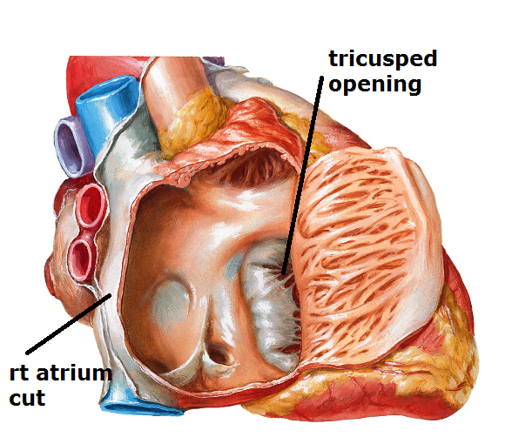
RT. Atrium
A-Tricuspid opening :-
-In lower anterior part of rt atrium
-Guarded by tricuspid valve
-admit 3 fingers

Slide 5
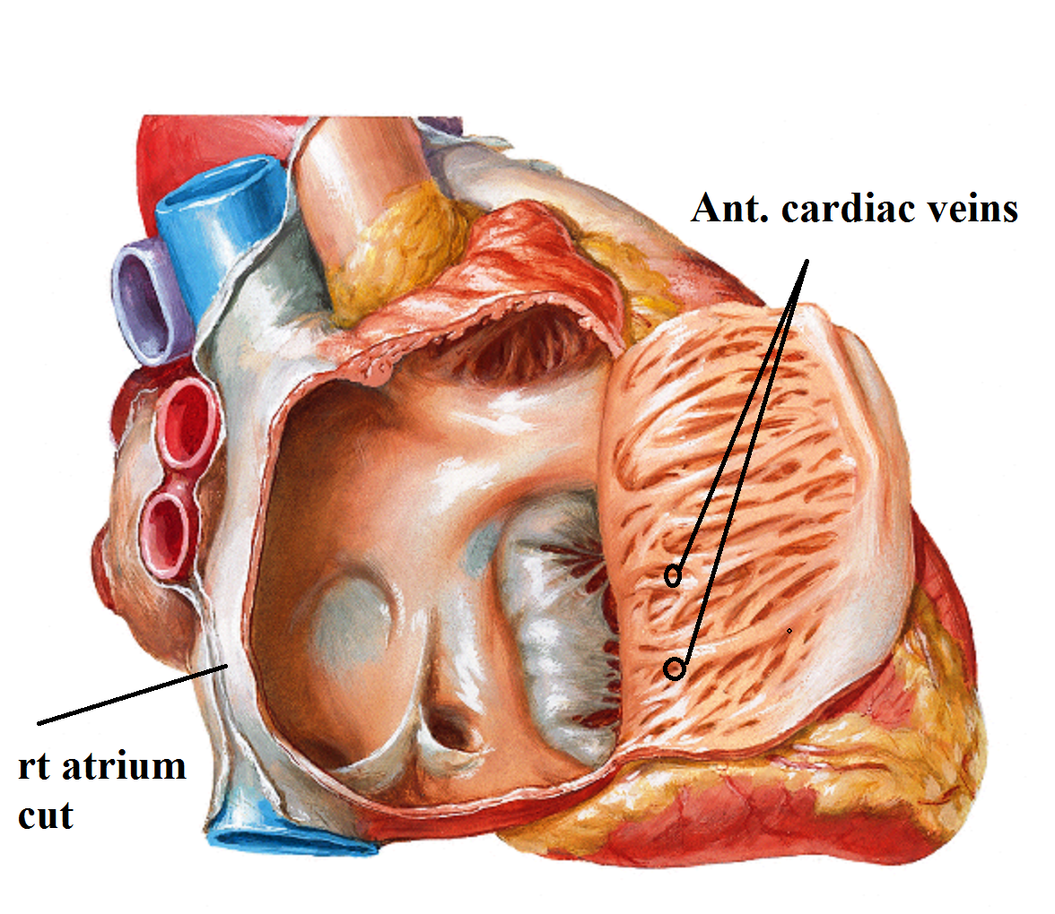
RT. Atrium
B. Rough anterior Part: shows
1.Openings of anterior cardiac veins.

Slide 6
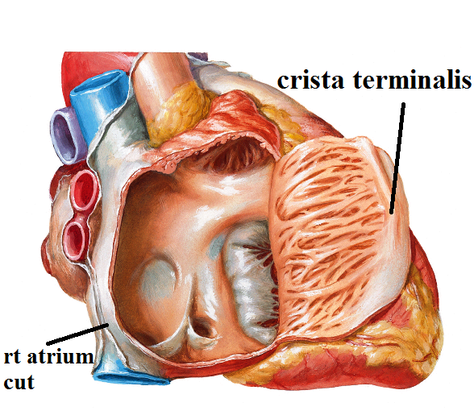
RT. Atrium
B. Rough anterior Part: shows
2.Crista terminalis:
Vertical muscular ridge between openings of SVC &IVC
Represented externally by sulcus terminalis
Separate ant part from post part.

Slide 7
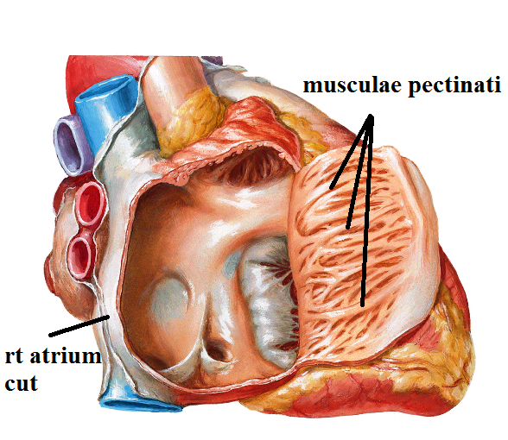
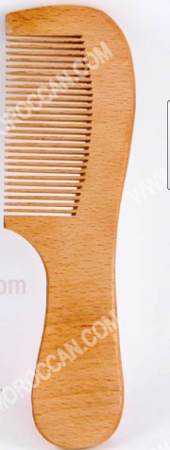
RT. Atrium
B. Rough anterior Part: shows
3- Musculae pectinati:
Transverse muscular ridges from crista terminalis to anterior wall of rt atrium

Slide 8
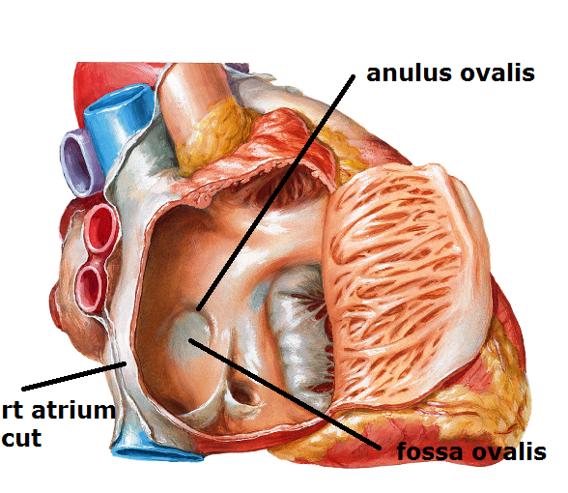
RT. Atrium
C. Smooth Posterior part :- shows
1-Fossa ovalis : depression on the interatrial septum above the opening of IVC
2-Anulus ovalis :- curved ridge above & in front of fossa ovalis

Slide 9
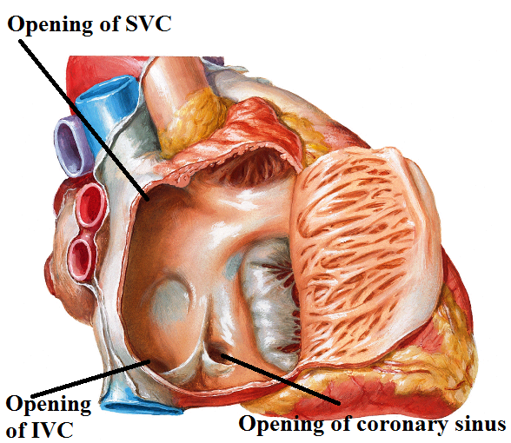
RT. Atrium
C. Smooth Posterior part :- shows
3-openings of S.V.C: opposite rt 3rd c.c. -has no valve
4-opening of I.V.C opposite rt 6th c.c.– has a nonfunctioning valve
5-opening of coronary sinus:-Between tricuspid opening & valve of IVC – has a nonfunctioning valve
6-venae cordis minimi

Slide 10
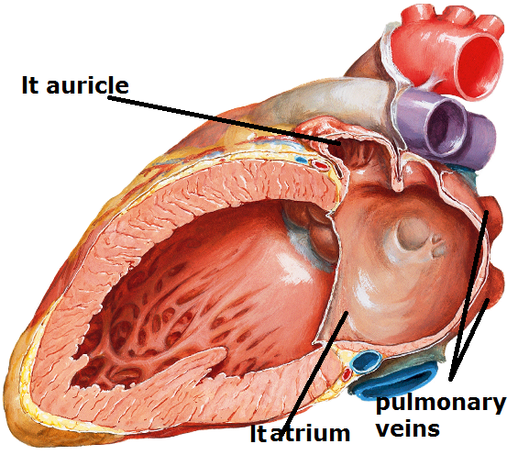
lT Atrium
A-Mitral opening : -Guarded by mitral valve
-admit 2 fingers
B- Rough anterior Part :
only the auricle that has musculi pectinati
C-Smooth posterior part: - shows openings of
-4 pulmonary veins(near to upper part) with no valves
-vena cordis minimi

Slide 11
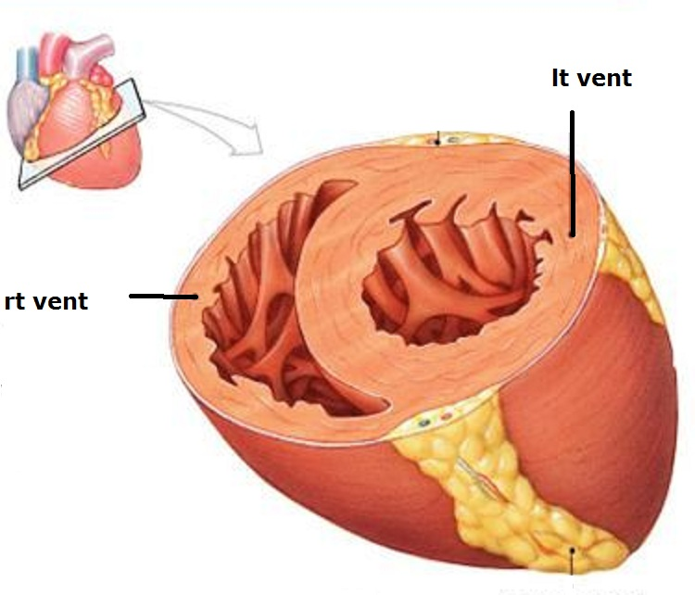
rT ventricle
Cross section
Semilunar- 1/3 thickness of the lt ventricle

Slide 12
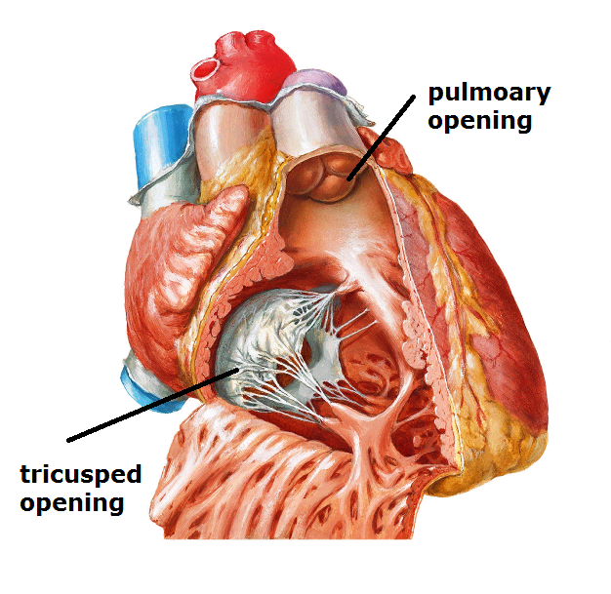
rT ventricle
A- 2 openings: tricuspid -pulmonary

Slide 13
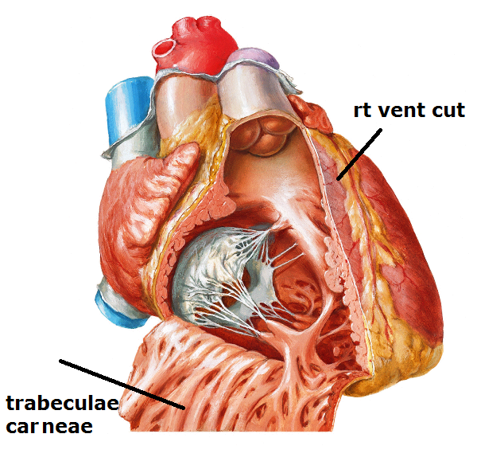
rT ventricle
B- rough (inflow) part : shows
1-Trabeculae carneae:
Muscular ridges that freely intercross forming sponge meshwork

Slide 14
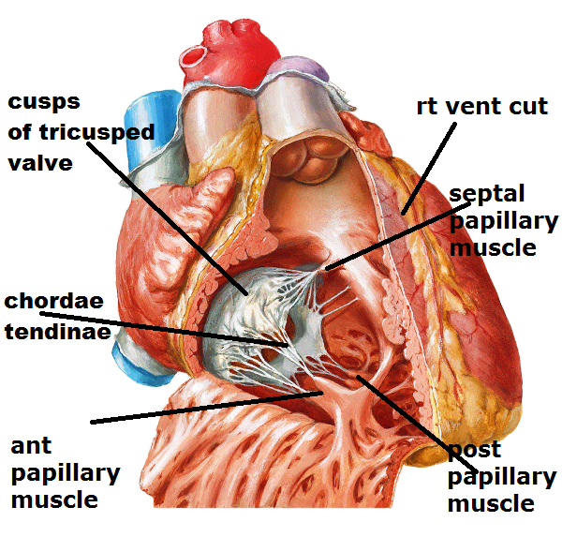
rT ventricle
B- rough (inflow) part : shows
2-papillary muscles : no.:- 3 Ant.(constant), post. & septal
shape:-conical has base:- attached to ventricular wall
apex:- give chordae tendinae to margins & ventricular surface of cusps of the tricuspid valve each muscle attach to 2 adjacent cusps function:- prevent valve regurge

Slide 15
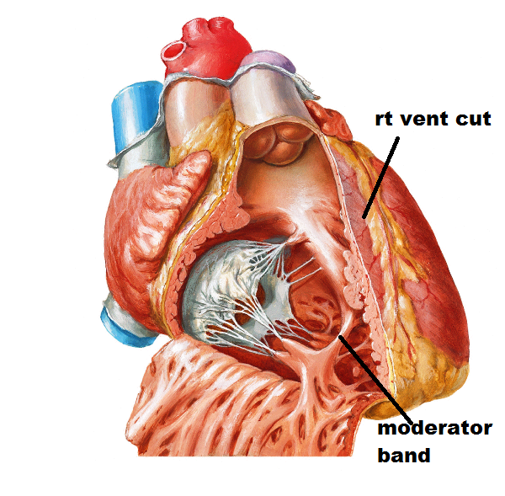
rT ventricle
B- rough (inflow) part : shows
3-moderator band : (septomarginal trabecula) :
- a trabecula from septum to base of ant. papillary muscle.
Function:- Transmit Rt bundle br.
Prevent over distention of Rt. ventr.

Slide 16
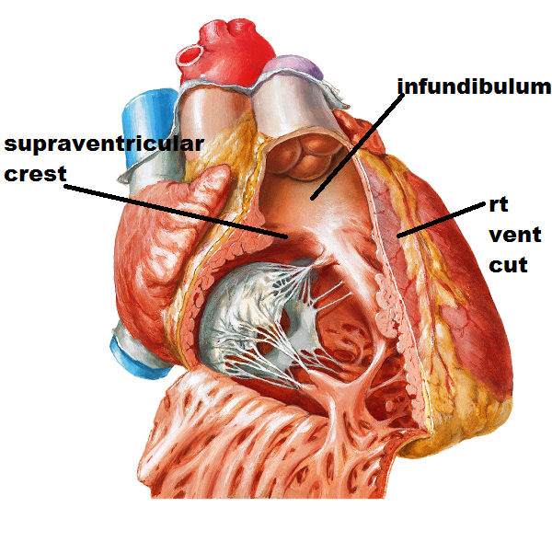
rT ventricle
C- smooth (outflow) part := Infundibulum separated from inflow part by supraventricular crest

Slide 17
lT ventricle
Cross section
circular- 3 times thickness of the rt ventricle

Slide 18
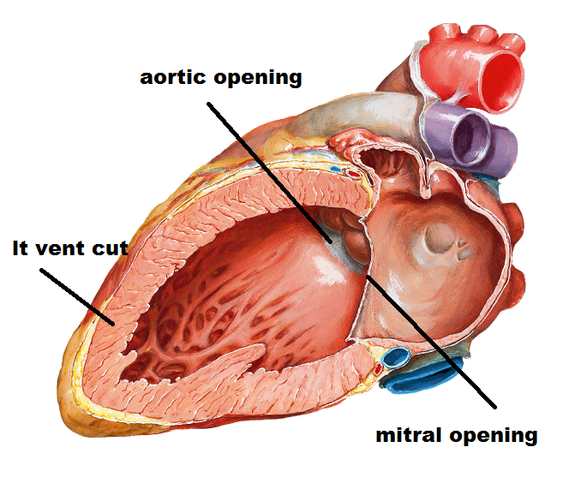
lT ventricle
A- 2 openings: mitral - aortic

Slide 19
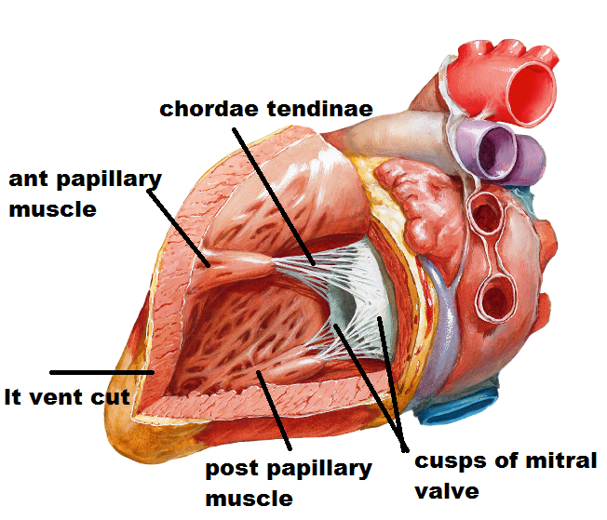
lT ventricle
B- rough (inflow) part : shows
1-Trabeculae carneae: finer , multiple than that of the rt vent. 2-papillary muscles : no.:- 2 Ant., post.
shape:- larger than that of rt vent. , chordae tendinae are thicker & fewer ,attach to margins & ventricular surface of both cusps of the mitral valve
3- has no moderator band
C-smooth(outflow)part:
= aortic vestibule

Slide 20
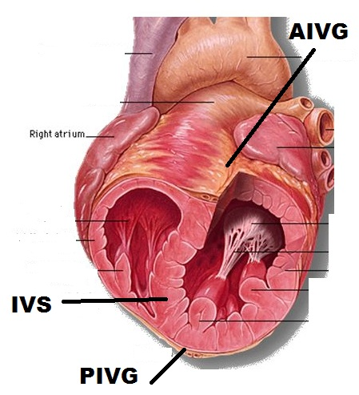
Interventricular septum
-Oblique septum between rt vent. ant to it, lt vent. behind it
-Convex towards the rt ventricle
-Its ant border corresponds to ant interventricular groove &its post border corresponds to post interventricu. groove
-Consists of 2 parts (Lower muscular & upper membranous parts)

Slide 21
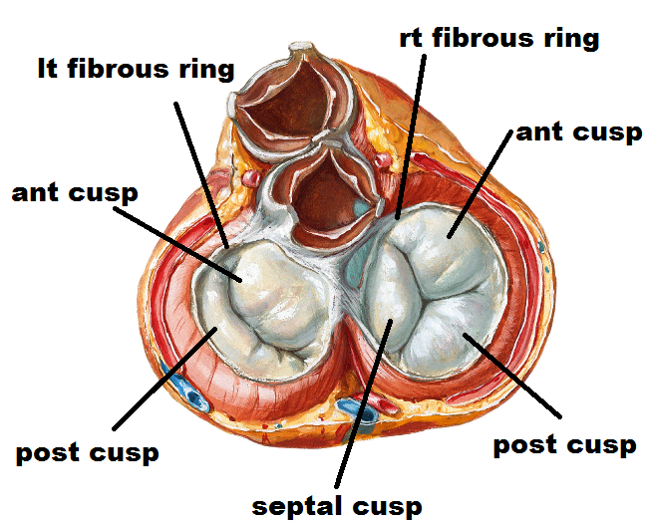
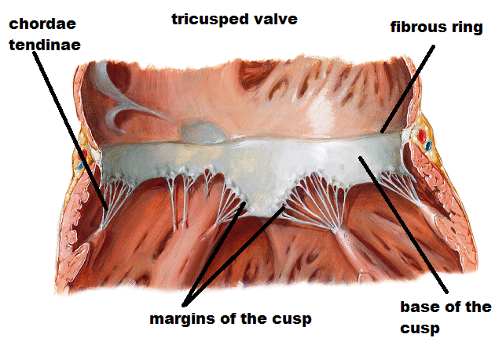
Atrioventricular valves
Tricuspid valve
-Formed of 3 cusps ant, post &septal -each cusp is triangular has a base that attached to fibrous ring &margin that attach to chordae tendinae
-The cusps has 2 surfaces; Smooth atrial surface & rough ventricular surface as it gives attachment to chordae tendinae

Slide 22
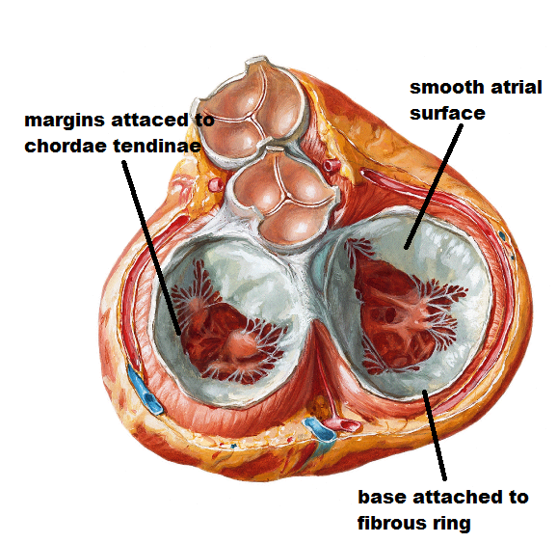
Atrioventricular valves
mitral valve
As the tricuspid valve but formed of 2 cusps(ant & post)
The ant cusp lies ant & to the right while post cusp lies post & to the left

Slide 23
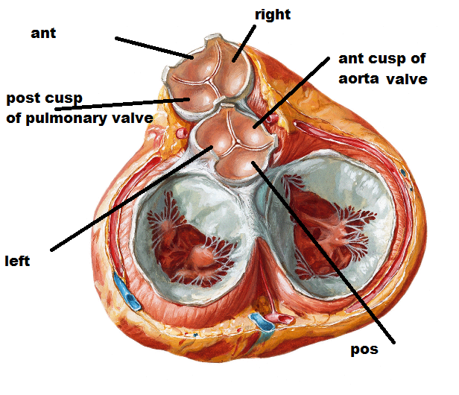
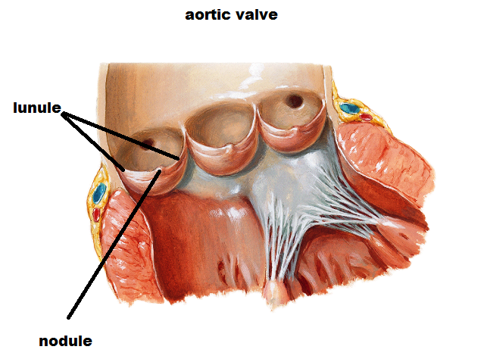
semilunar valves
aortic valve
-Formed of 3 cusps 1 ant& 2 post
-The cusps are semilunar has
upper margin (free) shows thickened nodule in the middle & thin lunule on the sides
lower margin & sides (attached to arterial wall)
-The cusps has 2 surfaces
upper surface concave
lower surface convex

Slide 24
semilunar valves
pulmonary valve
-Formed of 3 cusps 1 post & 2 ant
-The cusps are semilunar has
upper margin (free) shows thickened nodule in the middle & thin lunule on the sides
lower margin & sides (attached to arterial wall)
-The cusps has 2 surfaces
upper surface concave
lower surface convex

Slide 25
.
THANQ

