Slide 1
ORAL CAVITY
Dr. Bushra Al-Tarawneh, MD

Slide 2
The gastrointestinal tract is a hollow tube consisting of:
The esophagus.
The stomach.
The small intestine.
Colon.
Rectum.
Anus.

Slide 3
ORAL CAVITY
Pathologic conditions of the oral cavity can be broadly divided into diseases affecting the oral mucosa, salivary glands, and jaws.
We will discuss:
ORAL INFLAMMATORY LESIONS.
PROLIFERATIVE AND NEOPLASTIC LESIONS OF THE ORAL CAVITY.
DISEASES OF SALIVARY GLANDS.
ODONTOGENIC CYSTS AND TUMORS.

Slide 4
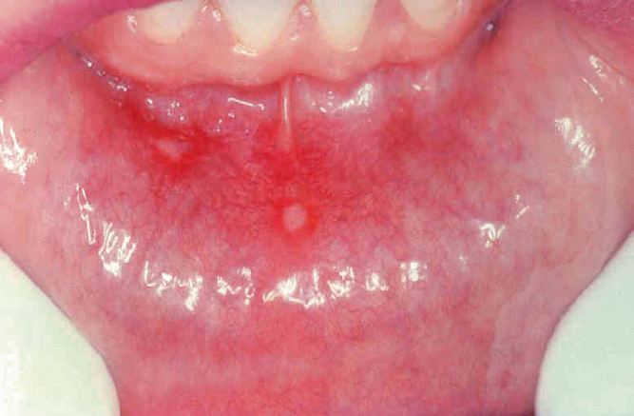
ORAL INFLAMMATORY LESIONS.
Aphthous Ulcers (Canker Sores)
These common superficial mucosal ulcerations affect up to 40% of the population. It may be associated disease (IBD), and Behçet disease. Lesions can be solitary or multiple; typically, they are shallow, hyperemic ulcerations covered by a thin exudate and rimmed by a narrow zone of erythema .In most cases they resolve spontaneously in 7 to 10 days but can recur.
Herpes Simplex Virus Infections.

Slide 5
Oral Candidiasis (Thrush).
Candidiasis is the most common fungal infection of the oral
cavity.
Candida albicans is a normal component of the oral flora and only produces disease under unusual circumstances.
The three major clinical forms of oral candidiasis are pseudomembranous, erythematous, and hyperplastic. The pseudomembranous form is most common and is known as thrush.
This condition is characterized by a superficial, curdlike, gray to
white inflammatory membrane composed of matted organisms
enmeshed in a fibrinosuppurative exudate .
In mildly immunosuppressed or debilitated individuals, such as diabetics, the infection usually remains superficial,
but can spread to deep sites in association with more severe immunosuppression, including that seen in organ or hematopoietic stem cell transplant recipients, as well as patients with neutropenia, chemotherapy-induced immunosuppression,
or AIDS.

Slide 6
PROLIFERATIVE LESIONS OF THE ORAL CAVITY
Pyogenic granulomas are pedunculated masses usually found on the gingiva of children, young adults, and pregnant women.
These lesions are richly vascular and typically are ulcerated, which gives them a red to purple color.. However, histologic examination demonstrates a dense proliferation of immature vessels similar to that seen in granulation tissue.
Pyogenic granulomas can regress, mature into dense fibrous masses, or develop into a peripheral ossifying fibroma.
Complete surgical excision is definitive treatment

Slide 7
NEOPLASTIC LESIONS OF THE ORAL CAVITY
Leukoplakia is defined by the World Health Organization as “a white patch or plaque that cannot be scraped off and cannot be characterized clinically or pathologically as any other disease.”
Leukoplakia includes a spectrum of histologic features ranging from hyperkeratosis overlying a thickened, acanthotic, but orderly mucosal lesions with marked dysplasia that sometimes merges with carcinoma in situ.
The most severe dysplastic changes are associated with erythroplakia, and more than 50% of these cases undergo malignant transformation. With increasing dysplasia and anaplasia.
A majority of oral cavity cancers are squamous cell carcinomas.
Oral squamous cell carcinomas are classically linked
to tobacco and alcohol use, but the incidence of HPVassociated
lesions is rising.
.

Slide 8
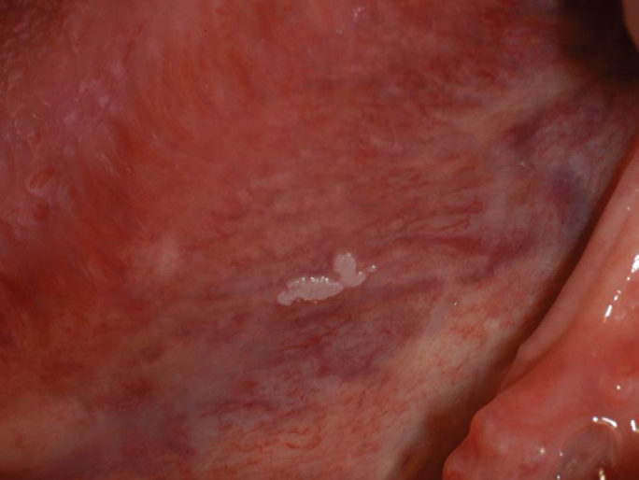
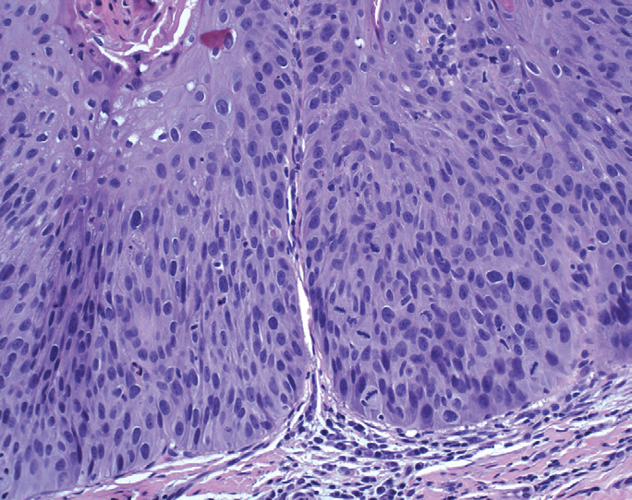
Leukoplakia. the lesion is smooth with well-demarcated borders and minimal elevation. B, Histologic appearance of leukoplakia showing dysplasia, characterized by nuclear and cellular pleomorphism and loss of normal maturation.

Slide 9
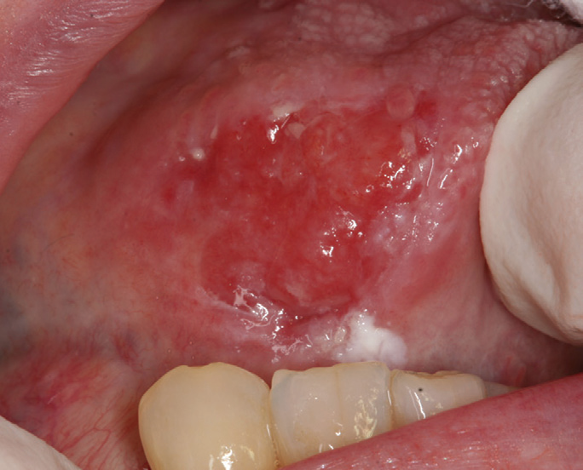
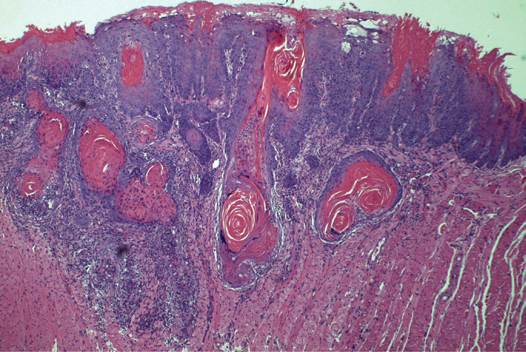
Clinical appearance demonstrating ulceration and induration of the oral mucosa. Histologic appearance demonstrating numerous nests and islands of malignant keratinocytes invading the underlying connective tissue stroma.

Slide 10
DISEASES OF SALIVARY GLANDS.
1- Xerostomia: is defined as a dry mouth resulting from a decrease in the production of saliva. It is caused by:
It is a major feature of the autoimmune disorder Sjögren syndrome, in which it usually is accompanied by dry eyes. Radiation therapy. Medications. Complications of xerostomia include increased rates of dental caries and candidiasis, as well as difficulty in swallowing and speaking.
2- Sialadenitis, or inflammation of the salivary glands, may be induced by trauma, viral or bacterial infection, or autoimmune disease.
The most common form of viral sialadenitis is mumps, which may produce enlargement of all salivary glands but predominantly involves the parotids. . While mumps in children is most often a selflimited benign condition, in adults it can cause pancreatitis or orchitis; the latter sometimes causes sterility.
3- Duct obstruction by stones (sialolithiasis)is a common antecedent to infection.
4-The mucocele is the most common inflammatory lesion of the salivary glands, and results from either blockage or rupture of a salivary gland duct.
Mucocele typically manifests as a fluctuant swelling of the lower lip.

Slide 11
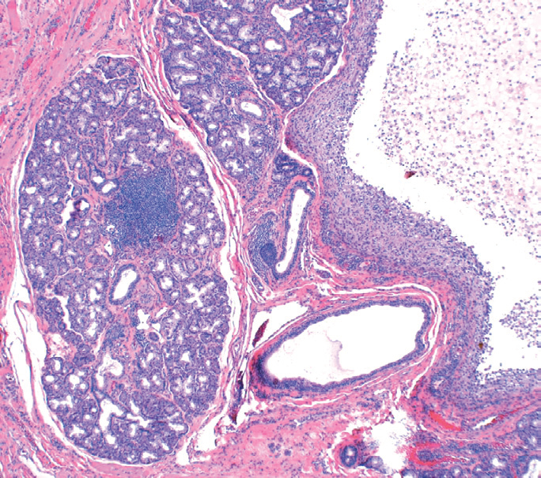
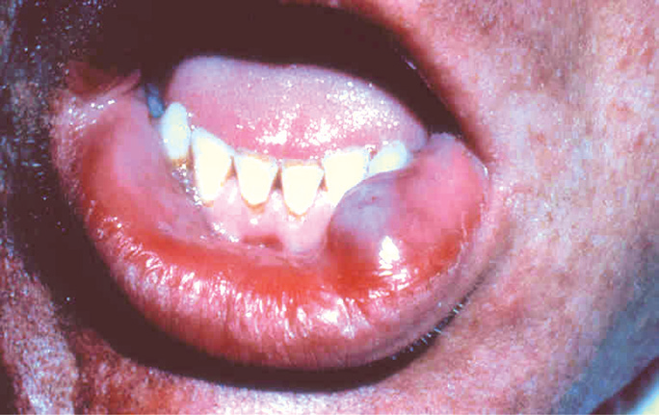
Histologic examination demonstrates a cystlike space lined by inflammatory granulation tissue or fibrous connective tissue that is filled with mucin and inflammatory cells, particularly macrophages.

Slide 12
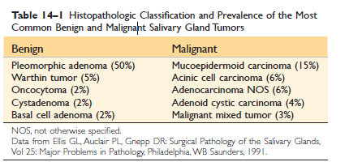
Salivary gland tumors
Salivary gland tumors are relatively uncommon and represent less than 2% of all human tumors.
Approximately 65% to 80% arise within the parotid, 10% in the submandibular gland. Approximately 15% to 30% of tumors in the parotid glands are malignant. 70% to 90% of sublingual tumors are cancerous.
Salivary gland tumor is malignant is inversely proportional, roughly, to the size of the gland.
Salivary gland tumors usually occur in adults, with a slight female predominance.

Slide 13
Pleomorphic Adenoma
Pleomorphic adenomas present as painless, slow-growing, mobile discrete masses.
They represent about 60% of tumors in the parotid.
Pleomorphic adenomas recur if incompletely excised:
Recurrence rates approach 25% after simple enucleation of the tumor, but are only 4% after wider resection.
Carcinoma arising in a pleomorphic adenoma is referred to variously as a carcinoma ex pleomorphic adenoma or malignant mixed tumor.

Slide 14
Macroscopically: Pleomorphic adenomas typically manifest as rounded, welldemarcated masses rarely exceeding 6 cm in the greatest dimension. The cut surface is gray-white and typically contains myxoid and blue translucent chondroid
(cartilage-like) areas.
Microscopically: The most striking histologic feature is their characteristic heterogeneity. Epithelial elements resembling ductal or myoepithelial cells are arranged in ducts, acini, irregular tubules, strands, or even sheets. These typically are dispersed within a mesenchyme-like background of loose myxoid tissue containing islands of chondroid and, rarely, foci of bone.. In other instances there may be strands or sheets of myoepithelial cells..

Slide 15
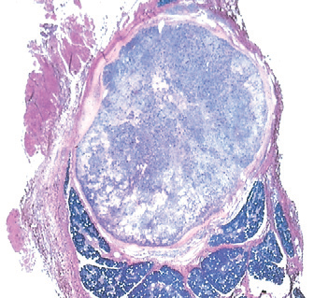
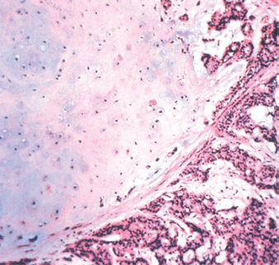
Low-power view showing awell-demarcated tumor with adjacent normal salivary gland parenchyma. B, High-power view showing epithelial cells as well as myoepithelial cells within chondroid matrix material.

Slide 16
Mucoepidermoid Carcinoma
These neoplasms represent about 15% of all salivary gland tumors, and while they occur mainly (60% to 70%) in the parotids.
Mucoepidermoid carcinoma is the most common form
of primary malignant tumor of the salivary glands.
Macroscopically: they lack well-defined capsules and often are infiltrative.The cut surface is pale gray to white and frequently demonstrates small, mucinous cysts.
On histologic examination, these tumors contain cords, sheets, or cysts lined by squamous, mucous, or intermediate cells. The latter is a hybrid cell type with both squamous features and mucus-filled vacuoles, which are most easily detected with mucin stains.

Slide 17
The jaws are a common site of epithelium-lined cysts derived from odontogenic remnants.
The odontogenic keratocyst is locally aggressive, with a high recurrence rate.
The periapical cyst is a reactive, inflammatory lesion associated with caries or dental trauma.
The most common odontogenic tumors are ameloblastoma and odontoma.

Slide 18
Thank you

