Slide 1
Hair Disorders
Prof Khitam Al-Refu
Muta University

Slide 2
Introduction
Human hair plays a significant role in the self-image of individuals and the image they present to the world.
Healthy hair conveys a sense of well-being, vitality and youthfulness.
Excess hair growth in females, particularly in prominent sites such as the face, is not only an embarrassment but may indicate underlying systemic disease.

Slide 3
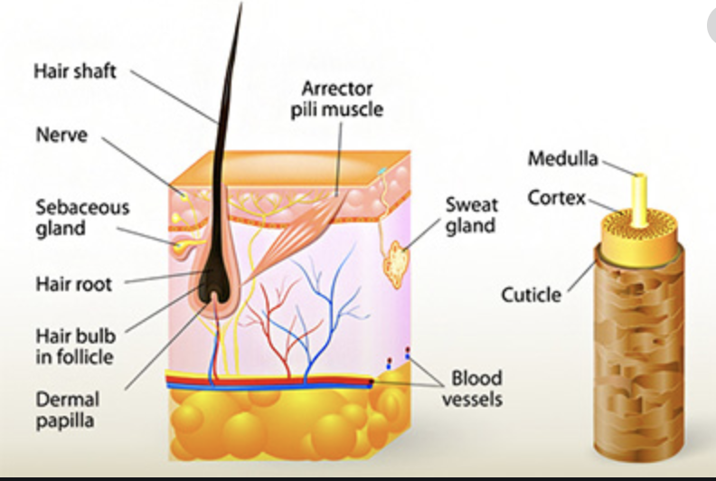
Hair Cycle
Hair is a modified type of keratin and is produced by the hair matrix, which is equivalent to the epidermis.

Slide 4
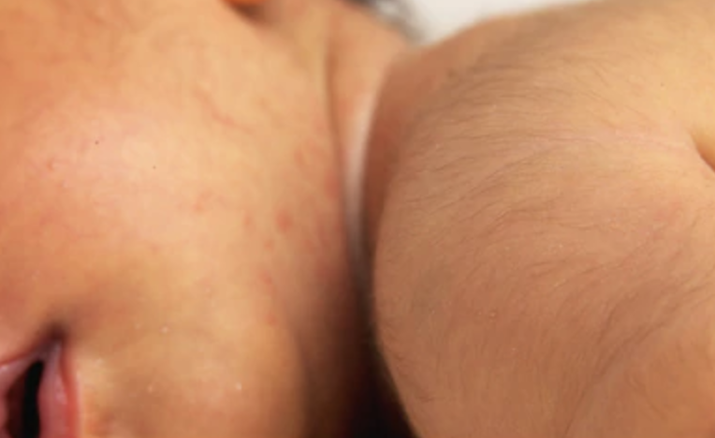
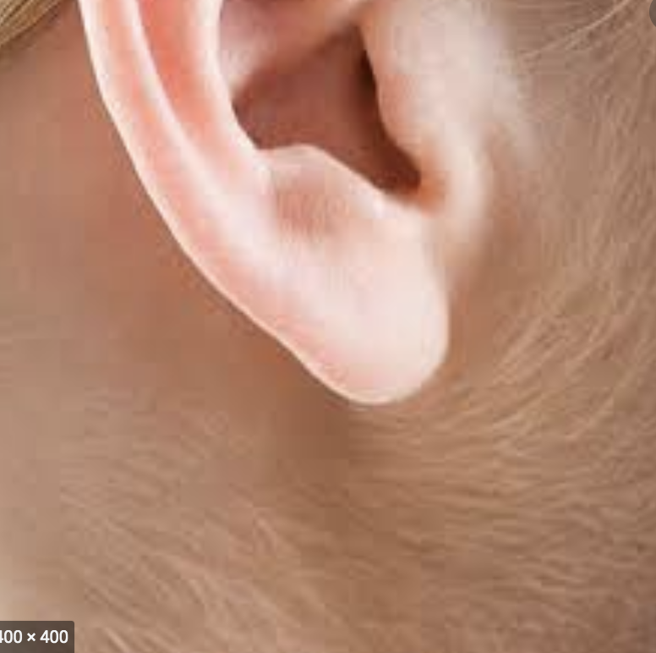
Three types of hair occur in humans.
Lanugo hair covers the foetus inutero and is normally shed before birth. This is long and silken.
Vellus hair covers the whole body (sparing the palms and soles only) and is short, fine and non-pigmented.

Slide 5
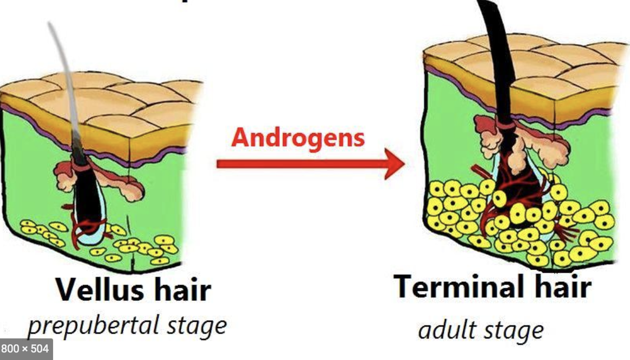
Terminal hair is limited to the eyebrows, lashes and scalp until puberty; following puberty secondary terminal hair develops in the axillae, pubic region and on the central chest in men in response to androgens. It is coarser than vellus hair and tends to be darker and longer.

Slide 6
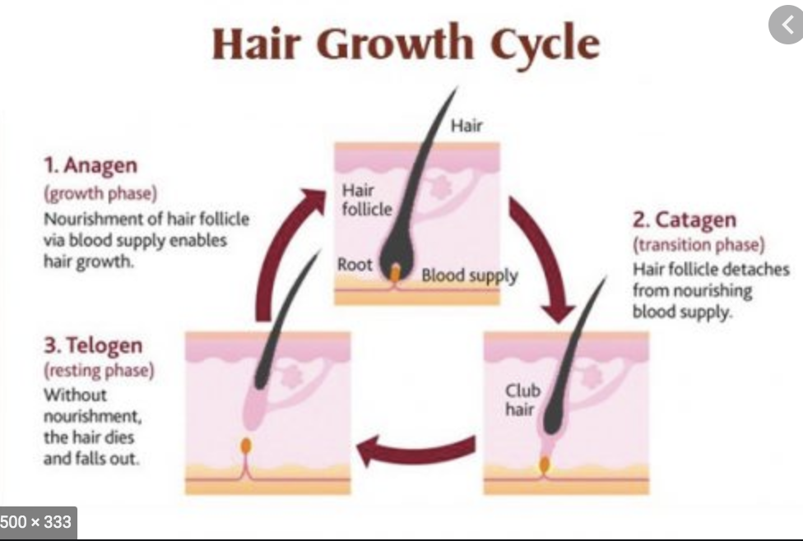
Hair Cycle
The hair follicle is unique among epidermal structures in that it grows in cycles.

Slide 7
There are Three Phases.
Anagen – the active growth phase, which typically lasts 1000 days depending on predetermined genetic factors (as opposed to body hair which lasts from 1 to 6 months).
Catagen – the short growth arrest phase, of approximately 10 days.
Telogen – the resting phase, lasting approximately 100 days irrespective of location.
The ratio of anagen to telogen hairs is 9:1 reflecting the fact that only a few hairs at a time are in catagen phase. On average, 100 hairs are shed per day although seasonal variation does occur.

Slide 8
Hair loss
Hair loss or alopecia can be divided into scarring and non-scarring
types depending on the underlying pathological process, and these can then be further categorized according to distribution, either diffuse or localized.

Slide 10
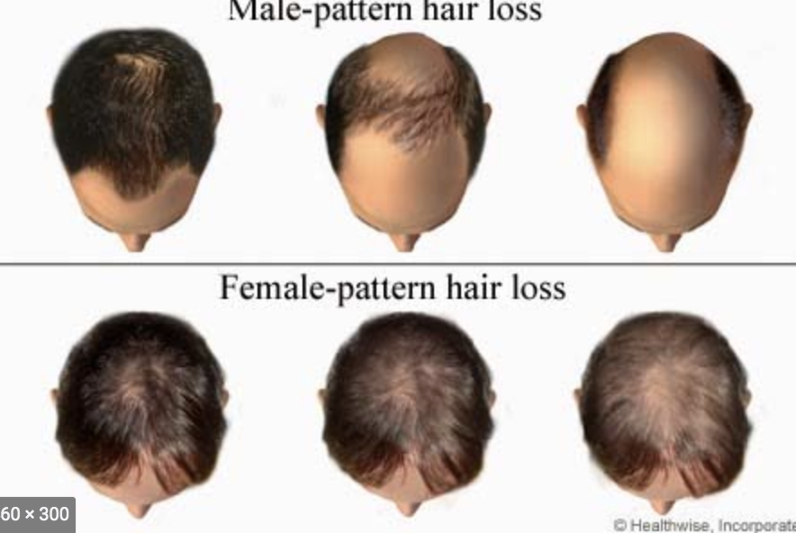
Androgenetic alopecia
Androgenetic alopecia (AGA) is synonymous with male-pattern baldness and is the most prevalent form of hair loss, affecting about 50% of Caucasian males to some extent by the age of 50.
It also affects a significant number of women and is synonymous with female pattern hair loss (FPHL).

Slide 11
It causes hair loss over the temples (fronto-temporal recession) or vertex in men and may progress to leave a horse-shoe distribution of hair over the ears and occipital scalp.
Women experience thinning over the central scalp. In contrast to men, there is usually preservation of the frontal margin.
Over time, the follicles become smaller, producing shorter and finer hairs.

Slide 12
However In some premenopausal women, there may be other signs of androgenisation suggesting gonadal (e.g. polycystic ovarian syndrome) or rarely adrenal disorders and elevated circulating androgens maybe present.
The diagnosis particularly in men is straightforward;

Slide 13
However, chronic telogen effluvium and rarely diffuse alopecia areata (AA) may be considered.
There is currently no cure for AGA and few treatments have been shown to be effective. Two drugs which are currently licensed to promote hair growth in men with AGA are oral finasteride and topical minoxidil.
Minoxidil provides improvement in around 60% of men after use for at least 3–6 months. Benefit may be sustained from continued use, but is lost on cessation.
Finasteride is a 5𝛼-reductase inhibitor and reduces circulating DHT levels. Daily dosing with 1mg orally may slow hair loss and improve growth. There is a small increased incidence of sexual dysfunction, for example, impotence in men.

Slide 14
Minoxidil also provides benefit.
Anti-androgens such as spironolactone, flutamide and cyproterone acetate are most useful in women with hyperandrogenism,
Finasteride may also be beneficial;
Hair transplantation is an option where medical therapy fails.

Slide 15
Alopecia areata
AA is an organ-specific autoimmune disease, which leads to non-scarring alopecia.
It affects 0.15% of the population and can affect any hair-bearing part of the body.
Extensive involvement may lead to total scalp hair loss (alopecia totalis), total body hair loss (alopecia universalis) or localised hair loss along the scalp margin (ophiasis).

Slide 16
Alopecia areata (patchy)

Slide 17
Alopecia Totalis

Slide 18
Alopecia Universalis

Slide 19
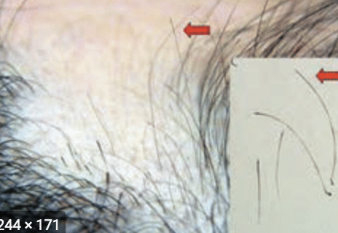
AA typically presents with smooth round or oval patches of non-scarring hair loss on the scalp.
Exclamation mark hairs, when present, are diagnostic of AA.
These characteristic hairs break at their distal point as they taper and lose pigment proximally, giving them the appearance of an exclamation mark and occur at the periphery of patches of alopecia.

Slide 20
Nail abnormalities, predominantly pitting or roughening, may occur in association with this condition.
Other organ-specific autoimmune disorders such as vitiligo and thyroiditis are occasionally associated with AA.
Investigation of associated diseases is usually indicated if symptomatic.

Slide 21
The age of onset is usually in the first two decades. The course of AA is difficult to predict.
Poor prognostic markers include
childhood onset of disease
atopy
ophiasis (band of alopecia in occipital region)
nail dystrophy
family history of other autoimmune disorders
presence of autoantibodies.

Slide 22
Trichotillomania, traction alopecia, telogen effluvium, AGA and tinea capitis should all be excluded by clinical examination, appropriate mycology and skin biopsy where there is diagnostic difficulty.
In AA, the hair follicle is not injured and maintains the potential to regrow hair should the disease go into remission.
There is, however, no cure for AA and no universally proven treatment to stimulate hair regrowth and sustain remission.
It is unclear if any of the treatment options available alter the course of the disease.
Treatment is therefore guided by the extent of the disease and the age of the person being treated.

Slide 23
Current treatments include the following.
Topical/intralesional corticosteroids.
Potent topical corticosteroids can be used on the scalp for 2–3 months on localised patches of alopecia.
Intradermal injection of triamcinolone diluted with local anaesthetic can be used. there is a risk of causing atrophy.
Systemic immunosuppression. This includes short-term systemic corticosteroids and oral psoralens with exposure to ultraviolet light A (PUVA).
Contact sensitisation using either irritants (dithranol or retinoids) or allergens (diphencyprone).
Topical minoxidil (also used in combination with corticosteroids).

Slide 24
Telogen effluvium
However, following a number of stimuli the majority of hair follicles may enter the resting phase (telogen) at the same time (synchronously) resulting in diffuse shedding approximately 2 months after the triggering event, often described as the hair ‘falling out by the roots’.
This is usually an acute self-limiting phenomenon, usually resolving within 6months; however, chronic telogen effluvium may occur.

Slide 26
Telogen Effluvium causes

Slide 28
Excessive hair
Two patterns of hair overgrowth are recognized:
hirsutism
hypertrichosis

Slide 29
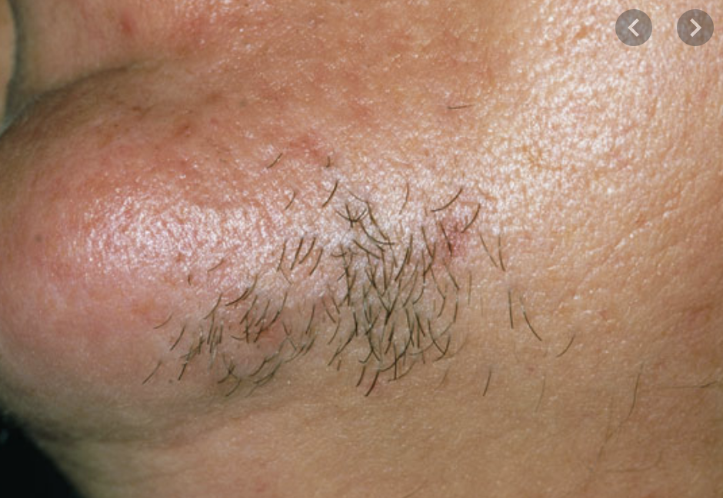
Hirsutism
This is defined as increased growth of the terminal hairs in androgen-sensitive areas such as the beard and moustache regions in females.

Slide 30
The assessment of the patient with hirsutism must include a general examination to identify an underlying endocrine abnormality, particularly if there is a relatively short history associated with amenorrhoea and signs of virilisation.
Features suggestive of virilisation in addition to hirsutism include deepening of the voice, increased muscle bulk and cliteromegaly, an extremely sensitive sign.

Slide 31
Causes of hirsutism

Slide 32
Treatments include suppression of androgens, peripheral androgen blockade and mechanical or cosmetic treatment.
The use of eflornithine cream is a useful new adjuvant licensed for facial hirsutism that inhibits ornithine decarboxylase, an enzyme involved in controlling hair growth and proliferation. It is most effective when combined with local cosmetic or depilatory treatments, including laser hair removal.

Slide 33
Hypertrichosis
This describes the excessive growth of hair in any part of the body and may be localised (e.g. Becker’s naevus) or generalised
Causes may be congenital or acquired; important systemic diseases associated with hypertrichosis include hyperthyroidism, porphyria and anorexia nervosa.
Treatment is directed at the underlying cause and stopping any implicated drug, where possible.
Symptomatic approaches include depilation using creams, shaving and waxing.

Slide 34
Localized hypertrichosis

Slide 35
General hypertrichosis

Slide 36
Generalized acquired hypertrichosis may be associated with: porphyria cutanea tarda, malnutrition, malignancy, drugs (ciclosporin, androgen steroids, minoxidil )

Slide 37
Localised acquired hypertrichosis may be associated with:Increased vascularity, Repetitive rubbing or scratching , Application of plaster cast (temporary), Repeated application of minoxidil, potent topical steroids, iodine, psoralen).

Slide 38
NAIL DISEASES & DISORDERS

Slide 39
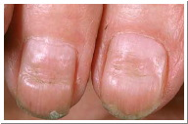
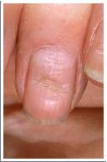
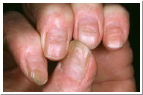
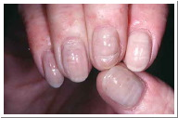
BEAUS LINES
DESCRIPTION/ CAUSE: Single horizontal ridge caused by a severe, short term illness, such as a heart attack, measles, etc.

Slide 40
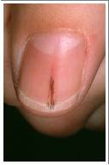
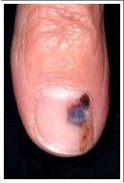
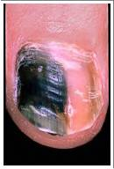
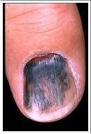
BRUISED NAIL
DESCRIPTION/ CAUSE: Dark, congealed spots of blood between nail plate and bed

Slide 41
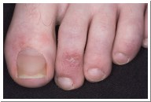
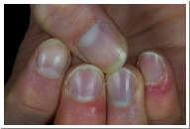
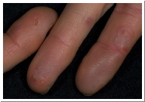
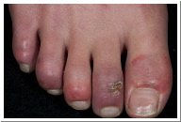
CHILBLAINS
DESCRIPTION/ CAUSE: An itchy, sore, tingly, red area resulting in broken skin caused by prolonged exposure to cold and poor circulation.

Slide 42
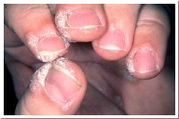
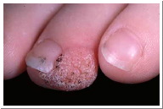
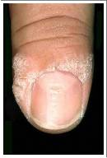
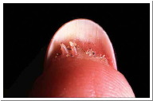
VERRUCA VULGARIS (COMMON WARTS)
DESCRIPTION/ CAUSE: A viral infection which causes raised lumps of horny tissue in areas of pressure, the warts are caused by the human papilloma virus.

Slide 43
ECZEMA OF THE NAIL
DESCRIPTION/ CAUSE: Can affect the eponychium, nail plate and bed, causing pitting and onycholysis.

Slide 44
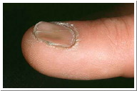
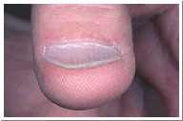
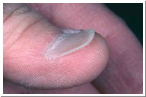
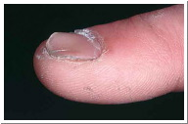
KOILONYCHIA (SPOON NAIL)
DESCRIPTION/ CAUSE: Flat or spoon shaped nail often thin and soft and is caused by iron deficiency (anaemia), excessive exposure to harsh chemicals etc, or is a congenital condition.

Slide 45
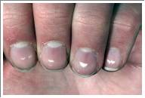
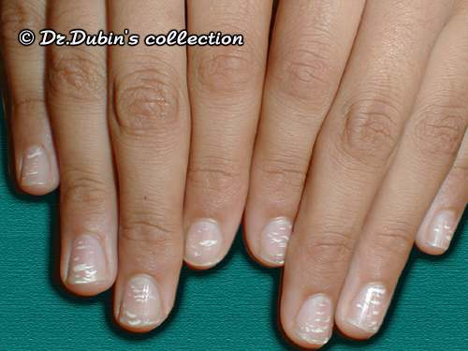
LEUCONYCHIA SPOTS
DESCRIPTION/ CAUSE: Small white spots are groups of whitish nail cells trapped inside the nail plate These spots are caused by minor trauma to the Matrix. Pseudoleukonychia/False Leukonychia surface layers develop a whitish flaky appearance due to a lack of moisture in the nail plate sometimes caused by picking off or removal of nail polish.

Slide 46
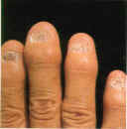
ONYCHATROPHIA
DESCRIPTION/ CAUSE: The wasting away of the nail, causing it to lose its lustre and become smaller. The nail can also shed completely. This condition is mainly caused by injury or disease.

Slide 47
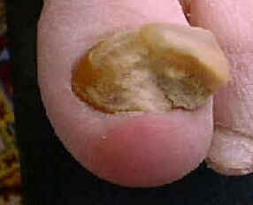
ONYCHAUXIS
DESCRIPTION/ CAUSE: An overgrowth of the nail, in thickness rather than in length. Usually caused by an internal disturbance, such as a local infection.

Slide 48
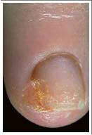
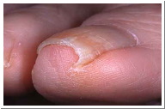
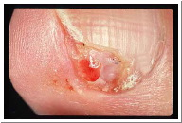
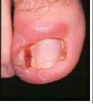
(INGROWN NAILS)
DESCRIPTION/ CAUSE: Also known as ingrown nails. May affect either the fingers or toes. The nail grows into the sides of the flesh and may cause infection. Filing the nails too much in the corners and failing to correct hang nails can cause the condition as well.

Slide 49
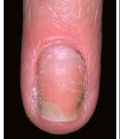
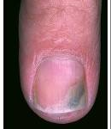
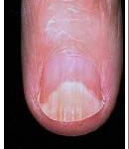
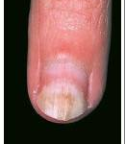
ONYCHOLYSIS
DESCRIPTION/ CAUSE: Most commonly associated with external trauma to the nail. Nail plate separates from the nail bed. Can also be associated with an internal disorder.

Slide 50
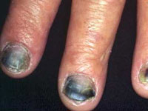
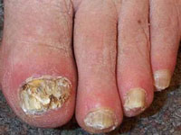
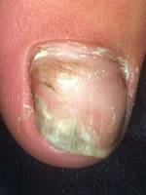
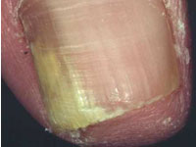
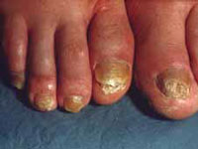
ONYCHOMYCOSIS (TINEA UNGUIUM)
DESCRIPTION/ CAUSE: An infectious fungal disease mainly seen as white spots that can be scraped off the surface, or long yellowish streaks within the nail substance. The disease attacks the free edge and moves its way to the matrix. The infected portion is thick and discoloured.
Notes:
First finger has evidence of a secondary bacterial infection.

Slide 51
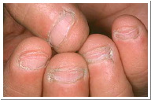
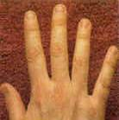
ONYCHOPHAGY
DESCRIPTION/ CAUSE: Bitten nails, often no free edge is visible. Nails look ragged and distorted, skin and nail bed can be exposed and raw.
ACTION: Regular manicure or apply nail enhancements to discourage the client from biting their nails.

Slide 52
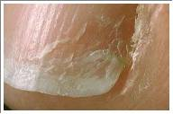
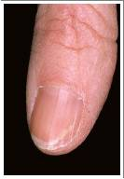
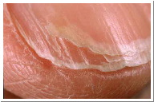
ONYCHORRHEXIS
DESCRIPTION/ CAUSE: Split or brittle nails. Caused by injury to the finger or exposure to harsh chemicals

Slide 53
PARONYCHIA
DESCRIPTION/ CAUSE: An infectious and inflammatory condition of nail folds. Infection is bacterial. Chronic paronychia may weaken defences and increase the risk of developing a fungal infection of the nail or may permanently deform the nail plate.

Slide 54
PSORIASIS
DESCRIPTION/ CAUSE: A skin disease which can affect the nail. It appears as silvery scales that build up to form a plaque which, when removed, leave a raw, red patch of skin. Plaques which form around the nail plate can cause pitting. Those which form beneath the nail plate can cause onycholysis.

Slide 55
PTERIGIUM
DESCRIPTION/ CAUSE: An abnormal winged like growth of skin (living tissue) on the nail plate. The skin is slowly stretched and dragged along the bed. Most commonly caused by severe trauma such as warts, burns & blood circulation disorders.

Slide 56
RIDGES, FURROWS, CORREGATIONS
DESCRIPTION/ CAUSE: Multiple shallow/ deep ridges due to illness or injury, excessive dieting, incorrect removal of nail enhancements, pregnancy, etc.

Slide 57
DISCOLOURED NAILS
DESCRIPTION/ CAUSE: Exposure to chemicals including dyes & nicotine. Some medications, bacterial infections and systemic disorders may also cause nail discolouration .

