Slide 1
Approach to OVARIAN & endometrial CANCER
Supervised by: Dr.Omar ALDabas
Khaled Omar Khader
Waleed Adnan Azayzeh
Alaa Mohamed AL Freahat

Slide 2
Ovarian Neoplasms
Done by:
Khaled Omar Khader
Waleed Adnan Azayzeh

Slide 3
Ovarian Neoplasms
● Ovarian neoplasms arise from the surface epithelium, germ cells, and sex-cord-
stromal tissue and may be benign, borderline or malignant. These neoplasms persist
unless excised.
● Epithelial tumors account for 60-65% of all ovarian tumors, germ cell tumors
account for 30% and sex-cord stromal tumors account for 8%.

Slide 4
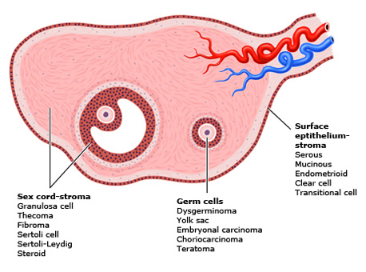

Slide 5
Epithelial Ovarian Cancer

Slide 6
The second most common gynecologic malignancy in developed countries.
The most common cause of gynecologic cancer death and the fifth leading cause of cancer death in women.
The majority of ovarian cancers are diagnosed at an advanced stage : confined to primary site (15 %); spread to regional lymph nodes (17 %); distant metastases (61%); and unstaged (7 %).
The majority of ovarian malignancies (95 %) are derived from epithelial cells; the remainder arise from other ovarian cell types (germ cell tumors, sex cord-stromal tumors).
Serous carcinoma, the most common histologic subtype of epithelial ovarian carcinoma (75 percent of epithelial carcinomas).
Epidemiology

Slide 7
Risk factors
1) Age:
The incidence increases with increasing age.
The average age at diagnosis of ovarian cancer is 63 years old.
The age at diagnosis of ovarian cancer is younger among women with a hereditary ovarian cancer syndrome.
2) Reproductive and hormonal factors:
1- Early menarche ( < 12 years )
2- late menopause ( > 52 years )
3- Nulliparity
4- Infertility
5- Endometriosis
6- Polycystic ovarian syndrome
7- Postmenopausal hormone therapy
8- Intrauterine device

Slide 8
Risk factors
3) Genetic factors:
Several ovarian cancer susceptibility genes have been identified, primarily BRCA1 and 2 and the mismatch repair genes (associated with Lynch syndrome).
The estimated lifetime risk of ovarian cancer is 35-46 % for BRCA1 mutation carriers and 13-23 % for BRCA2 mutation carriers.
The lifetime risk of ovarian cancer in women with Lynch syndrome is 3-14 % compared with 1.5 % in the general population.
4) Family history of ovarian cancer:
A personal or family history of breast cancer had been thought of as a risk factor for ovarian cancer; however, BRCA gene mutations appear to account for most of this increased risk

Slide 9
Risk factors
5) Environmental factors:
1- Cigarette smoking : Current smoking or past smoking appears to increase the risk of mucinous ovarian cancer, but not other types of EOC.
2- Talc and asbestos : e.g, genital use of talcum powder (talc).
3- Obesity : High body mass index (BMI) appears to increase ovarian cancer risk.
No association between alcohol intake and the risk of EOC.
There is no clear relationship between physical activity and ovarian cancer risk.
No association between vitamin D supplementation and ovarian cancer risk.

Slide 10
Protective factors
Oral contraceptives
Multiparity
Gynecological surgeries (Salpingo-oophorectomy, Tubal ligation, Hysterectomy)
Breastfeeding

Slide 11
High-grade serous carcinoma (70-80 %)
Endometrioid carcinoma (10 %)
Clear cell carcinomas (10 %)
Mucinous carcinoma (3 %)
Low-grade serous carcinoma (<5 %)

Slide 12
Clinical features and diagnosis
The clinical presentation of epithelial ovarian carcinoma (EOC), fallopian tubal carcinoma, and peritoneal carcinoma may be either acute or subacute.
Women who present in an acute fashion are typically those with advanced disease who present with a condition that requires urgent care and evaluation (eg, pleural effusion, bowel obstruction and VTE).
EOC may present in a subacute fashion (eg, adnexal mass, pelvic or abdominal pain, gastrointestinal symptoms) in women with either early or advanced disease. These conditions are usually evaluated in an outpatient setting.
Adnexal mass : may be discovered due to symptoms of pelvic pain or pressure or it may be found on a routine pelvic examination or an imaging study performed for another indication.
Pelvic or abdominal symptoms : Bloating, Urinary urgency or frequency, Difficulty eating or feeling full quickly, Pelvic or abdominal pain.
- The symptoms associated with ovarian cancer are nonspecific.
- The type or severity of symptom does not reliably correspond to disease stage.

Slide 13
Other subacute presentations :
1- Postmenopausal bleeding.
2- Rectal bleeding.
3- For fallopian tubal carcinoma, a classic triad of symptoms has been described: clear
or blood-tinged vaginal discharge, pelvic pain, and a pelvic mass.
4- Atypical glandular cells on cervical cytology : Women with a finding of atypical
glandular cells should be evaluated for cervical and endometrial carcinoma.
5- Paraneoplastic syndromes : cerebellar degeneration, polyneuritis, dermatomyositis,
hemolytic anemia, disseminated intravascular coagulation, acanthosis, or nephrotic
syndrome.
6- Palpable inguinal or cervical lymphadenopathy.
7- Incidental operative finding.

Slide 14
On Physical Examination
1. General examination
2. Abdominal examination:- Abdominal distention is one of the more common findings. The presence of flank fullness and shifting dullness implies the presence of ascites or a large pelvic-abdominal mass, Recent eversion of the umbilicus
3. Lymph Node examination :- the supraclavicular and inguinal areas,Sister Mary Joseph's nodule refers to a metastatic implant in the umbilicus.

Slide 15
On Physical Examination
4. Pelvic examination:- A careful and thorough pelvic examination provides many helpful clues regarding the etiology of a pelvic mass.# Benign mass:- Mobile, smooth, cystic, unilateral#malignant mass:- fixed, irregular, sold or firm, bilateral.•
If I find a mass... What could be else !!!!Endometrioma, Fibroid, Functional cyst, Ectopic pregnancy , Dermoid tumor (younger women)

Slide 16
investigations
Tumor serum biomarkers
Cancer antigen 125 ( CA 125 )
Cancer antigen 19-9 (CA 19-9)
Human epididymis protein 4 (HE4)
Carcinoembryonic antigen (CEA)

Slide 17
Cancer antigen 125 ( CA 125 )
The CA 125 antigen is a large transmembrane glycoprotein derived from both coelomic (pericardium, pleura, peritoneum) and müllerian (fallopian tubal, endometrial, endocervical) epithelia.
Normal value : CA 125: ≤35 U/Ml.
Serum CA 125 is the most commonly used laboratory test for the evaluation of adnexal masses for epithelial ovarian cancer (EOC).
CA 125 testing alone has a low sensitivity, particularly for early stage ovarian cancer. only raised in 50% of early stage disease.
CA-125 being raised in numerous conditions including fibroids, endometriosis, adenomyosis , pelvic inflammatory disease, liver cirrhosis with or without ascites , Cancers of the endometrium, breast, lung, and pancreas.

Slide 18
In postmenopausal women, the sensitivity for ovarian cancer was 69-87 %, specificity was 81-93 %. For premenopausal women, the sensitivity was 50 –74%, specificity was 69-78 %.
CA 125 is not consistently produced by some histologic types of epithelial ovarian cancer, including: mucinous, clear cell, and mixed müllerian ovarian tumors.
Serum CA 125 >200 U/mL had been used as a criterion for referral to a gynecologic oncologist.

Slide 19
Imaging
Pelvic ultrasound is the single most effective way of evaluating an ovarian mass. With transvaginal ultrasonography being preferable due to its increased sensitivity over transabdominal ultrasound.
CT or MRI are used for the presence of distant extension of the disease.
Chest radiography is performed in most patients to evaluate for pleural effusion, pulmonary metastases, and mediastinal lymphadenopathy.

Slide 20
Risk of Malignancy index (RMI)
Is a multimodality approach that combines three presurgical features: serum CA 125, pelvic ultrasound, and menopausal status into an index score to predict the risk of ovarian cancer in women with an adnexal mass.
The ultrasound result is scored 1 point for each of the following characteristics: multilocular cysts, solid areas, metastases, ascites and bilateral lesions. U = 0 (for an ultrasound score of 0), U = 1 (for an ultrasound score of 1), U = 3 (for an ultrasound score of 2–5).
The menopausal status is scored as 1 = premenopausal and 3 = postmenopausal.
Serum CA-125 is measured in IU/ml and can vary between zero to hundreds or even thousands of units.
RMI I score of >200 = high risk ( risk of cancer <80%)
RMI I score < 25 = low risk ( risk of cancer < 3%)
RMI = U * M * CA-125

Slide 21
A 46-year-old nulliparous woman comes to the office for a routine examination. She has been feeling well. Her last menstrual period was a week ago. The patient has regular menses every 30 days that last 3 days, with crampy abdominal pain on the first day relieved by ibuprofen. She has a history of heartburn, which is relieved by over-the-counter antacids. The patient has never had any surgeries. She does not smoke cigarettes. Abdominal examination shows a symmetric, nontender, nondistended abdomen with normal bowel sounds. Speculum examination shows a cervix with a closed external os. Bimanual examination shows a 5-cm, irregular, right adnexal mass. Urine pregnancy test is negative. Which of the following is the best next step in management?
A. CT scan of the abdomen and pelvis
B. MRI of the abdomen and pelvis
C. Pelvic ultrasonography
D. Reassurance and routine follow-up
E. Serum CA-125 level
F X-ray of the abdomen and pelvis

Slide 22
A 46-year-old nulliparous woman comes to the office for a routine examination. She has been feeling well. Her last menstrual period was a week ago. The patient has regular menses every 30 days that last 3 days, with crampy abdominal pain on the first day relieved by ibuprofen. She has a history of heartburn, which is relieved by over-the-counter antacids. The patient has never had any surgeries. She does not smoke cigarettes. Abdominal examination shows a symmetric, nontender, nondistended abdomen with normal bowel sounds. Speculum examination shows a cervix with a closed external os. Bimanual examination shows a 5-cm, irregular, right adnexal mass. Urine pregnancy test is negative. Which of the following is the best next step in management?
A. CT scan of the abdomen and pelvis
B. MRI of the abdomen and pelvis
C. Pelvic ultrasonography
D. Reassurance and routine follow-up
E. Serum CA-125 level
F X-ray of the abdomen and pelvis

Slide 23
An adnexal mass may arise from the ovary or fallopian tube and requires further investigation once identified on physical examination. An asymptomatic, palpable, smooth adnexal mass without any additional signs of ovarian cancer (eg, ascites, cul-de-sac nodularity) is likely benign.
However, an adnexal mass may be the only sign of ovarian cancer, and reassurance (Choice D) is not appropriate until further investigation.
Pelvic ultrasonography is the first-line test for evaluation of a palpable adnexal mass. The entire pelvis can be visualized on ultrasound using a combination of transabdominal and transvaginal techniques, providing a full overview of any masses that extend past the pelvis. Pelvic ultrasound will show the uterus (including endometrium), ovaries, and cul-de-sac. The fallopian tubes are not visible on ultrasound unless pathology is present. Ultrasound has a high specificity for detection of malignant sonographic features (eg, thick septations, solid components). It is noninvasive, well tolerated, requires no radiation, is readily available, and is cost effective. However, performance can be limited by patient obesity.
(Choice E) In a premenopausal patient, pelvic ultrasound should first confirm that the adnexal mass is ovarian; CA-125 can then be considered based on sonographic features and patient medical history. CA-125 testing has particularly low specificity in premenopausal women as it can be elevated from many other benign conditions (eg, endometriosis, leiomyomata, lupus) and ovarian cancer is less common before menopause. CA-125 is useful mainly in postmenopausal women and is not recommended for the initial evaluation of an adnexal mass in premenopausal patients.

Slide 24
A 62-year-old nulligravid woman comes to the office for follow-up after right adnexal enlargement was found on routine pelvic examination 2 weeks ago. Pelvic ultrasound reveals a 5-cm right ovarian cyst. Menopause occurred at age 52, and the patient has had no postmenopausal spotting or bleeding. her medical history is otherwise unremarkable. The patient has never had any surgeries. There is no family history of ovarian or breast cancer. Her most recent mammogram 2 months ago showed no abnormalities. Which of the following is the most appropriate initial course of action for this patient?
Endometrial biopsy
Laparoscopy
C. Needle aspiration for cytology
D. Papanicolaou test
E. Serum CA-125 level

Slide 25
A 62-year-old nulligravid woman comes to the office for follow-up after right adnexal enlargement was found on routine pelvic examination 2 weeks ago. Pelvic ultrasound reveals a 5-cm right ovarian cyst. Menopause occurred at age 52, and the patient has had no postmenopausal spotting or bleeding. her medical history is otherwise unremarkable. The patient has never had any surgeries. There is no family history of ovarian or breast cancer. Her most recent mammogram 2 months ago showed no abnormalities. Which of the following is the most appropriate initial course of action for this patient?
Endometrial biopsy
Laparoscopy
C. Needle aspiration for cytology
D. Papanicolaou test
E. Serum CA-125 level

Slide 26
Once an adnexal mass has been identified, the evaluation to exclude malignancy includes a medical history, physical examination, imaging studies, and laboratory evaluation for tumor markers.
Definitive diagnosis of ovarian cancer requires surgery and histopathology.

Slide 27
Staging System
Cancer of the ovary is surgically staged according to the 2014 International Federation of Gynecology and Obstetrics (FIGO) :
STAGE I (Tumor confined to ovaries)
IA : Tumor limited to 1 ovary,capsule intact, no tumor on surface, negative washings
IB : Tumor involves both ovaries , otherwise like IA
IC : Tumor limited to 1 or both ovaries
IC1 : Surgical spill
IC2 : Capsule rupture before surgery or tumor on ovarian surface
IC3 : Malignant cells in the ascites or peritoneal washings
STAGE II (Tumor involves 1 or both ovaries with pelvic extension (below the pelvic
brim) or primary peritoneal cancer)
IIA : Extension and/or implant on uterus and/or Fallopian tubes
IIB : Extension to other pelvic intraperitoneal tissues

Slide 28
STAGE III (Tumor involves 1 or both ovaries with cytologically or histologically
confirmed spread to the peritoneum outside the pelvis and/or metastasis to
the retroperitoneal lymph nodes)
IIIA : Positive retroperitoneal lymph nodes and/or microscopic metastasis beyond the
pelvis
IIIA1 : Positive retroperitoneal lymph nodes only
IIIA1(i) : Metastasis ≤ 10 mm
IIIA1(ii) : Metastasis > 10 mm
IIIA2 : Microscopic, extrapelvic (above the brim) peritoneal involvement ±
positive retroperitoneal lymph nodes
IIIB : Macroscopic, extrapelvic,peritoneal metastasis ≤ 2 cm ± positive retroperitoneal
lymph nodes. Includes extension to capsule of liver/spleen
IIIC : Macroscopic, extrapelvic, peritoneal metastasis > 2 cm ± positive retroperitoneal
lymph nodes. Includes extension to capsule of liver/spleen
STAGE IV (Distant metastasis excluding peritoneal metastasis)
IVA : Pleural effusion with positive cytology
IVB : Hepatic and/or splenic parenchymal metastasis, metastasis to extra-abdominal
organs (including inguinal lymph nodes and lymph nodes outside of the
abdominal cavity)

Slide 29
Cyto-reductive surgery (De-bulking surgery)(Staging laprotomy):
Total abdominal hysterectomy
Bilateral salpingo-oophorectomy
Peritoneal cytology
Infra-colic omentectomy
Pelvic and para-aortic lymph node dissection

Slide 30
There are several potential benefits of aggressive primary surgical management in women with epithelial ovarian carcinoma (EOC), particularly for those with advanced disease :
1) Optimal response to postoperative systemic chemotherapy is achieved in the setting
of minimal disease burden.
2) Disease-related symptoms (eg, abdominal pain, increased abdominal girth, dyspnea,
early satiety) are related to tumor burden. Removal of bulky disease rapidly
improves symptoms and quality of life.
3) Ovarian neoplasms produce multiple cytokines, at least some of which are
immunosuppressive (eg, interleukin-10, vascular endothelial growth factor).
Removal of tumor bulk may improve or restore host immune competence.
4) Cytoreduction is associated with increased survival. The volume of residual disease
remaining after cytoreductive surgery correlates inversely with survival.

Slide 31
The terminology regarding extent of cytoreduction is:
1) Complete cytoreduction – Cytoreduction to no grossly visible disease.
2) Optimal cytoreduction – The Gynecologic Oncology Group (GOG) defines optimal
cytoreduction as residual disease that is ≤1 cm in maximum tumor diameter.
3) Suboptimal cytoreduction – Cytoreduction with tumor nodules >1 cm remaining.

Slide 32
Adjuvant therapy
Women with EOC should undergo adjuvant treatment with the exception of those with stage IA EOC.
Neoadjuvant therapy
refers to the administration of systemic chemotherapy before definitive surgery.
The goal of NACT is to reduce perioperative morbidity and mortality and increase the likelihood of a complete resection of disease at the time of cytoreductive surgery.
In most cases of women treated with NACT, further chemotherapy is administered following surgery (ie, adjuvant chemotherapy).

Slide 33
A 60-year-old woman, gravida 3 para 3, comes to the office due to shortness of breath. Over the past 6 months, the patient has been finding it progressively more difficult to take deep breaths. She has also noticed that she cannot fit into any of her pants lately despite a decreased appetite and nausea. The patient has a history of type 2 diabetes and has never had any surgeries. All her children were born vaginally. Routine
mammography 4 years ago was normal. The patient has a sister with breast cancer, BRCA mutation positive. Physical examination shows an ill appearing woman with a distended abdomen and decreased bowel sounds. The lungs are clear on auscultation. Pelvic examination shows a firm, nodular, non-mobile mass in the left adnexa. A pelvic ultrasound is performed and confirms the physical examination findings. Which of the
following is the most appropriate next step in management of this patient?
A. Exploratory laparotomy
B. Hysteroscopy
C. Image-guided biopsy of pelvic mass
D. Loop electrosurgical excision procedure
E. Myomectomy

Slide 34
A 60-year-old woman, gravida 3 para 3, comes to the office due to shortness of breath. Over the past 6 months, the patient has been finding it progressively more difficult to take deep breaths. She has also noticed that she cannot fit into any of her pants lately despite a decreased appetite and nausea. The patient has a history of type 2 diabetes and has never had any surgeries. All her children were born vaginally. Routine
mammography 4 years ago was normal. The patient has a sister with breast cancer, BRCA mutation positive. Physical examination shows an ill appearing woman with a distended abdomen and decreased bowel sounds. The lungs are clear on auscultation. Pelvic examination shows a firm, nodular, non-mobile mass in the left adnexa. A pelvic ultrasound is performed and confirms the physical examination findings. Which of the
following is the most appropriate next step in management of this patient?
A. Exploratory laparotomy
B. Hysteroscopy
C. Image-guided biopsy of pelvic mass
D. Loop electrosurgical excision procedure
E. Myomectomy

Slide 35
Epithelial ovarian cancer (EOG) occurs primarily in postmenopausal women, and those with a family history of ovarian or breast cancer (eg,BRCA mutation carrier) are particularly susceptible. EOG commonly presents with advanced disease as early symptoms (eg, bloating, abdominal pain) tend to be vague and nonspecific. A firm, non-mobile pelvic mass with nodularity in a postmenopausal patient is concerning for EOG thathas extended beyond the adnexa. In addition, this patient has symptoms of ascites (eg, shortness of breath, decreased appetite, abdominal distension, decreased bowel sounds), which is likely due to peritoneal spread of cancer causing increased capillary permeability and decreased intravascular oncotic pressure.
Imaging (eg, pelvic ultrasound) is done to confirm the presumed clinical diagnosis of ovarian cancer and ascites; it may also evaluate for metastatic disease. CA-125 should be drawn to correlate with clinical findings and to monitor treatment in the future. Exploratory laparotomy with cancer resection and inspection of the entire abdominal cavity for metastases (ie, surgical staging) is required when there is a high clinical
suspicion of EOG, particularly with an acute presentation, as in this patient. During surgery, the ovaries, uterus, omentum, and any visually apparent cancerous lesion will be removed and pelvic and paraaortic lymph nodes will be dissected. Chemotherapy with platinum-based agents is initiated after surgery.

Slide 36
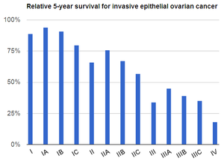
Prognosis
Overall five-year survival in women with ovarian cancer is less than 45 %.

Slide 37
The major prognostic factors associated with improved outcome were :
1) younger age : Younger patients are more likely to have a favorable prognosis
because they are more likely to have tumors of less aggressive
histology and lower grade, and better baseline performance status.
2) Low volume of residual disease.
3) Good performance status.
4) Serous histology.

Slide 38
POSTTREATMENT SURVEILLANCE
1) Office visits (including physical and pelvic exams) every three to six months up to five years posttreatment, then annually.
2) CA-125 or other tumor markers (eg, HE4) every visit if initially elevated, if indicated
3) Other testing (ie, chemistry profile or complete blood count, CT scan, or transvaginal ultrasound in women who underwent fertility-sparing surgery) only as clinically indicated.

Slide 39
Screening for ovarian cancer
Screening for high risk women : There is a consensus that women at average risk for
ovarian cancer should NOT undergo screening.
Screening tests : Measurement of CA 125 and transvaginal pelvic ultrasound.

Slide 40
A 58-year-old nulliparous woman comes to the office for a routine checkup. She is concerned about ovarian cancer because her cousin died of the disease last year and a close friend was recently diagnosed with it. Her medical history is significant for hypertension treated with an ACE inhibitor. Menopause was at age 55. The patient smokes a half pack of cigarettes a day. There is no other cancer history in her family. Physical examination is unremarkable. Which of the following is the most appropriate strategy for ovarian cancer screening in this patient?
A. Genetic testing for BRCA mutation
B. No further workup
C. Pelvic ultrasonography
D. Serum CA-125 level
E. Serum carcinoembryonic antigen level

Slide 41
A 58-year-old nulliparous woman comes to the office for a routine checkup. She is concerned about ovarian cancer because her cousin died of the disease last year and a close friend was recently diagnosed with it. Her medical history is significant for hypertension treated with an ACE inhibitor. Menopause was at age 55. The patient smokes a half pack of cigarettes a day. There is no other cancer history in her family. Physical examination is unremarkable. Which of the following is the most appropriate strategy for ovarian cancer screening in this patient?
A. Genetic testing for BRCA mutation
B. No further workup
C. Pelvic ultrasonography
D. Serum CA-125 level
E. Serum carcinoembryonic antigen level

Slide 42
Ovarian cancer is one of the leading causes of cancer mortality in the World as the disease is typically diagnosed in advanced stages with widespread metastasis. For average-risk patients (eg, no hereditary cancer syndromes), no screening tests exist to detect ovarian cancer in its early, more treatable stages. This patient's family history of a single second-degree relative with ovarian cancer does not impart increased likelihood of a hereditary cancer syndrome.

Slide 43
A 7-year-old girl is brought to the office due to breast development that has occurred over the past 6 months. Her parents are concerned that she appears older than her classmates. An episode of vaginal spotting 2 months ago resolved after 3 days. She has had no headaches or visual changes. The patient has no chronic medical conditions and has had no surgeries. She takes no daily medications and has no allergies. Height and weight are at the 98th and 70th percentiles, respectively. Physical examination shows Tanner stage 3 breast development. The abdomen is soft and moderately distended and a palpable fullness is present in the pelvic region. Bone age is advanced at age 10. Pelvic ultrasound reveals a large right-sided adnexal mass. Which of the following is the most likely diagnosis in this patient?
Notes:
juvenile-subtype granulosa cell tumors typically present with precocious puberty and an adnexal mass.

Slide 44
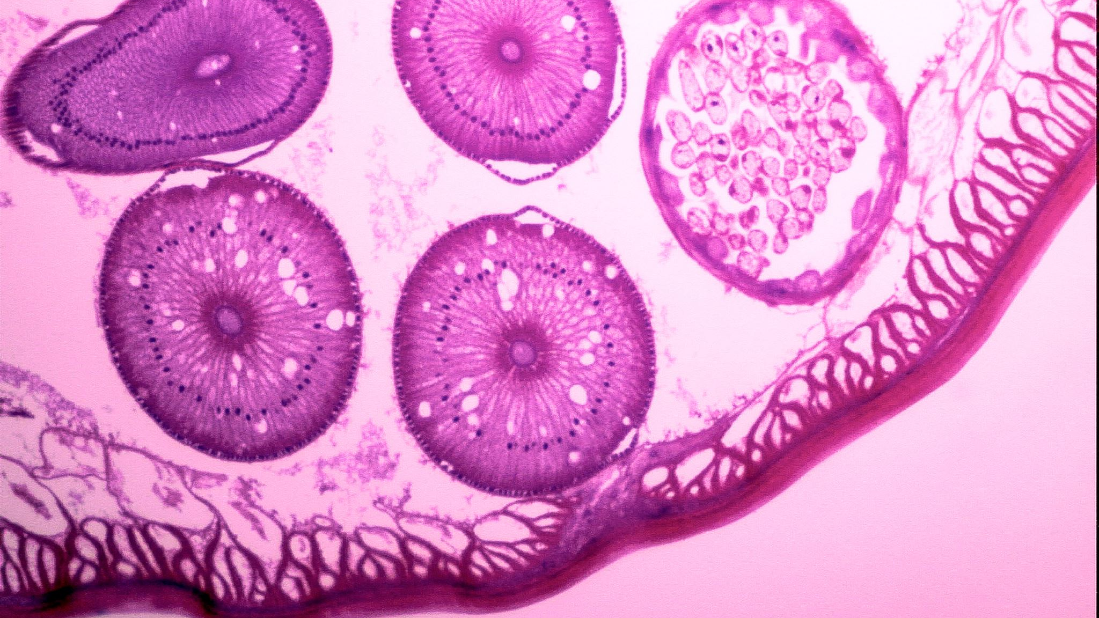
Endometrial hyperplasia and cancer
Done by :
ALAA AL-FREAHAT

Slide 45
Introduction
Endometrial hyperplasia is a disordered proliferation of endometrial glands. It results from the unopposed estrogenic stimulation of the endometrial tissue with a relative deficiency of the counterbalancing effects of progesterone.
the causes of estrogen excess could be endogenous or exogenous. The risk factors associated with endometrial hyperplasia are as follows :
Age
Nulliparity
Obesity
Diabetes Mellitus
Anovulatory cycles- PCOS, perimenopause
Ovarian tumors- granulosa cell tumors
Hormone replacement therapy- estrogen-only therapy can lead to endometrial hyperplasia at even a minimal dose and is contraindicated in women with a uterus. Over the counter/ herbal preparations may have a high amount of estrogen.

Slide 46
Clinical presentation
The majority of patients first present with symptoms of abnormal uterine bleeding. The change in the menstrual bleeding pattern alarms the woman to seek medical help early. This is the reason that most of the cases of endometrial cancer (more than 70%) are diagnosed early in stage I as opposed to other cancer where the symptoms are indolent for many years allowing cancer to spread to regional and distant sites. The importance of a detailed history and physical examination is of utmost importance in the evaluation.
The clinical documentation should include the history of present illness, menstrual history, and symptoms (duration of the cycle, flow, the passage of clots, intermenstrual bleeding, postmenopausal bleeding, unscheduled bleeding if the woman is on HRT). The age of menarche, transition through perimenopause, age of menopause should also be recorded.
It is important to note the obstetric history and whether the patient wishes to conceive in the future. This is necessary as it can change the course of treatment options for the patient.
It is ethical to consider medical treatment options for a woman who is keen on conception in the future without compromising the prognosis. A smear and contraceptive history should be taken.. The drug history should be taken meticulously and specifically asked for the intake of HRT, over the counter drugs, tamoxifen, etc. A family and social history should also be taken.

Slide 47
The main goals of management are as follows:
To prevent the development/progression of endometrial malignancy.
To rule out the presence of a coexisting endometrial malignancy.
To offer a treatment plan that best suits the needs of the patient.
the following clinical factors are to pay attention to in management :
Type of EH (with or without atypia).
Menopausal status.
Desire for fertility in premenopausal patients.

Slide 49
Indications for hysterectomy:
Atypical hyperplasia develops during the treatment period
No resolution of the disease after 12 months of treatment / Non-resolution of bleeding
Relapse of endometrial hyperplasia
A non-compliant patient who declines surveillance and follow-up

Slide 50
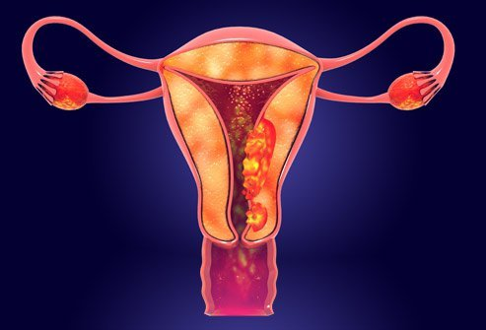
Endometrial cancer

Slide 51
Endometrial carcinoma is the fifth leading cancer in the women worldwide.
In developed countries it’s the most common gynecological cancer and second most common in developing countries after cervical CA.
Mean age of presentation is 56 years .
75% after menopause.
20% perimenopausal.
5% before age of 40.

Slide 52
Etiology
It is a case of hyperestrogenemia, so any case that include an increase in estrogen level will increase the risk of Endometrial carcinoma,
- indiscriminate use of oestrogen.
- unopposed oestrogen.
- Theca granulosa cell tumours.

Slide 53
Risk factors:
Diabetes or abnormal glucose tolerance test.
Hypertension.
Fibroids.
Polycystic ovarian syndrome.
overnight or obese patients .
Infertility, Arthritis, and Thyroid disease.
Early menrach and late menopause .
Use of TAMOXIFEN.
Previous pelvic irradiation.
Positive family history of breast, ovarian, and colon cancer.
ATYPICAL ADENOMATOUS HYPERPLASIA (complex atypical)
25% will progress into endometrial CA.

Slide 54
Protective factors:
Smoking
Use of oral contraceptive.
Use of progesterone.

Slide 55
Each is further graded according to Broder’s classification
Grade 1 tumors are more often seen than anaplastic , therefore carries a better prognosis .

Slide 56
Spread :
Invasion through the myometrium and by filling the uterine cavity.
Invasion to the cervix with subsequent lymphatic spread involving the iliac and para-aortic nodes.
From upper uterus may spread to round ligament to the deep inguinal nodes.
In advanced cases, the blood-stream spread may carry to the lungs, liver, and to the bone.

Slide 57
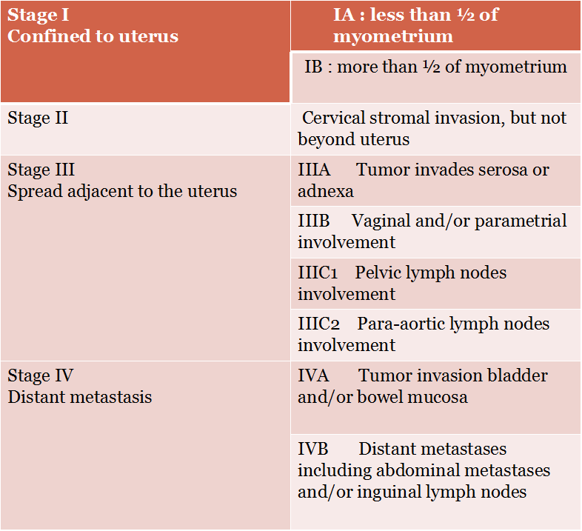
Staging is made surgically by the following procedure:
Laparatomy, peritoneal wash to detect the presence of mets.
Total abdominal hystrectomy with bilateral salpingophrectmoy.
3. Lymph nodes dissection.

Slide 58
History:
postmenopausal bleeding or staining( this symptom should be assumed to be caused by carcinoma of the endometrium until proved otherwise), only 10% of PMB have endometrial carcinoma.
Perimenopausal menstrual irregularities.
Blood stained vaginal discharge.
Heavy and irregular vaginal bleeding
Dysuria
Dysparenia
Back pain
pain or mass in the pelvis

Slide 59
Examination:
physical examination of the patient with endometrial carcinoma is frequently entirely normal, it should include palpation of supraclavicular and inguinal lymph nodes, abdominal palpation might be difficult due to obesity.
Gynaecological examination:
inspection of vulva, vaginal skin in suburethral area
and cervix.
Bimanual vaginal examination assesses uterine size, and mobility, state of parametria and adnexa.
Bimanual recto-vaginal examination. (rectal and
uterosacral ligament infiltration).

Slide 60
Investigations and imaging:
CBC.
Liver function test.
Renal function test.
Chest X ray.
Ultrasound: reveals a thick endometrium in a postmenopausal woman.(>5mm)
(must be thin as estrogen should be very low).
Cytology brush from lower cervical canal and posterior fornix to analyze the cells.

Slide 61
Thin endometrium Thick endometrium
Endometrial Cytology brush

Slide 62
Definite diagnosis is made by biopsy, which will be
obtained by:
1. Endometrial biopsy, blind sample.
Fractional curettage, piplle, jet irrigation and suction.
2. Examination under general anasthesia and D&C
3. Hysteroscopy and biopsy, the best, under vision, any abnormal lesions seen will be biopsied.
for staging:
proctoscopy and / or sigmoidoscopy, cystoscopy, and bone scan for some exceptional cases, when there is a clinical suspicion of metastasis.

Slide 63
management
During surgery, if a frozen section facility is available we can do so, if the stage is IA, no need for lymph nodes dissection.
Stage IA grade I (well differentiated) require surgery (TAH with BSO), no need for lymph nodes dissection, no need for postop chemotherapy or radiotherapy.
Stages IB-III all require surgery, postop radio/chemotherapy,
stage III require both to reduce the risk of recurrence.
stage IV adenocarcinoma: Rare
Symptomatic management ,control of tumour growth, so: “Palliative”
-hysterectomy to reduce the bleeding.
-Radiotherapy to decrease the bleeding.
-Cytotoxic drugs.
-Hormonal therapy
May all be required. Rarely limited surgery to stop the bleeding
as palliative procedure is carried out.

Slide 64
Indications for post operative radiotherapy:
Moderate or poor differentiation(G2,G3).
Other histological type than adenocarcinoma as papillary or clear cell carcinoma.
Invasion of myometrium of> 1/2. (IB)
Positive peritoneal wash.
Positive lymph nodes. (III)

Slide 65
Complications
peritonitis
hematometra (collection of blood within uterus due to lower uterine or cervical obstruction) and if it gets infected may result in pyometra
malignant fistula (bladder, rectum, ureters)

Slide 66
Prognosis
Generally endometrial CA has good prognosis, better than cervical CA due to:
Early presentation, as patient is symptomatic.
Slow growth.
Well differentiated .
Late lymph nodes involvement.
5 years survival:
Stage I : 80-90%
Stage II: 70-80%
Stage III: 20-60%
Stage IV: 15%

Slide 67
Thank You

