Slide 1
Neuroradiology III.
2021-2022

Slide 2
Multiple sclerosis
Multiple sclerosis (MS) is a chronic demyelinating condition affecting the central nervous system. Diagnosis requires good history, clinical examination, appropriate imaging, and laboratory tests (cerebrospinal fluid for IgG index and oligoclonal bands).
It is typified by "plaques" of disease which are spread by location and time. MRI is frequently the first-line imaging modality for diagnosis and follow-up.

Slide 3
Presentation
depends on the location of plaques
sensory or motor disturbance
cranial nerve involvement, e.g. optic neuritis, trigeminal neuralgia

Slide 4
pathophysiology
white matter demyelination
visible on MRI as plaques of disease
damage to the myelin sheath surrounding axons
little or no underlying neuronal damage
likely autoimmune, cellular-mediated condition
no unifying cause or trigger
some genetic and environmental factors ³
investigation
CT is insensitive
MRI is the investigation of choice
should be performed with contrast and include the spine

Slide 5
Imaging
role of imaging
initial diagnosis
determine degree of involvement, e.g. spine
follow up of plaques
radiographic features
CT
insensitive

Slide 6
MRI
preferred imaging modailty for diagnosis and follow up
best visualized on a fluid-sensitive sequence, e.g. T2, FLAIR
white matter lesions
characteristic periventricular, they tend to extend perpendicularly and on sagittal views are called "Dawson's fingers" (case 1)
lesions may occur throughout the CNS and be found in a variety of locations, e.g. juxtacortical, brainstem, cerebellum, or spinal cord (also part of the CNS)
enhancement is a marker of activity and can be used to determine lesion load and disease progression limits of conventional MRI technique: it is less sensitive to the associated diffuse damage in normal-appearing white matter.

Slide 7
Case one :MS Dawson fingers

Slide 8
Case two: MS T2

Slide 9
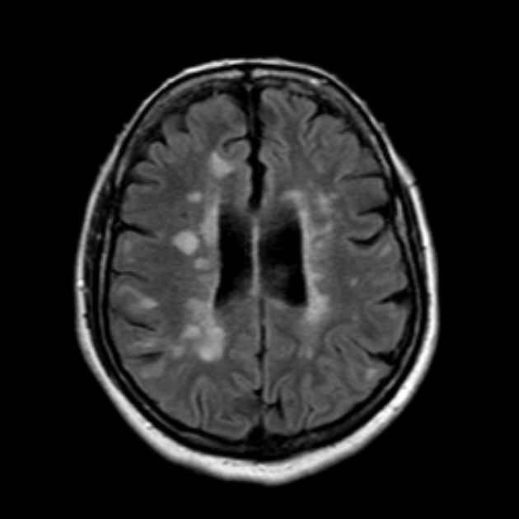
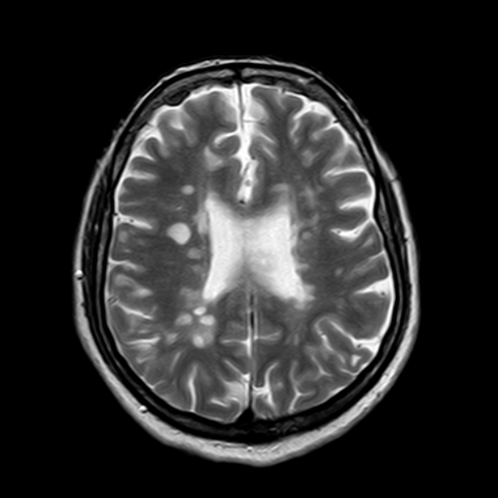
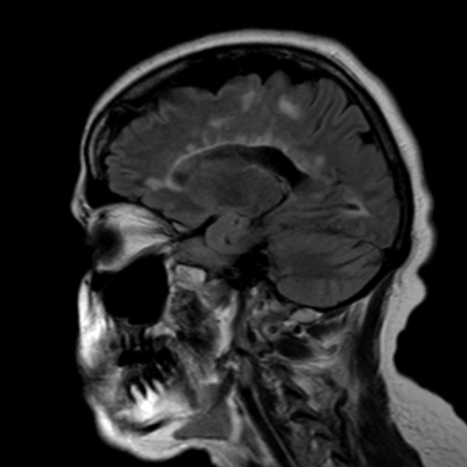
Case 3 : MS ,T1/FLAIR/ T2 /FLAIR SAGITTAL

Slide 10
Case 4: enhancement of plague post contrast T1

Slide 11
Brain atrophic changes
CT and MRI are equally able to demonstrate cortical atrophy, but MRI is more sensitive in detecting focal atrophic changes in the nuclei. Characteristic features include prominent cerebral sulci (i.e. cortical atrophy) and ventriculomegaly (i.e. central atrophy) without bulging of the third ventricular recesses.

Slide 12
Case: wide sulci and ventriculomegaly

Slide 13
Alzheimer disease

Slide 14
Alzheimer disease is characterized by the accumulation within the brain of cerebral amyloid-β (Aβ or Abeta) forming neuritic plaques, neurofibrillary tangles and eventually progressive loss of neurons

Slide 15
The diagnosis should be made on the basis of two features:
mesial temporal lobe atrophy particularly the hippocampus,
temporoparietal cortical atrophy

Slide 16
Classical/typical Alzheimer disease
The typical patient with Alzheimer disease will present initially with episodic memory deficits . Over time (often years), the disease progresses, with other symptom like memory loss, . Neuropsychiatric symptoms are . These include apathy, depression, anxiety, aggression/agitation, and psychosis (delusions and hallucinations) ,…….

Slide 17
Brain atrophic changes with sever hippocampi atrophy

Slide 18
Brain tumour

Slide 19
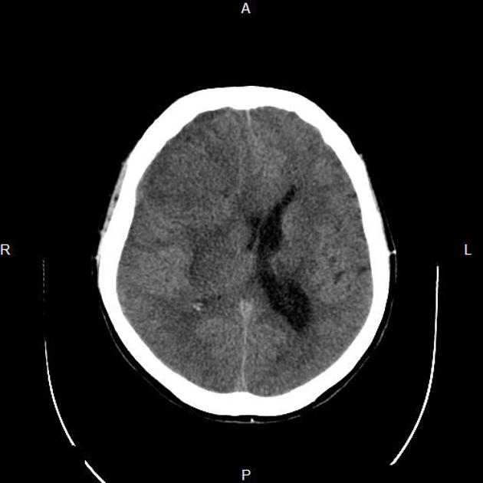
Case 1:Meningioma( pre and post contrast CT )
Extraaxial homogenous enhancing dura based

Slide 20
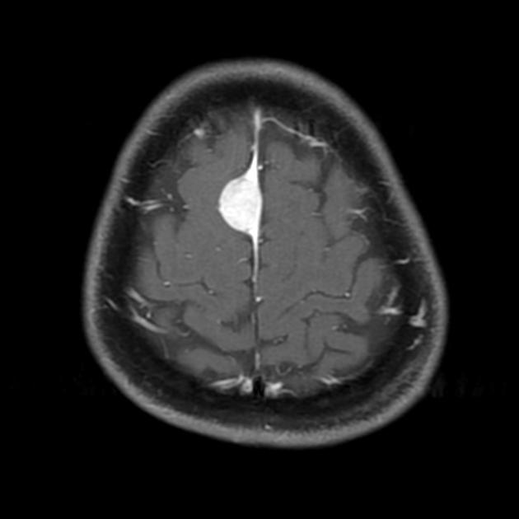
Case : meningioma T1 (pre and post contrast MRI )

Slide 21
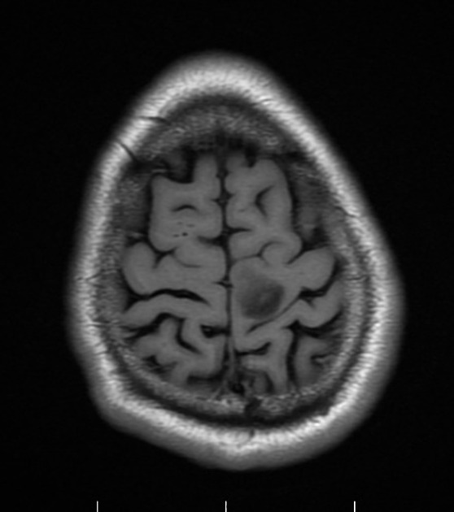
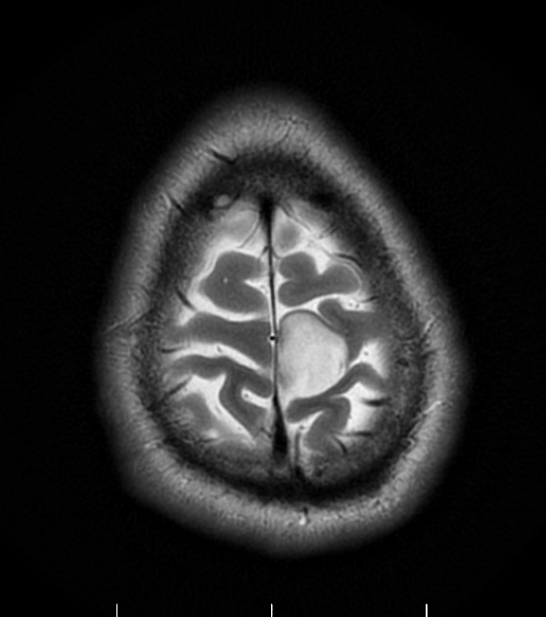
Low grade glioma:T1 :low /T2 high / T1 post non enhancing

Slide 22
High grade glioma like( GBM glioblastoma multiform ): T1 post contrast :heterogonous enhancement wit necrosis and cross midline

Slide 23
Venous Sinus Thrombosis

Slide 24
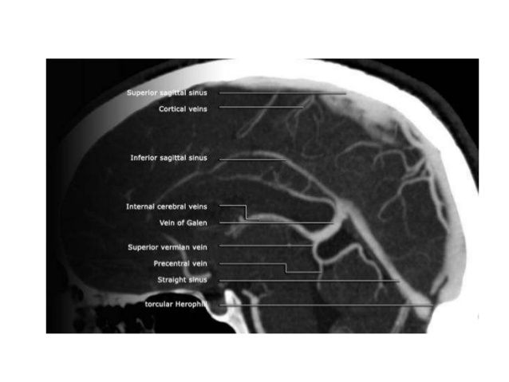
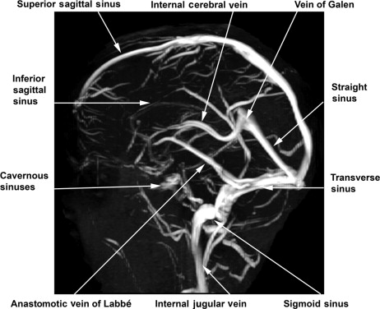
Normal venogram

Slide 26
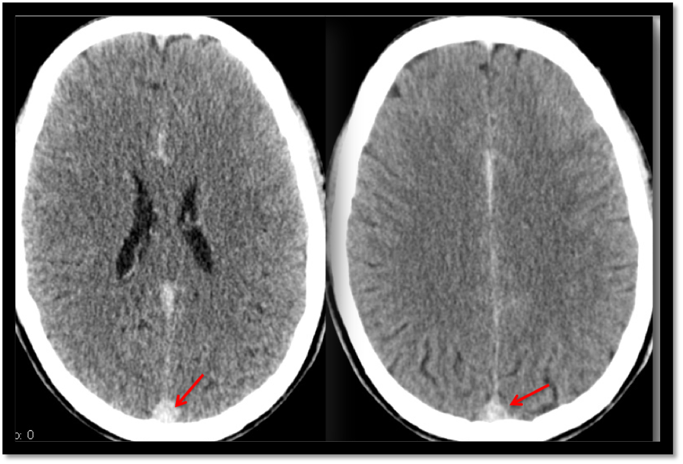
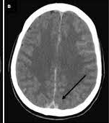
CT WITHOUT SHOWED HYPERDENSE SSS CT WITH SHOWED FILLING DEFECT

Slide 27
Small Vessel Disease

Slide 28
As we age, the small arterioles in the brain become more affected by arteriosclerosis. These small arterioles supply the subcortical, periventricular, and lacunar areas. These areas thus become ischaemic and low density on CT. This can lead to vascular dementia.

Slide 29
BRAIN EDEMA ALL EDEMA HYPER INTENSE ON T2 AND FLAIR /HYPOINTENSE ON T1 /HYPODENSE ON CT /ONLY CYTOTOXIC HAS IN ADDITION DIFFUSION RESTRICTION ON DWI
THREE TYPES :
VASOGENIC EDEMA: OCCURE IN BRAIN TUMOR LOOKS LIKE FINGERS IN THE WHITE MATTER OCCUR WITH BRAIN TUMOURS AND ABCESS
CYTOTOXIC EDEMA:INVOLVE BOTH GREY AND WHITE MATTER OCCURE WITH INVARCTIONS
TRANSEPENDYMAL EDEMA: OCCURE AROUND VENTRICULAR SYSTEM IN CASE OF HYDROCEPHALUS.

Slide 31
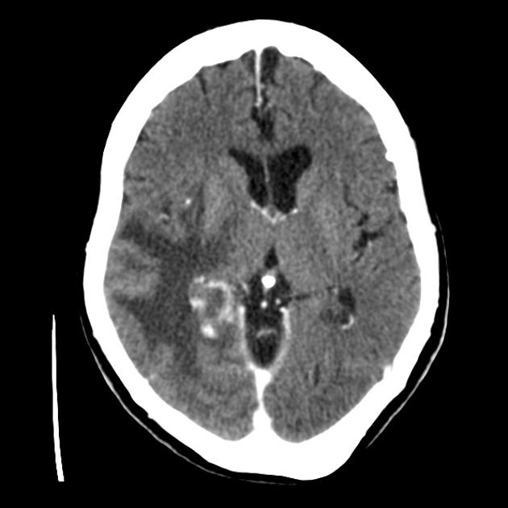
VASOGENIC EDEMA /FINGER LIKE AROUND BREAST METS

Slide 32
CYTOTOXIC EDEMA IN RT SUB MCA INFARCTION SHOWED DIFFUSION RESTRICTION ON DWI

Slide 33
TRANSEPENDYMAL EDEMA IN ACUTE HYDROCEPHALUS

