Slide 1
Eye Trauma
Hello!
Aya Tawalbeh And Mohammed Hashem
Hi!

Slide 2
Ocular Trauma is a major cause of preventable monocular blindness and visual impairment in the world .

Slide 3
Epidemiology
Bimodal age distribution : children and young adult ,more than 70 yrs of age
M/F: 3-5

Slide 4
Eye injury
Closed globe
Contusion
Lamellar laceration
Open globe
Rupture blunt trauma
Laceration
Penetrating injury
Intraocular FB
Perforating injury

Slide 5
EVALUATION OF CASE OF TRAUMA
Proper history
Systemic examination
In case of chemical injuries, take quick hx and give immediate eyewash and treatment .
Visual acuity testing
Thorough ophthalmic examination using slit lamp and ophthalmoscope

Slide 6
History
Sudden /gradual changes in vision since trauma occurred
Pain, diplopia and photophobia.
Date and time of incidant .
Mechanism of injury.
Mechanical trauma with a foreign object (size , shape).
Past ocular history.
Past medical history, medications, allergies.

Slide 7
EXAMINATION
Visual acuity
External examination
Pupil examination
Extra ocular muscle motility
Anterior segment
Posterior segment
Intraocular pressure.

Slide 8
Eyelid trauma

Slide 9
Laceration of the skin and lid.
Check if the eyelid margin is involved.
The naso- lacrimal drainage system may be involved if injury involves nasal portion of the eyelid.
Need to look for associated occult eye or orbital trauma.
The multiple layers of the lid must be apposed correctly to avoid poor lid function, which could result in corneal injury or scarring.

Slide 10
LACERATION
Superficial lacerations
Lid margin lacerations
Lacerations with mild tissue loss
Lacerations with extensive tissue loss
Canalicular lacerations

Slide 11
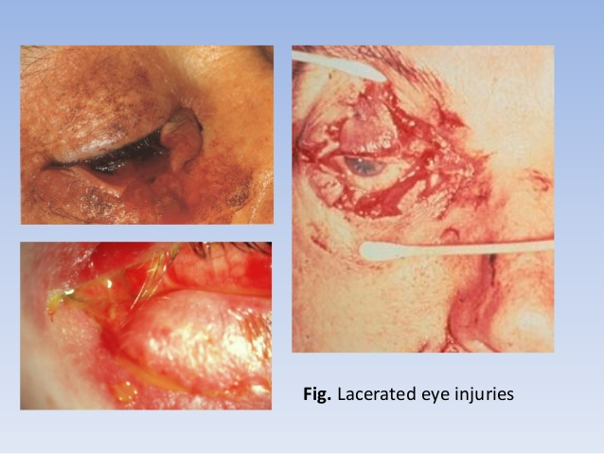

Slide 12
Treatment
-These require careful apposition and suturing, particularly if the lid margin is involved, to retain the lid contour.
- If one of the lacrimal canaliculi is damaged ,an attempt can be made to repair it, but if repair is unsuccessful, usually the remaining tear duct is capable of draining all the tears.
-If both canaliculi are involved, an attempt at repair should always be made.

Slide 13
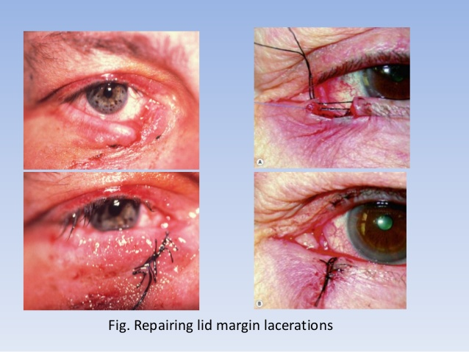

Slide 14
Periocular Haematoma :
Generally innocuous but it is very important to exclude :
Trauma to the globe or orbit .
Orbital roof fracture .
Basal skull fracture .

Slide 15
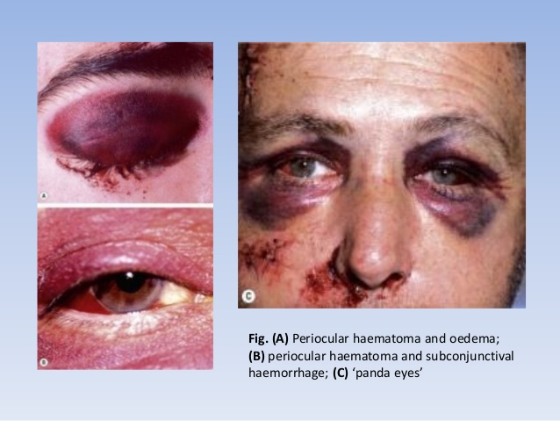

Slide 16
Orbital fractures

Slide 17
TYPES
Blow-out orbital floor fracture .
Blow-out medial wall fracture .
Roof fracture .
Lateral wall fracture.

Slide 18
Blow-out orbital fracture:
Sudden increase in orbital pressure by an impacting object greater in diameter than the orbital aperture (more than 5mm ) e.g : Fist , Tennis ball

Slide 20
lateral wall involvment is rare except in trama

Slide 23
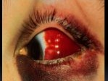
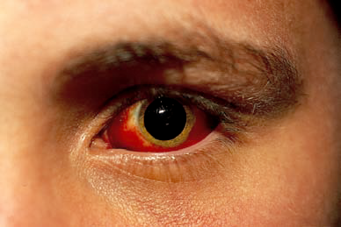
Traumatic Sub-Conjunctival Haemorrhage

Slide 24
If a chemical injury has occurred, the conjunctiva may appear white and ischaemic .
. If such changes are extensive, involving the greater part of the limbal circumference, corneal healing will be grossly impaired because of damage to the epithelial stem cells of the cornea, which are located at the limbus.
There will be additional complications such as uveitis, secondary glaucoma and cataract.

Slide 25
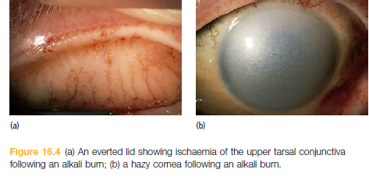

Slide 26
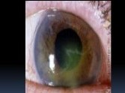
Corneal Abrasion
caused by f/b, rubbing ,fingernail injury..
Presentation : intense pain , redness , photophobia ,

Slide 27
antibiotic ointment, with or without an eye pad , cyclopentolate 1% (Prophylaxis against further recurrent corneal erosions is attempted, using a lubricating ointment at night for several weeks after an initial attack, but more permanent results are achieved by inducing a subepithelial scar at)
UV injury to the cornea responds quickly to topical steroids.

Slide 28
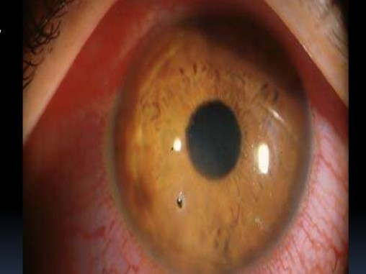
Foreign Body
Corneal foreign bodies should be removed with a needle under topical anaesthesia

Slide 29
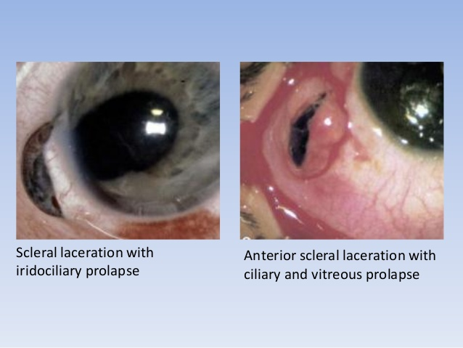

Slide 30
Anterior chamber

Slide 31
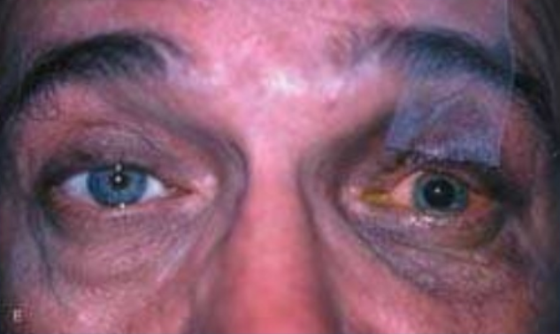
Tramatic Mydriasis
caused by injury to the iris sphincter and dialator muscle, iris nerves or ciliary body
presents as dilation of pupil and paralysis of accomodation

Slide 32
hyphaema
Blunt trauma may cause haemorrhage into the anterior chamber, where it collects with a fluid level, visible as a hyphaema . This is caused by rupture of the root of the iris blood vessels, or the iris may be torn away from its insertion into the ciliary body ( iris dialysis ) to produce a D - shaped pupil.
Hyphaema may also be seen with a penetrating eye injury and the shape of the pupil may be distorted if the peripheral iris has plugged a penetrating corneal wound .

Slide 33
How to treat “Hyphaema”?
its self-limiting
This usually settles with rest, but a rebleed may occur in the first 5 – 6 days after injury.
Steroid eye drops are given for a short time,Steroids reduce the risk of rebleeds.
Pupillary dialators (might seem couterinuitve with the raised IOP but it helps alot with stabilizing the clot, which is our main goal in teatment of hyphamea)
The commonest complication is a raised ocular pressure, particularly if there is a secondar bleed, which tends to be more severe than the first. It is for this reason that rest is important. Raised pressure is due to the accumulation of empty, red cell ‘ ghosts ’ in the trabecular meshwork or to damage to the drainage angle itself (e.g. angle recession)
Rarely we need to do an anterior chamber washing in the case of
Total hyphema
Unresolving in five days
Sickle cell (cant give some drugs as acetazolamide, they increase sickling) because sickled RBC can worsen the cloging of the trabecular mesh
Corneal Blood staining
IOP > 50 mm hg >5 days

Slide 34
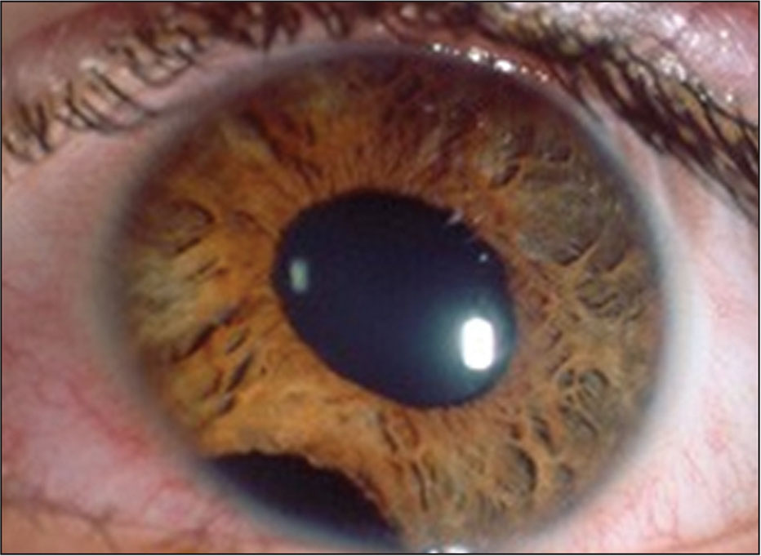
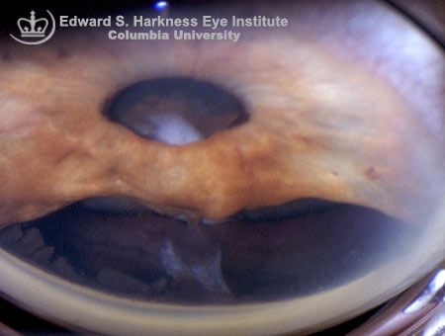
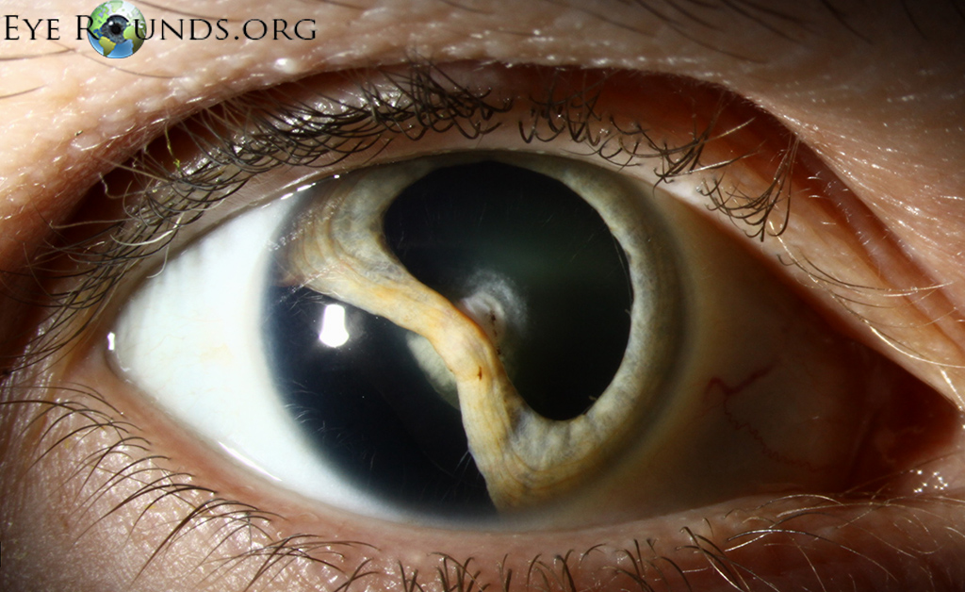
Iridodialysis
localized separation or tearing away of the iris from its attachment to the ciliary body.

Slide 35
Penitrating eye injury
note the eyelashes in the anteriour chamber

Slide 36
Lens
Lens clarity should be assessed with the slit lamp and against the red reflex after pupil dilatation as a first step after that theres multiple presentations

Slide 37
iridodonesis
Dislocation of the lens following blunt trauma may be suggested by a fluttering of the iris diaphragm on eye movement

Slide 38
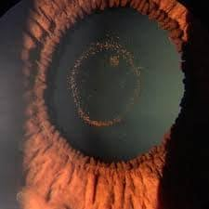
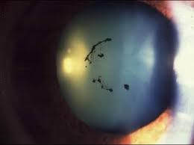
Vossius ring
imprint of the iris pigments on the lens

Slide 39
Cataract
Cataracts develop abruptly with direct penetrating trauma .
Blunt trauma also causes a posterior subcapsular cataract within hours of injury , which may be transient.

Slide 40
cataract
Sunflower cataract
Cataract following penetrating trauma
associated with wilson disease
associated with child abuse
caused by severe roking of the nuclues leading to seperation of the cortex

Slide 41
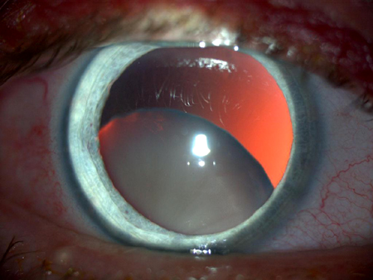
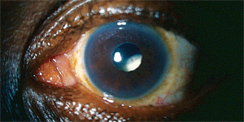
Lens subluxation
Can be caused by many other medical diseases

Slide 42
posterior segment
The fundus should be inspected with a direct ophthalmoscope after full mydriasis.
If no systemic neurological complications accompany the injury and ocular penetration is not suspected, the pupil can be dilated. (dialation can be contraindicated because it can mask other nurological problems in the case of severe trama)

Slide 43
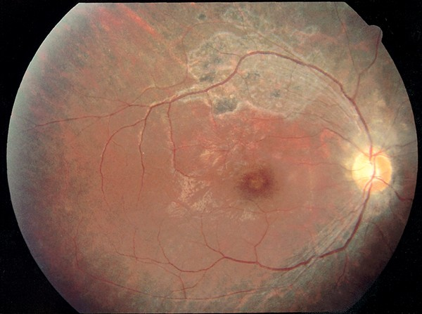
Commotio retinae
retinal oedema (of the photoreceptors
appears as white patchs
occurse do to coup contrecoup injury
prognosis depends on the original injury but most dont cause long term vision defects
in this picture theres Areas of retinal haemorrhage (can lead to scaring )

Slide 44
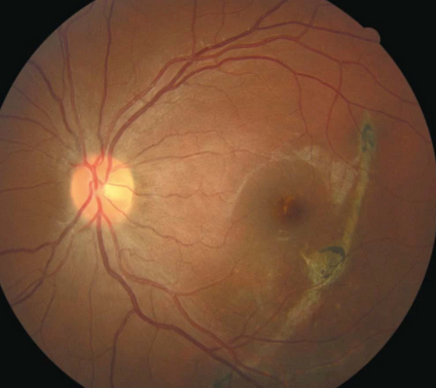
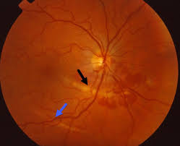
choroidal rupture
secondary to an opening of the proximal membrane
abrupt bleeding in the choroid
the problem is new vessels that will lead to vision problems

Slide 45
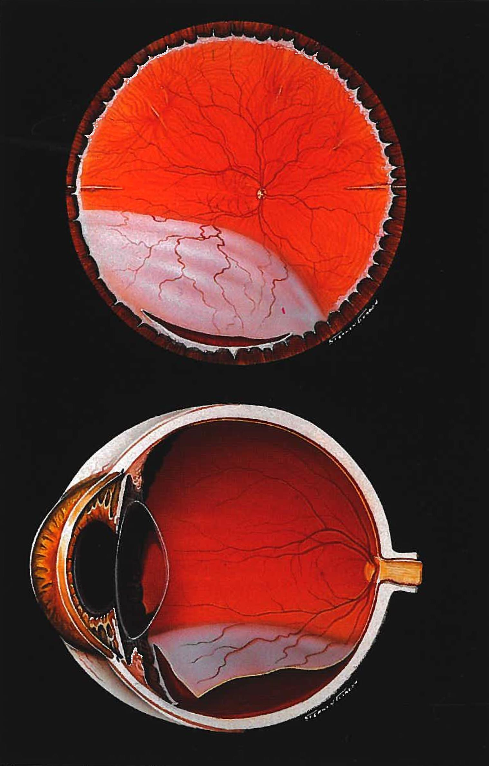
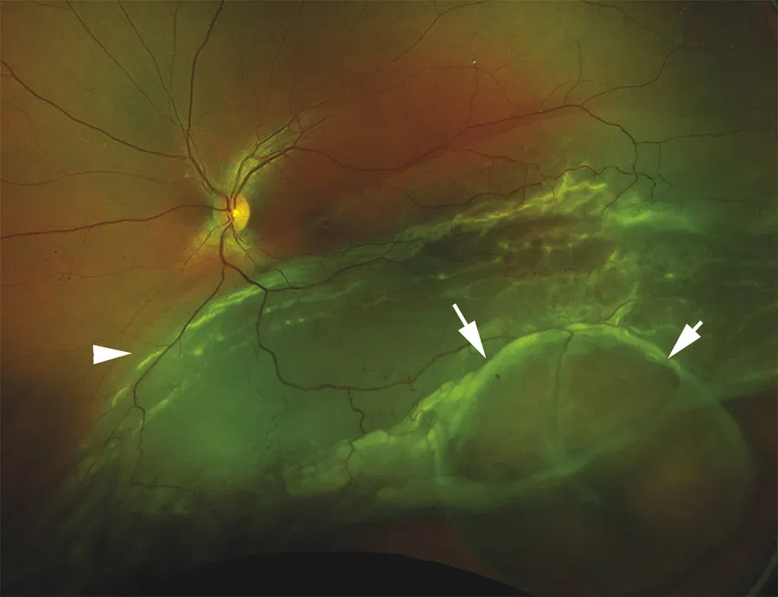
Retinal dialysis
avulsion of the vitreous base
tangential separation of the retina (total retina the pigmented and the receptor layer ) from the ciliary body
seen mostly in blut trama
different from retinal detachment (vertical separation of the pigmented epithelial layer from the photoreceptor layer )
not an emergency

Slide 46
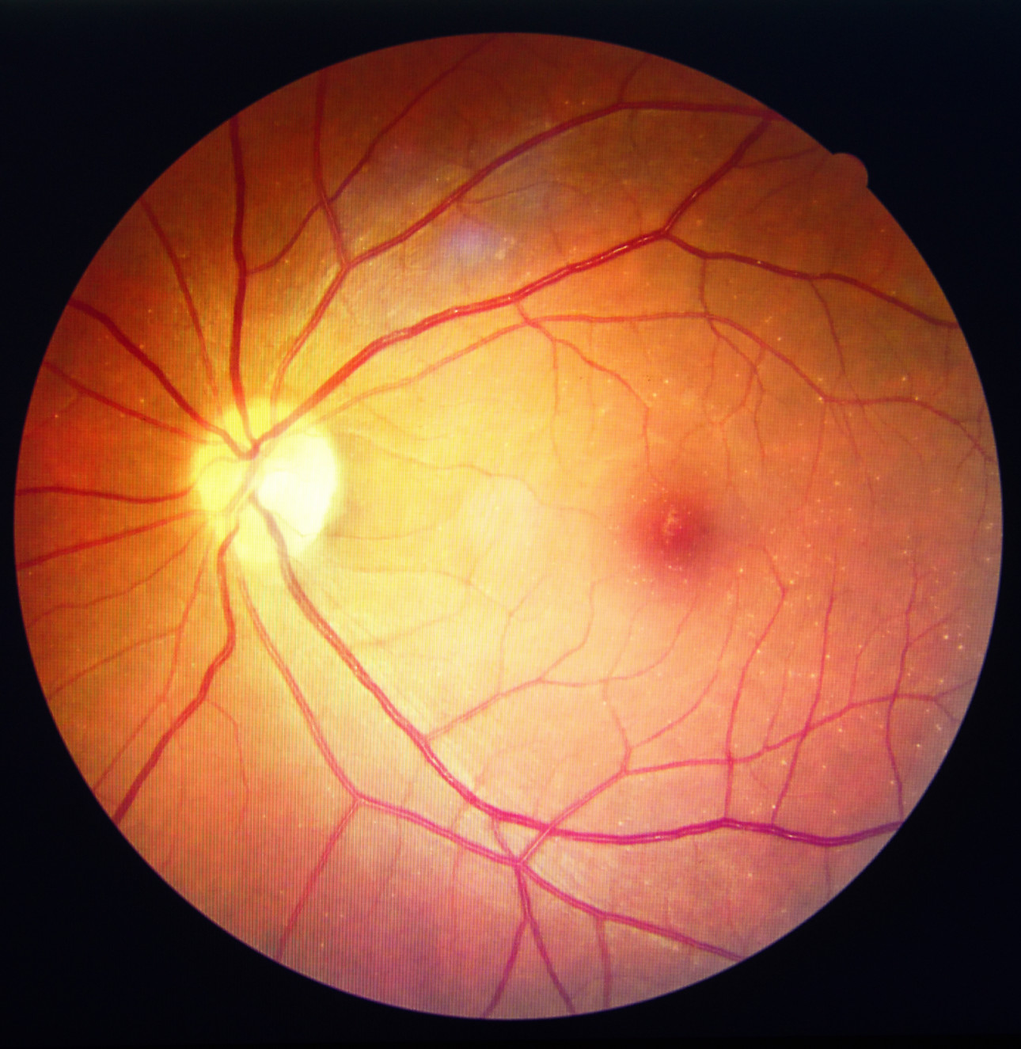
Macular hole

Slide 47
Peripheral retinal changes can only be excluded with indirect ophthalmoscopy or slit - lamp microscopy.
If there is no red reflex and no fundus details are visible, this suggests a vitreous haemorrhage.
The optic disc may be pale from a traumatic optic neuropathy caused by avulsion of the blood vessels supplying the optic nerve. Although this is uncommon, it leads to a profound loss of vision and no treatment is available.

Slide 48
treatment
Commotio retinae the affected zone of retina opacifies and obscures the underlying choroidal detail. It usually resolves on its own, but requires careful observation.
Vitreous haemorrhage
may absorb over several weeks,bed rest and head elevation is indicated
may require removal by vitrectomy.

Slide 49
Chemical injury
Hi!
Ammonia, Disinfectants, Oven Cleaners, Drain Cleaners, Bleach, Detergents, Makeup and Perfumes

Slide 50
TRUE EMERGENCY EVERY SECOND COUNTS
can be caused by both acids and alkali
Alkali is more sever and more rapid penetration and leads to more denaturation of collagen than acids
the main managmet is the same, Irrigation

Slide 51
Damage to the Eye from Chemical Injury Can Include:
Swelling of the cornea and conjunctiva
Redness
Tearing
Burns (either acid or alkali burns)
Infection .
Scar tissue altering vision .
Increased intraocular pressure. (glaucoma)
Dry eye syndrome .

Slide 52
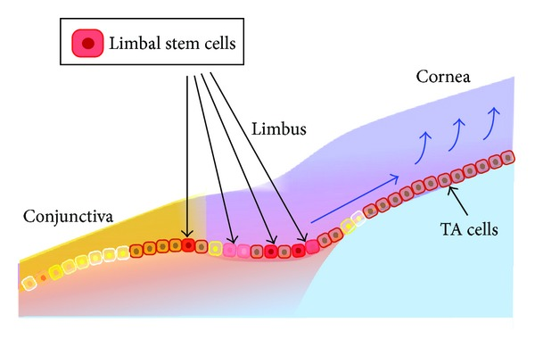
Grading of the chemical injuries
Prognosis of the chemical injury depends on the percentage of limbal ischemia
limbal cells are the stem cells responsible for regeneration fo the epithelium of the cornea, they are located on the limbus of the eye
they are devided into 4 grads

Slide 53
Grading of the chemical injuries
Grade | Prognosis | Limbal iscemia | Cornial involvment
I | Good | None | Epithelial damage
II | Good | Less that 1/3 | Corneal haze, Iris detalis are visible
III | Intermediat | 1/3 to 1/2 | Total epithelial loss stromal haze Iris details obscured
VI | Poor | over 1/2 | Total epithelial loss Cornea is opaque iris and pupile are obscursed

Slide 54
Treatment
Immediat and throught irrigation with clean water of saline
Removal of contaminants / Necrotic tissue
record visual acuity, IOP
Analgesics
Topical antibiotic drops
Steroid eye drops
Ascirbic acid
lubricant eye drops
Sodium citrate
Sweeping a glass rod in the fornices to prevent symblepharon

Slide 55
Important points to remmber
Immediate treatment is directed at preventing more injury
Always record visual acuity (Important medicolegally)
beware of the unilateral red eye as it's rarly conjunctivitis

Slide 56
Thanks
Do you have any questions?

