Slide 1
Irritable bowel syndrome IBS presenters: mohammad ibdah jana nusair yaqeen adaileh

Slide 5
Note:
Symptoms can be altered by emotional (ex: stress), social and cultural factors.

Slide 6
Complications:
Perforation
Pericolic abscess
Acute rectal bleeding s.t in NSAIDs & Aspirin users.

Slide 11
INVESTIGATIONS:
Barium Enema.
Flexible Sigmoidoscopy.
CT scan of the abdomen.
Colonoscopy

Slide 12
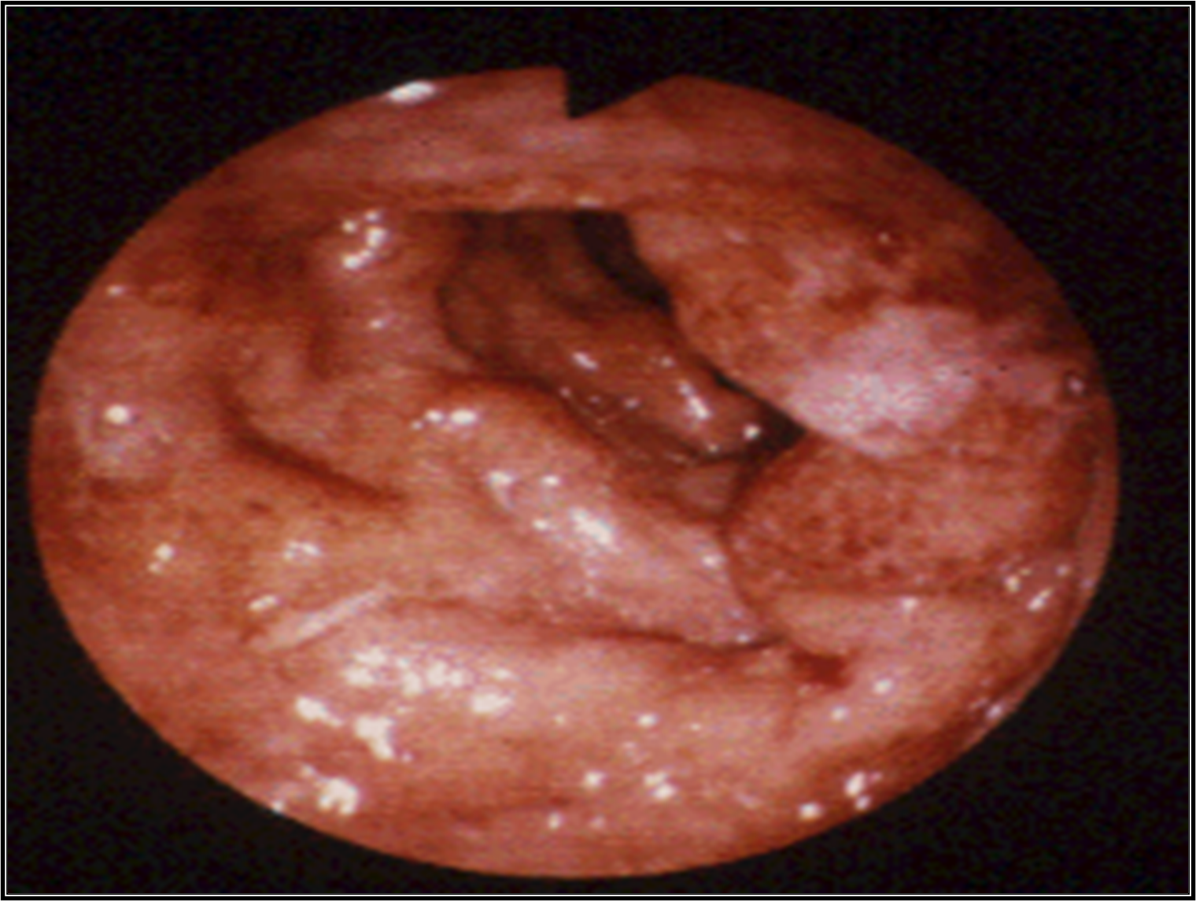

Slide 15
IBS: management
Asymptomatic: No treatment.
Constipation: Fiber diet +/- bulking laxative
Treatment of Diverticulitis:
Surgery for severe hemorrhage or perforation

Slide 17
thank you

