Slide 1
Upper GI Bleeding
Presented BY:
Mohammad Al-qudah
Ahmad Al-Dalaeen
Abd Al-Rhman Ibdah

Slide 2
Anatomy of UBGIT
Extend from oral cavity to ligament of treitz of duodenum
Blood supply:
Lt gastric AR. Giving esophageal branch supply esophagus & stomach
Common hepatic Ar. Giving Rt. gastric, gastroduodenal, Lt. hepatic and cystic branches supply stomach, liver, Gb and duodenum
Splenic Ar. giving Lt. gastroepiploic, short gastic and pancreatic branch supply spleen, pancreas, fundus of stomach and greater omentum

Slide 4
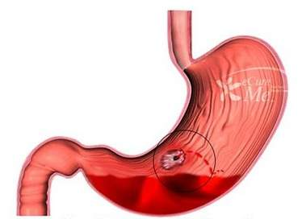
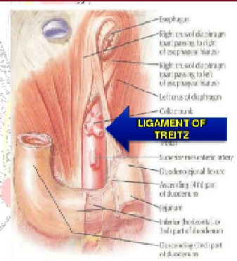
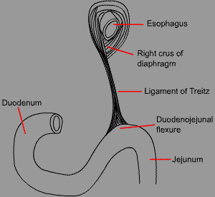
Definition Of UGIB
UGIB is defined as bleeding derived from a source of proximal to the ligament of Treitz which connect duodenum to the diaphragm and marks the beginning of the jejunum

Slide 8
Clinical Features
Hematemesis
Vomitus of red blood or “coffee-grounds” material.
Melena
Black, tarry, foul-smelling stool.
At least 14 hours, 50-100ml of blood in git are required.
Hematochezia
The passage of bright red or maroon blood from the rectum.
If it is the presenting symptom of UGIB, hemodynamic instability & dropping hemoglobin.
Occult GI Bleeding
Slow chronic blood loss, asymptomatic detected by rectal examination or by positive fecal occult blood test

Slide 9
Diagnosis
History
Physical examination
NGT Aspirate
Endoscopy

Slide 10
Diagnosis cont.
History
NSAIDs
Smoking
H. Pylori
Previous UGIB

Slide 11
Diagnosis cont.
Physical examination
measurement of postural changes in Bl.Pr. & pulse rate
Digital rectal examination
Liver disease or portal hypertension ( spider nevi, portosystemic shunt and bruising) in variceal hemorrhage

Slide 12
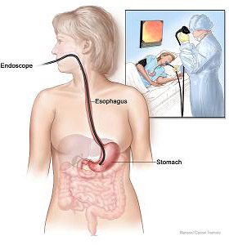
Diagnosis cont.
Endoscopy
‘Gold Standard’
URGENT
Requires experience and skill to avoid errors
Diagnostic and Therapeutic Measures

Slide 13
ASSESSMENT OF SEVERITY

Slide 15
Initial Management of UGIB
Resuscitation
Investigation urgently
Definitive Treatment

Slide 16
Resuscitation
Venous canulas
Fluid installing
Drawing blood (CBC, coagulation profile, urea, electrolytes, cross matching)
Central venous catheter
CV instability
NGT Suction
Confirming wither there is blood in stomach
Help guide the endoscopic therapy
Monitoring the bleeding
Bladder catheterization
Monitoring urine output

Slide 17
Prognosis
Mortality rate is about 5-10%
Decompensation of underlying illnesses cause death rather than exsanguination
Young pt. without malignancy or organ failure have mortality rate <1%

Slide 18
Prognostic Factors
The three independent clinical predictors of death in patients hospitalized with UGIB are:
Increasing age
Comorbidities
Hemodynamic compromise (tachycardia or hypotension)

Slide 19
Peptic Ulcer Bleeding

Slide 20
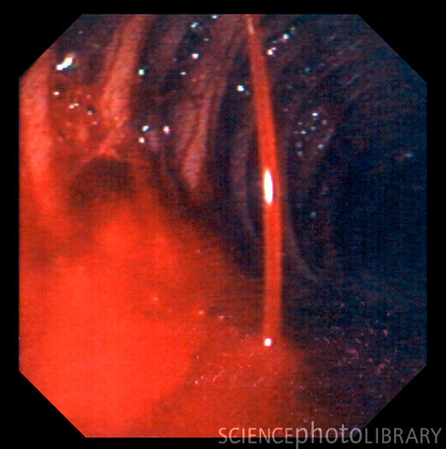
Peptic Ulcers Bleeding
Gastrointestinal hemorrhage remains a major medical problem with an incidence of over 1/1000 per year in Western practice .
In recent years the population affected has become much older and the bleeding is commonly associated with the ingestion of NSAIDs.

Slide 21
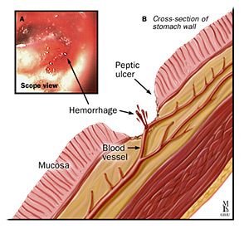
Internal bleeding is the most common complication of peptic ulcers
bleeding can occur when an ulcer develops at a site of blood vessel

Slide 22
Symptoms
Epigastric Pain
Bleeding
Back Pain
Decreased Appetite
Nausea, vomiting, anorexia
Signs
All forms of GI bleed
Tenderness

Slide 23
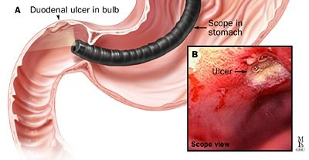
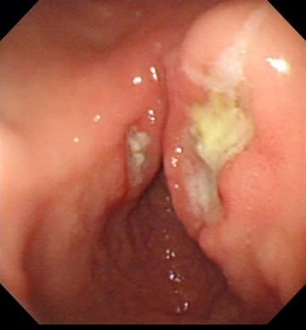
Duodenal ulcers:
The most common site of bleeding from a peptic ulcer is the duodenum.
the gastroduodenal artery, which is commonly the source of major bleeding.
The ulcers causing the bleeding are usually found in the posterior or superior aspect of the first part of duodenum.
The situation in which there is both an anterior
and a posterior duodenal ulcer is referred to as
‘kissing ulcers’.
Anteriorly placed ulcers tend to
perforate and, in contrast, posterior duodenal
ulcers tend to bleed, sometimes by eroding into the gastroduodenal artery.

Slide 25
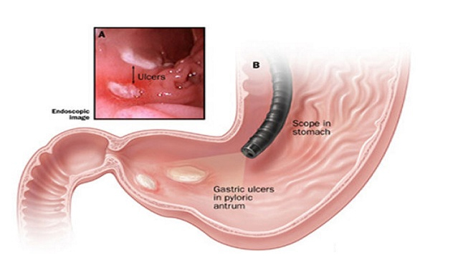
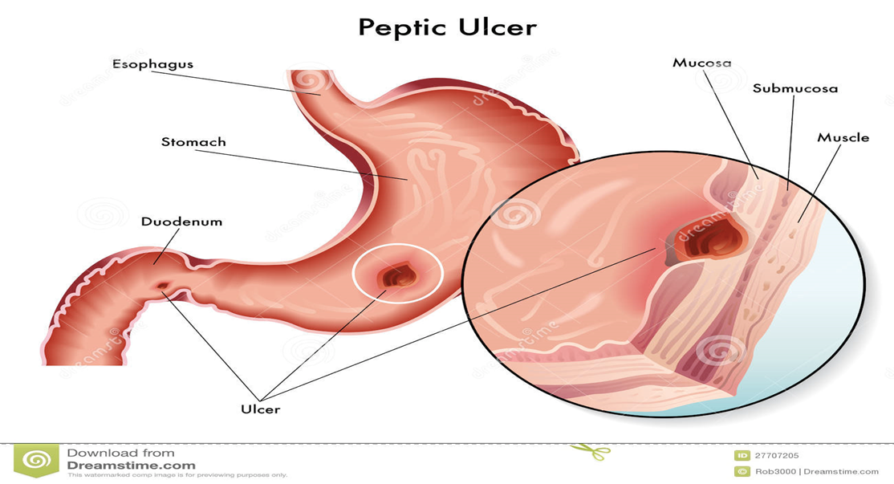
Gastric ulcers:
Large chronic ulcers may erode posteriorly into the pancreas and, on other occasions, into major vessels such as the splenic artery.

Slide 26
Investigations:
CBC
Examination of stool
Endoscopy ( diagnostic accuracy >95%)
Notes:
Haemorrhage can be challenging to identify and requires a multi-phase scan and active bleeding

Slide 27
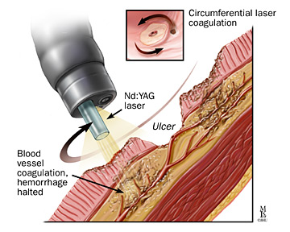
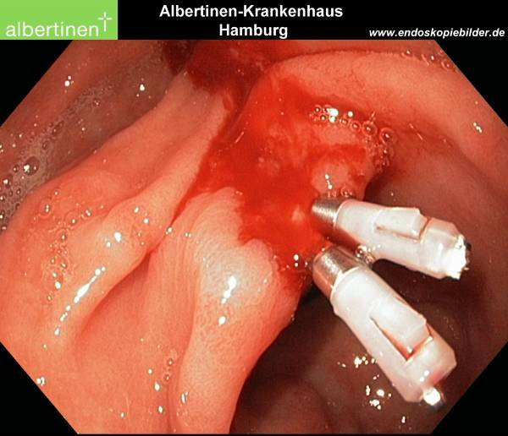
endoscopy
Therapeutic endoscopy can achieve hemostasis in approximately 70% of cases, with the best evidence supporting a combination of adrenaline injection with heater probe and/or clips.
Notes:
Therapeutic endoscopy will probably never be effective in patients who are bleeding from large vessels and with which the majority of the mortality is associated.

Slide 28
Management :
Medical and minimally interventional treatments:
Medical treatment has limited efficacy.
All patients are commonly started on a proton pump
antagonist or on an H2-antagonist , but well-performed
studies have failed to show that such treatments
influence re-bleeding, operation rate or mortality.
However, meta-analyses of studies does suggest that tranexamic acid, an inhibitor of fibrinolysis, reduces the rebleeding rate.

Slide 29
Successful when :
1. The bleeding is not from large vessels.
2. source of bleeding can be identiﬁed.
In those who re-bleed after endoscopy, angiography with trans-catheter embolisation may offer a valuable alternative to surgery .

Slide 30
Surgery
Indications :
A. Absolute indications :
Patient under adequate medical therapy and bleeds
Severe bleeding from the start of about 2L or more ( >4 units of blood needed for correction )
Continuous bleeding ( as evidenced by the need to transfuse 1000 ml of blood /day to maintain stability )
If bleeding recurs while patient is in the hospital
B. Relative indications :
Old patient
Associated with serious diseases ( the risk of surgery is far less than the risk of bleeding )
Long history of ulcer disease

Slide 31
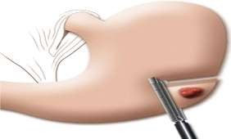
1.Bleeding gastric ulcer : is generally the excision of the ulcer and repair of the gastric defect . biopsy of the ulcer is important, as 4–5% of benign appearing ulcers are actually malignant ulcers
- For ulcers along the greater curvature of the stomach, antrum or body of the stomach wedge excision of the ulcer and closure of the resulting defect can easily be achieved in most cases without causing significant deformation of the stomach.
- For ulcers in the lesser curvature , due to the rich arcades of the left gastric artery , wedge excision would leave a stomach deformation, So distal gastrectomy with Bilroth I or Bilroth II as a reconstruction surgery to resume GI continuity .

Slide 32
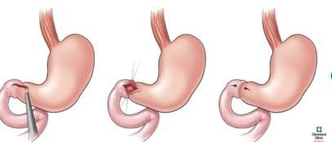
2.Bleeding duodenal ulcer
Dissection is carried out to expose the pylorus and first part of the duodenum. An anterior longitudinal duodenotomy is made extending through the pyloric channel to the distal stomach. Bleeding from the GDA complex is controlled with a ligation , then close the horizontal incision in a vertical fashion

Slide 33
Gastritis

Slide 34
Errosive gastritis
Erosive gastritis is : gastric mucosal erosion caused by damage to mucosal defenses. It is typically acute, manifesting with bleeding, but may be subacute or chronic with few or no symptoms. Diagnosis is by endoscopy. Treatment is supportive, with removal of the inciting cause and initiation of acid-suppressant therapy.

Slide 37
Common causes of erosive gastritis include
NSAIDs
Alcohol
Stress
Less common causes include
Radiation
Viral infection (eg, cytomegalovirus)
Vascular injury
Direct trauma (eg, NGTs)

Slide 38
Acute stress gastritis
Acute stress gastritis, mucosal erosions and superficial hemorrhages occurs
_in about 5% of critically ill patients
_those who are under severe physiological stress
. Pathogenesis likely involves hypoperfusion of the GI mucosa, resulting in impaired mucosal defenses.
Bleeding is directly related to the degree of stress
_Lesions typically occur in the body, but the antrum may also be involved.

Slide 39
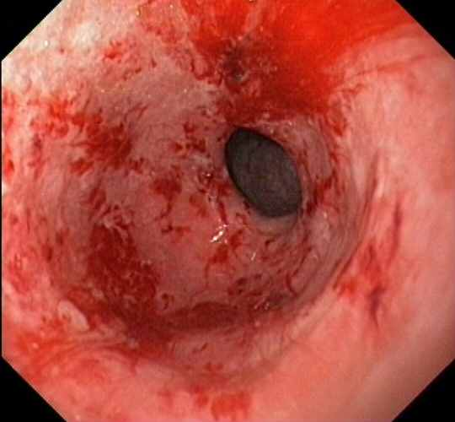
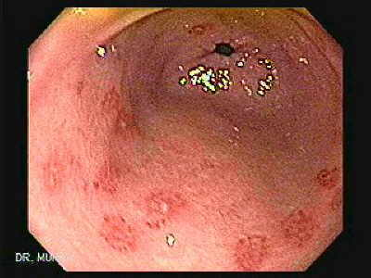

Slide 40
Prevention of stress gastritis
Prevention of the stress bleeding from the stomach is much easier than treating it ,hence we give the patient in ICU prophylactic :
The routine use of H2-receptor antagonist
With or without sucralfate

Slide 41
Treatment
_ Resuscitation
_ milder gastritis treat the underlying cause and drug to reduce the acidity ( PPI or H2 blocker )
_For bleeding ( severe gastritis ): Endoscopic hemostasis

Slide 42
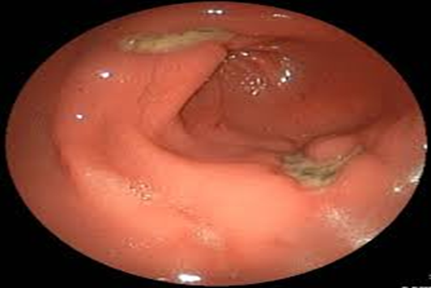
Curling's ulcer
Curling's ulcer (Stress Ulcer) : is an acute gastric erosion resulting as a complication from severe burns when reduced plasma volume leads to ischemia and cell necrosis (sloughing) of the gastric mucosa.
Symptoms of a Curling's ulcer usually begin with intermittent stomach pains. These pains are often accompanied by lack of appetite and persistent vomiting

Slide 43
Treatment
anti acids such as H2-receptor antagonists
proton pump inhibitors such as omeprazole

Slide 44
Cushing's ulcer
is a gastro-duodenal ulcer produced by elevated intracranial pressure caused by an intracranial tumor, head injury or other space-occupying lesion.
The ulcer, usually single and deep, may involve the distal esophagus, stomach, and proximal duodenum.
Surgical treatment
vagotomy, pyloroplasty,

Slide 45
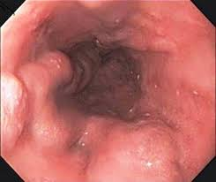
Oesophageal varices

Slide 46
Esophageal varices are abnormal, enlarged veins in the esophagus
Esophageal varices develop when normal
blood flow to the liver is blocked by a clot or scar tissue in the liver. To go around the blockages, blood flows into smaller blood vessels that aren't designed to carry large volumes of blood. The vessels can leak blood or even rupture, causing life-threatening bleeding

Slide 47
PORTAL HYPERTENSION
Definition and Pathogenesis:
Normal pressure in the portal vein is low (5 to 10 mmHg) because vascular resistance in the hepatic sinusoids is minimal.
Portal hypertension (10 mmHg) most commonly results from increased resistance to portal blood flow Most commonly caused by liver cirrhosis.

Slide 48
Clinical Features and Diagnosis
usually presents with painless but massive
hematemesis with or without melena.
Associated signs range from mild postural tachycardia to profound shock
Endoscopy is the best approach to evaluate upper gastrointestinal hemorrhage in patients with known or suspected portal hypertension.

Slide 49
Physical signs
Pallor ,low BP, increased pulse rate,postural hypotension
Cyanosis , jaundice , tremor
Telangiectasis of skin , gynecomastia in male
Palmer erythema , leuconychia
Ascites , caput medusa ,splenomegaly

Slide 50
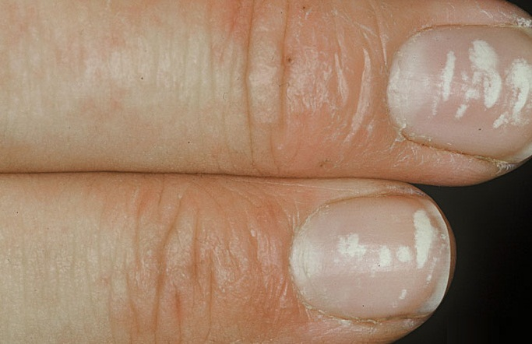
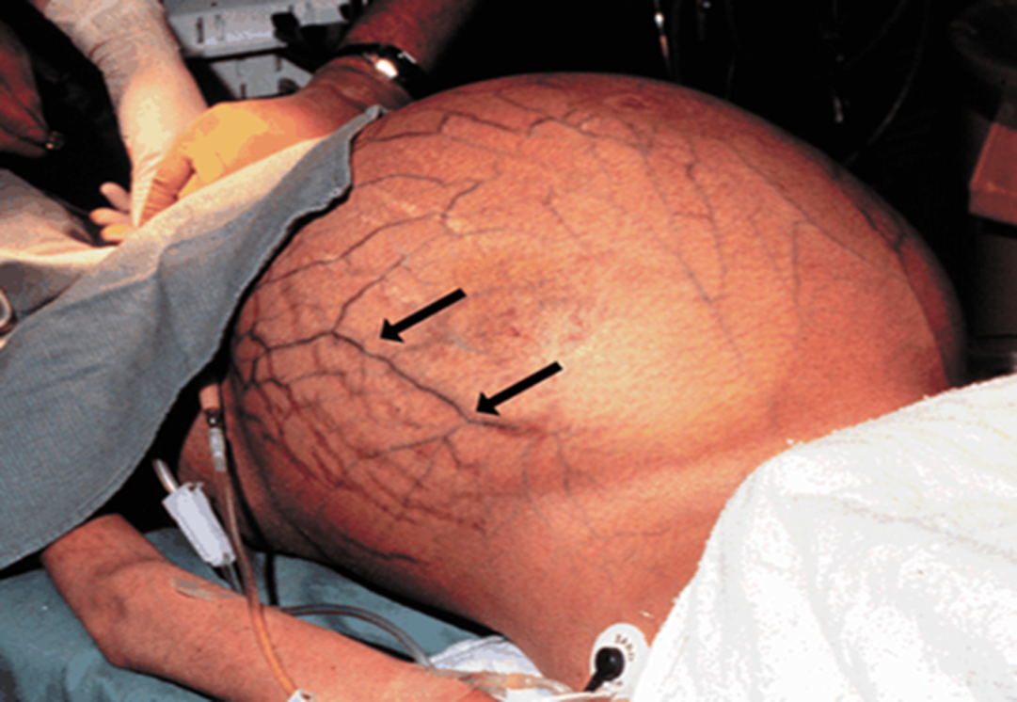
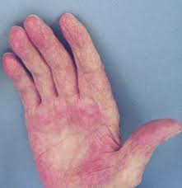

Slide 51
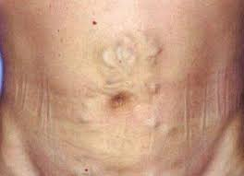
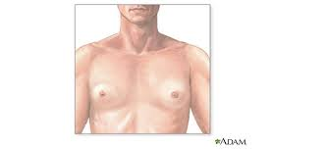
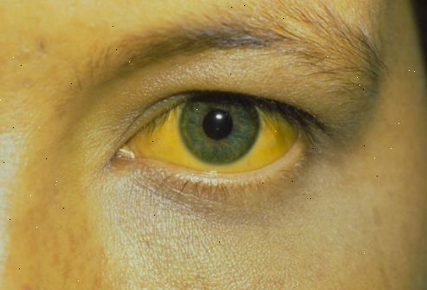

Slide 53
Management of bleeding varices guideline and means of management
Blood transfusion
Correct coagulopathy
Oesophageal Balloon Tamponade (Sengstaken–Blakemore tube)
Drug therapy (vasopressin/octreotide)
Endoscopic sclerotherapy or banding
Transjugular intrahepatic portosystemic stent shunts (TIPSS)
Surgery: Oesophageal transection

Slide 54
initial resuscitation:
Blood transfusion
This involves obtaining peripheral and subsequently central venous access while adequate blood is obtained (initially 10 units).
Correct coagulopathy
Vitamin K is administered [10 mg intravenously (i.v.)], but correction of a coagulopathy will require the administration of fresh frozen plasma (FFP).
An associated thrombocytopenia is usually secondary to hypersplenism due to cirrhosis and is treated if the platelet count falls below 50 × 10^9 l–1.

Slide 55
Oesophageal balloon tamponade (Sengstaken–Blakemore tube)
If the rate of blood loss prohibits endoscopic evaluation, a Sengstaken–Blakemore tube may be inserted to provide temporary haemostasis.
Once inserted, the gastric balloon is inflated with 300 ml of air and retracted to the gastric fundus, where the varices at the oesophagogastric junction are tamponaded by the subsequent inflation of the oesophageal balloon to a pressure of 40 mmHg.
The two remaining channels allow gastric and oesophageal aspiration.
The balloons should be temporarily deflated after 12 hours to prevent pressure necrosis of the oesophagus.

Slide 57
Drug therapy (vasopressin/octreotide)
This may be as effective as sclerotherapy in the initial control of variceal haemorrhage.
Vasopressin has been the most extensively used drug for the initial control of variceal haemorrhage (20 U in 10 ml of 5% dextrose i.v. over 10 min).
Octreotide, the longacting somatostatin analogue, may be equally effective.

Slide 58
Endoscopic sclerotherapy or banding
Initial treatment of oesophageal varices in most centres is endoscopic sclerotherapy,
The majority of variceal bleeds will respond to a single course.
An early rebleed is less likely to be controlled by further sclerotherapy and a third bleed only rarely.

Slide 59
Transjugular Intrahepatic Portosystemic Stent Shunts (TIPSS):
It has become the main treatment of variceal haemorrhage that has not responded to drug treatment and endoscopic therapy.
The shunts are inserted under local anaesthetic. Via the internal jugular vein and SVC, a guidewire is inserted into a hepatic vein and through the hepatic parenchyma into a branch of the portal vein.

Slide 60
Post-shunt encephalopathy is the confusional
state caused by the portal blood bypassing the
detoxification of the liver. It occurs in about 40%
of patients, a similar incidence to that found
after surgical shunts.
If severe, the lumen of the TIPSS can be reduced by insertion of a smaller stent.
The main contraindication to TIPSS is portal vein occlusion.
The main long-term complication of TIPSS is stenosis of the shunt, which is common (approximately 50% at 1 year) and may present as further variceal haemorrhage.

Slide 62
Surgical shunts for variceal haemorrhage:
Rarely used now adyas after the advent of TIPSS.
It is rarely considered for the acute management of variceal haemorrhage, as the morbidity and mortality in these circumstances are high.
The main current indication for a surgical shunt is a patient with Child’s grade A cirrhosis, in whom the initial bleed has been controlled by sclerotherapy.

Slide 63
Types of surgical shunts:
Shunts may be divided into:
selective (e.g.splenorenal) and
non-selective (e.g.portocaval).
the former attempting to preserve blood flow to the liver while decompressing the left side of the portal circulation responsible for giving rise to the oesophageal and gastric varices.
Selective shunts may be associated with a lower incidence of portal systemic encephalopathy (PSE).

Slide 64
MALLORY–WEISS SYNDROME
Definition:
1) vertical splits in the gastric mucosa, immediately below the squamocolumnar junction at the cardia in 90% of cases. In only 10% is the tear in the oesophagus flollowing a severe bout of vommiting.
2) longitudinal tear below the gastro-oesophageal junction, which is induced by repetitive and strenuous vomiting.
The condition presents with haematemesis.
Usually, the bleeding is not severe, but endoscopic injection therapy may be required for the occasional, severe case.

Slide 65
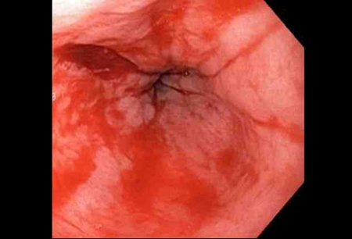

Slide 67
Dieulafoy’s disease
a gastric arterial venous malformation that has a characteristic histological appearance.
Bleeding as a result of this malformation is one of the most difficult types of upper gastrointestinal bleeding to treat.
The lesion itself is covered by normal mucosa and, when not bleeding, it may be invisible.
If it can be seen during the bleeding, all that may be visible is profuse bleeding coming from an area of apparently normal mucosa.
If this occurs, the cause is instantly recognisable. And could be treated with sclerotherpay.

