Slide 1
Anemia with pregnancy
Dr. Ahlam Al-Kharabsheh

Slide 2
● Anemia: A pathological condition in which the oxygen –carrying capacity of red blood
cells is insufficient to meet the body’s needs.
▪ World health organization( WHO ) : Hb < 11 g/dl.
▪ Centers for disease control and prevention of North America (CDC) :
Hb < 11 g/dl in the first and third trimesters and Hb < 10.5 g/dl in the second
trimester. Postpartum anemia is a Hb < 10 g /dl.
● Anemia is the most common medical disorder of pregnancy. Around 30-50% of
women become anemic during pregnancy, with iron deficiency being responsible in
more than 90% of cases. The incidence of folate deficiency is around 5%.
Rare types include : vitamin B12 deficiency, sickle cell disease, thalassemia and others.

Slide 3
Physiological changes
▪ Plasma volume increases by 50%.
▪ Red cell mass increases by up to 25%.
▪ There is a consequent fall in Hb concentration, hematocrit and red cell count because
of hemodilution.
▪ Mean cell volume (MCV) increases secondary to erythropoiesis.
▪ Mean cell Hb concentration (MCHC) remains stable.
▪ Serum iron and ferritin concentartion decreases secondary to increased utilization.
▪ Total iron binding capacity increases.
▪ Iron requirements increase(due to expanding red cell mass and fetal requirements )
from 2.5 mg/day in the first trimester to 6.6 mg/day in the third trimester (700-1400mg
total pregnancy).
▪ There is a moderate increase in iron absorption.
▪ Folate requirements increase in pregnancy ( due to the fetus, placenta,uterus and
expanded maternal red cell mass).
▪ There is no major effect on B12 stores, although levels decrease (preferential active
transport to the fetus).

Slide 4
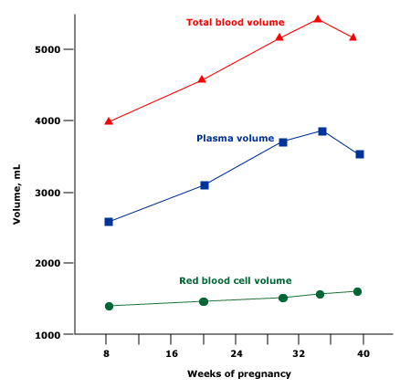

Slide 5
Severe chronic anemia is associated with :
Fetal
1-Increased risk of preterm delivery.
2-Fetal growth restriction(FGR) and low birth weight.
3-Intrauterine fetal death (IUFD).
4-Increased risk of spontaneous abortion.
5-Increased risk of perinatal mortality.
Maternal
1-Increased risk of infection.
2-Poor tolerance to blood loss at time of delivery.
3-Cardiovascular stress.
4-Increased risk of postnatal depression.
5-Increased risk of maternal mortality.

Slide 6
Screening
All pregnant women should be offered screening for anaemia, by estimating the Hb concentration by means of a full blood count (CBC) :
● In first trimester (or at booking)
● With the next screening bloods (usually performed between 28-32 weeks)
● And at 36 weeks gestation.

Slide 7
Iron deficiency anemia (IDA)
● Diagnosis :
▪ IDA is classically described as microcytic , hypochromic anemia
because of reduced MCV and MCHC. But the diagnosis should still be confirmed.
▪ The diagnostic test for iron deficiency is a serum ferritin concentration. This is not
affected by recent ingestion of iron, and a concentration of < 12 mcg/L is diagnostic. (the
greatest sensitivity and specificity
→ Iron def. can be present in the absence of anemia ( low Hb is a late event of iron
deficiency ) and other parameters of the full blood count that usually give a clue to
this ( reduced MCV,MCH and MCHC ) are not as accurate during pregnancy.
● Prevention :
▪ CDC guidelines : Pregnant women should begin taking low dose (30 mg/day)
elemental oral iron at the first prenatal visit as primary prevention of iron deficiency.
▪ Education about the diet.
▪ Treatment of hook worm infestations in non-industrialized countries.
Notes:
Is caused by blood loss, insufficient dietary intake, or poor absorption of iron from food

Slide 8
Lab test
Parameters
↓
ferritin, hemoglobin, mean corpuscular volume, mean corpuscular hemoglobin
↑
total iron-binding capacity, transferrin, red blood cell distribution width

Slide 9
● Treatment
Oral iron
Parenteral iron (IM & IV )
Blood transfusion

Slide 10
Oral iron
▪ If there is enough time, oral iron is the first line treatment (ferrous salts = elemental
iron).
▪ The recommended dose is 120-240 mg of elemental iron per day ( maximum
increase in Hb is 0.8 g/dl per week ).
▪ Side effects of oral iron are related to the amount of elemental iron contained.
There is a 40 % risk of side effects with oral iron preparations, mainly
gastrointestinal , and this can have a direct effect on tolerance and
compliance.
▪ Vitamin C taken simultaneously aids absoption, hence common advice to take iron
with fresh orange juice.
▪ Avoid consuming tea and coffee during or shortly after medication, preferably taken
on an empty stomach one hour before meals. Iron should be given two hours before,
or four hours after, ingestion of antacids.

Slide 11
Therapeutic Trial of Iron
Oral iron therapy
Increase in reticulocytes in 5 – 10 days
Rise in Hb at a rate of 0.8 gm/dl every 3 weeks till normal
If no response or incomplete response, do additional tests

Slide 12
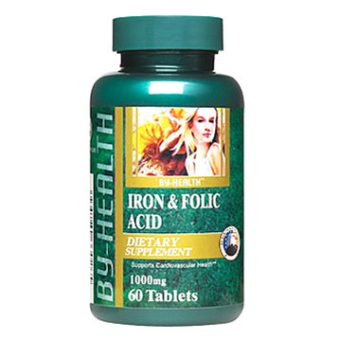
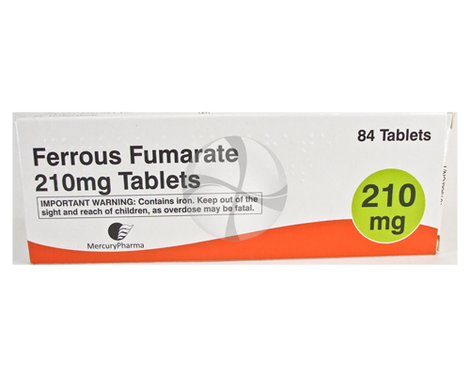

Slide 13
▪ Choice of preparation : The most appropriate oral iron therapy is use of a tablet
containing ferrous salts, such as :
●Ferrous fumarate – 106 mg elemental iron/tablet
●Ferrous sulfate – 65 mg elemental iron/tablet
●Ferrous gluconate – 28 to 36 mg iron/tablet
▪ Follow up : Re-check complete blood picture every 4 weeks. Once the [Hb] is in the
normal range, continue oral iron treatment until completion of breastfeeding
(with lower dose).
Parenteral iron ( IM & IV )
▪ Indication : For those can not be managed with oral therapy because of lack of
compliance, severe gastrointestinal side effects, malabsorption.
▪ Risk of anaphylactic-type reactions. So the recommendation that resuscitation
equipment and personnel trained in the detection and treatment of anaphylactic-type
reactions be readily available during administration of all parenteral iron preparations.
Notes:
Anaphylaxis which can include difficulty breathing, itching, and rash

Slide 14
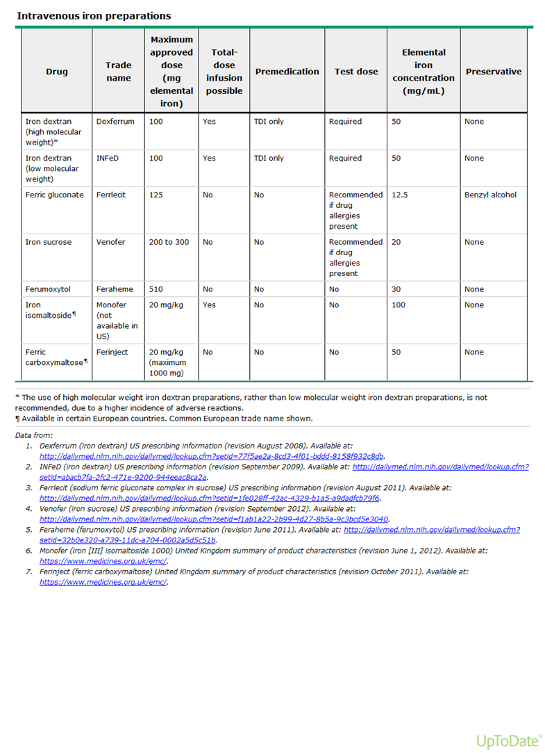
Total iron deficit = Body weight [kg] x (Target Hb – Actual Hb) [g/l] x 2.4 + Iron stores [mg]

Slide 15
Blood transfusion
● Indications:
1- Towards the end of pregnancy, no time to achieve reasonable Hb concentration
before delivery using iron therapy (oral & parenteral).
2- For the patient who is hemodynamically unstable.
3- Severe iron deficiency anemia (Hb < 7 g/dl).
● Transfusion is the most rapid way to increase Hb concentration, but is a relatively
slow way to increase iron stores.
● Each unit of packed RBCs with a volume of 300 mL contains approximately
200 mL of red cells and 200 mg of iron in the form of hemoglobin heme.
Transfusion of one unit of packed RBCs to an adult will raise the hematocrit by
roughly 3 percentage points (and the hemoglobin by approximately 1 g/dL).

Slide 16
Folate deficiency
● Aetiology :
▪ There is a significant increase in folate requirements during pregnancy because of the
increased cell replication that is taking place in the fetus , uterus and bone marrow (
increase in red cell mass ). Plasma folate concentrations decrease throughout
pregnancy , reaching half the non-pregnant levels by term.
▪ The incidence is higher in multiple pregnancies and closely spaced successive
pregnancies
** Daily requirement is 800ug.
● Consequences :
Neural tube defects : there are a clear links between periconceptional folate deficiency and neural tube defects, hence the advice that all women planning pregnancy should take 400 ug/day of folic acid and continue this for the first 12 weeks of pregnancy until the neural tube is closed.
Cleft lip and palate.
3) Megaloblastic anemia.
● Treatment : 5 mg folic acid per day and continue throughout the pregnancy.

Slide 17
Conditions that require folate supplements:
1- All pregnant epileptic women who take anti-convulsants.
2- Women with hemolytic anemia, such as hemoglobinopathies, red cell
membrane and enzyme disorders.
3- Lactating mothers?

Slide 18
Vitamin B12 deficiency
Red cell and serum Vitamin B12 concentrations decrease during pregnancy, due to increase tissue uptake under the influence of estrogen and preferential transport to the fetus.
Adult stores are 300 ug or more and these are affected by pregnancy as minimal amount is required for fetal development, so fetal risks are rare.
It is rare
Occurs in patients with gastrectomy , ileitis, distal illeal resection, pernicious anaemia, intestinal parasites (diphilobothrium latum), Crohn’s disease. Dietary deficiency is seen in strict vegetarian.
Clinical manifestations: numbness & paresthesia of the fingers & toes, followed by weakness, ataxia and poor concentration. Changes in mental status may occur.
Diagnosis:
Peripheral smear (hypersegmented neutrophils, oval macrocytes,
Howell-Jolly bodies
Vitamin B12 level < 80 pico g/ml.

Slide 19
Diagnosis in pregnancy: if suspected, look for the etiology.
Treatment of vit. B12 Deficiency:
Cyanocobalamin or hydroxycobalmin 1mg, 3 times a week for 2 weeks and then every 3 months.

Slide 20
Normal Hb
Normal Hb is composed
96-97% Hb A
2-3% Hb A2 hemoglobin alpha 2
Less than 1% fetal hemoglobin

Slide 21
Pregnancy in women with sickle cell disease (SCD)
● SCD is a group of inherited single-gene autosomal recessive disorders caused by
the ‘sickle’ gene, which affects haemoglobin structure. SCD has its origins in sub-
Saharan Africa and the Middle East, hence it is most prevalent in individuals of African descent as well
as in the Caribbean, Middle East, parts of India and the Mediterranean, and South and Central America.
● SCD is the most common inherited condition worldwide. About 300 000 children
with SCD are born each year; two-thirds of these births are in Africa.
● Although most pregnancies complicated by maternal SCD are likely to result in live
birth, these pregnancies are at increased risk of obstetrical and fetal complications,
as well as medical complications of SCD. These risks are due, at least in part, to the
metabolic demands, hypercoagulable state, and vascular stasis
associated with pregnancy.

Slide 22
Diagnosis
Normocytic normochromic anemia
The reticulocyte count increased 3-15 %
Lactate dehydrogenase elevated
Hepatoglobin is decreased
Peripheral blood : sickle cell, target cell ,Howell-Jolly bodies
***Screening and diagnosis by hb electrophoresis ( Hb S 85-100%, absent Hb A , normal Hb A2 , Hb F elevated more than 15 %)

Slide 23
Preconception care
Detailed evaluation of patient
Genetic counseling
Management of medications and immunization
Counseling about medical, obstetrical, and infant outcomes

Slide 24
Detailed evaluation of patient
1- Detailed history and full clinical examination.( history of pain events and
hospitalizations, Measurement of baseline blood pressure ( to rule out hypertension ).
2- Retinal evaluation to detect early proliferative sickle retinopathy, which may worsen
during pregnancy.
3- Chemistry panel, urinalysis, and 24-hour protein excretion to determine baseline
organ function, particularly sickle nephropathy.
4- Hemoglobin/hematocrit and ferritin level. Women with SCD often have excessive
iron stores, but a small proportion is iron deficient. Women with excessive iron stores
should not receive prenatal vitamins with iron and should consider delaying
pregnancy until they have been treated with iron chelators, which are contraindicated
in pregnancy.
5- Baseline urine culture, because of the increased frequency of asymptomatic
bacteriuria. Urinary tract infections are more common in sickle cell disease and
more difficult to treat because of underlying renal papillary necrosis.

Slide 25
6- Baseline pulmonary function tests, including pulse oximetry, are recommended
because of the increased risk of pulmonary embolism, acute chest syndrome, and
broncho-reactive lung disease in pregnancy.
7- Hepatitis B and C screening to assess risk of perinatal transmission.
8- Echocardiogram as a screening test for pulmonary hypertension and early cardiac
dysfunction, which are associated with increased mortality in SCD and pregnancy.
9- Serologic red cell phenotyping and screening for red cell alloimmunization to
identify patients with multiple red cell alloantibodies who may be difficult to match
for transfusion and may be at risk for hemolytic disease of the fetus and newborn.
-Ask about transfusion history.
10- Testing partner for hemoglobinopathy. The risk of SCD in offspring is 50 % if the
biologic father is heterozygous; the risk is 100 % if he is homozygous.
11- LFT: Elevated bilirubin may indicate hemolysis, or chololithasis as a result of chronic hemolysis
or chronic hepatitis.

Slide 26
Genetic counseling
●Discuss the type and risk of inherited disease in offspring, and the variability of
phenotype.
●Discuss the range of pregnancy options, as appropriate, including:
** Pre-implantation genetic diagnosis (PGD) for selection of embryos without SCD.
** Prenatal diagnosis.
** A gestational surrogate pregnancy allows the patient to avoid both the maternal
and fetal risks associated with pregnancy complicated by SCD.
**Use of donor sperm from a male without hemoglobinopathy.
**Adoption.

Slide 27
Management of medications and immunization
1- Immunization : Polyvalent pneumococcal, Hemophilus influenza type B, and
meningococcal vaccines are recommended for pregnant patients
with SCD.
Pregnancy should be avoided for at least four weeks after administration of a live
vaccine.
2- Folic acid supplementation ( 5 mg / day ).
3- Hydroxyurea : An increase in major congenital defects has been reported in animal
studies. it is prudent to discontinue hydroxyurea three months before
conception.
4- Iron chelators : (Deferoxamine), it should be discontinued. It is associated with
congenital anomalies in some animal studies. Data from exposure in
humans are limited. Delay pregnancy if on treatment for excessive iron
stores.
5- ACE inhibitors and ARBs : teratogenic
6- Prophylactic penicillin: It may be continued during pregnancy.
7- Analgesia: NSAIDs are generally avoided after 30 weeks of gestation because of the risk of
premature narrowing or closure of the ductus arteriosus.

Slide 28
Counseling about medical, obstetrical, and infant outcomes
SCD course during pregnancy
-There is consistent evidence that anemia and vasoocclusive or acute painful episodes
occur more often in pregnancy and are the most common maternal SCD
complications associated with pregnancy, occurring in over 50 % of pregnant women
with SCD.
Painful episodes are more common with advancing pregnancy and postpartum.
-Increased maternal mortality : 72 deaths per 100,000 deliveries versus 12.7 deaths per 100,000
deliveries in women without SCD
-Increased risk of transfusion, Systemic inflammatory response syndrome, Pneumonia ,
sepsis, Genitourinary tract infection , Cerebral vein thrombosis and Deep vein
thrombosis.
Pregnancy outcome
Increased risk of Miscarriages, IUGR, Eclampsia , Gestational hypertension and preeclampsia , Preterm labor, Postpartum infection , Abruption and Antepartum bleeding.
Perinatal Mortality: 1-8%.

Slide 29
Management during pregnancy
Prenatal care
1-Ideally, prenatal, intrapartum, and postpartum care are provided by a
multidisciplinary team experienced in caring for women and pregnancies
complicated by SCD.
2-If some or all of the baseline evaluation was omitted pre-pregnancy, the missing
assessments should be performed in early pregnancy.
3-Monthly determination of hemoglobin level and chemistry panel.
4- Iron supplementation is avoided unless iron deficiency is documented by a low
serum ferritin level.
5-Folic acid supplementation should be continued during pregnancy ( 5 mg/day).
6-Nausea and vomiting of pregnancy is common in all pregnant women. Control of
symptoms, especially prevention of dehydration from anorexia or vomiting, may
help to decrease the incidence of acute painful episodes.
7-Baseline and serial screening with urinalysis and culture.

Slide 30
8-Close monitoring for development of preeclampsia. Some suggest daily
use of low dose (75 mg) aspirin to reduce this risk. Start from the beginning of 2nd trimester
till -10 days before expected day of delivery.
9-Monitoring fetal growth with ultrasound and fetal well-being with NST or BPP
scoring is reasonable during the third trimester.
10-Dehydration, hypoxia, acidosis, infection, and cold may precipitate painful crisis;
therefore, these conditions should be avoided, if possible.
11-Prenatal diagnosis : Evaluation of the fetus for sickle hemoglobin, as well as other
hemoglobinopathies, can be performed in at-risk pregnancies using invasive
techniques, such as CVS at 11 to 14 weeks of gestation or amniocentesis as early
as 15 to 16 weeks.
12-All patients with SCD should receive venous thromboembolism (VTE) prophylaxis
with a low molecular weight heparin or unfractionated heparin.

Slide 31
13- RBC antibody screen, in 1st prenatal visit, if negative, repeat test at 24-28
weeks.
14- Anti-D : same recommendation.
15- Influenza vaccine: should be recommended if it has not been administered.
RCOG Green-top Guideline No. 61, page 9, Table 2: Specific antenatal care for
women with SCD

Slide 32
Labor and vaginal delivery
-There are no medical contraindications to vaginal delivery.
-Induction of labor and cesarean delivery are performed only for the usual obstetrical
indications.
-During labor and delivery the parturient should be kept well oxygenated (O2 saturation
≥95 percent), warm, and hydrated to prevent sickling. Continuous fetal
heart rate monitoring since these pregnancies are at higher risk of complications.
-Neuraxial anesthesia is useful to reduce maternal cardiac demands secondary to labor
pain and anxiety.

Slide 33
Postpartum management
-Antibiotic prophylaxis per local standards.
-Adequate fluid intake so the mother is well hydrated. This may necessitate IV fluid
administration and anti-emetic therapy until oral intake is adequate.
-Adequate oxygenation (O2 saturation ≥95 percent). Supplemental oxygen should be
given, as needed. Continuous positive airway pressure (CPAP) should be considered
if chest signs and/or symptoms develop, or oxygen saturation falls below 92 percent.
-Early ambulation and thromboembolism prophylaxis.
-Breastfeeding : Hemoglobinopathy is not a contraindication to breastfeeding, which should be encouraged
for its maternal and infant health benefits, except in mothers taking medications that are
transferred into breast milk and considered potentially harmful to the infant (hydroxyurea).
-Contraception : All methods of combined (estrogen-progestin) and progestin-only hormonal contraception
and the copper-releasing IUD safe and effective for women with SCD.

Slide 34
Thalassemia:
** Quantitative disorders of globin chain production that affect either alpha or
Beta globin chains.
Alpha thalassemia:
There are normally two pairs (four) of functional α globin genes on chromosome 16.
If one or two are missing α-thalassemia trait.
These traits are not detected on hemoglobin electrophoresis because no abnormal hemoglobin is made. In addition, there is neither excess nor lack of any normal hemoglobins.
Deletion of three genes hemoglobin H (HbH) disease.
Chronic hemolytic anemia, with moderate anemia, hypochromia, and marked microcytosis and normal life expectancy. On hemoglobin electrophoresis, HbH peak appears on the high-performance liquid chromatography trace and the presence of HbH inclusion bodies in the red cell that appear like “golf ball” cells on supravital staining.

Slide 35
α-thalassemia major no α chain production,tetramers of fetal gamma chains (γ₄), hemoglobin Barts.
Characterized by: Severe anemia, failure of oxygen delivery to tissues, cardiac failure, and abnormal organogenesis. The condition is incompatible with life and causes intrauterine hydrops.
-Serious obstetric complications often occur, including preeclampsia and delivery difficulties
because of the large fetus and placenta.
--Antenatal screening for α-thalassemia is directed at preventing hemoglobin
Barts hydrops.

Slide 36
Diagnosis and Management Options:
Pre-pregnancy
* Women who have α-thalassemia trait should be identified before pregnancy so that they can be alerted to the one in four chance of having a hydropic fetus if their partner carries the same trait.
Women with HbH disease should be encouraged to take regular folate supplementation outside of pregnancy to meet the demands of increased bone marrow turnover.
Prenatal
At-risk couples should be counseled about the risks and offered antenatal diagnosis with CVS or amniocentesis.
Oral iron supplements should not be prescribed on the basis of red cell indices alone ( hypochromia and microcytosis). They are indicated when ferritin levels are reduced.
In HbH disease, folate supplementation (5 mg daily) is recommended, and transfusion may be needed for women with severe symptomatic anemia or early signs of fetal compromise.
Labor and Delivery and Postpartum
no specific management recommendations.

Slide 37
β-Thalassemia
β-Thalassemia trait, or heterozygote state: is important to detect for antenatal screening purposes.
Racial groups at greatest risk include those of Mediterranean origin and some Asian populations, but it can occur in any racial group.
Partner screening should be performed to determine the risk of having a child affected with a major hemoglobinopathy.
The physiologic stress of pregnancy may exacerbate symptoms of thalassemia. The transfusion regimen needs careful monitoring because blood requirements tend to increase in pregnancy. Iron chelation therapy also needs to be reviewed.

Slide 38
Diagnosis and Management Options:
β-Thalassemia trait is indicated by:
** Hypochromic, microcytic red cell indices.
** Finding of increased hemoglobin A₂ on hemoglobin electrophoresis.
β-thalassemia major: Patients are often small in stature, and affected women have small pelvic bones. This finding might be the reason for the increased rate of cesarean delivery reported in these women. The fetus risks: Fetal hypoxia may occur and has been associated with: IUGR, pregnancy loss, and preterm labor. These complications do not occur when maternal anemia is managed well.
Women with iron overload are at increased risk for maternal diabetes, which can lead to an increased risk of birth defects and prenatal and maternal complications.

Slide 39
**Fertility is often reduced in women with transfusion-dependent thalassemia major owing to iron overload and central hypogonadism, but pregnancy is possible for some.
**Many require regular transfusion programs and iron chelation therapy. Unnecessary iron loading should be avoided. Oral and intravenous iron supplements are contraindicated. If possible, iron chelation therapy should be optimized prior to pregnancy and then discontinued during pregnancy. Iron chelation can be restarted after delivery. Desferrioxamine is safe to use if breast-feeding.
**Assessment of the function of organs affected by iron overload (heart, liver, and endocrine system) should be carried out regularly throughout medical follow-up. Assessment includes evaluation of cardiac status, liver function tests, thyroid and parathyroid function tests, and glucose testing.

Slide 40
**Bone problems with osteopenia and osteoporosis often occur in transfusion-dependent thalassemics, and these can worsen during pregnancy. Vitamin D and calcium supplements are advisable if bone density is reduced, but bisphosphonates should be discontinued. **Transfusion requirements tend to increase in pregnancy. Labor and Delivery and Postpartum There are no specific management recommendations.

