Slide 1
Postpartum contraception: Counseling and methods
Students presenting this seminar :
Tareq Al-oran
Zedan al-saleh
This seminar is under the supervision of Dr. Alaa Owais

Slide 2
The postpartum period is an ideal time to access contraception services.
Counseling involves understanding a patient's wishes regarding future pregnancy, her preferences regarding contraceptive options, and the characteristics and attributes of the contraceptive methods themselves.
Additional medical considerations include timing of contraceptive start after delivery, medical comorbidities, and breastfeeding status.

Slide 3
RESUMPTION OF OVULATION
In a systematic review of studies estimating the time to return to fertility in nonlactating postpartum women, the average time to first ovulation varied from 45 to 94 days postpartum, with the earliest reported ovulations at 25 and 27 days postpartum.

Slide 4
INTERPREGNANCY INTERVAL AND ROLE OF CONTRACEPTION ACCESS
Based on studies reporting adverse maternal, perinatal, and infant outcomes with shorter interpregnancy intervals (IPI; the interval between a live birth and conception of another pregnancy), the World Health Organization advises an interval of at least 24 months.
From a public health perspective, IPI is clearly associated with the effectiveness of the postpartum contraceptive method; women who use less effective methods are more likely to have shorter IPIs. Conversely, initiation of one of the most effective contraceptivesafter delivery, including sterilization and long-acting reversible contraception (LARC), is associated with an 80 percent lower hazard of having a repeat delivery within 27 months compared with women who did not initiate contraception.

Slide 5
OUR APPROACH TO COUNSELING
Discuss her reproductive life plan
Discuss contraceptive characteristics

Slide 6
Review medical issues or comorbidities
- Discuss plans for breastfeeding

Slide 7
Contraception Methods
1. Sterilization:
Permanent sterilization of either the female or male partner is an option for patients who do not desire future pregnancy. Efficacy rates are greater than 99 percent Female – Postpartum sterilization may be performed via bilateral partial salpingectomy or bilateral complete salpingectomy. After vaginal delivery, partial salpingectomy can be performed via infraumbilical mini-laparotomy, preferably within 24 to 48 hours but up to six days postpartum, or at the time of cesarean delivery. At cesarean delivery, sterilization may be performed via bilateral complete salpingectomy (to reduce the risk of high-grade serous ovarian cancer) or by partial salpingectomy.

Slide 8
For women whose desired sterilization is unable to be performed during the birth admission, we offer other highly effective contraceptive methods and schedule the patient for subsequent interval laparoscopic sterilization. Male – Vasectomy is a surgical procedure that provides permanent contraception for men. Advantages include that it is highly effective (less than 1 percent failure rate), aminimally invasive outpatient procedure, and widely available. 2. Progestin-only implants:
Etonogestrel (commercial name Nexplanon) and levonorgestrel(LNG) implants (commercial names Jadelle and Sino-implant [II]) can be safely inserted at any time after delivery, as the advantages generally outweigh the theoretical or proven risks.

Slide 9
3. Intrauterine devices:
Both copper and LNG-releasing intrauterine devices (IUDs) can be inserted after delivery.
Options for timing of insertion after delivery — For women who desire an IUD after delivery, explicit counseling should center on timing of IUD insertion:
Postplacental (immediate postpartum) – Defined as within 10 minutes of delivery of the placenta
Early postpartum insertion – Defined as IUD insertion >10 minutes to one week postpartum
Delayed postpartum – IUD insertion one week through six to eight weeks after delivery
Interval – IUD insertion unrelated to timing of delivery (ie, beyond the postpartum period)

Slide 10
4. Progestin-only injectable :
This method, which can be administered during the birth admission, has the advantage of being a single injection that lasts 12 weeks.
Postpartum depot medroxyprogesterone acetate (DMPA) can therefore bridge a woman to an outpatient postpartum visit, at which time she may initiate a long-acting reversible method or continue DMPA, as she desires. Some clinicians and practitioners have raised concerns about a link between DMPA and postpartum depression, but studies have reported conflicting results

Slide 11
5. Progestin-only pills:
Progestin-only pills (POPs) can be initiated at any time after delivery, but their efficacy is likely lower than CHCs due to the need to take them at nearly the same time every day.
6. Combined hormonal contraception (pills, patch, and vaginal ring):
CHCs include both an estrogen and a progestin. Formulations include pills, patch, and vaginal rings.
CHC is not recommended until three to six weeks postpartum due to the effect of estrogen on VTE risk.

Slide 12
7. Lactational amenorrhea method :
The lactational amenorrhea method (LAM) is defined as the educated use of breastfeeding as a contraceptive method by a woman who is amenorrheic and is not using supplementary feeding or breast pumps for up to six months after delivery.
8. Pericoital methods:
Pericoital methods of contraception, including diaphragms and cervical caps, are not to be used for the first six weeks postpartum, as the uterus is still undergoing involution at this time.
Spermicides and the contraceptive sponge may be used without restriction in the first weeks postpartum, although vaginal irritation is common with these methods. 9. Barrier methods:
In the first six weeks after delivery, both female and male condoms can be used for pregnancy prevention without restriction.

Slide 13
Thank you

Slide 14
IMPACT OF CONTRACEPTION ON BREASTFEEDING
1- Issues surrounding hormonal contraception during breastfeeding: Progesterone withdrawal after delivery initiates production of copious milk. The action of infant suckling and removal of milk increases prolactin levels, which causes alveolar cells to produce milk. This combination of suckling and elevated prolactin then prompts oxytocin levels to increase and causes alveolar contractions to release milk into the ductal system. Concerns have been raised that exogenous hormones could impact lactogenesis and thereby affect breastfeeding performance, infant milk intake, or infant health outcomes (such as weight and height).

Slide 15
however, concerns about the impact of hormonal contraception on lactation and breastfeeding must be balanced against the method benefits (both contraceptive and noncontraceptive) and the potential harms to the infant if breastfeeding is interrupted.
As an example, for women in low-resource regions, the World Health Organization (WHO) advises exclusive breastfeeding for the first six months of life to reduce the risk of infant diarrheal illness and respiratory infection.

Slide 16
The WHO contraceptive eligibility criteria advise delaying progestin-only injectable methods to six weeks postpartum and estrogen-progestin combined methods to six months postpartum, while the CDC table does not advise against any hormonal contraceptive method while breastfeeding, although use of combined hormonal contraception (CHC) is delayed for at least the first three weeks after delivery because of elevated risk of venous thromboembolism (VTE) . 2- Copper intrauterine device: The copper intrauterine device (IUD) does not affect milk supply or breastfeeding .

Slide 17
3- Progestin-only methods: - Progestin-only implants : * Neither the etonogestrel or levonorgestrel (LNG)contraceptive implants appear to have a negative effect on breastfeeding outcomes, although the available data are limited to observational studies or small trials. In a trial including 24 women who received either the contraceptive implant immediately after delivery or no contraceptive method, infant milk intake, rates of exclusive breastfeeding, and newborn weights were similar between the groups at six weeks postpartum.
both the WHO CDC agree that the advantages of progestin-only implants generally outweigh theoretical or proven risk, and support immediate use of progestin-only implants in breastfeeding women. In our practice, we routinely offer contraceptive implants to women prior to discharge from the hospital after delivery in order to ensure access to the method * Milk consumption was determined by having the women ingest the stable isotope deuterium (DO) on postpartum days 0 and 29, and then determining infant milk intake by measuring infant salivary DO levels.

Slide 18
- Progestin-releasing IUDs: Studies of the LNG IUD in breastfeeding women have generally reported minimal to no effect on breastfeeding outcomes, and the advantages of the LNG IUD are considered by the CDC's and WHO to outweigh any theoretical or proven risks in breastfeeding women.
Progestin-only injectable: The effect of progestin-only injectable contraception on breastfeeding has been examined in clinical trials and most have reported either no change or improved breastfeeding outcomes for depotmedroxyprogesterone acetate (DMPA) users and generally demonstrated no harmful effects on infant growth, health, or development .

Slide 19
* However, citing a concern from animal studies that reported a possible effect of DMPA on the developing rat brain, the WHO advise delaying initiation of DMPA in lactating women until six weeks postpartum, while In our practice, we offer DMPA at any time in the postpartum period, including immediately after delivery, in accordance with CDC guidance as we believe the benefits outweigh any theoretical risks. - Progestin-only pills: Both trial and observational data generally support the use of progestin-only pills (POPs) in the postpartum period. In a systematic review of eight observational studies including women who started POPs in the first six weeks postpartum, POP users had either no difference or improved breastfeeding outcomes compared with nonusers. * Both the WHO and the CDC agree that we can offer POPs at any time during the postpartum period.

Slide 20
- Combined estrogen-progestin methods: In general, studies assessing the impact of CHCs (pills, patch, vaginal ring) on breastfeeding duration and success have reported inconsistent data. * The WHO advise delaying use of estrogen-containing methods until six months postpartum for women who are primarily breastfeeding because of the importance of breastfeeding on infant health in low-resource settings. They advise women who desire CHCs to begin other progestin-only or non hormonal methods until CHC is initiated.
CDC guidance, avoid prescribing CHCs for the first three to six weeks postpartum due to increased risk of VTE in the postpartum period (timing of initiation varies based on VTE risk factors). After three to six weeks postpartum, breastfeeding is generally established, and CHC offered to postpartum women who are appropriate medical candidates.
Pericoital and barrier methods of contraception do not impact milk supply orbreastfeeding.

Slide 21
COUNSELING REGARDING VENOUS THROMBOEMBOLISM RISK AND HORMONAL CONTRACEPTION IN THE POSTPARTUM PERIOD
Women in the postpartum period have a higher risk of VTE compared with both non-pregnant, and pregnant women. Normal hematologic changes in the postpartum period include increasing coagulation factors and fibrinogen, and decreasing natural anticoagulants protein S, which likely occur to prevent hemorrhage after delivery. * A systematic review estimated that the risk of VTE is as much as five times higher during the postpartum period compared with pregnancy itself, and during the first six weeks postpartum, women's risk of VTE increases 21- to 84-fold from baseline.

Slide 22
* the risk of VTE associated with CHC use in healthy non pregnant women is three to seven times higher than in nonusers, and thus, use of CHCs for the initial three to six weeks postpartum is generally contraindicated.
Most evidence does not suggest an increase in odds for venous or arterial thromboembolic events with the use of progestin-only oral or implantable contraceptives.

Slide 23
Special Populations
Adolescents – Selection of contraception for postpartum teens and young adults does not differ from that of older women.
Women with depression and related disorders – Hormonal contraception, both estrogen-progestin and progestin-only methods, can be used by women with depressive disorders (either preexisting or postpartum)

Slide 24
Obese women – Obese women (ie, body mass index ≥30 kg/m) may have additional medical comorbidities or higher risk of venous thromboembolism that can impact their choice of postpartum contraception.

Slide 25
SUMMARY AND RECOMMENDATIONS
1- In a systematic review of studies estimating the time to return to - fertility in non lactating postpartum women, the average time to first ovulation varied from 45 to 94 days postpartum, with the earliest ovulation reported at 25 days postpartum. 2- For counseling women about contraception, we use a patient-centered, shared decision-making model. Key components to discuss include the patient's reproductive life plan, desired characteristics of contraceptives, medical issues or comorbidities, and plans for breastfeeding.

Slide 26
3- Contraceptive methods that can be initiated immediately after delivery include female and male sterilization, progestin-only implants, intrauterine devices (IUD; copper or levonorgestrel), the progestin injection, and the progestin-only pill.
4- For women who desire an IUD after delivery, we discuss IUD insertion timing can be post placental, delayed, or interval, and Risks of IUD expulsion, perforation of the uterus, and IUD malposition.

Slide 27
5- For women who desire short-acting combined estrogen-progestin contraception, the oral pill, transdermal patch, and vaginal ring should not be started earlier than 21 days postpartum for any woman because of the increased risk of venous thromboembolism(VTE). 6- In general, the progestin-only methods appear to have minimal to no effect on breast feeding outcomes. Studies assessing the impact of combined hormonal contraceptives (CHCs; pills, patch, vaginal ring) on breastfeeding duration and success have reported inconsistent data. The CDC WHO recommendations about hormonal contraceptives and breast feeding differ.

Slide 28
7- No studies have evaluated the incidence of VTE in postpartum women using CHCs or progestin-only contraceptives. However, the risk of VTE associated with CHC use in healthy non pregnant women is three to seven times higher than in nonusers, and thus use of CHC for the initial three to six weeks postpartum is generally contraindicated. 8- Women who are undecided about contraception at any point during pregnancy or postpartum should be counseled regarding all of their options and given written support materials on contraceptive methods.

Slide 30
Comparison of effectiveness of contraceptive methods

Slide 31
Reference:
Thank you

Slide 32
Approach to contraception in women with systemic lupus erythematosus
Students presenting this seminar :
Fatima Emad
Bayan Altarawneh
This seminar is under the supervision of Dr. Alaa Owais

Slide 33
Reference
This seminar was built from uptodate article
The article was built by Authors: Bonnie L Bermas, MD, Lisa R Sammaritano, MD

Slide 34
Why are SLE patients more candidate for family planning?
1- the peak incidence of this disorder is in women of reproductive age
2- approximately 50 percent of pregnancies in the United States are unintended
3- many of the medications used for the management of SLE and antiphospholipid syndrome (APS) are teratogenic

Slide 35
How do SLE women (of childbearing age) deal with their disease?
1- one-quarter have inconsistent or no use of contraception
2-over one-half of the women using contraception were depending solely on less effective barrier methods( the study including those on teratogenic medications )
3- 12.4% of SLE patients in one clinic showed low rates of regular screening with their rheumatologists

Slide 36
How do SLE women (of childbearing age) deal with their disease?
4- one-half of adult reproductive-aged women with SLE do not receive documented contraceptive counseling
5- Clinicians may advise against estrogen-containing contraceptives due to concerns regarding risk of disease flare or thrombosis
((in spite of good data that these methods are safe in SLE patients with stable, mild disease and without the presence of antiphospholipid antibodies (aPL) ))

Slide 37
The contraceptive decision, is it the same for all SLE patients?
SLE patients differ in : -
1- presence or absence of antiphospholipid antibodies (aPL)
2-current disease activity
3-the patient's age
4-reproductive history
5- , thromboembolic risk
6- medication interactions
7-desires; and religious and cultural factors
Individualizing
the contraceptive
decision

Slide 38
Factors to consider :-
1- Efficacy of contraception :
* perfect use vs typical use
* Long-acting reversible contraceptives (LARCs) is the most effective form of contraception
* barrier methods, which include condoms, diaphragms, and spermicides, have low rates of typical use effectiveness

Slide 39
Factors to consider :-
2- Disease activity
SLE patients with high disease activity are advised against the use of estrogen-containing contraceptives given the limited data on thromboembolic risk and risk of disease flare in patients with active disease.

Slide 40
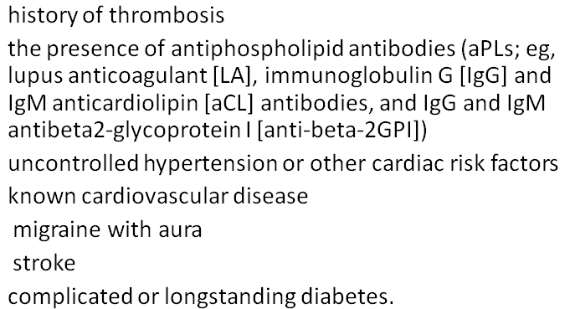
Factors to consider :-
3- Thromboembolic risk :
a careful assessment of thromboembolic risk is necessary to exclude patients at greatest risk when using some of the hormonal contraceptive methods.

Slide 41
Factors to consider :-
4- Medication interaction
* Medications commonly used in SLE that have potential interactions with estrogen-containing contraceptives include warfarin, mycophenolate, corticosteroids, cyclosporine, and anticonvulsants
*checking for pharmacologic interactions before advising hormonal contraception is recommended.

Slide 42
CHOOSING A METHOD OF CONTRACEPTION
Family planning takes into account achieving good disease control prior to pregnancy, and using the most effective method of contraception particularly for those with severe disease-related damage, high levels of disease activity, or use of teratogenic medications.

Slide 43
The overall approach
1- long-acting reversible contraceptive (LARC)
A)) (LNg)-containing intrauterine device (IUD)
* safe and effective option for most patients with SLE and/or positive antiphospholipid antibodies (aPLs)
* risk of pelvic infection in patients on immunosuppressive medication is unknown
* it has not been shown to increase thrombosis
* no detectable impact on bone density
* it reduces menstrual blood loss
Risk on thrombocytopenic patient ???

Slide 44
The overall approach
1- long-acting reversible contraceptive (LARC)
B)) copper IUD
It may worsen menstrual cramps and may cause heavier bleeding when compared with the LNg-IUD, although most women do not discontinue this IUD because of bleeding

Slide 45
The overall approach
2- oral hormonal contraceptive
* estrogen-progestin type
may be used in patients with stable low disease activity and documented negative aPLs but not for fluctuating aPLs or postive titers
*transdermal patch
. We suggest avoiding it as an alternative contraceptive due to the potentially higher estrogen exposure

Slide 46
3- progestin only contraceptives
progestin-only pill is the first drug of choice For SLE patients who do not want to use an IUD and have high disease activity, a positive aPL, or other contraindications to the use of estrogen.
* Depomedroxyprogesterone acetate (DMPA), an injectable progestin-only contraceptive, is not a good long-term option for patients with osteoporosis or long-term glucocorticoid use due to risk of decreased bone density

Slide 47
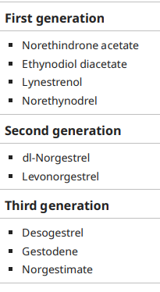
Progestin generations

Slide 48
4- physical and/or methods :
Pericoital and barrier methods are the least effective contraceptive method, and should be reserved for situations when hormone-containing contraceptives or IUDs must be avoided or are unacceptable to the woman

Slide 49
Thromboembolic risk and contraceptives :
Third-generation progestins confer greater venous thrombosis risk than do second-generation progestins due to greater activated protein C resistance.
Other factors such as genetic or acquired thrombophilia, smoking, age over 35 years, and obesity likewise increase the risk of venous thromboembolism in those taking hormonal contraceptives.
Thromboembolic risk and progestin — The risk for thromboembolism withprogestin-only contraception is very low, and they are generally safe for most SLE patients with or without positive aPLs. but the relative risk was significantly elevated for injectable progestins such as DMPA. However, the significance of this finding is uncertain due to the low number of DMPA users .

Slide 50
Contraception and lupus flare
Despite the common, long-held belief that estrogens provoke lupus disease activity, estrogen-progestin hormonal contraceptives are generally a safe form of contraception for stable aPL-negative SLE patients with mild-moderate disease activity.
Progestin-only contraceptives have not been observed to increase risk of lupus flare.

Slide 51
Progestin only contraceptive
Progestin only pill it is an alternative object for patients who cannot take estrogen containing contraceptive
DMPA , may cause reversible bone loss due to inhibition of ovulation.
Bone density in healthy women is reduced by 5.7 to 7.5 percent after two years of use .
A history of fragility fracture, known osteoporosis, or strong risk factors for osteoporosis (such as corticosteroid use) are generally considered contraindications to use of DMPA.
An additional disadvantage of DMPA in contrast to the LNg IUD and subdermal system is that there may be a delayed return to fertility.
Thus, it is not recommended for patients who plan pregnancy within the next year.

Slide 52
Barrier and pericoital contraceptives
Barrier (female and male condoms) and pericoital
(diaphragm, cervical cap, and spermicidal sponge) methods of contraception have low rates of typical use effectiveness
Since highly effective methods are preferred to avoid unintended pregnancy, barrier methods are not appropriate first-line methods.
However, reliance on barrier methods may be necessary during periods of acute illness, including acute thrombosis.
An additional consideration is that condoms are effective for reducing the risk of transmission of sexually transmitted diseases. Also, they may be used in combination with oral hormonal contraceptives as dual contraception when patients are on mycophenolate-containing medications that may interfere with efficacy of hormonal contraception.

Slide 53
Emergency contraception
— Emergency contraception is an option for all patients with SLE, including those with positive antiphospholipid antibodies (aPLs).

Slide 54
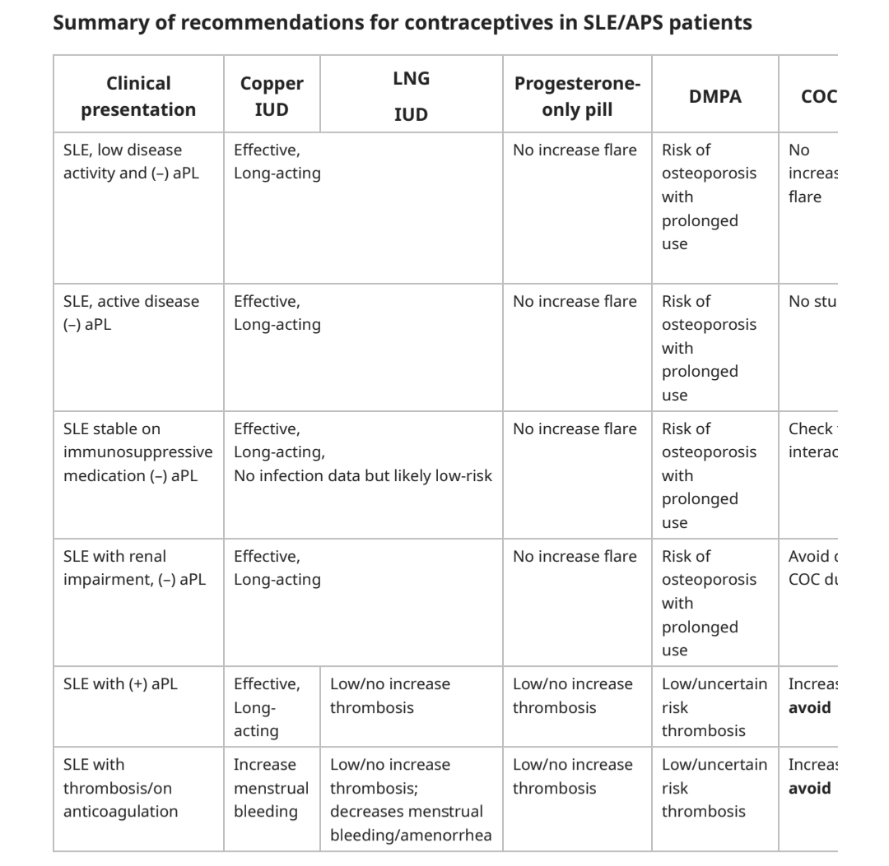

Slide 55
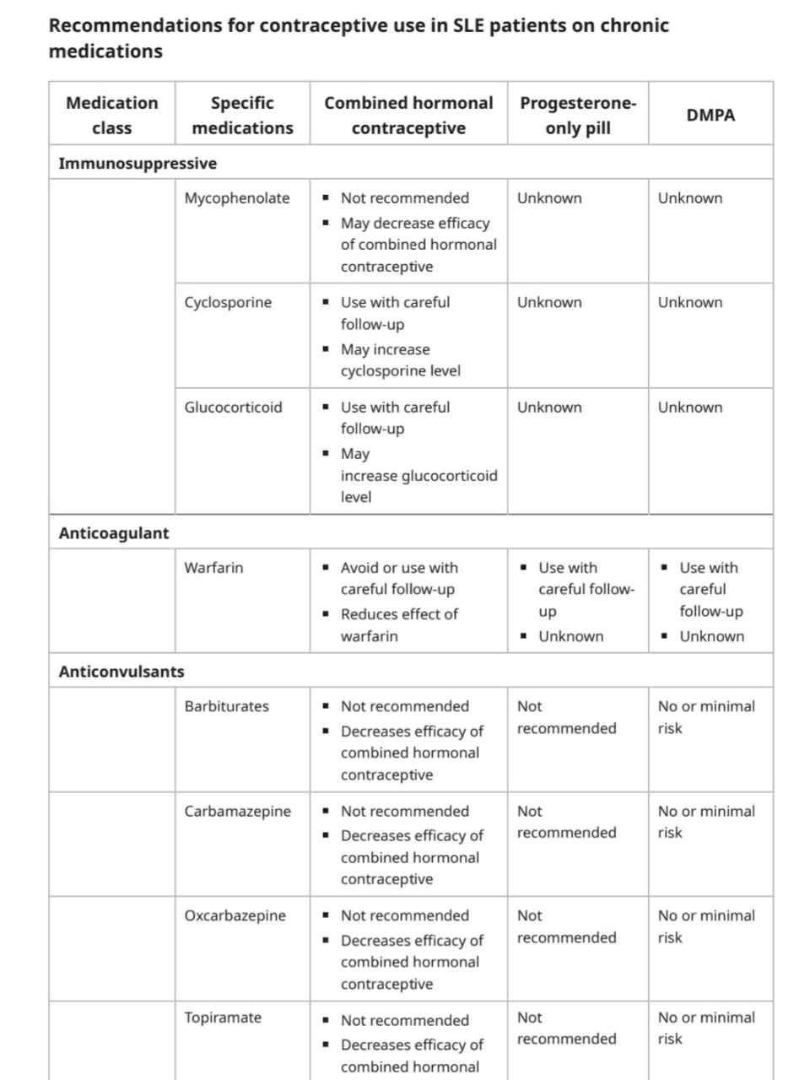

Slide 56
