Slide 1
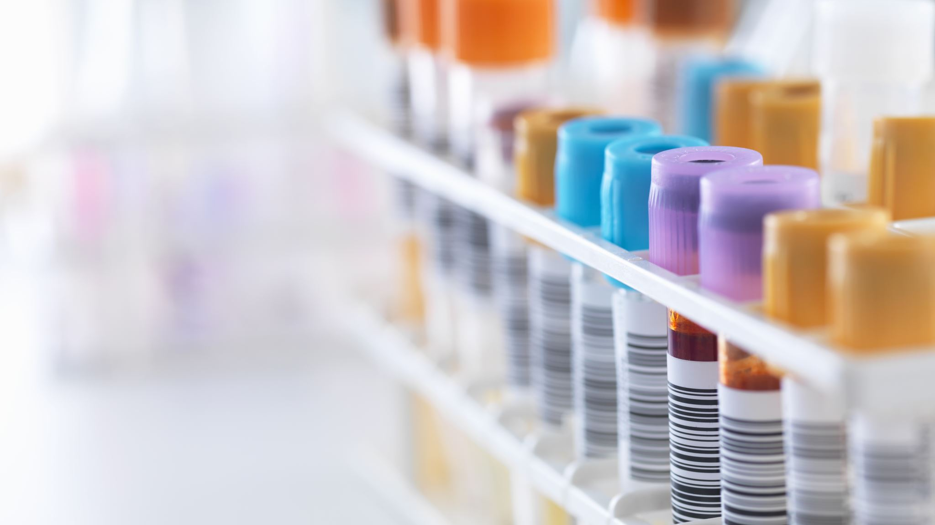
Approach to pt with jaundice
KHALED MOHAMMAD AL - MAJALI
MOHAMMAD AMIN AL - MAAITAH
AHMAD AYMAN AL - MAAITAH

Slide 2
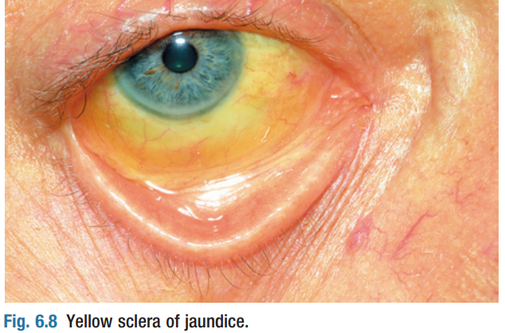
Jaundice
Jaundice is a yellowish discoloration of the skin , sclerae and mucous membranes caused by hyperbilirubinaemia.
There is no absolute level at which jaundice is clinically detected but , in good light , most clinicians will recognize jaundice when bilirubin levels exceed 50 µmol/L (2.92 mg/dL).

Slide 4
1-Prehepatic Jaundice :
(unconjugated hyperbilirubinemia)
- In hemolytic disorders , anemic pallor combined with jaundice may produce a pale lemon complexion.
- Serum liver enzyme concentrations are normal and jaundice is mild (plasma bilirubin less than 100 micromole/liter ( 5.85 mg/dl) but increases during prolonged fasting or intercurrent febrile illness.
- Gilbert’s syndrome is common and causes unconjugated hyperbilirubinaemia.
-The stools and urine are normal in color.

Slide 5
2-Hepatic Jaundice :
-Hepatocellular disease causes hyperbilirubinaemia that is (both unconjugated and conjugated).
-Conjugated bilirubin leads to dark brown urine.
-The stools are normal in color.
Viral hepatitis : e.g., hepatitis A–E, EBV, CMV, yellow fever
Liver disease : e.g., alcoholic hepatitis, nonalcoholic steatohepatitis, cirrhosis, congestive hepatopathy, Wilson disease, autoimmune hepatitis.

Slide 6
3-Post hepatic jaundice = cholestatic = obstructive = surgical
(conjugated hyperbilirubinemia)
- In biliary obstruction , conjugated bilirubin in the bile does not reach the intestine , so the stools are pale.
- Obstructive jaundice may be accompanied by pruritus (generalized itch) due to skin deposition of bile salt.
- Obstructive jaundice with abdominal pain is usually due to gallstones ; if fever or rigors also occur (Charcot’s triad) , ascending cholangitis is likely.
- Painless obstructive jaundice suggests malignant biliary obstruction, as in cholangiocarcinoma or cancer of the head of the pancreas.
- Obstructive jaundice can be due to intrahepatic as well as extrahepatic cholestasis , as in primary biliary cirrhosis, certain hepatotoxic drug reactions and profound hepatocellular injury.

Slide 7
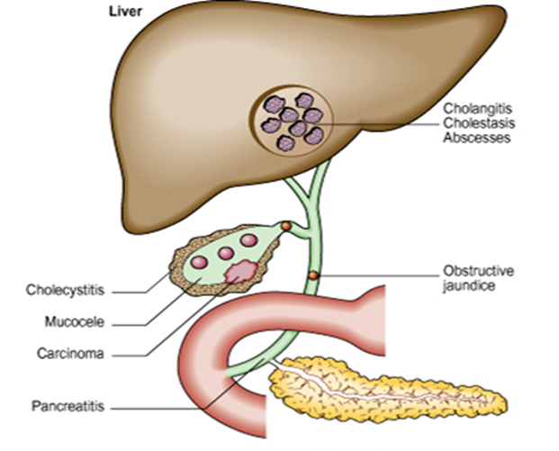
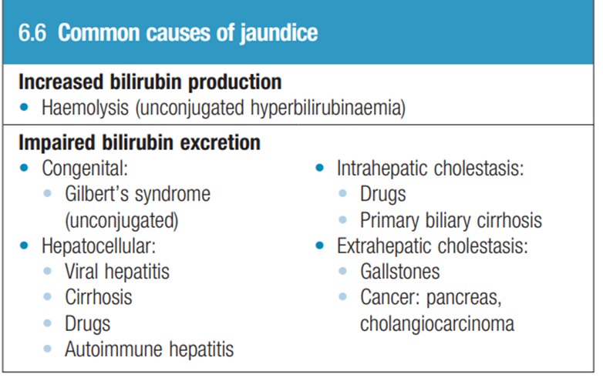

Slide 8
Ask about :
History
1- Duration
2- Associated symptoms: abdominal pain, fever, weight loss, itching, diarrhea or constipation (you can ask about all of gi symptoms)
3- color of stool (normal or pale), color of urine (normal or dark)
4- alcohol history
4- travel history and immunization
5- use of illicit or IV drugs
7- previous blood transfusion
8- recently prescribed drugs
9- previous episodes
Complete the scheme of Hx

Slide 9
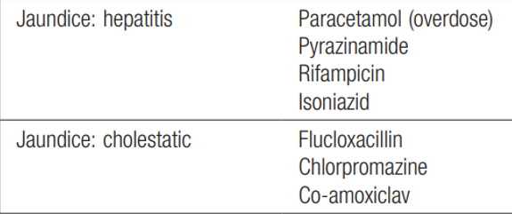
For drug history

Slide 10
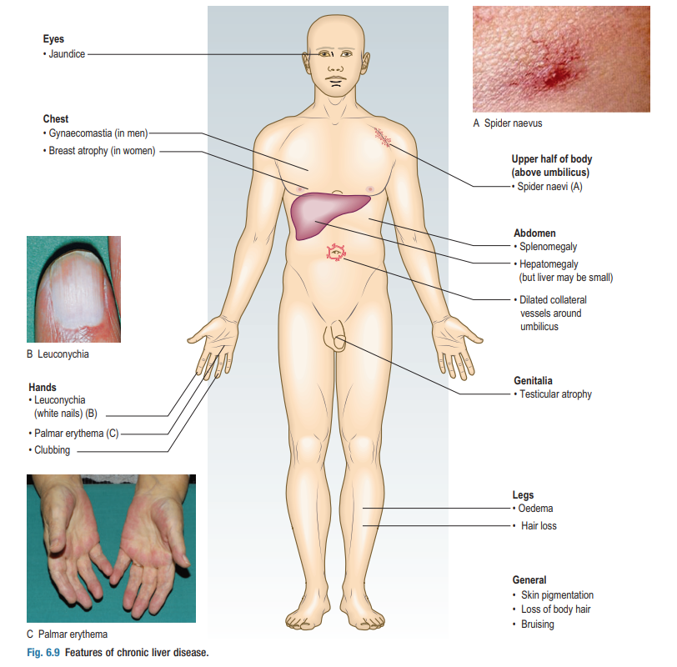
Physical examination:
1- Vitals
2- Focused focal exam :
Full abdominal examination(including assessment of hepatomegaly and splenomegaly)
Extremity exam for edema
Signs of chronic liver disease
Signs of anemia

Slide 13
Medical management
1) Antihistamine drugs (for itching)
Levocitrizine 5mg
Avle 25mg
2) Sedative for restlessness and irritability
Lorazepam,diazepam
3) Purgative enema if constipation
4) Antibiotics
5) Antipyretics
6) Vitamin K and B complex

Slide 14
Dietary management
Restrict fat intake
High protein diet
High carbohydrate diet
Give glucose water

