Slide 1
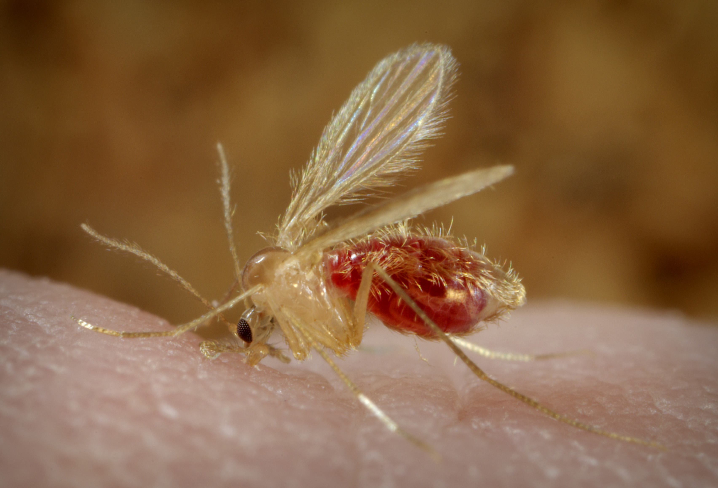
Parasitic infection of the skin
Presented by
Associate Professor Dina Abou Rayia

Slide 3
Skin diseases caused by parasitic infection
Caused by nematoda
Caused by protozoa
Cutaneous larva migrans
Trichinellosis
Cutaneous leishmaniasis

Slide 4
Cutaneous larva migrans

Slide 5
Cutaneous larva migrans (Creeping eruption, Plumber's itch, Sand worm)
Definition : serpiginous eruption of the skin due to skin invasion by animal hookworms’ larvae.
Causative parasite: filariform larvae of Ancylostoma caninum & Ancylostoma braziliense which are dog and cat hookworms
Geographical distribution: Cosmopolitan.

Slide 6
Cutaneous larva migrans
Mode of infection
Human infection is caused by penetration of the skin by animal hookworm’s filariform larvae which are not adapted to man.
Infection occurs due to contact with contaminated soil (moist or sandy) with dog & cat excreta.
The larvae migrate in the superficial layers of the skin and not go beyond the basal layer of the skin and keep migrating in the epidermis without development and rarely reaching the circulation.

Slide 7
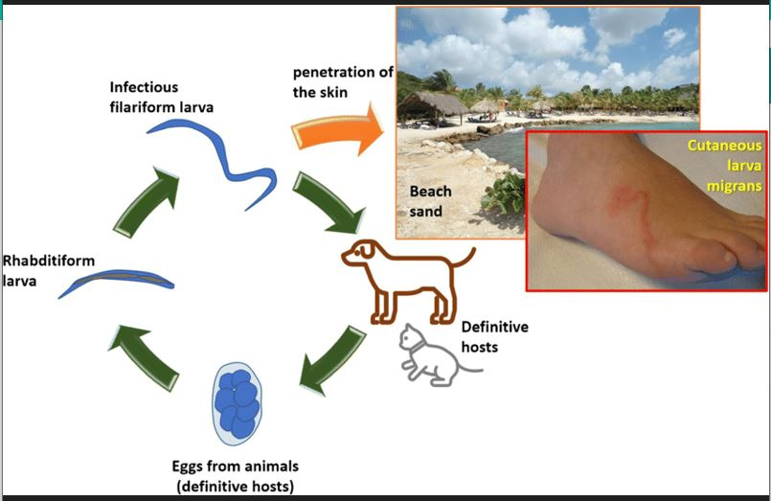
Life cycle

Slide 8
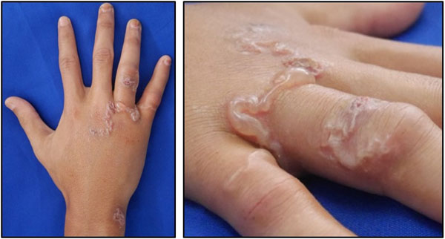
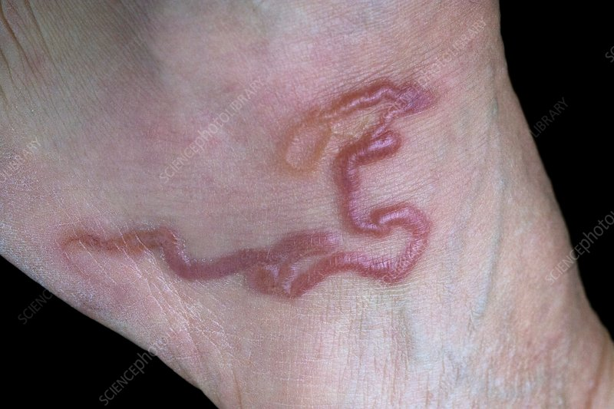
Pathogenesis and clinical picture
At the site of entry red itchy papule can develop few hours after penetration
Erythematous zigzag tunnel (2-4 mm), vesicular and elevated may be complicated by secondary bacterial infection causing sever irritation and pruritis.
Larvae remain active, move very slowly in the epidermis layer only for several weeks or months till die.
Commonly affect the skin of feet, hands or buttocks and may advances to 1-2 cm / day.
The skin lesion heals leaving linear white scars at the affected sites.
Rarely larvae may elicit generalized allergic manifestations

Slide 9
Treatment
Systemic:
Ivermectin 200 µg/kg single oral dose
Albendazole 400mg/kg orally for 3 days
Antihistaminic to relieve itching
Local:
Topical ivermectin cream
Local antibiotic for secondary
bacterial infection
- Local freezing: Spray of skin by ethyl chloride (local freezing) or carbon dioxide snow which produce freezing of larvae till death skin bleb  larvae are lost with epidermal sloughs.

Slide 10
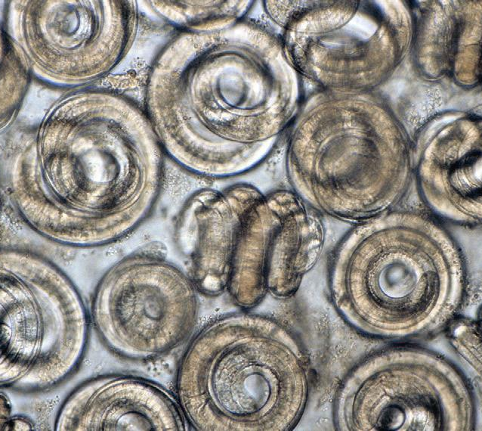
Trichinellosis

Slide 11
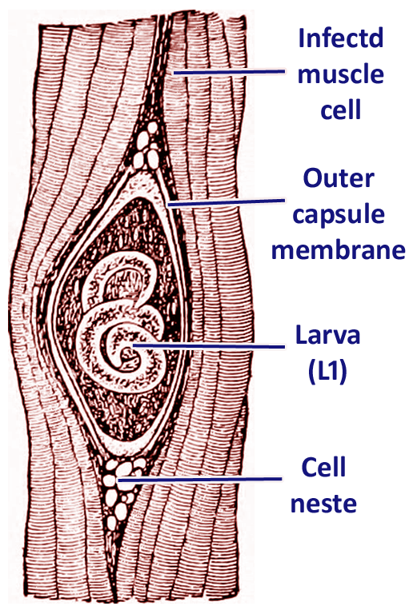
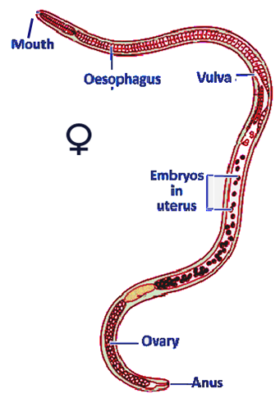
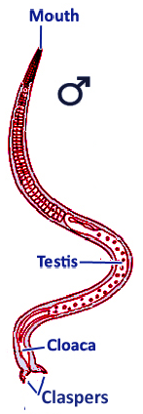
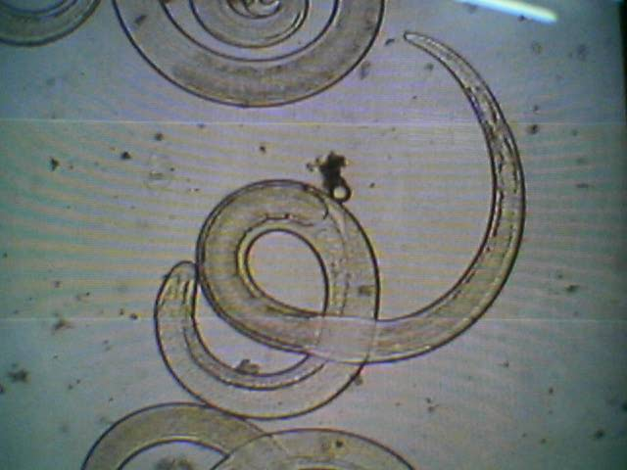
Trichinella spiralis
Distribution: worldwide specially in pork eating countries
Morphology:
Encysted larva in muscle
Female
Male
Newborn larva
0.1 mm long
1.5 mm long
1 mm long in a muscle capsule
of 0.5 mm long ??
3 mm long

Slide 12
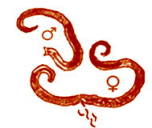
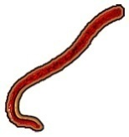
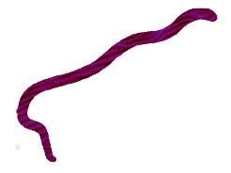
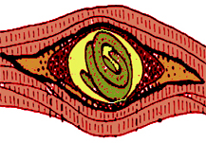
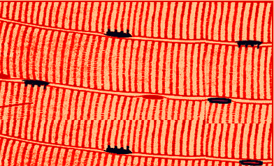
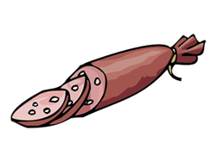
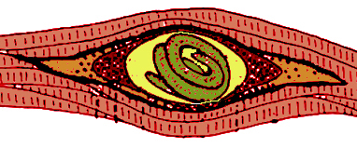
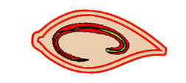
Life cycle of Trichinella spiralis
Adult in small intestine
Females start to deposit newborn larvae in the submucosa within five days
L5 mature to adults & male dies after mating
Larvae penetrate mucosa and molt four times→L5
Female lays larvae in submucosa
larva release by digestive
enzymes
Larvae migrate through
lymphatics or blood
Muscle cell transforms into Nurse Cell
Ingestion of cysts in
undercooked pork.
Larva grows & Nurse cell-parasite complex is formed (Infective cyst)
Larva enters skeletal muscle cells
Larvae enter heart or brain cells & can’t complete maturation
Pork meat containing
encysted larva

Slide 13
Trichinella spiralis
Trichinella spiralis
Trichinella spiralis
Definitive host:
Pigs, rats & sometimes man.
Intermediate host:
Pigs, rats & sometimes man.
Habitat: Adults live in the small intestine.
Males in lumen & females in tissues (embedded in submucoa). Infective larvae live mainly in active striated muscles.

Slide 14
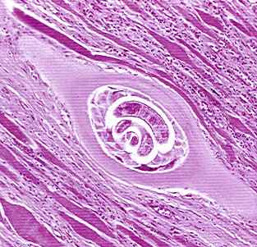
Trichinella spiralis
Diagnostic stages:
T. spiralis larvae in muscles
Adults and newborn larvae in stool
Infective stage: Encysted larvae in skeletal
muscles
Mode of infection: Eating undercooked pork meat, containing encysted T. spiralis larva
N.B: Man is a complete blind host.

Slide 15
Pathogenesis and clinical picture
Enteral phase
Parenteral phase
Muscular phase
From 2-7 days post infection
Due to burrowing of adults and larvae in the intestinal mucosa
Abdominal pain, diarrhea, nausea and vomiting
Second week post infection
Due to migratory larvae with blood vessels injury, hypersensitivity reactions and toxic product
Fever, facial oedema, splinter and subconjunctival haemorrhage, cough, skin rash
Patients die from encephalitis, myocarditis and peritonitis
Third week post infection
Due to encysted larvae in muscles
Severe muscle pain, swelling in muscles, Difficulty in breathing, may end in muscle paralysis

Slide 16
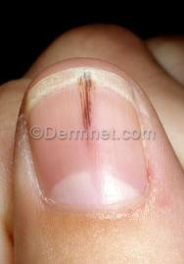
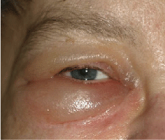
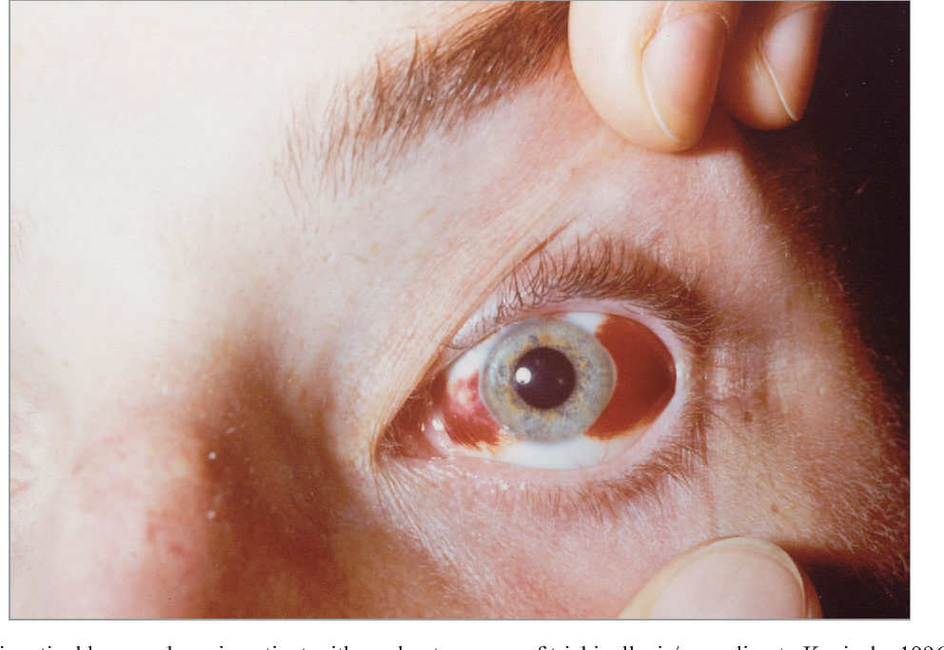
Trichinellosis

Slide 17
Laboratory diagnosis
Direct
Indirect
Stool examination: For larvae or adult.
Blood examination: For larvae.
Muscle biopsy: Taken from the swollen tender part & compressed between two slides after digestion in acid pepsin to see larvae .
Xenodiagnosis and Trichinoscopy: suspected meat is given to a lab animal and his muscles are examined after one month
X ray for calcified cyst.
CT for brain lesions.
Intradermal test (Bachman test).
Serological tests: CFT, IHA, IFAT, ELISA.
Eosinophlia (20-50%).

Slide 18
Treatment
General treatment
Specific therapy
Bed rest and fluid therapy
Sedatives for headache and muscle pain.
Corticosteroids to reduce inflammatory reaction.
Cardiac and respiratory monitoring.
Thiabendazole.
Mebendazole.

Slide 19
Cutaneous leishmaniasis

Slide 20
Leishmaniasis classified into
Cutaneous leishmaniasis
Mucocutaneous leishmaniasis
Visceral Leishmaniasis
(Kala azar)
Caused by
Caused by
L. tropica.
L. major.
L. aethiopica.
L. mexicana.
L. braziliensis.
New World Leishmaniasis
Old World Leishmaniasis

Slide 21
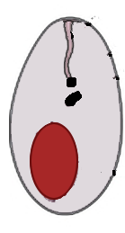
Morphological forms
Leptomonad or promastigote stage
Leishmanial or Amastigote stage
Flagellum
Axoneme
Kinetoplast
Nucleus
Round or oval
(2–4μm)
spindle-shaped
(15-20µm)

Slide 22
Morphological forms
1- Amastigote 2- Promastigote
Shape: Oval Fusiform or spindle
Kinetoplast: Beside the nucleus At the anterior end
Flagellum: Absent Present
Nucleus: -Eccentric with central -Central with central
Karyosome Karyosome
Habitat: -Intracellular (macrophage) -Midgut of the insect
-Tissue culture -Culture media

Slide 23
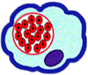
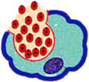
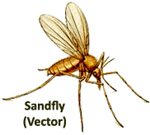
Promastigote
transformed
to Amastigote
Amastigote
multiplies
Macrophage
Rupture
Life Cycle of Leishmania species
Promastigote
invades
macrophage
Amastigotes release
Sandfly ingests Amastigotes
Vector infection
Host infection
Sandfly injects promastigote
Amastigote
transformed to
Promastigote
Migrate to
mouth parts
Multiplication in midgut

Slide 24
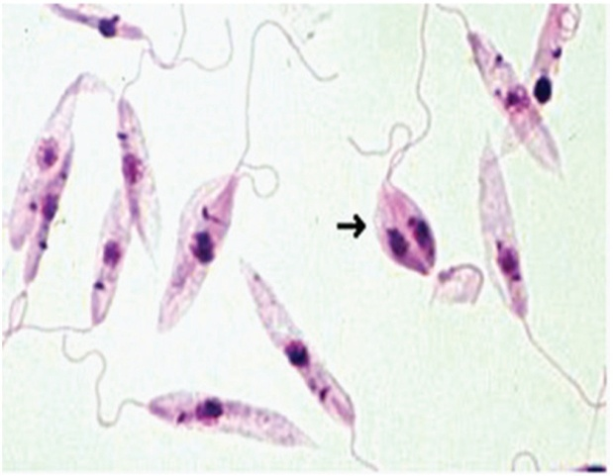
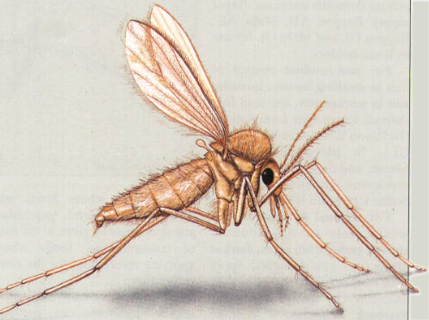
Mode of transmission
1- Bite of female sand fly (Phlebotomus species).
2- Direct contact with infected lesions.
3- Mechanical transmission by blood sucking fly as Stomoxys.
D.H:
Man
R.H:
Dogs in L. tropica.
Rodents in L. major & L. aethiopica.
D.S:
Amastigote (specimen)
Promatigote (culture)
I.S:
Promastigote (sand fly)
Amastigote (contact)
Vector:
Female sand fly (Phlebotomus)

Slide 25
Pathogenesis
The lesion develops on the exposed parts of the body
Single or multiple
Starts as erythematous papule that enlarges to form nodule that ulcerates forming an ulcer with sharp edge
The lesion is painless unless secondary bacterial infection occurs
The ulcer heals with a disfiguring scar
Solid immunity to the same species

Slide 26
L. tropica (Dry or urban oriental sore) | L. major (Moist or wet oriental sore) | L. aethiopica (Diffuse cutaneous)
Chronic course | Acute course | Chronic widely distributed lesions in immunosuppressed individuals (opportunistic)
Long incubation period (2-12 ms) | Short incubation period (3-6 ms) | Due to lack of cell mediated immune response to leishmania
Ulcer with scanty exudate and slow healing (12 ms) | Ulcer with serous exudate and rapid healing (6ms) | Lesions not restricted to the site of infection and appears as multiple nodules
In Europe, Asia and Africa (cities and urban regions) | In Europe, Asia and Africa (rural areas) | East Africa (Ethiopia and Kenya)
Solid immunity | Solid immunity | Can relapse

Slide 27
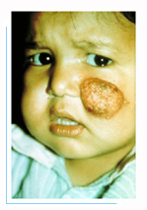
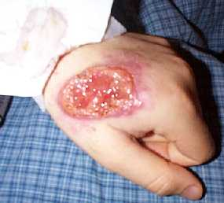
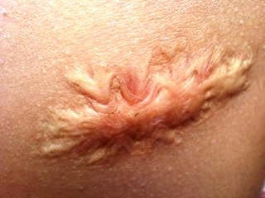
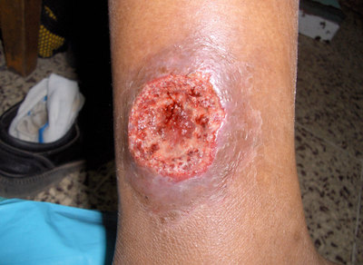
Oriental sore

Slide 28
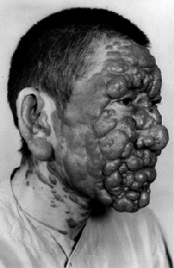
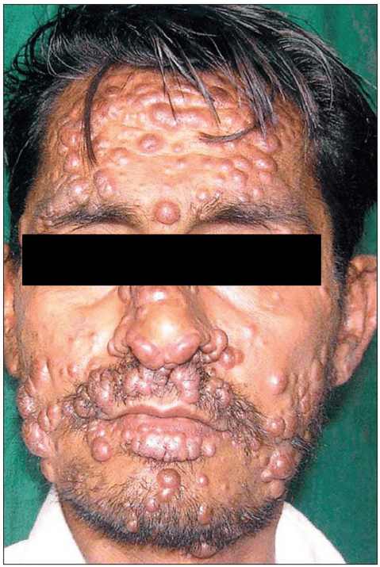
Leishmania aethiopica

Slide 29
New world (American) leishmaniasis
New World Cutaneous Leishmaniasis
New World Mucocutaneous Leishmaniasis
Leishmania mexicana
Leishmania braziliensis
Chiclero ulcer or bay sore
Mucocutaneous Leishmaniasis
(Espundia)

Slide 30
Chiclero ulcer Espundia Caused by L. mexicana Caused by L. braziliensis -A small single nodule at the site of -Primary skin lesion: Nodule in sand fly bite  ulcerates. exposed regions  ulcerates. -Usually on the face & ear pinna - The ulcer with raised indurated  heals within 6 months. margin  heals in scar in months. -Ear lesion causes destruction of the -Secondary metastatic lesion: cartilage of the ear pinna. The parasite migrates from the -Seen in chicleros who live in forests primary site to blood & lymph & collect gum from chicle trees. to mucocutaneous junctions. -Sites: nasal septum, lips, palate nasopharynx & larynx. -Deformity & 2nd bacterial infection. - Death from septicemia and bronchopneumonia.

Slide 31
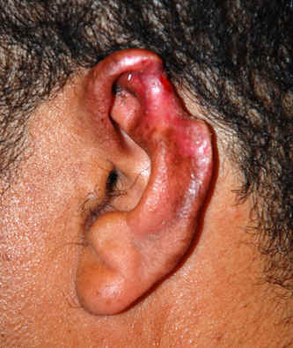
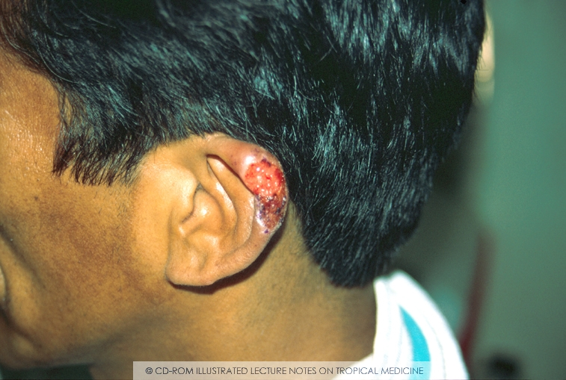
Chiclero ulcer
Espundia

Slide 32
Laboratory diagnosis
Direct
Indirect
1-Scraping the edge of the ulcer or aspiration by a needle or biopsy (not the base as contains pus and necrotic tissues) and examined by :-
Direct smear stained by Giemsa or leishman.
2- Culture on NNN medium (amastigotes changes into
promastigotes).
1-Immunodiagnosis:
Leishmanin I.D test (Montenegro test): Not a specific test. It is +ve with cutaneous and mucocutaneous leishmaniasis
but negative in diffuse cutaneous leishmaniasis.
Serological tests: Not useful for the diagnosis.
2- PCR: A reliable diagnostic test.
than routine smear and culture and it used also for species differentiation.

Slide 33
Treatment
1) Local
2) Chemotherapy
Cryosurgery, curettage or local application of heat to raise the intra- lesional temperature to 37- 43 ° C for 12 hours as amastigote do not grow above 33 ° C.
Surgical excision of the lesion.
Non-ulcerated lesion: Intra- lesional injection of pentavalent antimony compounds.
Ulcerated lesion: Should be treated with systemic pentavalent antimony compounds (ex. Pentostam).
Alternative drugs to pentostam: Amphotericin B, imidazoles or Allopurinol.
Antibiotics for secondary bacterial infection of lesions.

Slide 35
Case 1:
A 19-year-old-woman, who had spent several months of the previous year as a student in Brazil, presented to the hospital complaining of ulcers on her lips and mouth as well as on her nasal mucosa. When she returned from Brazil the previous year, she had noted multiple skin lesions on her arm that had disappeared. A biopsy taken from ulcer edge showed macrophages containing small oval parasites about 2-3 µm

Slide 36
Case 2:
A 40-year-old-woman presented to the hospital complaining of severe muscle pain. She reported being in France the previous month for studying. She had suffered from gastroenteritis while she was in France followed by unilateral oedema in the face which subsided and then she complained of continuous severe muscle pain.

