Slide 1
RSM-3 PULMONARY INFECTIONS-2
Dr. Eman Kreishan, M.D
16-10-2022

Slide 2
Chronic Pneumonias
Chronic pneumonia most often is a localized lesion in an immunocompetent individual, with or without regional lymph node involvement.
There is typically granulomatous inflammation, which may be due to :
bacteria (e.g., M. tuberculosis).
fungi.
In immunocompromised patients, the usual presentation is widespread disease due to systemic dissemination of the causative organism.
Tuberculosis is by far the most important entity within the spectrum of chronic pneumonias

Slide 3
Tuberculosis
Tuberculosis is a communicable chronic granulomatous disease caused by Mycobacterium tuberculosis.
It usually involves the lungs but may affect any organ or tissue in the body.
The World Health Organization (WHO) considers tuberculosis to be the most common cause of death resulting from a single infectious agent.

Slide 4
Etiology and Pathogenesis
Mycobacteria are slender rods that are acid-fast (i.e., they have a high content of complex lipids that readily bind the Ziehl-Neelsen stain.
M. tuberculosis hominis is responsible for most cases of tuberculosis; the reservoir of infection typically is found in individuals with active pulmonary disease.
Transmission usually is direct, by inhalation of airborne organisms in aerosols generated by expectoration or by exposure to contaminated secretions of infected individuals

Slide 5
Pathogenesis
**(the first 3 weeks) in the nonsensitized patient
1.Entry into macrophages
2.Replication in macrophages.

Slide 6
Development of cell-mediated immunity. This occurs approximately 3 weeks after exposure
Individuals with inherited mutations in any component of the TH1 pathway are extremely susceptible to infections with mycobacteria
patients with rheumatoid arthritis who are treated with a TNF antagonist have an increased risk for tuberculosis reactivation.

Slide 7
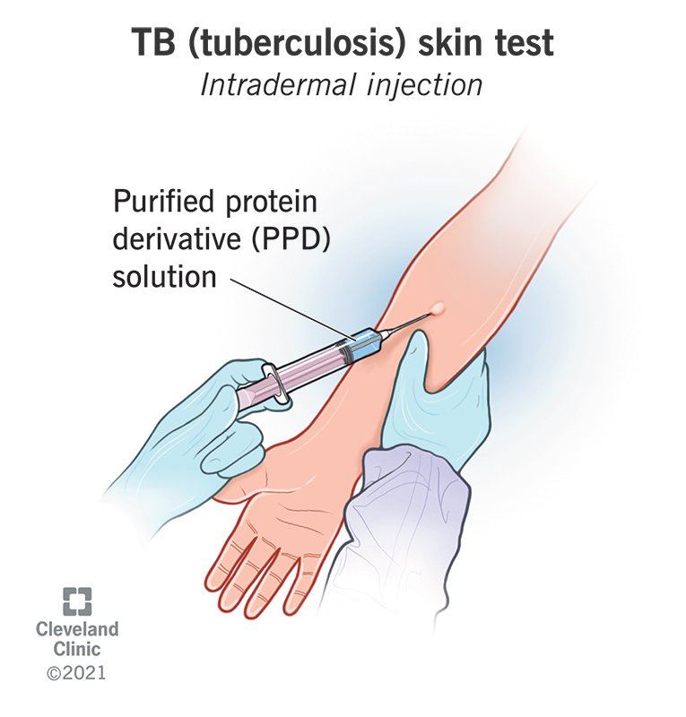
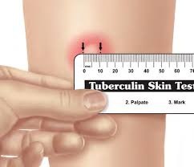
Tuberculin test
About 2 to 4 weeks after the infection has begun, intracutaneous injection of 0.1 mL of sterile purified protein derivative (PPD) induces a visible and palpable induration (at least 5 mm in diameter) that peaks in 48 to 72 hours

Slide 8
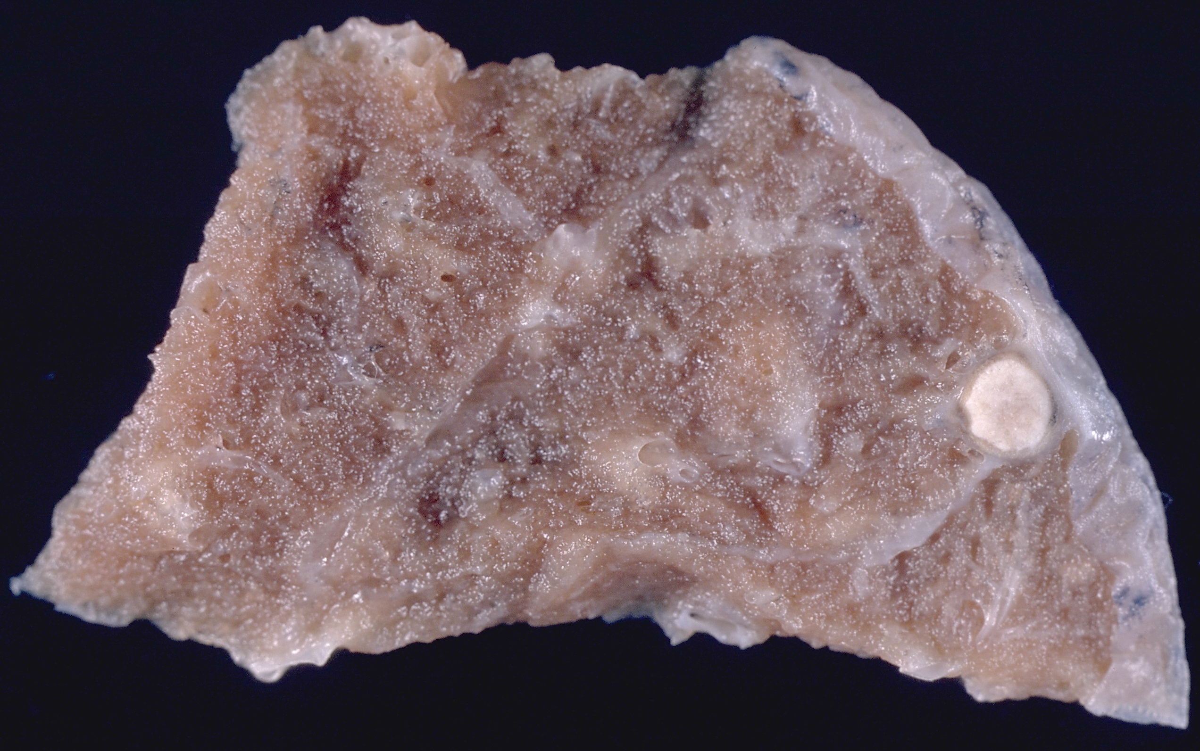
Primary Tuberculosis
Primary tuberculosis is the form of disease that develops in a previously unexposed and therefore unsensitized patient.
In the large majority of healthy individuals, the only consequence of primary tuberculosis are the foci of scarring (fibrocalcific nodule at the site of the infection).
BUT!!!!!!!!!
these foci may harbor viable bacilli and thus serve as a nidus for disease reactivation at a later time if host defenses wane

Slide 9
MORPHOLOGY
A 1-cm to 1.5-cm area of gray-white inflammatory consolidation emerges. This is called the Ghon focus, with caseous necrosis in the center.
Tubercle bacilli, either free or within phagocytes, travel via the lymphatic vessels to the regional lymph nodes.
This combination of parenchymal and nodal lesions is called the Ghon complex.
Lymphatic and hematogenous dissemination to other parts of the body also occurs during the first few weeks.

Slide 10
Ghon complex:
The gray-white parenchymal sub pleural focus with Hilar lymph nodes caseation.

Slide 11
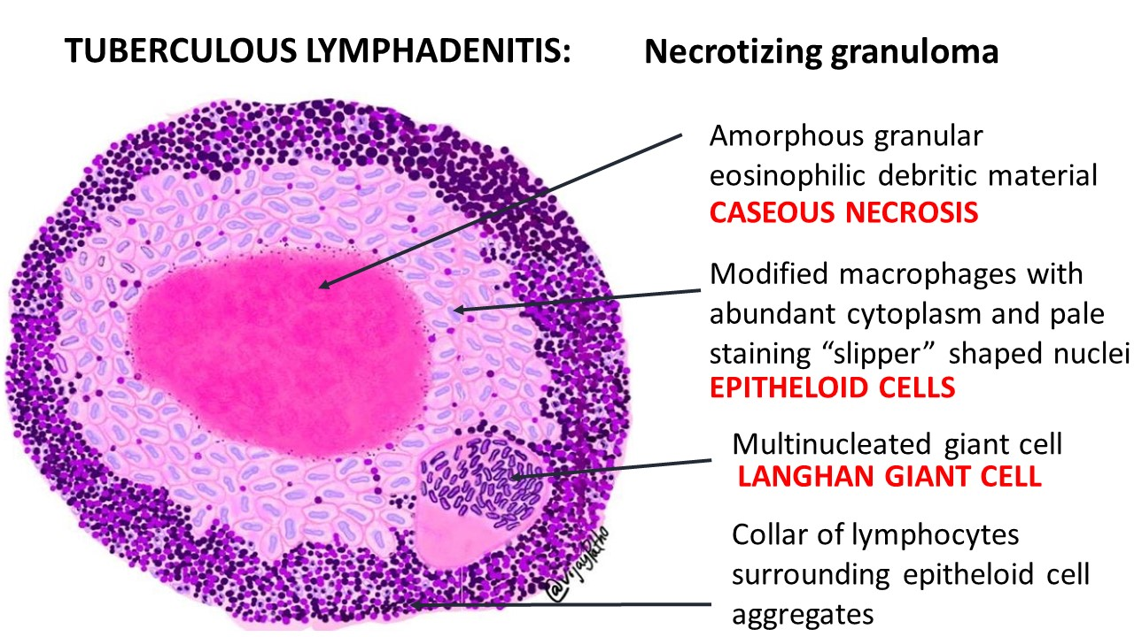
Histologically:
sites of infection are involved by a characteristic inflammatory reaction marked by:
the presence of caseating and noncaseating granulomas, which consist of epithelioid histiocytes and multinucleate giant cells.

Slide 13
Secondary Tuberculosis (Reactivation Tuberculosis)
Secondary tuberculosis is the pattern of disease that arises in a previously sensitized host.
It may appear shortly after primary tuberculosis, but more commonly arises from reactivation of dormant primary lesions many decades after initial infection.
only a few patients (<5%) with primary disease subsequently develop secondary tuberculosis.

Slide 14
Secondary pulmonary tuberculosis is classically localized to the apex of one or both upper lobes, may relate to high oxygen tension in the apices.
the regional lymph nodes are less prominently involved early in the disease .
cavitation is common in the secondary form, leading to erosion into and dissemination along airways.
So the sputum containing many bacilli!!!!!!

Slide 15
Secondary pulmonary tuberculosis consequences

Slide 16
Secondary pulmonary tuberculosis consequences
1. progressive pulmonary tuberculosis:
the apical lesion enlarges and the area of caseation expands.
Erosion into a bronchus evacuates the caseous center, productive cough?
Erosion of blood vessels results in hemoptysis.
2. Miliary pulmonary disease :
occurs when organisms reach the bloodstream through lymphatic vessels and then recirculate to the lung via the pulmonary arteries.

Slide 17
3. pleural involvement:
pleural effusions, tuberculous empyema, or obliterative fibrous pleuritis may develop.
4. Systemic miliary tuberculosis:
when the organisms disseminate hematogenously throughout the body.
Systemic miliary tuberculosis is most prominent in the liver, bone marrow, spleen, adrenal glands, meninges, kidneys, fallopian tubes, and epididymis

Slide 18
5. Isolated-organ tuberculosis:
if one of the organs or tissues seeded hematogenously and may be the presenting manifestation of tuberculosis.
Organs typically involved include the meninges (tuberculous meningitis), kidneys (renal tuberculosis), adrenal glands, bones (osteomyelitis), and fallopian tubes (salpingitis).
6. Lymphadenitis :
is the most frequent form of extrapulmonary tuberculosis, usually occurring in the cervical region .
Lymphadenopathy tends to be unifocal.

Slide 19
Clinical Features
Localized secondary tuberculosis may be :
Asymptomatic.
Cytokines-related (TNF, IL-1) symptoms:
include malaise, anorexia, weight loss, and fever.
mucoid and later purulent-bacilli containing sputum.
hemoptysis .
Pleuritic pain.

Slide 20
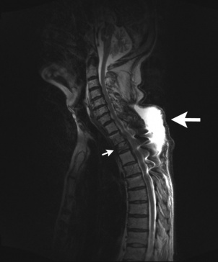
Extrapulmonary manifestations
E.g Extrapulmonary manifestations of tuberculosis :
tuberculous salpingitis may present as infertility.
tuberculous meningitis with headache and neurologic deficits.
Pott disease with back pain and paraplegia.
Notes:
Pott disease is tuberculosis of the spine.
It causes a kind of tuberculous arthritis of the intervertebral joints

Slide 21
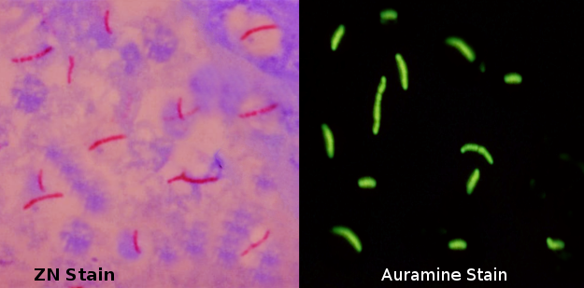
diagnosis
demonstration of acid-fast organisms in sputum by staining or by use of fluorescent auramine rhodamine.
cultures for mycobacteria require up to 10 weeks.
. PCR amplification.

