Slide 1
Wilm’s tumor & Neuroblastoma
Presented by:
Maha Emad
Shatha Rababa’a

Slide 2
Wilms tumor also known as nephroblastoma, is the second most common malignant abdominal tumor in children after neuroblastoma.
Affects about 1 in 10000 births
The mean age of diagnosis is 3 to 3.5 years of age.
Produces a mixed histological picture of epithelial structures

Slide 3
Etiology
The exact etiology of nephroblastoma remains unknown, but it is associated with several genetic mutations and syndromes.

Slide 4
Genetic predisposition
Associated with loss of function mutations of tumor suppressor genes on chromosome 11: Wt1 (wilms tumor 1) & wt2 gene
Leads to abnormal proliferation of the metanephric blastemal cells (primitive embryologic cells of the kidney).

Slide 5
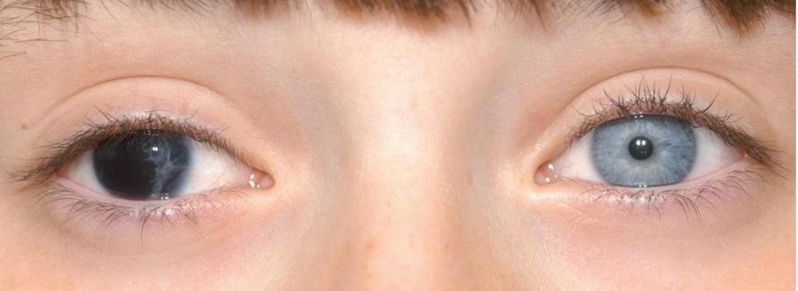
Associated syndromes
Wagr syndrome: Due to deletion of wt1 on chromosome 11
Nephroblastoma
Aniridia
Genitourinary anomalies (pseudohermaphroditism, undescended testis)
Intellectual disability

Slide 6
Denys-drash syndrome
Diffuse mesangial sclerosis
Wilms tumor
Pseudohermaphroditism (gonadal dysgenesis)

Slide 7
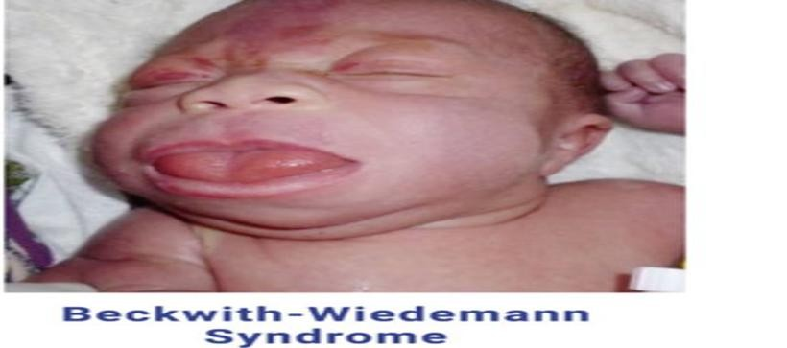
Beckwith-wiedmann (fetal overgrowth syndrome)
Mutation of wt2 gene mutations in short arm of chromosome11, that leads to overactivity of the igf-2 gene
Presented with hyperinsulinism, neonatal hypoglycemia, macrosomia, macroglossia, omphalocele, visceromegaly, hemihyperplasia, embryonal tumors

Slide 8
A 3 year male is brought to the pediatrician for a routine checkup. His mother explains that she believes that he is doing well. He has no medical concerns and has been eating and growing without issue. His vital sings are normal. A physical exam reveals the presence of a palpable right flank mass. The patient has no urgency or frequency, however a urinalysis shows hematuria, and there are 35 RBC/hpf. What is the likely diagnosis in this patient?

Slide 9
Clinical features
Large flank, palpable abdominal mass (often found incidentally) and rarely invasive(90% presented as abdominal mass) in previously healthy, asymptomatic child
Non-tender
Unilateral, not crossing midline
10% tumors are bilateral
Smooth and firm
Other signs and symptoms
Hematuria,dysuria ,fever,constipation
Hypertension
Symptoms caused by metastic spread (most common pulmonary symptoms)

Slide 10
Physical exam:
palpable, painless abdominal mass
does not cross midline
hemihypertrophy of kidney due to increased vascular demands
Hypertension due to renin secretion
some present with aniridia

Slide 11
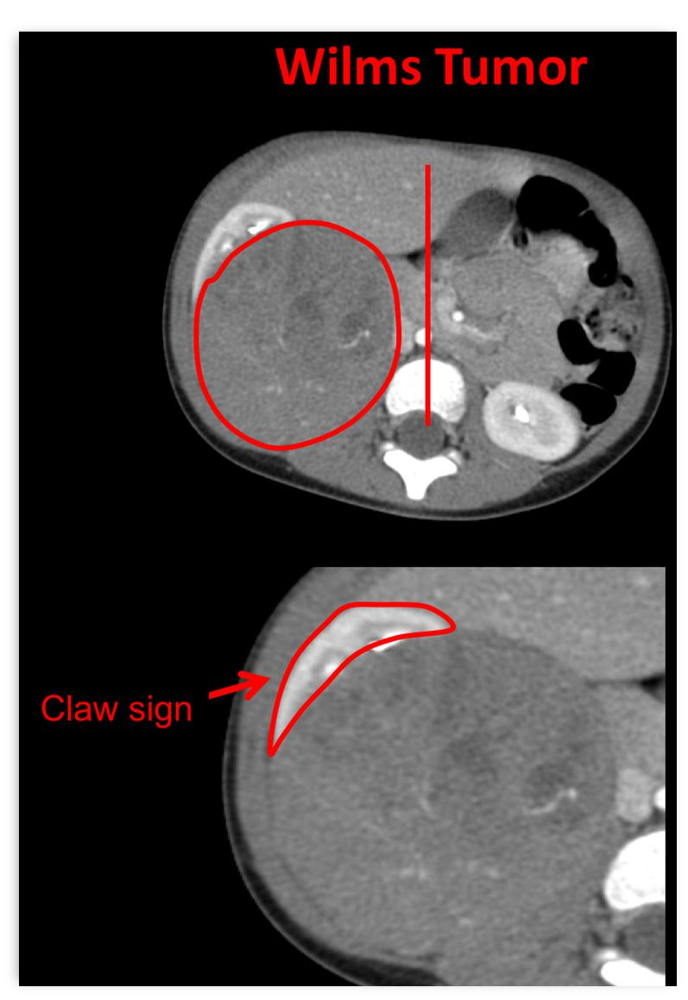
Diagnosis imaging
Ultrasound(best initial test)
Shows vascular infiltrations and hydronephrosis
Differentiates between cystic and solid masses
With doppler: Evaluates the collecting system and demonstrates
Intravascular spread and tumor thrombi in the renal veins and ivc
Abdominal ct (claw sign)
To assess location and extent of involvement
Surgical planning
Ct thorax/cxr
To detect lung metastasis

Slide 15
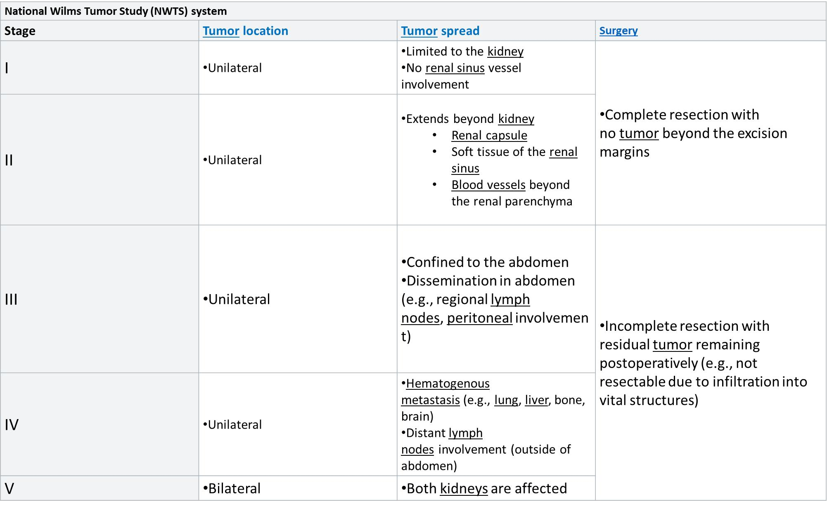

Slide 17
Neuroblastoma
Its an embryonal malignancy
Is a malignant neuroendocrine tumor of the sympathetic nervous system that originates from neural crest cells potentially secretes catecholamines, and is usually found in the adrenal glands or sympathetic ganglia..
The median age is 22 month ” 5 or younger “
Fourth most common childhood malignancy.
Is the most common extracranial solid tumor of childhood (8-10%).
The most common malignancy in infancy.
Given its origin, neuroblastoma can occur in any aggregation of sympathetic nervous tissue, including the adrenal glands, the sympathetic chain, and the paraganglia (e.g., the carotid body)

Slide 18
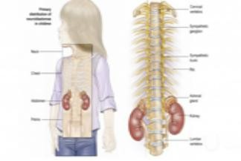
But the classical presentation is an abdominal suprarenal mass.
Adrenal glands 45%))
Retroperitoneal sympathetic ganglia (25%)
Paravertebral ganglia of chest (15%))
Neck (5%)
Pelvic sympathetic 5%))

Slide 19
Clinical features
The clinical presentation is mainly determined by the site of the primary tumor, if it secretes catecholamines, and whether it has metastasized.
General symptoms
Failure to thrive or weight loss
Fever
Nausea, vomiting, loss of appetite
Hypertension

Slide 20
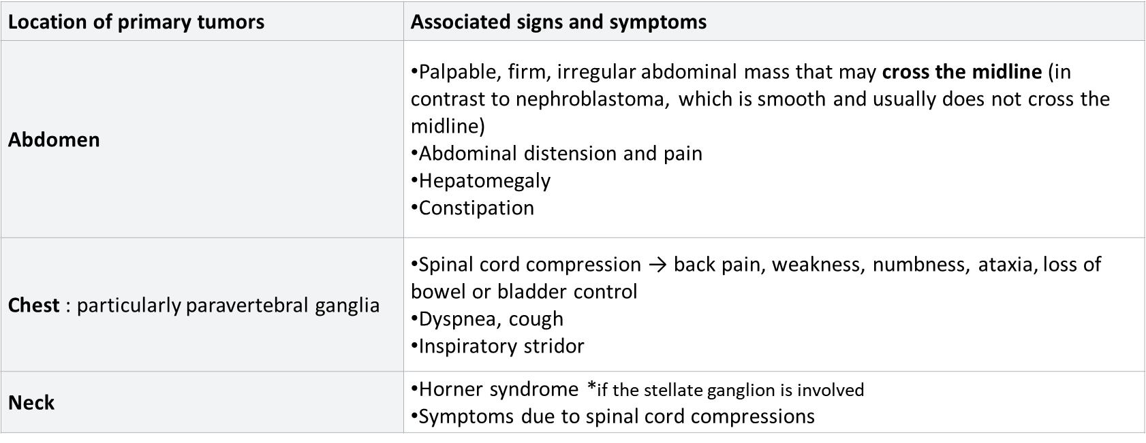
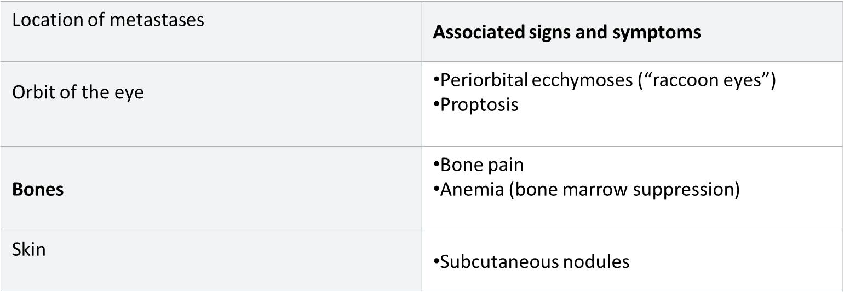

Slide 21
Paraneoplastic effects:
Vasoactive intestinal peptide secreting tumors and opsoclonus myoclonus syndrome (dancing eye, dancing feet)

Slide 22
Laboratory/imaging studies
Cbc
X-ray: Calcification within abdominal
Urinary catecholamines:About 90% of neuroblastomas produce catecholamines
(vanillylmandelic acid; homovanillic acid)
A computed tomography (ct) scan of the chest, abdomen, and pelvis;
Metaiodobenzylguanidine “mibg” Scan; radioactive substance taken by neurohrmonal tumor
Bilateral bone marrow aspiration and biopsies;
Definitive diagnosis of neuroblastoma requires tissue biopsy
The mass often contains calcification and hemorrhage that can be appreciated on plain radiography or ct.

Slide 23
A left supra-renal mass with typical stippled calcifications (arrow in a) and a mass with calcifications (arrow in b) displacing the left kidney inferiorly.
Treatment is determined mainly by patient age at the time of diagnosis, clinical stage,
Spontaneous remission may occur even in cases of metastatic disease.

Slide 27
Thank You!

