Slide 1
Lymph drainage of Abdomen ,
Head and Neck
Dr. Aiman Qais Afar Al-Maathidy
Surgical Anatomist
College of Medicine / University of Mutah

Slide 2
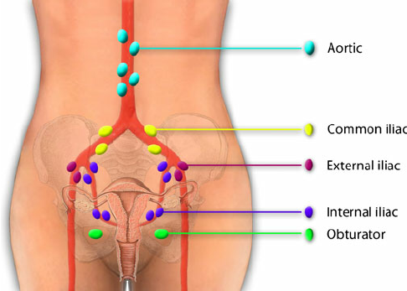
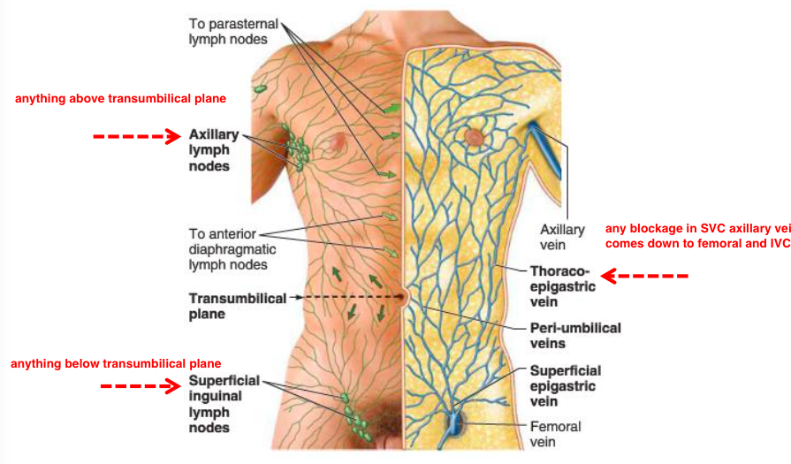
* Lymphatic Drainage of the Anterior Abdominal Wall
A- Superficial lymphatic
1- Above the umbilicus: they drain into the axillary lymph nodes.
2- Below the umbilicus: they drain into the superficial inguinal lymph nodes.
B- Deep lymphatic
1- Above the umbilicus: they drain into the parasternal lymph nodes.
2- Below the umbilicus: they drain into the external iliac Lymph nodes

Slide 3
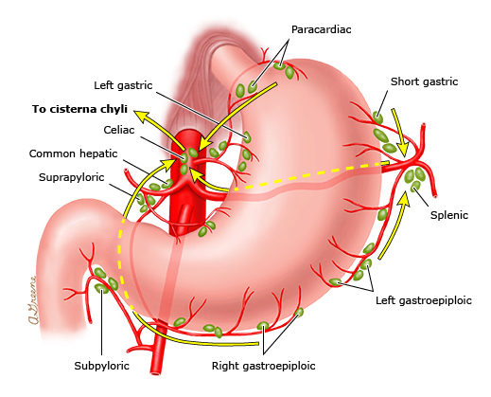
* Lymph Drainage of Stomach
The lymph vessels follow the arteries into the left and right gastric nodes, the left and right gastroepiploic nodes, and the short gastric nodes.
All lymph from the stomach eventually passes to the celiac nodes located around the root of the celiac artery on the posterior abdominal wall

Slide 4
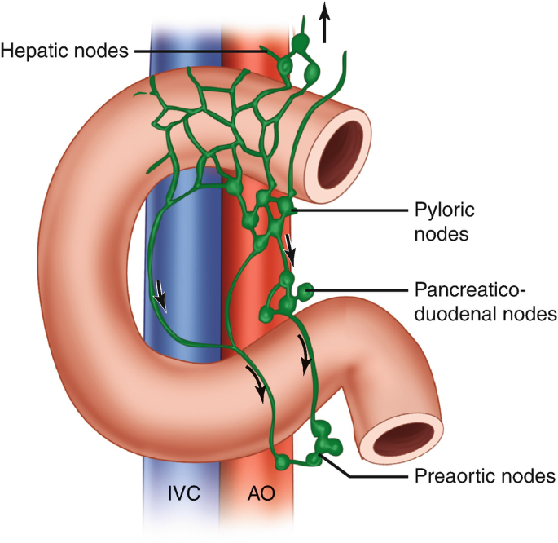
* Lymphatic drainage of the duodenum
The upper part: drains into the hepatic lymph nodes,
The lower part: drains into the superior mesenteric lymph nodes.
The lymph vessels follow the arteries and drain upward via pancreaticoduodenal nodes to the gastroduodenal nodes and then to the celiac nodes and
Downward via pancreaticoduodenal nodes to the superior mesenteric nodes around the origin of the superior mesenteric artery.

Slide 5
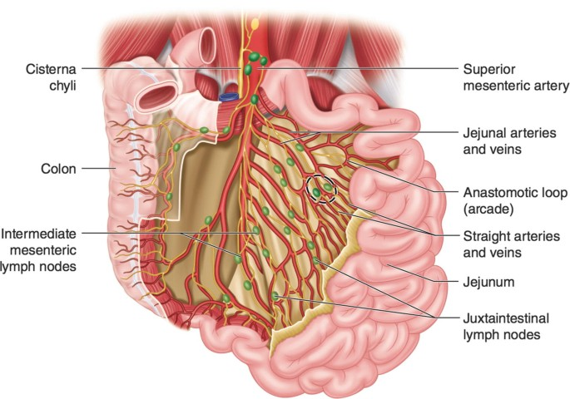
* Lymphatic drainage of the Jejunum and Ileum
The mesenteric lymph nodes are arranged into 3 groups:
A) Small and numerous lymph nodes close to the small intestine.
B) Larger and fewer lymph nodes along the jejunal and ileal vessels.
C) Larger and fewer lymph nodes along the superior mesenteric vessels

Slide 6
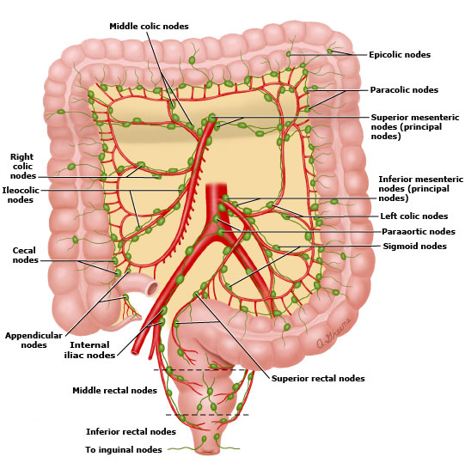
* Lymphatic drainage of the colon
The colic lymph nodes are arranged into 4 groups:
1- Epicolic lymph nodes: on the wall of the colon.
2- Paracolic lymph nodes: along the borders of the colon.
3- Intermediate colic lymph nodes: along the branches of the superior and inferior mesenteric vessels.
4- Terminal colic lymph nodes: along the superior and inferior mesenteric vessels.

Slide 7
* Lymph Drainage of the liver
The liver produces a large amount of lymph about one third to one half of all body lymph.
The lymph vessels leave the liver and enter several lymph nodes in the porta hepatis.
The efferent vessels pass to the celiac nodes.

Slide 8
* Lymph Drainage of the liver
1- Superficial lymphatic drain the whole surfaces of the liver and end into:
a- The lymph nodes around the terminal part of IVC.
b- Hepatic lymph nodes (along hepatic artery).
c- Para-cardiac group (around the lower part of oesophagus).
d- Coeliac lymph nodes (around the coeliac trunk).
2- Deep lymphatics: divided into ascending and descending trunks
Ascending trunk end in the lymph nodes around the I.V.C.
B. Descending trunk end in the hepatic lymph nodes.

Slide 9
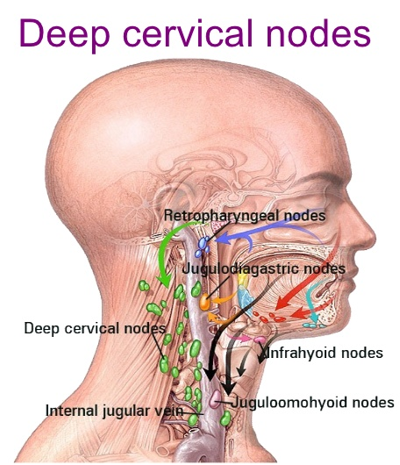
Lymph drainage of head and neck
All the lymph drainage from the head and neck goes to the deep cervical nodes.
They receive afferents from other lymph node groups in the head and neck as well as directly from organs in these regions.
Efferents from the deep cervical nodes form the jugular trunk which on the left drains into the thoracic duct and on the right into the right lymphatic duct.

Slide 10
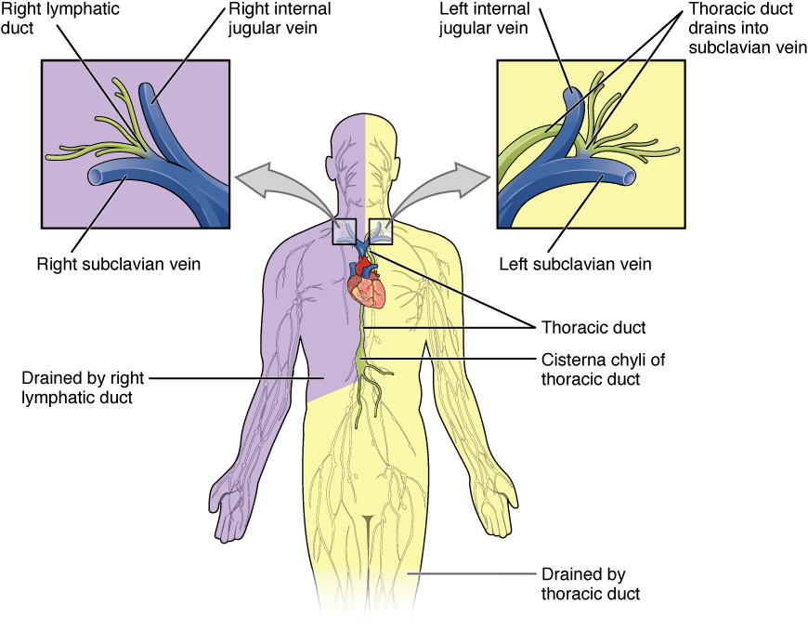
Lymph drainage of head and neck
The thoracic duct and
The right lymphatic duct
usually empty into the junction of the subclavian and internal jugular veins on their respective sides;
Otherwise they open into either of these veins.

Slide 11
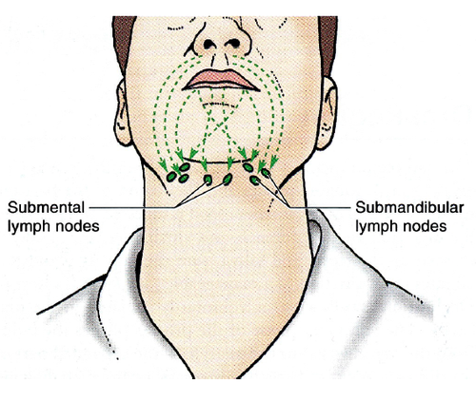
Lymph drainage of head and neck
There is a horizontal, encircling band of lymph node groups at the craniocervical junction.
Nodes in all these groups are clinically palpable when enlarged.
1: Submental Nodes lie across the midline, below the chin in the submental triangle
The other lymph node groups in the horizontal band are bilaterally represented.

Slide 12
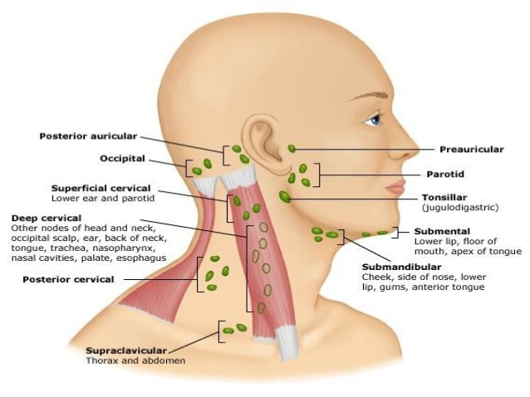
Lymph drainage of head and neck
2: Submandibular Nodes lie in the digastric triangle in relation to the submandibular salivary gland
3:Preauricular Nodes are found both superficial and deep to the fascial capsule of the parotid, as well as within the gland

Slide 13
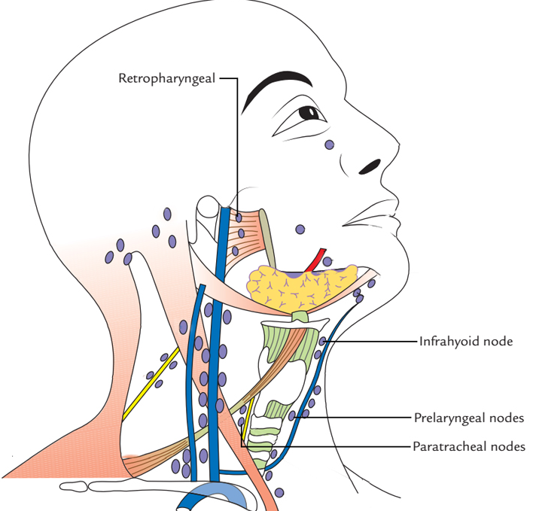
Lymph drainage of head and neck
4: A Small Mandibular Node is frequently present where the facial vessels cross the lower border of the mandible,
Buccal Node
5: A Small Buccal Node lie on the lateral surface of the buccinator.
Mandibular Node

Slide 14
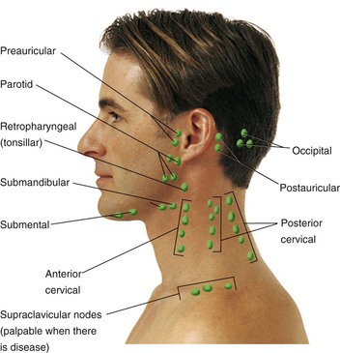
Lymph drainage of head and neck
6:One or two mastoid (postauricular) nodes lie on the mastoid process
7:two or three occipital nodes are present at the apex of the posterior triangle of the neck.

Slide 15
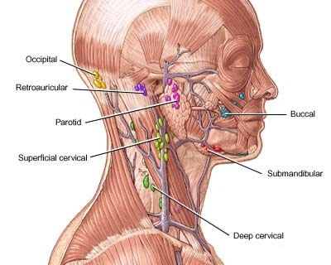
Lymph drainage of head and neck
8:A few superficial cervical nodes lie along the external jugular vein, on the superficial surface of the sternocleidomastoid, and drain the lobule of the auricle, floor of the external acoustic meatus and skin over the lower parotid region, as well as the lateral cervical skin.

Slide 16
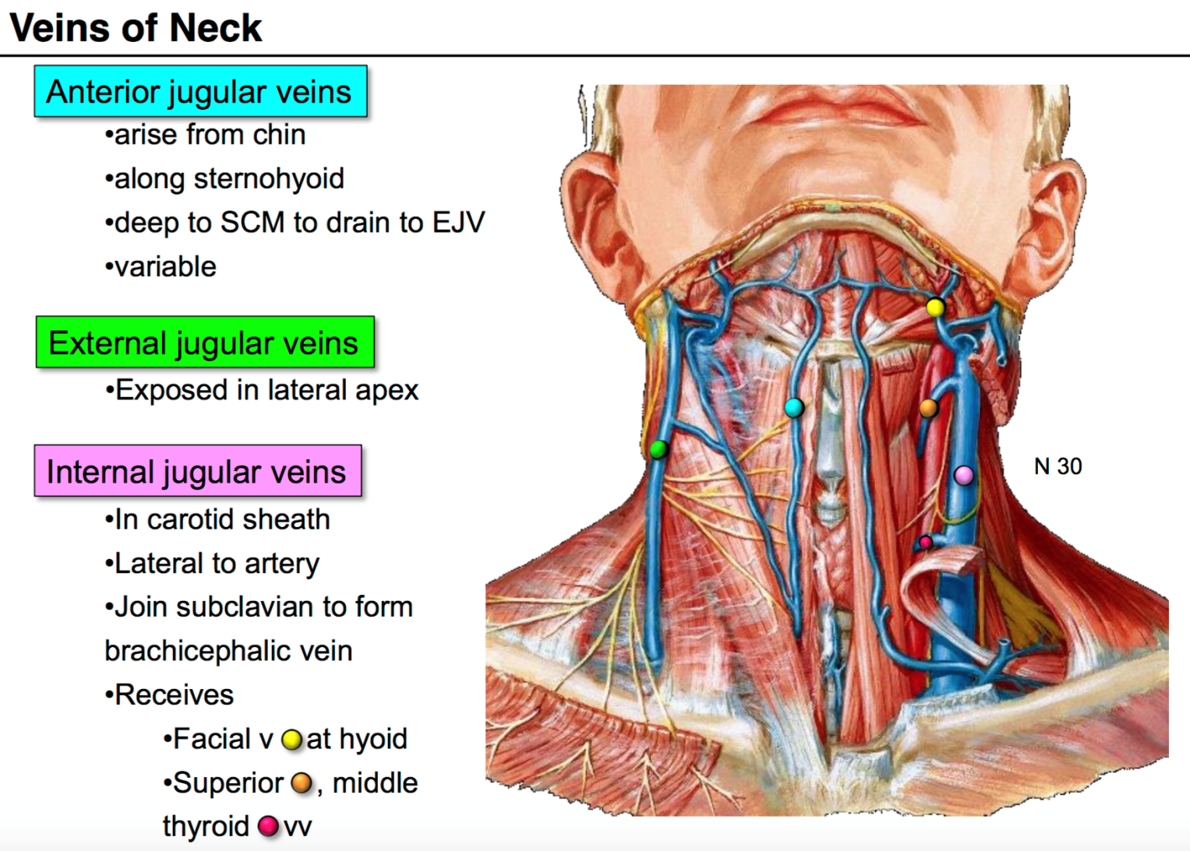
Lymph drainage of head and neck
Anterior cervical skin drains to a few superficially located anterior cervical nodes along the anterior jugular veins; one such node frequently lies in the suprasternal space.

Slide 17
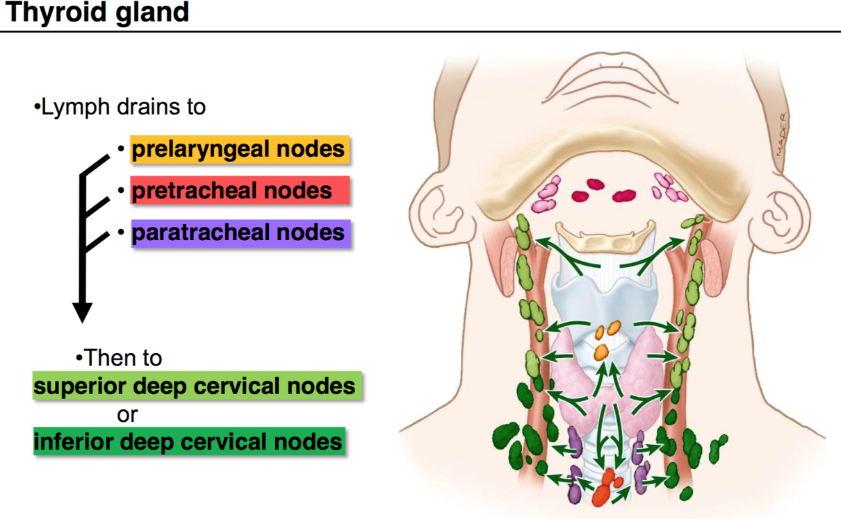
Lymph drainage of head and neck
Deep cervical lymph nodes, Arranged into 2 groups
1- In the middle line
2- On the side of the neck

Slide 18
Deep Cervical Lymph Nodes
1- In the middle line
Deep to the investing fascia at the front of the neck are
Infrahyoid nodes lying on the thyrohyoid membrane,
Prelaryngeal nodes on the cricothyroid membrane and
Pretracheal nodes on the tracheal rings.
They drain the anterior cervical nodes and receive lymph from the larynx, trachea and thyroid gland

Slide 19
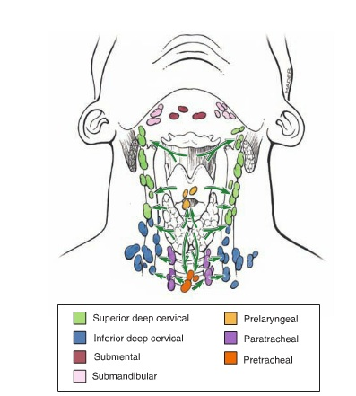
Deep Cervical Lymph Nodes
Paratracheal nodes on either side of the trachea and oesophagus receive lymph from pretracheal nodes and directly from the trachea and oesophagus.

Slide 20
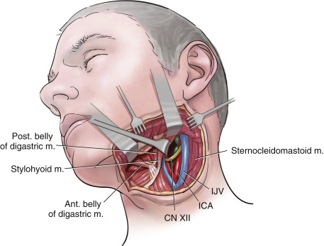
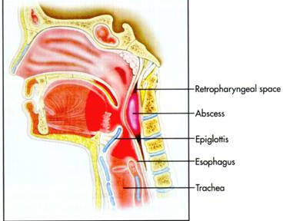
Deep Cervical Lymph Nodes
Retropharyngeal nodes lie posterior to the pharynx and anterior to the prevertebral fascia. They drain the pharynx, soft palate, posterior parts of hard palate and nose, and the cervical vertebrae. When enlarged, these nodes can cause difficulty in swallowing (dysphagia) due to pressure on the pharynx

Slide 21
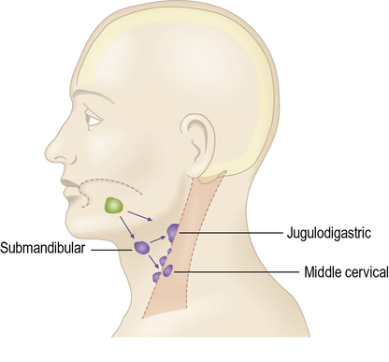
Deep Cervical Lymph Nodes
2- On the side of the neck
- These are the main lymph nodes in the neck.
- The lymph nodes are divided into 2 main groups,
A- The upper deep cervical lymph nodes.
- Along the upper part of the internal jugular vein deep to the sternomastoid muscle.
The most important one is called the ju­gulo-digastric Lymph nodes. They lie in the angle between the posterior belly of digastnic and the internal jugular vein.
It is concerned with the drainage of the tongue.

Slide 22
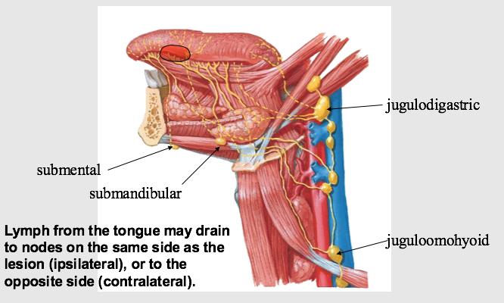
Deep Cervical Lymph Nodes
B- The lower deep cervical lymph nodes.
- Along the lower part of the internal jugular vein deep to the sternomastoid muscle.
- The most important one is called the jug­ulo-omohyoid lymph nodes. They lie in the angle between the intermediate tendon of omohyoid and the internal jugular vein.
It is concerned specially with the drainage of the tongue.
Efferent, The upper groups → lower groups → jugular lymph trunk

Slide 23
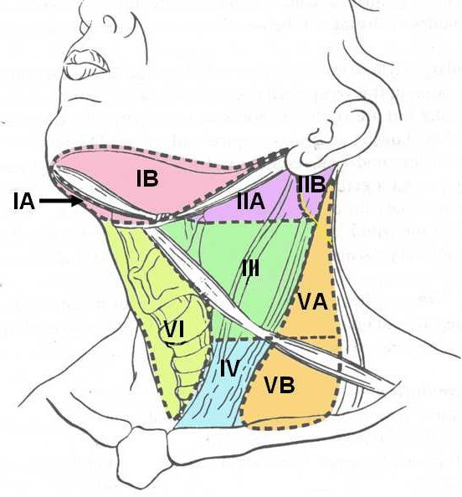
Surgical approach
Surgeons treating malignant lymph nodes in the neck tend to classify them by levels.
Level I nodes are in the submental and submandibular triangles
Level II–IV nodes are deep cervical nodes
Level II being from the base of the skull to the carotid bifurcation (hyoid bone),

Slide 24
Surgical approach
Level III from there to the intermediate tendon of omohyoid (cricoid cartilage), and
Level IV from there down to the clavicle and including the supraclavicular nodes.
Level V nodes are in the posterior triangle of the neck,related to the accessory nerve.
Level VI nodes are nodes surrounding the midline visceral structures and include the pretracheal and paratracheal nodes.
Level VII nodes are in the superior mediastinum.

Slide 25
Surgical approach
Classical radical neck dissection removed Level I–V nodes with the sternocleidomastoid muscle, internal jugular vein and accessory nerve.
Modified radical neck dissection (also called functional neck dissection) preserves some or all of these latter three structures.
Selective neck dissection removes some but not all Level I–V nodes.

Slide 26
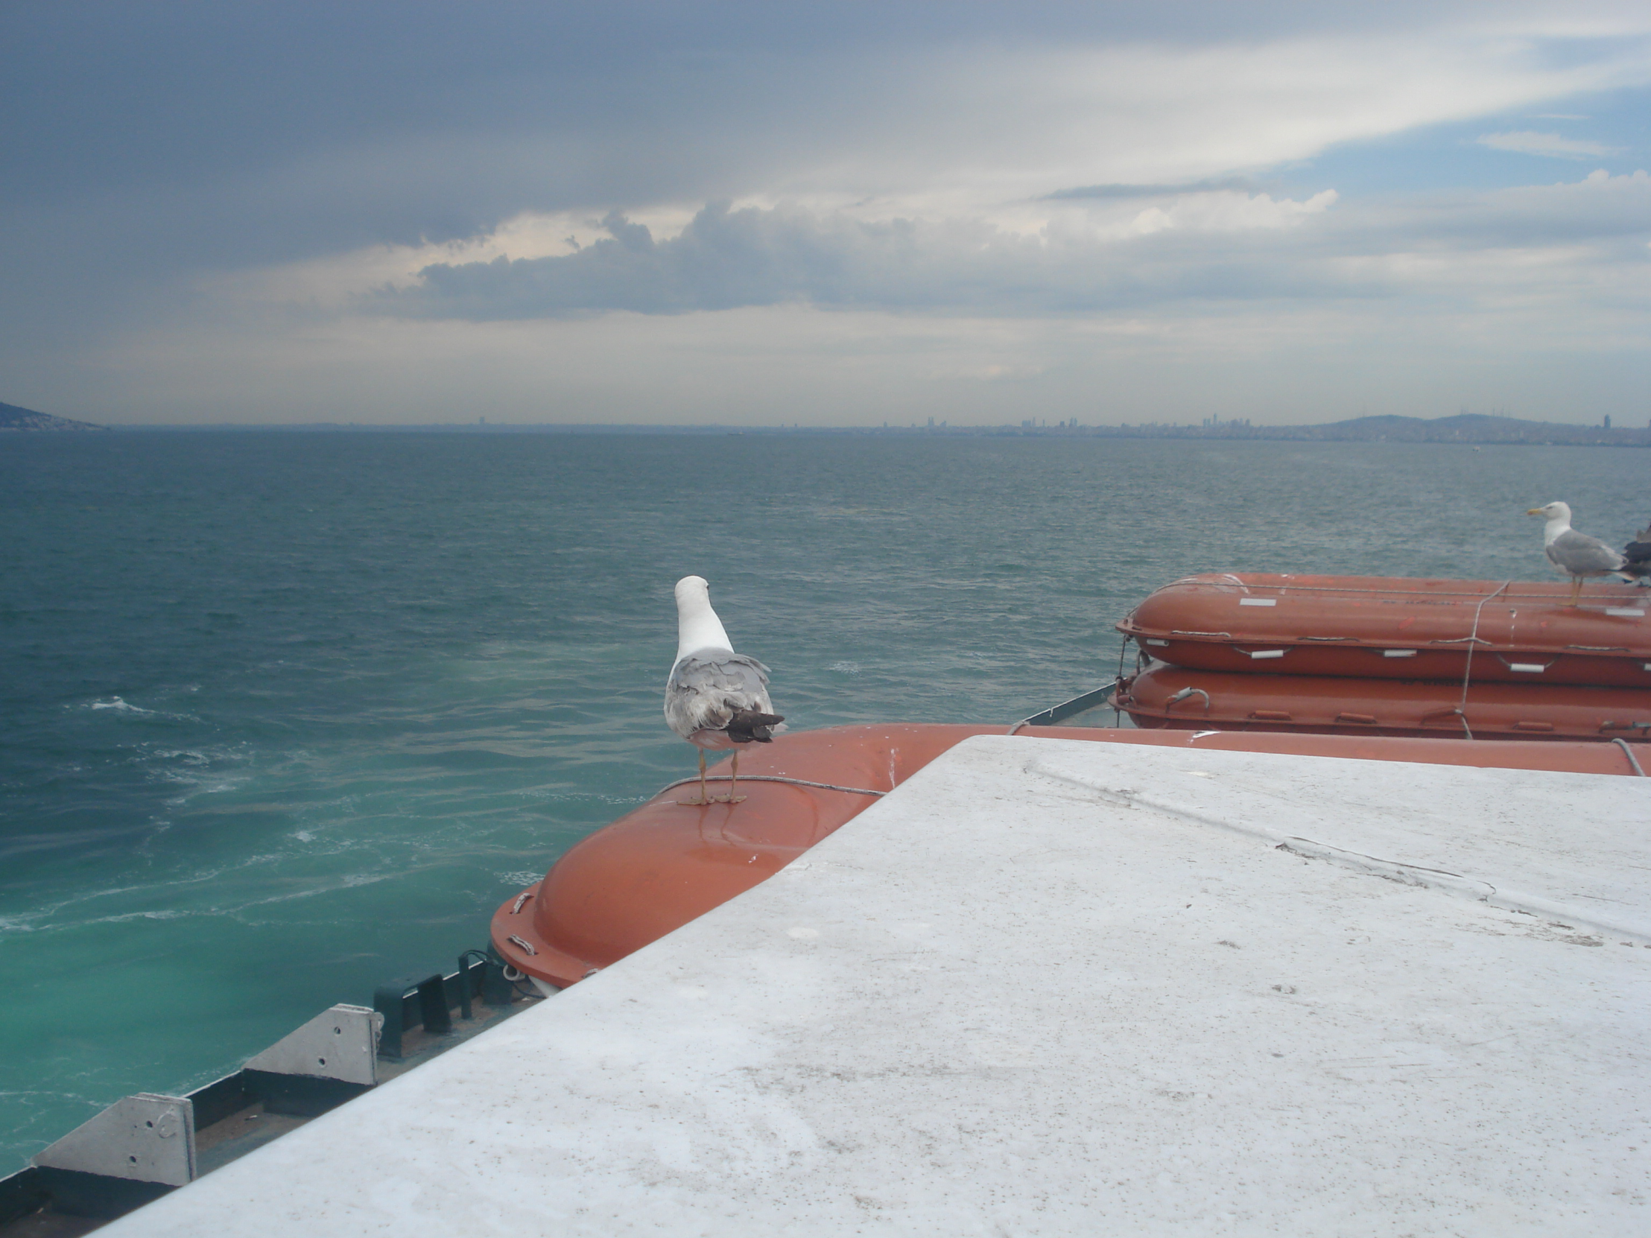
Dr. Aiman AL-Maathidy
Tuesday 3 April 2023

