Slide 1
Head Injury
Done By: Yara khaled yaseen

Slide 2
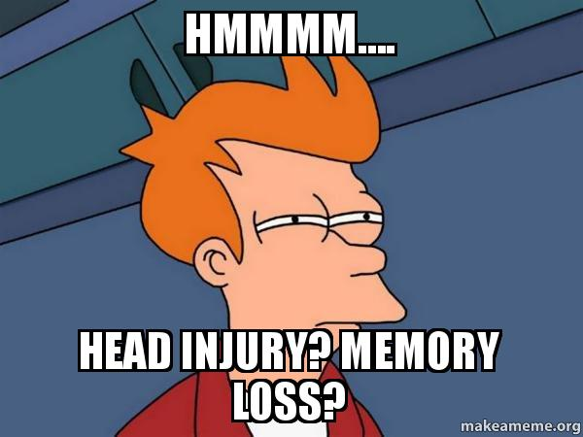
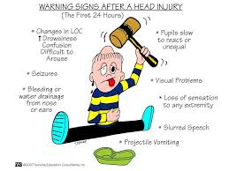
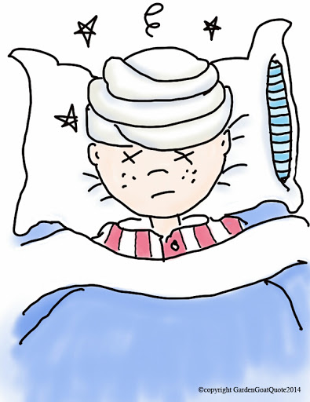
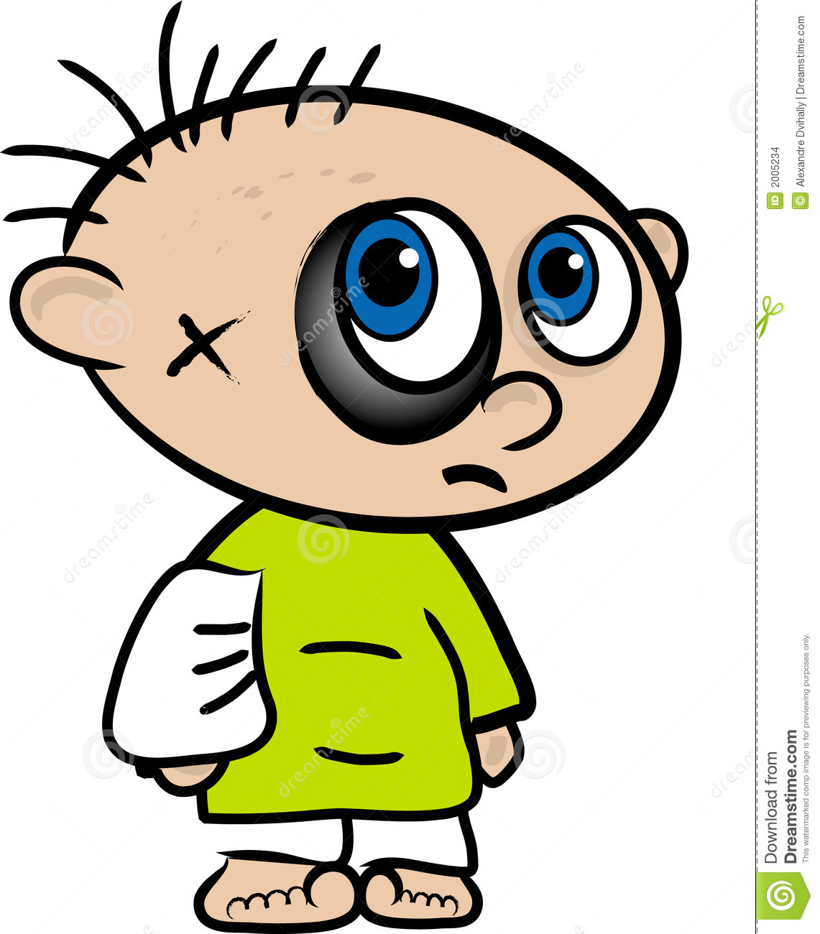
Definition
A head injury, as defined by the National Advisory Neurological Diseases and Stroke Council, is
a morbid state resulting from gross or subtle structural changes in the scalp, skull, and/or the contents of the skull, which is produced by mechanical forces. These injuries can range from a minor bump on the skull to serious brain injury.

Slide 3
Epidemiology
Third most common cause of death in the US.
Third most common cause of death in Jordan.
Number One Killer in Trauma.
More than 50% of all trauma deaths.
50% of all deaths from motor vehicle accidents.
200,000 people in the world live with the disability caused by these injuries.

Slide 4
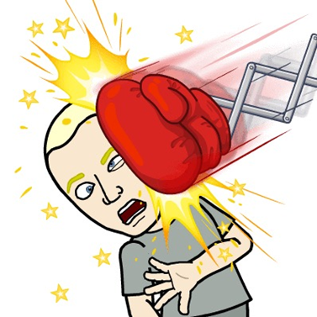
Traumatic brain injuries are more common in young patients, and men account for the majority (75%) of cases.

Slide 5
Etiology
32% of head injuries are caused by falls ,more common among the elderly people (>65 years) and in the very young (0-4 years).
17% by motor vehicle accidents, more common among adolescents and young adults (15-24) years.
16.5% by being struck or against something.
10% by assaults.
21% by other ways.

Slide 7
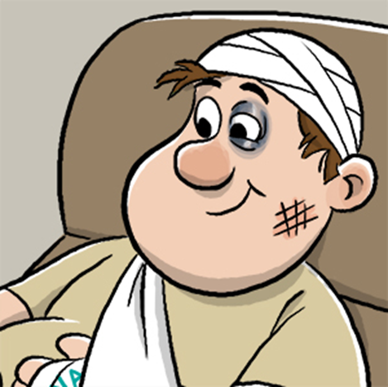
Classification
Head injuries can be classified broadly into:
Scalp injury.
Skull injury.
Brain injury.

Slide 8
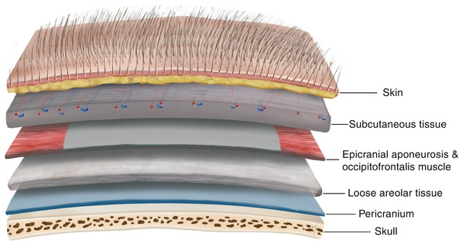
Scalp anatomy
The scalp has 5 layers:
Skin.
Connective tissue.
Aponeurosis.
Loose areolar connective tissue.
Pericranium.

Slide 9
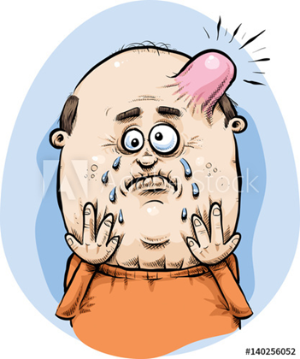
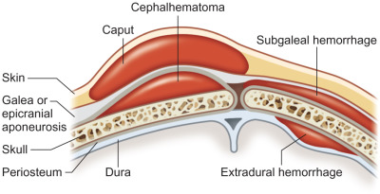
Scalp injury
It can manifest as:
Abrasion.
Bruising.
Laceration.
Subgaleal hematoma (subaponeuritic hematoma).
Subperiosteal hematoma (cephalhematoma).

Slide 10
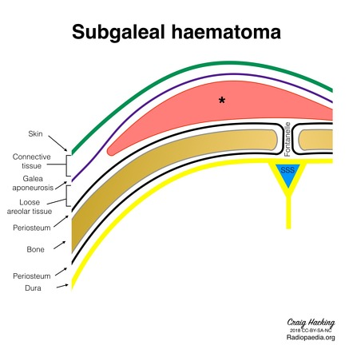
Subgaleal hematoma
Subgaleal hemorrhage or hematoma is bleeding into the potential space between the skull periosteum and the scalp galea aponeurosis.
Majority (90%) result from vacuum applied to the head at delivery (Ventouse assisted delivery).
Results from bleeding from the emissary veins into the loose connective tissue layer.

Slide 11
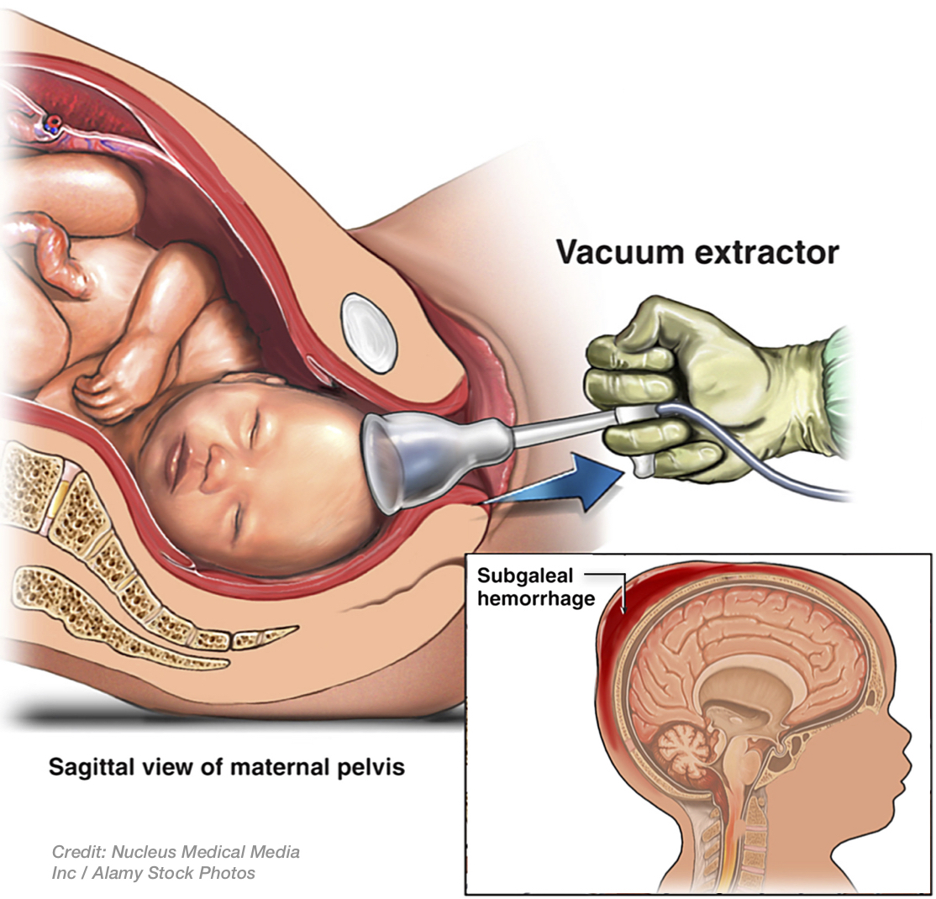
Subgaleal hematoma
It has a high frequency of occurrence with associated head trauma (40%), such as intracranial hemorrhage or skull fracture.
The occurrence of these features does not correlate significantly with the severity of subgaleal hemorrhage.

Slide 12
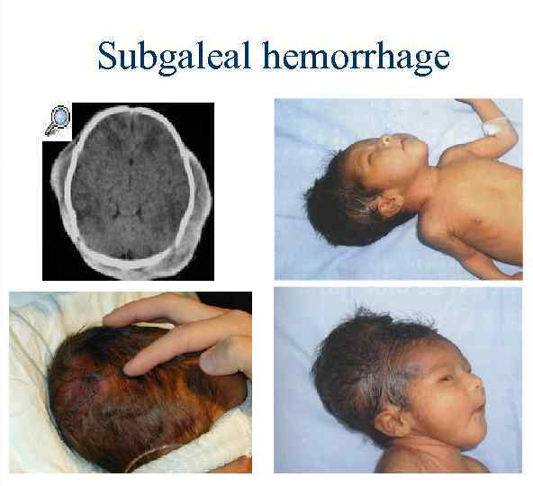
Subgaleal hematoma
The diagnosis is generally clinical with a fluctuant boggy mass developing over the scalp (especially over the occiput) with superficial skin bruising.
The swelling develops gradually 12–72 hours after delivery, although it may be noted immediately after delivery in severe cases.

Slide 13
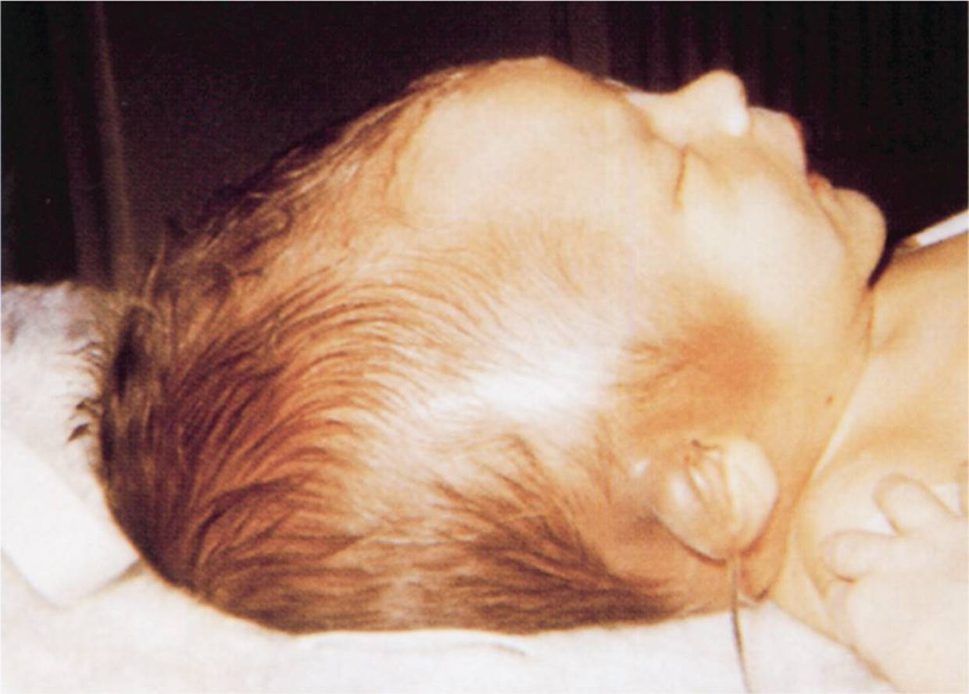
Subgaleal hematoma
Patients with subgaleal hematoma may present with hemorrhagic shock.
The swelling may obscure the fontanel and cross suture lines (distinguishing it from cephalohematoma).

Slide 14
Subgaleal hematoma

Slide 15
Subgaleal hematoma

Slide 16
Subperiosteal hematoma
Hemorrhage of blood between the skull and the periosteum secondary to rupture of a blood vessel crossing the periosteum.
Less extensive than subgaleal hematoma.
In 80% of cases treatement is conservative.

Slide 17
Subperiosteal hematoma
Its firmer than the subgaleal hematoma.
Scalp moves freely over the mass.
Mostly doesn’t cross the midline.
Observe, give good analgesia and avoid aspiration in newborns.

Slide 18
Subperiosteal hematoma

Slide 19
Subperiosteal hematoma

Slide 20
Comparison

Slide 21
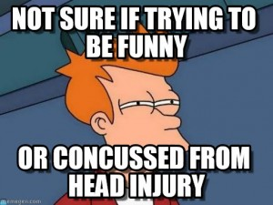
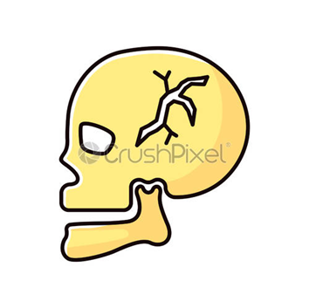
Skull Injury

Slide 22
Skull fractures
A skull fracture is a break in one or more of the eight bones that form the cranial portion of the skull, usually occurring as a result of blunt force trauma.
If the force of the impact is excessive, the bone may fracture at or near the site of the impact and cause damage to the underlying physical structures contained within the skull such as the membranes, blood vessels, and brain, even in the absence of a fracture.

Slide 23
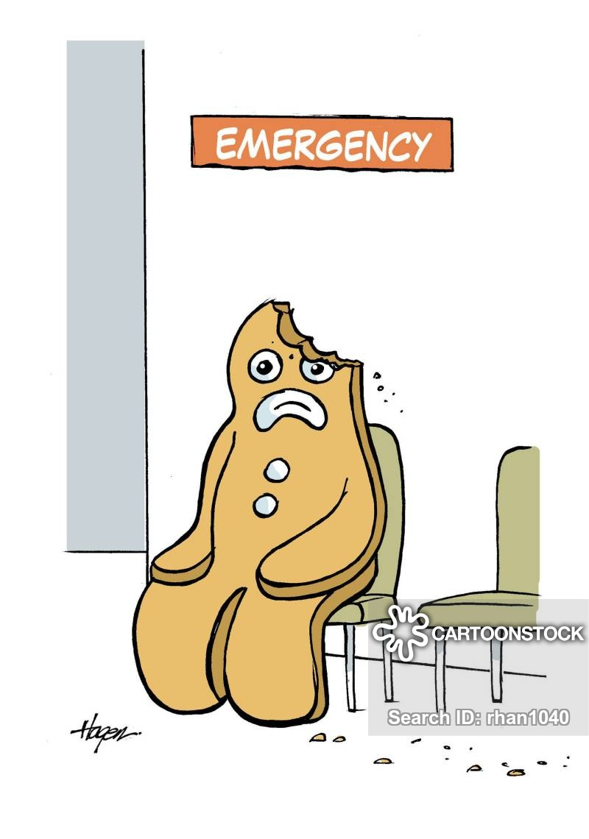
Skull fractures
There are two major types of skull fractures:
Linear fractures which are the most common.
Depressed fractures.

Slide 24
Linear skull fractures
Most common of skull fractures (90%).
Usually straight and involve no displacement of the bone.
The common method of injury is blunt force trauma.
Are usually of little clinical significance unless they parallel in close proximity or transverse a suture, or they involve a venous sinus groove or vascular channel.
Usually require no intervention.

Slide 25
Linear skull fractures

Slide 26
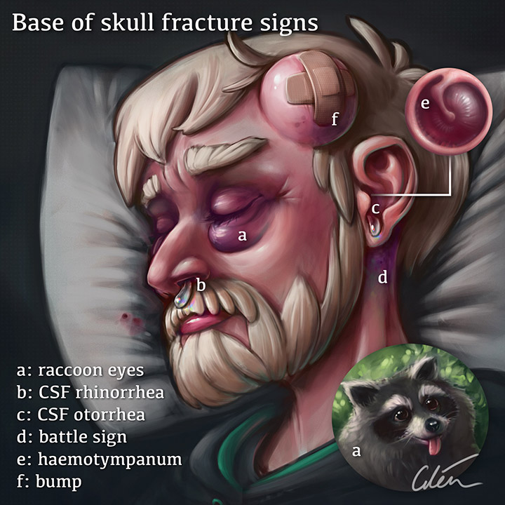
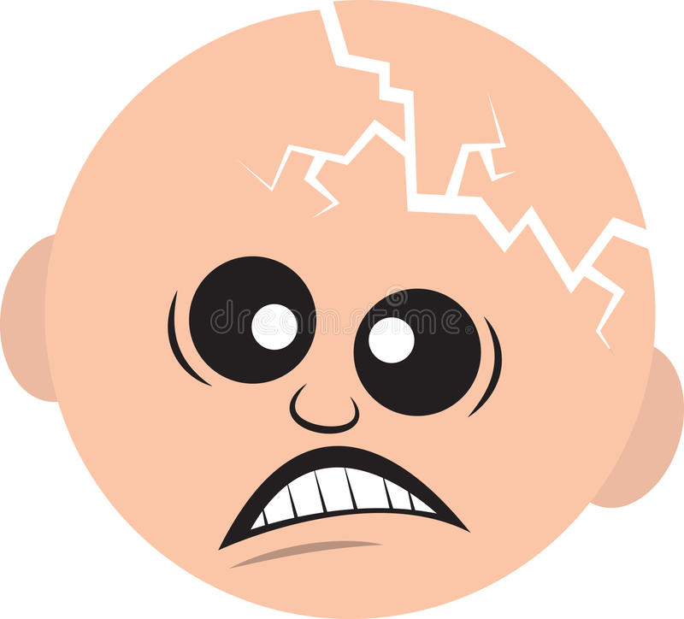
Linear skull fractures
According to their site, linear skull fractures may be called:
Basilar skull fractures.
Diastatic skull fractures.

Slide 27
Thank you
Hope you enjoy it !

Slide 28
Head injuries
AHMAD AL ABBADI

Slide 29
Basilar fractures
Are basically linear fractures that occur in the skull base.
May occur separately or as an extension of fractures of the vault.
They require more force to cause than other areas of the neurocranium; thus they are rare (4%).

Slide 30
Basilar fractures
Usual locations are:
Petrous part of temporal bone.
Orbital surface of frontal bone.
Basioocciput

Slide 31
Basilar fractures
They have characteristic signs:
hemotympanum
CSF leaking from the nose (rhinorrhea) or ears (otorrhea).
Periorbital ecchymosis often called raccoon eyes.
Retroauricular ecchymosis known as Battle's sign (bruising over the mastoid process).

Slide 32
Basilar fractures
Treatment:
Conservative :
Admit the patient.
stabilize airway, ventilation, and circulatory issues is the priority.
cervical spine immobilization
Neurological assessment every 2hrs.
Antibiotics.
Surgery: if there’s
Traumatic aneurysms.
Posttraumatic carotid cavernous fistula.
Meningitis or cerebral abscess.
Facial palsy.
Cosmetic deformities.

Slide 34
Battle’s sign

Slide 35
Racoon eyes

Slide 36
Diastatic fractures
Occur when the fracture line transverses one or more sutures of the skull causing a widening of the suture.
While this type of fracture is usually seen in infants and young children as the sutures are not yet fused it can also occur in adults.
When a diastatic fracture occurs in adults it usually affects the lambdoidal suture as this suture does not fully fuse in adults until about the age of 60 years.

Slide 37
Diastatic fractures

Slide 38
Depressed fractures
Depression beneath the vault.
Can be open or closed.
2 types:
One piece fracture.
Comminuted fracture (multiple pieces).

Slide 39
Depressed fractures
Treatment could be:
Conservative.
Elevation.
Craniectomy with immediate/delayed cranioplasty.

Slide 40
Depressed fractures
Criteria to elevate a depressed skull (surgical management):
Fracture is more than the thickness of the skull.
CSF leak.
Seizures.
Compound wounds.
Neurological signs.
Cosmetic.
Overlying an eloquent area of the brain.

Slide 41
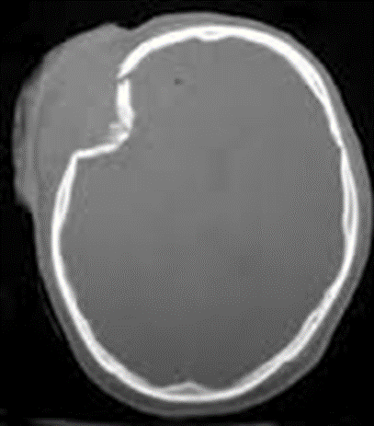
Depressed fractures

Slide 42
Brain injury

Slide 44
Primary brain injury
Primary brain injury occurs at the time of trauma.
It results from external mechanical forces transferred to intracranial contents.
The damage that results includes a combination of focal contusions and hematomas, as well as shearing of white matter tracts (diffuse axonal injury) along with cerebral edema and swelling.

Slide 45
Primary brain injury
Common mechanisms include:
Direct trauma.
Acceleration/ deceleration injuries.
Shearing forces.

Slide 46
Direct trauma
Can be classified into:
Closed Head Injury: no penetration of the skull (blunt).
Open head Injury: bullet, knife, or fracture (penetrating).
Here we have direct injury to the brain under the site of the impact.

Slide 47
Acceleration/ deceleration injuries
The skull has a minimal space for the brain to move within.
Here the brain is thrust against the skull opposite to the blow site due to the sudden movement of the brain inside the skull.
Also called coup-contrecoup injuries.
In old age patients, if the brain is atrophied, the insult is more severe, because of more space for movement.

Slide 48
coup and contrecoup injury
Damage may occur directly under the site of impact, or it may occur on the side opposite the impact (coup and contrecoup injury, respectively). When a moving object impacts the stationary head, coup injuries are typical, while contrecoup injuries are usually produced when the moving head strikes a stationary object

Slide 49
coup and contrecoup injury

Slide 52
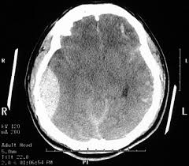
subdural
epidural

Slide 53
Thank you

