Slide 1
Circumcision Omar Abu Tawileh Suhayb Hussein Tareq Shdefat

Slide 2
Foreskin
-The foreskin is the double-layered fold of smooth muscle tissue, blood vessels, neurons, skin, and mucous membrane part of the penis that covers and protects the glans penis and the urinary meatus. It is also described as the prepuce
-The foreskin is mobile, fairly stretchable, and acts as a natural lubricant, and is linedup by an external keratinized layer and an internal mucosal layer .

Slide 3
-The foreskin contains a sheath of muscle tissue just below the skin(Dartos fascia)
which continue into the prineum and fuses with the superficial perineal fascia (colle )
In the penis the dartos fascia is loosely attached to skin and deep penile fascia (buck) and contains the superficial arteries ,vein and nerves of penis .
The foreskin is attached to the glans by a frenulum.
Notes:
- The outer surface of the prepuce is skin (keratinized layer ), however the inner surface is mucosal membrane although it resembles skin in appearance. There is a muco-cutaneous boundary just inside the tip of the prepuce.
3

Slide 4
The pouch thus created can collect desquamated epithelial cells forming the so called keratin pearls in infants and toddlers (not infectious ). In adolescence cellular debris and local secretion collect in the form of smegma if the penis not cleaned regularly .

Slide 6
Function of foreskin
functions including keeping the glans moist, protecting the developing penis in utero, or enhancing sexual pleasure due to the presence of nerve receptors .The foreskin helps to provide sufficient skin during an erection.
The foreskin protects the glans of infants from ammonia and feces in diapers, which reduces the incidence of meatal stenosis, and continues to protect the glans from abrasions and trauma throughout life.

Slide 7
-Arterial supply :Dorsal artery of the penis branch of internal pudendal artery
-Venous drainage : dorsal veins of the penis (superficial and deep dorsal veins)
-Nerve supply: Innervation of foreskin is complex ,the dorsal nerve of penis (deepest division of the pudendal nerve ) and branches of perineal nerve provide somatosensory input whereas outonomic innervation comes primarily from the pelvic plexus .
The foreskin contains Meissner's corpuscles, which are nerve endings involved in fine-touch sensitivity. They are most concentrated in the "ridged band

Slide 8
the foreskin is adherent to the glans penis. These adhesions separate spontaneously with time, allowing the foreskin to become retractile. At 1 year of age, about 50% of boys have a non-retractile foreskin. By 4 years this has declined to 10% and by 16 years to just 1%. Ballooning of the normal non-retractile foreskin may occur with micturition. Gentle retraction of the foreskin at bath times helps to maintain hygiene. The presence of preputial adhesions, when the foreskin remains partially adherent to the glans, is normal and resolves spontaneously.

Slide 9
Circumcision
Circumcision is a surgical procedure to remove the foreskin
Indications for Circumcision :
A- on request by the parents for religious, cultural or hygienic reasons.
B- medical indication:
1 -Recurrent urinary tract infection. Circumcision is occasionally justiﬁed in boys with an abnormal upper urinary tract and recurrent urinary infection. It may also help boys with spina biﬁda (neurogenic bladder) who need to perform clean, intermittent urethral catheterisation or children with poorly emptying urinary tracts .
2-Recurrent balanitis( inflammation of the glans) and posthitis

Slide 10
3. Prevention of sexually transmitted infections (syphilis ,HIV) .
4.prevention of penile cancer
5. Phimosis :inability to retract the foreskin because of the narrowed preputial opening , two types:
- physiologic phimosis (until progressive keratinization )
- acquired phimosis occurs as a result of poor hygiene , chronic balanitis or repetitive forceful retraction of foreskin which eventually leads to the formation of fibrotic ringof tissue close to opening of the prepuce which prevent s retraction to expose the glans .
6.Paraphimosis(urologic emergency ):the foreskin is not pulled back over the glans after retraction .A tight constricting band causing a swelling of the distal penis and acute discomfort

Slide 11
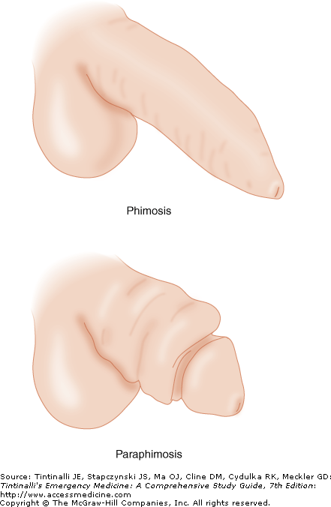

Slide 12
Contraindications
1. Circumcision is contraindicated in infants with certain genital structure abnormalities:
Hypospadias (urethral meatus on the ventral aspect of the penis)
Epispadias (rare malformation in which the urethra ends in an opening on the upper aspect of the penis )
Chordee (head of the penis curves upward or downward )
Webbed penis (scrotal skin extends onto the ventral penile shaft )
ambiguous genitalia, because the foreskin may be needed for reconstructive surgery

Slide 13
Buried penis (normal size but hidden under the skin of the abdomen ,thigh or scrotum )
Penis torsion
Micropenis
2. premature infant
3. failure to thrive
4. ill baby
* Bleeding disorder as hemophilia are not absolute contraindications for circumcisions should be discouraged in these cases .

Slide 14
Complications of circumcision

Slide 15
complications
The most common complications of male circumcision are bleeding and local infection followed by unsatisfactory cosmetic results (too little or too much skin removed) and surgical trauma or injury
Rare but significant complications include life-threatening sepsis and meningitis, buried penis due to cicatrix formation, amputation of the glans, and necrotizing fasciitis

Slide 16
SURGICAL COMPLICATIONS
Urethral injuries
Glans injury
Removal of excessive skin
Inadequate skin removal
Epidermal inclusion cyst
Abnormal scarring, resulting in adhesions, cicatrix, or penile curvature
Anesthetic complications

Slide 17
bleeding
The first step to control minor bleeding is the application of firm manual pressure for 10 to 20 minutes, followed by compression dressing or carefully applied circumferential bandage.
If this fails to stop the bleeding, the next step is the topical administration (1 cc on a moist sponge) of 1:100,000 lidocaine with epinephrine
If a specific bleeding vessel can be identified, then fibrin glue and/or silver nitrate can be directly applied
If bleeding continues, fine absorbable sutures can be placed if a discrete source is visualized

Slide 18
Tareq Shdefat
Circumcision compilcations

Slide 19
Infection
It is usually mild and manifested by local inflammatory changes typically resolve with local topical triple antibiotic ointment.
fever, irritability or poor feeding suspect systemic infection treat by systemic antibiotics and surgical debridement.

Slide 20
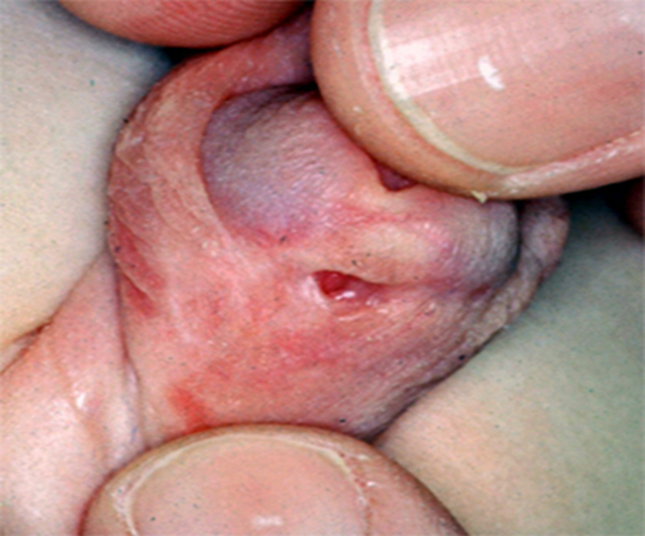
Urethrocutaneous fistulas
Fistula correction requires a second operation that is performed six months after the initial procedure. These repairs are generally cosmetically and functionally successful

Slide 21
Meatal stenosis
Treatment involves office or operating room meatotomy where a few millimeters of the ventral lip of the meatus are divided. Sutures are then usually used to reapproximate the cut edges.

Slide 22
Glans injury
If the glans is amputated, the tissue should be wrapped in saline-soaked gauze and placed indirectly on ice for transport. The patient should be transferred immediately to a referral center, as successful reattachment is possible if performed within eight hours of injury.

Slide 23
Newborn penile glans amputation during circumcision and successful reattachment.
(A) Glans and foreskin amputated specimen.
(B) Graft anastomosis with stent.
(C) Three-month follow-up with good cosmesis and function

Slide 24
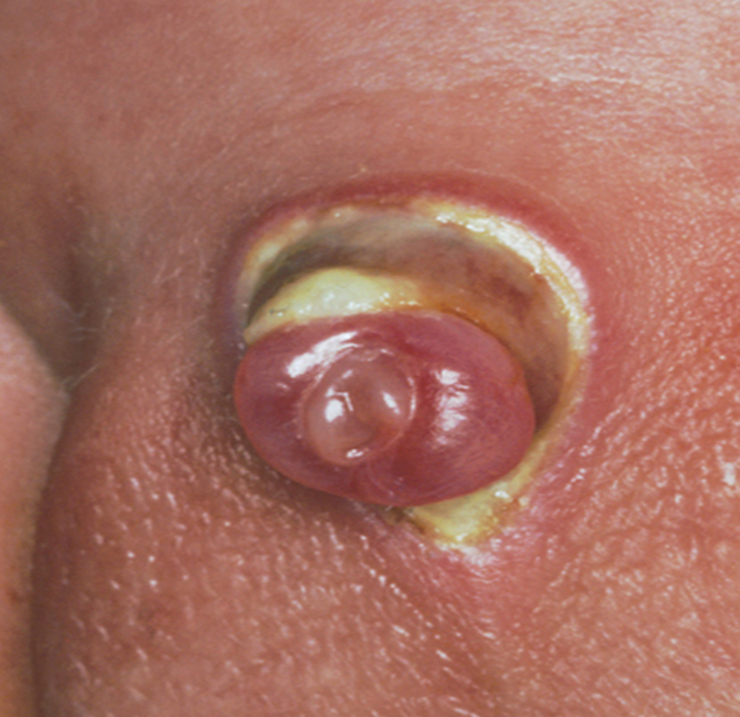
Excessive skin removal
In many cases, conservative therapy consisting of wet to dry or antibiotic ointment dressings results in adequate healing by secondary intention

Slide 25
Too little skin removed

Slide 26
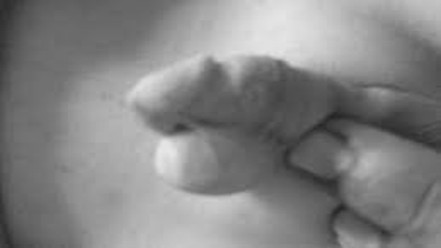
Epidermal inclusion cyst
occurs when an island of skin is left to heal underneath the skin of the penile shaft. Cysts usually are diagnosed by physical examination. Treatment consists the entire cyst.

Slide 27
Minor adhesions
These adhesions usually resolve with time Gentle retraction can be used to lyse the adhesion, followed by application antibiotic ointment for one week to prevent new adhesions from developing. If gentle traction is not effective, betamethasone 0.05 percent which are used to treat adhesions in patients with phimosis

Slide 28
Minor adhesions

Slide 29
Hidden penis
Circumcision in obese children or those with a relatively small phallus is generally discouraged during infancy because of the tendency for the penis to become Hidden

Slide 31
circumcision – methods Suhayb Hussein

Slide 32
Clomp techniques
Free-hand technique

Slide 33
Clamp techniques
Generally utilized for neonatal circumcision.
Most appropriate when infant is under 4-6 weeks of age and under 12 pounds .

Slide 34
Free-hand techniqe
Performed in operating room.
Requires general anesthesia for children .
Lower complication.
Performed after 3 months gestational age.

Slide 35
Types of clamps
Gomco clamp
Plastibell clamp
Mogen clamp
higher bleeding risk with gamco
Higher site injuries and serious complication with plastibell
Higher injury rates to the tip of the penis injuries with mogen

Slide 37
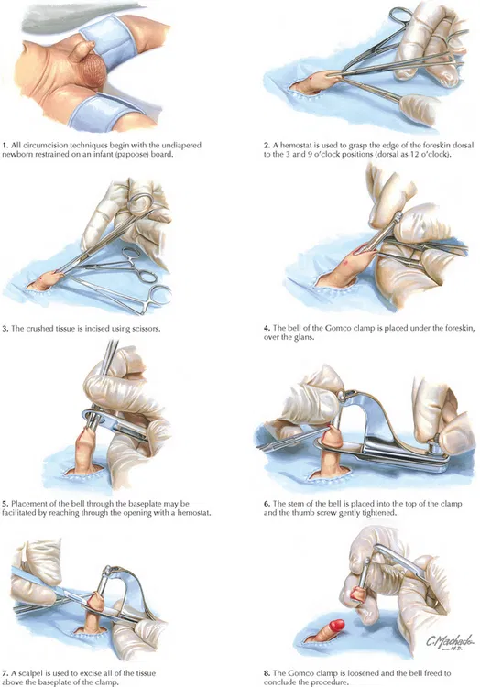
Gomco clamp
Foreskin drawn up into the clamp over the bell, the arm is being connected to the bell , then gets screwed down ,we excise the sleeve of foreskin.

Slide 38
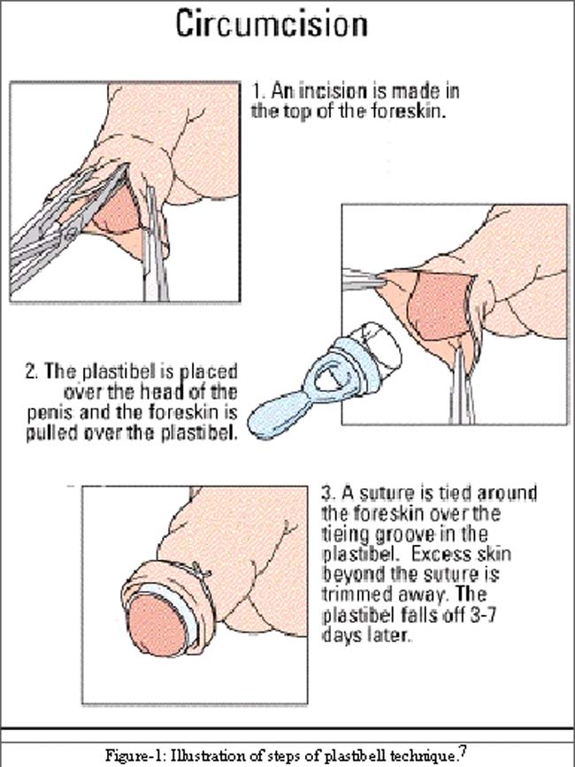
Plastibell clamp
An incision is made in the top of the foreskin.
The plastibel is placed over the head of the penis and the foreskin is pulled over the plastibel
A suture is tied around the foreskin, falls off 3-7 days later.

Slide 39
THANK YOU

Slide 40
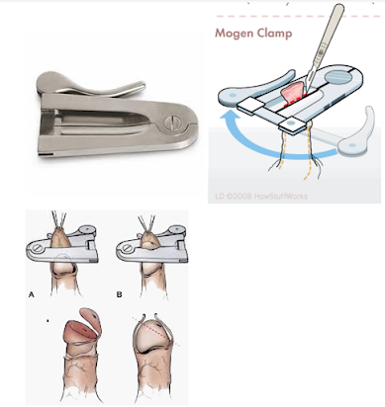
Mogen clamp
After adhesions inside the foreskin are reduced.
The foreskin is drawn up into the clamp.
The clamp compressed down, and the foreskin is excised.

