Slide 1
Thyroid gland

Slide 2
Thyroid gland
Structure
Stroma
Thyroid gland is covered by a double capsule
Outer: deep cervical fascia
Inner: true CT capsule
incomplete septa , reticular fibers
lobules surrounded by interlobular connective tissue, and each lobule is composed of a number of follicles

Slide 3
Thyroid gland
Parenchyma
1. Follicles
2. Blood vessels
Thyroid capillary beds SEM

Slide 4
Parenchyma
Follicles the structural and functional building block of the thyroid gland spherical in shape
separated by scant interfollicular connective tissue.
Lining epithelium of the follicles
Follicular cells
Parafollicular (clear) cell
Interfollicular cells

Slide 5
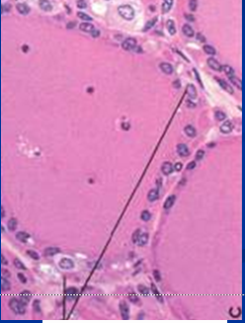
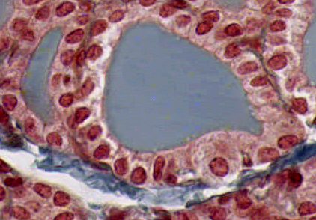
Thyroid epithelial cells
Follicular cells:
a simple cuboidal epithelium (variable - depending on the functional state) not secreting T3/T4 (inactive), the epithelial cells range from low columnar to cuboidal cells. When active, the epithelial cells become tall columnar cells.
Parafollicular cells
(or "C cells") parafollicular cells are scattered among follicular cells and in spaces between the spherical follicles, they secrete calcitonin. –large, pale stain and few in number
No direct contact with the follicular lumen. They are always situated within the basement membrane, which surrounds the entire follicle

Slide 6
 | Follicular cells | Parafollicular cells
Size | smaller | larger
Number | numerous | Few
Extension | Reach the lumen | Do not
Stain | basophilic | pale
Secretion | Stored extracellularly in the lumen Secrete T3 &T4 | Stored intracellularly in small basal secretory granules Secrete calcitonin
Lysosomes & phagosomes | abundant | Few in No
Notes:
6

Slide 7
Parafollicular cells
Parafollicular
cells
Clusters of
Parafollicular
cells

Slide 8
Interfollicular cells

Slide 9
Follicular cells synthesis of T3 & T4
The colloid is the secretory product of the follicular cell (extracellular storage). Its main component, thyroglobulin
consists of T3 and T4.
rER , golgi apparatus , exocytotic vesicles
Synthesis & dischargeThyroglobulin into the lumen
Follicular cells trap the iodide and liberate it as iodine in the follicular lumen
iodination takes place extracellularly.
reabsorb thyroglobulin.
hydrolyse thyroglobulin to thyroxine by lysosomes
thyroxine which is released into the fenestrated blood capillaries

Slide 10
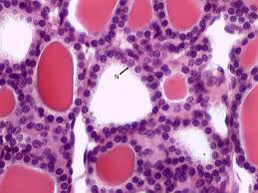
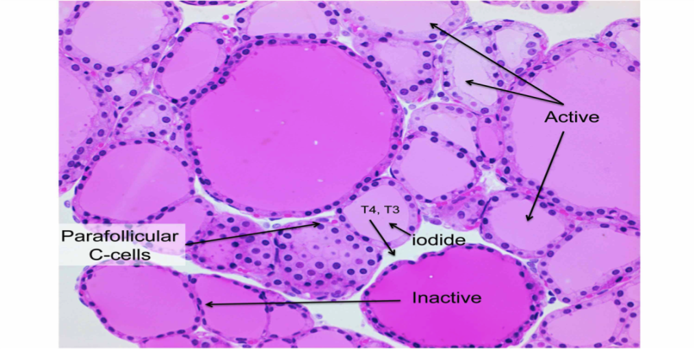
Functional states of thyroid follicles
(hypoactive)
Normal
(hyperactive)
Iodine deficiency goiter
Hypertrophy of thyroid gland
↓ iodine in diet →↓ T3 &T4 →↑ TSH
Hypothyroidism
In children → cretinism (dwarf & mental retardation)
In adults → myxedema
Hyperthyroidism (thyrotoxicosis)
Grave’s disease or exophthalmic goiter
autoimmune disorder

Slide 11
Parathyroid gland

Slide 12
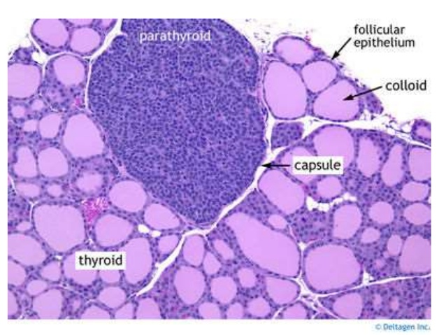
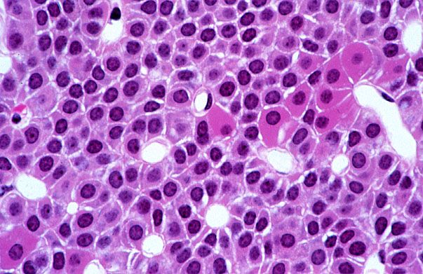
Parathyroid gland
Stroma :
C.T. capsule
Each parathyroid gland is surrounded by a thin connective tissue capsule, delicate connective tissue septa , a considerable number of fat cells infiltrate the gland
Parenchyma :
Two types of cells arranged in cords , separated by blood vessels
Chief cells
Oxyphil cells

Slide 13
 | Chief cells (principal) | Oxyphil cells
size | Small polygonal | Large polygonal
number | numerous | few
Stain | Faint acidophilic | Deep acidophilic
nucleus | Large vesicular | Small dense
rER | more | few
Function | Parathyroid hormone (↑ Blood Ca level) | unknown
Notes:
13

Slide 14
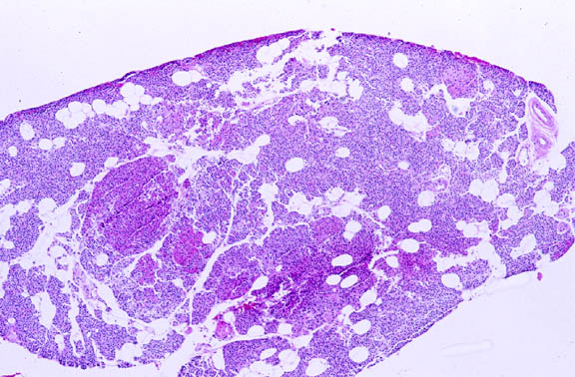
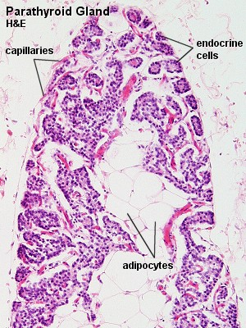
Parathyroid gland in old people
Increase in fat cells
Increase in oxyphil cells
Notes:
14

Slide 15
Regulation of blood calcium level
↓ Blood Ca level ↑ PTH → ↑ Blood Ca level through:
bone: ↑ osteoclasts
kidney: ↑ Ca reabsorption
intestine: ↑ Ca absorption
↑↑ Blood Ca level ↑ Calcitonin ↓↓ Ca level by ↓activity of osteoclast
Notes:
15

Slide 16
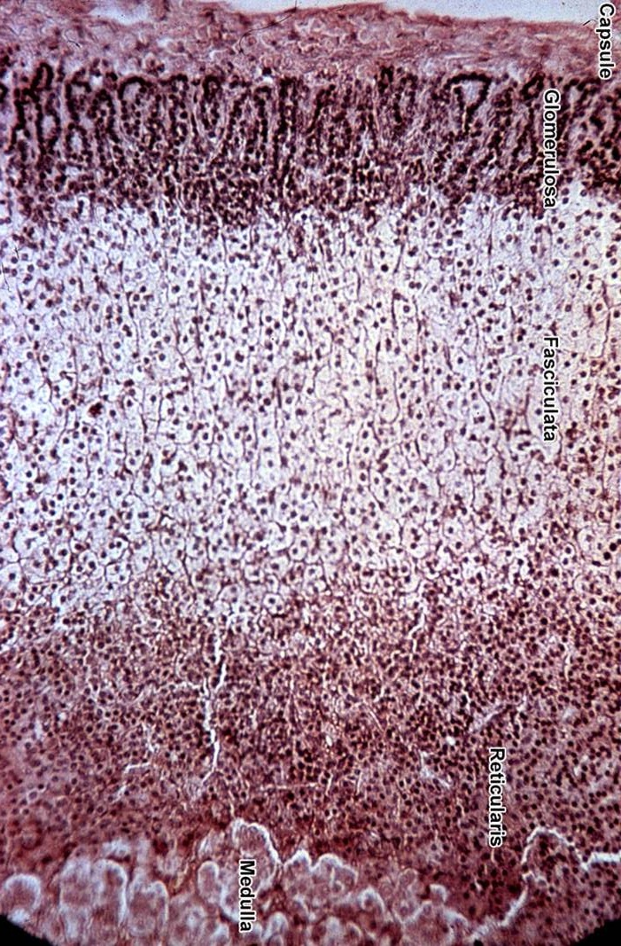
ADRENAL GLANDS or suprarenal gland
Notes:
Part 2 start here *-*

Slide 17
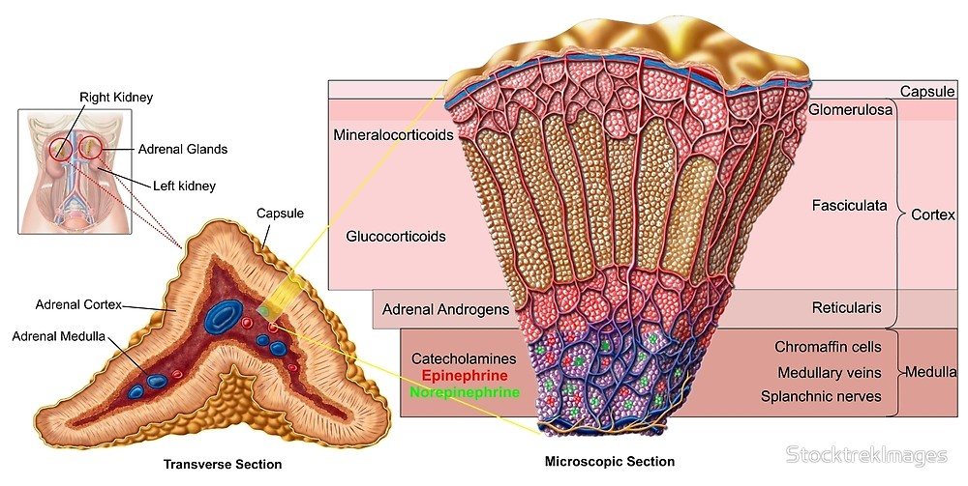

Slide 18
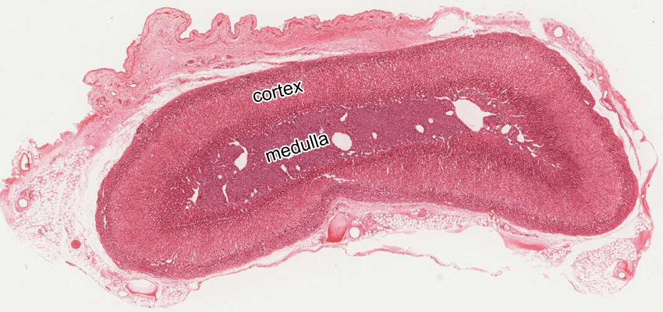
Stroma : The gland is surrounded by a thick connective tissue capsule.
Vessels and nerves reach the medulla by way of connective tissue trabeculae which extend from the capsule towards the medulla.
Parenchyma : consist of
outer cortex (the main part)
inner medulla 10%
 | Cortex | Medulla
Colour | Yellow | Reddish-brown
Position | Peripheral | Central
Origin | Coelomic mesoderm (mesodermal) | Neural crest (ectodermal)

Slide 19
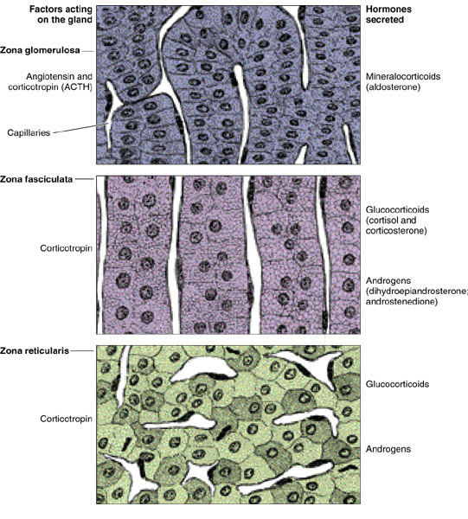
Zones of the cortex
zona glomerulosa (15%)
small rounded cells groups (clusters) or curved columns.
mineralocorticoid
2- zona fasciculata (65%)
consists of radially arranged cell cords separated by fenestrated sinusoid capillaries.
has a characteristic foamy or spongy appearance (lipid droplets) spongiocytes
Glucocorticoids
3- zona reticularis (7%).
like zona fasciculata but with fewer lipid droplets
Irregular cords
glomerulosa
fasciculata
reticularis

Slide 21
Cortex | Z. Glomerulosa | Z. Fasciculata Spongiocytes | Z. Reticularis
% of volume | 15% | 65% | 7%
Shape of cells Arrangement | Columnar or pyramidal cells Closely packed rounded or arched clusters | Polyhedral Cords 1 or 2 cell thick | Polyhedral Anastmosing Irregular cords
Cytoplasm (Acidophilic) | Slightly vacuolated | Numerous vacuoles (spongiocytes) | less
Lipid droplets | few | numerous | less
Function | mineralocorticoids | glucocorticoids | Sex hormones
Notes:
21

Slide 22
Cells in adrenal cortex are steroid secreting cells
Extensive smooth ER
Numerous mitochondria
Lipid droplets
Spongiocytes in zona fasiculata (highly vacuolated cells due to lipid droplets)

Slide 23
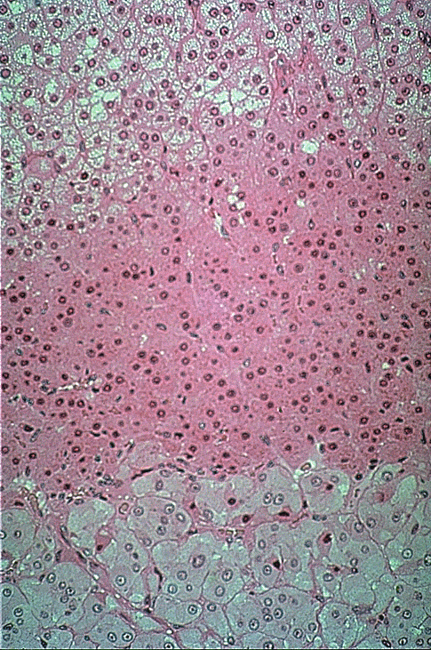
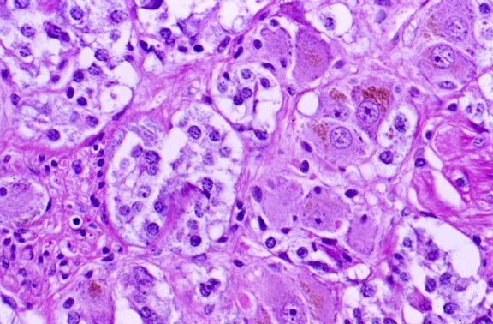
Adrenal medulla
-not sharply demarcated from the cortex.
-Cells are arranged in cords or small clusters with capillaries and venules,
-It includes 3 types of cells:
1- Chromaffin cells
2- Sympathetic ganglion cells
3- Lymphocyte like cells
chromaffin cells, granules of these cells can be stained with potassium bichromate.
-Catecholamines adrenaline and noradrenaline
-Chromaffin cells are, like ganglion cells of the PNS, derived from neural crest cells.
Zona reticularis
medulla
medulla

Slide 24
Chromaffin cells epinephrine cells & nor epinephrine cells
LM:
large ovoid cells
large spherical nuclei
pale basophilic cytoplasm
arranged in rounded groups or short cords intimately
related to BVs
Chromaffin reaction

Slide 25
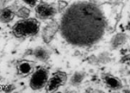
Granules of epinephrine & norepinephrine
Granules in: | Epinephrine-secreting cells | Norepinephrine-secreting cells
Size | Small | larger
Contents | Fill the granule | Do not
 | E M protein synthesizing cells: rER membrane-limited electron-dense granules of either epinephrine or norepinephrine
Notes:
25

Slide 26
Blood supply of adrenal gland
The adrenal glands are supplied by several arteries ,these arteries can be divided into:
Cortical arteries, arteries that irrigate the capsule; branching into capillaries and eventually reach the medullary capillaries;
medullary arteries, which pass through the cortex and form an extensive capillary network in the medulla.
The cells of the medulla are, thus, bathed with both arterial blood from the medullary arteries and venous blood originating from the capillaries of the cortex.
Glucocorticoids produced in the cortex, which reach the medulla through capillaries that bathe cells of the cortex, constitute another mechanism of control.

Slide 27
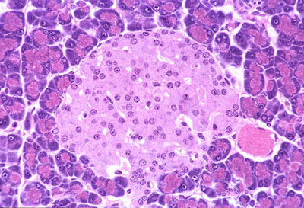
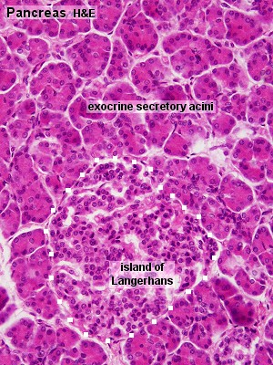
PANCREAS
exocrine and endocrine gland.
The exocrine part produces about 1.5L of pancreatic juice every day.
The endocrine part, ~1% , consists of the cells of the islands of Langerhans.
The pancreas has thin capsule
cellular composition of the islands
- 70% beta-cells, insulin. Insulin stimulates
- 20% alpha-cells, glucagon.
- 5- 10 % delta-cells which secrete somatostatin,

