Slide 1
contraception
Done by :
Toqa Al-saraireh
Fatima Al-bustanji
Rania Al-bustanji
Jana Al-muhasin
Supervision by :
Dr . Samer yagi

Slide 2
Contraception methods
Types
Natural
hormonal
Mechanical
Surgical
Barriers

Slide 3
Methods of contraception are compared by the Pearl index.
Pearl Index (PI): number of unintentional pregnancies related to 100 women using certain method of contraception for I year. (first-year pregnancy rates/100 women) , its indicate the effectiveness of a contraceptive .
Perfect Use efficacy rates (Correct Use); reflect what happens when a contraceptive method is used correctly all of the time.
Typical Use efficacy rates (Actual Use); reflect what happens in the real world when we factor in human error in the first year of use of a method.

Slide 4
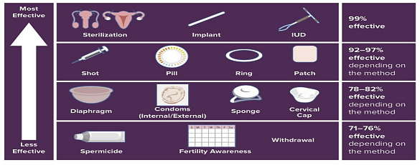

Slide 5
Natural methods

Slide 6
1. Calendar method:
This method is based on avoiding sexual intercourse around the time of predicted ovulation.
Ovulation: expected next period-14 days( because the luteal phase is fixed).
3 days before(sperms stay alive up to 72 hours) and 2 days after(ovum up to 48 hours)
Due to personal error avoid intercourse 3 days before and after.
It must be regular period. (28 days cycle )
But , in irregular period :
Fertile period = shortest cycle -18 (gives first day of the fertile period) to longest cycle -11 (gives last day of the fertile period )
ex. Shortest cycle =25 , longest cycle= 35 , fertile period ?
25-18=day 7 , 35-11= day 24 , fertile period = day 7- day 24

Slide 7
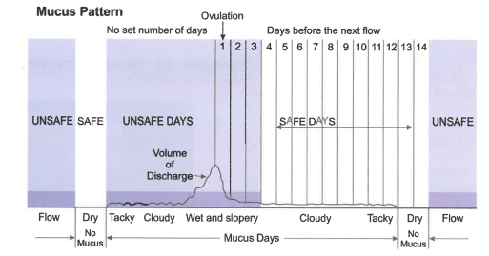
2- Cervical mucous method
This method is based on the observation of changes in the characteristics of cervical mucous .
Immediately after menses → no cervical mucous (dry)
At time of ovulation→ the cervical mucous is watery ,clear and high in quantity (profuse) .” under the influence of estrogen “
After ovulation → the cervical mucous is thick and low in quantity “under the influence of progesterone “

Slide 8
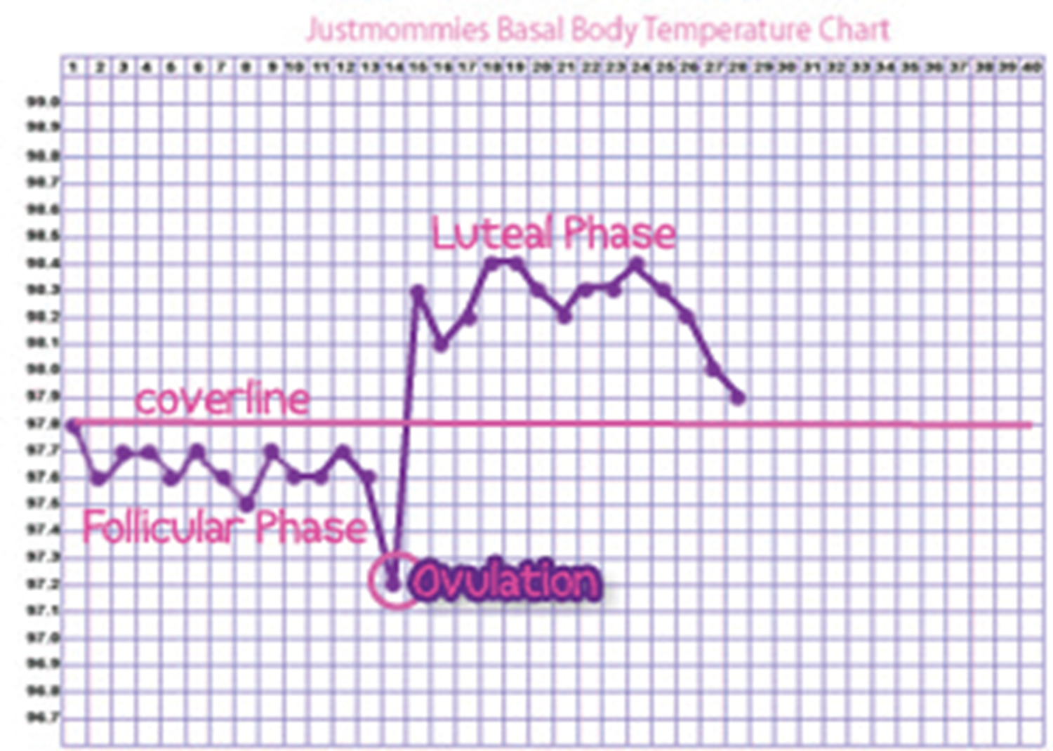
3- Basal body temperature method
At time of ovulation there reduction of temperature by 0.3 ºC then raise by 0.5 ºC due to progesterone .
So, the safe period start from third day of raised temperature .

Slide 9
4- Lactational amenorrhea
to ensure that this contraception is effective :
1- exclusive breast feeding
2-there is amenorrhea (menses should not have resumed after delivery)
3- 6 months

Slide 10
5. Withdrawal (coitus interruptus)
Ejaculation outside.
depends on psychological state during intercourse
Semen can enter vagina and cervical mucus prior to ejaculation.

Slide 11
Disadvantage of natural methods
1-not suitable for women with irregular cycles or shorter than 21 days .
2- not protective against STDs .
3- not suitable for uncooperative husbands .

Slide 12
Barrier methods

Slide 13
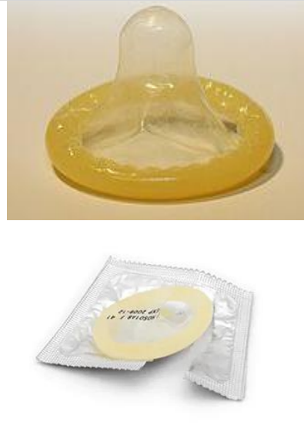
Male condom
Safe and easy use
Made of latex
Failure rate = 15%
Only method that offers:
• protection from STIs,PID.
• It can be used for sperm collection
Disadvantage : allergy to latex

Slide 14
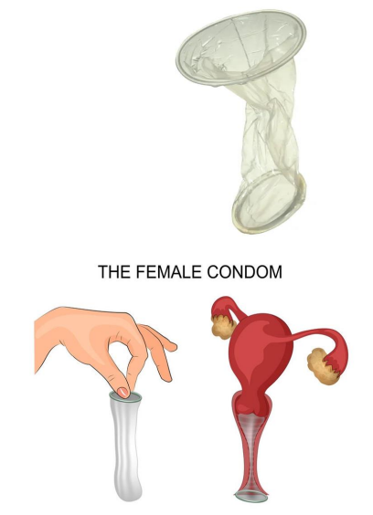
Female condom
thin plastic pouch that lines the vagina. It is held in place by a closed inner ring at the cervix and an outer ring at the opening of the vagina.
Polyurethane
Perfect rate = 95%
Typical rate = 79%
Woman can use female condom if partner refuses

Slide 15
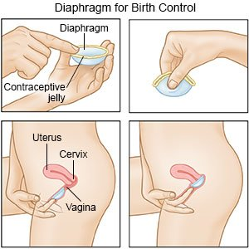
Vaginal diaphragm
The diaphragm is a small, dome-shaped device
made of silicone or latex that fits inside the vagina and covers the cervix
Fitted by physician
Spermicidal jelly before insertion
Perfect use Rate = 94%
Typical use Rate = 80%
Inserted up to 18 hours before intercourse
and can be left in for a total of 24 hour

Slide 16
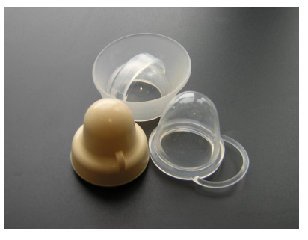
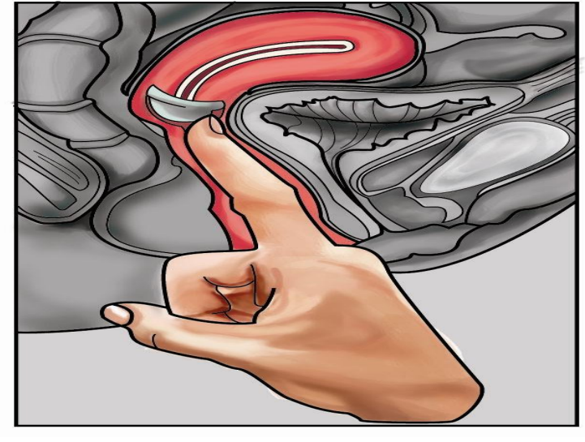
Cervical cap
The cervical cap is a small plastic dome that fits tightly over the cervix and stays in place by suction
Fitted by physician
Fill with spermicidal jelly prior to use
Perfect use rate = 91%
Typical use rate = 80%
Can be left in body for up to a total of 48 hours ,
Must be left in place six hours after sexual intercourse

Slide 17
Hormonal contraception

Slide 18
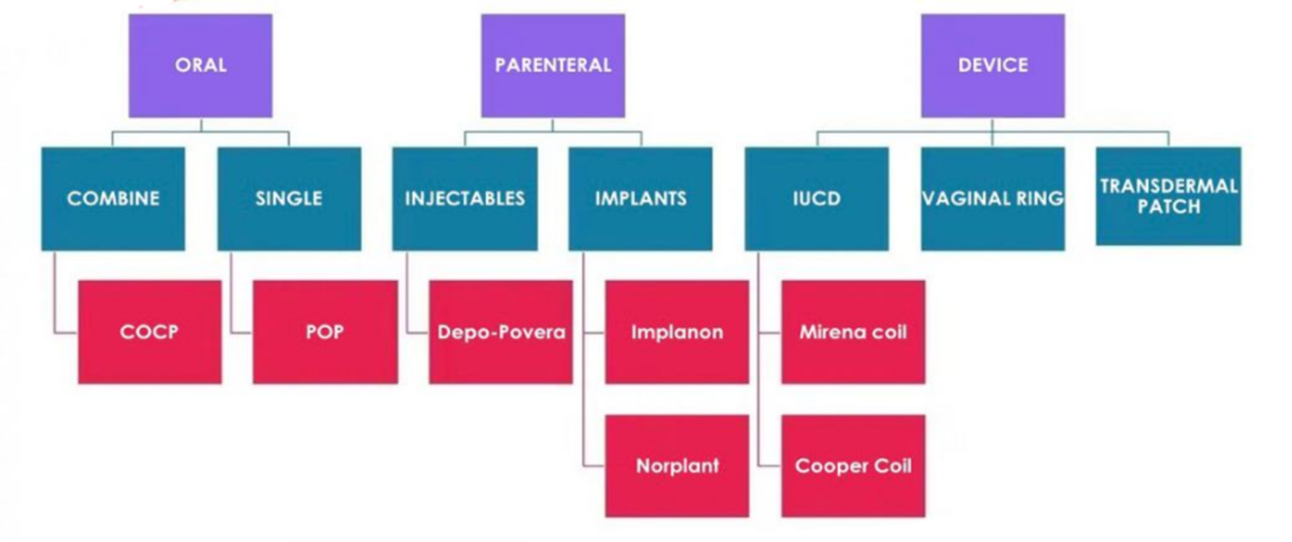
Hormonal contraception

Slide 19
Combined Hormonal Contraceptives
Containing Estrogen + Progesterone
The primary mechanisms of all CHCs are to (1) thicken cervical mucus and (2) suppress ovulation.
Progesterone is responsible for thickening the cervical mucus to compromise the passage of sperms = prevents fertilization - in addition to its action on endometrium (endometrial atrophy= preventing implantation)
Estrogen causes –ve feedback on FSH = stabilizes the endometrial thickness = preventing breakthrough bleeding.

Slide 20
Combined Hormonal Contraceptives
Safe for most young women
Added benefit of regulation of menses
Usually started during the first 5 days of the cycle
Oral contraceptives consist of a combination of an estrogen (ethinyl estradiol 20mcg - 35mcg) and a progesterone (Levonorgestrel/ norethisterone/ desogestrel).

Slide 21
Combined Hormonal Contraceptives
CHCs Regimens:
Combined Contraceptive Pill: Used for 3 weeks every 4 weeks (taken 21 days with 7-days pill-free interval (monophasic regimen) The pill-free interval is the time of breakthrough bleeding.
Contraceptive patch: Weekly transdermal patch for 3 weeks and one week off to have withdrawal bleeding.
The vaginal ring: 3 weeks with 1 week ring-free interval, or 24-4, or continuous.

Slide 22
Combined Hormonal Contraceptives
Combined Contraceptive Patch:
Releases150 g progestin norelgestromin + 20 g of ethinyl estradiol daily.
Applied to: Buttocks, Upper arm/ shoulder, Lower abdomen or Upper back above the scapula.
For 3 weeks and one week off (one patch weekly) to have withdrawal bleeding.
INTRAVAGINAL RING:
Contains ethinyl estradiol (15g/day) + etonogestrel (120g/day).

Slide 23
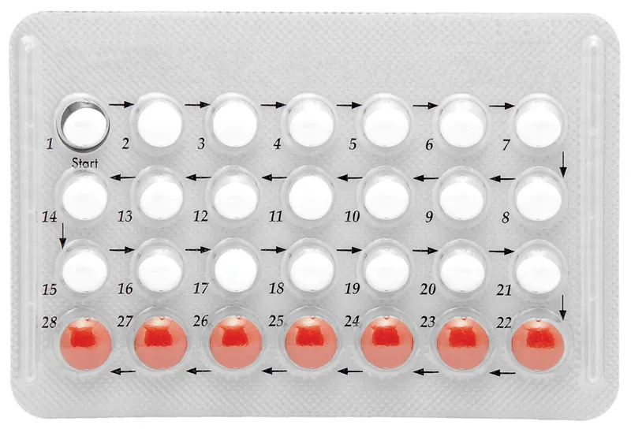
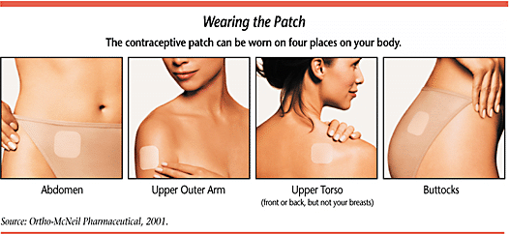
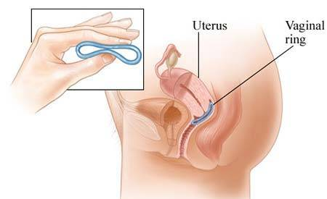

Slide 24
Combined Hormonal Contraceptives
Alternate Regimen for CHCs:
Standard 21-7. Start on day 1- 5 of the cycle usually 3 weeks on and 1 week off.
Alternative regimen: 24 days of the cycle and 4 days off.
Advantages:
1. Decreased follicular activity
2. Potential for increased efficacy
3. Fewer bleeding days.

Slide 25
Combined Hormonal Contraceptives
CHCs Contraindications:
History of a venous thromboembolism
Known thrombogenic mutations
Smokers over 40 years
Migraines with aura
Hypertension, esp. if poorly controlled
Lupus with antiphospholipid antibodies
Use of liver enzymes inducers as antibiotics as rifampicin/ ampicllin and antiepileptic drugs such as, Valoprate and Phenytoin
Severe obesity and/or hypercholesterolemia
Women with liver tumors, Hepatic carcinoma or severe cirrhosis of the liver
Known or suspected breast cancer.

Slide 26
Combined Hormonal Contraceptives
CHCs Side Effects:
Most common is breakthrough bleeding (pill-free period)
Thromboembolism
Hypertension
Headache
Stroke
CHCs decrease the risk of ovarian, endometrial and colorectal cancers.

Slide 27
Combined Hormonal Contraceptives
Breakthrough bleeding is a common cause for discontinuation, but improved with extended regimens.
Management:
If near end of cycle, discontinue early
If severe, consider exogenous estrogen or higher estrogen dose pill.

Slide 34
. Safe during lactation

Slide 36
(

Slide 37
Mirena
(releasing levonorgestrel 20 microgram 12 hourly)

Slide 38
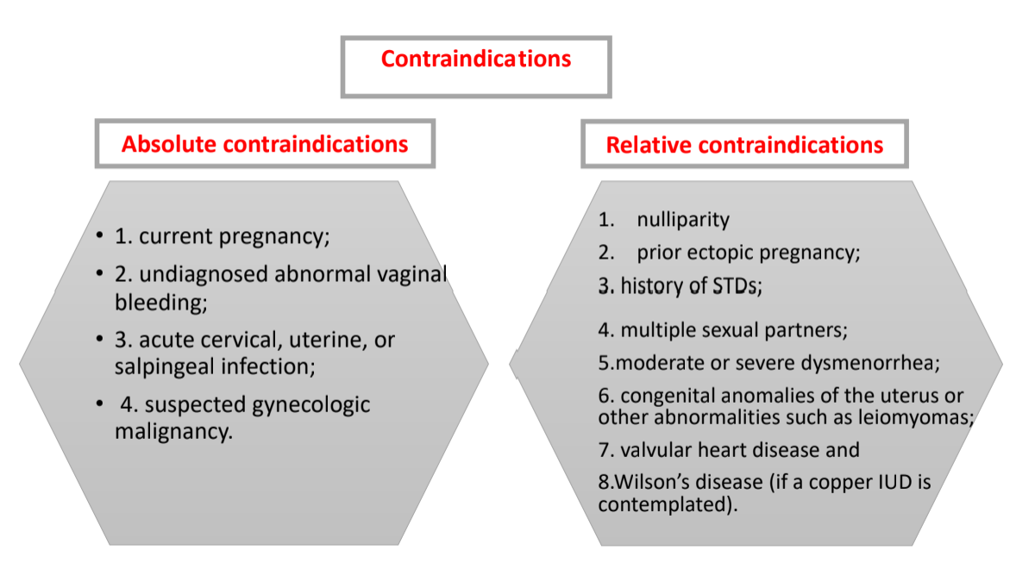

Slide 41
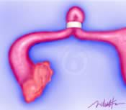
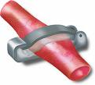
Sterilization- Tubal ligation
Surgical procedure performed for Female Sterilization in which Fallopian tubes are band, cut and tied, cauterized , or clipped to prevents sperms from reaching egg.
Done by Laparotomy, Laparoscopy, Pomeroy's technique (Partial salpingectomy).

Slide 42
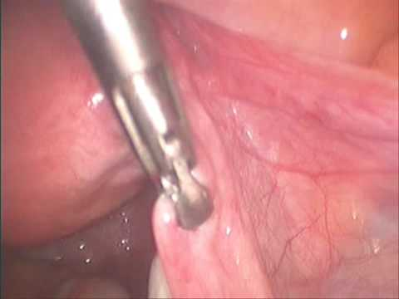
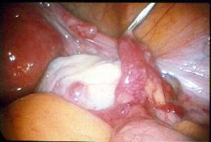
Commonly done at time of CS, may be performed postpartum, postabortion, or as an interval procedure ( between days 6 and 13 of menstrual cycle)
Failure rates vary by procedure, from 0.8-3.7%
Complications : regret ,heavier periods, ectopic pregnancy.

Slide 43
Sterilization- Vasectomy
Male sterilization procedure
Ligation of Vas-Deferens tube
Faster and Easier recovery than a tubal ligation
Failure rate is 0.1% (more effective than female sterilization)
Woman should be protected for 3 months (till semen analysis shows azospermia). So, she can offer DMPA injection

Slide 44
Emergency (Post-coital) Contraception
From fertilization to implantation about 6-7 days
Hormonal
Effectiveness rate 52-94%.
Mode of action; Preventing or Delaying ovulation, may prevent fertilization by affecting the cervical mucus or the ability of sperm to bind to the egg.
levonorgestrel (Progestin),:
-single dose (1.5 mg) within 72 hrs of unprotected intercourse.
-two doses (0.75 mg each; 12 hrs apart).

Slide 45
Combined pill :
standard dose is 2 tablets of Orally in 2 dose regimen (2 tablets/dose)1
• each dose contains ethinyl estradiol (0.1 mg) and levonorgestrel (0.5 mg)
• administer 1st dose within 72 hours of unprotected intercourse and 2nd dose 12 hours later
ulipristal acetate progesterone receptor modulator / given as single 30 mg dose
considered most effective when taken up to 120 hours (5 days) after unprotected intercourse

Slide 46
IUCD
WHO recommends that a copper-IUD, inserted within 5 days of unprotected intercourse.
When inserted within 5 days of unprotected intercourse, a copper-bearing IUD is over 99% effective in preventing pregnancy. This is the most effective form of emergency contraception available.
Mode of action: prevent implantation

