Slide 1
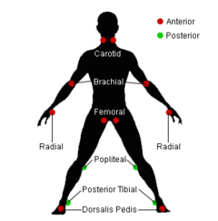
Pulse Check
Dr.Mahmoud Al-Awaysheh General & Colorectal Surgeon
Mutah University - Introductory Course 2021

Slide 2
Learning Objectives
Defining a pulse
Assessing a pulse and location of pulses
Specialized tests
Assessing for peripheral vascular disease
JVP and its assessment
Pathological problems identified with pulse checks

Slide 3
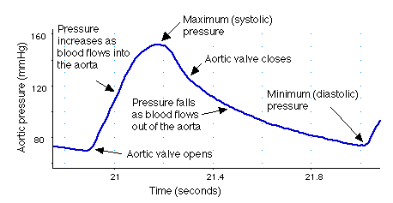
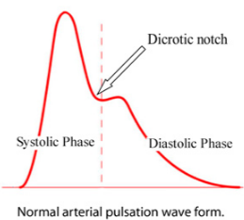
What is a pulse?
A pulse is a rhythmic beat felt in an artery. With each systolic beat of the heart, blood is ejected into the arteries. This pumping action (contraction) of the heart causes a rhythmic dilation of the arteries, which is palpable through light touch.

Slide 4
What can you assess on a pulse check?
Rate:Adult 60-100
Neonate 120-160
Infant (1m-12m) 80-140
Toddler 1-5yr 80-130
Rhythm: normal or irregular / dropped beats or extra beats
Volume: volume of pulse (difference between systolic and diastolic pressure) best assessed at carotid pulse
Character: waveform of arterial pulse e.g. collapsing, slow rising or pulsus paradoxus…

Slide 5
What do you expect to find on pulse check after you read the following ECG?

Slide 6
Clinical Scenario
65 year old Mohammed Al-Sherif comes to you with new onset of palpitations. He has suffered with hypertension for the last 15 years. You find he has an irregular, irregular pulse of 120.
a) What is your likely diagnosis?
b) What risk factors does this man have for this condition? c) What other particular examinations and investigations would you make?

Slide 7
Where are your pulses?
Radial pulse (lateral to flexor carpi radialis tendon - use 3 middle fingers)
Brachial pulse (antecubital fossa medial to biceps tendon –use thumb)
Carotid pulse (angle of jaw, anterior to sternocleidomastoid muscle and larynx - use right thumb for left carotid and vice versa)
Abdominal aorta (abdominal midline above umbilicus–use flat of hands)
Femoral artery (midline between ASIS and pubic tubercle – 1-3 finger(s)
(Remember NAVY for arterial blood gas or venous blood taking – Nerve, Artery, Vein and Y-fronts!)

Slide 8
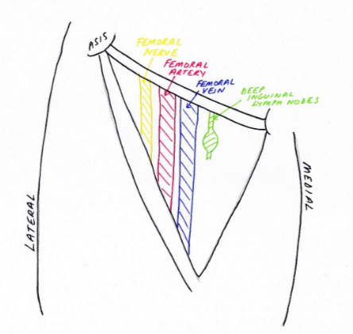
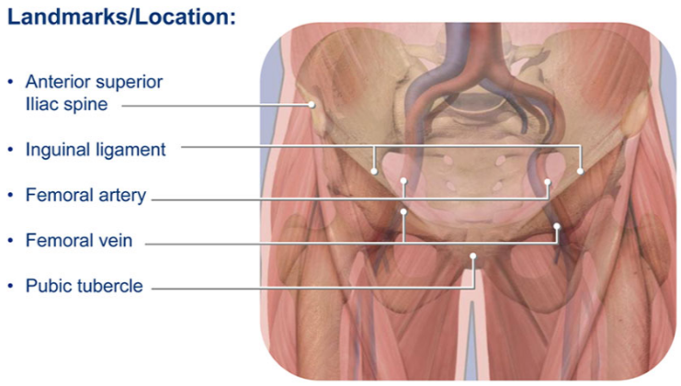
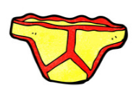
Femoral Artery
NAV-Y

Slide 9
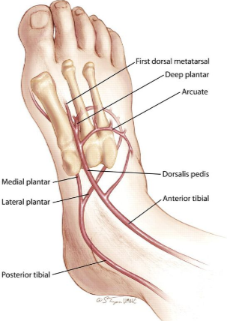
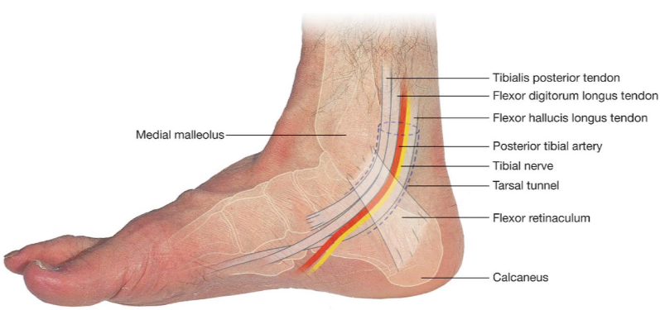
Where are your pulses?
Popliteal pulse (deep in popliteal fossa with knee flexed at 30 degree – thumbs on tibia anteriorly and press middle fingers firmly in midline pressing the artery against the back of the tibia)
Dorsalis pedis pulse (lateral to hallucis extensor longus – 3 middle fingers)
Posterior Tibialis pulse (posterior to medial malleolus
– 3 middle fingers)

Slide 10
Specialized tests
Collapsing pulse – hold radial pulse with hand and lift patients hand above their head (severe aortic regurgitation)
Check for radial – femoral delay – palpate radial and femoral pulses (on same ipsilateral side) and check for delay (coarctation of aorta)
Pulsus paradoxus – exaggerated normal phenomenon where increase in pulse volume on expiration and decreases in inspiration (asthma, cardiac tamponade with pericardial effusion)
Auscultate for carotid bruits with bell of stethoscope - ?carotid stenosis if unilateral or radiating aortic systolic murmur if bilateral
Buerger’s test - Buerger's angle, is the angle to which the leg has to be raised before it becomes pale, whilst the patient is supine. In a limb with a normal circulation the toes and sole of the foot, stay pink, even when the limb is raised by 90 degrees. In an ischaemic leg, elevation to 15 degrees or 30 degrees for 30 to 60 seconds may cause pallor.
Ankle Brachial Pressure Index (ABPI) – Doppler used over brachial and DP pulses and ratio calculated (used to assess arterial and venous insufficiency)

Slide 11
Sequencing of radial pulse assessment
Place pads of index and middle finger over right radial artery
Assess rate and rhythm
Palpate both radial pulses – assess for any delay and any difference in volume
Detect for radio-femoral delay – palpate radial and femoral pulses simultaneously (on ipsilateral side) noting for any timing and volume difference
Detect for collapsing pulse (checking patient has no shoulder or arm pain or restriction) and feel pulse with base of fingers then lift arm vertically above head

Slide 13
Clinical Scenario
74 year old gentleman Abdullah Abu Shemasani lifelong smoker has been developing right calf pain climbing the hill to his house. He has to stop and then his pain eases off. What clinical assessment would you make of this man?

Slide 14
Assessment for peripheral vascular assessment
Begin by washing hands
Introduce yourself and check ID of patient
Explain procedure and gain consent / chaperone if necessary
Inspection
General: nicotine staining, scars (CABG / AAA repair…)
Specific : gangrene, arterial / venous ulcers, varicose veins, check between toes and underneath legs, colour changes – black / brown (hemosiderin deposits) / pallor, shiny skin, loss of hair
Palpation – test for temperature with back of hands – start distally and more proximally
Check for capillary return (squeezing toe) and if more than 2secs go on to perform Buerger’s test
Check for AAA, femoral, popliteal pulses, dorsalis pedis, posterior tibial – checking both sides to compare for presence and strength
Check for radio-femoral delay on same side of body
Check for sensation of light touch – cotton wool – testing with patient’s eyes closed and asking which foot / leg is being touched?
Ausculate for abdominal aortic, femoral and popliteal bruits

Slide 15
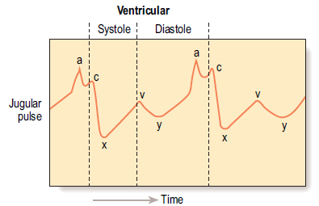
Jugular Venous Pressure
No valves between right atrium and internal jugular vein therefore the degree of distension of this vein is dictated by the right atrial pressure. Measuring the JVP gives information about the cardiac function.
a = atrial systole
c = transmitted pulsation of carotid artery at onset of ventricular systole
x = descent, due to atrial relaxation
v-y = descent at commencement of ventricular filling

Slide 16
How to examine for JVP
Position patient at supine at 45 degrees
Ensure neck muscles are relaxed by resting back of head on pillow and turn head away slightly
Look across neck from right side of patient
Identify internal jugular pulsation (use abdominojugular reflux if necessary)
Estimate vertical height in cm between top of venous pulsation and sternal angle to give venous pressure
Identify timing an form of pulsation and note any abnormality

Slide 17
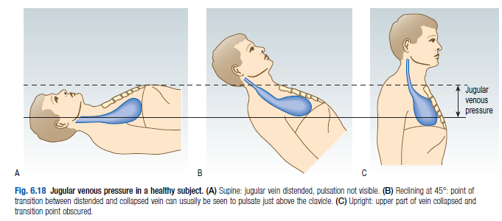
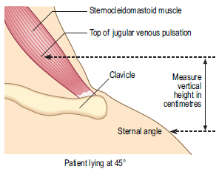
Jugular Venous Pressure
Normal JVP up to 4cm above sternal angle

Slide 18
Abnormal JVP
Elevated JVP most commonly heart failure
Other causes: pulmonary embolism, pericardial effusion, pericardial constriction, superior vena caval obstruction (loss of pulsation too)
Absent `a’ waves (no atrial systole) – atrial fibrillation
Giant `a’ waves (due to restriction of blood flow from atrial to right ventricle) – pulmonary hypertension, rarely tricuspid regurgitation
Giant `v’ waves – severe tricuspid regurgitation
Cannon waves (giant `a’ waves when right atrium contracts against closed tricuspid valve) – complete heart block, some VT and SVT
Kussmaul’s sign – paradoxical rise of JVP on inspiration – pericardial constriction and tamponade, severe right ventricular failure and restrictive cardiomyopathy

Slide 19
Abnormalities in pulses
Bradycardia (>60 bpm) | Tachycardia (<100 bpm)
Athletic training | Exercise
Hypothyroidism | Fever
Medication e.g. beta-blockers, digoxin, verapamil | Pain / Excitement / Anxiety
 | Hyperthyroidism
 | Medication e.g. Ventolin inhaler, vasodilators
 | Arrhythmia e.g. AF, SVT, VT

Slide 20
Resources
Macleod’s Clinical Examination – Graham Douglas, Fiona Nicol, Colin Robertson.
www.patient.info/doctor/pulse-examination

