Slide 1
Anaesthesia Machine

Slide 2
Anaesthesia Machine
In recent years, the anaesthesia machine has been renamed the anaesthesia delivery system, or anaesthesia workstation because modern devices do more than simply delivering inhalational anaesthesia.
The term ‘‘Anaesthesia Machine’’ specifically refers to that component of the anaesthesia delivery system that precisely mixes the compressed and vaporized gases that are inhaled to control patient’s level of consciousness , analgesia or both during surgical procedures.

Slide 3
Purposes of anaesthesia machine
Provides oxygen
Accurately mixes anaesthetic gases & vapours
Enables patient ventilation
Minimizes anaesthesia related risks to patients & staff

Slide 4
Type of anaesthesia machine
Continuous-flow anaesthetic machine or Boyle's machine : which is designed to provide an accurate supply of medical gases mixed with an accurate concentration of anaesthetic vapour, and to deliver this continuously to the patient at a safe pressure and flow.
Intermittent-flow anaesthetic machines : which provide gas flow only on demand when triggered by the patient's own inspiration.

Slide 5
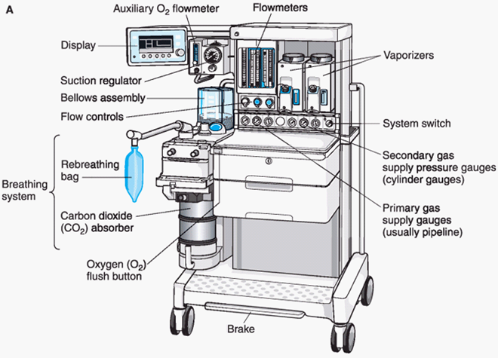
Component of anaesthesia machine
Oxygen source
Flowmeter
Vaporizer
Patient breathing circuit
Scavenging system
Heads-up display

Slide 6
Medical gases
The medical gases commonly used in operating rooms are oxygen, nitrous oxide, and air.
Gases used in anaesthesia are usually supplied under high pressure either in cylinders or as a piped gas supply.

Slide 7
Characteristics of Medical Gas Cylinders

Slide 8
Valves
Raghad Amr

Slide 9
Functions of valves
On/off: starts or stops flow within a system
Flow control: regulates flow
Directional flow: determines the direction of flow
Over-pressure protection: safely relieves system pressure if a pressure spike occurs
Excess flow protection: shuts off or restricts flow to prevent an uncontrolled release of process fluid

Slide 10
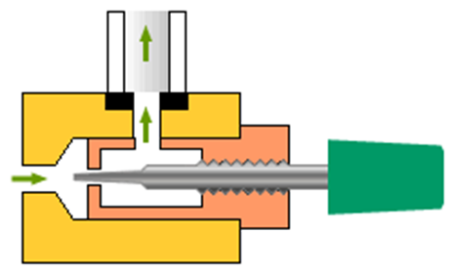
Valves used for pipelines and gases
Valves
As the valve is opened, the orifice around the needle becomes larger and flow increases.

Slide 11
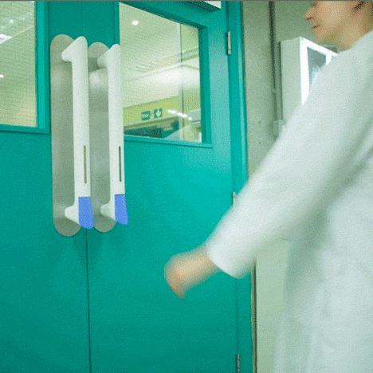
Doors as valves in the OR
Positive pressure vs negative pressure

Slide 13
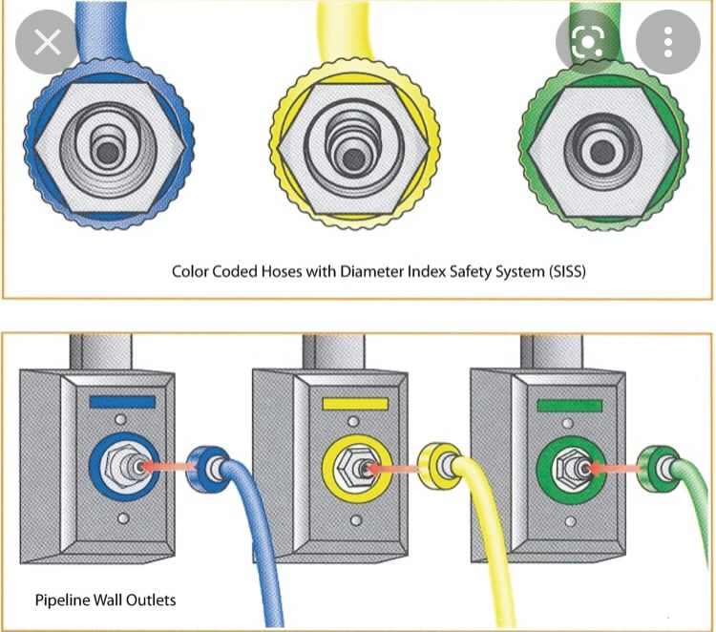
Pipelines
Medical gases are delivered from their central supply source to the operating room through a piping network.
The tubing is colour-coded and connects to the anaesthesia machine through a non-interchangeable diameter-index safety system (DISS) fitting that prevents incorrect hose attachment.
The anaesthetist should check that the pipeline pressure displayed on the anaesthetic machine should indicate 400 kPa.

Slide 15
Flowmeters
Tapered glass tube containing a bobbin or ball, which floats on the stream of moving gas.
Flowmeters are specifically constructed for each gas, since the flow rate depends on both the viscosity and density of the gas.
Inaccuracy in flowmeters are due to:
- The tube not being vertical.
- Back-pressure, from for example, a ventilator.
- Static electricity causing the float to stick to the tube.
- Dirt causing the float to stick to the tube

Slide 16
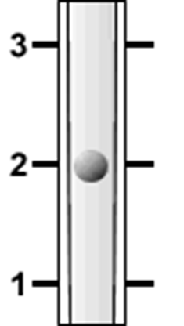
Bobbins and balls
Bobbin flowmeter, reading 2 L/min Ball-float flowmeter, reading 2 L/min

Slide 17
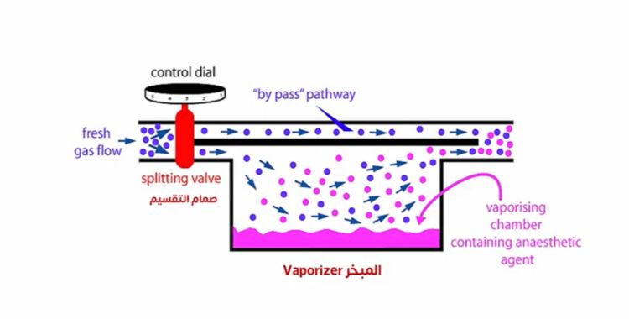
Vaporisers
The purpose of an anaesthetic vaporiser is to produce a controlled and predictable concentration of anaesthetic vapour in the carrier gas passing through the vaporiser.
Most vaporisers are of the plenum type, which consists of a vaporising chamber containing the liquid anaesthetic, and a bypass.
Gas passing through the vaporising chamber volatilises the anaesthetic and is then mixed with the anaesthetic-free gas bypassing the chamber, the proportion of vapour-containing gas and bypass gas being controlled by a tap.

Slide 19
Factors affecting vaporiser output
Flow through the vaporising chamber
Efficiency of vaporization
Temperature Time
Gas flow rate
Carrier gas composition
Ambient pressure

Slide 20
Breathing Circuits. ibraheem alkhawaldeh
Breathing circuits link the patient to the anaesthesia machine. Therefore, The function of the circuit is to; deliver Oxygen and anaesthetic gases to the patient, providing humidity and warmness to inspired gases, and to eliminate Carbon Dioxide.
Types of Breathing Circuit:
- Insufflation
- Open-Drop Anaesthesia
- Draw-Over Anaesthesia
- Mapleson's Circuits
- The Circle System

Slide 21
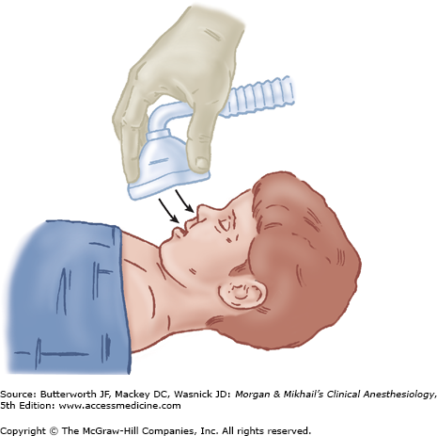
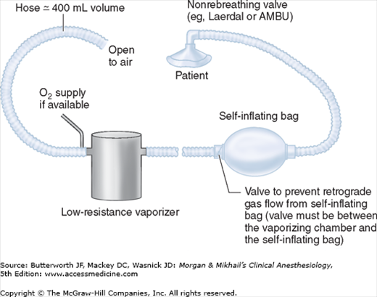
INSUFFLATION: the blowing of anaesthetic gases across a patient’s face, avoiding direct connection between a breathing circuit and a patient’s airway. It used mainly in children.
OPEN-DROP ANESTHESIA: Ether or Chloroform dripped onto a gauze-covered mask, then applied to the patient’s face. Not used in modern medicine, not precise , not applicable for long surgeries.
DRAW-OVER ANESTHESIA: nonrebreathing circuits that use ambient air as the carrier gas. compact and portable, Not dependent on compressed gase. The insufflation and draw-over systems have several disadvantages:
- poor control of inspired gas concentration (poor control of depth of anesthesia)
- mechanical drawbacks during head and neck surgery
- pollution of the operating room with large volumes of waste gas

Slide 23
Mapleson's Circuits
Is preferable than Insufflation and Draw-over systems; as it solves some of their disadvantages.
The relative location of these components determines circuit performance and is the basis of the Mapleson's classification.
Classified into 6 types (A, B, C, D, E, and F).
E, F is used in children, The rest is not used because of the their high pressure .
The main goal is to assist respiration and prevent rebreathing.

Slide 24
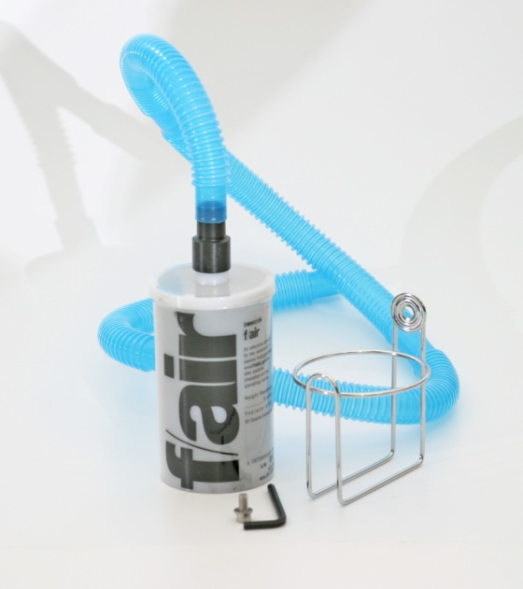
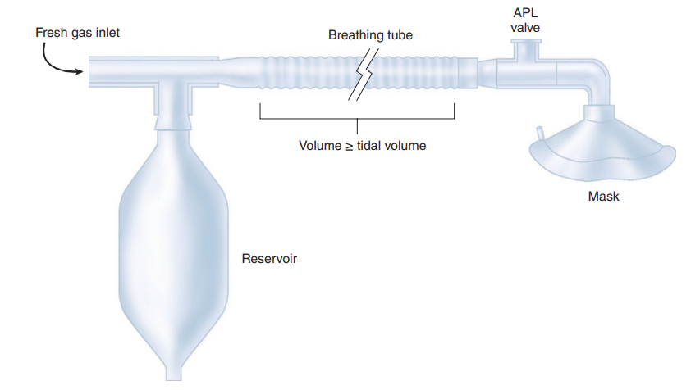
Scavenging System
Components:-
Fresh Gas Inlet (FGI)
Corrugated Breathing Tubes made of either; rubber (reusable) or plastic (disposable) , this creates a low-resistance pathway.
Adjustable Pressure-Limiting Valve (APL Valve, Pressure-Relief Valve, Pop-Off Valve) ; allows gases to exit the circuit as pressure rises and APL releases anesthetic gases into the scavenging system)
- Open in Spontaneous Breathing
- Partially closed in Controlled Breathing
Waste-gas Scavenging System; for exiting gases.
Reservoir Bag (Breathing Bag); a reservoir for the anaesthetic gas, and a method for positive pressure ventilation. تخزين الغازات
Patient Connection (I.e., Face Mask)

Slide 25
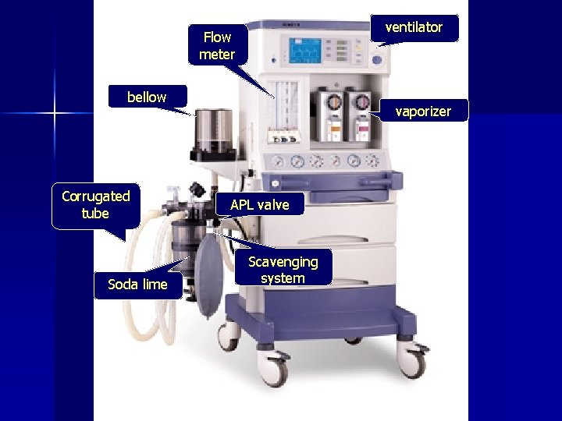

Slide 26
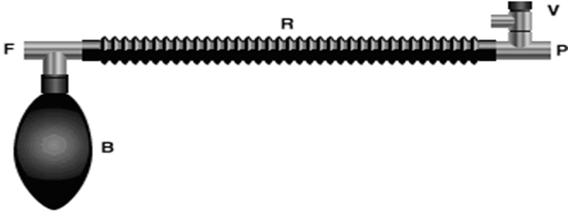
It consist of a three-way T-tube connected to the fresh gas outlet (F), a breathing bag (B) and a reservoir tube (R). The other end of the reservoir tube is connected to the patient (P) and a spring-loaded expiratory valve (V).

Slide 27
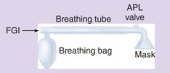
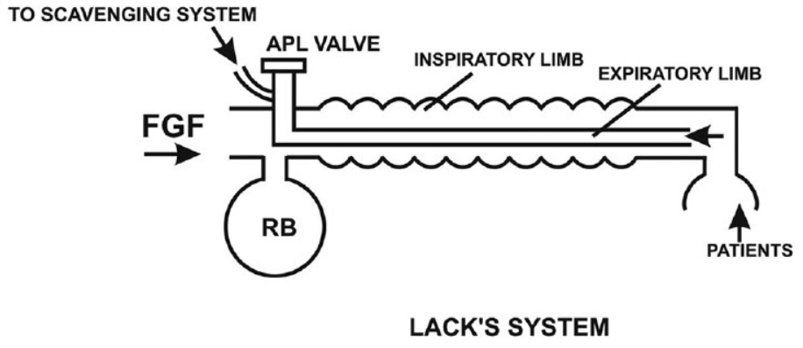
Mapleson's A (Magill Circuit)
FGI is near reservoir bag, APL valve is near face mask.
The most efficient Mapleson's circuit for spontaneous ventilation.
Not good for controlled ventilation.
Enclosed Magill system is a modification that improves efficiency.
Coaxial Mapleson A modification (Lack's Circuit) provides waste gas scavenging.
Magill Circuit
Notes:
Poor choice during controlled ventilation; a very high fresh gas flows (greater than three times minute ventilation) are required to prevent rebreathing with a Mapleson A circuit during controlled ventilation.

Slide 28
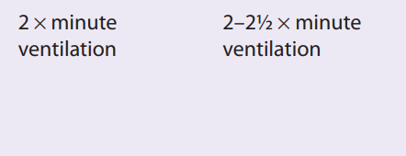
Mapleson's B
FGI and APL valve are close to face mask (FGI being just distal to APL valve).
Fresh gas flows are conveniently available because the FGI is near the APL valve.
In order to prevent rebreathing, fresh gas flow should be around 20-25L/min.
Mapleson's A is more efficient.

Slide 29
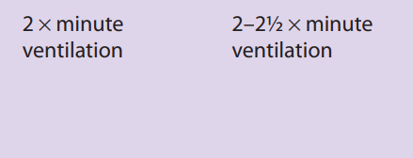
Mapleson's C (Waters’ to-and-fro)
Similar to Mapleson's B, but it has a shorter breathing tube.
It does not have a corrugated tube.

Slide 30
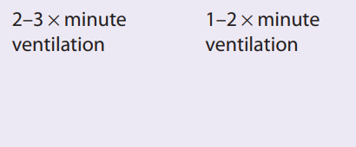
Mapleson's D
Interchanging the position of APL and FGI transforms Mapleson's A into D.
It is efficient during controlled ventilation; since fresh gas flow forces alveolar air away from the patient and toward the APL valve. This alters the fresh gas requirements.
It is also modified into Bain circuit.

Slide 31
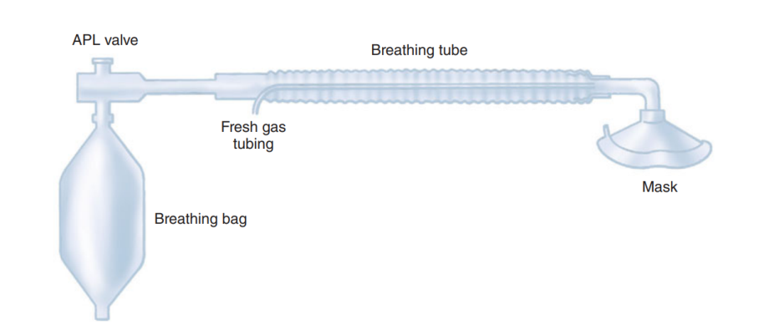
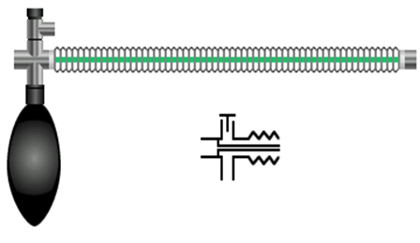
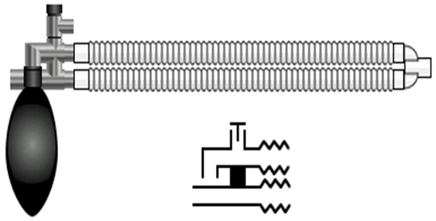
Bain Circuit
It is a popular modification of the Mapleson's D system.
A coaxial version of the Mapleson's D system that incorporates the FGI tubing inside the breathing tube.
This decreases circuit's bulk and retains efficiently the heat and humidity (inspired gas is warmed by the expired gas).
Disadvantage: the possibility of kinking or disconnection of FGI tube.

Slide 32
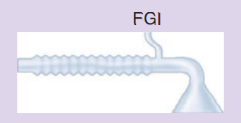
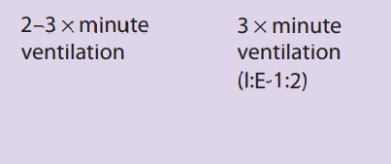
Mapleson's E (Ayre’s T-piece)
Does not have an APL valve nor a Reservoir bag. FGI is near to patient's mask.
Exhalation tubing should provide a larger volume than tidal volume to prevent rebreathing. Scavenging is difficult.
Not good for spontaneous breathing.
Used for pediatric patients weighted up to 30 Kg.

Slide 33
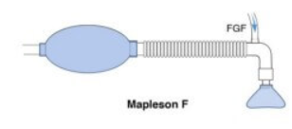
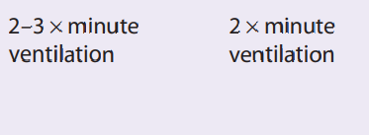
Mapleson's F (Jackson-Rees’ modification)
It is a Mapleson E with an open-ended reservoir bag connected to the end of the breathing tube (operator end) , it allows controlled ventilation and scavenging.
Does not have an APL valve.
Requires higher fresh gas flow.
Not good for spontaneous breathing.

Slide 34
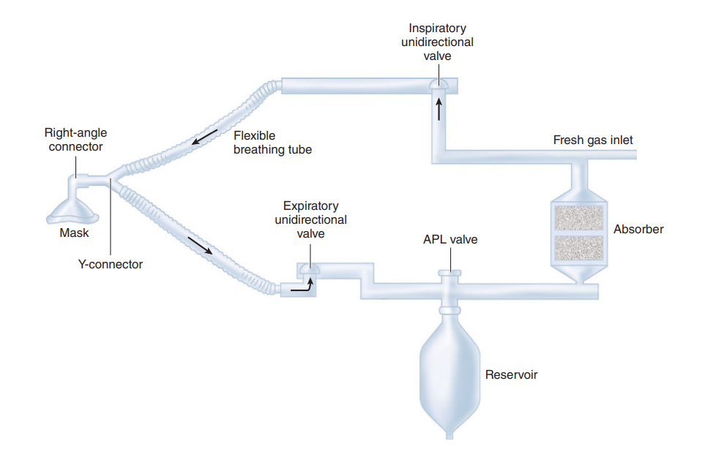
The Circle System
The Circle System aids the breathing system by avoiding the problems that are caused the Mapleson's circuits (as; waste of anaesthetic agent, pollution of the Operating Room, loss of patient's heat and humidity) and this is achieved by adding components to the breathing system, as:
- CO2 Absorber & Absorbent
- FGI
- Unidirectional Valves; Inspiratory & Expiratory
- Breathing tubes; Inspiratory & Expiratory
- Y-shaped connector
- APL Valve
- Reservoir Bag
- Right angle (90°) connector
- Ventilation Mask

Slide 35
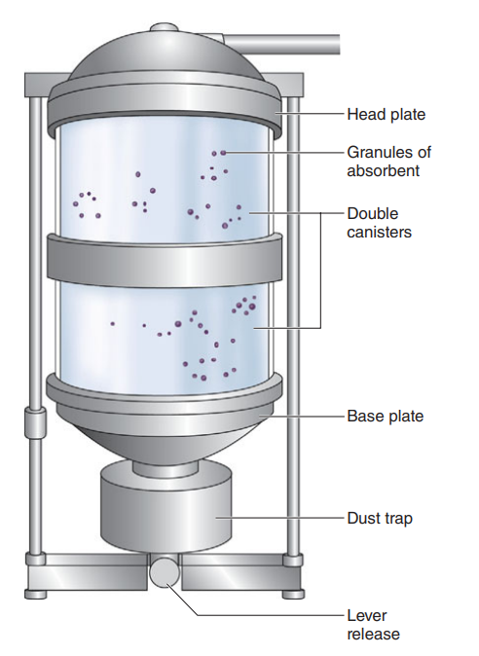
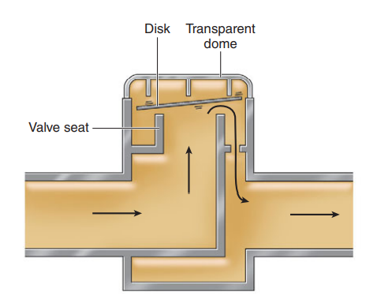
Carbon Dioxide Absorbent: to avoid hypercapnia upon rebreathing alveolar gas (reserves heat and humidity).
Soda Lime (more common) and Barium Hydroxide Lime are known absorbents.
Unidirectional Valves: contains a ceramic or mica disk resting horizontal on an annular valve seat, this prevents reflux of gas in the circuit.

Slide 36
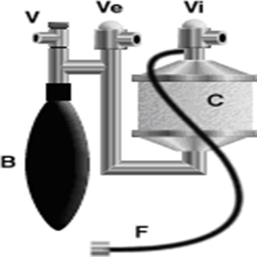
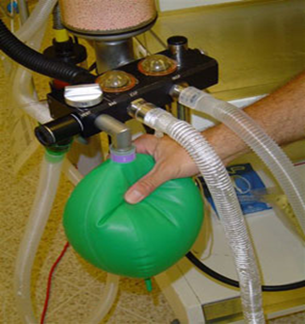
The essential features of the circle absorber are:
- Carbon dioxide absorber canister (C)
- Breathing bag (B)
- Unidirectional inspiratory (Vi) valve
- Unidirectional expiratory (Ve) valve
- Fresh gas supply (F)
- Pressure-relief valve (V)
N.B.
* The breathing system most used with anaesthesia machines is the Circle System.​
* Bain circuit is occasionally used.​

Slide 37
Mechanical Ventilation
Ventilators generate gas flow by creating a pressure gradient between the proximal airway and the alveoli.
All modern anaesthesia machines are equipped with a ventilator, and they usually have the double circuit system design (Pneumatically powered and electronically controlled).
Older units relied on the generation of negative pressure around and inside the chest (e.g., iron lungs), whereas modern ventilators generate positive pressure and gas flow in the upper airway.
Types:-
- Positive Pressure Ventilators
- Negative Pressure Ventilators

Slide 38
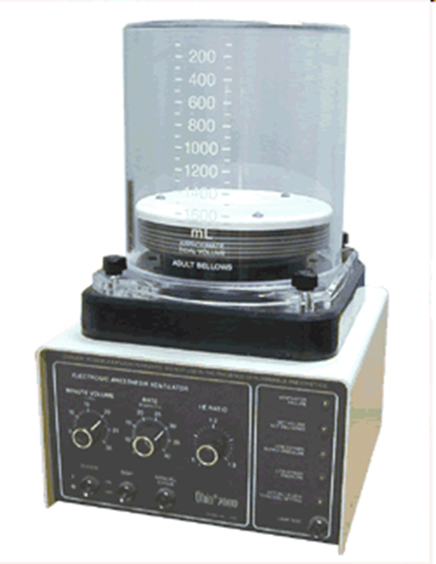
Positive Pressure Ventilators
The lungs are intermittently inflated by positive pressure generated by a ventilator, and gas flow is delivered to the airway.
Able to use endotracheal or tracheostomy tube.
Volume-cycled ventilation
The ventilator delivers a pre-set tidal volume regardless of the pressure generated.
Pressure-pre-set ventilation
The ventilator delivers a pre-set target pressure to the airway during inspiration. The resulting tidal volume delivered is therefore determined by the lung compliance and the airway resistance.

Slide 39
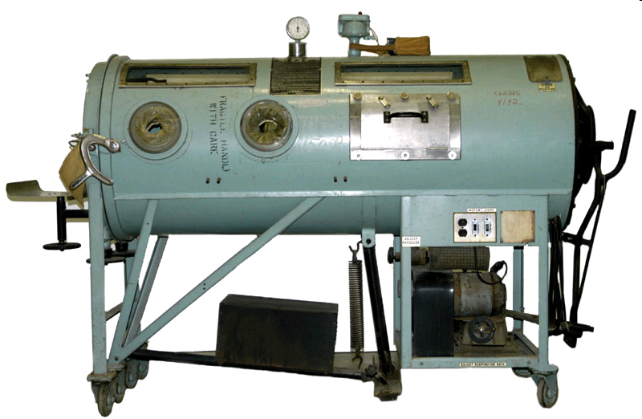
An iron lung, also known as a tank ventilator or Drinker tank, is a type of negative pressure ventilator (NPV); a mechanical respirator which encloses most of a person's body, and varies the air pressure in the enclosed space, to stimulate breathin

Slide 40
Humidification
Prevention of cilial damage and reduced drying of secretions.
As prolonged severe dehydration of the bronchial tree leads to encrustation of mucus and bronchial or endotracheal obstruction, particularly in neonates and patients with respiratory infection.
Humidifiers added to the breathing circuit minimize water and heat loss.
Prolonged humidification of gases by the lower respiratory tract leads to dehydration of mucosa, altered ciliary function, and, if excessively prolonged, could potentially lead to inspissation of secretions, atelectasis, and even ventilation/perfusion mismatching, particularly in patients with underlying lung disease.

Slide 41
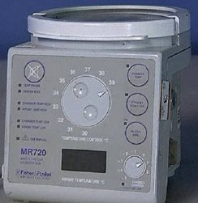
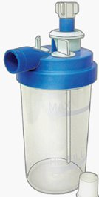
Types:-
Passive: The simplest designs are condenser humidifiers or heat and moisture exchanger (HME) units. They do not add heat or vapor but rather traps exhaled humidification and heat, which is released upon the subsequent inhalation.
Active: More effective in preserving moisture and heat. They add water to gas, by;
- passing the gas over a water chamber (pass-over humidifier)
- saturated wick (wick humidifier)
- bubbling through water (bubble-through humidifier)
- mixing it with vaporized water (vapor-phase humidifier)
Disadvantages of Humidifiers
- Disconnection
- Overheating
- Overhydration
- Infection
- Circuit resistance
- Interference with other devices

