Slide 1
DETECTION &QUANTITATION OF PROTEINS

Slide 2
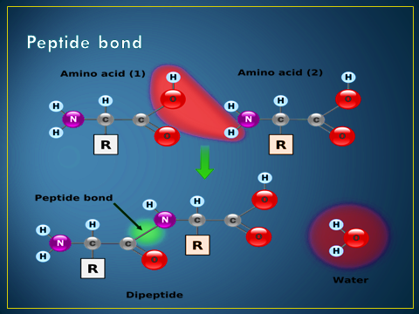
What is protein ?
Amino acid chains are linked by peptide bonds in condensation reactions

Slide 3
Ninhydrin Test
Ninhydrin is a chemical used to detect free amino acid and proteins
Amino acids(NH2) also react with ninhydrin at pH=4.
The reduction product obtained from ninhydrin then reacts with NH3 and excess ninhydrin to yield a dark blue or purple violet colored substance.
This reaction provides an extremely sensitive test for amino acids.

Slide 5
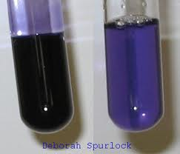
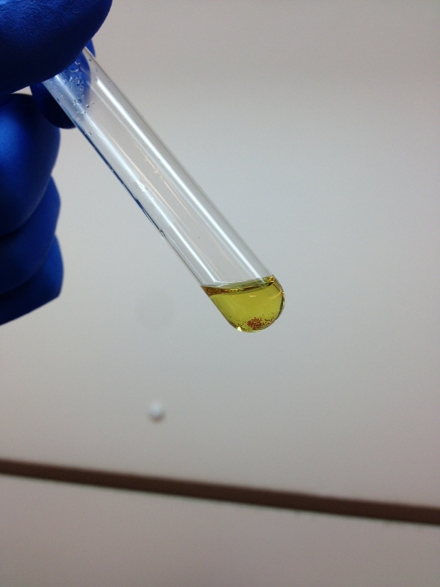
With all amino acid will give purple violet or deep blue with exception Proline gives yellow not violet (why)

Slide 6
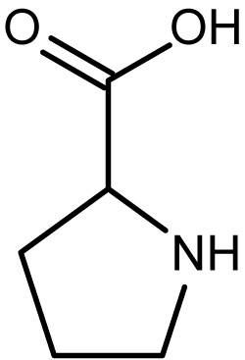
Proline reacts with ninhydrin, but in a different way. While most ninhydrin tests result in a purple violet color, the proline reaction is more yellow due to substitution of the alpha amino group that ninhydrin reacts with carbon rings

Slide 7
Procedure:
To 1 mL solution add 5 drops of 2% ninhydrine solution
Boil over a water bath for 2 min.
Allow to cool and observe the purple color formed.

Slide 8
Bradford method
use of coomassie brilliant blue dye in a colorimetric reagent for the detection and quantitation of total protein.
In the acidic environment of the reagent protein binds to the coomassie dye
This results in a special shift from the reddish/brown form of the dye absorbance maximum at 465nm to the blue form of the dye absorbance maximunm at 610nm

Slide 9
The differences between the two forms of the dye is greatest at 595nm, so that is the optimal wavelength to measure the blue color from the coomassie dye protein complex.
development of color in coomassie dye based bradford protein assays has been associated with the presence of certain basic amino acids primarily arginine, lysine ,histidine in the protein.
A dvantages of the method include that:
it is highly sensitive,
it is able to measure 1-20 µg of protein
it is very fast.

Slide 10
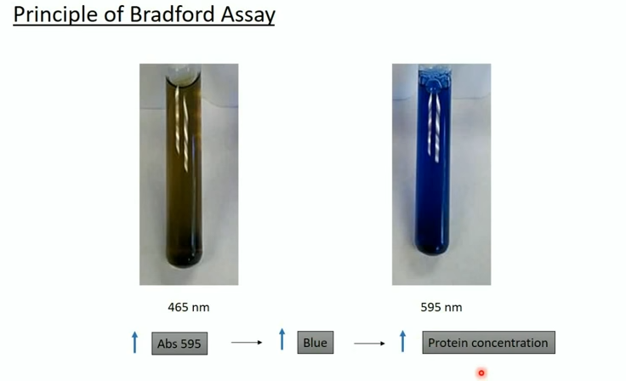

Slide 11
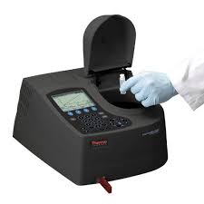
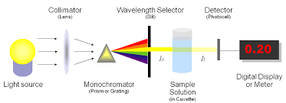
Spectrophotometer

Slide 12
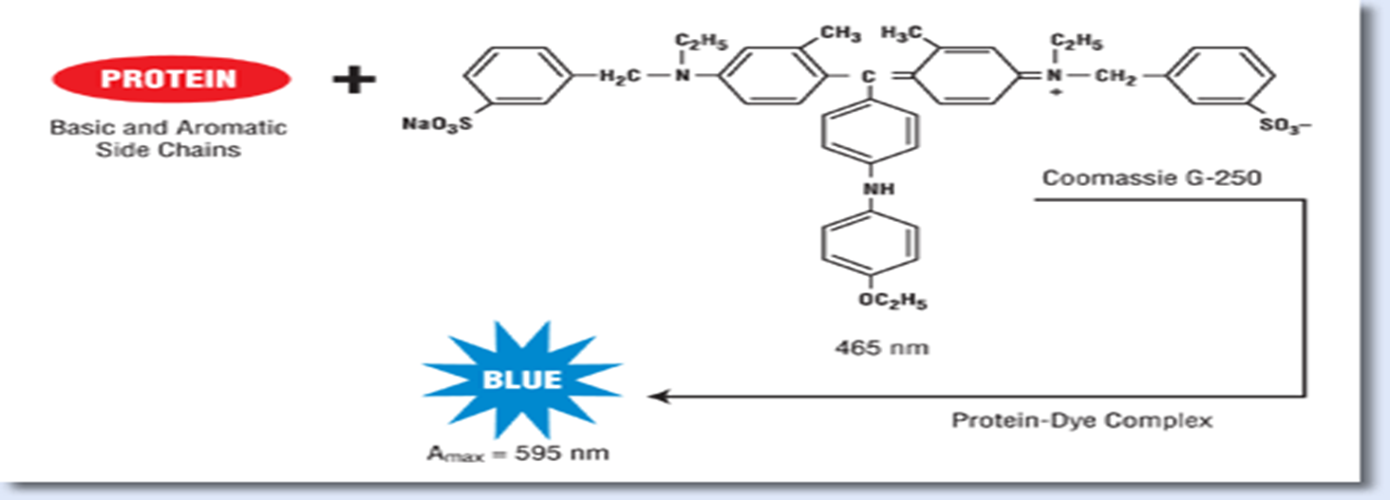
Samples treated with the Bradford assay. The brown sample (lower absorbance) contains no protein, while the blue sample (higher absorbance) contains protein.
The amount of protein in the second sample can be determined by comparison to a standard curve

Slide 13
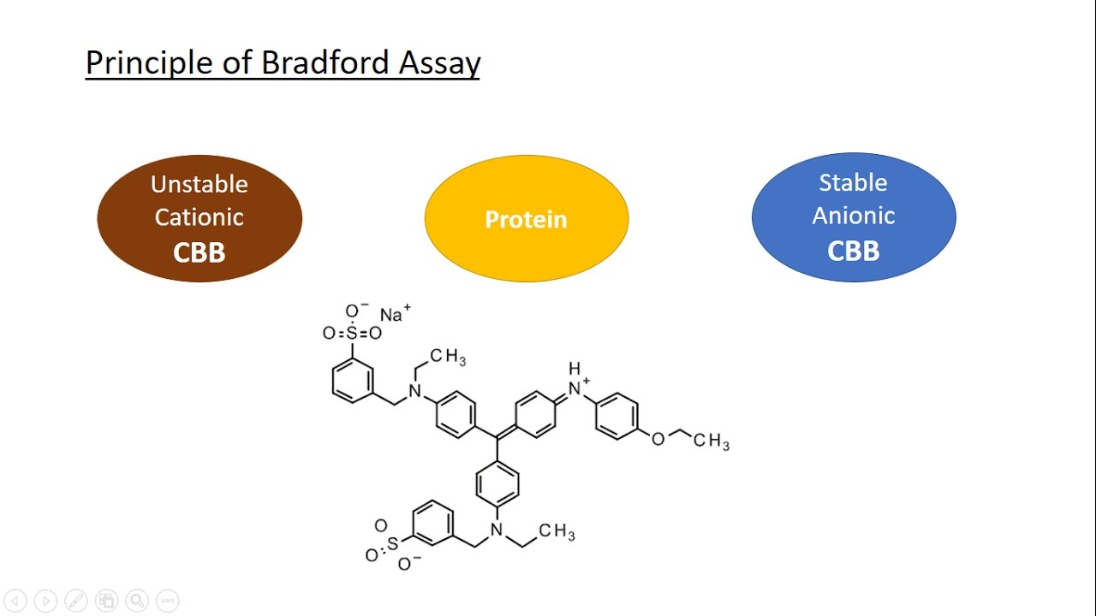

Slide 14
Spectrophotometer

