Slide 1
Breast 2 ( Pathology )
Dr. Tariq Khaled Aladwan, MD.
Consultant General, Laparoscopic and
Oncoplastic Breast Surgery .
Faculty of Medicine, Mutah University.

Slide 2
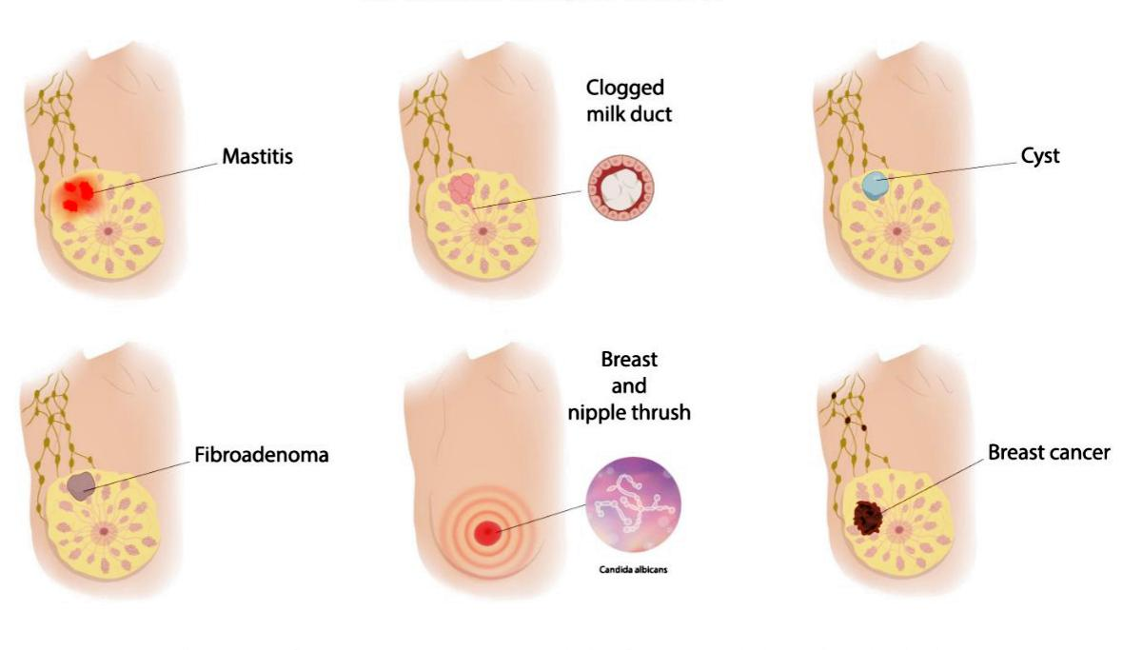
Breast Pathology ( Non-Neoplasmatic & Neoplasmatic Diseases )

Slide 3
Outlines:
* How to deal with Breast Symptoms “ Triple Assessment “
* Investigations In Breast Diseases.
* Specific Benign and Malignant Breast Diseases.

Slide 4
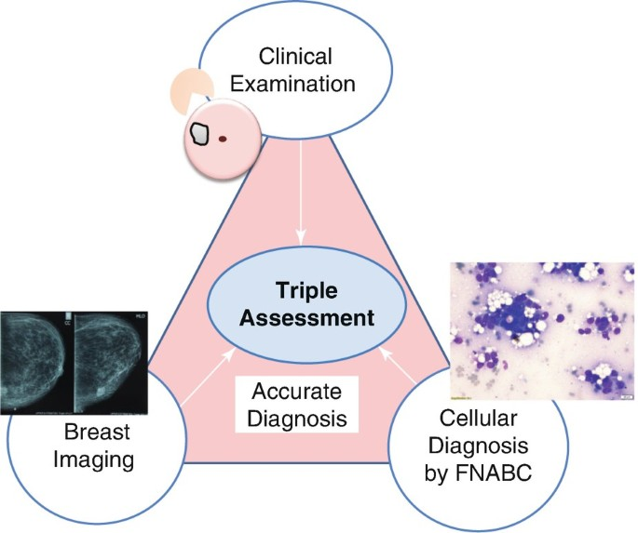
Dealing with Breast Symptoms( Triple Assessment ):

Slide 6
1. Clinical Assessment : ( History and Examination (

Slide 7
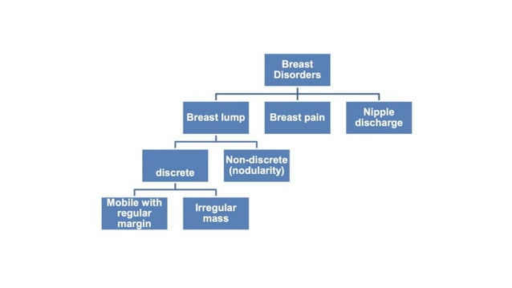
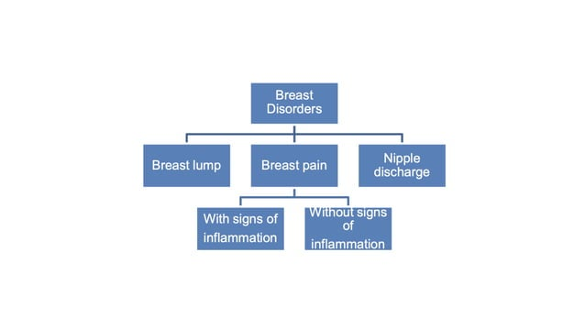
History:

Slide 9
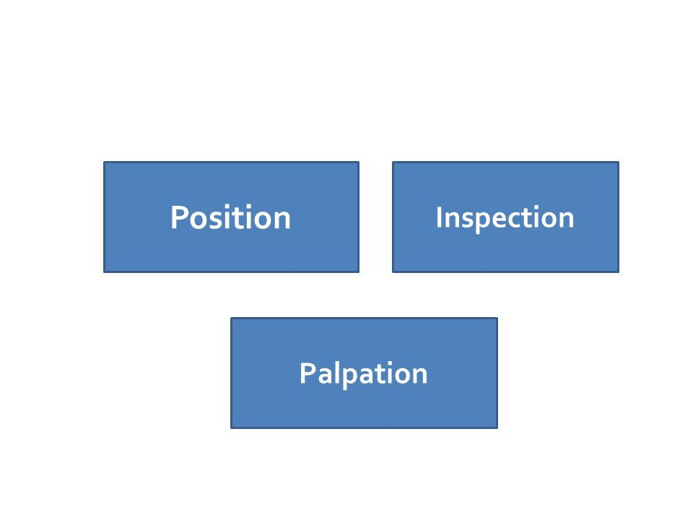
Examination:

Slide 10
2. Imaging :

Slide 11
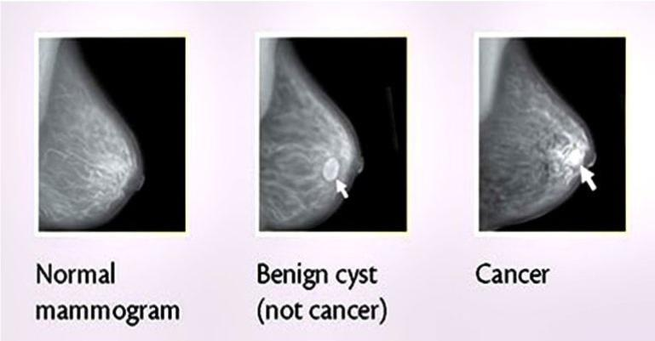

Slide 15
3. Tissue Sampling :

Slide 16
Common Benign Breast Diseases :

Slide 17
Congenital Abnormalities :

Slide 18
Diffuse Hypertrophy :

Slide 19
Breast Injuries ( Trauma) :

Slide 20
b. Traumatic fat necrosis

Slide 28
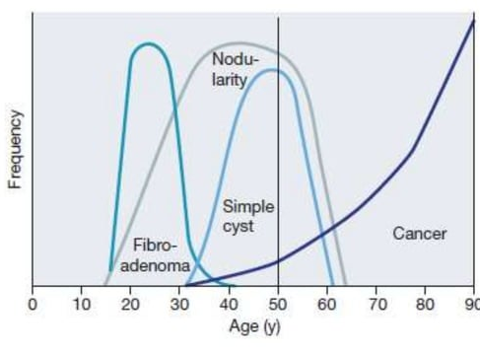

Slide 29
Specific Benign Breast Diseases:

Slide 31
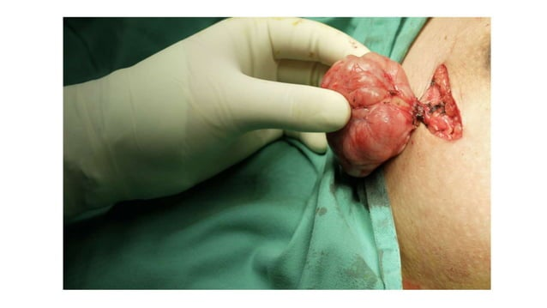
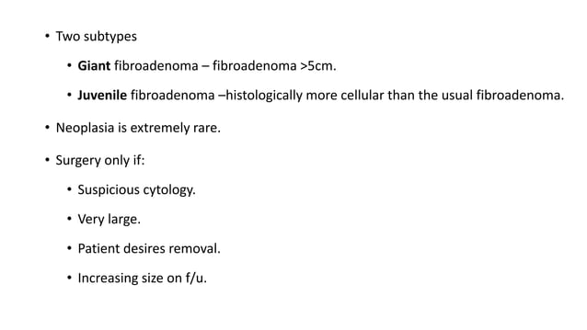

Slide 37
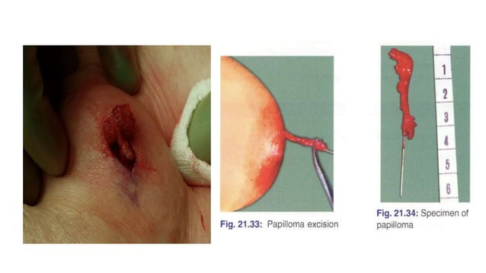

Slide 41
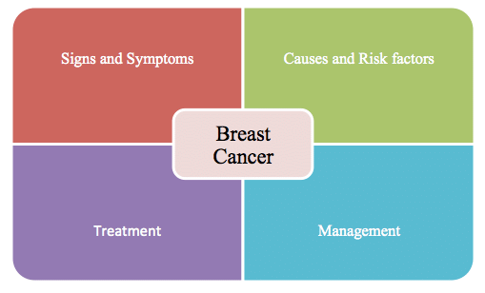

Slide 42
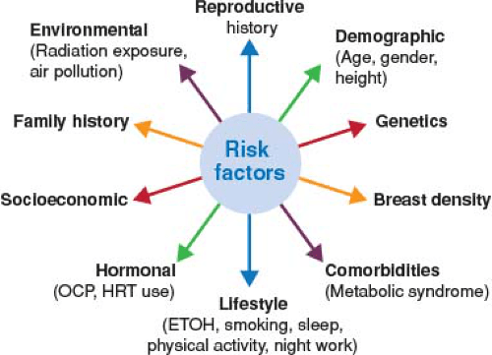

Slide 43
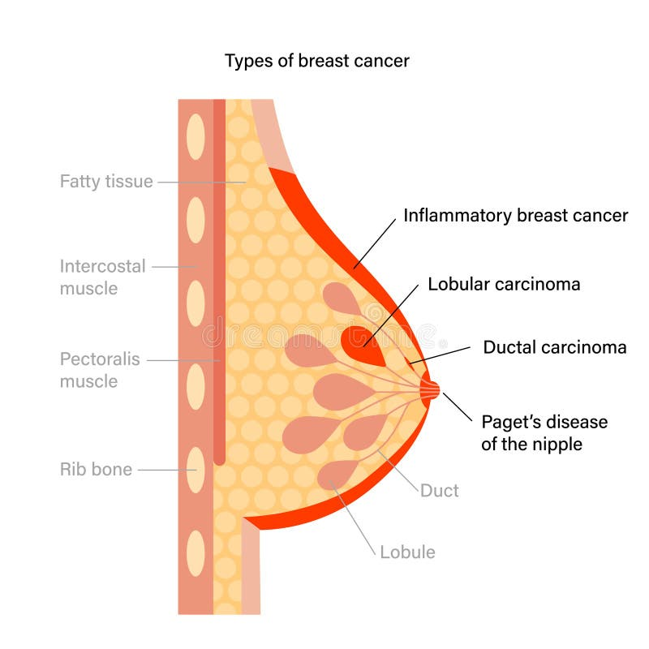

Slide 45
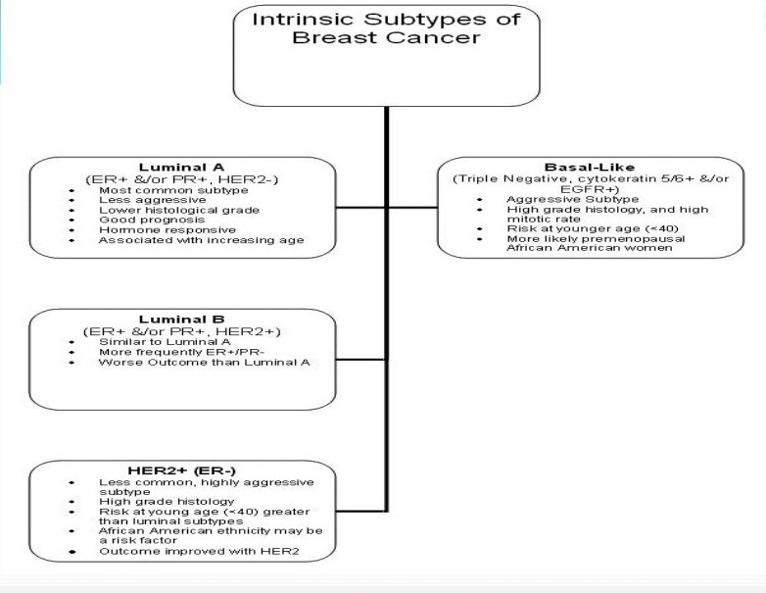

Slide 46
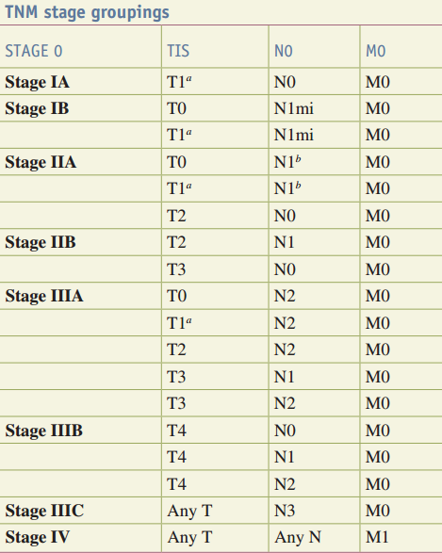
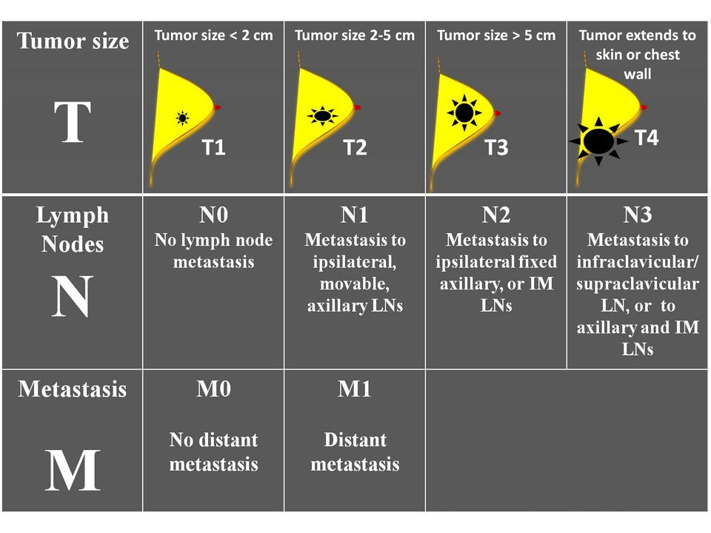

Slide 49
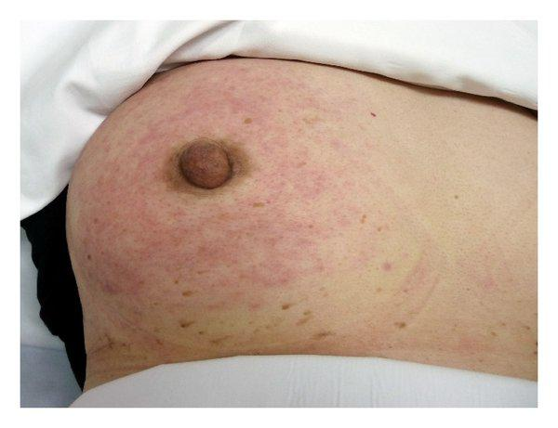
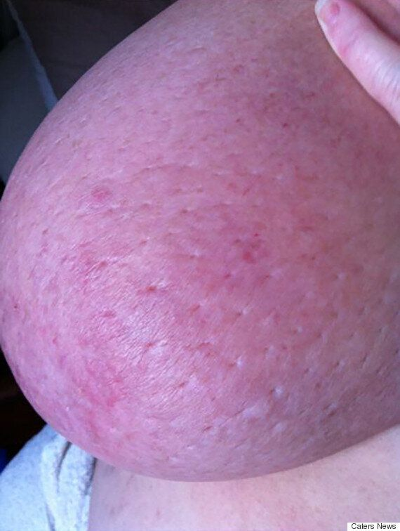
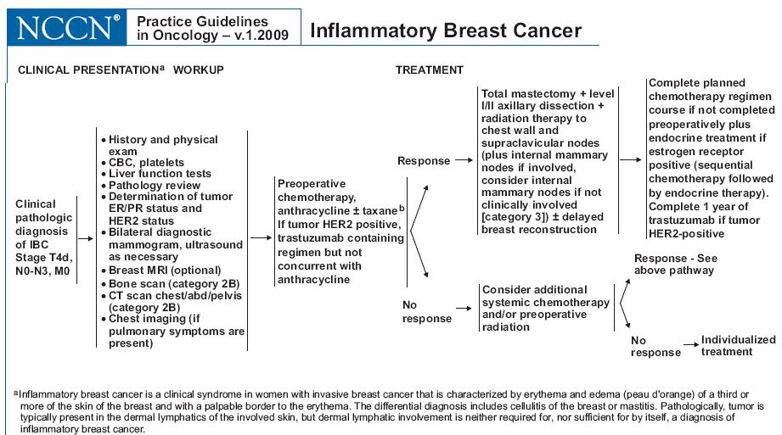

Slide 50
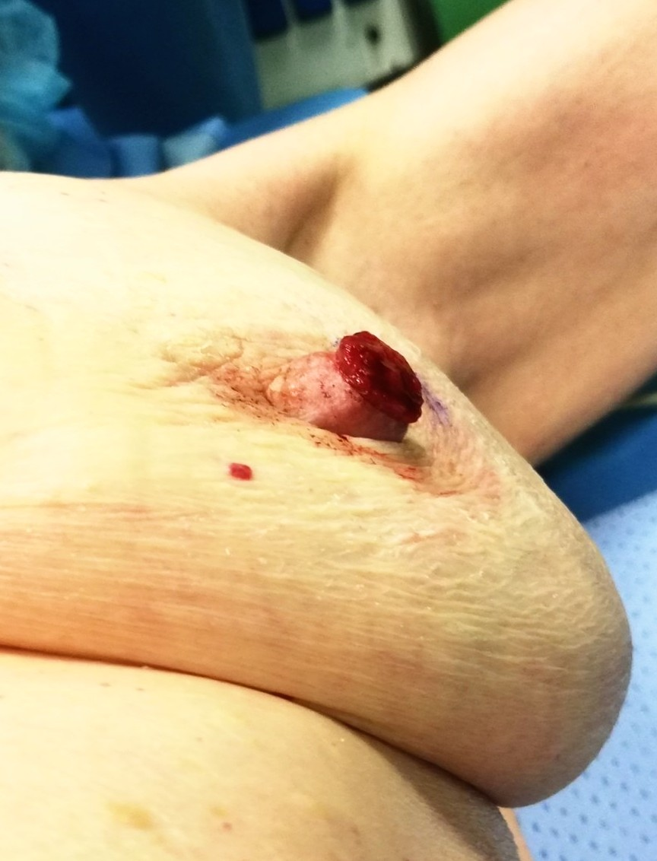
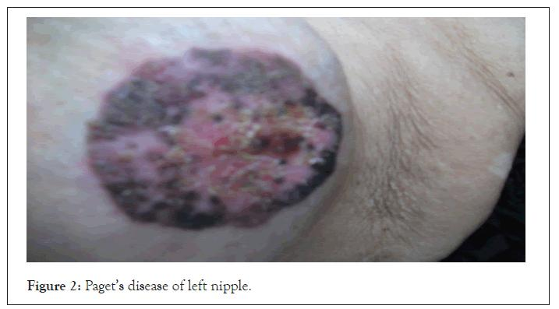
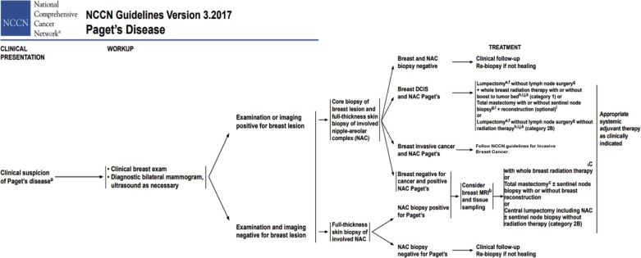
Early Stage
Late stage

Slide 62
# Recurrence of breast cancer:
Consider Systemic Therapy (CT, preferably Single agent)

Slide 63
Follow-Up of Patients Treated with BCS & RT :

Slide 64
Challenges of breast cancer treatment in Jordan :
low public awareness that breast cancer is treatable.
inadequate pathology services for diagnosis and staging.
Costly and poor treatment availability, especially for radiotherapy and drug treatments.
Most of the doctors who do breast surgeries are often general surgeons, and are not well trained in cancer diagnosis and treatment .
After surgery, patients fail to receive the critical drug therapies that can prevent metastatic disease from becoming established.
These factors combined are the reason that breast cancer morbidity and mortality rates are high.

Slide 65
References :

Slide 66
God bless all Mothers
& Babies.
Thank you

