Slide 1
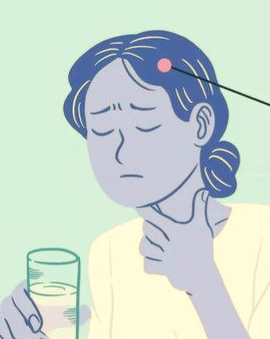
Dysphagia
Done by:
Malak A AL-maaitah
Toqa Mohammad
Mais Jameel
Tasneem Abuolaim
Supervised by: Dr.Mohammad Nofal

Slide 2
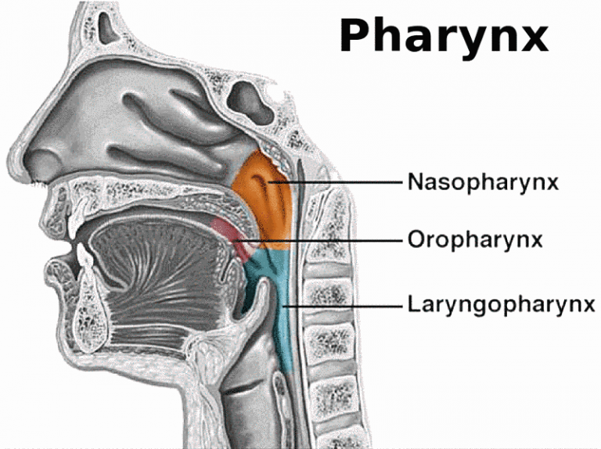
Pharynx
The pharynx, more commonly known as the (throat), is a 12-14 cm, or 5-inch, long tube

Slide 3
Anatomy
The esophagus (oesophagus) is a 25 cm long fibromuscular tube extending from the pharynx (C6 level) to the stomach (T11 level)
It actively facilitates the passage of the food bolus into the stomach

Slide 4
Swallowing
Swallowing, or deglutition, is a complex reflex mechanism by which food is pushed from the oral cavity into the esophagus and then pushed to the stomach.

Slide 5
Swallowing phases
Oral phase: food moistens with saliva and chewed forming bolus , tongue push the food backward to the pharynx.
Pharyngeal phase: food bolus stimulate involuntary neuromuscular swallow reflex which leads to closure of the oral cavity and the nasopharynx by the tongue and soft palate respectively , epiglottis closes trachea preventing food from entering the lungs.
Esophageal phase: food bolus propelled down the esophagus by peristalsis to reach stomach.

Slide 6
Dysphagia
sensation of difficulty or abnormality of swallowing or transferring food from the mouth to the stomach.
Odynophagia
pain during swallowing

Slide 7
Types of dysphagia
Oropharyngeal dysphagia
occurs when a person has difficulty in INITIATING the swallowing process or moving food or liquid from the mouth to the throat.
Esophageal dysphagia
occurs when food or liquid stops in the esophagus, usually because of a blockage or irritation.

Slide 8
Oropharyngeal dysphagia
A . Neuromuscular disorders :
CVA
MI
Myasthenia gravis
Poliomyelitis
Primary myositis
Oculopharyngeal muscular dystrophy
B. Mechanical or obstructive lesions :
Inflammatory(pharyngitis , abscess)
Neoplastic
Plummer-Vinson syndrome
Extrinsic compression (goiter , cervical osteophytes)
Disorder of upper esophageal sphincter.
Notes:
CVA: cerebrovascular accident ‘stroke’, it occurs when a lesion occurs in the brain stem or cortex affecting swallowing muscles’ nerve fibers.
MI: by compression of the left atrium on the esophagus.
Plummer-vinson syndrome: occurs due to prolonged chronic iron deficiency anemia forming webs in the esophagus making it hard to swallow.

Slide 9
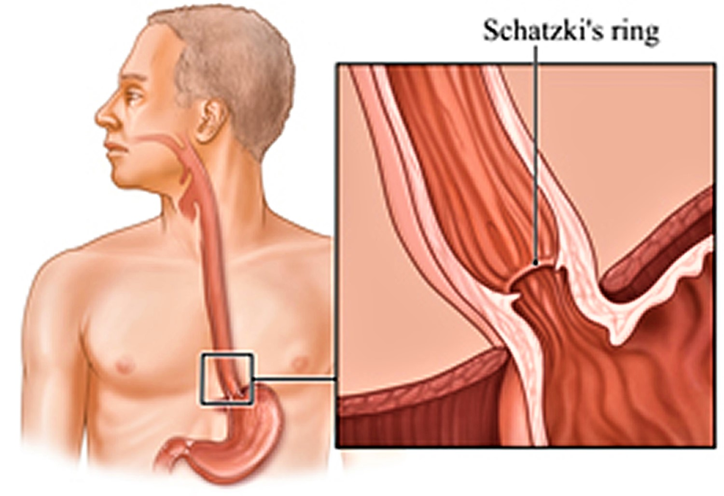
Esophageal dysphagia
A. Neuromuscular disorders :
Achalasia
Diffuse esophageal spasm
Nutcracker esophagus
Hypertensive lower esophageal sphincter
scleroderma
B. Mechanical or obstructive :
Disorders of wall (esophageal stricture , diverticula)
External compression(hiatus hernia , mediastinal growth)
Luminal obstruction (foreign bodies , esophageal webs , schatzki rings)
Notes:
Nutcracker esophagus: strong abnormal esophageal contractions mainly due to GERD.
Scleroderma : a condition in which the smooth muscles of the esophagus are damaged and replaced with scar tissue esophageal dysfunction and aperistalsis and hypotensive LES.
Schatzki’s rings: is a thin circular membrane of tissue that is formed at the lower esophagus causing esophageal narrowing.

Slide 10
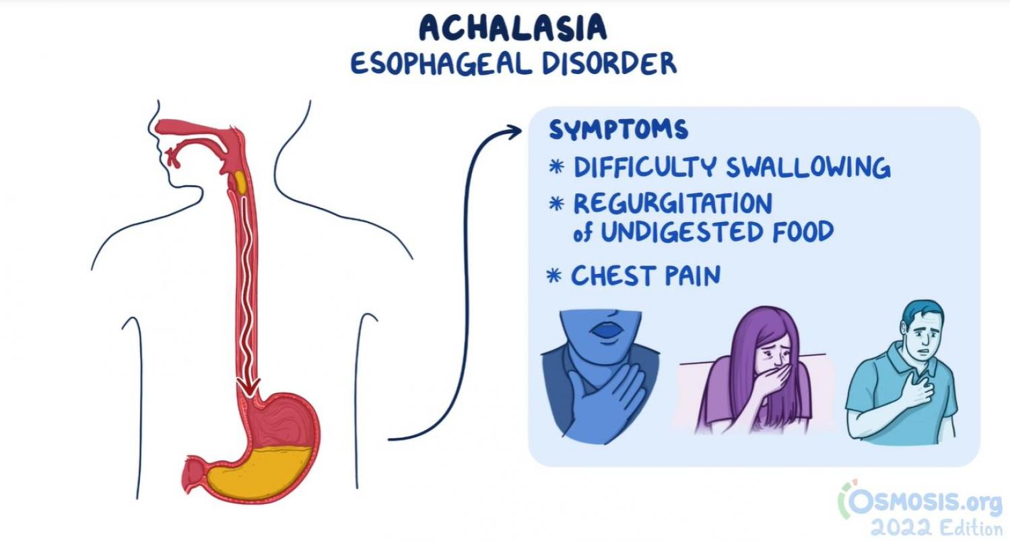
Achalasia
Solids and liquids
Weight loss & Heart burn
Is a rare swallowing disorder that affects the esophagus (the tube between the throat and the stomach).
People with achalasia, the esophagus muscles do not contract properly and do not help propel food down toward the stomach. At the same time, the ring of muscle at the bottom end of the esophagus, called the lower esophageal sphincter (LES), is unable to relax to let the food into the stomach

Slide 11
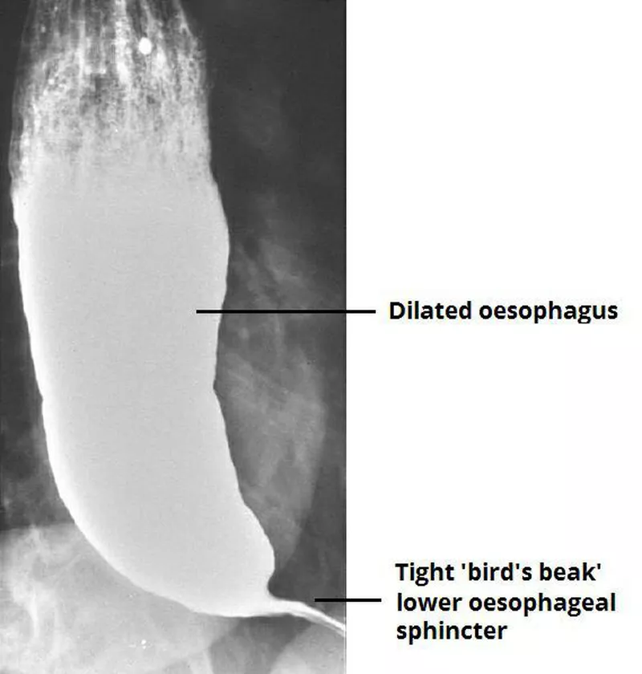
Achalasia
Diagnosis – Based on Symptoms
Barium Swallowing Test : will show a bird’s beak appearance ( Dilation of the esophagus and a narrow region at the End LES )
Esophageal Manometry :
measures strength and coordination of esophageal contraction when an individual swallows
there is no peristalsis and there is a raised resting pressure in esophagus

Slide 12
Achalasia
3.
Upper GI endoscopy: done to rule out esophageal cancer or secondary causes

Slide 13
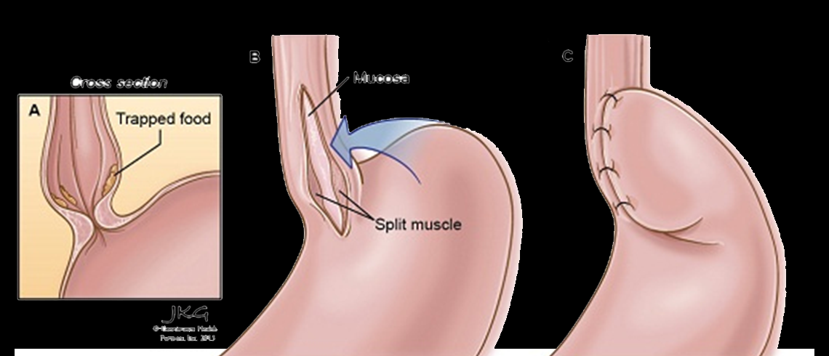
Achalasia treatment
Food eating changes increased amount of chewing)
Medications such as calcium channel blockers
Botox injection during endoscopy
Esophageal dilation ( pneumatic balloon )
Surgery; heller myotomy

Slide 14
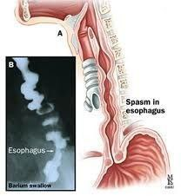
Diffuse esophageal spasms
Esophageal spasms are abnormal muscle contractions in the esophagus. These spasms make it harder for food to reach your stomach. They can be painful.

Slide 15
Symptoms of DES
•Chest pain or discomfort, often resembling angina (heart-related chest pain).
•Difficulty swallowing (dysphagia) or the sensation of food getting stuck in the throat.
•Regurgitation of food or liquids.
•Heartburn or acid reflux (though this is less common in DES compared to gastroesophageal reflux disease, or GERD)

Slide 16
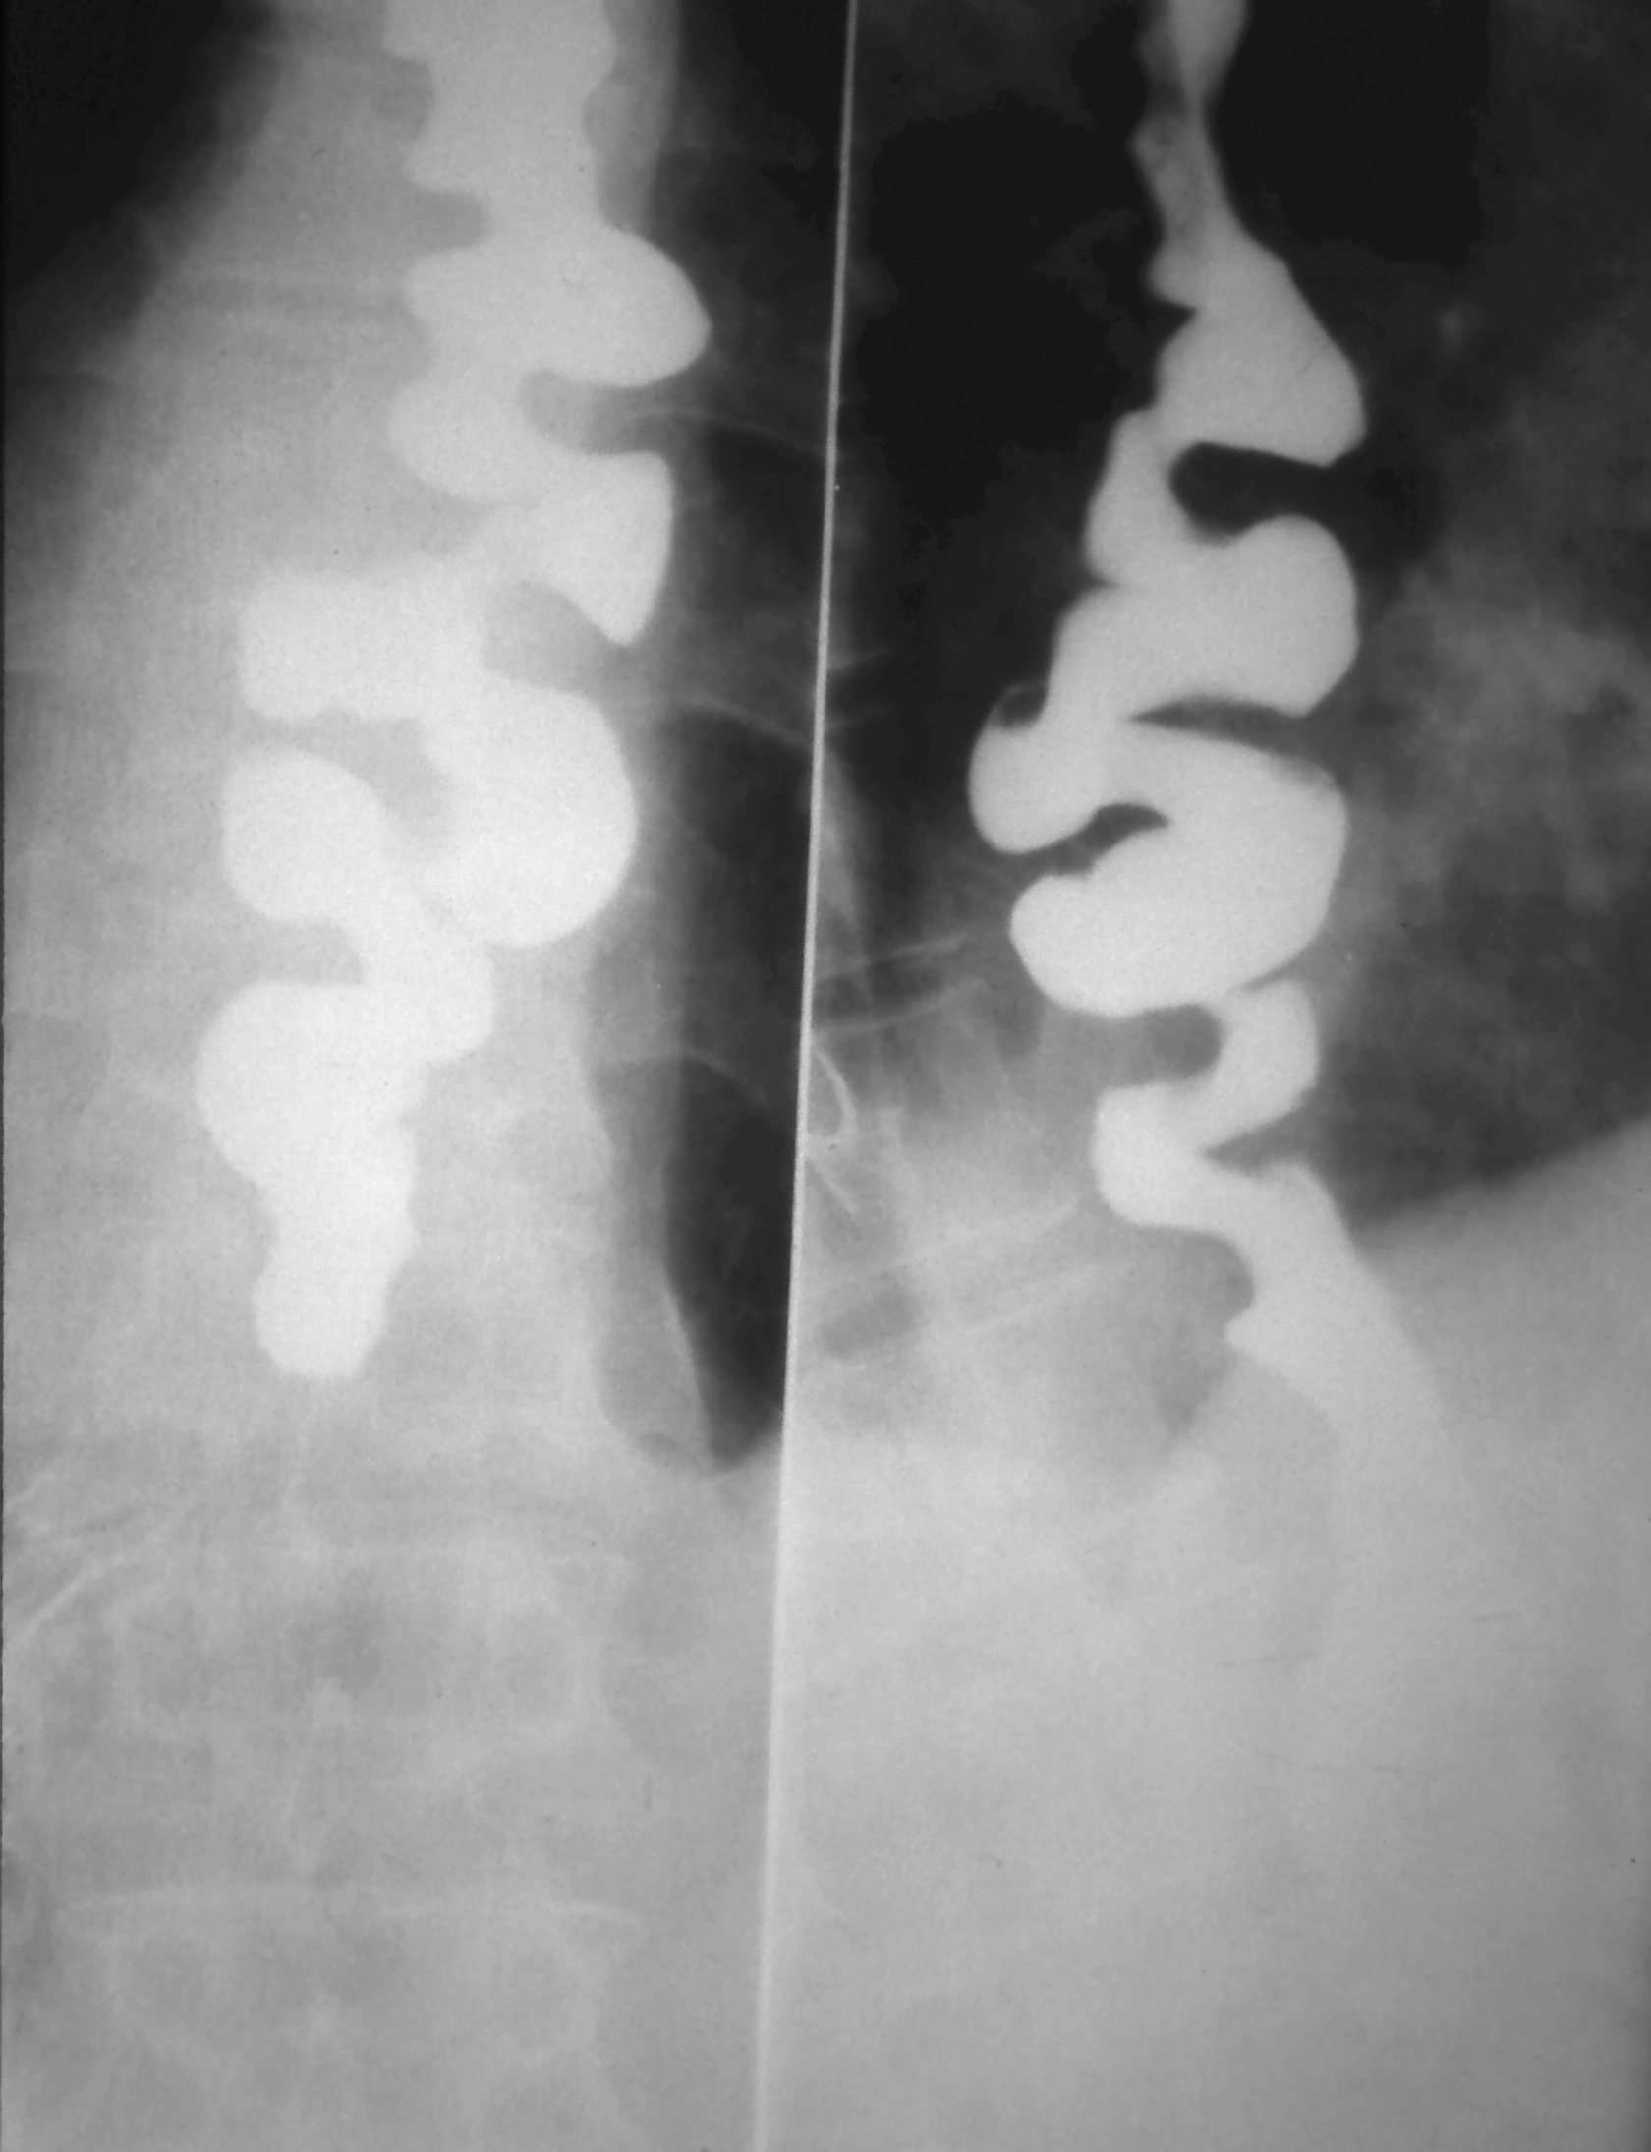
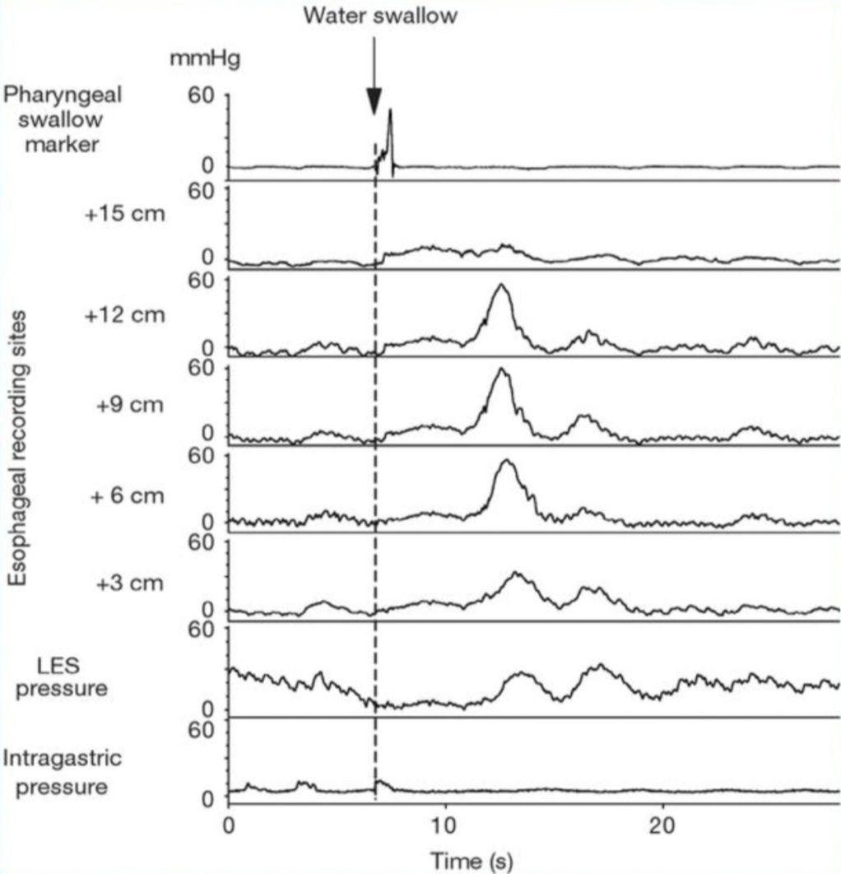
Diagnosis of DES
Diagnosis: Diagnosing DES typically involves a combination of tests, which may include:
1. Barium swallow: corkscrew esophagus
2. Esophageal manometry
3. Endoscopy
Treatment: NO CURE!
Calcium channel antagonists, vasodilators and endoscopic dilatation have only transient effects.

Slide 17
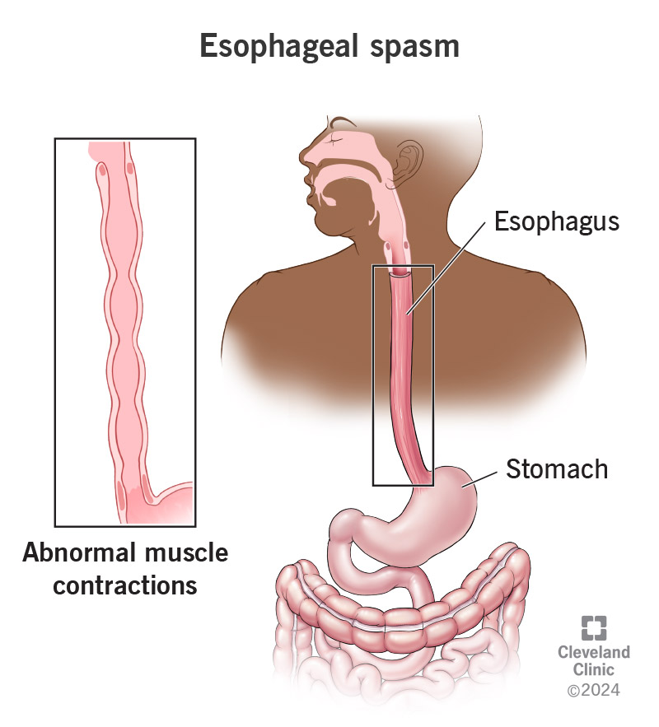
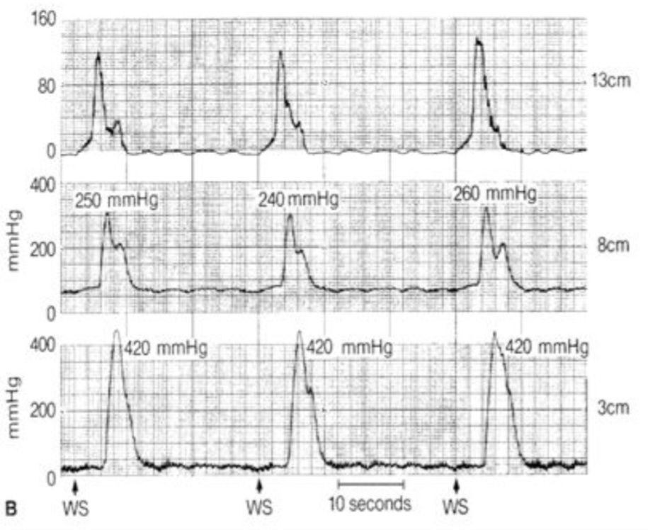
Nutcracker Esophagus
Described as an esophagus with hypertensive peristalsis or high amplitude peristaltic contractions in which peristaltic pressures of more than 180 mmHg develop
Symptoms:
1.episodic chest pain(most severe pain of all esophageal disorders)
2.dysphagia.
3. NO FOOD REGURGITATION.
Notes:
Treatment and diagnosis similar to DES

Slide 18
Benign esophageal stricture
narrowing of the esophagus, occurs when stomach acid and other irritants damage the lining of the esophagus, over time this leads to inflammation (esophagitis) and scar tissue which causes the esophagus to narrow.
The most common cause of stricture 80% is (GERD), also known as acid reflux.

Slide 19
Symptoms of benign esophageal stricture
Investigation
- Dysphagia - Weight loss - Regurgitation - Hiccups - Heartburn
1-barium swallow
2-endoscopy
3-Esophageal pH monitoring

Slide 20
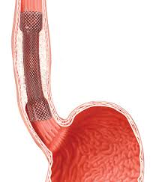
Treatment of esophageal stricture
Esophageal dilatation
Esophageal stent

Slide 21
Hiatus Hernia
It is a condition that occurs when the lower part of the esophagus and the cardia of the stomach or other organs move up in the chest through the hiatus of the diaphragm.

Slide 22
Schatzki’s ring
Schatzki ring is a benign, thin,
circular mucosal and submucosal
membrane seen at the
lower esophagus.
Its located approximately 2cm above gastro esophageal junction.
It is often associated with a hiatal hernia

Slide 23
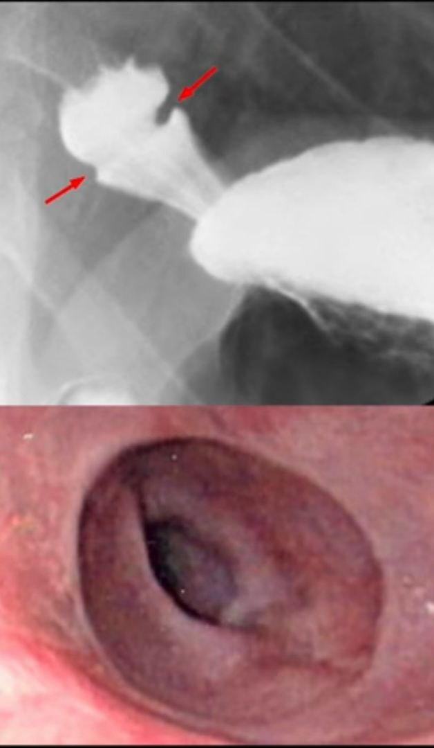
Pathophysiology
The pathogenesis is not clear but there are many hypotheses as :
The ring is congenital in origin.
The ring is a complication of gastroesophageal reflux disease or pill induced esophagitis.

Slide 24
Management & Investigation
-Investigation:
dysphagia
upper esophageal webs
-Treatment:
Balloon and bougie.

Slide 25
Plummer Vinson syndrome
Prolonged iron deficiency anemia causes postcricoid dysphagia and upper esophageal webs causing dysphagia, with unknown etiology.
Signs:
Angular stomatitis
Glossitis
Koilonychias
Pallor
Postcricoid webs
Symptoms:
dysphagia
odynophagia
Weakness , fatigue and dyspnea

Slide 26
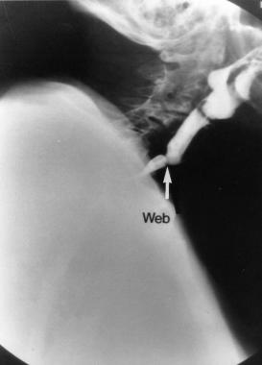
Plummer Vinson syndrome
Investigation:
1- complete blood cell (CBC) counts: decrease value of hemoglobin,hematocrit,mean corpuscular volume
2-Peripheral blood smear: microcytic hypochromic anemia
Decrease value of iron and ferritin
Imaging studies:
Barium swallow: it may detect the web,
which characteristically appears as a thin projection of the postcricoid, anterior esophageal wall

Slide 27
Pulmmer-vinson syndrome
Esophagogastroduodenoscopy (EGD):
If webbing is suspected, the endoscope should be advanced carefully.

Slide 28
Zenker diverticulum
A pulsion diverticulum of the hypopharynx, is a rare lesion that occurs in elderly populations. The pathologic process in Zenker diverticulum involves herniation of the esophageal mucosa posteriorly between the cricopharyngeal (CP) muscle and the inferior pharyngeal constrictor muscles.

Slide 29
Diagnosis
Gold standard is Barium Swallow.
*Symptoms:
-Halitosis
-regurgitation
-aspiration
-Dysphagia
*Treatment:
Only symptomatic lesions need treatment; lesions less than 2 centimeters rarely require treatment.
-surgery

Slide 30
Esophageal cancer
Pathology:
• Age:old age >50 years • Sex:males >females • Predisposing factors:
Barrets esophagus (most important)
achalasia
3.long standing reflux esophagitis.
4. Corrosive Stricture of the esophagus
5. Plummer Vinson syndrome
6. Spicy food,smoking, alcohol.

Slide 31
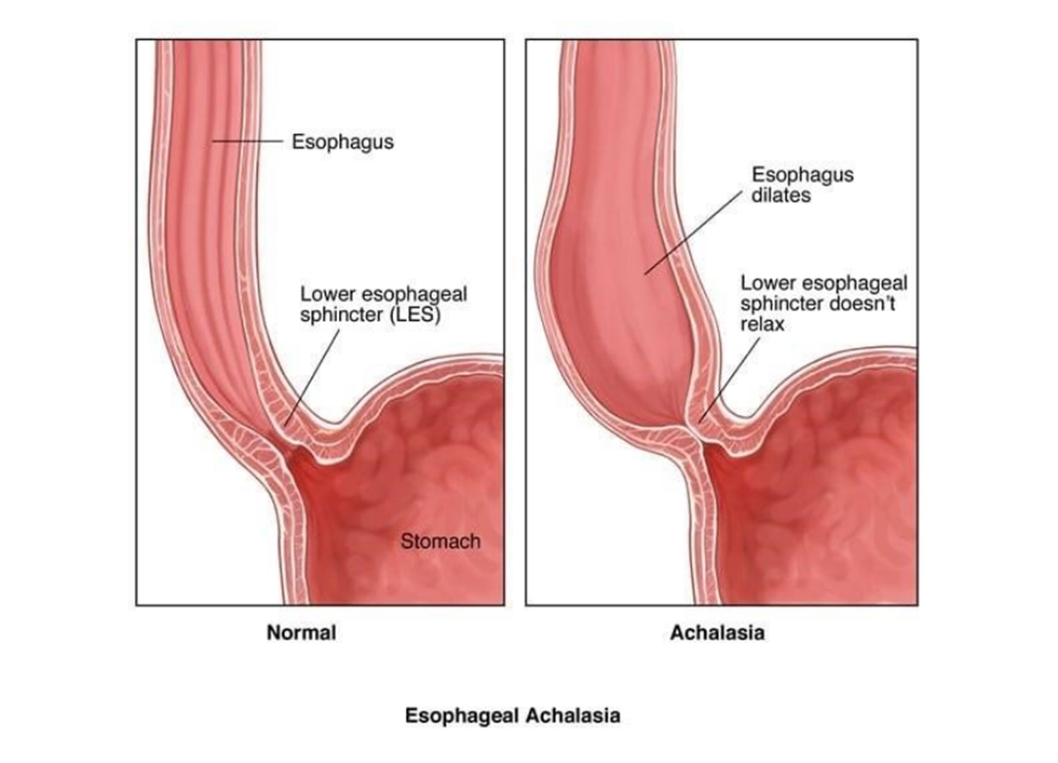
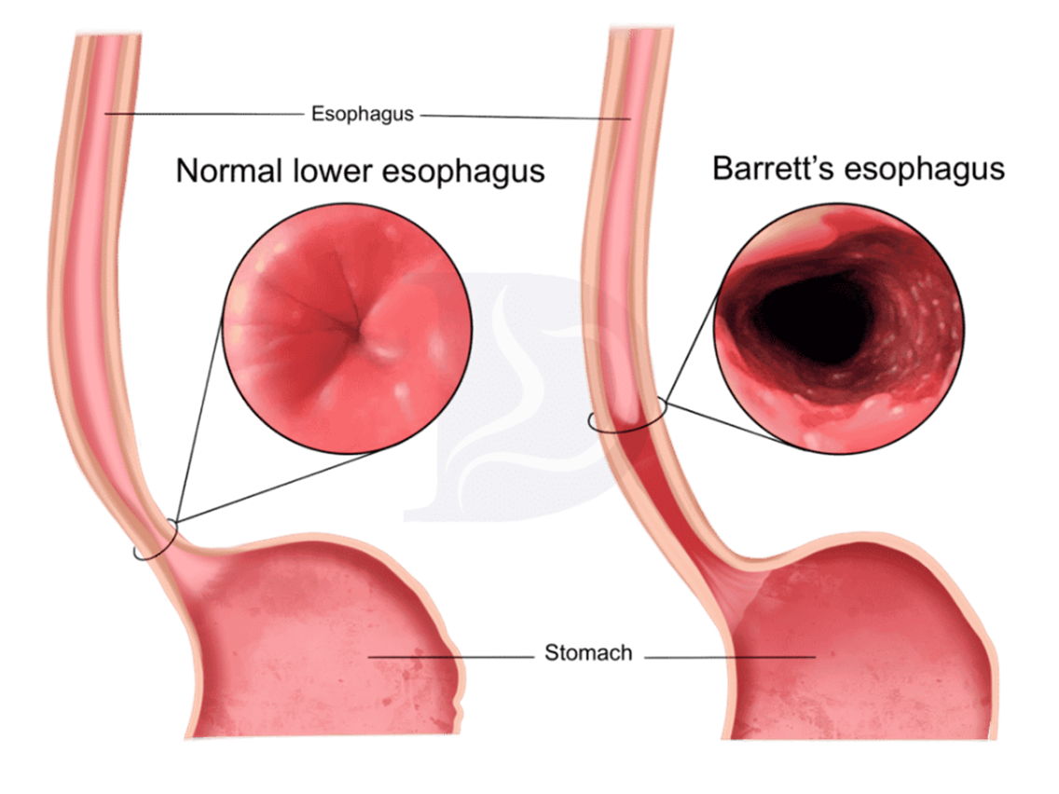
Barret`s Esophagus Achalasia

Slide 32
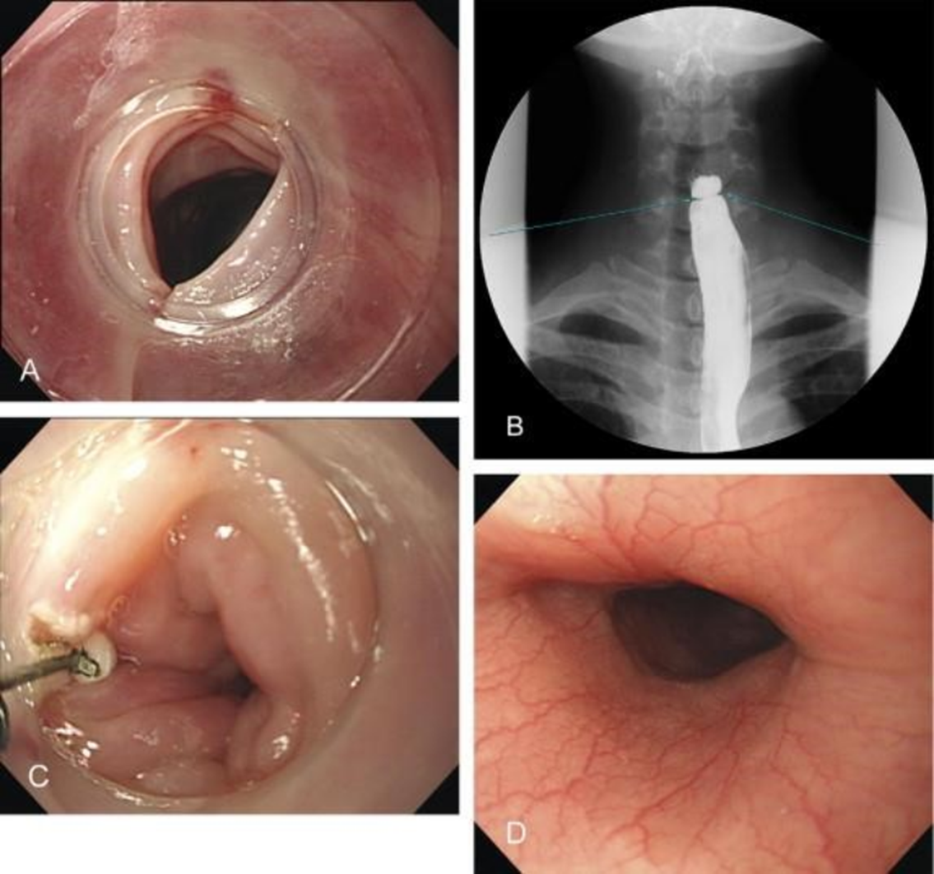
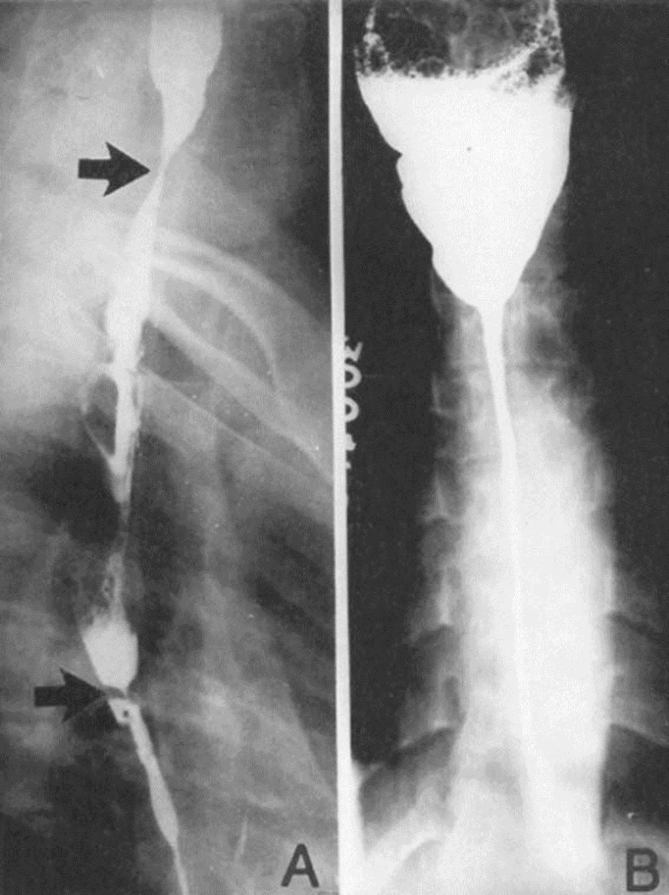
Esophageal web resolved by endoscopic incision in a patient with Plummer-Vinson syndrome
Corrosive Stricture of the esophagus

Slide 33
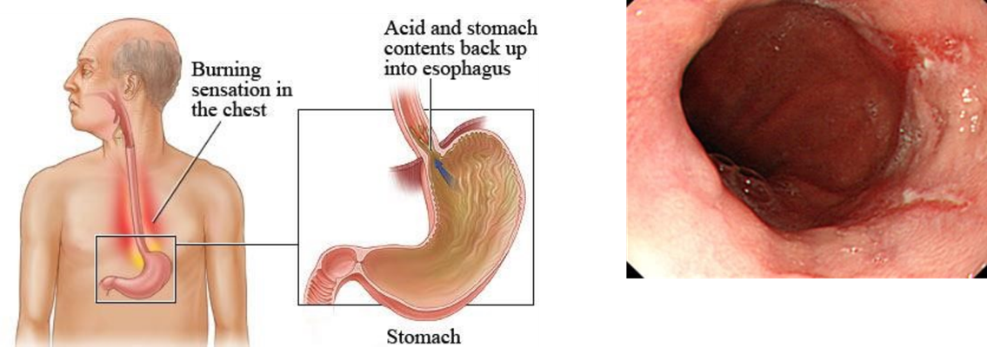

Slide 34
Microscopic pictures:
Site:
1.Middle 1/3 →50%(commonest)
2. Lower 1/3→33%
3. Upper 1/3 →15%
Gross appearance:
Ulcer.
Fungating mass.
Stricture.

Slide 35
Esophageal Cancer
1.Squamous cell carcinoma : the most common (middle esophageal
2. Adenocarcinoma: On top of baretts esophagus And upward spread from gastriccrcinoma

Slide 36
Esophageal Cancer/ Symptoms
◻ Progressive dysphagia is most common
◻ Initially with meat, then soft foods and liquids
◻ Dysphagia present late only when more than 60% of the esophageal circumference is infiltrated with cancer. With tumors of the cardia, anorexia and weight loss usually precede the dysphagia
◻ - Pain develops late ◻ Substernal, epigastric, or back area Increases with swallowing
◻ asymptomatic
◻ nonspecific upper GI symptoms
◻ stridor, tracheoesophageal fistula and coughing, choking, and aspiration pneumonia :Extension of the primary tumor into the tracheobronchial tree
◻ severe bleeding : from the primary tumor or from erosion into the aorta or pulmonary vessels occurs
◻ Vocal cord paralysis

Slide 37
DIAGNOSTICTESTING&findings
◻ we should start with barium swallow for prescence then followed by endoscope for diagnosis.
◻ Findings:
◻ Early esophageal cancers appear endoscopically as superficial plaques, nodules, or ulcerations .
◻ Advanced lesions appear as strictures , ulcerated masses , circumferential masses , or large ulcerations

Slide 38
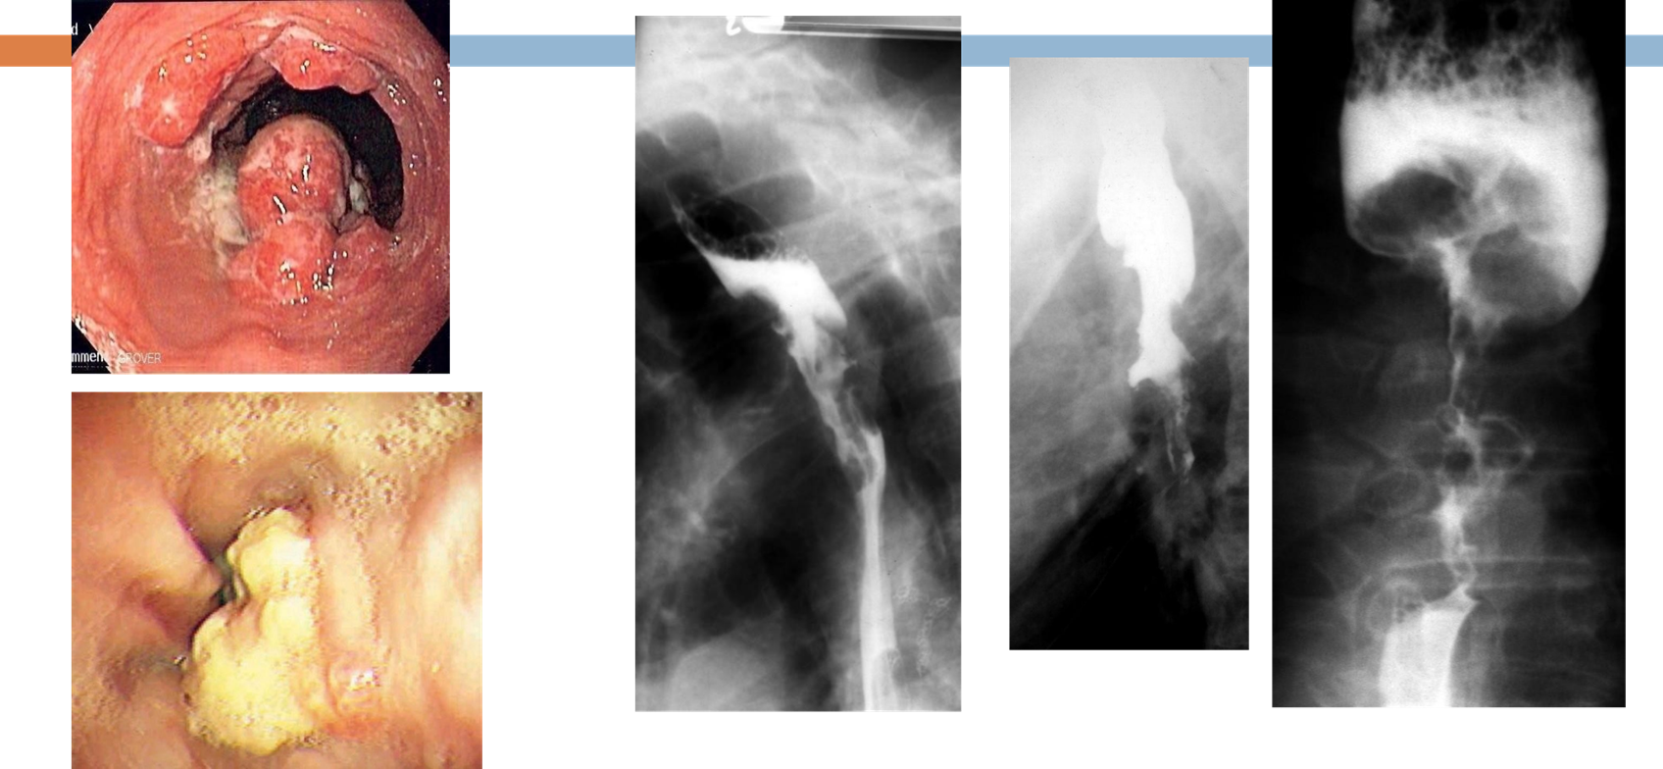

Slide 39
Staging
◻ Computed tomographic (CT)
◻ positron emission tomography (PET)
◻ Endoscopic ultrasonography
◻ Laparoscopy and thoracoscopy

Slide 40
Treatment
*Therapy of esophageal cancer is dictated by the stage of the cancer at the time
of diagnosis and (age, health, tumor location and extent):
◻ Stage I: resection of the tumor with adjacent lymph nodes.
◻ Stage II&III: resectionwith adjuvant/ neoadjuvant chemotherapy.
◻ Stage IV: palliativetherapy,for dysphagia(endoscopicplacement of an
expandable stent)
*Surgery must be done with
thoracoscope(VATS) or thoracotomy.
*It’s preferred by surgeons to do trans
hiatal esophagectomy for all tumor
locations

Slide 41
Approach:
HISTORY
EXAMINATION
INVESTIGATION

Slide 42
History
* Age of patient:
Children: foreign body or congenital malformations.
Middle aged patient: reflux esophagitis , hiatus hernia , anemia or achalasia.
Elderly patient : malignancy , strictures, motility disorders ass. With aging and neurological disorders..

Slide 43
History
*Difficulty in initiating swallow
Oropharyngeal dysphagia
*Food stuck after swallow in chest
Esophageal dysphagia
*Dysphagia related to solid food
Obstructive
*Solid and liquid
neuromuscular

Slide 44
Onset:
Progressive dysphagia
Neuromuscular , carcinoma
Sudden dysphagia
Foreign body , esophagitis
Intermittent dysphagia
Rings and webs , diffuse esophageal spasm , nutcracker esophagus
Ass. Symptoms:
aspiration , chocking ,drooling or nasopharyngeal regurgitation
Oropharyngeal dysphagia
Weight loss:
In elder patient
Carcinoma

Slide 45
HISTORY:
Pain after swallowing
Esophagitis
Regurgitation of old food with halitosis
Zenker’s diverticulum
Peptic stricture
History of heartburn

Slide 46
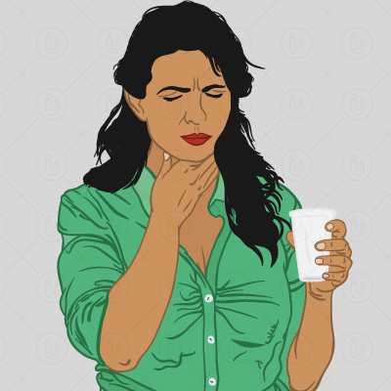
Surgical hx
medical hx
Drug hx

Slide 47
Physical Examination:
Genaral inspection:
Cranial nerve examination
Neurological examination
Oral cavity examination
direct observation of the act of swallowing

Slide 48
Physical Examination:
Neck examination:
Lymph node enlargement
Neck mases
Thyroid enlargement

Slide 49
Radiographic studies:
Plain X-ray
Barium esophagus
Modified barium swallow(gold standard)
MRI
CT
Lab tests:
.LFT, KFT, CBC, Thyroid function.

Slide 50
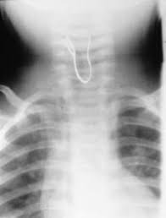
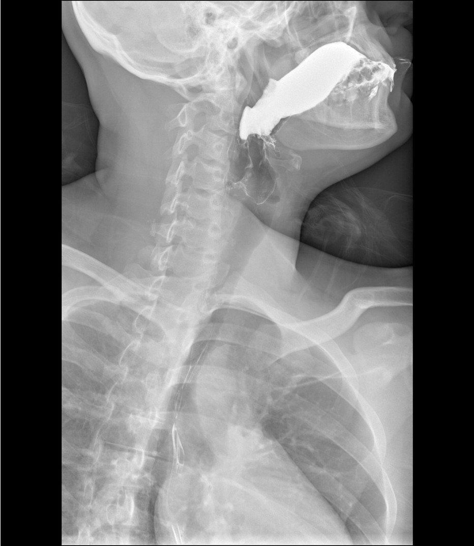

Slide 51
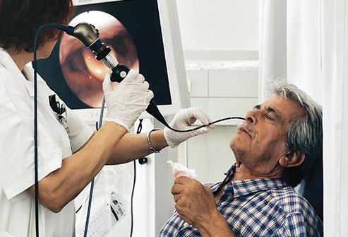
Endoscopy:
Rigid
flexible
Diagnostic:
Visual
Biopsy
Therapeutic:
Foreign body dissipation.
Stenting
dilatation

Slide 52
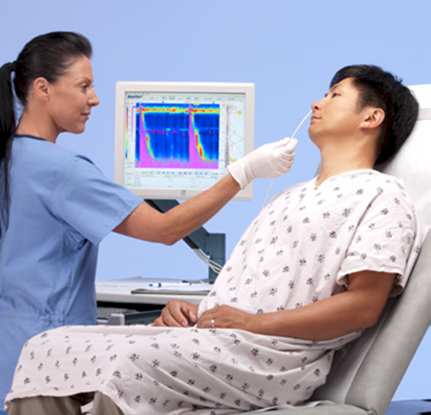
Manometry:
Indications:
Achalasia of the cardia
diffuse esophageal spasm
nutcracker esophagus
Hypertensive esophageal sphincter

Slide 53
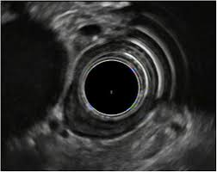
Endoscopic ultrasound:
Used for dysphagia due to carcinoma for T,N staging
Biopsy can also be taken
24 hour PH monitoring

Slide 54
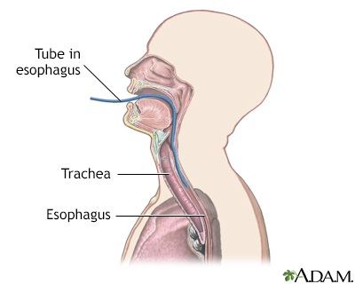
PH MONITORING

Slide 55
