Slide 1
Brain Tumors

Slide 2
Brain tumors are neoplastic growth within the brain.
They can be primary(30%) or Secondary metastatic(70%), benign or malignant.
Meningioma is the most common benign tumor overall in cadaveric studies ,while in clinical studies most common primary benign tumor is GBM.
Most common sources of mets:
Lung
Breast
GI tract
Kidney
Melanoma

Slide 3
Clinical evaluation
Obtain a thorough patient history and neurological examination.
Suspect a brain tumor in patients with clinical features including:
-Headaches (especially with headache red flags):
Recurrent vomiting
Change in sensorium(Level of consciousness)
Other signs of elevated intracranial pressure (ICP), e.g., papilledema
New onset seizures
Focal neurological deficits depending on tumor location, e.g., sensory deficits or focal motor weakness
Cognitive, behavioral, and personality changes

Slide 4
Grade vs. Stage: grade describes the appearance , stage describes size of tumour + how far it has spread from where it originated .
Also we classify them into : intra-axial, extra –axial tumours
WHO classification is according to :
1) histological appearance , into grades
2) Genetic mutation

Slide 5
Grading; 4 grades
Grade 1: cells looks like normal cells , slowly growing and likely to spread .Surgery is the only treatment you need .
Grade 2: cells look less normal, slowly growing but grow into near brain tissue .They have high recurrence rate after surgery comparing to grade 1 and some can develop into malignant tumour.
Grade 3 : tumour grows quickly, likely to spread into nearby tissue , cells are very different from normal cells
Grade 4:Tumor grows + spread very quickly , tumour cells doesn’t look like normal cell. ( there are necrotic cells)

Slide 6
Intra-axial is intra parenchymal, neuromas and gangliogliomas, gliomas ( astrocytoma +oligodendromas + glioblastoma+oligoastroglioma). They are infiltrative , they infiltrate to normal brain tissue , so we can’t differentiate it from the normal brain parenchyma even grossly.
Extra – axial is out of parenchyma, ex. Meningioma, ex. hemangioblastoma
Histological appearance depend on the type of tumour
Ex) pilocytic astrocytoma (low mitotic index )
EX) oligo dendroglioma , can be either low mitotic index so grade 1,
Or with high mitotic index so grade 2
EX)oligo astrocytoma is grade 2
EX)Diffuse astrocytoma is grade 3

Slide 7
Diagnostic imaging
1) Gadolinium-enhanced MRI head: preferred because it’s the best at visualizing soft tissue structures and vascularity.
gold standard to detect brain tumor is : MRI with contrast
On MRI : hyperintense not dense
2) CT head and neck with IV contrast (iodine): if MRI is not possible.
# Contraindications of MRI : Metal( retained bullets, prosthesis ,pace-maker )
Relative Contra-indications: claustrophobia
It’s advised not to do MRI in the first 4 weeks of pregnancy

Slide 8
Contraindications of giving Contrast(gadolinium) in MRI : End stage Renal disease
If you give Gadolinium-enhanced MRI contrast to a patient with End stage renal disease →7% chance to develop Nephrogenic systemic fibrosis (gadolinium nephrogenic systemic sclerosis)
note : common neurosx complication of end stage renal disease patients who are on hemodialysis is infection that may speared to brain and spine .
Remember : we can use CT with or without iodine based contrast ,in MRI the T1 is the only modality on MRI that contrast can be used.
3) Biopsy for histologic diagnosis.

Slide 9
Treatment
Treatment is based on type of tumor:
Surgery
Radiation: Whole brain radiotherapy (WBRT) , Stereotactic radiosurgery (SRS) /”that also called gama knife radiosurgery that can cauterization to specific area”.
Chemotherapy
Glucocorticoids for ↓ ICP

Slide 10
Types of brain edema :
1. Cytotoxic : Accumulation of fluid inside the cells(intra-cellular)
2. vasogenic : Accumulation of fluid Intra/extra cellular due to many underlying mechanisms(Breakdown of blood brain barrier due to brain tumor which releases cytotoxins making the vessels leaky .
Treatment is by glucocorticoids in acute stage, which stabilizes Blood Brain Barrier.
So it treat vasogenic edema thus decreasing the ICP causing by vasogenic edema ,so it’s a symptomatic treatment.
-BUT its not ttt for increase ICP itself.
3.interstitial : extracellular due to CSF leakage between cells ( main cause is acute hydrocephalus not increase in intracranial pressure)
Sign on CT: CSF seepage ,appear as hypodense in frontal, temporal , occipital bones

Slide 11
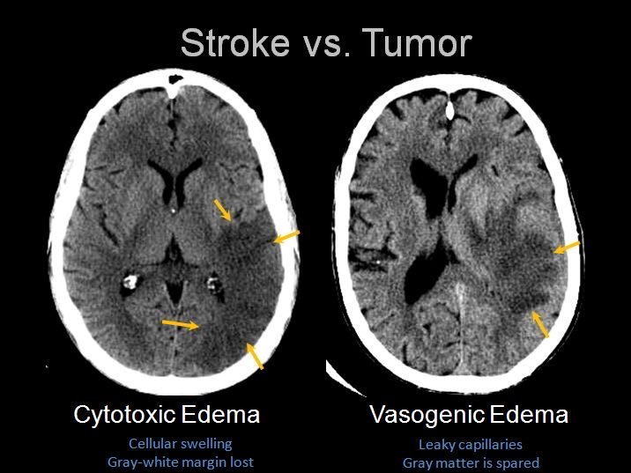

Slide 12
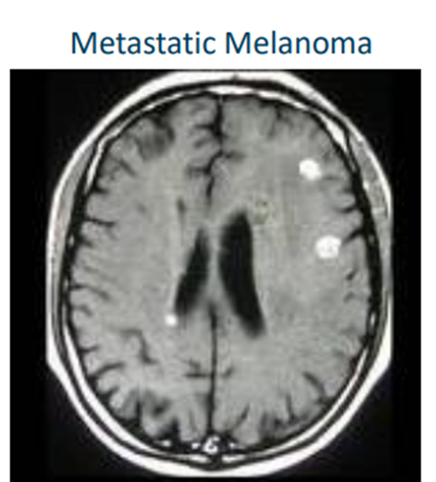
Brain Metastasis
One or more lesions
Usually at gray-white matter junction
Generally very poor survival (months)
Good survival predictors: age < 65, limited extracranial disease
1-3 lesions can be removed by surgery (>3 is palliative) .
Can significantly improve prognosis ,followed by radiation.
Multiple lesions often treated with radiation
Note :"The lung is the most common origin of primary tumors that metastasize to the brain.
Melanoma has the highest propensity to metastasize to the brain. Therefore, if you detect melanoma, it is advisable to perform a direct brain CT."

Slide 13
CNS Tumors

Slide 16
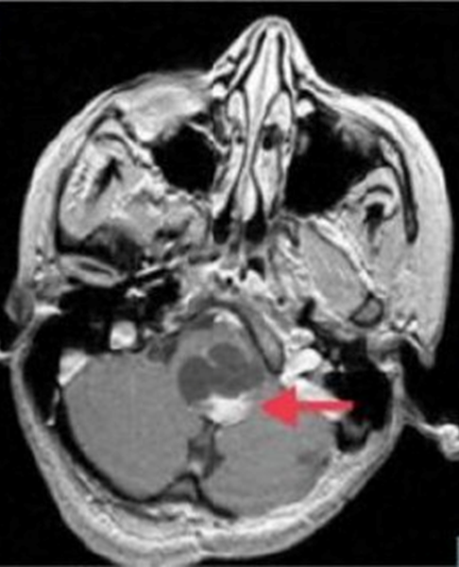
Pilocytic astrocytoma
Most common benign primary brain tumor in childhood, Astrocyte origin
Low-grade astrocytoma( WHO grade 1 )
It has a good prognosis.
• Pilocytic: fiber-like cells
• Usually in posterior fossa (cerebellum)
• Presents with cerebellar dysfunction: ataxia
• Usually slow-growing, well-defined circumscribed
• Often successfully treated with surgery
• Cure rates of 90 to 95%

Slide 17
Pilocytic astrocytoma
Even the tumor is benign and has good prognosis but it has a mass effect and we should resect it .
Pilocytic astrocytoma has solid (called a mural nodule “in the wall”) and cystic component .

Slide 18
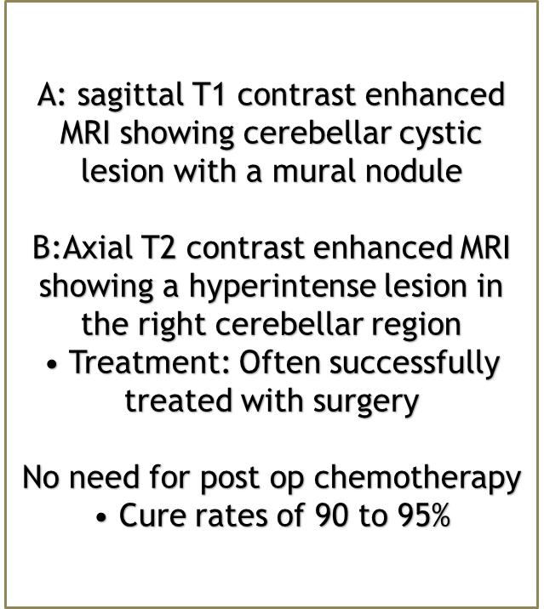
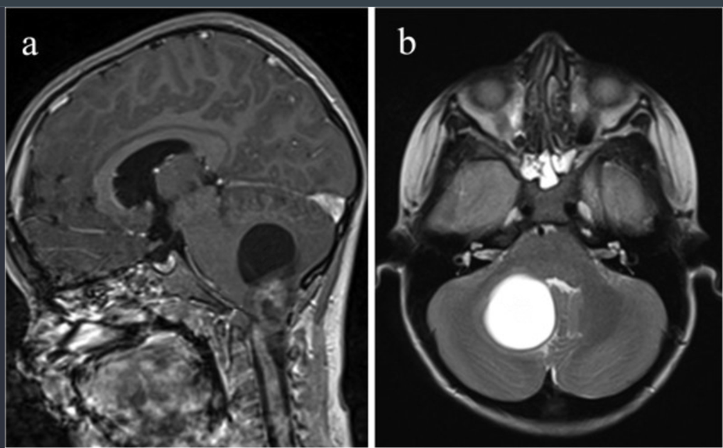
MRI head (a: T1-weighted; with contrast; sagittal plane; b: T2-weighted; axial plane) of a child
A large lesion in the right cerebellar hemisphere displaces the vermis to the left of midline. It has a large cystic component (T1 hypointense and T2 hyperintense; red overlay) and a heterogeneously enhancing solid nodular component (green overlay)

Slide 19
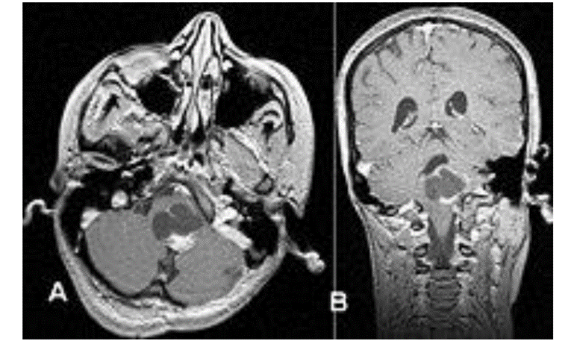
B:Coronal T1 contrast enhanced MRI showing ring enhancement
A:Axial T1 Contrast enhanced MRI showing a hyperintense mural nodule

Slide 20
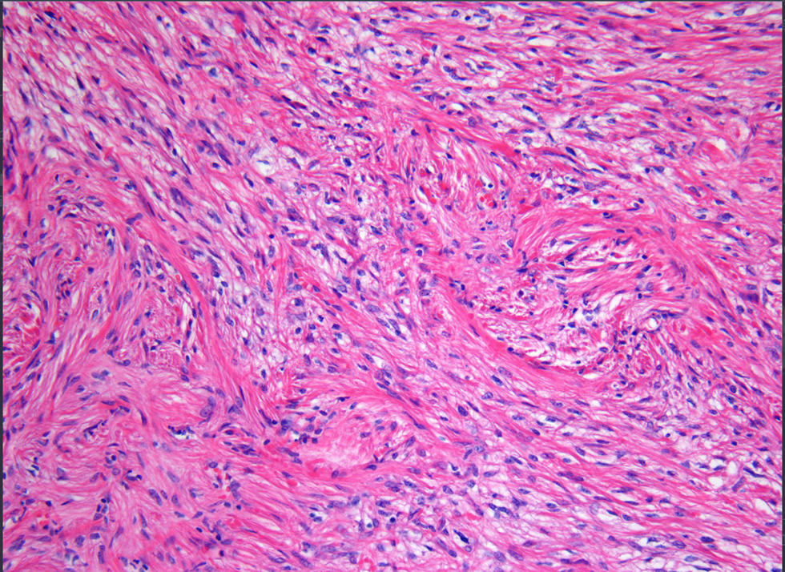
Rosenthal fibers
The bright red-pink bodies in astrocytes and indicate intense gliosis.

Slide 21
Medulloblastoma
•Originates from the roof of the 4th ventricle
Most common childhood malignant brain tumor
• Usually occurs in children
Associated conditions:- Turcot syndrome (Brain tumor-polyposis syndrome)
• Usually occurs in cerebellum
• Often midline causing Truncal ataxia
Truncal ataxia :A lack of coordination of voluntary movements that primarily affects the central body. Most commonly presents with an inability to sit upright and/or stand without support.

Slide 22
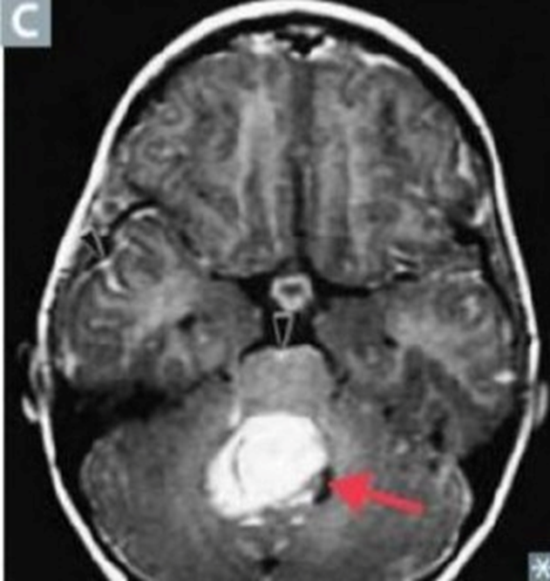
Homer-Wright rosettes

Slide 23
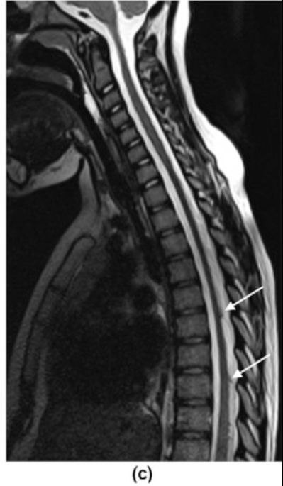
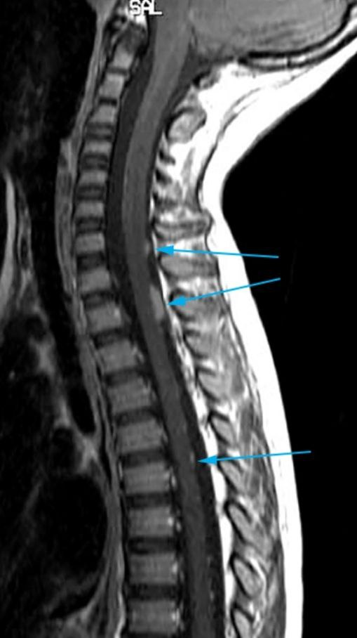
Can compress 4th ventricle → Non-communicating hydrocephalus
Symptoms of ↑ ICP: Headache, nausea, vomiting
Can spread to CSF causing DROP METASTASIS → Paraplegia
Drop metastasis :The metastasis of a primary central nervous system (CNS) neoplasm inferiorly, typically via cerebrospinal fluid (CSF). Typically presents as nodules along the spine and cauda equina that can cause back pain with neurologic symptoms (e.g., limb weakness). Can be detected by lumbar puncture.
ON MRI T1 contrast enhanced : sugar coating

Slide 24
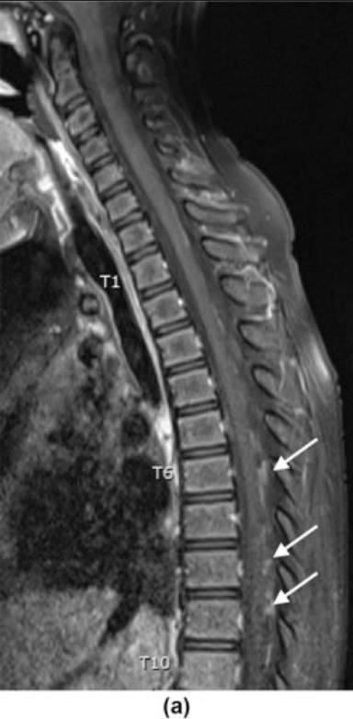
Medulloblastoma: most common pediatric CNS malignant tumor.
• Treatment: surgery, radiation, chemo
• 75% children survive to adulthood

Slide 25
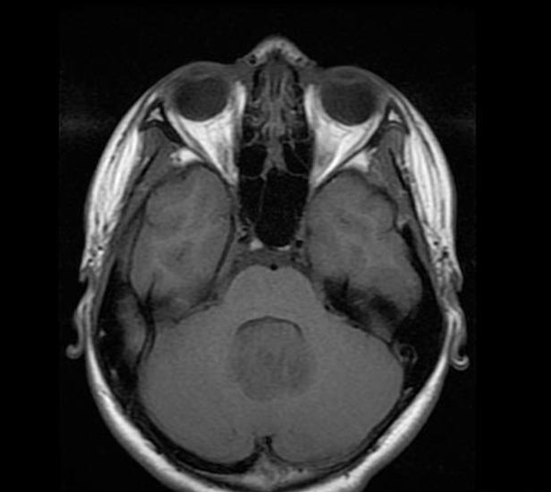
T2-weighted cranial MRI (axial view) of a 7-year-old boy with medulloblastoma
A lobulated heterogeneous mass in the midline at the level of the fourth ventricle shows intermediate-to-high T2 signal.
ON CT (or MRI) : banana sign

Slide 26
Ependymoma
Ependymoma originates from the base of the 4th ventricle .
Arises from ependymal cells of the ventricular system.
Associated conditions: neurofibromatosis type II .
Clinical features: 4th ventricle is the most common location in children → noncommunicating hydrocephalus → features of increased intracranial pressure (e.g., papilledema, headache)
Imaging: intra-parenchymal tumor with calcifications and cystic components .
Both medullo and ependymoma intraventricular within 4th ventricle . Both cause obstructive hydrocephalus .
Less likely to cause mets in contrast with medulloblastoma that cause drop mets.
The expansion to ependymoma usually like to exist and inter foramen of luschka and magendie while medullo not likely to see this expansion with it.

Slide 27
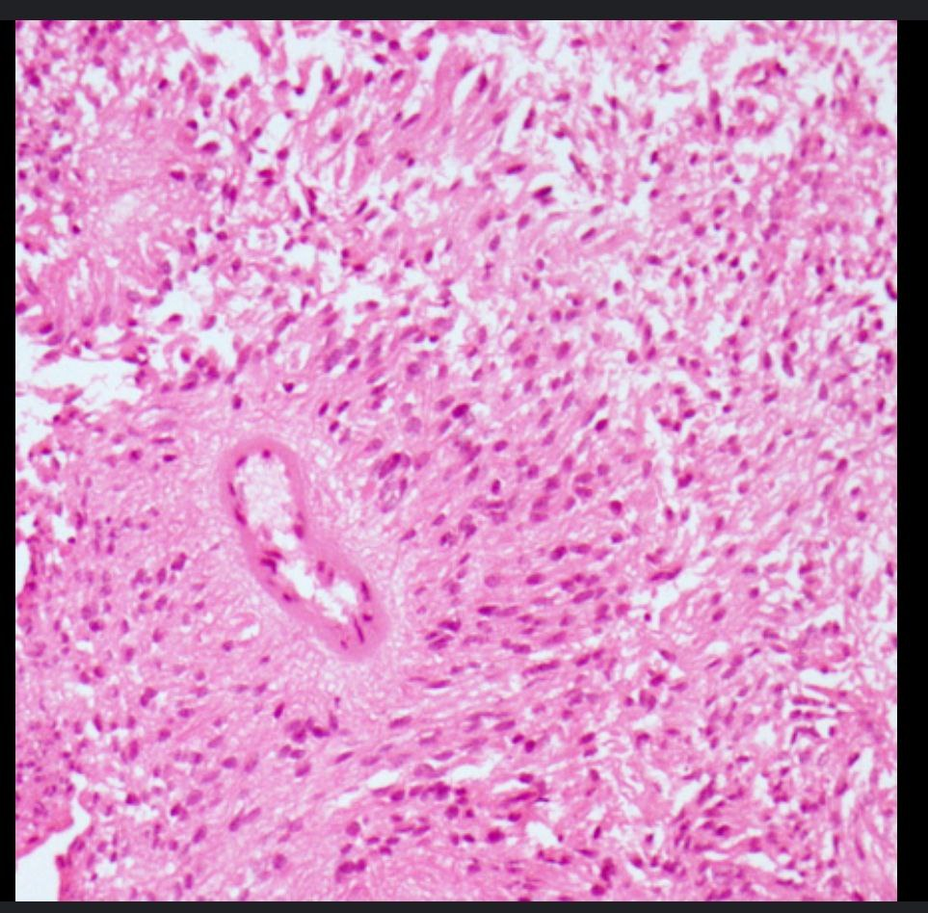
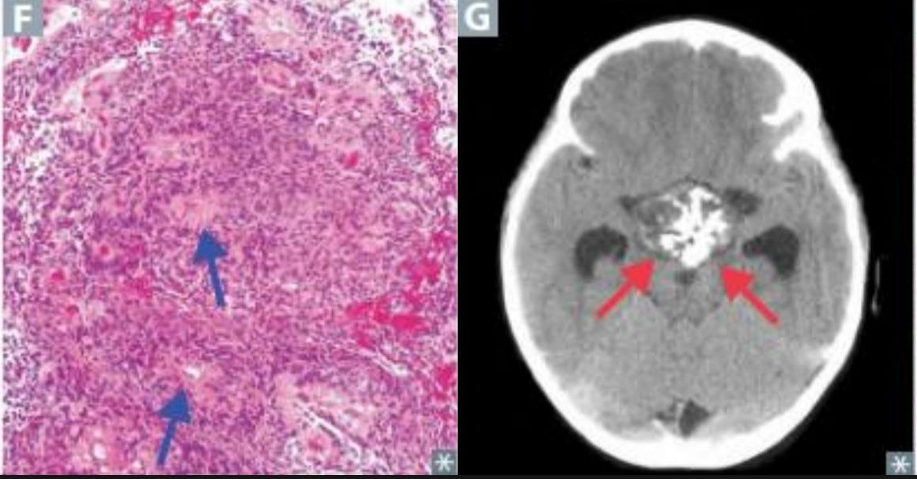
Histology :
• Ependymal cell origin.
• Characteristic perivascular
pseudorosettes .
• Rod-shaped blepharoplasts (basal ciliary bodies) found
near the nucleus.
Prognosis :usually poor
Treatment : surgery and radiation

Slide 28
Cranial MRI (FLAIR-sequence, sagittal view)
A hyperintense, heterogeneous, extended mass is visible on the roof of the 4th ventricle .At the superior aspect of the tumor, multiple cysts are present .As a result of an obstructed circulation of the cerebrospinal fluid, the 3rd ventricle appears widened

Slide 29
Craniopharyngioma
Craniopharyngiomas are approximately equally common in males and females. There is a bimodal age distribution, with one peak in children between 5 and 14 years old and a second peak in adults between 50 and 75 years of age.
There are two types of craniopharyngioma: adamantinomatous craniopharyngioma for pediatrics and papillary craniopharyngioma for adult .
Pediatric type :
Most common childhood supratentorial tumor.
Craniopharyngiomas usually arise along the pituitary stalk in the suprasellar region adjacent to the optic chiasm .

Slide 30
Compression of the pituitary gland due to intrasellar extension (stalk effect) → hypopituitarism
Hypogonadotropic hypogonadism
Failure to thrive.
Central diabetes insipidus.
Compression of the infundibular stalk → disconnection hyperprolactinemia
Compression of the optic chiasm → bitemporal hemianopsia(visual fields are lost in outer portion of both eyes in temporal field)

Slide 32
MRI head (T1 weighted; with contrast; sagittal plane) of a patient with acute visual loss in the right eye
There is an intrasellar and suprasellar mass with both cystic and solid portions. The solid portions show strong contrast enhancement.

Slide 33
Pinealoma
Pineal gland :A gland located along the midline on the dorsal surface of the midbrain. Secretes melatonin and plays a role in the control of circadian rhythm.
Pinealoma : Most commonly extragonadal germ cell tumors. ↑ incidence in males.
a tumor that forms in or near the pineal gland, and also called third eye tumor.
Occur in children 1 to 12 years old
They are often germ cell tumors (extra-gonadal tumors)

Slide 34
Clinical features and treatment
Compression of dorsal midbrain leads to:
Compression of tectum(important for coordinating upward gaze) → vertical gaze palsy (Parinaud syndrome)
Compression of cerebral aqueduct → noncommunicating hydrocephalus
Compression of hypothalamic inhibiting pathways → increased hCG secretion → precocious puberty
Histology :Approx. 70% are germinomas (similar appearance to testicular seminoma)
Highly responsive to radiation therapy .
Survival rates > 90% in localized cases .

Slide 35
Parinaud syndrome:
(compression of dorsal
midbrain)—triad of upward gaze palsy, convergence-retraction
nystagmus, and light-near
dissociation.(Pseudo-Argyll-Robertson pupils: react to accommodation but not light.)

Slide 36
Adult tumors

Slide 37
Glioblastoma
• Most common primary brain tumor in adults
• Derives from astrocytes
• Occurs in cerebral cortex
• Butterfly appearance on MRI
• Tumor spanning corpus callosum
• Rapidly progressive
• Usually fatal < 1 year • Half of patients > 65 years old
• Older age = worse prognosis

Slide 38
GBM : Grade 4
highly vascularized , necrotic because of high mitotic index ,so blood supply isn’t enough for all the cells .
On MRI ring enhancing lesion .
Buttery appearance on MRI ( only occur late
Gliomas are infiltrate with axons
Corpus callosum connect right with left hemisphere
Hallmark for GBM IS on MRI is ring enhancement
The gold standard modality for brain tumours is MRI

Slide 39
Pseudopalisading
butterfly glioma

Slide 40
Histopathology
“ Pseudopalisading” cancer cells typically recruit BV to provide nourishment in a process called angiogensis , but gliobalstoma proliferates so fast that even with angiogensis the neuitrient demand outpaces blood supply , as a result because the blood supply serves peripheral tumor cells first , the tumor cells in the center die first because the are the furthest from blood supply , the remaining viable tumor collect along edges of necrotic region ( neucli are lining up on the edges because they are being pushed out from something in the middle which is the necotic cells )

Slide 41
Glioblastoma
Diagnosis : Neurologic exam , imaging test , biobsy
Treatment :
• Surgical resection
Neoadjuvant (pre-surgery) radiation
Temozolomide
Oral alkylating agent
Given daily during radiation
Followed by post-radiation cycles

Slide 42
Meningioma
A meningioma is a tumor that arises from the meninges (the membranes that surround your brain and spinal cord). Although not technically a brain tumor, it is included in this category because it may compress or squeeze the adjacent brain, nerves and vessels.
• Second most common brain tumor in adults
• From arachnoid cells
• Forms along dura
• “Extra-axial” - external to brain
• Can have dural attachment ("tail")
• Usually benign (no metastasis) and resectable
• Treatment: observation or surgical resection

Slide 43
meningioma
• Often asymptomatic, typically benign
• Tissue compression can cause focal defects or seizures
• Classically affects female more than males
• Expresses estrogen receptors
• Prior radiation to head is risk factor
• Childhood malignancies
• Latency period ~20 years

Slide 44
Meningioma
Histology:
Psammoma bodies (laminated calcifications)
Spindle cells concentrically arranged in whorled pattern.

Slide 45
Meningioma
CT scan :
Extra-axial ( external to brain parenchyma ) so can attach to dura and have this ” tail” of thickened dura from the meningioma cells.

Slide 46
Meningioma
Characteristic of meningioma on CT scan : it appears on the outside pushing its way in, no little fingers of growth diving into the cortex because it is extra-axial.
Treatment : Because most meningiomas grow slowly, often without any significant signs and symptoms, they do not always require immediate treatment and may be monitored over time.

Slide 47
Meningioma's come from arachnoid cap cells
Appear on MRI as Dural tail + vivid enhancement ( on T1 with contrast)
axial T1 without contrast
Dural tail : mean that there is expansion
On MRI without contrast meningioma appears as iso-intense on both T1 and T2
If you found blood vessels are hyper-intense , then this is with contrast
CT with contrast because sagittal sinus is enhanced
Note: meningioma is highly vascular
Note: in digital substraction angiography (DSA) , what is substracted is the bone
Note: meningioma on DSA , mother in law sign (as you give contrast , when it comes out of the vessel it vanishes, comes early goes late
Meningioma : ( grade1)

Slide 48
Schwannoma
third most common adult primary brain tumor
Derives from Schwann cells of PNS
Classically at cerebellopontine angle involving both CN 7 and 8 , but can be along any periphral nerve . Often localized to CN 8 in internal acoustic meatus , leading to vestibular schwannoma that presents as:
Cochlear nerve lesions: hearing loss, tinnitus
Vestibular nerve lesions: ataxia, rarely vertigo
Rarely compresses trigeminal (V) or facial (VII) nerves
Facial paralysis or paresthesias
Treatable with surgery for resection and radiation

Slide 49
Internal acoustic meatus is a ring neuro-vascular bundle passes from it CN7 (UP) and CN8 , divided into vestibular and cochlear
Facial palsy is always late presentation of schwannoma
Note : sensory effect of any nerve Is affected sooner than motor.
Labyrinthine artery moves with this neurovascular bundle
Shwanomma: (grade 1)
Most common schwannoma is vestibular schwannoma
CN5,CN7,CN8: are bundle nerves , schwannoma comes out of them .

Slide 50
Histology : dense , hypercellular areas containing spindle cells alternating with hypocellular , myxoid areas
vestibular schwannoma

Slide 51
Neurofibromatosis
Type 2 (less common)is ass/w :
• Bilateral schwannomas: almost all patients with Neurofibromatosis develop Bilateral schwannomas.
• Many patients also develop Meningioma.
•Neurofibromas
•Lisch nodules
•Café-au-lait spots

Slide 52
Neurofibromatosis type2
Lisch nodules :hamartoma in iris
Note: schwannomas are typically benign tumours that occur sporadically in neurofibromatosis type2 or in an intially called schwannomatosis
If NF2 is pathognomonic for bilateral schwannoma

Slide 53
Oligodendroglioma
• Rare, slow-growing tumors of oligodendrocytes
• Most patients 25 to 45 years old
• White matter of the cerebral hemispheres
• Usually in frontal lobe
• Most common presenting symptom: seizure
• Contrast with glioblastoma
• Older patient
• Fast growing
• Worse prognosis
Histology :“ Fried egg” “ Chicken-wire “ capillary pattern

Slide 54
Oligodendroglioma most common location prefrontal cortex

Slide 55
Pituitary Adenoma
Formed by hormone secreting cells of anterior pituitary , may be nonfunctioning or hyperfunctioning .
classified by the hormone that is released as tumor forms, and by size of tumor .
The non-functioning type 1.presents with mass effect (like : bitemporal hemianopia , due to pressure on optic chiasm you can't see in the outer portion of both your eyes. )
2.Pituitary apoplexy is characterized by a sudden onset of headache, visual symptoms, altered mental status, and hormonal dysfunction due to acute hemorrhage or infarction of a pituitary gland.
3. Hypopituitrism

Slide 56
Optic chiasm is anterior superior to pituitary
Temporal hemianopia can be seen in suprasellary ( craniopharyngioma) or in intrasellary tumours ( pituitary adenoma)

Slide 57
Pituitary adenoma can be classified as;
Functional or non-functional
Or based on the secreted hormone
Also can be classified according to the size : into micro or macroadenoma
Microadenoma | Macroadenoma
Less than 1 cm | More than 1 cm | Size
Present with hormonal symptoms | Present with visual symptoms | Presentation
Note:
If there is hormonal symptoms patients will come earlier

Slide 58
Pituitary Adenoma
Hyperplasia of only one type of endocrine cells found in pituitary , most commonly form lactotrophes , causes hyperprolactinemia present at galactorrhea, amenorrhea , decrease in bone density , decreased libido and infertility in men.
Somatotrophes : acromegaly , gigantism.
Corticotrophins : Cushing disease
Rarely from thyrotrophes and gonadotrophes
•<10mm = microadenoma
•>10mm = macroadenoma

Slide 59
Pituitary Adenoma

Slide 60
Treatment
There are three types of treatment used for pituitary tumors:
surgical removal of the tumor
radiation therapy using high-dose x-rays to kill tumor cells
medication therapy to shrink or eradicate the tumor.

Slide 61
Surgical approach
The transsphenoidal approach involves accessing the tumor through the nasal cavity using either a microsurgical or endoscopic approach, whichever the surgeon prefers. Surgery is usually combined with the use of computer guidance, allowing a minimally invasive approach.
Transsphenoidal surgery is invariably the procedure of choice in small “functional” adenomas and in most macroadenomas, with the exception of prolactinomas. In prolactinomas (prolactin hormone-secreting microadenomas or macroadenomas), the use of a specific dopamine agonist medication is generally advised with surgery reserved for those tumors failing to show a good response to the treatment.
Transsphenoidal surgery is generally very well tolerated because of its minimally invasive characteristic, few side effects and quick patient recovery. Patients can often leave the hospital as early as two to three days after surgery.

Slide 62
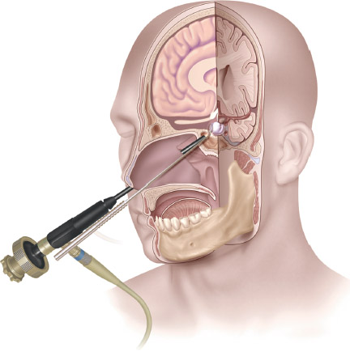
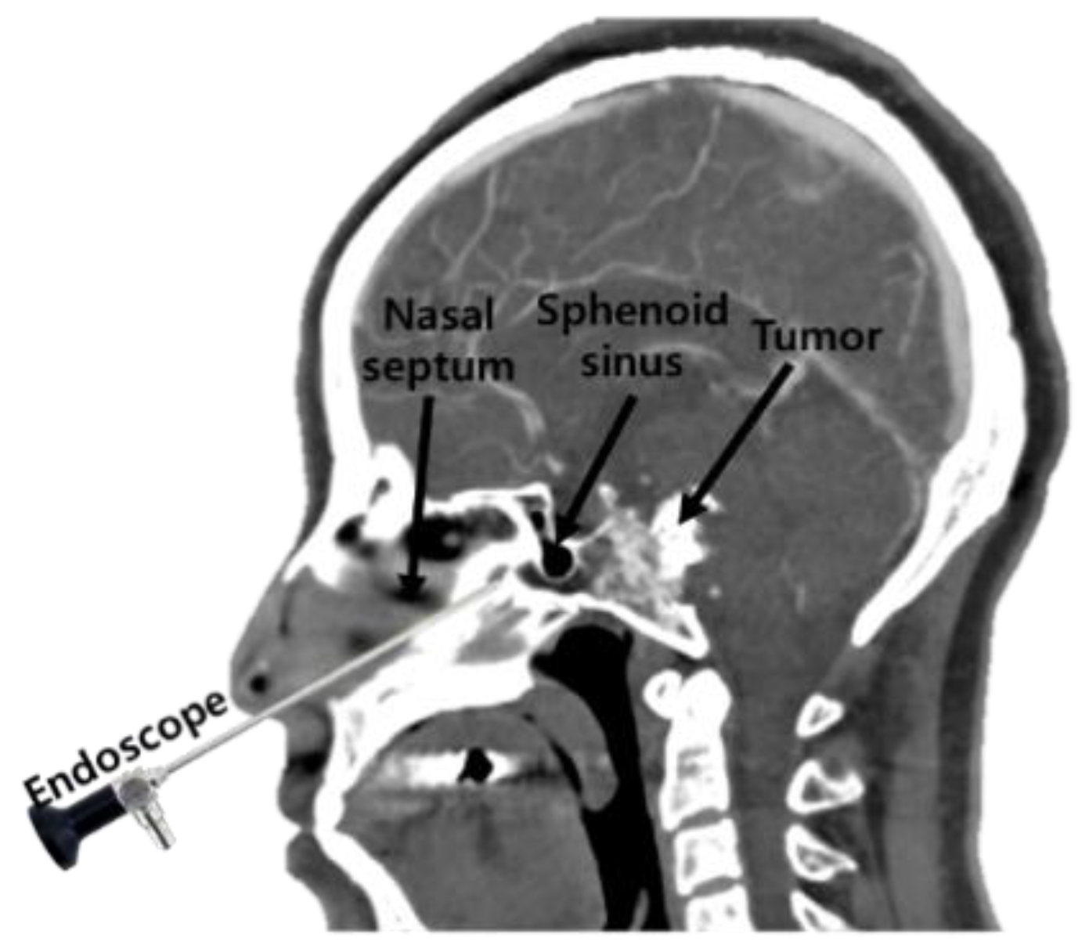
Transsphenoidal procedure

Slide 63
All types of pituitary adenoma is treated surgically except prolactienoma, treated non-surgically (cabergoline or bromocriptine)
Note: cabergoline safest
Macro pituitary adenoma emergent surgery ( vision saving surgery if you didn’t do it there is permanent visual damage
Also growth hormone secreting pituitary adenoma (emergent surgery ), they also should undergo colonoscopy ((screening )),why? High risk of colon cancer
Choices of surgery : 1) coventional surgery ( fronto –parito-temporal craniotomy) ,2)Endonasal trans-sphenoidal resection (best for tumours that are small in size , also confined to sella even if there is some suprasellar extension ),BUT contraindicated in massive suprasellar extension .
Internal carotid artery is adherent to sella turcica

Slide 64
Hemangioblastoma
Description: highly vascularized neoplasm
Epidemiology :20–50 years
Associated conditions: von Hippel-Lindau disease(AD , tumor suppressor gene mutation)
Clinical features:
cerebellum is the most common location → cerebellar defects(ataxia, imbalance, uncoordinated movements (dysmetria), dysarthria, and oculomotor disorders (e.g., nystagmus
Erythropoietin production by tumor cells → secondary polycythemia
Diagnostics:
MRI; cystic mass with a non-enhancing wall and an enhancing mural nodule
Biopsy: thin-walled capillary vessels, densely packed together with scarce parenchyma

Slide 65
Hemangioma is the most common posterior fossa tumor in adults , but this isn’t the only site of it , but it can also be found in spinal cord
VHL any patient with hemangiomblastoma , look for VHL , because they are highly associated together ( chromosome 3)
Which tumour is associated with polycythemia ? (Hemangioblastoma)
On MRI hemangioblastoma and pilocytic astrocytoma both look the same
BUT hemangioblastoma appears as mural nodule that is toward a vascular structure , so you will find the hemangioblastoma attached to sinuses

