Slide 1
Acne Vulgaris & Rosacea
Tala Alshahateet
Lana M Fraijat
Waqar Mahameed

Slide 2
Table of contents
01
02
03
04
05
06
Pathogenesis
Acne variants
Differential diagnosis of Acne
Available treatments
Rosacea
Acneform skin rash

Slide 3
ACNE
a common skin condition that happens when hair follicles under the skin become clogged. Sebum—oil that helps keep skin from drying out—and dead skin cells plug the pores, which leads to outbreaks of lesions, commonly called pimples or zits.

Slide 4
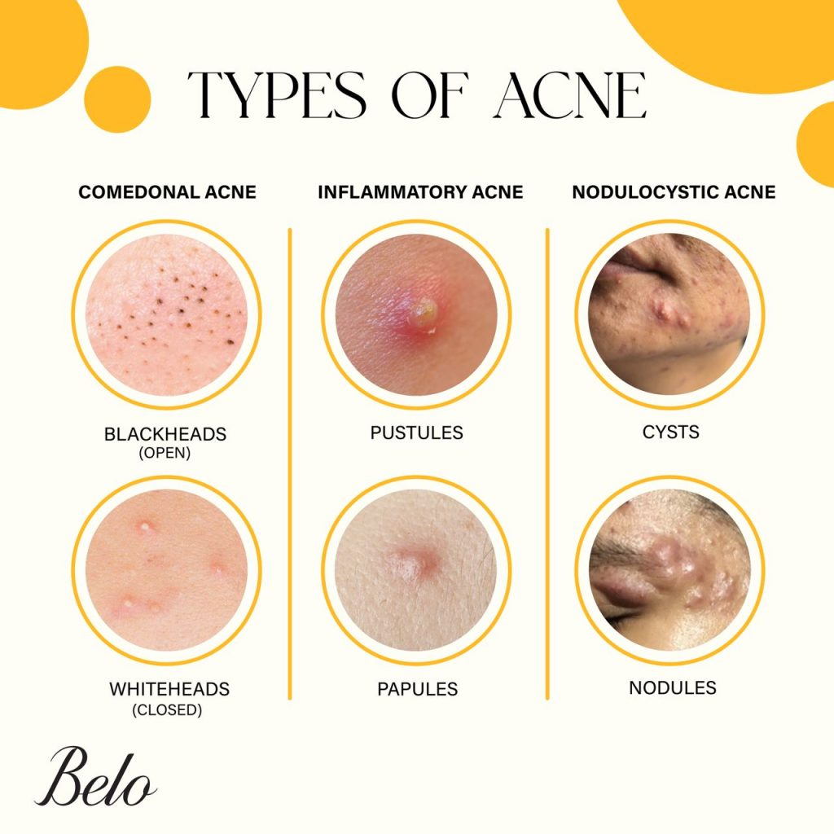

Slide 5
Risk factors and complications
Risk factors | Description | Prevalence | Contributing factors | Complications | Severity
Genetics | Genetic predisposition to the disease | 80% of cases | Family history | Dark spots | High
Hormonal changes | Fluctuations in hormones can lead to increased oil production | 30% of cases | Puberty, menstrual cycles, pregnancy | Scarring | Moderate
Excess oil production | Overactive sebaceous glands produce excessive oil | 40% of cases | Sebaceous glands | Emotional distress | High
Bacteria | Bacteria on the skin can contribute to inflammation and acne | 10% of cases | Bacterial growth | Anxiety | Moderate

Slide 6
01
Pathogenesis

Slide 7
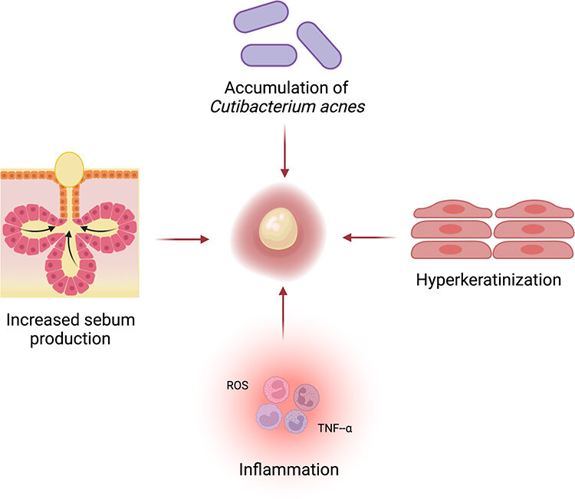
Family history predisposition leads to interaction between: - Hormonal role, androgens, Testosterone, DHEAS. - Increased sebum production. - Hypercornification of the pilosebaceous duct (infundibulum). - Role of propionibacterium acne - enzyme production (lipase).
Formation of comedones papule pustule cyst scar.
Comedones : are small, flesh-colored, white, or dark bumps that give skin a rough texture.
→ are essential and characteristic for acne diagnosis

Slide 8
Propionibacterium
Acne
(lipase)
Increased sebum production
inflamatory respons
(lesions)
Comedone formation
Follicular hypercornification

Slide 9
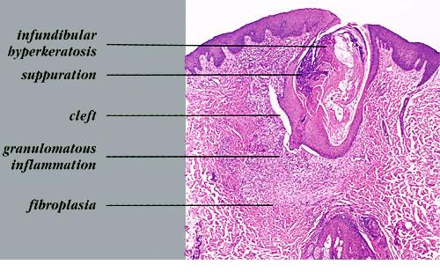
The infundibulum segment is the upper portion of the follicle

Slide 11
Usually in teenagers and asymptomatic , in the face ( most common) , arms ,back and upper chest .
Non inflammatory lesions (acne) : Comedones are the characteristic primary skin lesions for acne .
White head comedon (closed comedon), better appreciated by palpation, will develop into inflammatory lesions .
Black head comedon (open comedon), will not develop into inflammatory lesions because they are open.
Melanin deposition or oxidation of lipids are responsible for black coloration → +VE lipase → consume the glycosaccharide inside the Comedones.
Inflammatory lesions (acne) :
Papules.
Pustules.
Nodules.
Cysts .
Sequelae :
Scars.
Hyperpigmentation .
Erythema.
So, acne must be treated in its early stage to avoid those Sequelae.

Slide 13
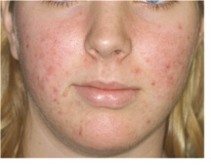
Erythema and hyperpigmentation.
White comedones , and inflammatory papules and pustules.

Slide 14
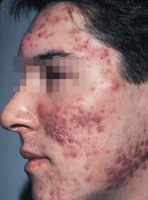
White Comedonal acne.
Inflammatory lesions : papules and nodules.
Some scars.

Slide 15
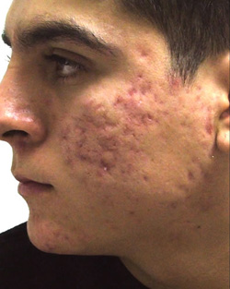
Scarring acne.
Indication for Vitamin A derivatives use.

Slide 16
02
Acne variants

Slide 17
Acne variants
Acne vulgaris.
Acne conglobata ( Nodulocystic).
Acne fulminans.
Acne mechanica.
Acne excoriee.
Drug induced acne.
Occupational acne.
Neonatal acne.
Infantile acne.
Late onset acne ( adult type).

Slide 18
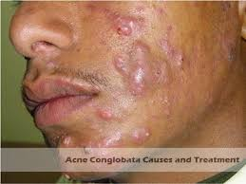
1- Acne conglobata-Nodulocystic acne
Nodulocystic lesions.
Severe form of acne.

Slide 19
It usually presents with tender, disfiguring, double or triple interconnecting comedones, cysts, inflammatory nodules, and deep burrowing abscesses on the face, shoulders, back, chest, upper arms, buttocks, and thighs.
Exposure to halogenated aromatic hydrocarbons (eg, dioxins) or ingestion of halogens (eg, thyroid medication, hypnotic agents) may trigger acne conglobata in an individual who is predisposed. Other factors that can provoke acne conglobata include androgens (eg, androgen-producing tumors) and anabolic steroids
Treatment: isotretinoin 0.5-1 mg/kg for 4-6 months

Slide 20
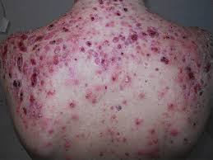
2- Acne Fulminans
Young man with inflammed cystic lesions.
Inflammed cystic lesions on the back.

Slide 21
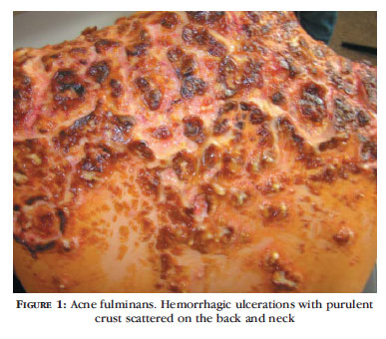
Crusted lesions on the back and face.

Slide 22
Severe form with cystic lesions and systemic symptoms.
Rare form.
Young men 13-16 yr.
Osteolytic bone lesions.
Fever, arthralgia, Hepatosplenomegaly.
Increased ESR , leukocytosis.
Treatment : Isotretinoin with systemic steroid ( the only type of acne that is treated with steroids).

Slide 23
3- Acne Mechanica
Pustules and papules at the site of contact.
Yellowish discoloration indicates secondary infections.

Slide 24
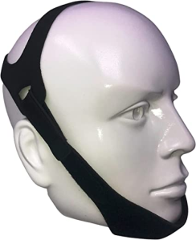
Caused by:
Repeated mechanical and frictional obstruction.
Rubbing by helmets, chin straps, masks.
Treatment: eliminating these factors.

Slide 25
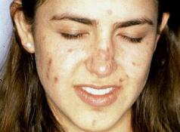
4- Acne Excoriee
Excoriations only.
No comedones, papules or pustules.

Slide 26
The picked lesions become scarred and infected, causing itching which leads to further picking. Sometimes the picking continues long after the original acne has healed
Young women.
Underlying psychiatric components.
Treatment: antidepressants or psychotherapy may be indicated.

Slide 27
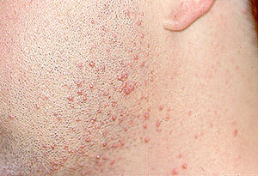
06
Drug induced acne
➢ Anabolic steroids – Danazole , Stanazole.
➢ Corticosteroids.
➢ phenytoin .
➢ Lithium.
➢ Iodides , bromides , Vit. Supplements , cough compounds and sedatives .
➢ Azathioprine ,Vit.B12, cyclosporine.
✓ Monomorphic eruption of papules and pustules
✓ Steroid induced acne ( in spring) : after oral or topical use of steroids.

Slide 29
07
Occupational Acne
Exposure to insoluble , follicle – occlusion substances in the workplace.
➢ Cutting oils , petrolatum – based products (Vaseline) , coal tar.
➢ Comedones dominate usually.
❑ Chloracne:
Kinds of occupational acne due to Exposure to chlorinated aromatic hydrocarbons.
➢ Malar , retro-auricular , mandibular areas , axillae , sacrum , buttock are involved.
➢ The causative agents found in : electrical conductors , insulators , insecticides , fungicides and wood preservatives (poly chlor naphthalenes tetra chlorobenzene and others).
➢ Old age ( not typical age for acne

Slide 30
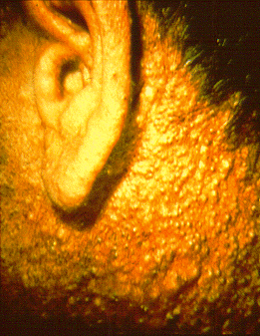
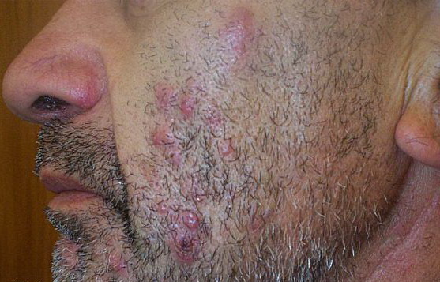
✓Comedone predominant, some papules.
✓Inflammatory lesions on the
malar area and cheeks.

Slide 31
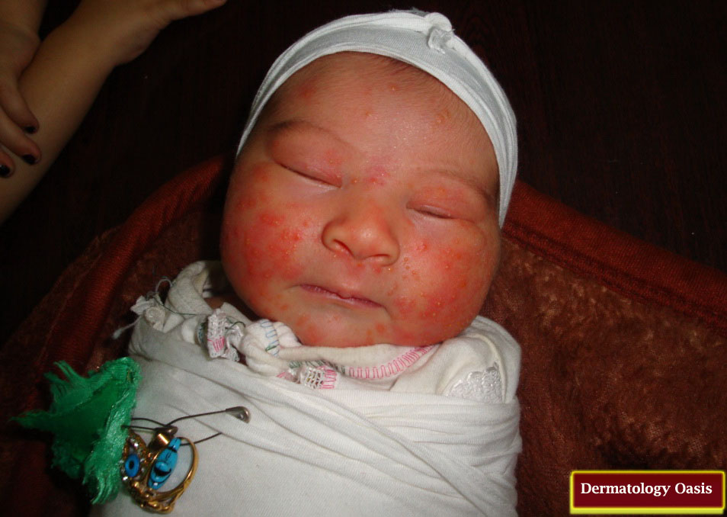
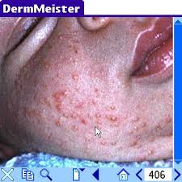
08
Neonatal Acne
Hormonal factors from mother and malasezia
➢ 20% of healthy newborn
➢ Appears at the ages of 2 weeks and resolves at the age of 3 months.
➢ Small papules on cheeks .
➢ Treatment : 2% ketoconazole , Benzoyl Peroxide.
Papules and few comedones on the cheeks

Slide 32
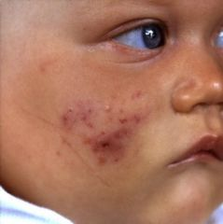
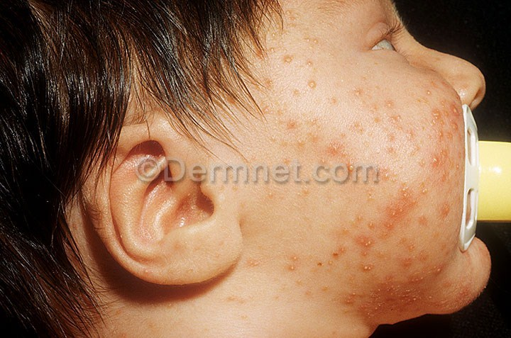
09
Infantile Acne
Hormonal factors DHEA.
➢ If acne present at 3-6months of age: infantile acne.
➢ More comedones than in neonatal.
➢ Resolves within 1-2 years.
➢ Treatment : Tretinoin , Benzoyl Peroxide .
✓Comedones and papules.
✓ Comedones , papules , erythema and hyperpigmentation.

Slide 33
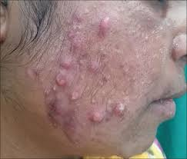
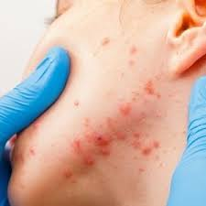
10
Late onset Acne ( Adult acne)
✓ Papules , erythema and Hyperpigmentation .
✓ Must do investigations to rule out causes of androgen excess.
✓ Usually affect the jaw area and the neck.

Slide 34
Endocrinologic abnormalities
Most patients do not have acne , investigations for late onset acne include :
1. Hyperandrogenism should be suspected in female with ; Hirsutism , irregular cycles , severe acne , abrupt onset , coarse voice.
2. AM serum cortisol level if hypercortisolism is suspected.
3. Androgenetic alopecia :Free testosterone , DHEAS , 17-hydroxyprogesterone.
4. Elevated DHEAS and 17-OH-progesterone suggest adrenal source of excess androgen.
5. DHEAS 4000-8000g\ml or 17-OH progesterone level > 3ng\ml congenital adrenal hyperplasia.
6. Increased LH /FSH ratio to > 2-3 in polycystic ovary syndrome.
7. Elevated testosterone suggest ovarian source.
8. Serum testosterone >200ngIdl indicates ovarian tumor.
9. Ovarian US : Ovarian cysts

Slide 35
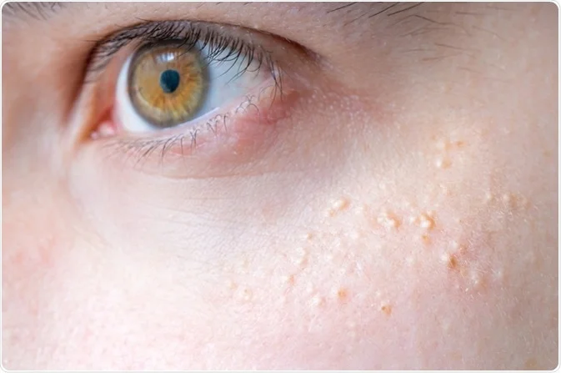
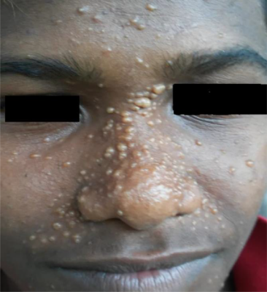
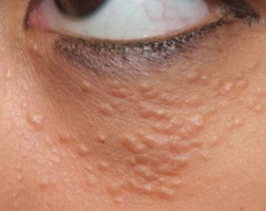
DDX of ACNE :
1
Milia ( small facial cysts).
Sebaceous hyperplasia ( appear as papules).
Folliculitis.
Pseudofolliculitis.
Trichoepithelioma (benign adnexal neoplasm originating from basal cells of hair follicles), syringoma .
Seborrheic dermatitis.
Rosacea.
Perioral dermatitis.
2
syringoma
Trichoepithelioma

Slide 36
Treatment of Acne
➢ Topical:
1st line of treatment
❑ Retinoids ( the best choice) , Benzoyl peroxide.
❑ Antibiotic ( Erythromycin , Clindamycin).
❑ Keratolytic : Salicylic acid.
➢ Systemic :
1st line :
Antibiotics ( Antibacterial + Anti inflammatory) :
✓ Tetracycline ,Doxycycline , Erythromycin , Azithromycin. (DETA)
2nd line : Retinoids
✓ Isotretinoin ( the best treatment but last choice).
*** Lesions may flare in the first 2 weeks of treatment.

Slide 37
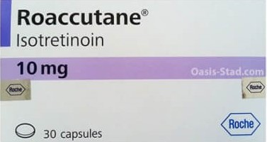
Isotretinoin ( Roaccutane )
➢ For severe cases :
Nodulocystic acne not responding to first line measurements
Scarring acne
Dysmorphophobia acne.
Gram negative folliculitis
Acne Fulminans
➢ Effective but toxic.
➢ Teratogenic – cause fetal anomaly in > 95% of cases ( abortion or fetal anomalies).
➢ Needs close follow up ( liver enzymes , serum lipids , bleeding , papilledema).
➢ Dose 0,5-1mg\kg , used alone without any combination with other drugs.
➢ Duration 5-6 months or total accumulative dose 120mg\kg\course.
NOTE : With white comedone don’t give vit A becauce the risk of keloid formation , so use keratolytics first .

Slide 38
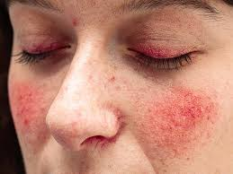
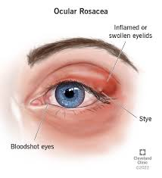
Rosacea
-Chronic inflammatory skin disease with characteristic
lesions on the face .
-Affecting mostly middle aged women
-there is eye manifestations too ( cojunctivitis , Blepharitis )
-Female to male ratio is 9:1
-Characteristic skin lesions : Telangiectasia , erythema , papules , pustules on cheeks, forehead and chin .
-Rhinophyma (enlargement of the nose) is a feature in -some cases
-No comedones

Slide 39
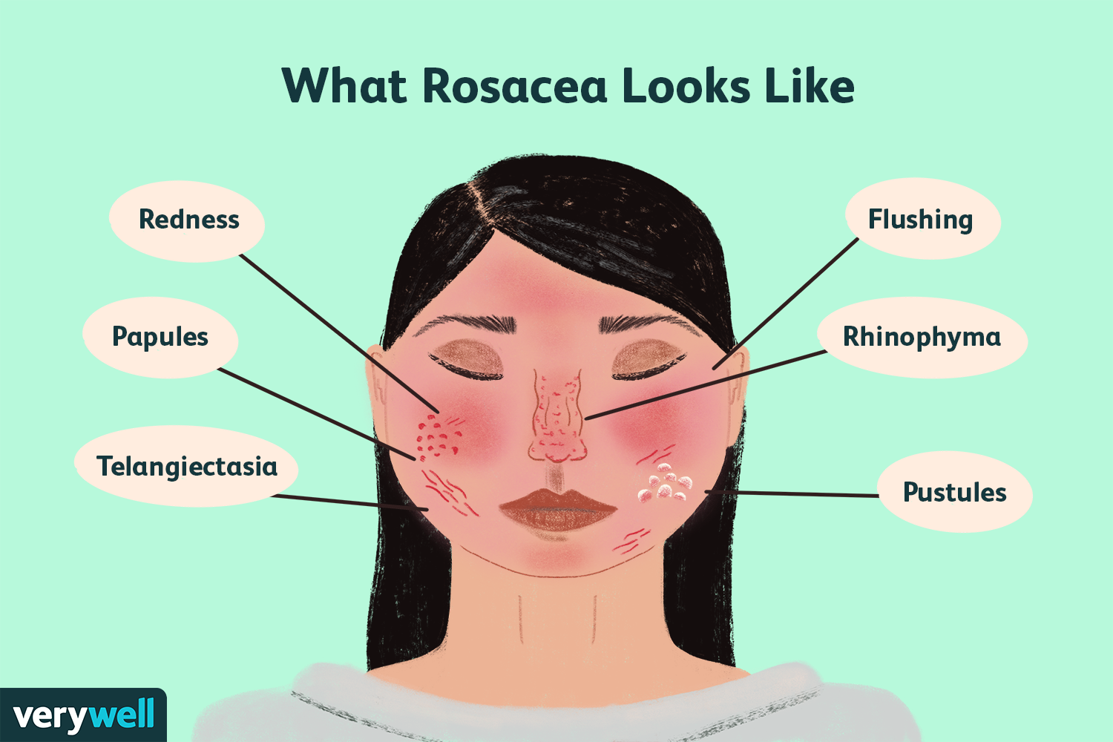

Slide 40
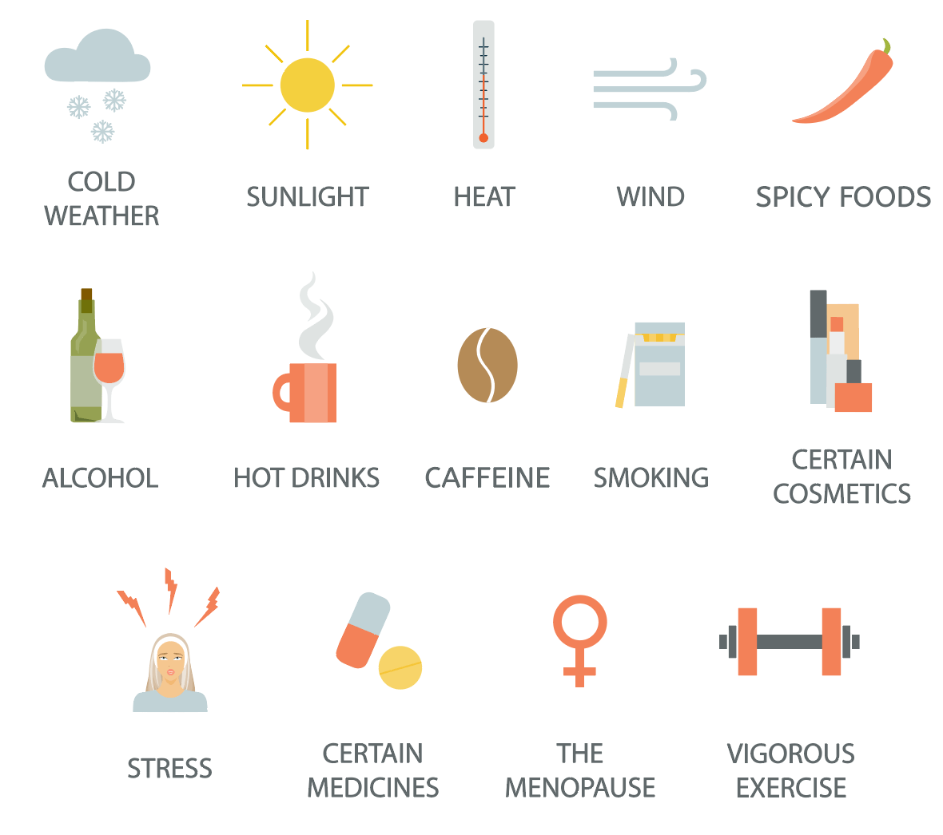
Rosacea provoked by ?

Slide 41
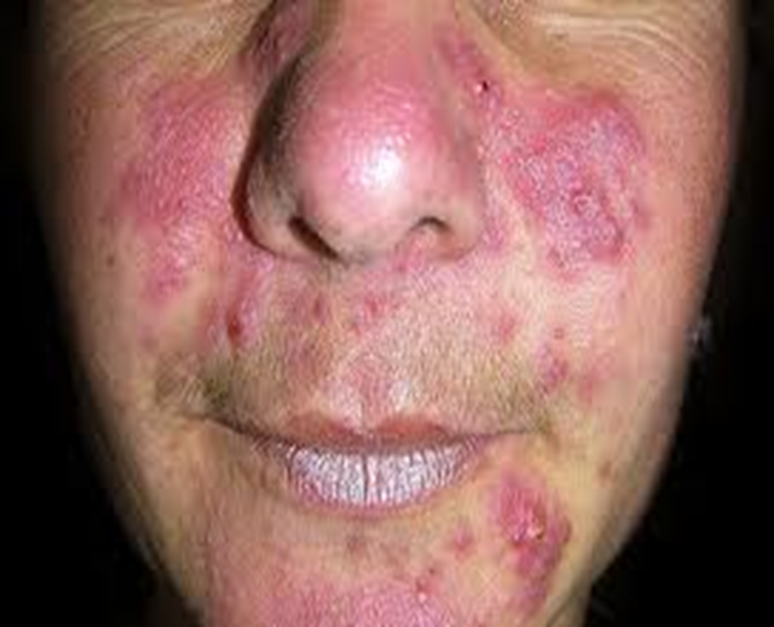
Bilateral pink papules on the cheeks , nose and chin

Slide 42
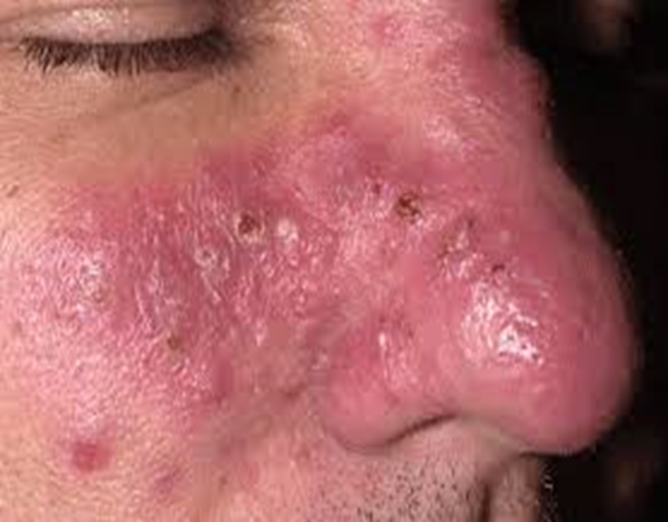
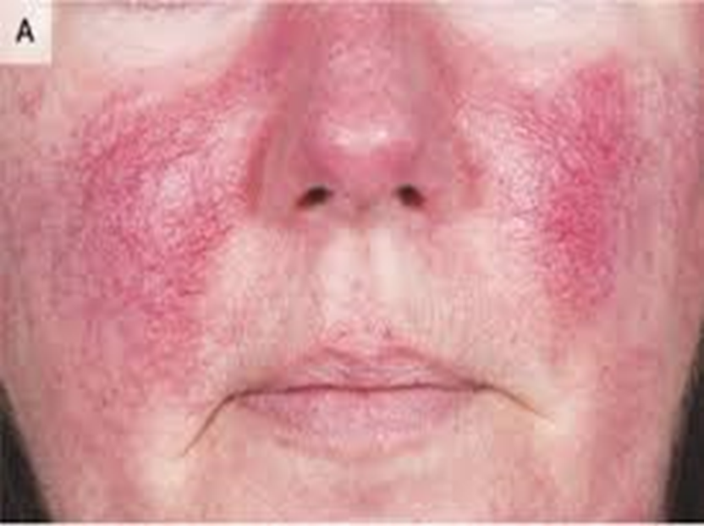

Slide 43
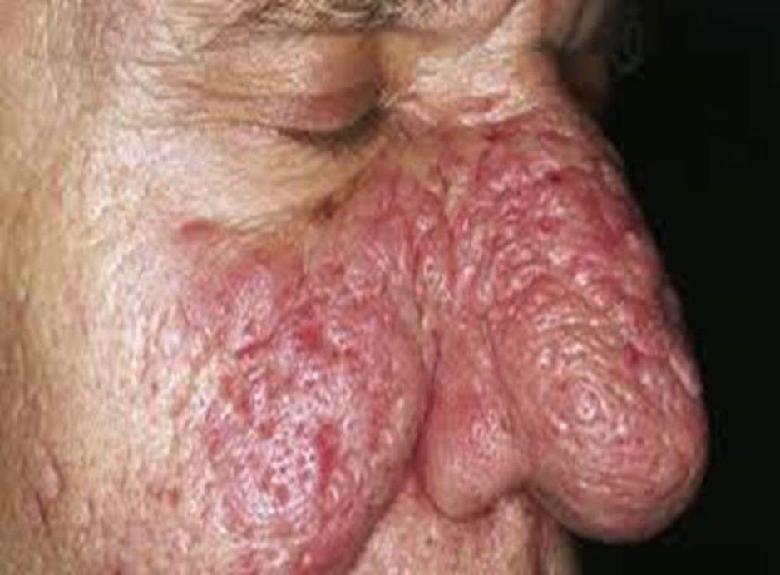
Rhinophyma

Slide 44
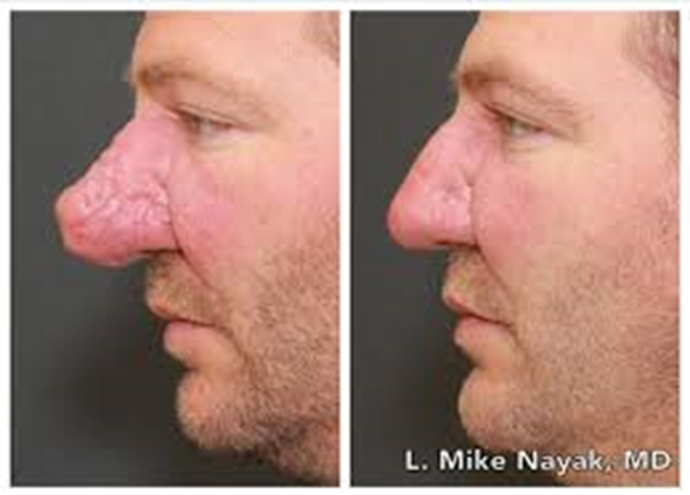
Rhinophyma-treated(surgically)

Slide 45
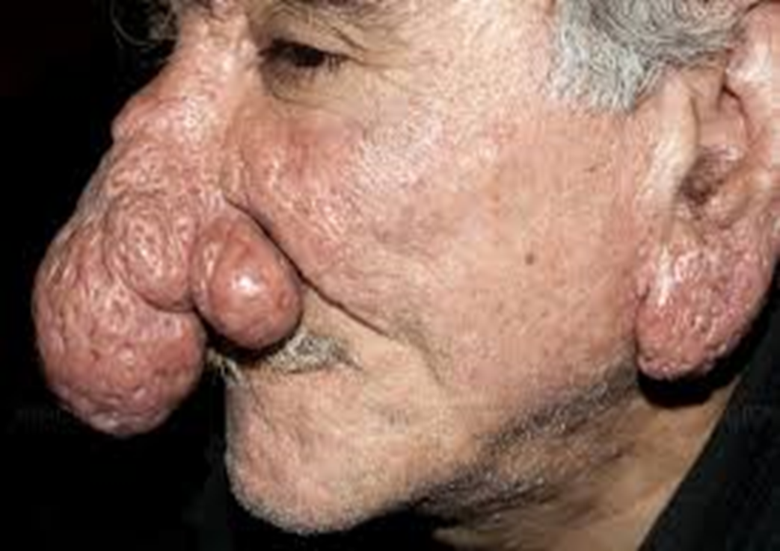
Rhinophma and otophyma-severe form

Slide 46
Acneform skin rash
-Pseudofolliculitis Barbae ; Skin reaction to hair as foreign -Body
- Pityrosporum folliculitis
-Acne keloidalis nuchae :inflammatory keloidal lesions on the nape of the neck

Slide 47
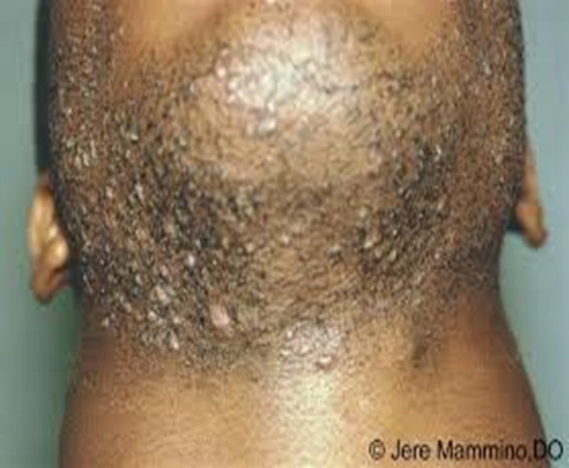
pseudofolliculitis
Not a true folliculitis ( not due to infection ) but due to a reaction against the hair itself when its plugged inside ( foreign body reaction )
Occurs in Negroid people , Curley hair

Slide 48
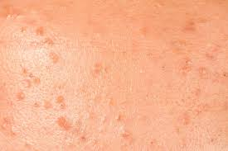
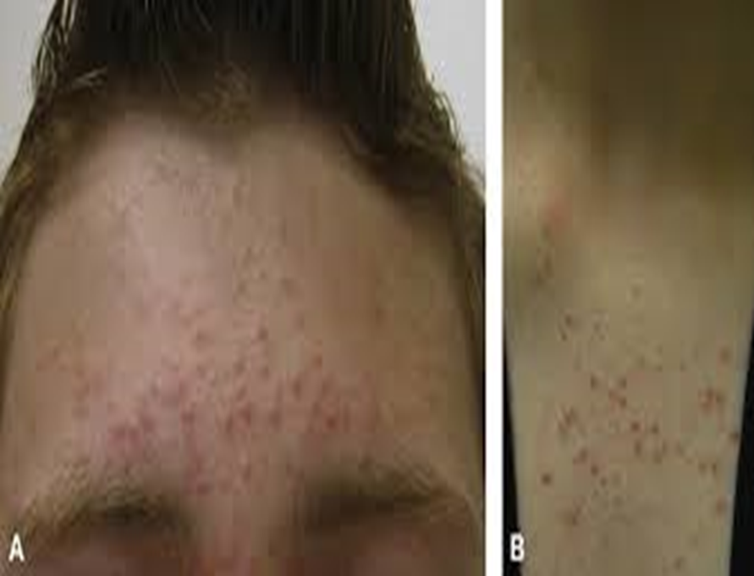
Pityrosporum folliculitis
-Acne form rash due to Fungal infection

Slide 49
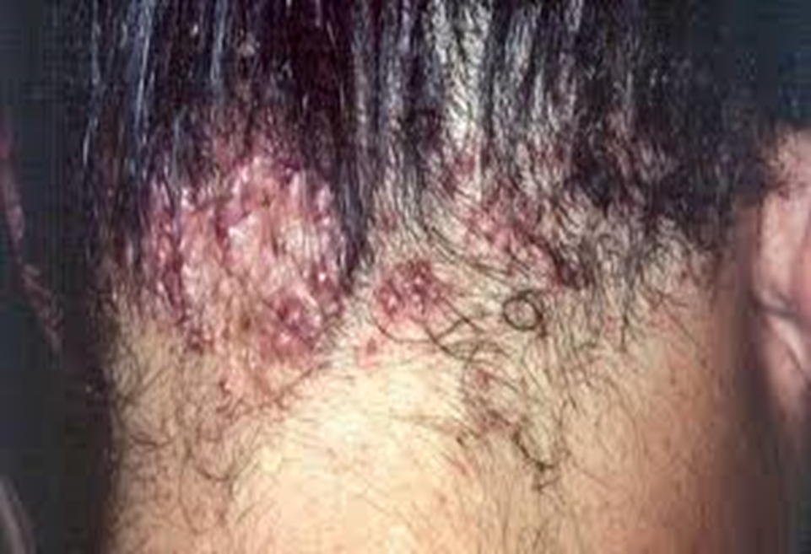
Acne keloidalis nuchae

Slide 50
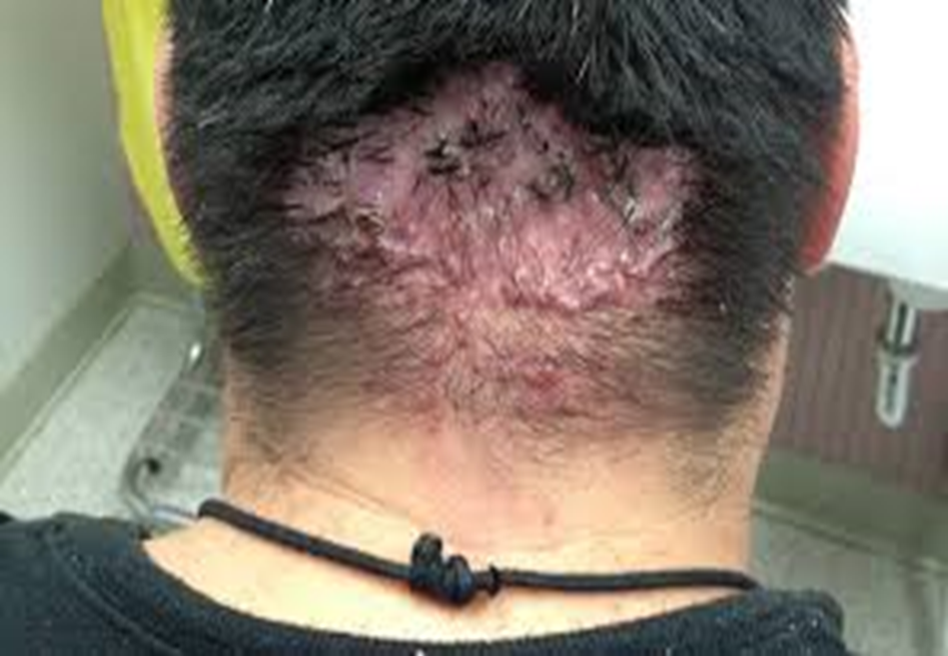
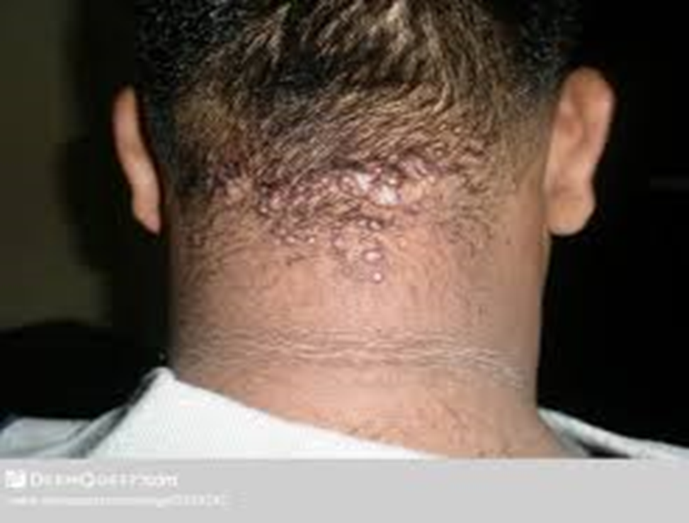
- Acne form rash with scarring on the nape of the neck , could lead to permanent hair loss

