Slide 1
Prions and Rabies
NSII Module
2021-2022
Dr. Mohammad Odaibat
Department of Microbiology and Pathology
Faculty of Medicine, Mutah University

Slide 2
Prions
The prion protein PrP, also known as CD230 (cluster of differentiation 230) is encodd by the PRNP (PRioN Protein) gene on the short arm of chromosome 20
They are Proteinaceous infectious particle that lacks nucleic acid.
It is most predominant in the nervous system and in many other tissues throughout the body

Slide 3
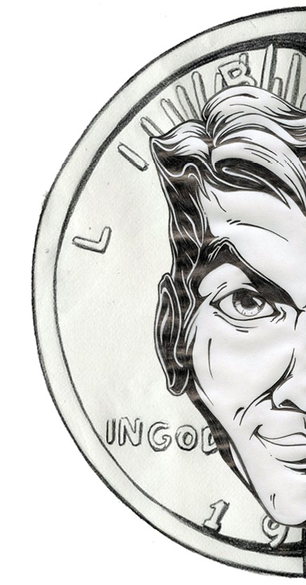
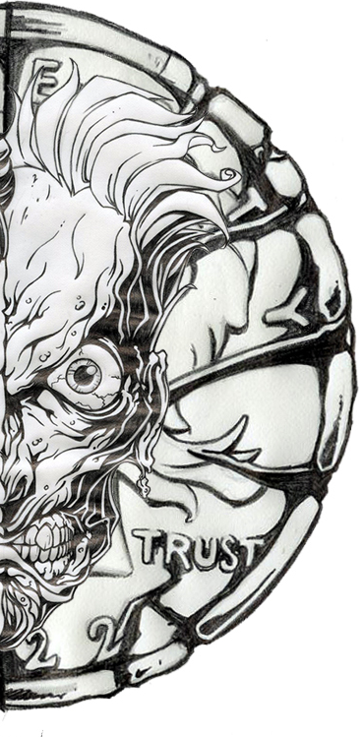
Prions protein is a coin with two faces
Good face
Ugly face

Slide 4
The Good face of prions
Prions have many essentail Funtions including:
PrP protein is important for myelin repair in Schwann Cells and that the lack of PrP proteins caused demyelination.
Cell-cell adhesion and intracellular signaling, and may therefore be involved in cell-cell communication in the brain.
Maintenance of long-term memory
The PrP expression on stem cells is necessary for an organism's self-renewal of bone marrow.
Prions have antioxidative function epeciaplly in the at synapses which indiated a role in synaptic homeostasis.

Slide 5
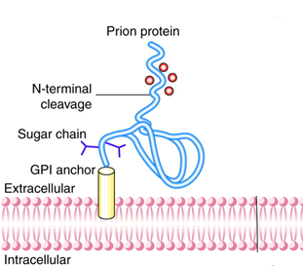
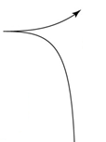
The Good face of prions
Antioxidative function of Prions:
The amino-terminal domain of PrP^{C} exhibits five to six sites that bind copper Cu(II) which facilitate its uptake by cells
PrP^{C} + Cu (Copper)
↓
Copper is an important part pf Superoxide dismutase
(SOD)
↓
- SOD free radicals to hydrogen peroxide, which can
subsequently be reduced to water
- Prevent neuronal dysfunction
Protease
Notes:
Antioxidant functions
Superoxide dismutase
Superoxide dismutase (SOD) functions as an antioxidant by catalyzing the conversion of superoxide radicals (free radicals or ROS) to hydrogen peroxide, which can subsequently be reduced to water by other antioxidant enzymes(12). Two forms of SOD contain copper: (1) copper/zinc SOD is found within most cells of the body, including red blood cells; and (2) extracellular SOD is a copper-containing enzyme found at high levels in the lungs and low levels in plasma (2).

Slide 6
The ugly face of the prions
During the 1960s Stanley B. Prusiner discovered the the caustive agents of bovine spongiform encephalopathy ("mad cow disease") and its human equivalent, Creutzfeldt–Jakob disease
The diseases are caused by Proteinaceous infective particle
It was called proin
Proin changed to prion to sound it rhythmic.
Prion diseases were caused by misfolded proteins.
Notes:
Stanley Benjamin Prusiner M.D (born May 28, 1942^{[3]}) is an American neurologist and biochemist. Currently^{[when?]} the director of the Institute for Neurodegenerative Diseases at University of California, San Francisco (UCSF). Prusiner discovered prions, a class of infectious self-reproducing pathogens primarily or solely composed of protein. He received the Albert Lasker Award for Basic Medical Research in 1994 and the Nobel Prize in Physiology or Medicine in 1997 for prion research developed by him and his team of experts (D. E. Garfin, D. P. Stites, W. J. Hadlow, C. W. Eklund) beginning in the early 1970
Prusiner won the Nobel Prize in Physiology or Medicine in 1997 for his work in proposing an explanation for the cause of bovine spongiform encephalopathy ("mad cow disease") and its human equivalent, Creutzfeldt–Jakob disease.^{[3]} In this work, he coined the term prion, which comes from the words "proteinaceous" and "infectious," in 1982 to refer to a previously undescribed form of infection due to protein misfolding.^{[7]}

Slide 7
The ugly face of the prions
Whatis the pattern of inheritance?
Familail
Familial spongiform encephalopathy
Fatal familial insomnia (FFI)
Familial Creutzfeldt–Jakob disease (fCJD)
Infectious
Kuru
Creutzfeldt–Jakob disease (CJD)
Gerstmann–Sträussler–Scheinker syndrome (GSS)
Sporadic Creutzfeldt–Jakob disease (sCJD)
Notes:
Familial forms of prion disease are inherited in an autosomal dominant pattern, which means one copy of the altered PRNP gene in each cell is sufficient to cause the disorder. In most cases, an affected person inherits the altered gene from one affected parent. In some people, familial forms of prion disease are caused by a new mutation in the gene that occurs during the formation of a parent's reproductive cells (eggs or sperm) or in early embryonic development. Although such people do not have an affected parent, they can pass the genetic change to their children.
The sporadic, acquired, and iatrogenic forms of prion disease, including kuru and variant Creutzfeldt-Jakob disease, are not inherited.
They discovered that PrPsc is able to spontaneously form within the cytosol. Once there, it can convert normal PrP into PrPsc, aiding in the destruction of host nerve cells and helping the disease to spread from cell to cell.

Slide 8
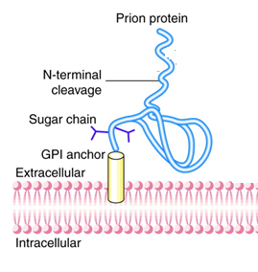
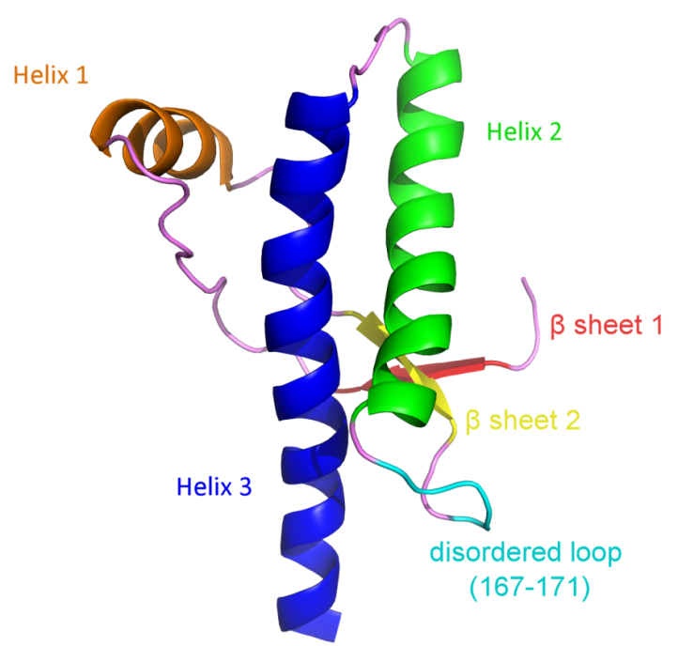
Normal structure of the prion protein
Notes:
Familial forms of prion disease are inherited in an autosomal dominant pattern, which means one copy of the altered PRNP gene in each cell is sufficient to cause the disorder. In most cases, an affected person inherits the altered gene from one affected parent. In some people, familial forms of prion disease are caused by a new mutation in the gene that occurs during the formation of a parent's reproductive cells (eggs or sperm) or in early embryonic development. Although such people do not have an affected parent, they can pass the genetic change to their children.
The sporadic, acquired, and iatrogenic forms of prion disease, including kuru and variant Creutzfeldt-Jakob disease, are not inherited.

Slide 9
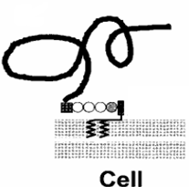
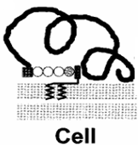
Generation of abormal structure of the prion protein
Normal PrP
Prion proteins have an ability to undergo structural conversion from a normal “cellular” isoform (PrP^{C}) into a pathogenic conformer known as “scrapie” (PrP^{Sc})
Why is it called scrapie?
The name scrapie is derived from one of the clinical signs of the condition, wherein affected animals will compulsively scrape off their fleeces against rocks, trees or fences. The disease apparently causes an itching sensation in the animals.
Mutated PrP
X
Notes:
PrPc is rich in α-helises and has little β-structure, while PrP Sc has less α-helix and a high amount of β-structure

Slide 10
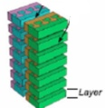
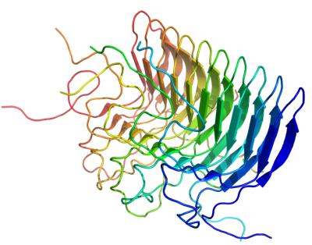
Generation of prions’ amyloid
How does the prion replicate?
Lacking nucleic acid, prions cannot reproduce, but they reproduce by recruiting the normal cellular isoform of the prion protein (PrP^{C}) and stimulating its crefolding into PrP^{Sc} (Scrapie)
Notes:
The beta bleated sheet of the PrPsc is able to bind to other PrPsc to form three PrPsc,
Through the binding ablities of the beta shheets to othet beta sheets on other molecules
Due to the liear orienation of amnio acids in the sheet.then the triple PrPsc struture
(amyloid)can convert the PrPc into PrPsc through
Ununderstood mechanism.
The amyloid is toxic to neuron cells and start damaging them to from wholes in the brain
thet eventually r
Resemles te sponge+

Slide 11
Normal vs. pathologic struture of the prion protein
PrP^{C} PrP^{SC}
Solubility
Soluble Non soluble
Structure
Alpha-helical Beta-sheeted
Multimerisation state
Monomeric Multimeric
Infectivity
Non infectious Infectious
Susceptibility to Proteinase K
Susceptible Resistant

Slide 12
Routes of Prion Transmission
Eating infected beef from cows carrying (BSE).
Kuru was transmitted from human to human by cannibalism (eating the brains of infected people).
Oral, wound, and parenterally has been approved.
Through surgical instruments or infected tissues. CJD transmitted by medical procedures is known as iatrogenic CJD.
Body fluids such as blood or saliva.
Corneal transplantation, contaminated EEG, electrode implantation, and surgical procedures.
Dura mater grafts
Notes:
Oral transmission is only one possible route. In fact, oral transmission is not particularly efficient, and is not well understood. Generally, proteins ingested orally are degraded. Somehow, the stable toxic prion manages to survive the usual digestion process .
There are known cases where prion disease has been transmitted on surgical instruments, or by use of infected tissues. These cases are extremely rare, but they are clear, and they do help in understanding the transmission process. CJD transmitted by medical procedures is known as iatrogenic CJD.
Eating infected beef from cows carrying (BSE).
BSE is transmitted from cow to cow by feeding the cows material containing products from infected cows.
Kuru was transmitted from human to human by cannibalism (eating the brains of infected people).
Transmission through oral, wound, and parenterally has been approved.
PrPsc manages to survive the usual digestion process .
Through surgical instruments, or by use of infected tissues. CJD transmitted by medical procedures is known as iatrogenic CJD.

Slide 13
Clinical course
An incubation period of 1.5–2 years and it might reach 40 years years preceded the development of clinical disease.
Most patients with CJD live 6–12 months after the onset of clinical signs and symptoms, whereas some live for up to 5 years.

Slide 14
Clinical features
One third of patients with CJD develop:
fatigue, sleep disturbance, weight loss, headache, anxiety, vertigo, malaise, and ill-defined pain.
Most patients with develop over weeks or months a state of profound dementia characterized by memory loss, impaired judgment, and a decline in virtually all aspects of intellectual function.
A few patients present with either visual impairment or and coordination deficits.

Slide 15
Clinical features
Other symptoms and signs include:
Difficulty walking
Hallucinations
Muscle stiffness
Confusion
Fatigue
Difficulty speaking

Slide 16
Diagnosis
The most widely used method involves the detection of PrP by immunoassay after denaturation.
Brain biopsy if PrPsc is detected.
Magnetic resonance imaging (MRI).
At autopsy, immunoassay and immunohistochemistry of tissue section.
Sequencing of the PRNP gene must be performed.
CT may be normal or show cortical atrophy.
CSF is nearly always normal but may show protein elevation and, rarely, mild pleocytosis.
The EEG is often useful in the diagnosis of CJD, although only about 60% of individuals show the typical pattern.

Slide 17
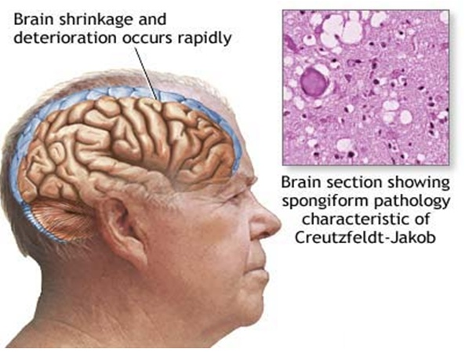
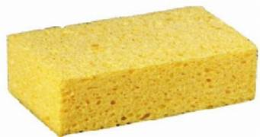
Microscopic changes
Scrapie
BSE
Kuru
CJD

Slide 18
Treatment
There's no proven cure for Creutzfeldt-Jakob disease (CJD)
At present, treatment involves trying to keep the person as comfortable as possible and reducing symptoms through the use of medicines.
Notes:
For example, psychological symptoms of CJD, such as anxiety and depression, can be treated with sedatives and antidepressants, and muscle jerks or tremors can be treated with medicines such as clonazepam and sodium valproate.
Any pain experienced can be relieved using powerful opiate-based painkillers.

Slide 19
Rabies

Slide 20
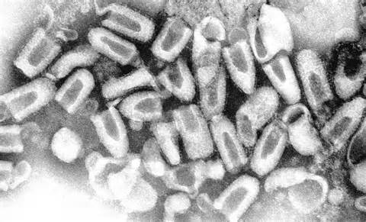
Definition of Rabies
Rabies is a preventable viral disease of mammals most often transmitted through the bite of a rabid animal
Rabies is a rapidly progressive, acute infectious disease of the CNS in humans and animals.

Slide 21
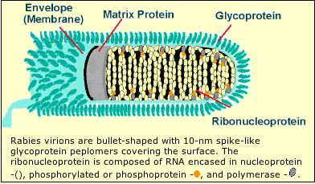
Etiologic agent of Rabies
Main properties:
Belongs to Rhabodoviruses family
Single stranded negative sense RNA
Has its own RNA-dependent RNA polymerase
Surrounded by a bullet shaped capsid and a lipoprotein envelop
Single antigenic type
It has a broad range of hosts, all mammals basically but also birds, reptiles.

Slide 22
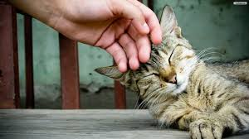
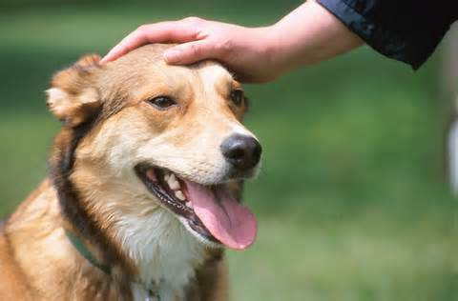
Virulence
Depends on severity of bite
If treatment is given and when
Once the disease manifests in CNS: ultimate death
Factors do not constitute exposure
Petting
Handling an animal
Contact with blood
Contact with urine or feces

Slide 23
Types of exposure to Rabies virus
Bite :
Any penetration of the skin by teeth constitutes a bite exposure.
Non-bite
Exposure to large amounts of aerosolized rabies virus.
The contamination of open wounds and mucous membranes.
Human-to-human transmission:
Human-to-human transmission has occurred among eight recipients of transplanted corneas.
Notes:
Non-bite exposures from terrestrial animals cause rabies and rarely require post-exposure prophylaxis.
Human-to-human transmission a. Human-to-human transmission has occurred among eight recipients of transplanted corneas. Stringent guidelines for acceptance of donor corneas have been implemented to reduce the risk.

Slide 24
Pathogenesis
The incubation period:
Usually 20–90 days
In rare cases is as short as a few days or is >1 year
Why there is a variation in the incubation periods?
The mechanism of reaching the CNS:
In neurons: rabies virus spreads toward the CNS via retrograde fast axonal transport to the spinal cord or brainstem at a rate up to ∼250 mm/d
In muscles: the virus is known to bind to nicotinic acetylcholine receptors on postsynaptic membranes at neuromuscular junctions
Once the virus enters the CNS, it rapidly disseminates to other regions of the CNS via fast axonal transport along neuroanatomic connections
Notes:
The incubation period defined as the interval between exposure and the onset of clinical disease)

Slide 25
Pathogenesis
After CNS infection becomes established, there is centrifugal spread along sensory and autonomic nerves to other tissues, including the salivary glands, heart, adrenal glands, and skin.
Pathologic studies show mild inflammatory changes in the CNS in rabies, with mononuclear inflammatory infiltration in the leptomeninges, perivascular regions, and parenchyma.
Degenerative neuronal changes usually are not prominent, and there is little evidence of neuronal death.
Notes:
There is no well-documented evidence for hematogenous spread of rabies virus.

Slide 26
Pathogenesis
The pathologic changes are surprisingly mild in light of the clinical severity and fatal outcome of the disease.
The most characteristic pathologic finding in rabies is the Negri body.
Negri bodies are not observed in all cases of rabies.
The lack of prominent degenerative neuronal changes has led to the concept that neuronal dysfunction—rather than neuronal death—is responsible for clinical disease in rabies.
The basis for behavioral changes, including the aggressive behavior of rabid animals, is not well understood.
Notes:
Rabies transmission usually occurs through the percutaneous bite of a rabid mammal shedding the virus in its saliva (Figure 68-3). Nonbite exposures such as scratches and licks can also lead to rabies infection, although less frequently than bites. Under atypical conditions, transmission may also occur through inhalation of highly concentrated aerosolized viral particles. Access to the nervous system is granted either through inoculation directly into peripheral nerves or via infection of surrounding tissue (e.g., muscle cells) with subsequent nerve entry at the neuromuscular junction (see Figure 68-3).
After peripheral nerve invasion, the rabies virus reaches the CNS via retrograde axoplasmic transport. Once the virus infects the ventral horn of the spinal cord and/or the dorsal root ganglia, viral amplification leads to rapid dissemination of the virus in the rostral gray matter of the spinal cord. Progression to the brain is achieved through axoplasmic transport within several ascending and descending fiber tracts, leading to early placement in the brainstem followed by retrograde diffusion into the rest of the brain. Resulting neurologic signs are considered to be primarily a product of nerve cell dysfunction as opposed to necrosis or apoptosis; however, the exact functional impairment involved is unclear.
Viral migration from the brain into peripheral sites such as the salivary glands provides a gateway for virus particles to escape from the body and invade a new host. After infection of brainstem nuclei, the facial and glossopharyngeal cranial nerves convey virus to the salivary glands via their associated ganglia. Subsequent infection of glandular epithelia results in considerable viral shedding into salivary secretions. Virions are also dispatched to ocular structures such as the cornea and retina and deposited in organs and tissues serviced by parasympathetic and sympathetic nerves, including the heart, kidneys, and liver. The iatrogenic implications of this latter phenomenon were demonstrated in 2004, when four people contracted rabies after receiving transplanted material from a then-undiagnosed rabies-infected organ donor. Rabies transmission via corneal transplants has also occurred on several occasions. Because the virus frequently accumulates in the free sensory nerve endings of nuchal tactile hair, a skin biopsy sample from this area is used as a standard diagnostic specimen.
View chapterPurchase book

Slide 27
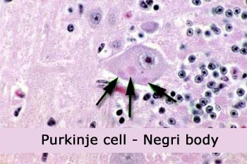
Negri bodies: are eosinophilic cytoplasmic inclusions in brain neurons that are composed of rabies virus proteins and viral RNA

Slide 28
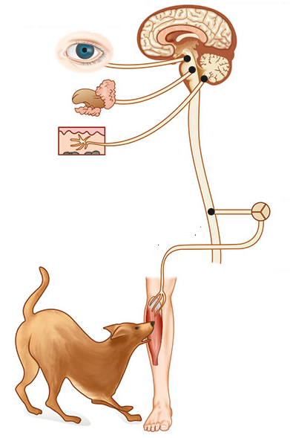
Rout of infection
Pathogenesis

Slide 29
Pitutary dysfunction,
Hypoventelation, hypotension, cardiac arrthymia, cardiac arrest, coma
In 80%: Anxiety, agitation, hyperactivity, unusual behavior, hallucinations, autonomic dysfunction, hydrophobia
Clinical course and manifistations
Fever, malaise, anorexia, nausea, vomiting, paresthesias, pain, or pruritus at the wound site
Flaccid paralysis in limb(s) progressing to quadriparesis with facial paralysis
None
Clinical stage
Exposure
(Incubation period)
Coma, deatha
Prodromal satge
Acute neurologicl phase
Paralytic (20%)
Duration
20-90 days
2-10 days
2–7 days
2–10 days
0–14 days

Slide 30
Rabies
Two clinical patterns:
dumb (paralytic) and Furious (encephalitis)
Non-specific symptoms:
Fever, headache, bite site pain numbness and pain
Dry throat, cough, insomnia
1. Dumb:
symmetrical ascending paralysis
1/3 of cases
May develops into encephalitis in 2-3 weeks > coma and death

Slide 31
Rabies
2. Furious:
Encephalitis (delirium, convulsions, coma and death)
Hydro and aerophobia
In 2/3 cases
Death usually in 1 week
Prognosis:
Once symptoms occur: fatal in 3-10 days

Slide 32
Laboratory investigations of Rabies
Most routine laboratory tests in rabies yield normal results or show nonspecific abnormalities.
Complete blood counts are usually normal.
Examination of CSF often reveals mild mononuclear cell pleocytosis with a mildly elevated protein level.
Severe pleocytosis (>1000 white cells/μL) is unusual and should prompt a search for an alternative diagnosis.
CT head scans are usually normal in rabies.
MRI brain scans may show signal abnormalities in the brainstem or other gray-matter areas, but these findings are variable and nonspecific.
EEG show only nonspecific abnormalities.

Slide 33
Laboratory investigations of Rabies
Specimens include
Serum
CSF
Fresh saliva
Brain tissue (rarely obtained before death).
RT-PCR amplification: This technique can detect virus in fresh saliva samples, CSF, and skin and brain tissues.
Direct fluorescent antibody: skin biopsies and brain tissue
Notes:
Because skin biopsy relies on the demonstration of rabies virus antigen in cutaneous nerves at the base of hair follicles, samples are usually taken from hairy skin at the nape of the neck. Negative antemortem rabies-specific laboratory tests never exclude a diagnosis of rabies, and tests may need to be repeated after an interval for diagnostic confirmation

Slide 34
Prognosis
Prognosis Rabies is an almost uniformly fatal disease but is almost always preventable with appropriate postexposure therapy during the early incubation period.
Most patients with rabies die within several days of illness, despite aggressive care in a critical care uni

Slide 35
Pre-exposure vaccination
Control and Prevention
Pre-exposure vaccination should be offered to:
Persons in high-risk groups, such as:
Veterinarians and all at risk with frequent contact with the rabies virus or potentially rabid bats, raccoons, skunks, cats, dogs, or other species at risk for having rabies.
Pre-exposure vaccination schedule:
 | Route | Regimen
Vaccine | Intramuscular (IM) Intradermal (ID) | 1 ml on days 0, 7, 28 0.1 ml on days 0, 7, 28
Bosster | Intramuscular (IM) Intradermal (ID) | 1 ml every 2 years 0.1 ml every 2 years

Slide 36
Post-exposure prophylaxis guide
Control and Prevention
Vaccination Status | Treatmen | Regimen
Not previously vaccinated | Wound cleansing | The wound needs to be thoroughly scrubbed with soap and water, or, if available, iodine solution, 40-70% alcohol, cetrimide 0.1% or a similar compound, or the virucidal agent povidone, all under local anaesthesia if possible. The rabies virus is killed by sunlight, drying, soap, and the other agents mentioned.
 | RIG* | Administer 20 IU/kg body weight. If anatomically feasible, the full dose should be infiltrated around the wound(s) and any remaining volume should be administered IM at an anatomical site distant from the vaccination site. Also, RIG should not be administered in the same syringe as the vaccine. Because RIG may partially suppress the active production of antibodies, no more than the recommended dose should be given
 | Rabies vaccine | Administer 1 ml IM or 0.1 ml ID in the deltoid area on days 0, 3, 7, 14 and 30. A booster dose on day 90 is optional.
Previously vaccinated | Wound cleansing | The same
 | RIG | RIG should not be administered
 | Rabies vaccine | If vaccinated within one year: 1 ml IM or 0.1 ml ID on day 0. If vaccinated more than one year prior: 1 ml IM or 0.1 ml ID on days 0, 3, and

