Slide 1
بسم الله الرحمن الرحيم
Muscle histology lap
انَّمَا الْمُؤْمِنُونَ الَّذِينَ إِذَا ذُكِرَ اللَّهُ وَجِلَتْ قُلُوبُهُمْ وَإِذَا تُلِيَتْ عَلَيْهِمْ آيَاتُهُ زَادَتْهُمْ إِيمَانًا وَعَلَى رَبِّهِمْ يَتَوَكَّلُونَ

Slide 2
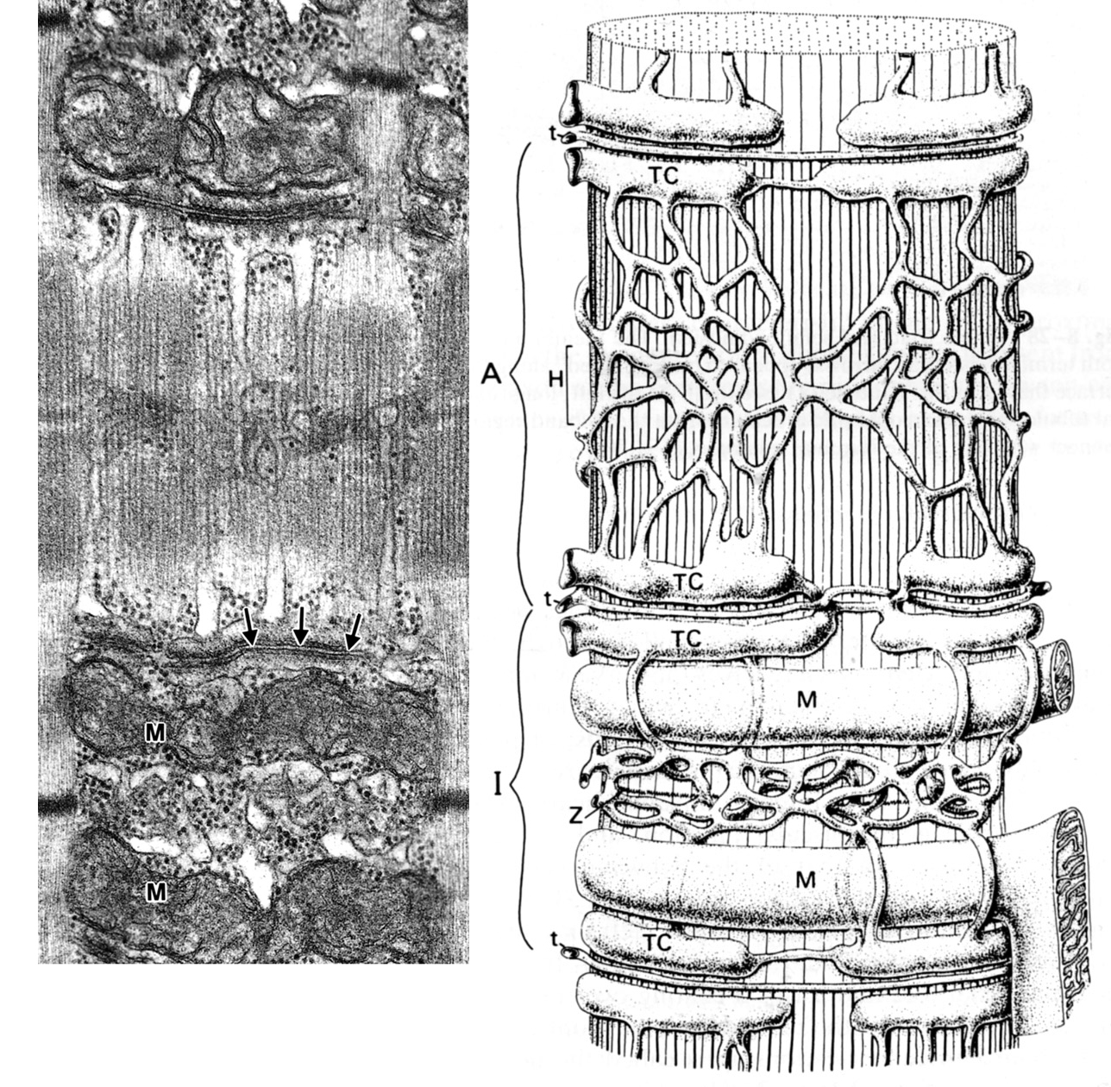
T tubule, is an invagination of the muscle cell membrane (sarcolemma) located at the level of junction between A and I bands for skeletal muscle

Slide 3
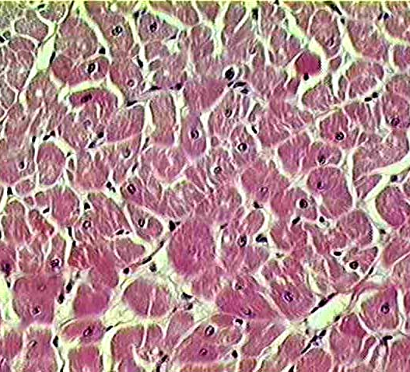
Cross section of cardiac muscle

Slide 4
Cardiac muscle intercalated disk (longitudinal section)

Slide 5
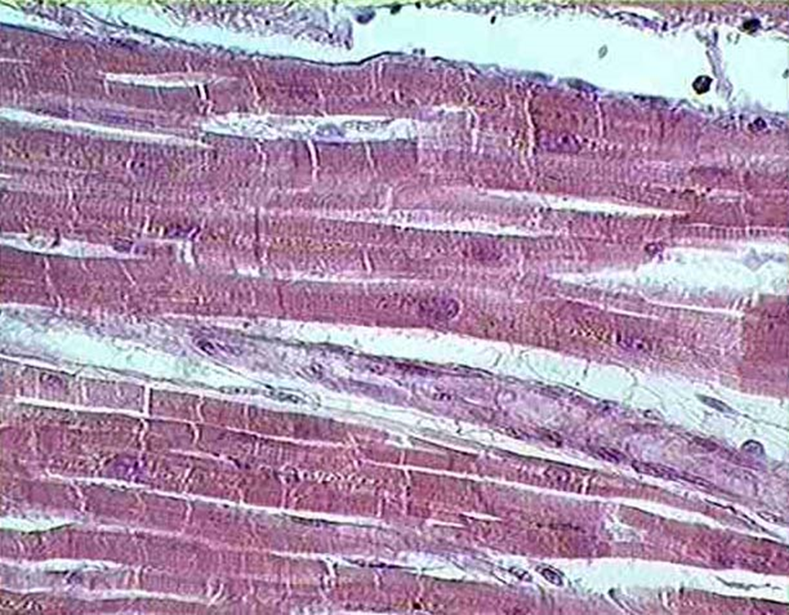
Cardiac muscle

Slide 6
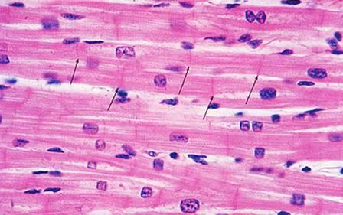
Cardiac muscle

Slide 7
smooth muscle

Slide 8
Skeletal muscle

Slide 9
motor end plates

Slide 10
This is the motor end plate.

Slide 11
Cross section of a blood vessel showing smooth muscle layers

Slide 12
Smooth muscle

Slide 13
cardiac muscle cross section

Slide 14
Skeletal muscle cross (transverse) section

Slide 15
This is skeletal muscle. The ← ← show the peripheral nuclei of a skeletal muscle fiber. Notice the cross striations and that the fibers don’t have any connections.

Slide 16
This is a cross section through skeletal muscle. The ↑indicate the peripheral nuclei of skeletal muscle fibers.

Slide 17
This is cardiac muscle. Notice the centrally placed nuclei and the cross bridges linking fibers. Between lie endomysium and capillaries. The ← indicate the intercalated discs

Slide 18
This is cardiac muscle

Slide 19
Cardiac muscle : specialised cardiac muscle cells organized into nodes to transmit the impulse to various parts called cardiac conducting cells (Purkinje cells)

Slide 20
smooth muscle. Longtudinal section

Slide 21
This is smooth muscle – high magnification. The ....... indicate the spindle shape of the smooth muscle fiber. Notice the elongated nuclei. Longtudinal section

Slide 22
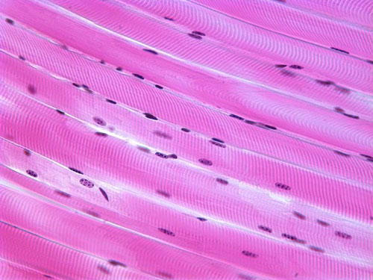
Skeletal muscle

Slide 23
Skeletal muscle

Slide 24
Tongue, Skeletal Muscle longitudinal section on the left. Cross section on the right

Slide 25
Skeletal muscle

Slide 26
Smooth muscle longtudinal section

Slide 27
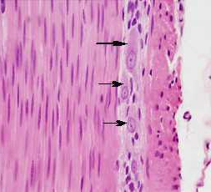
Smooth muscle

