Slide 1
SURGICAL JAUNDICE

Slide 2
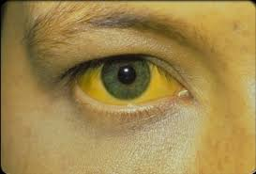
Jaundice is a condition marked by yellowing of the skin and the whites of the eyes, caused by high levels of bilirubin in the blood. Bilirubin is a yellow pigment formed during the breakdown of red blood cells. Typically, the liver processes and removes bilirubin from the body through bile. However, when this process is disrupted, bilirubin builds up, resulting in jaundice.
Surgical jaundice refers to jaundice that arises due to a blockage in the bile ducts, preventing the normal flow of bile from the liver into the intestines. This condition is often referred to as obstructive jaundice, and it typically requires surgical intervention or endoscopic procedures to correct the underlying issue.

Slide 3
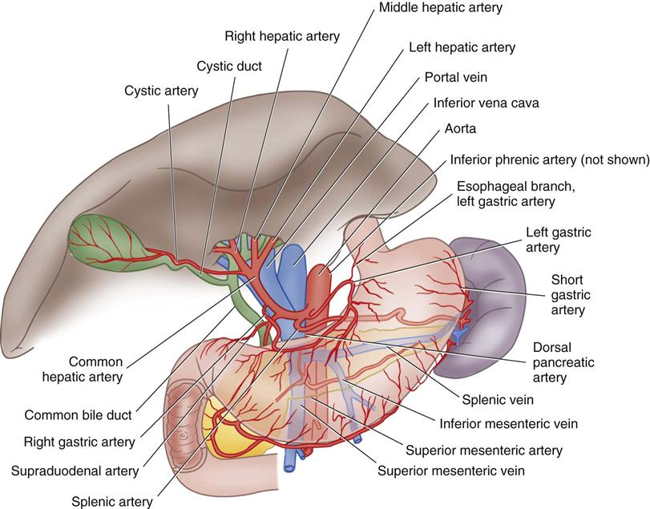

Slide 4
To better understand these disorders, a brief discussion of the normal structure and function of the biliary tree is needed. Bile is the exocrine secretion of the liver and is produced continuously by hepatocytes. It contains cholesterol and waste products, such as bilirubin and bile salts, which aid in the digestion of fats.
Half the bile produced runs directly from the liver into the duodenum via a system of ducts, ultimately draining into the common bile duct (CBD). The remaining 50% is stored in the gallbladder. In response to a meal, this bile is released from the gallbladder via the cystic duct, which joins the hepatic ducts from the liver to form the CBD. The CBD runs in the hepatodudoenal ligament and then courses through the head of the pancreas for approximately 2 cm; it joins the terminal part of the pancreatic duct to form the ampulla of Vater before passing through the papilla of Vater into the duodenum, [0,3]

Slide 5
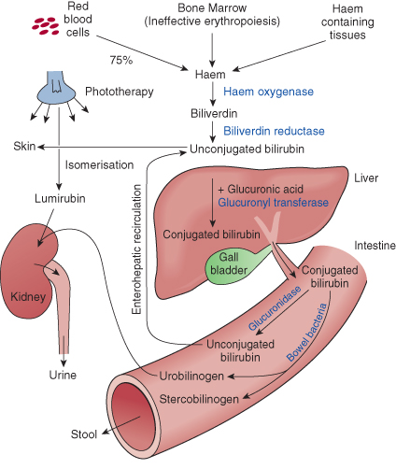
Physiology of bilirubin metabolism
[0,2]

Slide 6
Bilirubin type | Bilirubin level
Total bilirubin | 0.1-1.2 mg/dl (1.7-20.5 mmol/L)
Direct bilirubin | 0.1-0.3 mg/dl (1.7-5.1 mmol/L)
Indirect bilirubin | 0.2-0.8 mg/dl (3.4-12mmol/L)
Bile is produced by hepatocytes 500-1000 ml/day An exocrine secretion Contains bilirubin (a pigment) + bile salts Bile goes from liver to duodenum and also stored within gallbladder

Slide 7
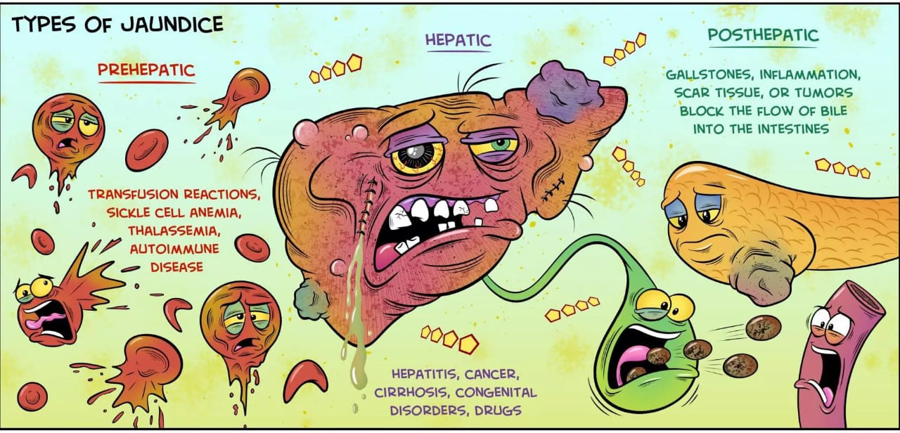

Slide 8
Causes of biliary obstruction
Intra hepatic jaundice
Extrahepatic jaundice
A) Intraductal causes
B) Extraductal causes

Slide 9
Intrahepatic Causes
Mechanical or intrahepatic causes are most commonly hepatitis and cirrhosis. Drugs may also cause direct damage to hepatocytes and metabolic obstruction. Note the following: Hepatitis is inflammation of the liver characterized by diffuse or patchy necrosis. Causes of hepatitis include viruses, drugs, and alcohol. Cirrhosis is characterized by generalized disorganization of hepatic architecture with nodule formation and scarring in the parenchyma. Cirrhosis results from chronic, not acute, inflammation of the liver. Although many causes exist, the majority of cases of cirrhosis in the United States are sequelae of alcoholic hepatitis or chronic hepatitis B and C infections. Primary biliary cirrhosis (PBC) is a chronic, progressive, nonsuppurative, granulomatous destruction of the intrahepatic ducts. PBC, an autoimmune destruction of small hepatic ducts, is more common in women than in men.[ 0,3]

Slide 10
Drugs, such as anabolic steroids and chlorpromazine, are known to directly cause cholestasis (by mechanisms not entirely understood). Thiazide diuretic use may slightly increase the risk for developing gallstones, the most common cause of biliary obstruction. Amoxicillin/clavulanic acid (Augmentin) is one of the most frequent causes of acute cholestatic injury that can mimic biliary obstruction. Other drugs, such as acetaminophen or isoniazid, can cause hepatocellular necrosis. Typically, drug-induced jaundice appears early with associated pruritus, but the patient’s well-being shows little alteration. Generally, symptoms subside promptly when the offending drug is removed. Liver space occupying lesions (SOLs) e.g. cysts (including hydatid), abscesses, tumors (including metastases and primary)[0,3]

Slide 11
Extrahepatic causes
Extrahepatic causes may be further subdivided into those that are intraductal and those that are extraductal. Intraductal causes include stone disease, neoplasms, biliary stricture, parasites, primary sclerosing cholangitis (PSC), AIDS-related cholangiopathy, and biliary tuberculosis. Choledochal cysts cause functional biliary obstruction. Extraductal obstruction caused by external compression of the biliary ducts may be secondary to neoplasms, pancreatitis (acute and chronic), pancreatic pseudocysts, collaterals of portal hypertension (portal biliopathy), or cystic duct stones with subsequent gallbladder distension.[0,3]

Slide 12
Obstructive jaundice
Occurs in case of obstruction of the common bile ducts prevents excretion of conjugated bilirubin. Total bilirubin increased due to increase blood direct bilirubin level.
modest elevation of transaminases, and very high levels of alkaline phosphatase Dark brown color of urine Clay color of feces Absence of urobilinogen from urine
Biliary obstruction refers to the blockage of any duct that carries bile from the liver to the gallbladder(intrahepatic) or from the gallbladder to the small intestine (extrahepatic). This can occur at various levels within the biliary system. The major signs and symptoms of biliary obstruction result directly from the accumulation of bilirubin and bile salts in the blood and failure of bile to reach its proper destination.

Slide 13
Cause of obstructive jaundice

Slide 14
post-hepatic jaundice
Intraluminal:
Common bile duct stones : is the commonest cause
Parasitic infections
Hydatid cysts
Biliary tree tumors
Extramural :
pancreatitis
Carcinoma of the head of the pancreas
Periampullary tumors
Merizzi's syndrome
Intramural:
Choledochal cyst
Biliary atresia
iatrogenic strictures
Inflammatory strictures
Trauma
Tumors of bile duct: Cholangiocarcinoma

Slide 15
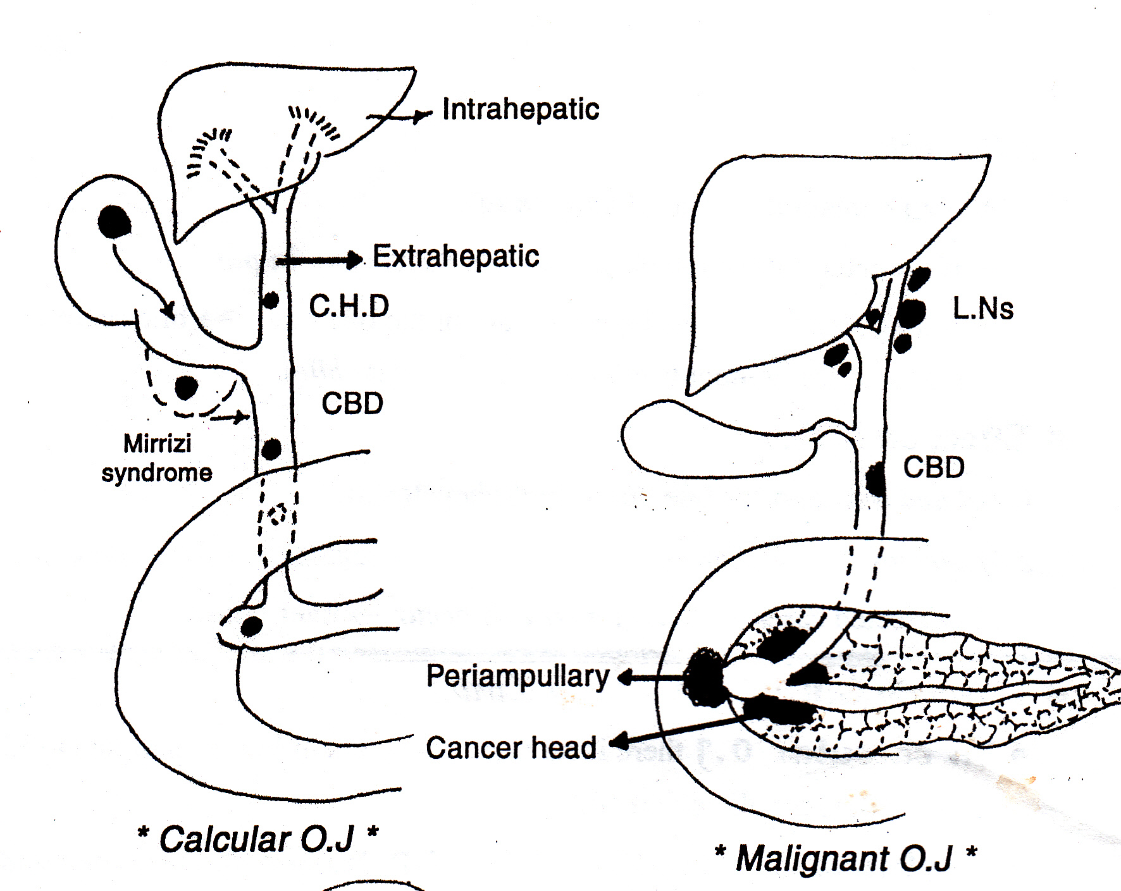

Slide 16
1.Common bile duct stones : is the commonest cause
Intraluminal:
Stone disease is the most common cause of obstructive jaundice. Gallstones may pass through the CBD and cause obstruction and symptoms of biliary colic and cholangitis.
Larger stones can become lodged in the CBD and cause complete obstruction, with increased intraductal pressure throughout the biliary tree.
Aetiology : 1- The commonest cause of CBD stones , is GB stones migrating through the cystic duct into the CBD . 2- Rarely , brown pigment stones in the CBD are formed due to prolonged stasis and infection .[0,4]

Slide 17
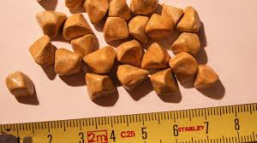
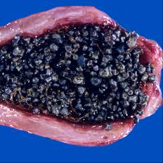
Types of gallstones
1-pure cholesterol 2- pure pigment(BLACK /BROWN) 3-mixed

Slide 18
EPIDEMIOLOGY & Risk factors (5F : Female, Forty, Fertile, Fat, Fair)
1-Age — Age is a major risk factor for the gallstones
Age 40 appears to represent the cutoff between relatively low and high rates of cholecystectomies
2-Sex — As noted above, a higher prevalence of gallstones has been observed in women in all age groups . The difference between women and men is particularly striking in young adults.
3-Pregnancy — Pregnancy is a major risk factor for the development of cholesterol gallstones. The risk is related to both the frequency and number of pregnancies. high estrogen and progesterone(increase synthesis and less motility)
4-Oral contraceptives and estrogen replacement therapy
5-Family history and genetics
6-Obesity
7-Rapid weight loss[0,4]

Slide 19
8-DM
9-Hyperlipidemia
10-Cirrhosis
11-Drugs(Ceftriaxone)
12-Crohns
13-Hemolysis
14-Recurrent biliary infections [0,4]
Complicated choledocholithiasis:-
1-The two major complications associated with choledocholithiasis are pancreatitis and acute cholangitis.
2-secondary Biliary cirrhosis may occur in Long-standing biliary obstruction
If the obstruction is not relieved either spontaneously or by operation, the chronic back-pressure in the biliary system may result in secondary biliary cirrhosis and liver failure.

Slide 20
Clinical picture :
choledocholithiasis may be symptomless(f there is no obstruction).
More often, there are attacks of biliary colic due to the increased pressure that develops within the obstructed bileduct – pain in Right Hypochondrium accompanied by obstructive jaundice with clay-coloured stools and dark urine, the attacks lasting for hours or several days.
If cholangitis occur , there are attacks of : a) Charcot’s triad : • Pain • Jaundice • Fever & rigors b) Reynold’s pentad : • Charcot’s triad • Septic shock • Altered mental status

Slide 21
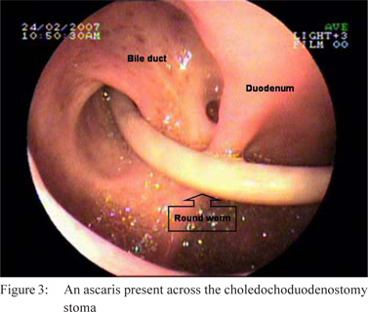
2.Parasitic infections
ASCARIS LUMBRICOIDES, IS THE MOST COMMON PARASITIC INFECTION IN HUMAN , LIVES IN SMALL INTESTINE IN MAN , FECO-ORAL ROUTE
adult Ascaris lumbricoides can migrate from the intestine into the bile ducts, thereby obstructing the extrahepatic ducts

Slide 22
Clinical feature
Most patients are asymptomatic Early symptoms
Dry cough, blood-tinged sputum, wheezing Loeffler syndrome: a transient respiratory disorder characterized by accumulation of eosinophils in the lungs due to certain infections (usually parasites) or allergic reactions to drugs. Symptoms are usually mild and resolve spontaneously
• Late symptoms : anorexia, abdominal discomfort, nausea, vomiting, and diarrhea • Additional symptoms due to blockage by adult worms depend on the location of the obstruction: ■ Bowel obstruction, especially at ileocecal valve (may lead to intestinal perforation) ■ Obstruction of the appendix features of appendicitis ■ Obstruction of biliary and pancreatic ducts features of cholestasis, pancreatitis
[0,5]

Slide 23
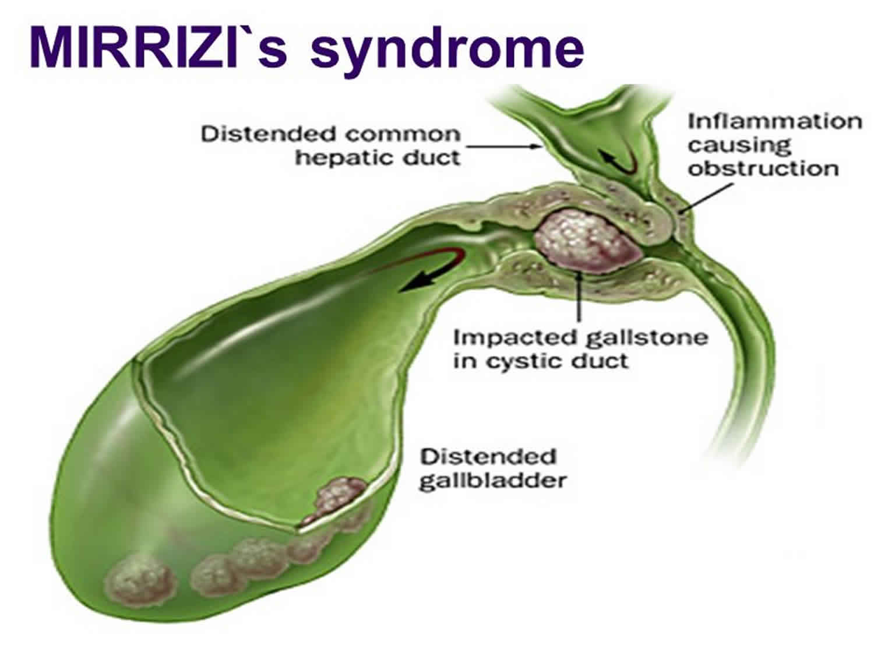
3.Mirizzi syndrome
[49][51]
Mirizzi syndrome is the presence of a stone impacted in the cystic duct or Hartmann’s pouch, causing inflammation and external compression of the common hepatic duct and thus biliary obstruction(jaundice,RUQ pain).

Slide 24
Csendes classification of mirizzi syndrome

Slide 25
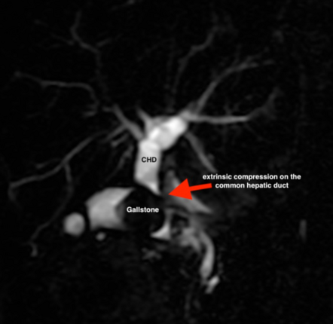
Diagnosis:
preferably ERCP/MRCP
Narrowing of the common hepatic ductS
stone within the cystic duct
Dilation of the intrahepatic biliary tree
Treatment: ERCP-guided CBD stent placement may be considered preoperatively to allow for biliary drainage. [52]
Open cholecystectomy may be preferred if diagnosed preoperatively. [50]

Slide 26
1.Biliary atresia
Intramural:
most common surgical cause of cholestatic jaundice in newborn(25-40 %
Biliary atresia is a fibroproliferative condition in infants in which the bile ducts outside and inside the liver are scarred and blocked. Bile can’t flow into the intestine so bile builds up in the liver and damages it
S&S : jaundice (at birth or shortly after2w ) grey stool / dark urine /hepatomegaly
Treatment
Kasai procedure (hepatoportoenterostomy): a connection is created between the liver and the small intestine to allow for bile drainage.
In cases of liver cirrhosis: liver transplantation (primary reason for liver transplantation in children

Slide 27
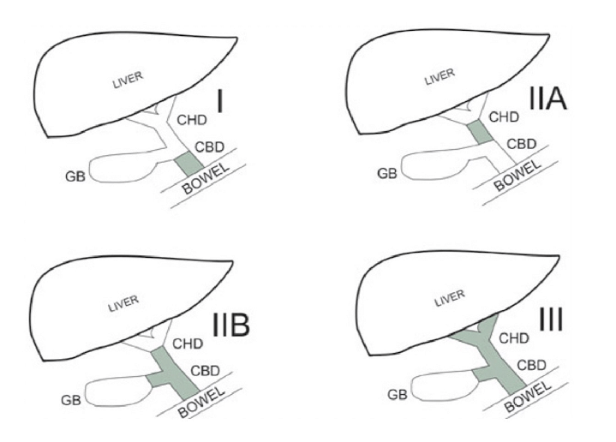
Kasai classification of BA
Type I
Atresia at the level of the common bile duct (patent cystic and CHD)
Type IIa
Atresia is at the level of the common hepatic duct (patent cystic and CBD)
Type IIb
Atresia in the cystic duct, CBD and CHD
Type III
Is the most frequent type, atresia occurs at the porta hepatis

Slide 28
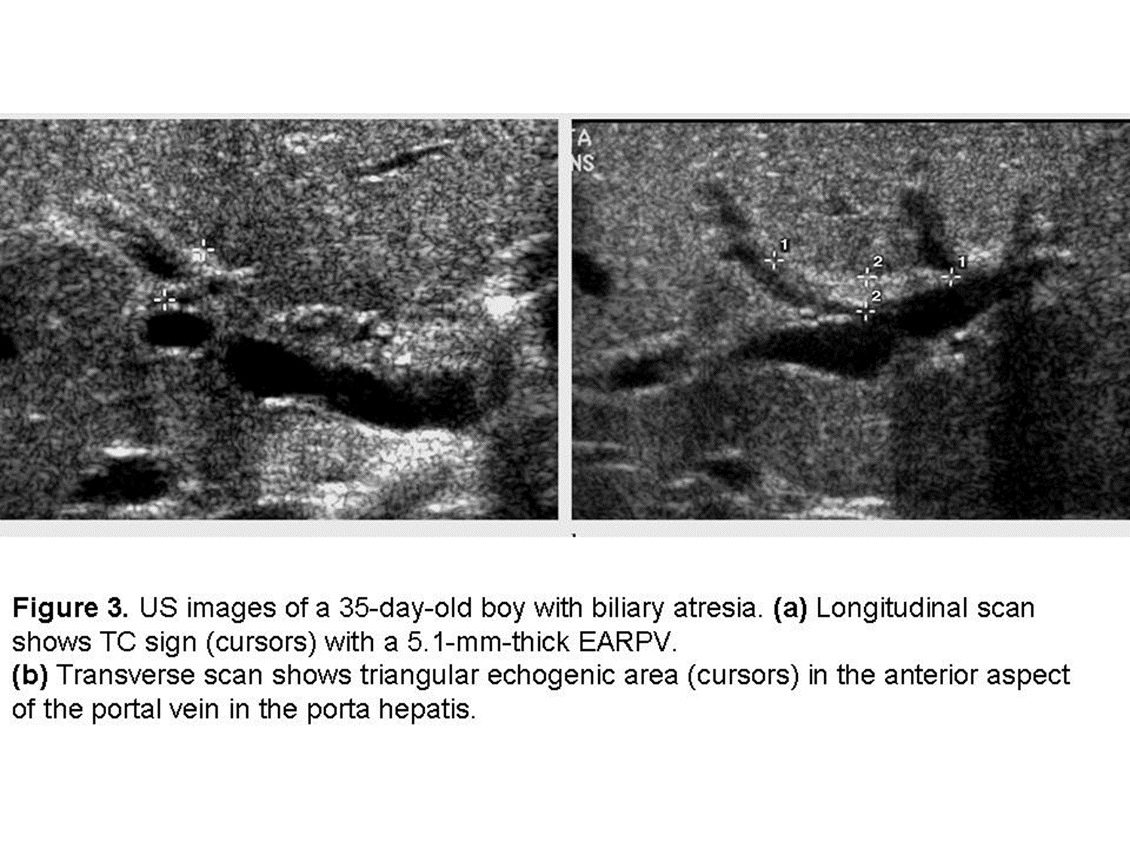
Investigations
1)LIVER FUNCTION TEST;
Elevation in serum conjugated bilirubin (>2 mg/dL [34 micromol/L])
High Aminotransferase and Alkaline phosphatase
High GGT (Gamma-glutamyl transferase).
5) Intraoperative cholangiography
which is the gold standard in the confirm diagnosis of BA.
2) Abdominal ultrasound:
several findings (if present) support the diagnosis of BA:
Absence of the gallbladder
Irregularly shaped gallbladder.
Triangular cord sign.
3) Nuclear medicine scan and HIDA scan :
4) Percutaneous Liver biopsy
Active inflammation with bile duct degeneration and fibrosis
Bile duct proliferation
Portal stromal edema

Slide 29
Choledochal cyst
2-
[26][27]
premalignant condition characterized by dilatations (enlargements) of the bile ducts
Most commonly diagnosed during childhood (although 25–50% are diagnosed in adulthood)

Slide 30
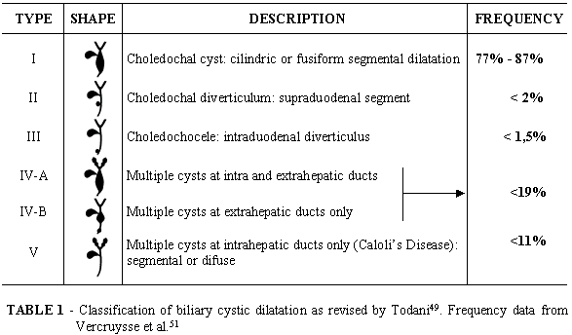
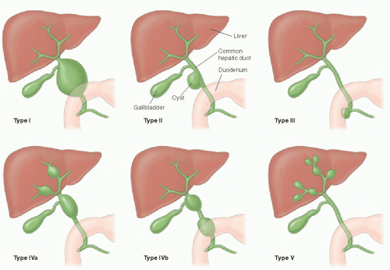

Slide 31
Signs and symptoms:
symptoms typically develop before the age of 10
The classic triad of abdominal pain, palpable abdominal mass, and jaundice is present in < 30% of affected individuals.
Clinical presentation varies with age:
Children ≤ 12 months: obstructive jaundice and abdominal mass
Children > 12 months and adults: right upper quadrant pain (most common), fever, and nausea
Imaging Studies:
Ultrasound: Best initial study.
MRCP: Gold Standard diagnostic test.
Total excision of the cyst with hepaticojejunostomy in a Roux-en-Y

Slide 32
3.Benign biliary strictures
Benign bile duct strictures causes include the following:
Postoperative injury after cholecystectomy: Approximately 80% of benign strictures occur following injury during a cholecystectomy
Pancreatitis: Jaundice due to an obstruction of the intrapancreatic segment of the CBD occurs in patients with chronic pancreatitis and accounts for approximately 10% of the benign strictures
Primary sclerosing cholangitis (PSC): PSC is a disease that causes strictures, beading, and irregularities of the intrahepatic and extrahepatic bile ducts due to a diffuse inflammatory process. Approximately 70% of PSC cases are associated with inflammatory bowel disease(UC).
Most common - men aged 20-40 Associated with ulcerative colitis (UC).
Inflammatory strictures: In addition to pancreatitis, choledocholithiasis can also cause chronic inflammation and fibrosis, leading to strictures of the CBD and sphincter of Oddi.

Slide 33
stricture due to trauma:
4-
Traumatic bile duct injuries usually present clinically as bile leaks. Less commonly, trauma to the bile duct can result in a biliary stricture.
Because these injuries tend to be subtle, they may go unrecognized at the time of injury. Patients may have a delayed presentation of jaundice with or without abdominal pain, and such strictures may be mistaken for malignancy.
Presentation of the case of traumatic biliary stricture as painless jaundice takes about more than 1 year after the initial injury.

Slide 34
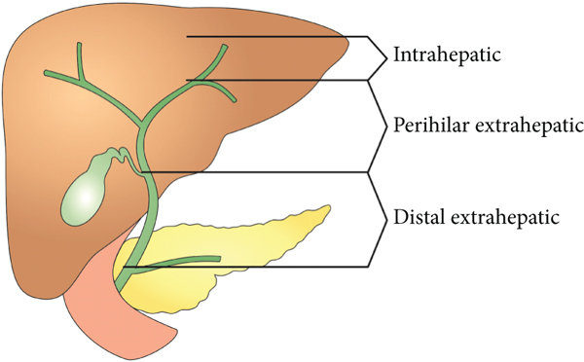
1.BILE DUCT CARCINOMA
Extramural :
Cholangiocarcinoma:
This cancer arises from the biliary epithelium and is usually seen in association with choledochal cysts, PSC, chronic ulcerative colitis, and parasitic infestation , cholelithiasis, chronic liver disease , chronic viral hepatitis . Obstructive jaundice is the major clinical manifestation of cholangiocarcinoma.
More than 90% of these bile duct cancers are adenocarcinomas
[1][4][5]

Slide 35
Classification
[1][2]
Extrahepatic CCA: 90% of CCA cases
Perihilar CCA (Klatskin tumor): junction of the right and left hepatic ducts (50% of cases)
Distal extrahepatic CCA: common bile duct (40% of cases)
Intrahepatic CCA: 10% of CCA cases; the second most common intrahepatic malignancy after hepatocellular carcinoma (HCC) [3]

Slide 36
Bismuth classification for perihilar cholangiocarcinoma.

Slide 37
Clinical features [1]
Extrahepatic CCA
Signs of cholestasis: jaundice, pale stools, dark urine, pruritus
Abdominal pain and weight loss is usually a sign of late (unresectable) disease.
Intrahepatic CCAUsually asymptomatic in early stages
Nonspecific symptoms (e.g., weight loss, nausea, fever, weakness, fatigue)
Dull abdominal pain (RUQ or epigastric)
Signs of cholestasis are rare.

Slide 38
Laboratory studies
Routine liver studies: to assess for obstructive jaundice and hepatocellular injury↑ Total bilirubin, ↑ conjugated bilirubin and ↑ ALP (↑ GGT confirms hepatobiliary cause)
AST and ALT may be increased or unchanged. [9]
Tumor markers↑ CA19-9 and/or ↑ CEA
↑AFP: typically elevated in HCC

Slide 39
Imaging
Transabdominal ultrasound: first-line in suspected CCA; may show biliary dilatation
if ultrasound findings suggest CCA
MRCP
Extrahepatic CCA: Bile duct dilatation
Intrahepatic CCA: lobulated irregular mass
PET-CT for staging

Slide 40
Treatment
Surgical resection:
Pancreaticoduodenectomy: for distal extrahepatic CCA
Radical hepatic resection plus regional lymphadenectomy: for intrahepatic or perihilar CCA
Liver transplant: for select patients with unresectable perihilar CCA
Biliary decompression: e.g., stenting; often used palliatively
Chemotherapy:
Adjuvant chemotherapy
Palliative chemotherapy in unresectable disease

Slide 41
2-Ampullary cancer
[17][18][19]
Ampullary cancer is a rare type of gastrointestinal cancer (< 1% of all gastrointestinal malignancies) that forms in the ampulla of Vater, usually causing symptoms of cholestasis.
Etiology: Usually sporadic May be associated with genetic cancer syndromes, e.g., familial adenomatous polyposis, Lynch syndrome
[20][21]

Slide 42
Clinical features
[19]
Symptoms of cholestasis such as jaundice (most common) and pruritus Painless progressive jaundice is the classic presentation, This is because the bile duct is compressed at an early stage, before extensive painful invasion of surrounding tissues.
Nonspecific symptoms (e.g., weight loss, fatigue)
Abdominal pain
Nausea, vomiting, steatorrhea
Diagnostics ERCP for diagnostic confirmation
Pathology
Adenocarcinoma of the ampulla of Vater (AAV): most common type of ampullary cancer
Treatment Curative pancreaticoduodenectomy Adjuvant chemotherapy and/or radiation therapy [19]

Slide 43
3.Carcinoma of the head of pancreas
Cancers that start in the head of the pancreas are near the common bile duct. These cancers can press on the duct and cause jaundice while they are still fairly small, which can sometimes lead to these tumors being found at an early stage.
But cancers that start in the body or tail of the pancreas don’t press on the duct until they have spread through the pancreas. By this time, the cancer has often spread beyond the pancreas.
Any elderly patient with progressive painless jaundice should be considered cancer of head of pancreas until proven otherwise .
Exogenous risk factors :Smoking (strongest risk factor) ,Chronic pancreatitis (especially when present for more than 20 years),High alcohol consumption Type 2 diabetes mellitus,Obesity
[5][6][7]

Slide 44
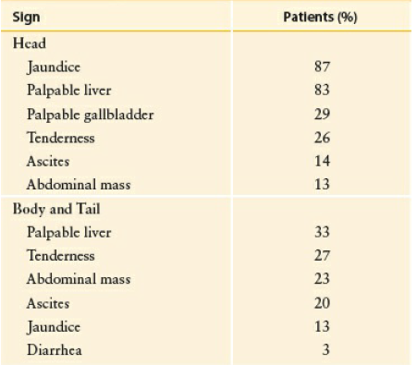
Clinical presentation :
1. painless obstructive jaundice which is the classical presentation, but more than half of the patients present with abdominal or back pain.
2. Weight loss.
3.anorexia.
4. Weakness
5.Palpable non-tender gallbladder
(courvoisier’s sign).
6.Enlarged liver.
7.pruritis

Slide 45
4-Gallbladder cancer Gallbladder cancers originate within the mucosal lining of the gallbladder
[4]
Risk factors: Cholelithiasis with chronic inflammation (most common risk factor),Porcelain gallbladder ,Choledocholithiasis , Chronic cholecystitis Chronic gallbladder inflammation increases the risk of gallbladder cancer
Clinical features :
Asymptomatic in early stages
Symptoms of biliary colic or chronic cholecystitis
Advanced disease :Nonspecific symptoms (e.g., weight loss, nausea, weakness, fatigue) ,Abdominal mass
Abdominal pain (RUQ or epigastric)
Obstructive jaundice (with or without Courvoisier sign) is a rare feature of gallbladder cancer.
[5]
[4][5]

Slide 46
Gallbladder cancer is most commonly diagnosed incidentally following cholecystectomy
[11][14][15]
Imaging studies Transabdominal ultrasound show gallbladder mass or wall thickening
MRI/MRCP: to evaluate local disease (e.g., gallbladder wall thickening, local invasion)
PET-CT for staging
EUS Occasionally used to provide more accurate visualization
surgical resection with or without adjuvant chemotherapy may be curative for early gallbladder cancer[15]

Slide 47
Clinical evaluation<1>:
Jaundice is the main presenting symptom. The main aims of clinical evaluation are:
1. Determining the obstructive nature of jaundice.
2. Identifying the cause for obstructive jaundice.
3. Whether the aetiology is benign or malignant in nature.
4. If malignant then whether the disease is metastatic in na- ture.
5. Impact of jaundice on other organ systems.
6. The need for multiorgan system support.
7. Postulate an investigation algorithm based on the clinical findings.

Slide 48
- Jaundice
- Prurittus
- Passage of clay stool
- Dark urine

Slide 49
Pain as an associated symptom is important in identifying the cause of obstructive jaundice. Jaundice associated with pain and fever suggestive of cholangitis is seen in bile duct stones. Jaundice typically shows waxing and waning. Intermittent at- tacks of right upper abdominal pain accompanied by vomiting is seen in cholecystitis. Severe pain and associated symptoms suggestive of pancreatitis can also cause transient obstructive jaundice. Painless progressive jaundice related to weight loss is highly suspicious of malignant aetiology. The previous history of biliary surgery presenting as jaundice is suggestive of a biliary stricture. History of inflammatory bowel disease presenting as jaundice is suggestive of primary sclerosing cholangitis. [18]
Weight loss, bone pains, and abdominal distension due to ascites are suggestive of malignant aetiology. History of abdom- inal masses is highly suggestive of malignancy.

Slide 50
Long-standing jaundice can affect other organ systems. Neurological symptoms are suggestive of impending coma. Renal dysfunction is a common accompaniment in severe jaundice. Co- agulopathies are seen in advanced stages. Generalized oedema due to hypoproteinaemia is a bad prognostic sign.

Slide 51
Physical examination reveals deepening of scleral icterus. Vital parameters may be altered if the patient presents late. Fever is an important feature. Pain, fever and jaundice is Charcot’s triad seen in cholangitis. In addition to these, if there is hypotension and mental obtundation, then that constitutes Reynold’s pentad. Reynold’s pentad is seen in suppurative cholangitis. Scratch marks of pruritus are commonly visible in obstructive jaundice. Signs of hepatocellular failure are seen in advanced cases. Flapping tremors and mental obtundation are red flags of poor prognosis.

Slide 52
Tenderness in the right hypochondrium suggests cholecystitis. A palpable gall bladder in a jaundiced patient is highly suggestive of malignant obstruction. (Courvoisier law) Hepatomegaly may be due to hepatitis or due to chronic cholestasis. Metastases in the liver can also cause hepatomegaly. A mass in continuity with the liver can be due to an advanced gall bladder tumour. Free fluid in the abdomen due to ascites is a sign of advanced malignant disease.

Slide 53
Haematological investigations are very critical in the evaluation of obstructive jaundice. A complete blood count will reveal anaemia in malignant cases. Leucocytosis is seen in cholangitis.
Total bilirubin will be raised. There will be a predominant increase in the direct reading component. Alkaline phosphatase is a membrane-bound enzyme located in the bile canalicular pole of the hepatocyte. A value of three times the upper limit of normal value is seen in the obstructive pattern of jaundice. It is elevated in almost all patients of biliary obstruction except for incomplete or intermittent obstruction. Gamma-glutamyl transpeptidase is raised in bile duct obstruction. Its level parallels the level of alkaline phosphatase in patients with cholestasis.
Serum transaminases (ALT, AST) are mildly elevated in cholestasis while markedly elevated in cholangitis. PT/INR is prolonged due to malabsorption of vitamin K. It is corrected by parenteral administration of vitamin K. If PT/INR improves with vitamin K injections, then it is more in favour of obstructive pattern while no improvement is seen in the liver parenchymal disease.
Renal function is best assessed and monitored by evaluation of serum creatinine, blood urea nitrogen and electrolytes.
Viral markers for hepatitis B and C should be done in all cases of obstructive jaundice.

Slide 54
ultrasound
Therefore, this modality is seen as the study of choice for the initial evaluation of jaundice or symptoms of biliary disease. The finding of a dilated common bile duct in the setting of jaundice suggests an obstruction of the duct from stones, usually associated with pain, or from a tumor, which is commonly painless (Fig. 54-9). The density of gallstones allows crisp reverberation of the sound wave, showing an echogenic focus with a characterstic shadowing behind the stone (Fig. 54-10). Most gallstones, unless impacted, will move with positional changes in the patient. This feature allows their differentiation from gallbladder polyps, which are fixed, and from sludge, which will move more slowly and does not have the sharp echogenic pattern of gallstones. Pathologic changes seen in many gallbladder diseases can be identified by ultrasound. For example, the gallbladder wall thickening and pericholecystic fluid seen in cholecystitis are visible by ultra- sound (Fig. 54-11). Porcelain gallbladder, with its calcified wall, will appear as a curvilinear echogenic focus along the entire gall- bladder wall, with posterior shadowing (Fig. 54-12)

Slide 58
Computed tomography
CT provides superior anatomic information and therefore is indicated when more anatomic delineation is required. Because most gallstones are radiographically isodense to bile, many will be indistinguishable from bile. However, because ultrasound is operator dependent and provides no anatomic reconstruction of the biliary tree, CT can be used to
identify the cause and site of biliary obstruction (Fig. 54-15). When it is performed for the evaluation of hepatic or pancreatic parenchyma or possible neoplastic processes, CT is invaluable in preoperative planning, and the use of arterial phase, portal venous phase, and delayed phase imaging, known as a triple-phase CT, has essentially replaced diagnostic angiography of the liver.

Slide 60
Magnetic resonance cholangiopancreatography
Magnetic resonance imaging uses the water in bile to delineate the biliary tree and thus provides superior anatomic definition of the intrahepatic and extrahepatic biliary tree and pancreas. Although management of most patients with biliary disease
does not require the fine detail of anatomic evaluation shown by cross-sectional imaging, magnetic resonance imaging is noninvasive, requires no radiation exposure, and can prove extremely useful in planning resection of biliary or pancreatic neoplasms or management of complex biliary disease. By use of the water content of bile, a cholangiopancreatogram can be created (Fig. 54-16), which makes it an excellent modality for cross-sectional imaging of the biliary tree.

Slide 62
Endoscopic retrograde cholangiopancreatography (ERCP)
Endoscopic retrograde cholangiopancreatography (ERCP) is an invasive test using endoscopy and fluoroscopy to inject contrast material through the ampulla to image the biliary tree (Fig. 54-17). Although it does carry a complication rate of up to 10%, its usefulness lies in its ability to diagnose and to treat many diseases of the biliary tree. For patients with malignant obstruction, ERCP can be used to provide tissue samples for diagnosis while also decompressing an obstruction, but it does not stage disease accurately. Many benign diseases, such as choledocholithiasis, can be easily treated by endoscopic means. ERCP has also proven extremely useful in the diagnosis and treatment of complications of biliary surgery.

Slide 64
Percutaneous transhepatic cholangiography
Interventional radiologic techniques can be used in the evaluation of biliary anatomy. Similar to ERCP, percutaneous transhepatic cholangiography (PTC) is an invasive procedure used to evaluate the biliary tree. A needle is passed directly into the liver to access one of the biliary radicals, and the tract is then used for insertion of transhepatic catheters. Useful for patients with intrahepatic biliary disease or in whom ERCP is not technically feasible, PTC can decompress biliary obstruction, stent obstructions nonoperatively, and provide anatomic information for biliary reconstruction (Fig. 54-18).

Slide 66
Intaraoperative cholangiography
Another imaging tool for the diagnosis of biliary tract abnormalities is intraoperative cholangiography. With the injection catheter inserted through the cystic duct during a cholecystectomy or through another point in the biliary tree, intraoperative cholan giography can help delineate anomalous biliary anatomy, identify choledocholithiasis, or guide biliary reconstruction. Some surgeons advocate routine cholangiography during cholecystectomy. Advocates for routine cholangiography note that common duct injuries can be identified and managed immediately when cholangiography is used routinely. However, because it adds operative time and fluoroscopic exposure to the operation, many surgeons use intraoperative cholangiography selectively during the perfor-mance of a cholecystectomy. Although debated, the routine use of intraoperative cholangiography does not reduce significantly the incidence of injury to the biliary tree during laparoscopic cholecystectomy. Indications for the selective use of cholangiography include pain on the day of operation, abnormal hepatic function panel, anomalous or confusing biliary anatomy, and alteration in anatomy that precludes the ability to perform ERCP after cholecystectomy, such as Roux-en-Y gastric bypass, dilated biliary tree, or any preoperative suspicion of choledocholithiasis (Box 54-1).

Slide 67
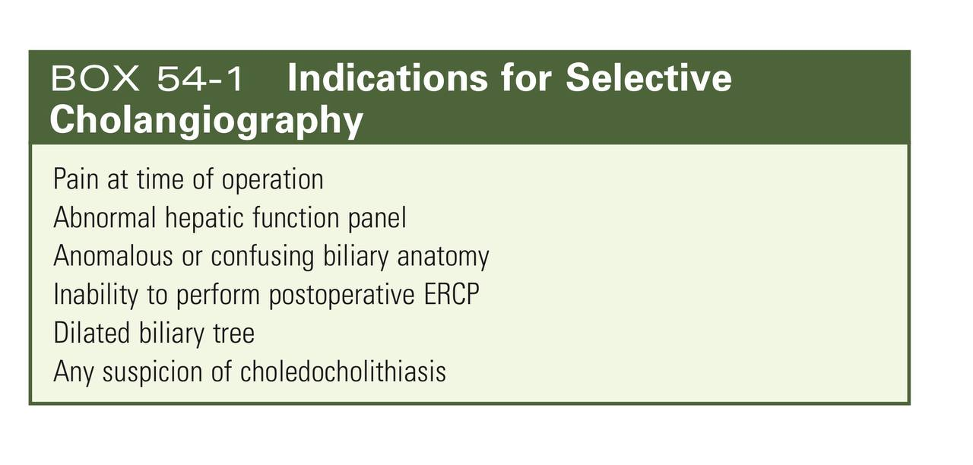

Slide 68
mangment
Identify and treat the underlying cholestatic causes of conjugated hyperbilirubinemia.

Slide 69
Management of cholestasis-associated pruritus [2]
Mild: emollient solutions for skin hydration
Moderate to severe
Cholestyramine (first-line
Rifampin (off-label) [16][15]
Opioid antagonists: e.g., naltrexone (off-label)

Slide 70
choledocholithiasis
Approach [17]]18][19]
Provide supportive therapy for patients with acute symptoms.
Provide initial supportive therapy of acute biliary disease, e.g., analgesics, spasmolytics, antiemetics.
NPO for patients with acute pain
Identify and treat any complications (e.g., acute pancreatitis, cholangitis, cholecystitis).
Provide definitive management of choledocholithiasis:
Removal of CBD stone, e.g., via ERCP
Elective cholecystectomy to prevent recurrence

Slide 71
CBD stone removal [18]
CBD stones may be removed endoscopically (ERCP) or surgically (LCBDE).
Lithotripsy may be considered in patients not suited, or unwilling, to undergo endoscopic or surgical stone removal.

Slide 72
ERCP-guided stone extraction
Indications
Suspected choledocholithiasis [18]
Cholangitis [20]
Consider in biliary pancreatitis caused by persistent choledocholithiasis. [18]
Timing: depends on whether there are complications and the timing of diagnosis
Uncomplicated choledocholithiasis: preoperatively or postoperatively, depending on when the diagnosis was confirmed in relation to cholecystectomy
Associated cholecystitis: same as that for uncomplicated choledocholithiasis
Associated cholangitis: depends on the severity of cholangitis as well as operative and anesthesia risks [21][22]
Mild/moderate acute cholangitis in low-risk patients: within 24–48 hours of presentation
Moderate/severe acute cholangitis or high-risk patients: after resolution of acute symptoms (i.e, after urgent biliary drainage)
Associated acute biliary pancreatitis with cholangitis: within 24 hours of presentation (see “Acute pancreatitis” for further details) [23]

Slide 73
Laparoscopic bile duct exploration (LCBDE; intraoperative stone extraction) [7][25][24]
Indications
An alternative to ERCP-guided stone extraction when surgical expertise is available [18][25]
Stones not suited to extraction
Patients with altered GIT anatomy (e.g., status post-Roux-en-Y surgery) for whom ERCP-guided stone extraction is not feasible
Procedure: incision is made either on the cystic duct (transcystic approach) or CBD directly (choledochotomy approach) and the stone is either flushed out or manually extracted [25]
Lithotripsy [18]
Indications
Large choledocholithiasis not suited to extraction via ERCP or surgery
Complex bile duct anatomy (e.g., distal CBD stricture) that makes ERCP and LCBDE challenging
Persistent choledocholithiasis despite ERCP and LCBDE is not possible
Options: include mechanical and laser lithotripsy

Slide 74
Elective interval cholecystectomy
Goal: recurrence prevention
Procedure: laparoscopic cholecystectomy
Indication: recommended in all patients with choledocholithiasis
Timing: depends on associated complications
Uncomplicated choledocholithiasis: within 72 hours of successful ERCP-guided stone clearance [26][19]
Mild biliary pancreatitis: during the same hospital admission [18][23][27]
Cholangitis: within 6 weeks of successful ERCP-guided stone clearance [20]
Acute cholecystitis [28][29]
Early laparoscopic cholecystectomy: patients with low operative and anesthesia risks
Delayed laparoscopic cholecystectomy: patients with high operative and anesthesia risks at initial presentation

Slide 75
Acute cholangitis

Slide 76
Initial mangment[30][31][32][33]
Stabilize the patient as needed.
Identify and treat sepsis. Provide immediate hemodynamic support (e.g., IV fluid resuscitation) and respiratory support (e.g., mechanical ventilation) if necessary.
Administer empiric antibiotic therapy for acute biliary infection to all patients.
Grade III acute cholangitis: within one hour of presentation [31]
Grade I–II acute cholangitis: within 4–6 hours of presentation [31][33]
Determine the need and timing for urgent biliary drainage and treatment of the underlying cause, based on severity grading for acute cholangitis (see “Definitive management”).
Identify and treat concurrent choledocholithiasis
Provide initial supportive therapy for acute biliary disease: e.g., analgesics (preferably NSAIDs), antiemetics, nasogastric tube insertion as needed, electrolyte repletion
Keep patients NPO.
Consult gastroenterology, interventional radiology, and/or surgery for urgent biliary drainage and decompression.

Slide 77
definitive treatment[34][30][32][35]
Grade I acute cholangitis :
Antibiotic therapy alone may be sufficient.
Consider urgent biliary drainage within 24–48 hours of presentation in patients with either of the following:
No response to antibiotic therapy within 24 hours
Choledocholithiasis
Underlying cause
If antibiotics are given alone: Treat electively, after acute symptoms resolve.
If biliary drainage is performed: Treat concurrently (i.e., a single-stage procedure).

Slide 78
Grade II acute cholangitis
Urgent biliary drainage within 24–48 hours of presentation
Underlying cause
Treat concurrently with biliary drainage (i.e., a single-stage procedure)
OR treat electively, after the patient improves with biliary drainage (i.e., a two-stage procedure)

Slide 79
Grade III acute cholangitis
Urgent biliary drainage within 24 hours of presentation [30][36]
Treat the underlying cause once the patient's condition improves after urgent biliary drainage (i.e., a two-stage procedure)

Slide 80
Procedure for biliart drainage[32][37]
Therapeutic ERCP-guided transpapillary biliary drainage
Indication: preferred biliary drainage procedure in acute cholangitis [30][37][38]
Procedures ERCP with papillotomy (sphincterotomy): Consider in patients with grade I–II acute cholangitis with no evidence of coagulopathy.
ERCP with temporary biliary stenting: Consider in patients with grade III acute cholangitis, uncorrected coagulopathy, biliary stricture, or cholangiocarcinoma. [38][32][36]

Slide 81
EUS-guided biliary drainage [[39][40][320
Indications :Second-line procedure if ERCP-guided drainage is unsuccessful
Second-line procedure if balloon-enteroscopy-assisted ERCP is not feasible in patients with altered upper gastrointestinal anatomy
Procedure: Under EUS guidance, a fistula is created and a stent placed between the stomach/duodenum and the CBD/(dilated) hepatic duct to allow for internal biliary drainage

Slide 82
other
Double balloon enteroscopy-assisted ERCP [32][41]
Percutaneous transhepatic biliary drainage (PTBD)[32]
Surgical choledochotomy with T-tube biliary drainage [31][42]
Indication: Consider if minimally invasive endoscopic and percutaneous biliary drainage procedures are unsuccessful or not feasible
Procedure: The CBD is opened laparoscopically or via open surgery (choledochotomy), a T-tube placed within the CBD, and the choledochotomy closed around the T-tube. The long limb of the T-tube is brought out through the abdominal wall to allow for external biliary drainage[43]

Slide 83
Procedures for treatment of the underlying cause[30]
For choledocholithiasis [33]
ERCP-guided stone extraction
Elective interval cholecystectomy: ∼ 6 weeks after the resolution of acute symptoms to minimize the risk of recurrence[44]
For biliary stricture: ERCP and CBD stenting
For parasitic infections (rare): ERCP-guided parasite extraction and anthelmintics [45][46]

Slide 84
Obstructive biliary tract malignancy
Cholangiocarcinoma
Surgical resection: Less than 10% of patients are candidates for resection.[48][50[51]
Pancreaticoduodenectomy: for distal extrahepatic CCA [50]
Radical hepatic resection plus regional lymphadenectomy: for intrahepatic or perihilar CCA[47][48][49]
Liver transplant: for select patients, e.g., those with unresectable perihilar CCA with a diameter ≤ 3 cm
Biliary decompression: e.g., stenting; often used palliatively in unresectable distal CCA with biliary obstruction [50][47]
Chemotherapy
Adjuvant chemotherapy with a 6-month course of capecitabine after surgical resection [50][51]
Palliative chemotherapy in unresectable disease49][50][52]
Radiotherapy
Adjuvant: if node-positive or if resection margins are not clear [51]
Palliative: may be offered in advanced disease [50]

Slide 85
Carcinoma of the head of pancreas
Management :
Treatment is surgical combined with chemo and radiotherapy , surgery could be palliative or curable .
Full staging to determine resectability
- 95% tumors are unsuitable for surgical resection
Contraindications for surgery include distant metastases, encasement of SMA or celiac artery vessels
Pancreatoduodenectomy (Whipple procedure) for resectable cases
Unresectable cases are treated with palliation including biliary stent placement, chemotherapy, and adequate analgesia

Slide 86
Other causes
Primary biliary cholangitis:
ursodeoxycholic
Mngment of pruritis
Primary sclerosing cholangitis:
Dailatation of strictures
Liver transplant
Biliary cyst:
Surgical excision of the cysts

Slide 87
Thank you

Slide 88
resources

Slide 89
1.chiff ER, Bergasa NV. Advances in Hepatology: Current Developments in the Treatment of Hepatitis and Hepatobiliary Disease. Gastroenterol Hepatol. 2009; 5(8): pp. 550–552. url: https://www.ncbi.nlm.nih.gov/pmc/articles/PMC2886403/.
2.. Bassari R, Koea JB. Jaundice associated pruritis: a review of pathophysiology and treatment. World J Gastroenterol. 2015; 21(5): pp. 1404–1413. doi: 10.3748/wjg.v21.i5.1404
3. Roche SP, Kobos R. Jaundice in the adult patient. Am Fam Physician. 2004; 69(2): pp. 299–304. pmid: 14765767.
4. Peterson CM, McNamara MM, et al. American College of Radiology ACR Appropriateness Criteria® Right Upper Quadrant Pain. https://acsearch.acr.org/docs/69474/Narrative/. Updated January 1, 2018. Accessed August 28, 2019.
5. Hindman NM, Arif-Tiwari H, Kamel RI, et al. American College of Radiology ACR Appropriateness Criteria® Jaundice. https://acsearch.acr.org/docs/69497/Narrative/. Updated January 1, 2018. Accessed May 26, 2020.
6. Webb WR, Brant WE, Major NM. Fundamentals of Body CT. Philadelphia: Saunders; 2014

Slide 90
7. Thaker AM, Mosko JD, Berzin TM. Post-endoscopic retrograde cholangiopancreatography pancreatitis. Gastroenterology report. 2015; 3(1): pp. 32–40. doi: 10.1093/gastro/gou083.
8. Kelly NM, Tham T. Abnormal Liver Function Tests in Acute Cholecystitis With and Without Choledocholithiasis. Gastroenterology. 2011; 140(5): pp. S–450. doi: 10.1016/s0016-5085(11)61847-7.
9. Peng WK, Sheikh Z, Paterson-Brown S, Nixon SJ. Role of liver function tests in predicting common bile duct stones in acute calculous cholecystitis. Br J Surg. 2005; 92(10): pp. 1241–7. doi: 10.1002/bjs.4955
10. Sugiyama M, Atomi Y. Endoscopic ultrasonography for diagnosing choledocholithiasis: a prospective comparative study with ultrasonography and computed tomography. Gastrointest Endosc. 1997; 45(2): pp. 143–146. doi: 10.1016/s0016-5107(97)70237-2.
11. Tazuma S, Unno M, Igarashi Y, et al. Evidence-based clinical practice guidelines for cholelithiasis 2016. J Gastroenterol. 2016; 52(3): pp. 276–300. doi: 10.1007/s00535-016-1289-7.
12. European Association for the Study of the Liver (EASL). EASL Clinical Practice Guidelines on the prevention, diagnosis and treatment of gallstones. J Hepatol. 2016; 65(1): pp. 146–181. doi: 10.1016/j.jhep.2016.03.005.
13. Oak JH, Paik CN, Chung WC, Lee K-M, Yang JM. Risk Factors for Recurrence of Symptomatic Common Bile Duct Stones after Cholecystectomy. Gastroenterology Research and Practice. 2012; 2012: pp. 1–6. doi: 10.1155/2012/417821.
14. Komarowska M, Snarska J, Troska P, Suszkiewicz R. Recurrent residual choledocholithiasis after cholecystectomy – endoscopic exploration of bile ducts performed 6 times. Polish Annals of Medicine. 2011; 18(1): pp. 118–124. doi: 10.1016/s1230-8013(11)70030-3.
15Lindor KD, Kowdley KV, Harrison EM. ACG Clinical Guideline: Primary Sclerosing Cholangitis. Am J Gastroenterol. 2015; 110(5): pp. 646–659. doi: 10.1038/ajg.2015.112.
16. EASL. EASL Clinical Practice Guidelines: Management of cholestatic liver diseases. J Hepatol. 2009; 51(2): pp. 237–267. doi: 10.1016/j.jhep.2009.04.009.

Slide 91
17Kelly NM, Tham T. Abnormal Liver Function Tests in Acute Cholecystitis With and Without Choledocholithiasis. Gastroenterology. 2011; 140(5): pp. S–450. doi: 10.1016/s0016-5085(11)61847-7.
18. Peng WK, Sheikh Z, Paterson-Brown S, Nixon SJ. Role of liver function tests in predicting common bile duct stones in acute calculous cholecystitis. Br J Surg. 2005; 92(10): pp. 1241–7. doi: 10.1002/bjs.4955.
19. Kiriyama S, Kozaka K, Takada T, et al. Tokyo Guidelines 2018: diagnostic criteria and severity grading of acute cholangitis (with videos). Journal of Hepato-Biliary-Pancreatic Sciences. 2018; 25(1): pp. 17–30. doi: 10.1002/jhbp.512.
20. Tenner S, Baillie J, Dewitt J, Vege SS. American College of Gastroenterology guideline: management of acute pancreatitis. Am J Gastroenterol. 2013; 108(9): pp. 1400–1415. doi: 10.1038/ajg.2013.218.
21. Molvar C, Glaenzer B. Choledocholithiasis: Evaluation, Treatment, and Outcomes. Seminars in interventional radiology. 2016; 33(4): pp. 268–276. doi: 10.1055/s-0036-1592329.
22. Memon MA, Hassaballa H, Memon MI. Laparoscopic common bile duct exploration: the past, the present, and the future. Am J Surg. 2000; 179(4): pp. 309–15. doi: 10.1016/s0002-9610(00)00346-9.
23. Huang RJ, Barakat MT, Girotra M, Banerjee S. Practice Patterns for Cholecystectomy After Endoscopic Retrograde Cholangiopancreatography for Patients With Choledocholithiasis. Gastroenterology. 2017; 153(3): pp. 762–771.e2. doi: 10.1053/j.gastro.2017.05.048.
24. Crockett et al. American Gastroenterological Association Institute Guideline on Initial Management of Acute Pancreatitis. Gastroenterology. 2018; 154(4): pp. 1096–1101. doi: 10.1053/j.gastro.2018.01.032.
25. Schuster KM, Holena DN, Salim A, Savage S, Crandall M. American Association for the Surgery of Trauma emergency general surgery guideline summaries 2018: acute appendicitis, acute cholecystitis, acute diverticulitis, acute pancreatitis, and small bowel obstruction. Trauma surgery & acute care open. 2019; 4(1): p. e000281. doi: 10.1136/tsaco-2018-000281.
26. Gutt CN, Encke J, Köninger J, et al. Acute Cholecystitis. Ann Surg. 2013; 258(3): pp. 385–393. doi: 10.1097/sla.0b013e3182a1599b.
27. Nuño-Guzmán CM, Marín-Contreras ME, Figueroa-Sánchez M, Corona JL. Gallstone ileus, clinical presentation, diagnostic and treatment approach. World J Gastrointest Surg. 2016; 8(1): p. 65. doi: 10.4240/wjgs.v8.i1.65.
28. Abich E, Glotzer D, Murphy E. Gallstone Ileus: An Unlikely Cause of Mechanical Small Bowel Obstruction. Case Reports in Gastroenterology. 2017; 11(2): pp. 389–395. doi: 10.1159/000475749.
29. Caldwell KM, Lee SJ, Leggett PL, Bajwa KS, Mehta SS, Shah SK. Bouveret syndrome: current management strategies. Clinical and experimental gastroenterology. 2018; 11: pp. 69–75. doi: 10.2147/CEG.S132069

Slide 92
38. Kiriyama S, Kozaka K, Takada T, et al. Tokyo Guidelines 2018: diagnostic criteria and severity grading of acute cholangitis (with videos). Journal of Hepato-Biliary-Pancreatic Sciences. 2018; 25(1): pp. 17–30. doi: 10.1002/jhbp.512.
33. Miura F, Okamoto K, Takada T, et al. Tokyo Guidelines 2018: initial management of acute biliary infection and flowchart for acute cholangitis. Journal of Hepato-Biliary-Pancreatic Sciences. 2018; 25(1): pp. 31–40. doi: 10.1002/jhbp.509.
34. European Association for the Study of the Liver (EASL). EASL Clinical Practice Guidelines on the prevention, diagnosis and treatment of gallstones. J Hepatol. 2016; 65(1): pp. 146–181. doi: 10.1016/j.jhep.2016.03.005.
30 Peterson CM, McNamara MM, et al. American College of Radiology ACR Appropriateness Criteria® Right Upper Quadrant Pain. https://acsearch.acr.org/docs/69474/Narrative/. Updated January 1, 2018. Accessed August 28, 2019.
31. Zimmer V, Lammert F. Acute Bacterial Cholangitis. Visceral Medicine. 2015; 31(3): pp. 166–172. doi: 10.1159/000430965.
. 32Iqbal U, Khara HS, Hu Y, et al. Emergent versus urgent ERCP in acute cholangitis: a systematic review and meta-analysis. Gastrointest Endosc. 2020; 91(4): pp. 753–760.e4. doi: 10.1016/j.gie.2019.09.040.
35 Manes G, Paspatis G, Aabakken L, et al. Endoscopic management of common bile duct stones: European Society of Gastrointestinal Endoscopy (ESGE) guideline. Endoscopy. 2019; 51(05): pp. 472–491. doi: 10.1055/a-0862-0346.
36. Buyukasik K, Toros AB, Bektas H, Ari A, Deniz MM. Diagnostic and therapeutic value of ERCP in acute cholangitis. ISRN gastroenterology. 2013; 2013: p. 191729. doi: 10.1155/2013/191729.
37. Baars JE, Kaffes AJ, Saxena P. EUS-guided biliary drainage: A comprehensive review of the literature. Endoscopic ultrasound. 2018; 7(1): pp. 4–9. doi: 10.4103/eus.eus_105_17.
39. Salerno R, Davies SEC, Mezzina N, Ardizzone S. Comprehensive review on EUS-guided biliary drainage. World journal of gastrointestinal endoscopy. 2019; 11(5): pp. 354–364. doi: 10.4253/wjge.v11.i5.354.
40. Kashani A, Abboud G, Lo SK, Jamil LH. Double balloon enteroscopy-assisted endoscopic retrograde cholangiopancreatography in Roux-en-Y gastric bypass anatomy: expert vs. novice experience. Endoscopy international open. 2018; 6(7): pp. E885–E891. doi: 10.1055/a-0599-6059.
41. Jarnagin WR. Blumgart's Surgery of the Liver, Biliary Tract, and Pancreas. Elsevier; 2016.
42. Ahmed M, Diggory RT. Case-based review: bile peritonitis after T-tube removal. Ann R Coll Surg Engl. 2013; 95(6): pp. 383–5. doi: 10.1308/003588413X13629960048596.
43. Li VK, Yum JL, Yeung YP. Optimal timing of elective laparoscopic cholecystectomy after acute cholangitis and subsequent clearance of choledocholithiasis. Am J Surg. 2010; 200(4): pp. 483–488. doi: 10.1016/j.amjsurg.2009.11.010.
44. Ha JS, Choi HJ, Moon JH, et al. Endoscopic Extraction of Biliary Fascioliasis Diagnosed Using Intraductal Ultrasonography in a Patient with Acute Cholangitis. Clinical endoscopy. 2015; 48(6): pp. 579–82. doi: 10.5946/ce.2015.48.6.579.
45. Yılmaz S, Akıcı M, Şimşek M, Okur N, Erşen O, Tuncer AA. Endoscopic retrograde cholangiopancreatography for biliary system parasites. Turkish journal of surgery. 2018; 34(4): pp. 306–310. doi: 10.5152/turkjsurg.2017.3808.
46. Kimura Y, Takada T, Kawarada Y, et al. Definitions, pathophysiology, and epidemiology of acute cholangitis and cholecystitis: Tokyo Guidelines. J Hepatobiliary Pancreat Surg. 2007; 14(1): pp. 15–26. doi: 10.1007/s00534-006-1152-y.

Slide 93
47.Goljan EF. Rapid Review Pathology. Philadelphia, PA: Elsevier Saunders; 2013.
52. Valle JW, Borbath I, Khan SA, Huguet F, Gruenberger T, Arnold D. Biliary cancer: ESMO Clinical Practice Guidelines for diagnosis, treatment and follow-up†. Annals of Oncology. 2016; 27(suppl_5): pp. v28–v37. doi: 10.1093/annonc/mdw324.
48. Bowlus CL, Arrivé L, Bergquist A, et al. AASLD practice guidance on primary sclerosing cholangitis and cholangiocarcinoma. Hepatology. 2022. doi: 10.1002/hep.32771.
49. Alvaro D, Gores GJ, Walicki J, et al. EASL-ILCA Clinical Practice Guidelines on the management of intrahepatic cholangiocarcinoma. J Hepatol. 2023; 79(1): pp. 181–208. doi: 10.1016/j.jhep.2023.03.010.
50. Brindley PJ, Bachini M, Ilyas SI, et al. Cholangiocarcinoma. Nat Rev Dis Primers. 2021; 7(1). doi: 10.1038/s41572-021-00300-2.
51. PDQ Adult Treatment Editorial Board. Bile duct cancer (cholangiocarcinoma) treatment (PDQ) – health professional version. PDQ Cancer Information Summaries. 2024. pmid: 26389308.
52. Dhanasekaran R, Hemming AW, Zendejas I, et al. Treatment outcomes and prognostic factors of intrahepatic cholangiocarcinoma. Oncol Rep. 2013; 29(4): pp. 1259–67. doi: 10.3892/or.2013.2290.
53. Jang JY, Kim SW, Park DJ, et al. Actual long-term outcome of extrahepatic bile duct cancer after surgical resection. Ann Surg. 2005; 241(1): pp. 77–84. doi: 10.1097/01.sla.0000150166.94732.88.

Slide 94
49.Jarnagin WR. Blumgart's Surgery of the Liver, Biliary Tract, and Pancreas. Elsevier; 2016
51.van Eijck FC, van Veen RN, Kleinrensink GJ, Lange JF. Hartmann's gallbladder pouch revisited 60 years later.. Surg Endosc. 2007; 21(7): p.1122-5. doi: 10.1007/s00464-006-9058-y
50.Beltrán MA. Mirizzi syndrome: history, current knowledge and proposal of a simplified classification.. World journal of gastroenterology. 2012; 18(34): p.4639-50. doi: 10.3748/wjg.v18.i34.4639
52.Buxbaum JL, Abbas Fehmi SM, Sultan S, et al. ASGE guideline on the role of endoscopy in the evaluation and management of choledocholithiasis. Gastrointest Endosc. 2019; 89(6): p.1075-1105.e15. doi: 10.1016/j.gie.2018.10.001
26.Townsend CM Jr, Beauchamp RD, Evers BM, Mattox KL. Sabiston Textbook of Surgery: The Biological Basis of Modern Surgical Practice. Elsevier; 2016
27.Hoilat GJ, John S. Choledochal Cyst. StatPearls. 2021. pmid: 32491694

Slide 95
1.Nestor F. Esnaola, Joshua E. Meyer, Andreas Karachristos, Jennifer L. Maranki, E. Ramsay Camp, Crystal S. Denlinger. Evaluation and management of intrahepatic and extrahepatic cholangiocarcinoma. Cancer. 2016; 122(9): p.1349-1369. doi: 10.1002/cncr.29692Open in Read by QxMD
2.Razumilava N, Gores GJ. Classification, Diagnosis, and Management of Cholangiocarcinoma. Clin Gastroenterol Hepatol. 2012; 11(1): p.13-e4. doi: 10.1016/j.cgh.2012.09.009Open in Read by QxMD
3.Massarweh NN, El-Serag HB. Epidemiology of Hepatocellular Carcinoma and Intrahepatic Cholangiocarcinoma. Cancer Control. 2017; 24(3): p.1073274817729245. doi: 10.1177/1073274817729245Open in Read by QxMD
4.Goljan EF. Rapid Review Pathology. Elsevier Saunders; 2013
5.Valle JW, Borbath I, Khan SA, Huguet F, Gruenberger T, Arnold D. Biliary cancer: ESMO Clinical Practice Guidelines for diagnosis, treatment and follow-up†. Annals of Oncology. 2016; 27(suppl_5): p.v28-v37. doi: 10.1093/annonc/mdw324Open in Read by QxMD
9. Brindley PJ, Bachini M, Ilyas SI, et al. Cholangiocarcinoma. Nat Rev Dis Primers. 2021; 7(1). doi: 10.1038/s41572-021-00300-2Open in Read by QxMD

Slide 96
17.Xia T, Wu X, Mou Y, et al. Clinicopathological Prognostic Factors and Chemotherapeutic Outcome for Two Histopathological Types of Ampulla of Vater Adenocarcinoma. Frontiers in Oncology. 2021; 11. doi: 10.3389/fonc.2021.616108Open in Read by QxMD
18.Albores-Saavedra J, Schwartz AM, Batich K, Henson DE. Cancers of the ampulla of vater: Demographics, morphology, and survival based on 5,625 cases from the SEER program. J Surg Oncol. 2009; 100(7): p.598-605. doi: 10.1002/jso.21374Open in Read by QxMD
19.Ahn DH, Bekaii-Saab T. Ampullary Cancer: An Overview. American Society of Clinical Oncology Educational Book. 2014: p.112-115. doi: 10.14694/edbook_am.2014.34.112Open in Read by QxMD
20.Mantas D, Charalampoudis P, Nikiteas N. FAP related periampullary adenocarcinoma. Int J Surg Case Rep. 2013; 4(8): p.684-686. doi: 10.1016/j.ijscr.2013.05.006Open in Read by QxMD
21.Patel M, Uboha NV. Treatment Approach to Adenocarcinoma of the Ampulla of Vater. Curr Treat Options Oncol. 2021; 22(11). doi: 10.1007/s11864-021-00894-5Open in Read by QxM

Slide 97
5.Pancreatic Cancer Risk Factors. https://www.cancer.org/cancer/pancreatic-cancer/causes-risks-prevention/risk-factors.htmlUpdated: May 31, 2016. Accessed: September 3, 2017.
6.Edderkaoui M, Thrower E. Smoking and pancreatic disease. J Cancer Ther. 2013; 4(10A): p.34-40. doi: 10.4236/jct.2013.410A005Open in Read by QxMD
7.Alcohol Use and Cancer. https://www.cancer.org/cancer/cancer-causes/diet-physical-activity/alcohol-use-and-cancer.htmlUpdated: April 5, 2017. Accessed: September 3, 2017

Slide 98
4.Goljan EF. Rapid Review Pathology. Elsevier Saunders; 2013
5.Valle JW, Borbath I, Khan SA, Huguet F, Gruenberger T, Arnold D. Biliary cancer: ESMO Clinical Practice Guidelines for diagnosis, treatment and follow-up†. Annals of Oncology. 2016; 27(suppl_5): p.v28-v37. doi: 10.1093/annonc/mdw324
11.Lamarca A, Edeline J, Goyal L. How I treat biliary tract cancer. ESMO Open. 2022; 7(1): p.100378. doi: 10.1016/j.esmoop.2021.100378
14.PDQ Adult Treatment Editorial Board. Gallbladder cancer treatment (PDQ) – health professional version. PDQ Cancer Information Summaries [Internet]. 2024. pmid: 26389371
15.Roa JC, García P, Kapoor VK, Maithel SK, Javle M, Koshiol J. Gallbladder cancer. Nat Rev Dis Primers. 2022; 8(1). doi: 10.1038/s41572-022-00398-y

Slide 99
https://www.uptodate.com/contents/bilirubinmetabolism/contributors
[0,2]
[0,3] Oct 16, 2019 Author: Jennifer Lynn Bonheur, MD; Chief Editor: Vinay K Kapoor, MBBS, MS, FRCSEd, FICS, FAMS
[0,4] https://dx.doi.org/10.1055/a-0644-2972
[0,5] Diestel et al.: Harrison ‘s Internal Medicine (2 volumes) . 16th edition ABW Wissenschaftsverlagsgesellschaft 2005 , ISBN: 978-3-936-07229-7

