Slide 1
Common Chromosomal Disorders
VIP
YaraZoubi
Lina Yousef
Batool Yamin
تبييض الطالب : رائد علي

Slide 2
Somatic
Cells
Sex
Cells
Body cell
46 chromosome (23 pairs of chromosome )
Diploid (2n)
Sperm &egg
23 single chromosome
Haploid (1n)
Each cell in our bodies should have 23pairs of chromosome , if there is less or more thus result : chromosomal abnormalities .

Slide 3
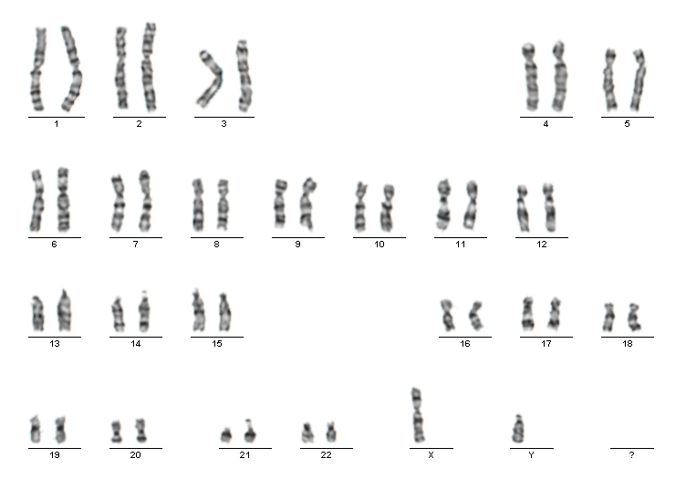
Karyotype :
1950s
Show all of chromosome in one person cell . (Number , Size , Shape )
Y chromosome shorter than X chromosome
Each pair of chromosome composed of two sister chromatid
Determine gender of baby :
XX : Female
XY : Male

Slide 4
Types of cell division :
Mitosis
Meiosis
2n
1n
1n
2n
2n
1n
1n
2n
Notes:
Mitosis :
Diploid cell result in two identical diploid cells
Meiosis :
Two division transport diploid parent cell into four different daughter cells each of them haploid .
Each of them have genetic variation because of two process called :
Homologous recombination
Crossing over
Each daughter cell different from each other as well as different from parent cell .

Slide 5
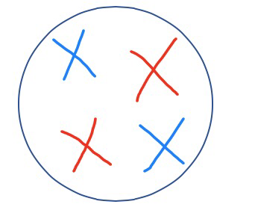
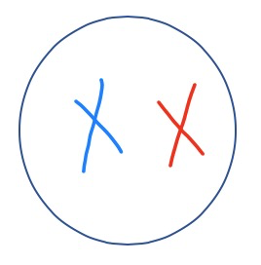
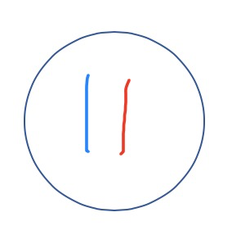
Meiosis
NORMAL
Meiosis I
PMAT
Meiosis II
Notes:
Process of meiosis pass on two steps each one composed of 4 phases ( PMAT) result in 4 daughter cells each one with chromatids (haploid )
PMAT : prophase , metaphase , anaphase , telophase .

Slide 6
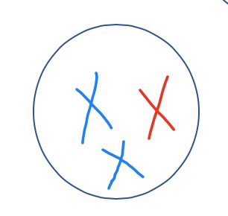
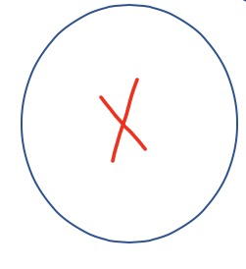
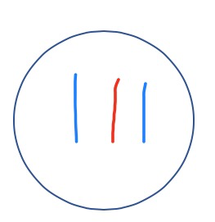
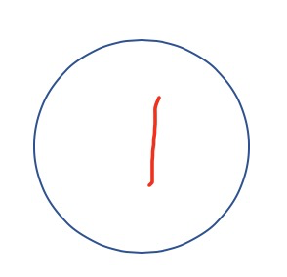
Defect in division during meiosis I
Daughter cell will have abnormal number of chromosome (some will have too many & some will have too less)
Notes:
Usually the problem occur on the anaphase when the chromosome not pole toward the correct side of the cell

Slide 7
Defect in division during meiosis II
Non disjunction :
Sister chromatid fail to separate.
More common on older individual .
Notes:
Usually the problem occur on the anaphase where the chromosome fail to separate into two chromatid .
Non disjunction more common on older individual as the older one -----> more steaky chromatid thus less likely to separate .
The older parents are more likely to have baby with chromosomal abnormalities .

Slide 8
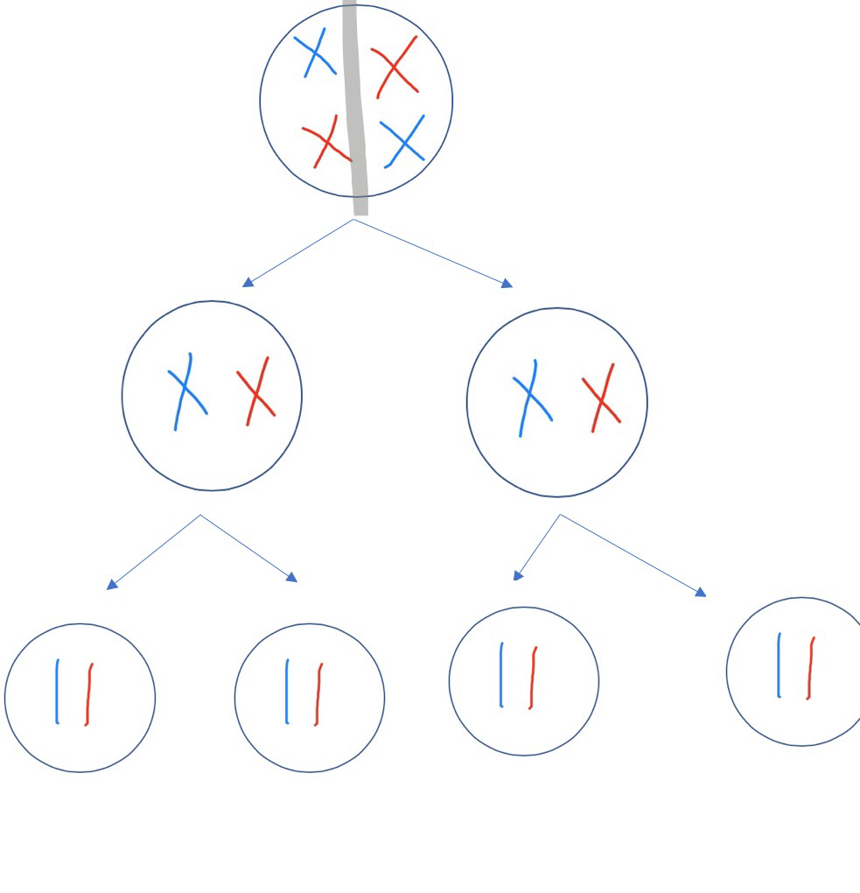
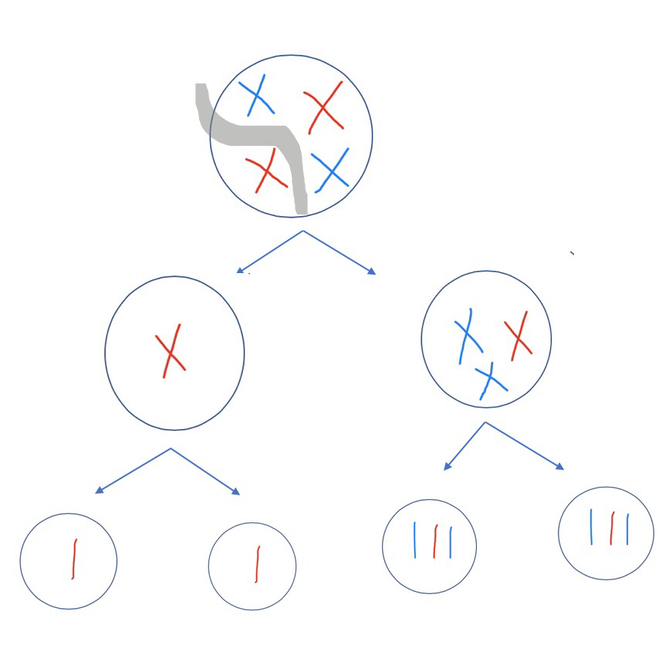
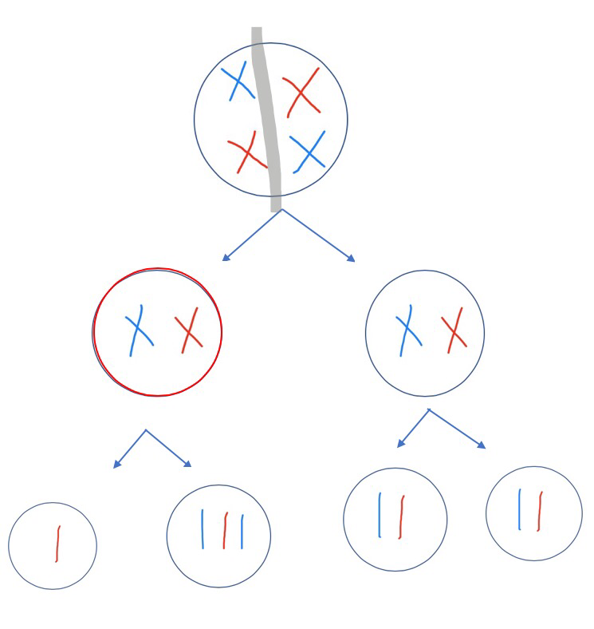
Normal
Abnormal meiosis I
Abnormal meiosis II
Which one is better ?
Which is common ? !?!
Half of cells have incorrect number of chromosomes .
Thus 50% chance to have normal baby .
Every cell have incorrect number of chromosomes .

Slide 9
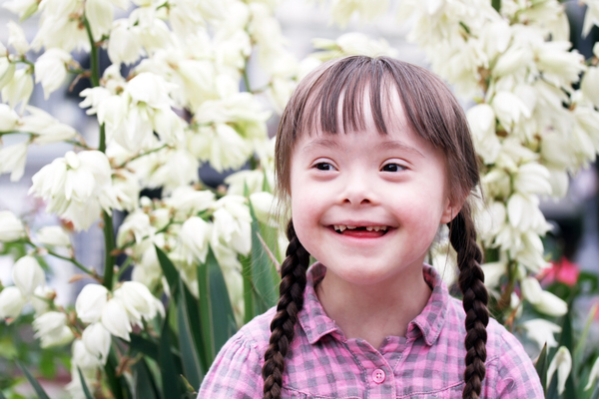
Down syndrome
(Trisomy 21)

Slide 10
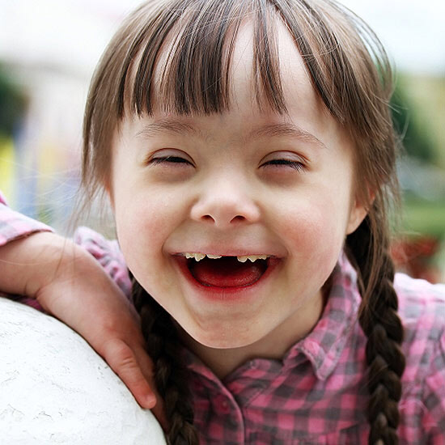

Slide 11
trisomy 21, Down syndrome
It is the most common chromosome abnormality in humans——autosome
the presence of all or part of a third copy of chromosome 21
Only Autosomal trisomy that's compatible with long term life
Most common genetic cause of mental retardation
The frequency ：1 in 600~800 live births

Slide 12
History
In 1866, British physician, John Langdon Down, described the syndrome ——Down syndrome
In 1959,Down syndrome was identified as a chromosome 21 trisomy by Dr. Jérôme Lejeune——trisomy 21

Slide 13
Risk factors:
Most imp. Risk factor is advacing maternal age >35 y , this risk increases as the age increases after that \\ here ; mostly non-disjunction (most common cause of down s)
the only factor shown to Increase the risk of having a child with down syndrome from nondisjunction is increasing maternal age
Most important factor for recurrence is translocation
Advancing maternal age – usually women of age 35 and above
Mothers who already have one child with Down syndrome – increased risk for subsequent pregnancies
Parents who are carriers of the genetic translocation for Down syndrome
virus infections: EB virus, mumps virus, rubella virus
radiation

Slide 14
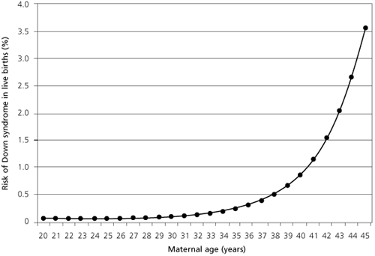
Notes:
At maternal age 20 to 24, the probability is one in 1562; at age 35 to 39 the probability is one in 214, and above age 45 the probability is one in 19
Recent data also suggest that paternal age, especially beyond 42,^{[94]} also increases the risk of Down syndrome manifesting.^{[95]}

Slide 15
Etiology :
Non disjunction
92.5%
Robertsonian translocation 4%
Mosaicism
1-2%

Slide 16
Non disjunction
92.5%
using standard cytogenetic nomenclature, trisomy 21 is designated 47,XX,+21 or 47,XY,+21
Trisomy 21

Slide 17
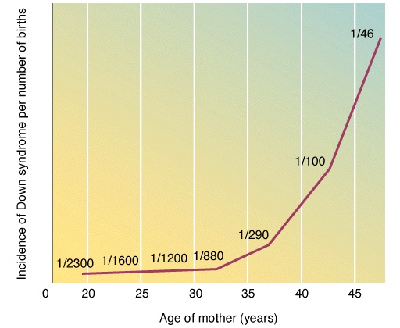
This occurrence is correlated with advanced maternal and paternal age.
88% coming from nondisjunction in the maternal gamete
8% coming from nondisjunction in the paternal gamete
So Mostly from maternal gamete
Advanced paternal age ass with achondroplasia

Slide 18
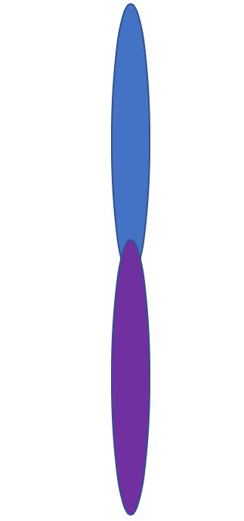
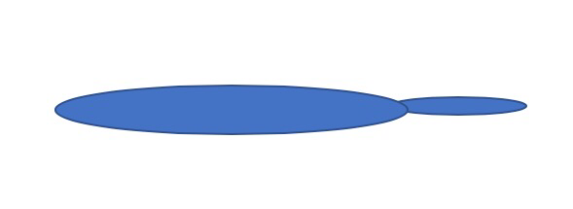
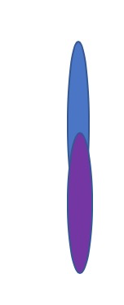
Robertsonian translocations
Involves breaks at the extreme end of two non-homologous acrocentric chromosomes (13, 14, 15, 21, 22)
The short ends are lost, long ends fuse (Robertsonian Translocation)
If Translocations occur in parents , they will be carrier (asymptomatic).
This cause isnt related to age
There is increased risk of recurrance
Chromosome 21
Chromosome 14
صار عندك 3 نسخ من كروموسوم 21 ..و كروموسوم 14 طارت منه نسخة
Both long arms
Both short arms
Doesn't carry much of genatic information , usually lost at the end of meiosis
standard nomenclature is 46,XX,t(14q21q) or 46,XY,t(14q21q).
In down s case :
If maternal age <35 y or recurrance down syndrome , you can suspect the cause is translocation (not nondisjunction)
It does not show the maternal age effect, and is just as likely to have come from fathers as mothers

Slide 19
Mosaic Trisomy 21
These individuals have two populations of cells: one with trisomy 21 and one with a normal chromosome complement.
Mosaicism results from a either a nondisjunctional event that occurs after fertilization and after a few cell divisions, or from trisomic rescue.
standard nomenclature is
47,XX, +21/46XX or 47,XY,+21/46,XY.
Mosaic trisomy 21 : Nondisjunction beyond the fertilization , the pt has normal cells and 21 trisomy cels ,, presentation isnt typical (has milder presentation of down s)

Slide 20
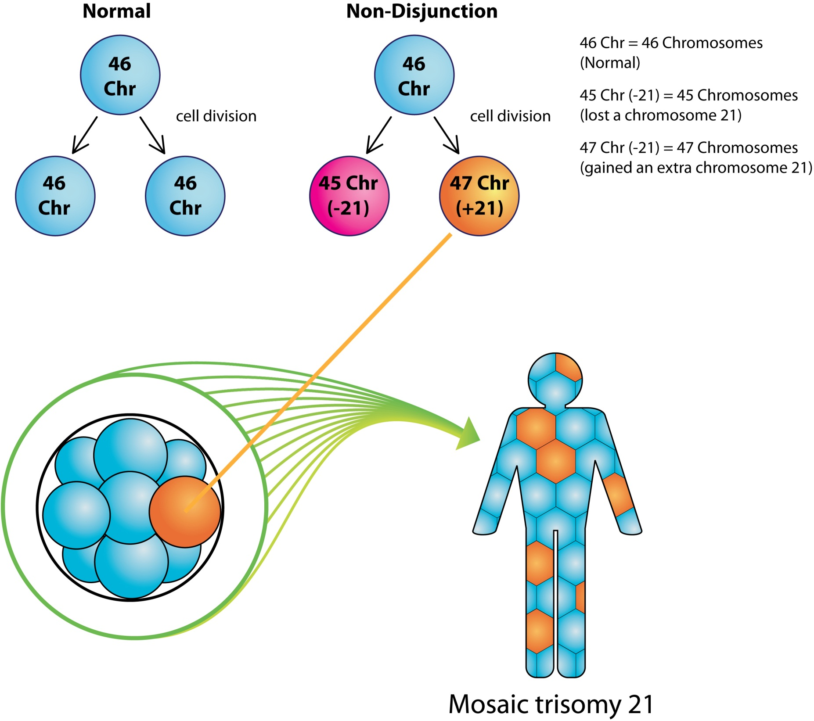

Slide 21
Clinical features :
Down syndrome symptoms vary from person to person and can range from mild to severe
Mental retardation most common cause of mental retardation in children is down syndrome \\( mental retardation means IQ<70 )
Particular facial characteristics& Dermatoglyphics abnormalities
Growth retardation
Other abnormality

Slide 22
Mental retardation
Most Down syndrome have intellectual disability in the mild (IQ 50–70) to moderate (IQ 35–50)
Language skills show a difference between understanding speech and expressing speech, and commonly individuals with Down syndrome have a speech delay (expressive rather than receptive )
Fine motor skills are delayed and often lag behind gross motor skills
Pt with down syndrome have global developmental delay but eventually they will gain the skills lateron (global developmental delay : delay in 2 or more aspects of developmental assessment ) \\ in down s the delay usually in the four aspect

Slide 23
Children may also have delayed mental and social development. Common problems may include:
Impulsive behavior
Poor judgment
Short attention span
Slow learning
Mental retardation varied from mild to moderate – some even have special abilities after training and early interventions.

Slide 24
Clinical features :
Down syndrome symptoms vary from person to person and can range from mild to severe
Mental retardation
Particular facial characteristics& Dermatoglyphics abnormalities
Growth retardation
Other abnormality

Slide 25
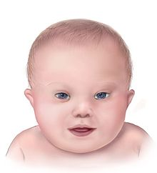
Particular facial characteristics
flat occiput vs (protruding occiput in trisomy 18)
flattened facial appearance
increased interocular distance (hypertelorism)
flat nasal bridge
Up-slanting palpebral fissures
epicanthic folds
low-set small ear with overfolded helix
Small mouth
protruding tongue
high-arched palate
dental abnormalities

Slide 26
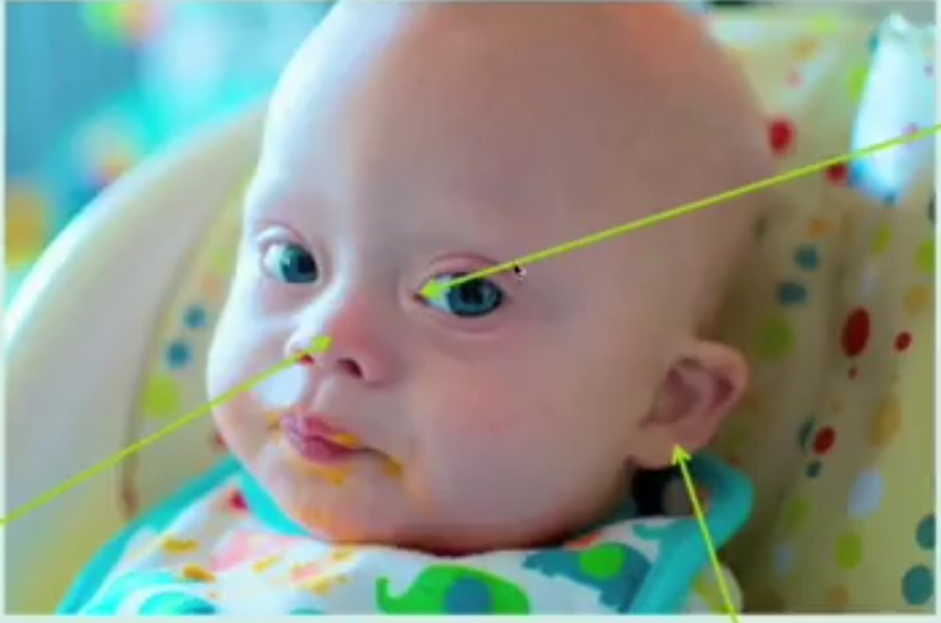
epicanthic fold
Flat nasal bridge
Displaystic ear

Slide 28
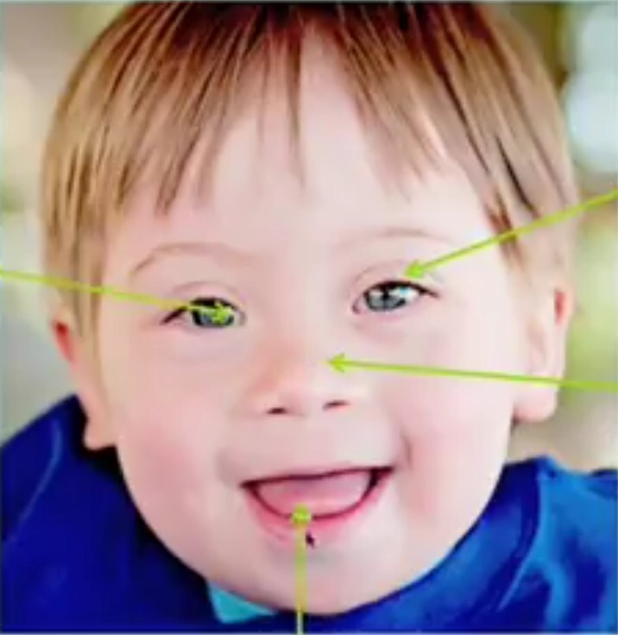
Up-slanting palpebral fissures
epicanthic fold
Flat nasal bridge
protruding tongue

Slide 29
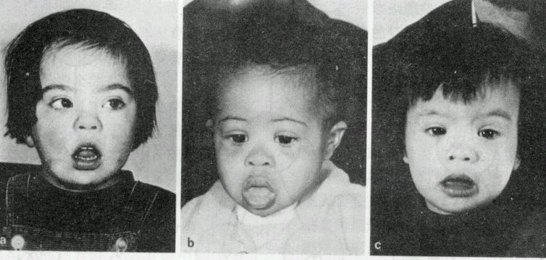
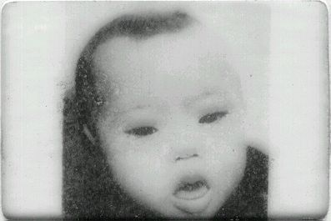
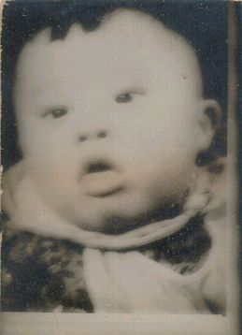
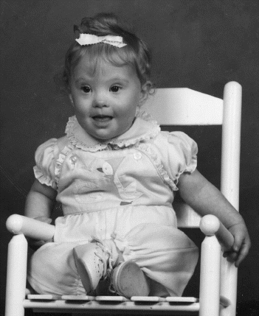

Slide 31
Dermatoglyphics
abnormalities
Wide, short hands with short fingers
Single crease in the palm of the hand

Slide 32
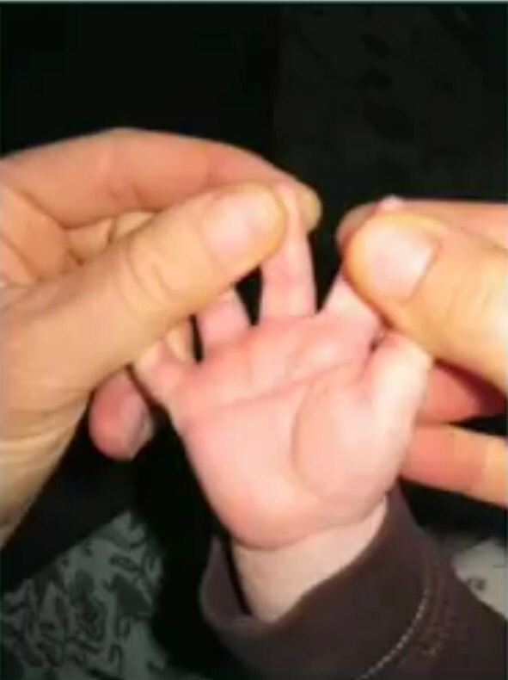
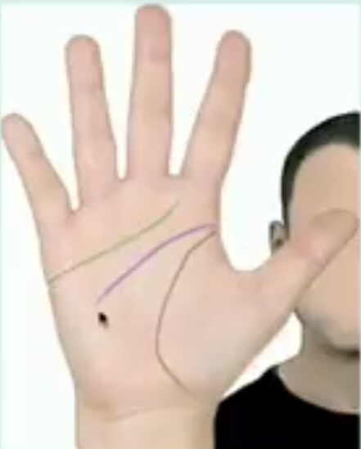
Normal
a single palmar crease

Slide 33
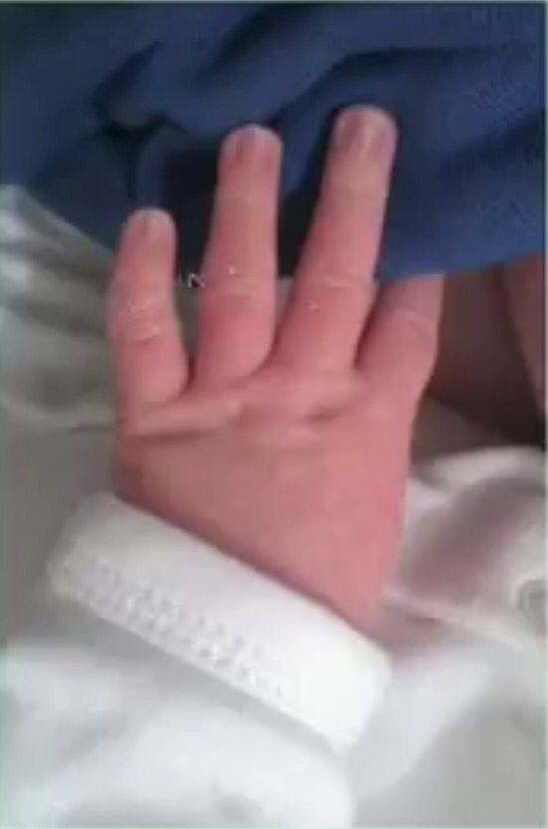
Also seen in turner syndrome
clinodactyly : short thin curved fifth finger

Slide 34
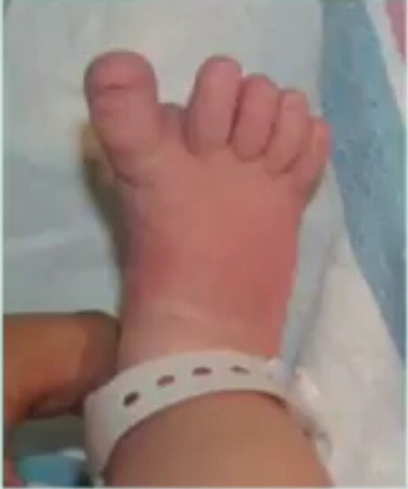
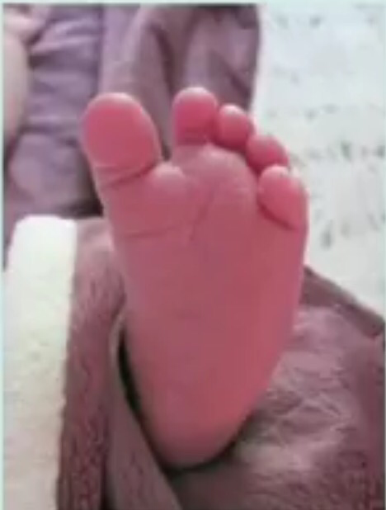
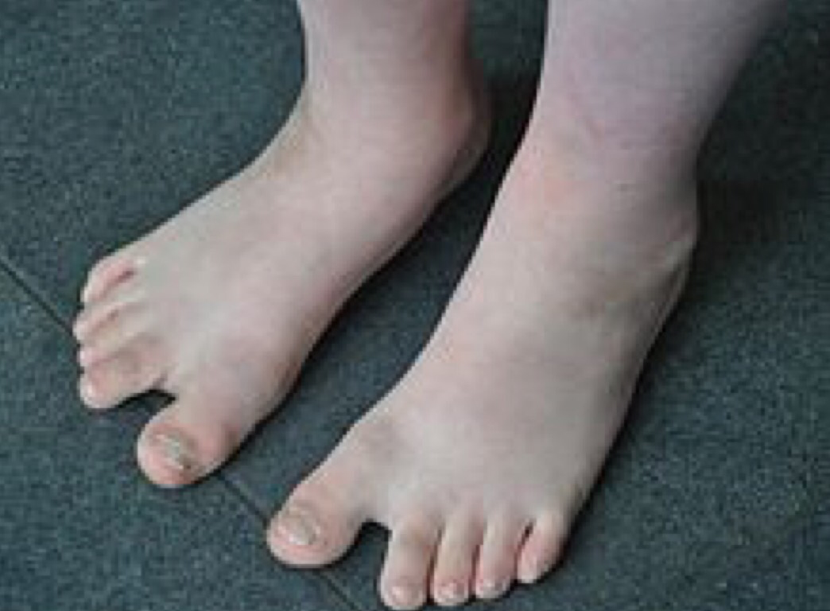
Sandal sign : a wide gap between the first and second toes

Slide 35
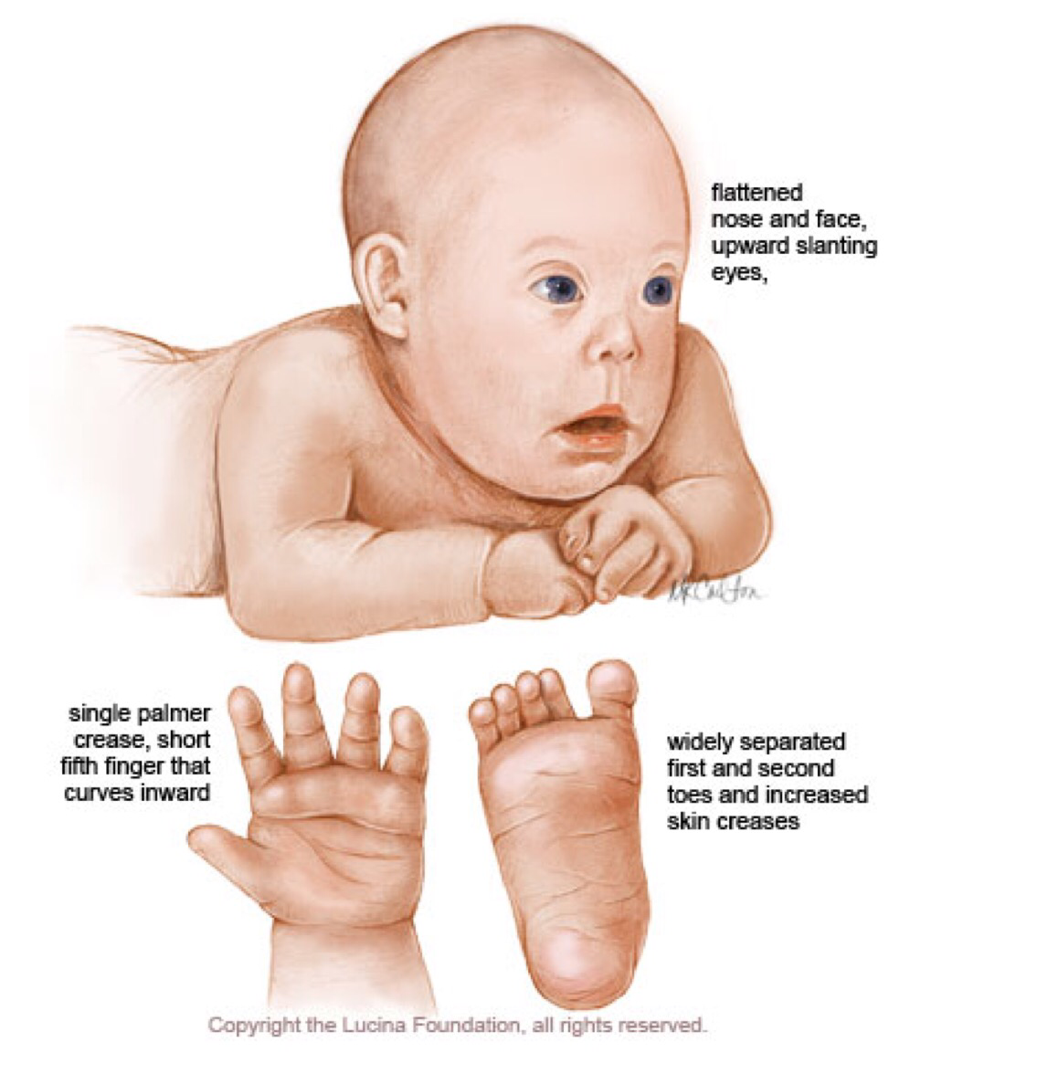

Slide 36
Clinical features :
Down syndrome symptoms vary from person to person and can range from mild to severe
Mental retardation
Particular facial characteristics& Dermatoglyphics abnormalities
Growth retardation
Other abnormality

Slide 37
Growth retardation::
Growth parameters are smaller in children with DS
Adults with DS tend to have short stature and bowed legs
Physical development is often slower than normal. Some children will begin walking at around 2 years of age, while others will not walk until age 4
Most children with Down syndrome never reach their average adult height

Slide 38
short legs and arms in relation to torso
short neck
broad hands and feet
stubby fingers and toes
poor balance
perceptual difficulties
poor vision and audition
Hypotonia ( if sever may lead to feeding problem & decrease the activity)

Slide 39
Clinical features :
Down syndrome symptoms vary from person to person and can range from mild to severe
Mental retardation
Particular facial characteristics& Dermatoglyphics abnormalities
Growth retardation
Other abnormality

Slide 40
Congenital heart defects:
Congenital heart defects are common (40-50%) in Down syndrome
The most common congenital heart defects :
endocardial cushion defect (43%)(atrioventricular canal)
ventricular septal defect (32%)
secundum atrial septal defect (10%)
tetralogy of Fallot (6%),
isolated patent ductus arteriosus (4%)

Slide 41
Gastrointestinal abnormalities :
10% of newborns with DS have gastrointestinal tract anomalies.
The three most common defects are duodenal atresia, annular pancreas, and imperforate anus.
High risk to have Hirschsprung's disease and autoimmune disease as (ceoliac disease)
18% of infants with DS are found to have congenital hypothyroidism
And autoimmune thyroid disease

Slide 42
Polycuthemia : hematocrit >65% with symptoms
Hematocrit >70 is indication for management
Polycythemia at birth (hematocrit levels >70%) is common and may require treatment.
children with DS also have an increased risk of leukemia, with a 10- to 20-fold increase in risk compared with individuals without DS, with acute lymphoblastic leukemia being the predominant type.
solid tumor malignancies are less common in DS, possibly due to increased numbers of tumor suppressor genes contained in the extra genetic material.
Due to this also down syndrome with ALL have better prognosis than non down s ALL \\ so they have higher risk to have ALL but better prognosis
Notes:
Some infants with DS show a leukemoid reaction, with markedly elevated white blood cell counts. Although this resembles congenital leukemia, it is a self-limited condition, resolving on its own over the first month of life.

Slide 43
DS are more susceptible to Infection
Cataracts
Atlantoaxial instability
Alzheimer-like features.(>35year)
Approximately 75% trisomy 21 die in embryonic or fetal life
The median age at death is 49 years ( may earlier specially in first year of life due to respiratory infections (bronchopneumonia) and congenital heart disease.
Notes:
atlantoaxial instability, an increased distance between the first and second cervical vertebrae that may predispose to spinal cord injury10%

Slide 44
Management :
In the presence of down syndrome suspetion (either antenataly diagnosis or dymorphic features at birth) :
1st step : make sure if this down syndrome (by doing chromosomal studies and karyotyping to diagnose DS in all pt
2nd : 1-all pt with DS should have cardiac evaluation with echocardiogram (even withot cardiac manifestations)
2- thyroid studies : newborn screening for hypothyroidism then annually T4 and TSH
3- CBC : bcz they are risk of leukemia
4- opthalmological evaluation : congential cataract , strabismus , refractive errors
5- ENT evaluation :hearing evaluation
6- dental evaluation
No specific treatment however,
Regular checkups
Special education
Treatment to prevent heart failure for those with heart conditions
Surgery for children with digestive or cardiac problems
Monitor for eye problems
Monitor for lymphocytic leukemia
TFT
Growth chart on Down curve
Check hearing annually ( high risk of serious otitis media )
Annually

Slide 45
Prenatal diagnosis :
The risk is significantly higher among women age 35 and older.
Couples who already have a baby with Down syndrome have an increased risk of having another baby with the condition

Slide 46
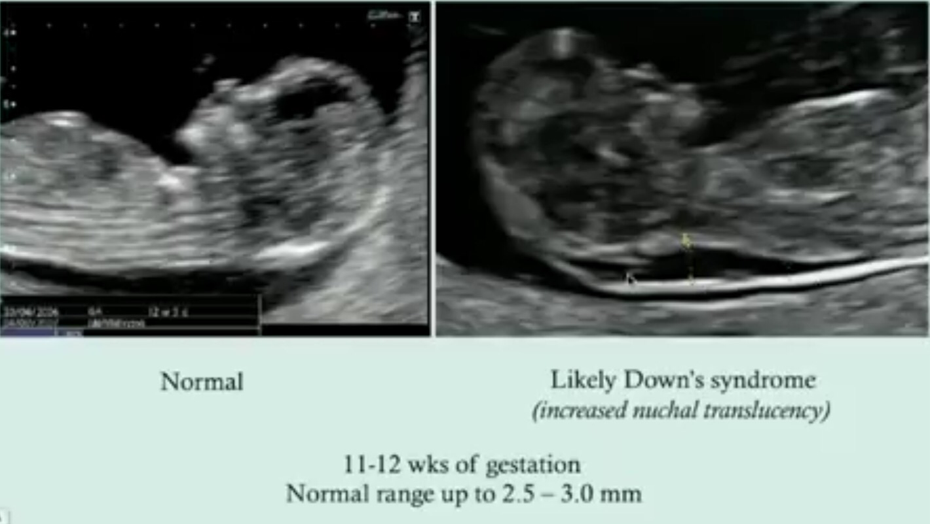
First trimester : fetal nuchal Translucency ( increase )
Not diagnostic

Slide 47
Second trimester : Biochemical markers
 | Dawn syndrome | Edward | Patau | Turner
AFP | Low | Normal | High | Low
hCG | High | Very Low | Normal | High
Estriol | Low | Low | Normal | Low
Inhibin A | High | Normal | Normal | High
Dawn : HIgh
Edward : HE LOW
Patau : AFPatau is high
Turner : HIgh

Slide 48
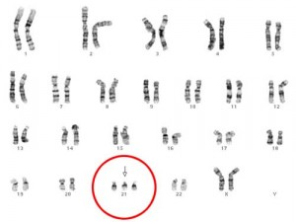
Chorionic villus sampling
Suspicious result on sono and or marker screening
Advanced mother age > 35 Y
Past history of baby with Down .

Slide 49
Thank you

