Slide 1
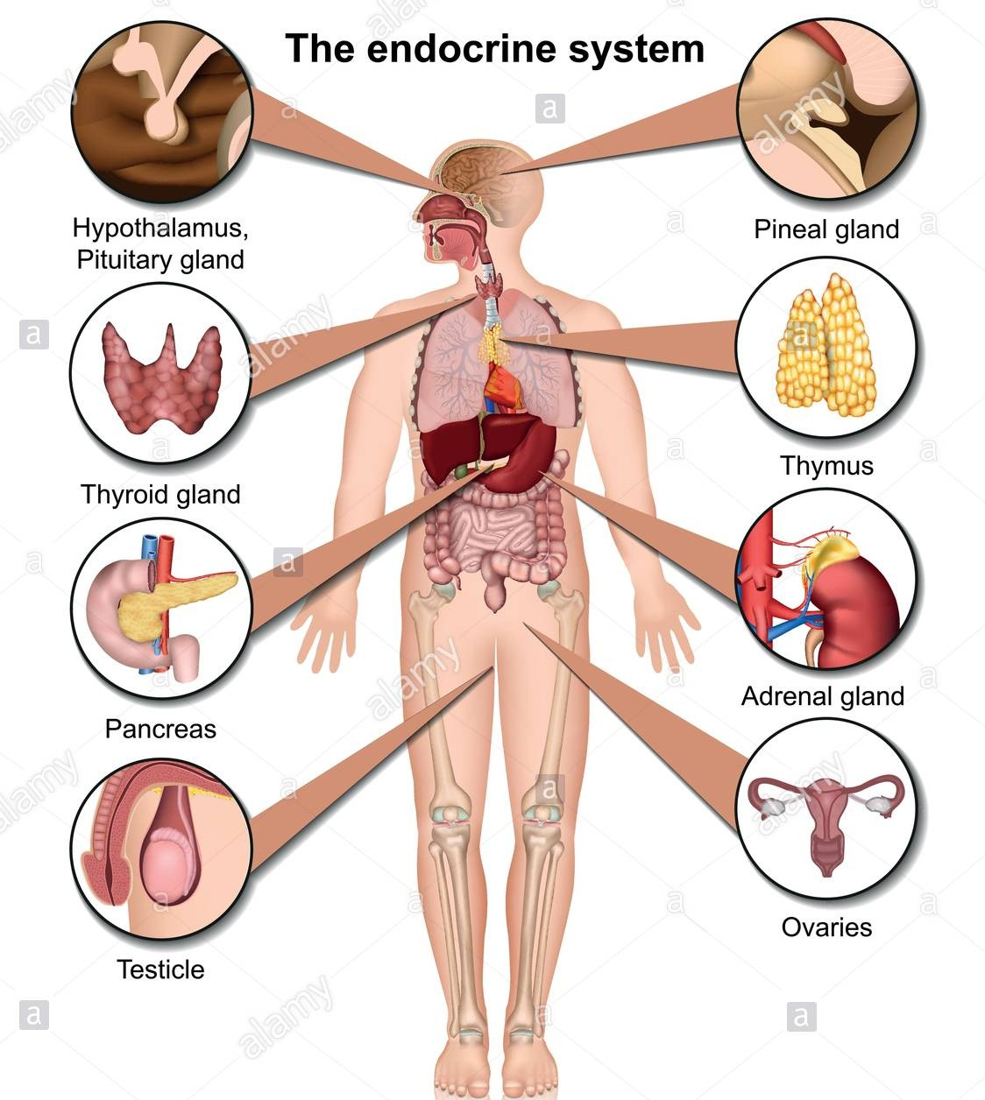

Slide 2
Glands
Most glands are formed during development by proliferation of epithelial cells so that they project into the underlying connective tissue.
Some glands retain their continuity with the surface via a duct and are known as EXOCRINE GLANDS.
Other glands lose this direct continuity with the surface when their ducts degenerate during development. These glands are known as ENDOCRINE glands.
MIXOCRINE : Both endocrine + Exocrine e.g. Pancreas ,Secretes digestive enzymes in the intestine & insulin hormone to the blood

Slide 3
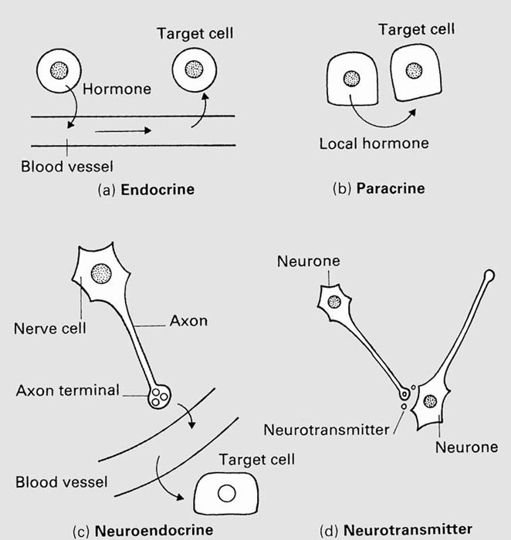
Patterns of Hormone Action
Endocrine: circulated by blood to distant target cells.
Paracrine: Hormones that affect neighboring cells
Autocrine: Hormones that act on the cells that secrete them
Neuroendocrine
Neurotransmitter

Slide 4
Endocrine Glands
Endocrine glands do not have ducts. Their secretions (hormones) are secreted into the blood stream.
The secretory cells of endocrine glands are therefore always have a rich network of blood vessels.
The released - hormones, are usually released by exocytosis, by the secretory cells, into the interstitial spaces and pass through fenestrated cpaillaries to enter the blood stream and move to target organs.
The target organs will have specific receptors for the hormone, and can respond when the hormone binds to it .

Slide 5
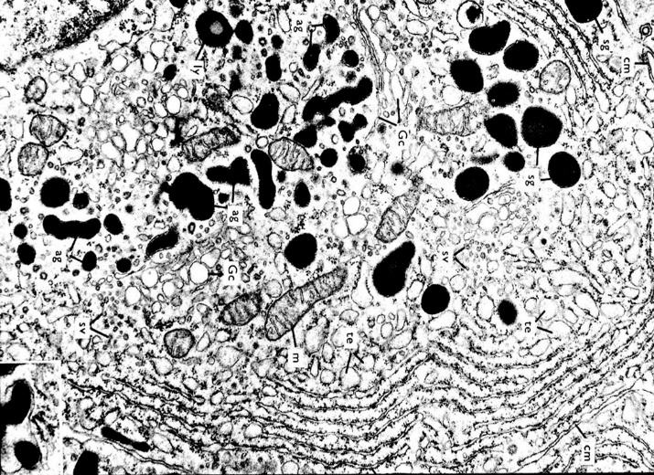
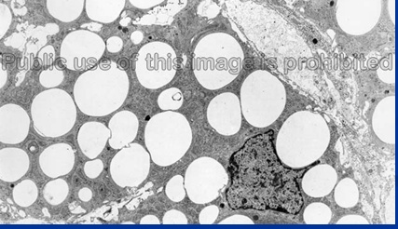
Hormones (chemical messanger) can be chemically classified into:
Proteins :A.A. peptides
,polypeptide
e.g. pituitary gland
Lipids : Hormones that are lipids synthesized from cholesterol (steroids) .
E.g. adrenal cortex
1. Protein secreting cells
Basophilic cytoplasm
Numerous ribosomes & rER
Secretory granules
stored hormones
2. Steroid secreting cells
Acidophilic cytoplasm
Numerous sER
numerous mitochondria
Numerous lipid droplets
Not stored hormones
1
2

Slide 6
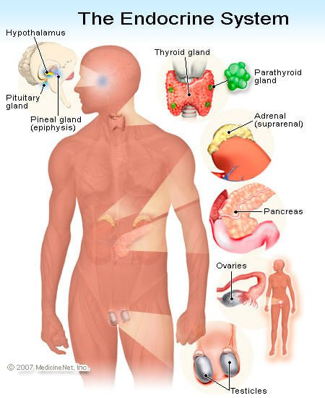
Introduction to the Endocrine System
The endocrine glands
Principle glands :
Hypothalamus
Pituitary gland
Pineal body
Thyroid gland & Parathyroid
Suprarenal gland (adrenal )
Pancreas
Gonads (testis, ovary)
Others
Kidney (erythrop + renin)
heart(ANF)
Thymus (hormone stimulate T cell maturation)
adipose (leptin)
Local Hormones
GIT (Diffuse neuroendocrine system)
Neurotransmitter (nerve ending)

Slide 7
Pituitary gland (Hypophysis Cerebri)
The pituitary gland is found in the inferior part of the brain and is connected by the pituitary stalk so it is called (Hypophysis Cerebri)
The pituitary gland consists of two major regions:
Anterior pituitary gland (anterior lobe or adenohypophysis
Posterior pituitary gland (posterior lobe or neurohypophysis
.
The Anterior pituitary is involved in sending hormones that control all other hormones of the body so referred to as the :
master gland .

Slide 8
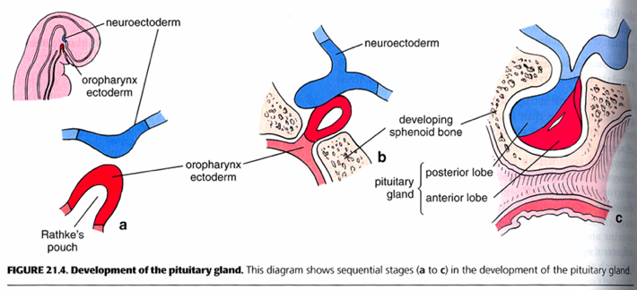
 | Adenohypophysis (glandular part) | Neurohypophysis (nervous part)
Derived from | Oral ectoderm pinched off Rathke’s pouch | Neural ectoderm 3rd ventricle Is connected with the brain by neural stalk (infundibulum)
Stain | Dark | Pale
Consist of | Glandular epithelium in the form of irregular branching cords | Nerve fibers
Notes:
8

Slide 9
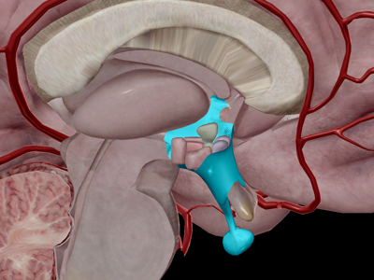
Pituitary gland (Hypophysis Cerebri)
The pituitary gland (hypophysis) is attached to the bottom of the hypothalamus by a slender stalk called the infundibulum.
size of a pea /0.5 gm / protrusion off the hypothalamus, Lies in the sella turcica
(bony cavity of sphenoid) covered by diaphragma sellae (fold of dura mater)

Slide 10
Histological structure of Pituitary gland
Stroma : surrounded by a thin connective tissue capsule/ loose connective tissue between the capsule and the periosteum.
Parenchyma : it has plexus of thin-walled veins & capillaries +
epithelial component: adenohypophysis
(anterior pituitary)
neural component: Neurohypophysis
(posterior pituitary).

Slide 11
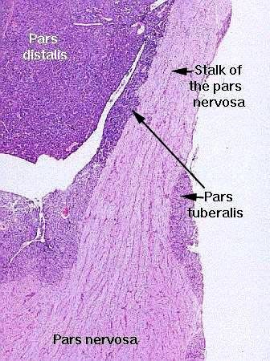
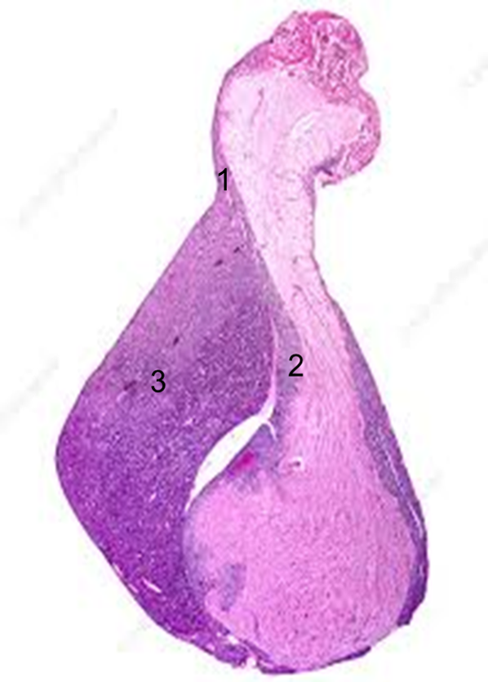
Adenohypophysis
1. Pars Tuberalis
2- Pars Intermedia
3. Pars distalis
1. Pars Tuberalis
Highly vascular region containing the veins of the hypophyseal portal system and wraps the pituitary stalk (infundibulum).
Principal cells of the pars tuberalis are low columnar .

Slide 12
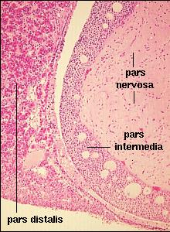
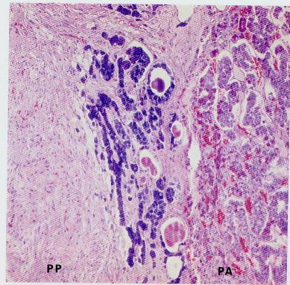
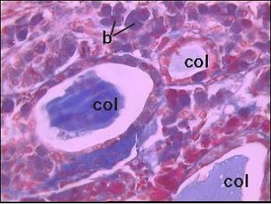
2- Pars intermedia
contains basophilic and chromophobic cells surrounding colloid-filled cysts
 | In humans | In animals
Development | rudimentary | Well developed
Arrangement | cords | Layers and cysts
Cells | Cuboidal Faint basophilic | Cuboidal basophilic
Function | Non specific and unknown | MSH (melanocytes-stimulating hormone)
Notes:
12

Slide 13
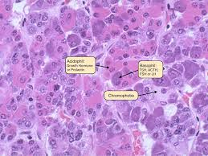
3- Pars distalis
Stroma : CT capsule, reticular fibers.
Parenchyma
Cells cords of epithelial cells
staining characteristics the cells are of two types :
1. chromophobes 52% not stain intensely
2. chromophils 48% densly stained cytoplasmic granules
basophils 11% (darkly pink stained)
acidophils 37% (eosinophilic or reddish stained)
+ Blood vessels
fenestrated capillaries (sinusoids)

Slide 14
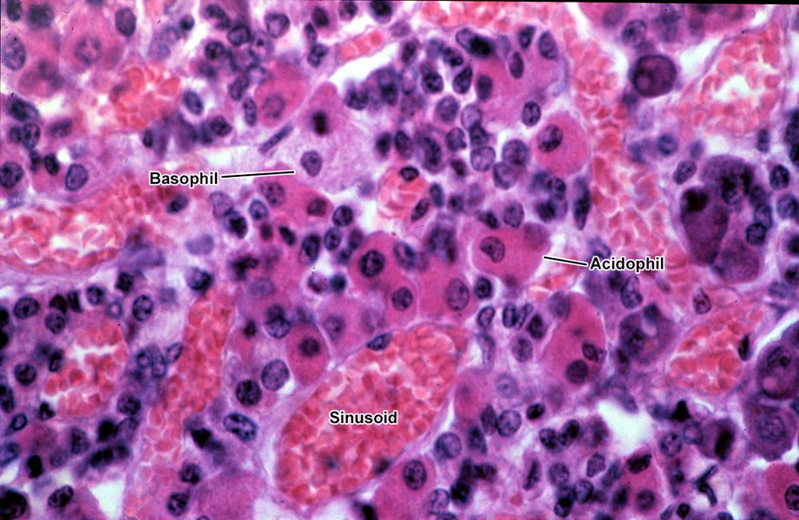
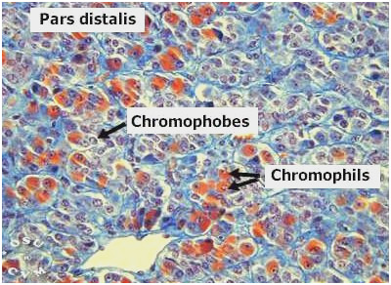
Cells of pars distalis
Identification of the cells
Routine stains
Special stain
Immuno-histochemistry
Transmission electron microscope
Chromophils
Chromophobes
Function | Endocrine cells | Stem cells or exhausted chromophils
Affinity for stain Size & shape | Great Large , polyhedral | Weak Small, rounded
Percentage | 48% 11% basophils, 37% acidophils | 52%
Granules | protein secretion Granulated | Degranulated cells or reserve cells
Notes:
14

Slide 15
Adenohypophysis hormones
Function | % | Cells
degranulated cell, , They are now thought to represent acidophil and basophilic cells in degranulated stage | 52% | Chromophobes
FSH LH | 11% | gonadotropic cells | Basophils
TSH |  | thyrotropic cells
ACTH |  | corticotropic cells
GH or somatotropic hormone (STH) | 37% | somatotropic cells | Acidophils
Prolactin (PR) or lactogenic hormone (LTH) Large in lactation & small in males & non pregnant |  | mammotropic cells = Erdheim cells crinophagy

Slide 16
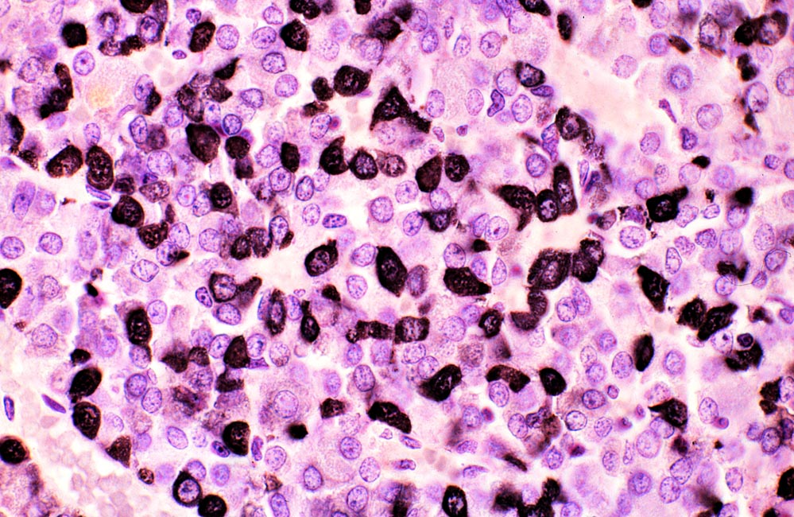
Immunohistochemical localization of growth hormone

Slide 17
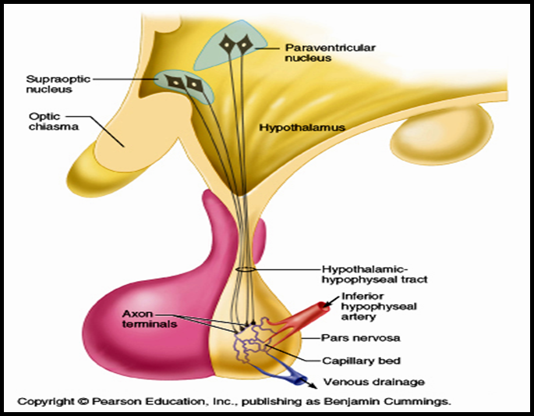
Neurohypophysis (Pars nervosa) Two parts Infundibulum, a slender stalk of nerve tissue that suspends the pituitary gland from the base of the brain pituitary stalk The Pars Nervosa, is connected directly with the Hypothalamus of the brain by axons .
components
1- unmyelinated axons:
of neurosecretory cells present in supraoptic and paraventricular nuclei of hypothalamus
Transmit secretion through hypothalamo-hypophyseal tract.
2- Herring bodies:
homogeneous red bodies stored in dilated terminal ends of these axons
Neurosecretory cells forms Herring bodies
Oxytocin stimulate contraction of
Smooth muscle of uterus
Myoepithelial cells of mammary glands
Antidiuretic hormone (ADH) (vasopressin) increasing reabsorption of water in renal tubule

Slide 18
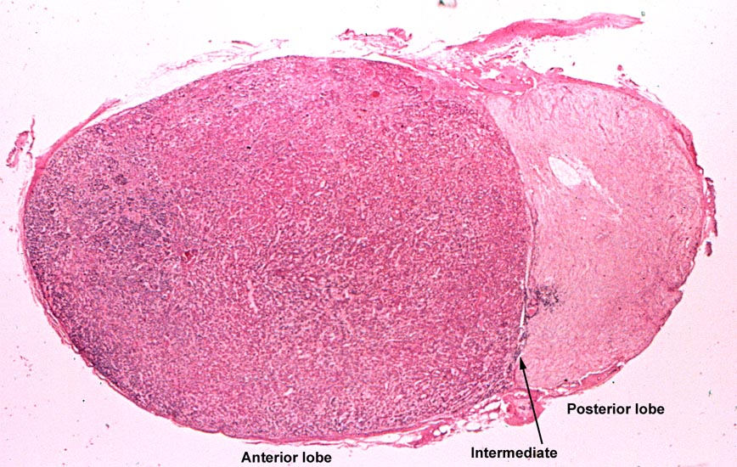
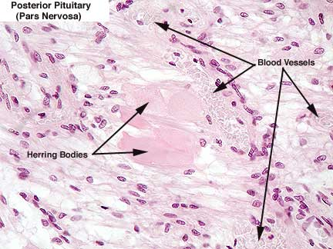
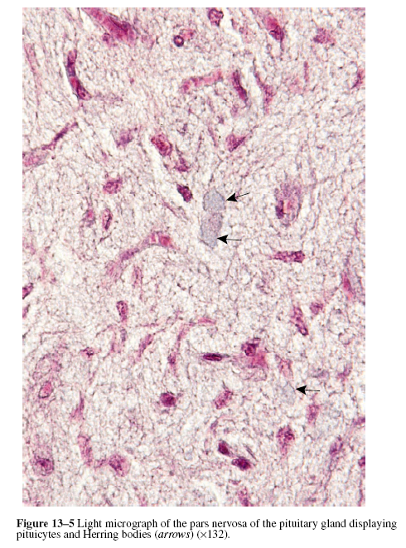
3-Pituicytes: modified branched glial cells having supportive , nutritive and insulating function. Pituicyte is a glial cell of the posterior pituitary.They are similar to the astrocytes /glial cells of the CNS. irregular with processes / cytoplasm contain pigment granules / function: provides metabolic support of nerve fibres
4-Rich blood capillary plexus

Slide 19
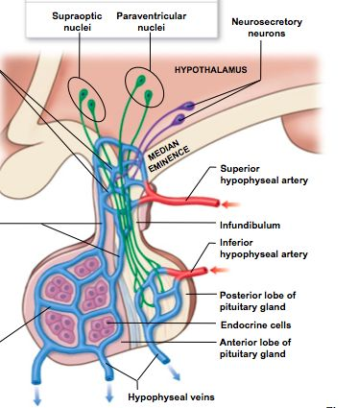
Blood supply of pituitary gland Releasing and inhibiting hormones Pass to hypophyseal portal system to pars distalis

Slide 20
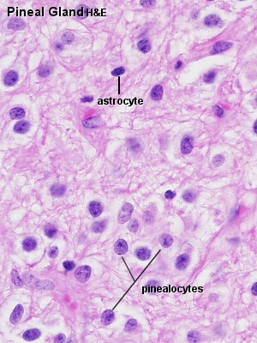
Pineal gland
Structure :
Stroma:
pia mater → septa ( BVs & unmyelinated nerve fibers
Parenchyma:
Two types of branching cells are present:
 | Pinealocytes | Astrocytes (neuroglia)
Nuclei | large irregular or lobulated with prominent nucleoli | elongated and denser
Cytoplasm | pale basophilic
Function | Melatonin secretion | Supportive & nutritive
Notes:
20

Slide 21
Pineal gland (Epiphysis cerebri)
parenchyma
Contains:
1. pinealocytes (95%), are large and lightly stained nuclei secrete melatonin
melatonin - is involved in daily cycles or circadian rhythms.
Levels are high at night as we grow sleepy & low at day light as we awake. The pineal body is directly light sensitive;
2. glial cells (astrocytes 5%)
with small dark nuclei

Slide 22
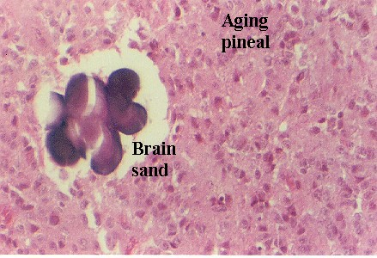
Pineal gland with aging
↑ fibrosis
↑ formation of calcified bodies
= (brain sand)
Brain Sand
(areas of calcification) that are easily seen with the microscope. These are not a degenerative change

