Slide 1
Smoking cessation
SUPERVISED BY : DR. ABEER AL-HABARNEH
Done by :
Mosa Al-Ataiqah
Suhaib AL-shdifat

Slide 2
Definition
smoking, the act of inhaling and exhaling the fumes of burning plant material. A variety of plant materials are smoked, including marijuana and hashish, but the act is most commonly associated with tobacco as smoked in a cigarette, cigar, or pi
Tobacco contains nicotine, an alkaloid that is addictive and can have both stimulating and tranquilizing psychoactive effects.

Slide 3
Production
Tobacco products are manufactured with various additives to:
1- preserve the tobacco’s shelf life,
2- alter its burning characteristics, control its moisture content.
3-mask the irritative effects of nicotine.
4- provide any of a wide array of flavours and aromas.
The smoke produced when tobacco and these additives are burned consists of more than 4,000 chemical compounds. Many of these compounds are highly toxic, and they have diverse effects on health.

Slide 4
primary constituents of tobacco smoke:
nicotine : The main health effect of nicotine is its addictiveness
carbon monoxide: has profound, immediate health effects.
Hydrogen cyanide
Formaldehyde.
Lead.
Arsenic.
Ammonia.
Radioactive elements.
Benzene.
tobacco-specific nitrosamines (TSNAs).

Slide 6
Health effects
1- addiction
2-cancer Smoking can cause cancer almost anywhere in your body
3-lung diseasesCOPD
4-heart disease stroke and coronary heart disease
Others(pregnancy effects , reduce fertility, rheumatoid arthritis

Slide 7
Types :
tobacco-specific nitrosamines (TSNAs)

Slide 8
Smoking in Jordan
Jordan has one of the highest rates of tobacco smokers in the world, with 8 out of 10 males and 17% of females , according to the MOH .
fifth of women smoke tobacco or e-cigarettes, over three-quarters suffer from second-hand smoke at home, from male family members lighting up.
-Every year, 9,000 people die because of tobacco and tobacco-related diseases.

Slide 9
Family medicine role
Primary care physicians are the first line for whome want to sessate smoking by seeking for advice .
Most of other specialties only give simple methods with no observation or feddback, unlike family physician who can deal periodicaly with patients and give a programs with observation and feedbacks on effects.
Also motiviation is an important element for sessation wich is done by regular follow up.

Slide 10
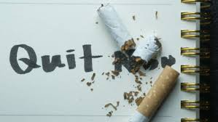
The approch
-The approach is simplified by 5 phases:

Slide 11
1- ask:
It is the first thing to do ,addressing smoking to the medical record ,help in disease investigastion and dealing with patient who have medical condition as pregnancy.
2-advice:
As a physician you are a trusty source that patient depend on so a few words as first sep may light up the pstient well.
3-assess:
Knowing patient well and motive to cessation is important to know how to intervent (confrontation vs motiviation).

Slide 12
Behavior stage to assess progression: -Precontemplation -contempaltion -preparation -action -relapse -maintenance.

Slide 13
1-2 = low 3-4 = mild 5-7 =moderate 8+ = high

Slide 14
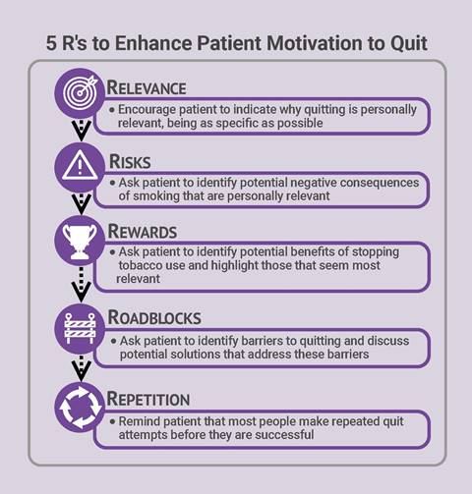
4-Assist:
patient who not will to cessate
should not be lefted.

Slide 15
5-Arrange(follow up) :
Contact Should be done the First week of quitting to encourage. Implants confidence and fix any obstacle wich counter cessation.
Patient who is unable to quit should be reassessed And encouraged to set a new quit planning.
Pharmacological therapies should be considered after that.

Slide 16
most cost-effective strategy for smoking cessation for most smokers is
self-care

Slide 17
Smoking-cessation treatment consists of three phases
Preparation
build confidence that he or she can be successful
increase the smoker's motivation to quit
intervention
maintenance.

Slide 21
Medications
NICOTINE REPLACEMENT THERAPIES
The goal of nicotine replacement therapies (NRTs) is to
relieve cravings for nicotine
reduce nicotine withdrawal symptoms.
NRTs are available as slow release skin patches and in more rapidly acting forms (i.e., chewing gum, nasal spray, inhalers, and lozenges), which deliver nicotine to the brain more quickly than skin patches but more slowly than smoking cigarettes.
A Cochrane review of 132 trials concluded that all forms of NRTs increase the chances of quitting successfully by 50 to 70 percent.
Heavy smokers should be encouraged to use higher dosages of an NRT or try a “patch plus” method, using the nicotine patch to provide a base level of slowly delivered nicotine and adding a more rapidly acting NRT to control breakthrough cravings. This regimen is safe because smokers typically obtain less nicotine than through smoking, and it is more effective than using a single NRT.

Slide 23
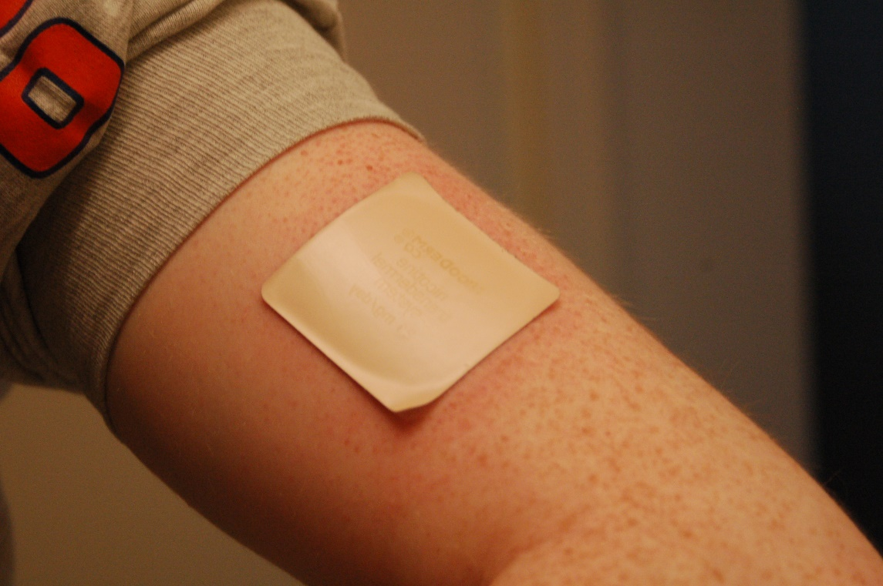
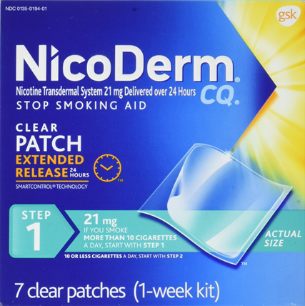
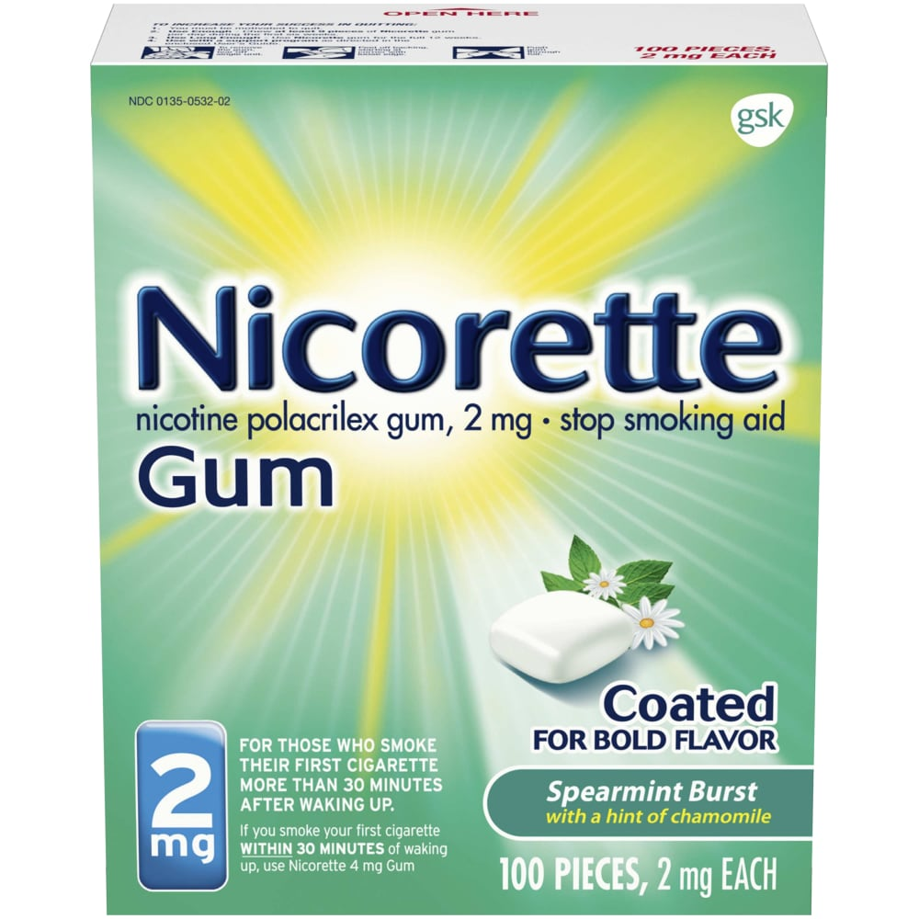

Slide 27
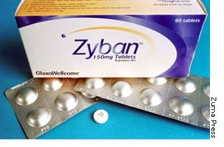

Slide 29
SE:
nausea.
constipation.
diarrhea.
gas.
abdominal pain.
vomiting.
heartburn.
bad taste in the mouth.

Slide 31
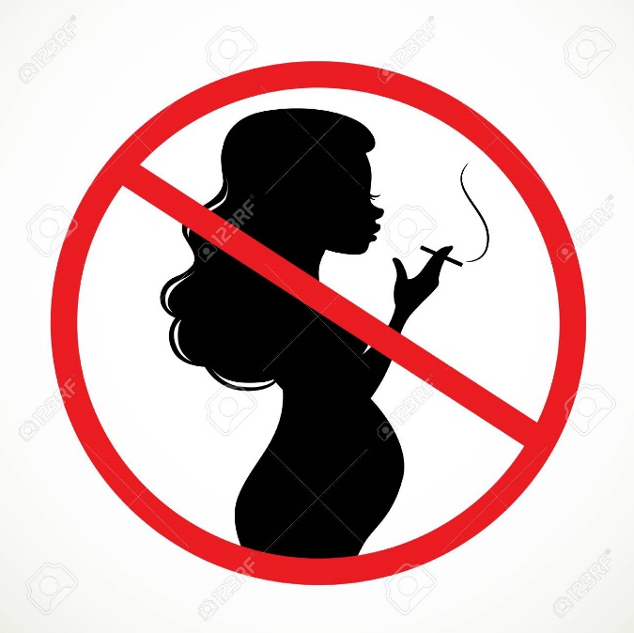
Special Populations
PREGNANT WOMEN
Tobacco is a known teratogen that can harm a developing fetus.
Smoking cessation therapies also carry risks in pregnant women.
Pregnant smokers should be offered intensive person-to-person interventions that exceed minimal advice to quit, such as behavioral support and problem solving, counseling, and referral to support organizations

Slide 32
Thanks!

