Slide 1
Benign Lesions Of The Upper Genital Tract
التبييض
Done by:
Sanabil Nae’em Al-Hassanat Lujain Ibrahim Al-Adayleh
Rahaf Hasan Al-Tawarah Tala Al-Ja’abari
Jood Sagarat Bara Kafafi
Supervised by:
Dr.Omar Azzam

Slide 2
Anatomic Anomalies of The Uterus (when you think of it you diagnose to so keep these conditions in your mind)
It is a type of female genital malformation resulting from an abnormal development of Mullerian Ducts during embryogenesis.
Occur in less than 5% of all women, but have been noted in up to 25% of women who have had miscarriages and/or deliveries of premature babies.
Symptoms range from amenorrhea, infertility, recurrent pregnancy loss and pain, to normal functioning depending on the nature of the defect.

Slide 4
Types of Uterine Anomalies
* AMERICAN FERTILITY SOCIETY CLASSIFICATION:
Class 1: Hypoplasia uterus or Agenesis: Segmental or complete (absent uterus).
Class2: Unicornuate uterus with or without rudimentary horn (a one- sided uterus).
Class3: Didelphus uterus also uterus didelphis (double uterus).
Class4: Bicornuate uterus: Complete or partial (uterus with two horns).
Class5: Septate uterus: Complete or partial (uterine septum or partition).
Class6: Arcuate uterus: There is a concave dimple in the uterus fundus within the cavity
Class7: Des related uterus: The uterine cavity has a "t-shaped" as a result of fetal exposure to diethylstilbestrol.

Slide 6
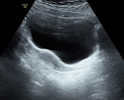
Hypoplasia uterus or Agenesis ممههمم
The Most common presentation: 1ry amenorrhea
Uterine agenesis, also known as Mayer-Rokitansky-Küster-Hauser (MRKH) syndrome, is a congenital condition characterized by an absence or hypoplasia of the uterus, proximal vagina and sometimes fallopian tube.
Symptoms: Primary amenorrhea (absence of menstrual periods) and potential issues with sexual function.
Diagnosis: Often diagnosed through imaging studies like ultrasound or MRI, usually at age of 15-18.
Management: surgical correction (Plastic Surgery), may involve surgical options for vaginal creation and discussions around fertility, as individuals with this condition may require assisted reproductive technologies using a gestational carrier.
Preserved ovaries so normal hormonal profile
+ uterus transplantation

Slide 7
Unicornuate uterus
Incidental finding during infertility workup
US: useless
A Unicornuate uterus is a congenital uterine anomaly where the uterus is formed from only one of the paired Müllerian ducts, resulting in a banana-shaped or asymmetrical uterus.
Symptoms: Many individuals may be asymptomatic, but some may experience menstrual irregularities, pelvic pain, or complications during pregnancy.
Diagnosis: Often identified through imaging techniques such as ultrasound, MRI, or (hysterosalpingography→ the best imaging techniques to do, findings: single laterally deviated Ut. Tube).
Complications: Increased risk of infertility, (miscarriage: give progesterone+ do cerclage), preterm labor, Increased risk of breech presentation and ectopic pregnancy on the non-formed side.
All these complications related to the resultant small sized uterus
Management: No surgical intervention is required unless endometrial tissue in a rudimentary horn results in pain or a pelvic mass or unless an incompetent cervix is suspected during pregnancy. Also monitoring during pregnancy and addressing specific complications as they arise.

Slide 10
Didelphus uterus → cervix1+ 2
Uterus didelphys is a rare congenital malformation where a woman is born with two separate uteri, two cervices, and sometimes even a divided vagina. This condition occurs due to incomplete fusion of the Müllerian ducts during fetal development.
Two Uteri: Each uterus is fully developed and separate from the other. This means that two uterine cavities exist.
Two Cervices: Each uterus has its own cervix that opens into the vagina.
Double Vagina

Slide 11
Diagnosed mostly by HSG or incidentally during CS
Speculum→ 2 cervixes
Symptoms and Diagnosis:
Many women with uterus didelphys are asymptomatic and might only discover the condition during a pelvic exam, ultrasound: useless, or imaging tests like MRI.
In some cases, women may experience reproductive challenges such as:
Painful periods (dysmenorrhea), Recurrent miscarriages, Premature birth and Difficulty with pregnancy due to reduced uterine space, malpresentation
Treatment and Management:
Many women with uterus didelphys can conceive and carry a pregnancy to term without intervention.
In cases of pregnancy complications, close monitoring by an obstetrician is often recommended.

Slide 12
Bicornuate uterus speculum: 1 cervix
Definitive Dx by laprotomy
A bicornuate uterus is a congenital uterine anomaly where the uterus is heart-shaped or has two distinct cavities (or "horns"), rather than a single cavity. This condition occurs when the Müllerian ducts, which normally fuse together to form the uterus, only partially fuse during fetal development. As a result, the uterus has two distinct sections or "horns" at the top, while the lower part remains unified, often with a single cervix.
Heart-shaped Uterus: The most defining feature is the external indentation at the top of the uterus, making it appear heart-shaped.
Two Uterine Cavities: The inside of the uterus is divided into two cavities, though this division may vary in degree.
Single Cervix: Most women with a bicornuate uterus have a single cervix, though rarely, two cervices may be present.
Normal Vagina: Unlike uterus didelphys, the vagina is typically normal and does not have a septum or division.

Slide 13
Symptoms and Diagnosis:
Many women with a bicornuate uterus experience no symptoms and only discover the condition during pregnancy or fertility testing. However, some may experience: Painful periods (dysmenorrhea), Irregular menstruation, Recurrent miscarriages, Preterm labor or delivery and Breech presentation of the baby during pregnancy
Diagnosis typically involves imaging tests:
Pelvic Ultrasound: Can visualize the shape of the uterus and identify the bicornuate structure.
MRI: Provides more detailed images of the uterus and can differentiate between other uterine anomalies.
Hysterosalpingography (HSG): X-rays with contrast dye can help assess the uterine cavity shape and fallopian tubes.
Treatment and Management:
Most women with a bicornuate uterus don’t need treatment unless they experience reproductive issues. For those who do, treatment may include:
1. Surgical Correction (Metroplasty) no need: If a bicornuate uterus is causing recurrent miscarriages or severe reproductive problems, a surgery called Strassman metroplasty can be performed to unify the uterine cavity. However, this surgery is rare and usually reserved for significant cases.
Pregnancy in the small side→ mostly the pregnancy not completed
Pregnancy in the side with good size→ better outcomes

Slide 14
2. Pregnancy Management:
Close Monitoring: Pregnant women with a bicornuate uterus are at a higher risk for miscarriage, preterm birth, and breech births. Regular monitoring by an obstetrician is important to detect complications early.
Cervical Cerclage: In cases of cervical insufficiency (when the cervix opens too early), a stitch may be placed around the cervix to prevent preterm birth.
3. Fertility Assistance: While many women with a bicornuate uterus can conceive naturally, fertility treatments such as IVF may be recommended if there are difficulties conceiving.
Impact on Pregnancy:
Women with a bicornuate uterus have a higher risk of pregnancy complications compared to those with a normal-shaped uterus, such as:
Miscarriage: The divided uterine cavity can sometimes limit space for a growing fetus, increasing the risk of early pregnancy loss.
Preterm Labor
Breech Presentation
While a bicornuate uterus can increase the risk of certain pregnancy complications, many women with this condition go on to have healthy pregnancies. Regular prenatal care and early intervention can help manage potential risks and ensure better outcomes.

Slide 15
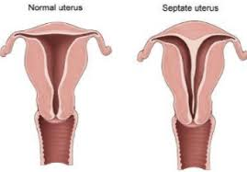
Septate uterus
A septate uterus (also called a uterine septum) is a congenital uterine abnormality where the uterine cavity is divided by a fibrous or muscular wall, called a septum. This occurs when the ducts that form the uterus fail to fuse properly during fetal development. The degree of septation can vary: in some cases, the septum is partial, and in others, it may divide the uterus completely.
Women with a septate uterus may experience certain reproductive challenges, including an increased risk of miscarriage, infertility, or preterm labor. However, many women with this condition can have normal pregnancies, and surgical procedures like hysteroscopic resection can correct the septum if needed, especially in cases where it is linked to recurrent pregnancy loss or other issues.
Septal resection: carry a high success rates
→Myometrium not reached
→Risk of adhesions so give estrogen for 3 months post op.

Slide 16
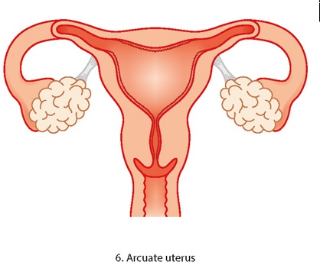
Arcuate uterus normal variation
An arcuate uterus is a mild congenital uterine anomaly where there is a slight indentation or dip in the uterine fundus (the top of the uterus). Unlike a septate uterus, where a fibrous or muscular wall divides the uterine cavity, the arcuate uterus has only a shallow, broad indentation that doesn’t significantly alter the shape of the cavity.
Mild indentation: The dip at the top of the uterus is subtle and doesn’t extend far into the uterine cavity.
Normal or near-normal shape: The rest of the uterus typically functions like a normal, pear-shaped uterus.
Symptoms and Impact:
Most women with an arcuate uterus have normal reproductive function and experience no symptoms. It is often discovered incidentally during imaging, such as an ultrasound or MRI, performed for other reasons. The condition is considered the mildest form of uterine anomalies and generally does not interfere with: Fertility or pregnancy.

Slide 17
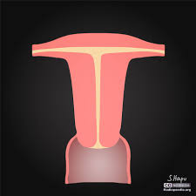
Des related uterus
A T-shaped uterus is a rare congenital uterine anomaly where the uterine cavity is narrow and resembles the shape of a "T." This condition is usually a result of exposure to diethylstilbestrol (DES), a synthetic estrogen, in utero. DES was prescribed between the 1940s and 1970s to prevent miscarriages and preterm labor, but it was later found to cause a range of reproductive issues in the daughters of women who took the drug.
Narrow uterine cavity: The uterus is constricted, with a thin and elongated central cavity, resembling the vertical line of the "T."
Thickened lateral walls: The walls on either side of the uterus may be thick, contributing to the shape.
Reduced uterine volume: The abnormal shape leads to a decrease in the internal space, which can impact reproductive function.
DES: affect the delivered girl not the mom

Slide 18
Benign lesions of the cervix

Slide 19
Cervical Ectropion
Ectropion: in hyper-estrogenic states
Columnar epi. Has a superficial BV ,so easily bleed
Most common presentation: PCB
Mx: stop the cause. High recurrence rates. No risk for malignancy
Definition: a state in which the squamous cell epithelium of the ectocervix is replaced by columnar cell epithelium of the endocervix under the physiological influence of estrogen
Epidemiology: Common in adolescents. After adolescence, it may be observed in women who are pregnant or taking estrogen-progestin contraceptives or who had a cervical laceration during labor and delivery
On colposcopy seen as a sharply demarcated bright red area with papillary structures.
Clinical features: mostly asymptomatic; occasional postcoital bleeding and vaginal discharge
Ectropion should not be treated except in the rare occurrence of excessive mucous discharge or spotting that is very bothersome to the woman. In such cases, malignancy should be excluded before undertaking any treatment.
Treatment
2 weeks trial of an acidifying agent, such as boric acid suppositories 600 mg or deoxyribonucleic acid 5 mg vaginally at bedtime
An ablative procedure using cryocautery or electrocautery; (invasive, can result is cervical stenosis, will result in copious vaginal discharge until healing is completed)

Slide 20
If you see this presentation: firstly, exclude malignancy→ do pap if abnormal go for colposcopic biopsy

Slide 23
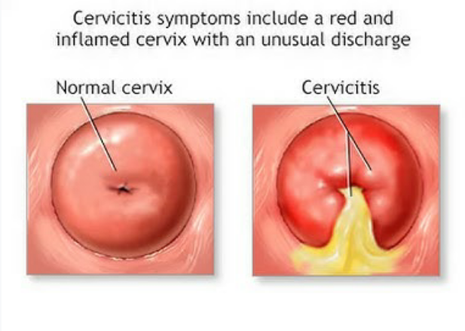
Cervicitis part of PID
Cervicitis is classified as either acute or chronic
The most common symptom is purulent vaginal discharge
The appearance of the acutely inflamed cervix varies greatly, depending upon the degree of involvement and the infecting organism
Chlamydia & N.gonorrheae: Mucopurulent cervical discharge, cervical friability, and cervical edema
Trichomonas vaginalis: Punctate hemorrhages (strawberry cervix)
HSV: Vesicular or ulcerative lesions

Slide 24
Cystic lesions
Cervical cysts are usually asymptomatic but may cause dyspareunia or a pressure sensation.
Nabothian cysts انبعاجات عنق الرحم (aka mucinous retention cysts, epithelial inclusion cysts)
Definition: Discrete cystic structures that form when a cleft of columnar epithelium becomes covered with squamous cells and the columnar cells continue to secrete mucoid material → accumilation
Etiology: Nabothian cysts may occur following minor trauma or childbirth
On colposcopy: The cysts vary from microscopic to several centimeters in size; the larger cysts project above the surface of the portio (supravaginal portion of cervix). They may appear translucent or opaque.
The only indication for treatment is relief from pain or a bothersome feeling of fullness in the vagina
Treatment: Ablation of the cyst using electrocautery is the usual approach; however, if the diagnosis is uncertain, excision to evaluate histopathology is advised. The main disadvantage to surgical treatment is the possibility of causing scar tissue, which itself can lead to dyspareunia.

Slide 26
Cystic lesions
Cervical cysts are usually asymptomatic but may cause dyspareunia or a pressure sensation.
Mesonephric cysts
Microscopic remnants of the mesometanephric (Wolffian) duct may be found deep within the cervical stroma when tissue removed at conization is examined pathologically.
Occasionally, one or more of these remnants form a cyst, which may be confused with Nabothian cysts.
Mesonephric cysts rarely reach a size greater than 2.5 cm and are usually located at the 3 and 9 o'clock points, near the base of the cervix. (ducts sites)
Intervention should be avoided in asymptomatic women.
Treatment similar to that recommended for Nabothian cysts is indicated if the patient has bothersome symptoms. A large cyst can be marsupialized

Slide 27
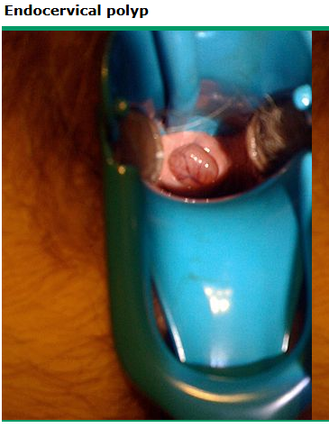
Non-cystic lesions
Polyps
Commonly occur during the reproductive years, especially after age 40 years
The etiology is unknown.
Risk factors: chronic inflammation of the cervical canal and hormonal factors
Differential diagnosis includes leiomyoma and endometrial polyps
Polyps should be removed when symptomatic (e.g., bleeding, excessive discharge), large (≥3 cm), or appearing atypical.
Polypectomy can usually be accomplished by grasping the base of the polyp with forceps and twisting it off
Malignancy is rarely found in a cervical polyp
Polyps:
Presentation: PCB, pedunculated from the cervix
Mx:
Narrow pedicle→ twist it off in the clinic by ovum forceps
Wide pedicle→ cauterization under GA

Slide 28
Non-cystic lesions
Polyps cont.
Single or multiple cervical polyps usually arise from the endocervical canal but can also originate from the portio.
The tear-shaped or lobular structures appear red, purple, or flesh-colored, depending upon the vascularity and congestion present, and usually look succulent and glistening.
The size is typically < 3 cm in diameter; however, polyps large enough to fill the vagina or presenting at the introitus have been described.
The pedicle is usually long and thin but may be short and broad-based.
Histologically, cervical polyps are characterized by vascular connective tissue stroma covered by epithelium, which may be columnar, squamous, or squamocolumnar.

Slide 29
Non-cystic lesions
Warts HPV 6, 11
Vulvar, perineal, and anogenital warts are frequently associated with vaginal and cervical lesions.
Single or multiple condylomata acuminata due to HPV infection may be visible grossly and are asymptomatic.
These warts are often flat, in contrast to condyloma in other areas of the anogenital region.
They become white, and thus more visible to the naked eye when swabbed with a solution of 3-5% acetic acid.
Cytology/colposcopy may reveal squamous intraepithelial neoplasia.

Slide 31
Cervical stenosis
Might present as hematometra
Etiology: Usually caused by
Contraction of scar tissue (Cervical surgery and radium application are common causes of scarring; secondary dysmenorrhea or amenorrhea after cervical procedures strongly suggests cervical stenosis has developed)
Agglutination of raw surfaces within the endocervical canal (The hypoestrogenic state of menopause induces endocervical changes favorable for agglutination)
Obliteration of the endocervical canal by tumor (e.g., endometrial, cervical)
Some cases are congenital
Diagnosed when cervical canal does not permit the insertion of an instrument, such as a Hegar dilator (2.5 mm in diameter).
The diameters of the cervical canal in nulli ~5 mm and multi ~8 mm
Potential consequences of cervical stenosis include
Impeded menstrual flow: Menses may be scant, painful, or prolonged. In severe stenosis, hematometra can develop.
Impeded access to the endocervical canal and endometrial cavity for diagnostic and therapeutic procedures.
Cervical dystocia during labor.
Treatment: dilatation of the cervix by hegar dilators

Slide 32
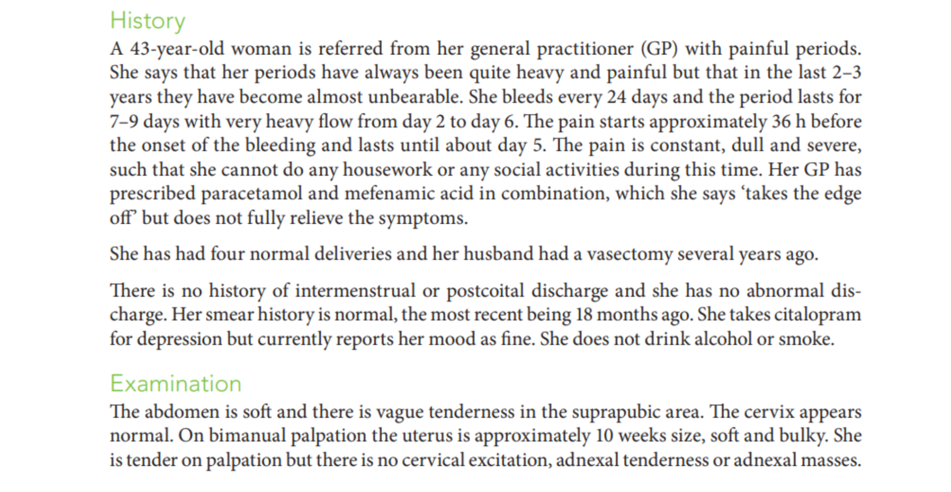

Slide 33
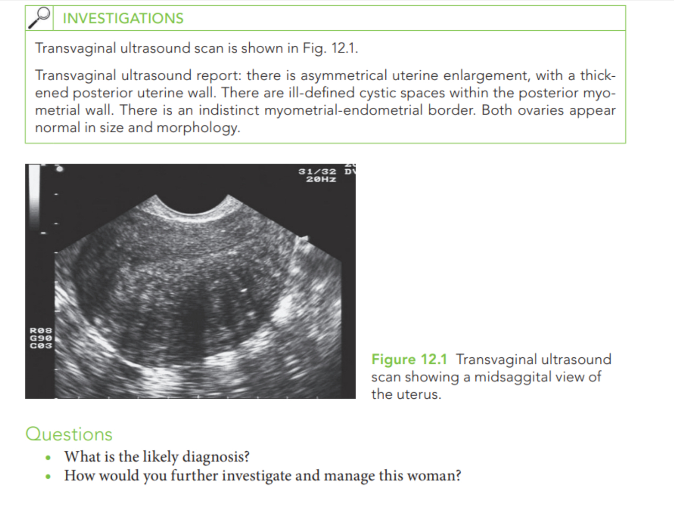

Slide 34
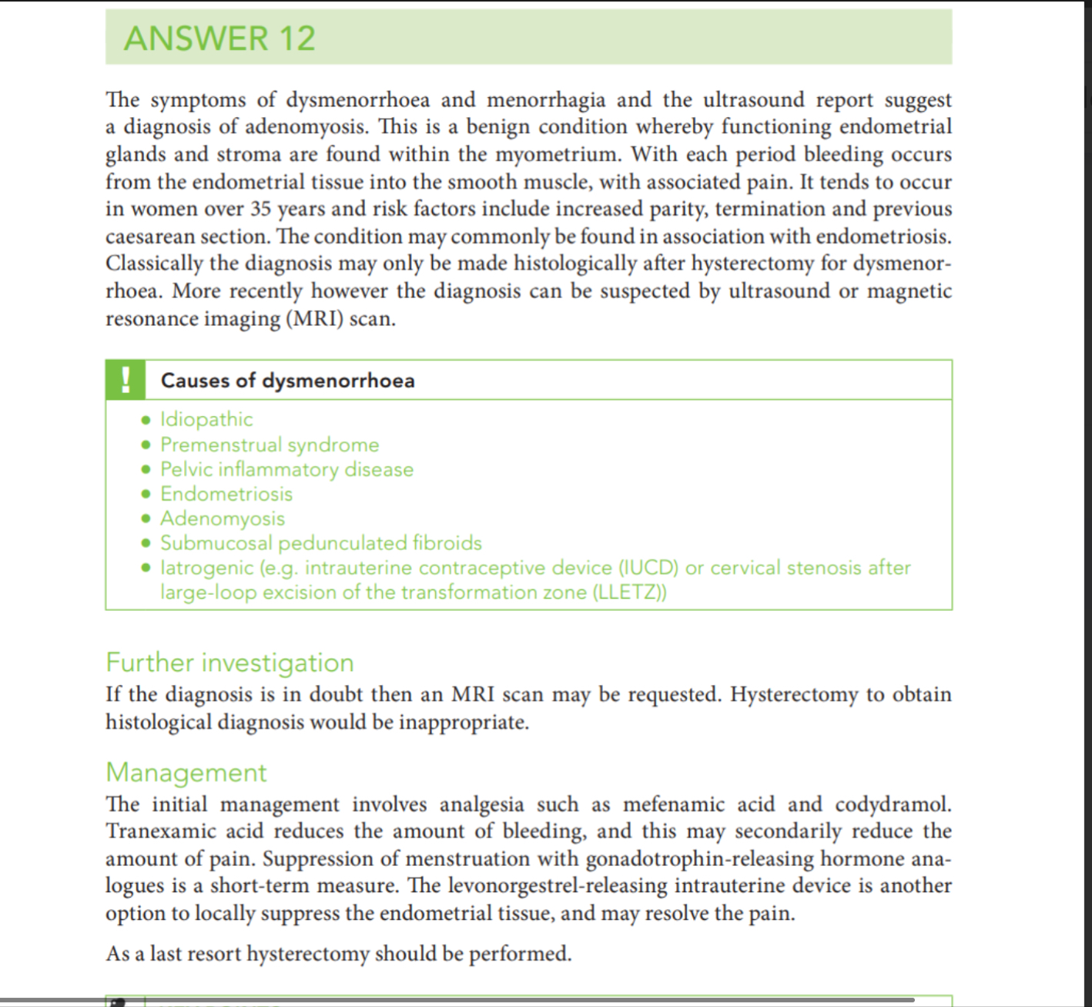

Slide 35
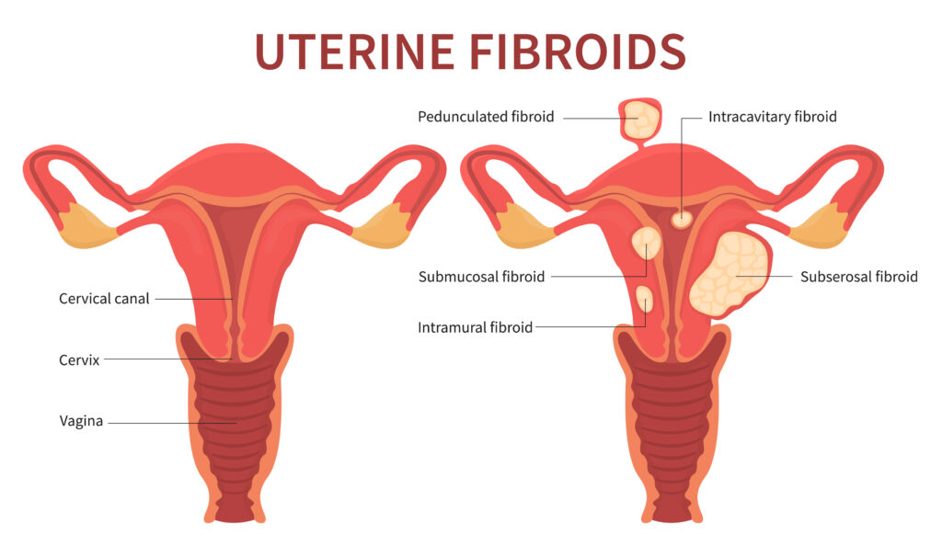

Slide 36
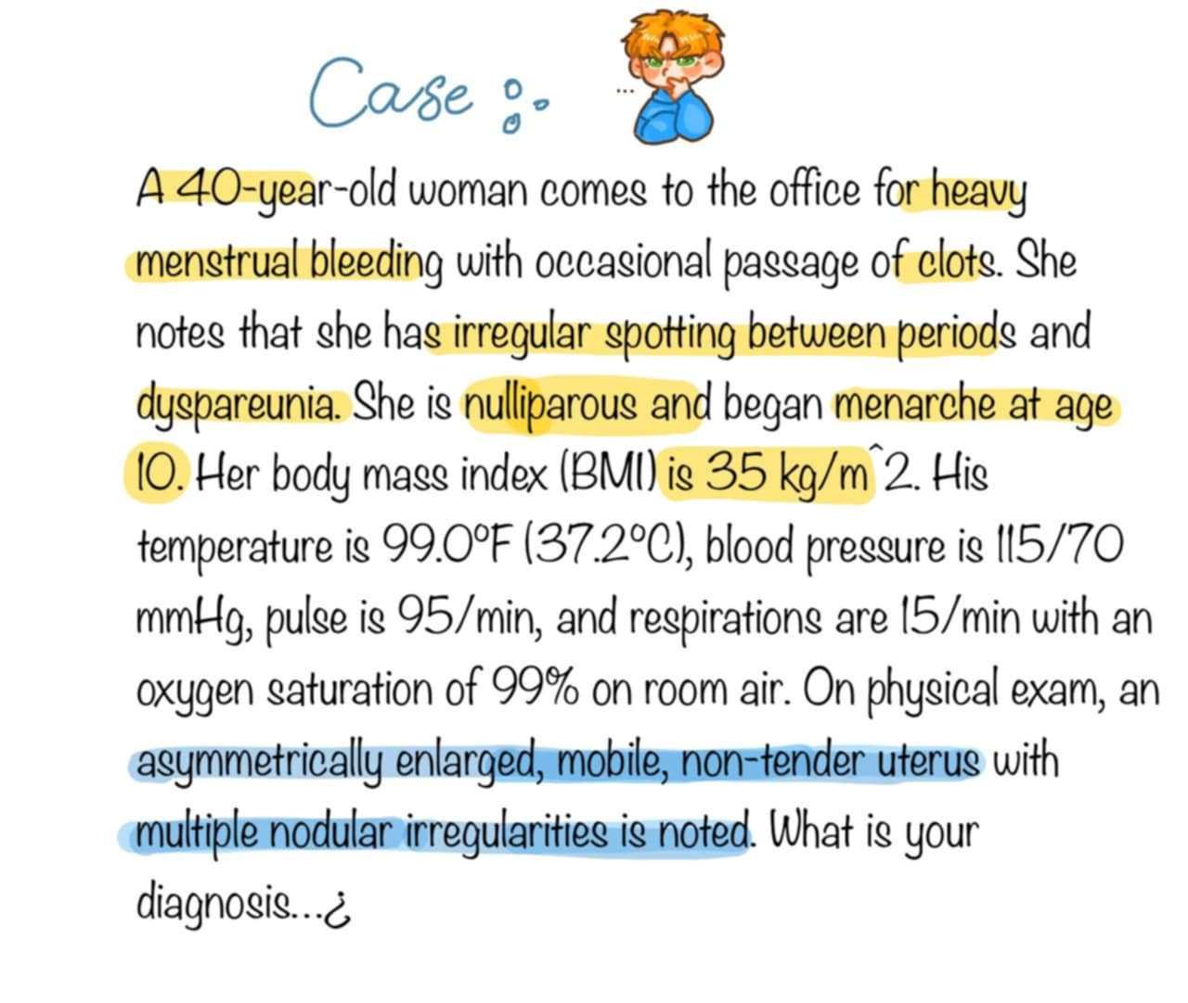

Slide 37
Risk factors: nulliparus, obese
Presentation: depend on the size and size
Mostly presented as HMB
Actually all are intramural fibroids, →Other types considered as overgrowth toward the cavity (submucus), outward the cavity (subserus)

Slide 38
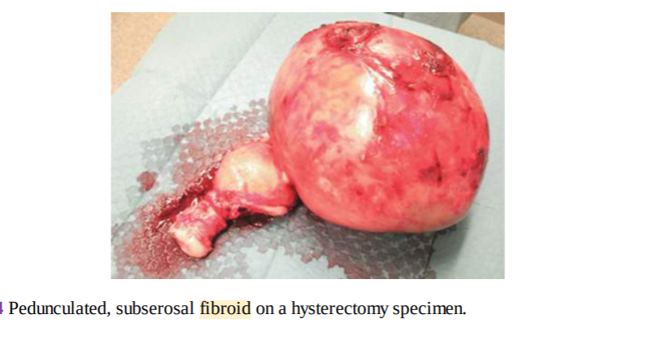

Slide 39
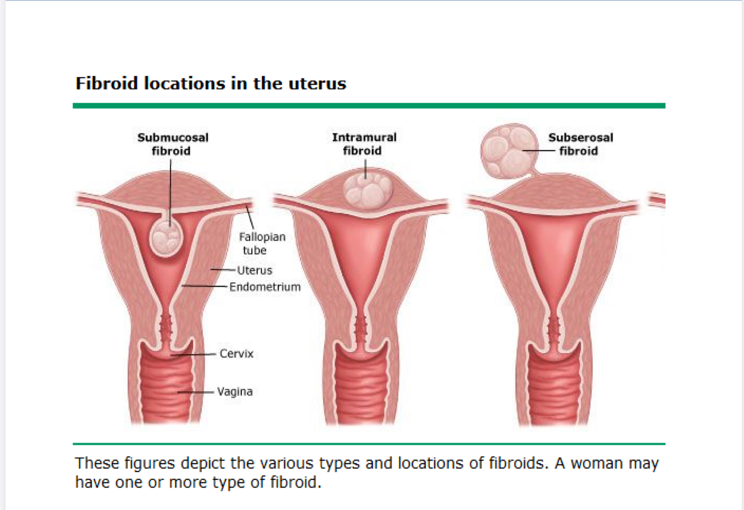

Slide 42
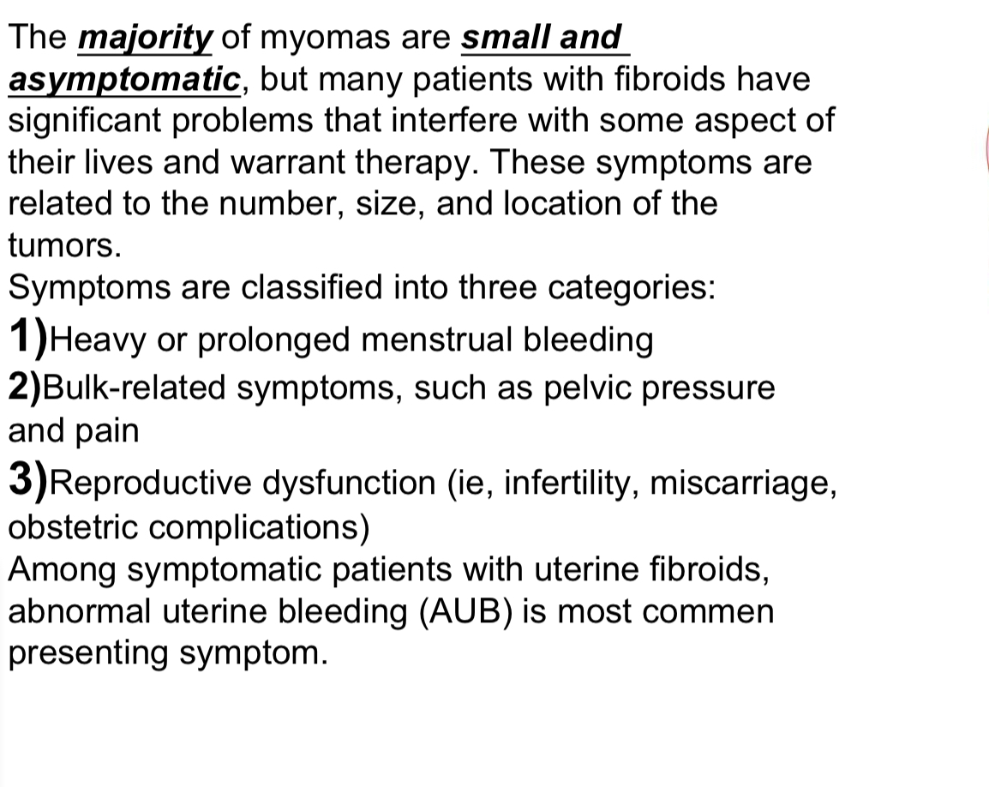
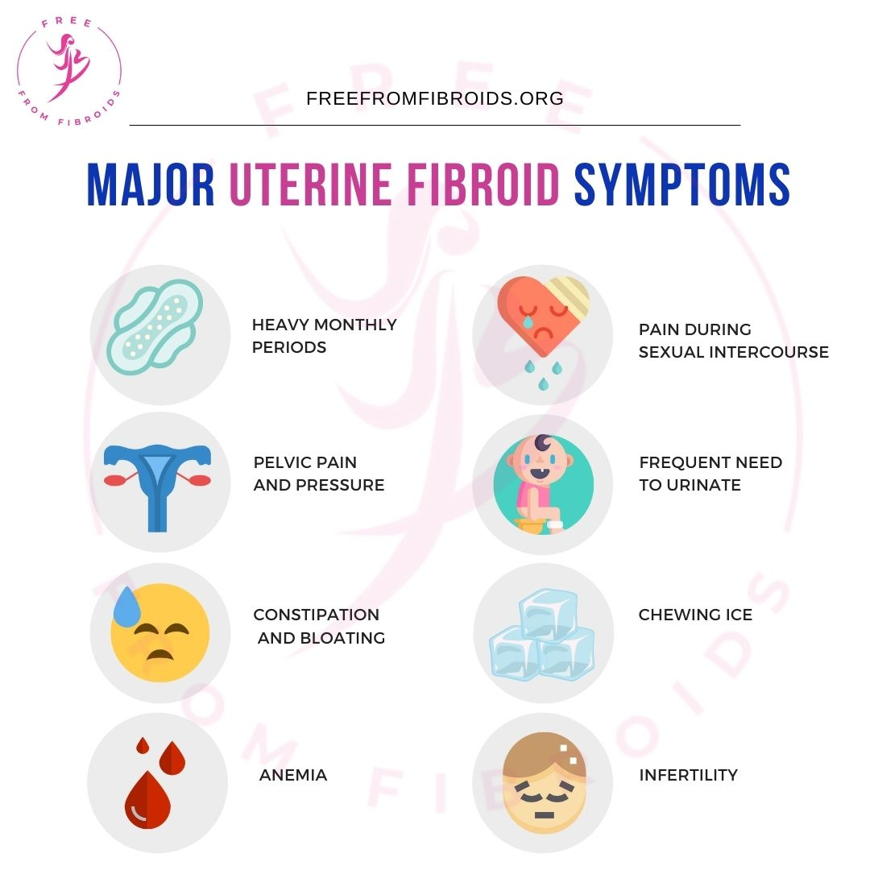

Slide 43
Red degeneration:
Due to the increase in fibroid size→ insufficient blood supply→ necrosis→ ischemic pain
Mx: admission, fluids, analgesics. DON’T do any surgery during pregnancy

Slide 44
Diagnosis

Slide 45
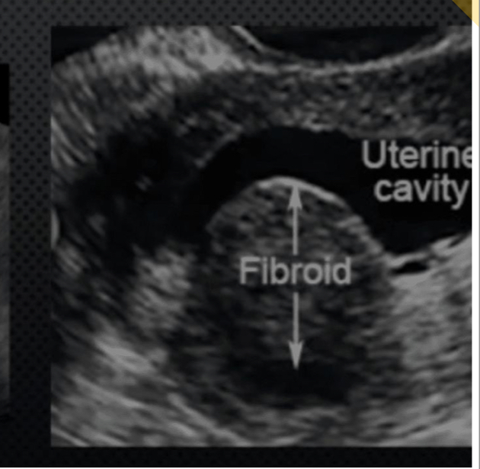
Gold standard

Slide 46
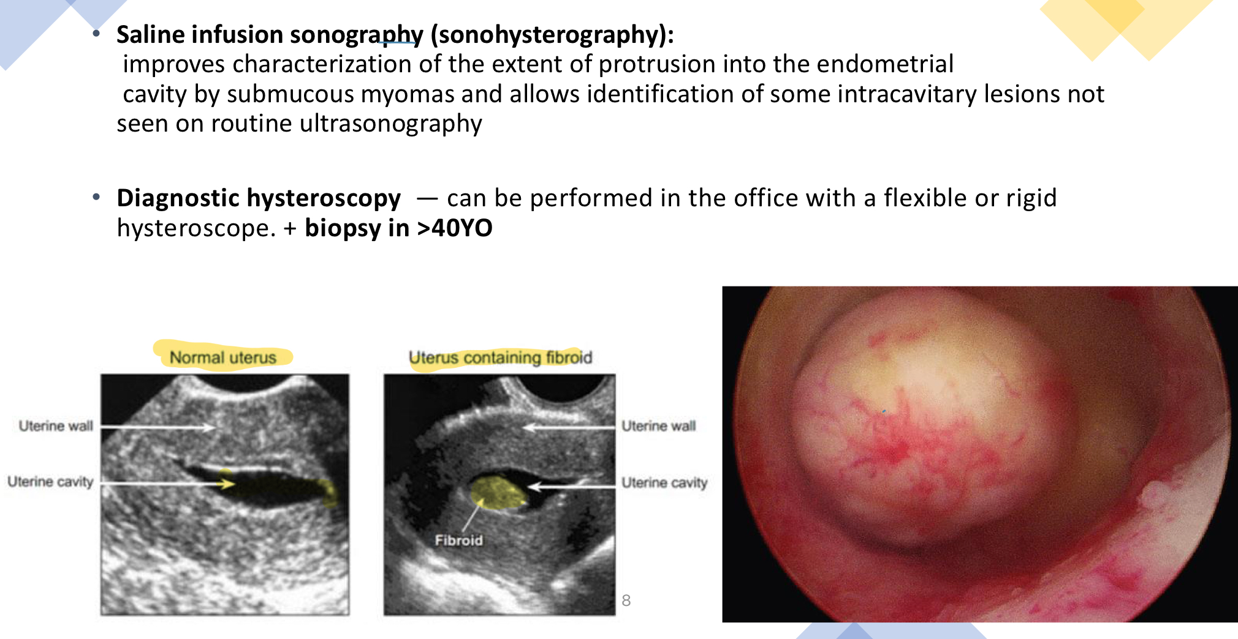
Useful in cases of submucus fibroid
In cases of IVF: to detect whether the fibroid reaching the cavity or not
Mx:
If we are now doing hysteroscopy and fibroid is found→ myomectomy directly (no role for medical Mx here because we are already in!
If hysteroscopy not yet done you can try medical Mx then surgical

Slide 47
No need
By HSG: filling defect. Useful in cases of submucus only

Slide 52
Hx, P/E, US are enough to diagnose

Slide 53
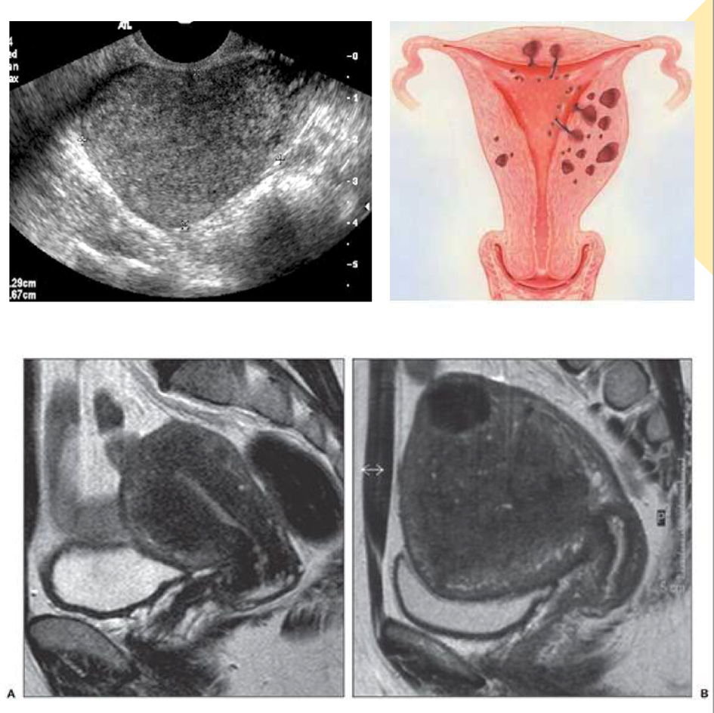

Slide 54
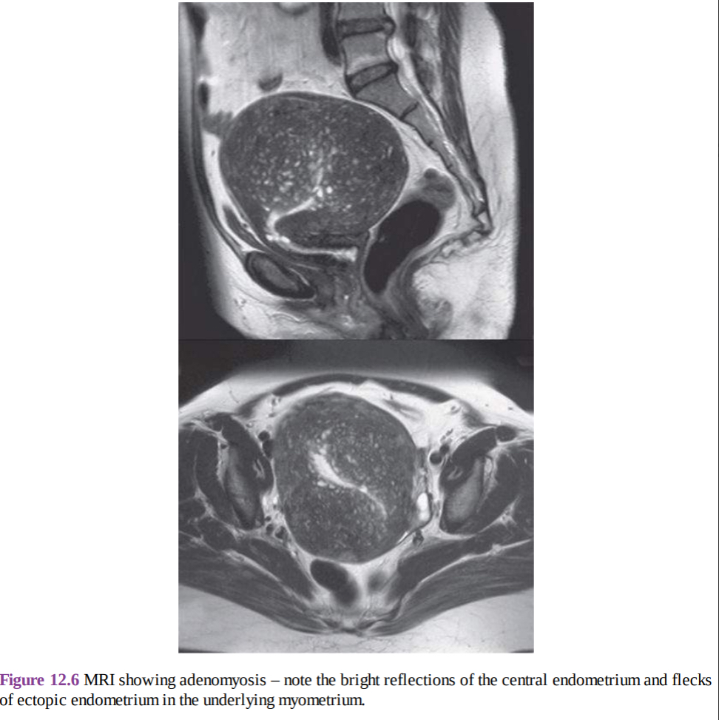

Slide 55
Management of Uterine Fibroid
Expectant Management
Expectant management is recommended for asymptomatic women. This approach is appropriate unless the woman has a hysteroscopicaly resectable submucosal leiomyoma while pursuing pregnancy. In such cases, intervention may be necessary to alleviate symptoms and prevent complications.
Mostly in pre- menopausal women

Slide 56
Medical management for Uterine Leiomyomas
1. Hormonal Therapies
Oral Contraceptive Pills (OCPs): While traditionally considered contraindicated for women with uterine leiomyomas, some patients with heavy menstrual bleeding may benefit from OCPs. These contraceptives can help manage bleeding but may not reduce fibroid size.
Levonorgestrel-Releasing Intrauterine System (IUS): Observational studies indicate that the IUS can reduce uterine volume and bleeding while increasing hematocrit levels. However, its use is contraindicated in cases of intracavitary leiomyomas that can be resected hysteroscopicaly. Additionally, this method provides contraception for women who do not wish to conceive.
Progestin Implants, Injections, and Pills: The efficacy of progestin-only contraceptives in treating leiomyomas is unclear. However, these agents can induce endometrial atrophy and alleviate menstrual bleeding, making them suitable for mild symptoms, especially in women requiring contraception. Cohort studies suggest a decreased risk of leiomyoma formation with these treatments.

Slide 57
2. Gonadotropin-Releasing Hormone (GnRH) Agonists
Mechanism of Action: GnRH agonists are the most effective medical treatment for uterine leiomyomas. They initially stimulate gonadotropin release, followed by desensitization and downregulation, leading to a hypogonadal state similar to menopause. Most women experience amenorrhea, improved anemia, and a significant reduction in uterine size (35-60%) within three months.
Considerations: Discontinuation leads to rapid resumption of menstrual cycles and uterine volume. Common side effects include hot flashes, vaginal dryness, sleep disturbances, and mood changes. Long-term use (over 12 months) can result in significant bone loss and osteoporosis. +expensive choice
Indications for Use: GnRH agonists are primarily utilized as preoperative therapy for three to six months, often with iron supplementation to manage anemia. They can facilitate surgical procedures by reducing uterine size, minimizing intraoperative blood loss, and increasing the feasibility of minimally invasive approaches.
Add-Back Therapy: To mitigate long-term side effects, low-dose estrogen-progestin can be administered after initial downregulation.

Slide 58
3. Gonadotropin-Releasing Hormone (GnRH) Antagonists
Mechanism: GnRH antagonists offer similar clinical results by competing with endogenous GnRH for pituitary binding sites. They provide a rapid onset of action without the initial flare-up associated with GnRH agonists.
4. Antiprogestins and Progesterone Receptor Modulators
Mifepristone (Antiprogestin) and Ulipristal Acetate (PRM): These agents can increase the risk of endometrial hyperplasia or cancer and are used with caution.
Raloxifene: A selective estrogen receptor modulator that may be beneficial in certain cases.

Slide 59
5. Aromatase Inhibitors
Mechanism: These agents reduce estrogen synthesis, potentially leading to a decrease in fibroid size.
6. Antifibrinolytic Agents
Tranexamic Acid: Useful in managing idiopathic menorrhagia, providing approximately a 35% reduction in bleeding.
7. Nonsteroidal Anti-Inflammatory Drugs (NSAIDs)
Indications: While NSAIDs do not significantly reduce blood loss associated with fibroids, they are effective in alleviating dysmenorrhea.

Slide 60
Surgical Management
1- Minimally invasive surgery
2- Hysterectomy, Myomectomy
Indications for Surgery
Surgery is the primary treatment for uterine leiomyomas, with hysterectomy as the definitive procedure. Other surgical options include myomectomy, endometrial ablation, uterine artery embolization (UAE), magnetic resonance-guided focused ultrasound (MRgFUS), and myolysis. Surgical intervention is indicated in cases of:
1.Abnormal uterine bleeding or bulk-related symptoms.
2.Infertility or recurrent pregnancy loss.

Slide 61
Hysterectomy
Hysterectomy is recommended in the following situations:
1. Women with acute hemorrhage unresponsive to other treatments.
2. Women who have completed childbearing and have a heightened risk of other conditions (e.g., cervical intraepithelial neoplasia, endometriosis, adenomyosis, endometrial hyperplasia, or increased risk of uterine or ovarian cancer) that could be mitigated by hysterectomy.
3. Women who have not succeeded with previous minimally invasive treatments for leiomyomas.
4. Women with significant symptoms and multiple leiomyomas who have completed childbearing and seek definitive symptom relief.
Advantages: Hysterectomy effectively eliminates both current symptoms and the risk

Slide 62
Uterine artery Embolization:
Don’t forget the risk of premature ovarian failure 1%, so don’t use it for any pt. seeking fertility
New technique: selective fibroid artery embolization
Any emblization Mx→ admission is needed to Mx the resultant ischemic pain
Uterine Ablation:
→Used in cases of anovulatory cycle.. Not used when there is local causes e.g. fibroid
→ High recurrence rate

Slide 63
Benign Ovarian Cysts
Presented by :
Lujain Adaileh
Bara Kafafi

Slide 64
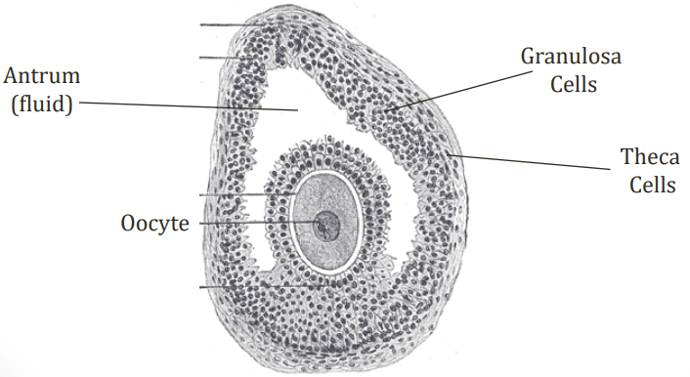
Ovarian Cysts – Introduction
Ovarian Follicle
Egg surrounded by cells
Two key cell types: theca and granulosa cells
Hormone Synthesis
Theca cells
Convert cholesterol into androstenedione (androgen)
Stimulated by LH
Granulosa cells
Convert androstenedione into estradiol (estrogen)
Stimulated by FSH
Ovarian Cysts
Often detected by ultrasound
Often “functional”; From normal ovarian structure (Follicle, Corpus luteum)

Slide 65
Benign diseases of the ovaries
Most ovarian disorders are benign, with the majority being functional ovarian cysts and benign neoplasms. Imaging can often aid in diagnosis and risk assessment. Benign ovarian disorders are frequently incidental findings, but they may cause symptoms from hormonal overproduction, mass effects, or torsion.

Slide 66
Medical history
Should include the following-:
Menstrual history (including last menstrual period and presence/severity of dysmenorrhea)
Abdominal pain )Pain , Distention , Pressure)
Presence/absence of fever
Sexual history
Presence/absence of infertility , acne, hirsutism
Endocrine symptoms
Pressure effect
GI symptoms
Shortness of breath
Current history of PID

Slide 67
Physical examination
Pelvic examination to assess the size, consistency, mobility of a mass
Findings such as pain with palpation (abdominal distention, ascites)
Pelvic tenderness
Rebound tenderness and decrease bowel sounds
Mass that is irregular, fixed and asso with posterior cul-de-sac nodularity
Cervical motion and adnexal tenderness
Signs of a hormonally active mass such as virilization

Slide 68
Laboratory evaluation
Serum B-HCG + AFP+ LDH→ as tumour markers
Complete blood count
ESR, CRP
Swabs for gram stain and culture
NAAT , urinalysis
Serum estradiol, estrone
Serum LH

Slide 69
IMAGING
The diagnosis of an adnexal mass may be suspected on pelvic examination and confirmed with pelvic imaging usually (transvaginal ultrasonography)
Definitive diagnosis of the etiology of an adnexal mass is made by characteristic histologic findings following surgery

Slide 70
Physiological(functional) ovarian cysts
Follicular cyst
Corpus luteum cyst
Theca Luten Cyst
→Functional cysts: managed conservatively by OCPs for 2-3 months بالمصطلحات العامة بحكولها تذويب الكيس!!
Its actually a wrong term because we are stop the formation of new cysts by inhibiting the ovulation
→If failed do cystectomy
During the normal ovulation process, a follicle matures and releases an ovum. Afterward, the corpus luteum forms and eventually regresses.
– *Follicular cysts* form when the follicle fails to rupture, and it continues to grow. If the cyst becomes larger than 3cm, it is called a follicular cyst.
*Corpus luteum cysts* develop when the corpus luteum does not regress and keeps growing after ovulation. Normally, the corpus luteum enlarges during the first six weeks of pregnancy, doubling in size compared to its pre-pregnancy state.
Both types of cysts are generally small, usually less than 10 cm, and usually asymptomatic.
However, complications can occur, such as rupture, bleeding, or ovarian torsion.
Most cysts resolve spontaneously within a few weeks, but some may persist for several weeks or longer.

Slide 71
Theca Luten Cyst
Theca lutein cysts are bilateral multiseptated, luteinized follicular cysts that form as a result of excessive hCG stimulation or hypersensitivity to hCG
(i.e can occur in normal pregnancy ? YES)..
• They are typically associated with conditions such as gestational trophoblastic disease, multiple gestation, or ovarian hyperstimulation.
It can also occur in pregnancy complicated by fetal hydrops.
• While most patients remain asymptomatic, some may experience complications like maternal virilization ,thyroid dysfunction hyperemesis gravidarum or preeclampsia.
• These cysts typically resolve spontaneously once the source of hCG is removed.(often need weeks to months)

Slide 72
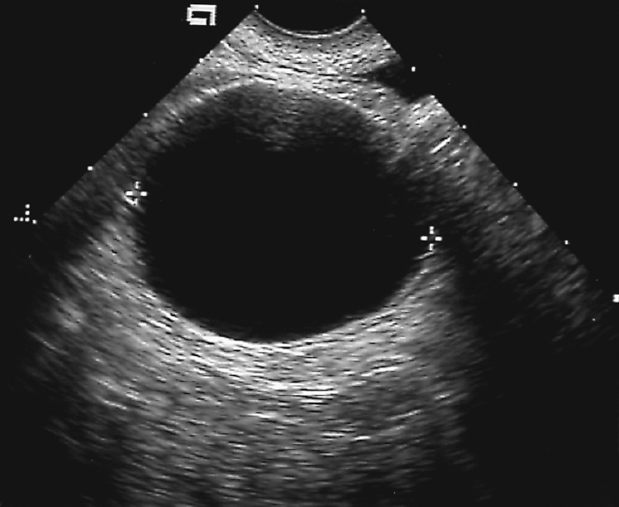
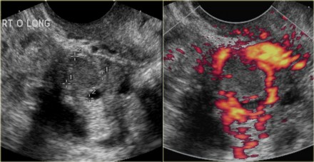
Ovarian Cysts on ultrasound examination
Follicular cysts
Appear as simple unilocular, anechoic cysts with a thin, smooth wall.
There should be no enhancing nodules or other solid components, no enhancing septations, and no more than physiologic ascites
Corpus luteum cysts
Appear usually as a small complex ovarian cyst with wall vascularity on power Doppler analysis.
The characteristic circular Doppler appearance is called the 'ring of fire'.
May appear as simple cyst.
Theca lutein cysts
Bilateral multiseptated cystic adnexal masses
Hormonal problem, so presented bilaterally
Follicular+ corpus luteum cyts: ovulatory problems, so unilateral presentation

Slide 73
Luteoma
rare, nonneoplastic ovarian change that arise in response to elevated hormone levels (e.g., β-hCG) during pregnancy
Clinical features
majority asymptomatic.
Occasionally, they are functionally active (i.e., cause androgen hypersecretion) and manifest with symptoms of virilization of the mother or the fetus
- *Maternal symptoms*: Acne, hirsutism, deepening of the voice, temporal balding, and clitoromegaly. –
*Fetal symptoms*: Signs of masculinization such as labioscrotal fusion and an enlarged clitoris. In some cases, luteomas can lead to ambiguous genitalia at birth, necessitating a decision on the infant's gender based on parental preference.
Risk factors
- *Polycystic Ovary Syndrome (PCOS)*
- History of luteoma
- Multiple pregnancies
- Advanced maternal age

Slide 74
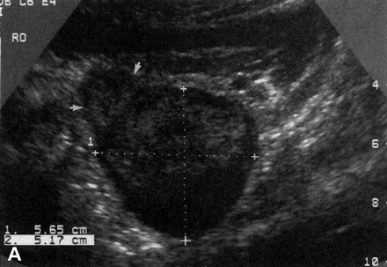
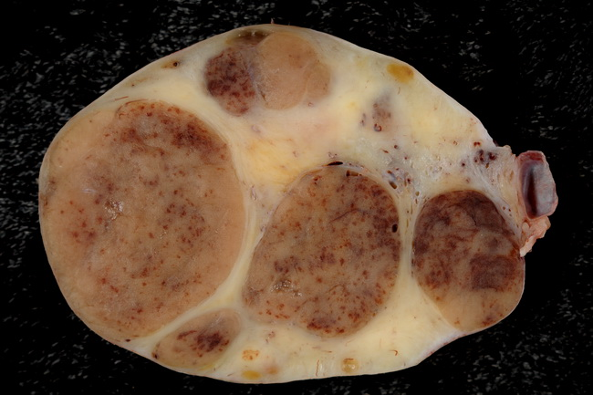
Luteoma
Diagnostics
*Pelvic ultrasound*: Reveals a solid adnexal mass, which can be unilateral or bilateral, with significant venous or arterial blood flow. (Normal Range :between *1 to 25 cm*)
NOTE The diagnosis should be suspected in the presence of a solid adnexal mass and maternal hirsutism or virilization during pregnancy.
Definitive diagnosis-
Treatment
*Observation*: Most luteomas regress spontaneously postpartum without the need for intervention.
Confirmed by histopathological examination post-surgery.
- Luteomas are often diagnosed incidentally during *cesarean delivery* or routine imaging. i.e INCIDENTALLY

Slide 75
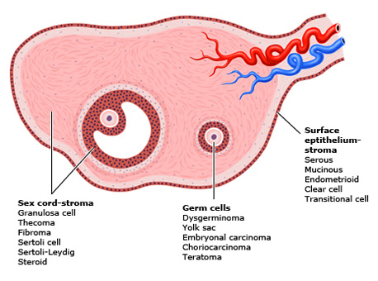
Ovarian Neoplasms
Ovary Structures
Surface epithelium
Adenomas/Carcinomas
Supporting cells (Theca/granulosa, Fibroblasts)
Sex cord stromal tumors
Oocytes (eggs)
Germ cell tumors
Ovarian Neoplasms
Ovarian neoplasms arise from the surface epithelium, germ cells, and sex-cord-stromal tissue and may be benign, borderline or malignant.
These neoplasms persist unless excised
Epithelial tumors account for 60-65% of all ovarian tumors, germ cell tumors
account for 30% and sex-cord stromal tumors account for 8%.

Slide 76
Benign ovarian neoplasms
Predominantly they occur in premenopausal women, they are uncommon in premenarchal and postmenopausal women. Among premenopausal patients, more than 90% of cases are benign, as opposed to just 60% in the postmenopausal population.
Presentation
Asymptomatic: incidental finding on examination or imaging.
Lower abdominal pain. (Mild pain)
Ovarian cyst accidents: torsion, rupture or hemorrhage. Present as acute abdomen.
Dyspareunia.
Pressure effects, e.g., on the bladder, causing urinary frequency, or on venous return, causing varicose veins and leg oedema.
Ascites (e.g., Meigs' syndrome).
Endocrine: hormone-secreting tumors may cause virilization, menstrual irregularities or postmenopausal bleeding. This is uncommon though.
Diagnosis: by histopathology.
Treatment: ovarian cystectomy / oophorectomy.

Slide 77
A) Epithelial ovarian tumors :
1) Serous cystadenoma
2) Mucinous cystadenoma
3) Endometrioid cystadenoma
4) Brenner tumor
B) Germ cell ovarian tumors :
1) Mature cystic teratoma (dermoid cyst)
2) Mature solid teratoma
3) Monodermal highly specialized teratomas (e.g., struma ovarii, carcinoid)
C) Sex-cord stromal cell ovarian tumors :
1) Fibroma
2) Thecoma
Benign ovarian neoplasms

Slide 78
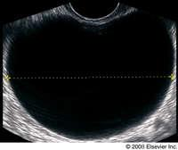
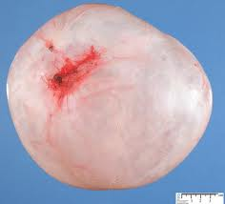
Serous cystadenoma
The most common benign ovarian neoplasms
The peak incidence is at the 4th - 5th decades of life
Pathology
Grossly: They are thin-walled, usually unilocular (or sometimes multilocular), that contain clear, straw-colored fluid and range in size from 5 to over 20 cm.
Bilateral in 20-25%

Slide 79
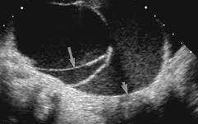
Mucinous cystadenoma
● The second most common benign ovarian neoplasms.
● The peak incidence occurs between 30-50 years of age.
● Grossly : They are thin-wall, usually multilocular (or sometimes unilocular) , that contain mucin, generally tend to be larger than serous cystadenomas at presentation (they can attain an enormous size), bilateral in 5%.

Slide 80
Endometrioid cystadenoma
● Histopathology :The glands resemble normal endometrium. Stroma is moderately
cellular.
No cytologic atypia, no architectural complexity.
● Many of these tumors arise from endometriosis.
Brenner tumor
● They are rare ovarian tumors

Slide 81
Mature cystic teratoma (Dermoid cyst)
● The most common germ cell tumor and the most common ovarian tumor in women the second and third decade of life
● Histopathology : Mature cystic teratomas contain mature tissue of ectodermal (eg, skin, hair follicles, sebaceous glands), mesodermal (eg, muscle, urinary), and endodermal origin (eg, lung, gastrointestinal).
Clinical manifestations
● Most women with dermoid cysts are asymptomatic.
● The most common complication associated with mature cystic teratomas is torsion.
The reported rate of torsion ranges from 3.2-16%. Torsion is more common in tumors of intermediate size than in small or extremely large tumors.
● Rupture of dermoid cysts with spillage of sebaceous material into the abdominal cavity can occur, but is uncommon. Shock and hemorrhage are the immediate sequelae of rupture; a marked granulomatous reaction (chemical peritonitis) may subsequently develop and lead to formation of dense adhesions.

Slide 82
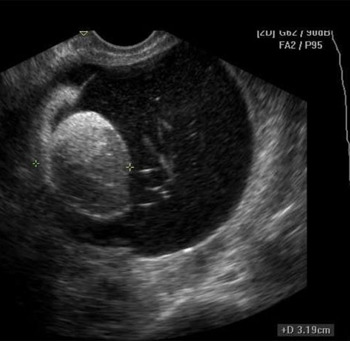
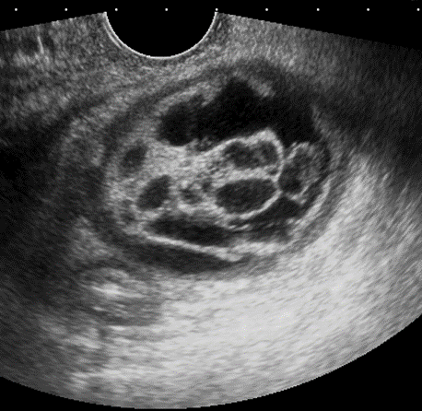
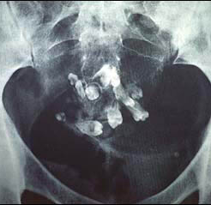
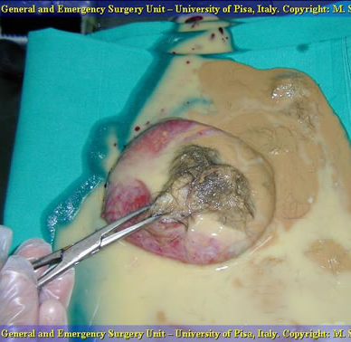
Diagnosis :
These tumors have a characteristic ultrasound appearance, which allows reasonably
accurate noninvasive diagnosis in many cases. The reported specificity is 98-100 %.
Definitive diagnosis is made at the time of surgical excision
ON U/S- thick or thin wall, solid part, cystic
TRETMENT- ovarian cystectomy
2%- malignant transformation
‘ squamous cell carcinoma’

Slide 83
Mesodermal highly specialized teratomas
The specialized or monodermal teratomas are a rare and remarkable subset of teratomas that consist of a predominant mature histologic cell type, the most common of which are struma ovarii and carcinoid, a well-differentiated neuroendocrine neoplasm. They are usually unilateral, although a contralateral teratoma may be present.
Struma ovarii : Is a teratoma predominantly composed of mature thyroid tissue. The secretion of thyroid hormones results in clinical hyperthyroidism in 25-35 % of patients.
Carcinoid neoplasms- is a teratoma predominantly composed of GI tissue. The secretion of bioactive polypeptides and amines, producing a constellation of symptoms, predominantly flushing and diarrhea.
Mature solid teratoma
Like mature cystic teratoma but it’s a solid component

Slide 84
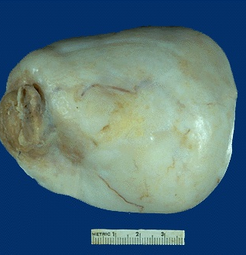
Fibroma
Benign ovarian neoplasm
The most common sex cord ovarian tumor
They tend to occur mostly during perimenopause and post-menopause, the median age having been reported to be about 52 years
Presentation
Asymptomatic
Ascites: 40% of tumors > 6 cm are associated with ascites
Grossly: Mean 6 cm, usually unilateral, solid, lobulated, firm, white and may have myxoid change
- Meigs syndrome = Ovarian fibroma + Ascites + Pleural effusion ( right side

Slide 85
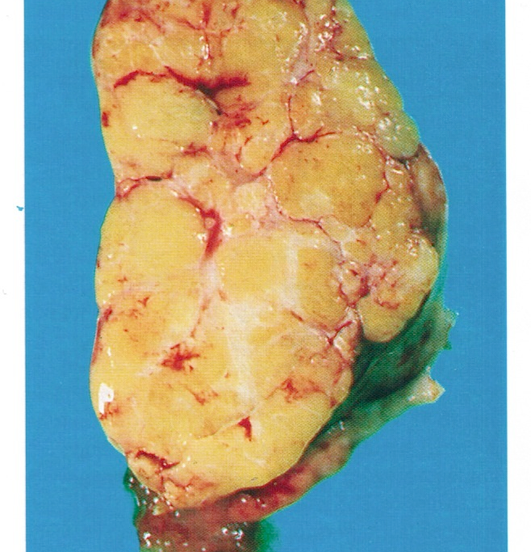
Thecoma
Rare benign ovarian neoplasm
Occur in old women (mean age 59 years; 84% after menopause)
Presentation
They are typically estrogen-producing tumors (60%): abnormal uterine bleeding
20% have concurrent endometrial carcinoma
Androgen producing tumors (10%)
Non-functioning tumor
Grossly: Unilateral (90%), well-defined, firm, solid and covered by intact ovarian serosa, variable size; usually yellow; often a mixture with fibroma (white)

Slide 86
Thank
You

