Slide 1
Breast Pathology Breast Carcinoma

Slide 2
Breast carcinoma

Slide 3
Breast carcinoma

Slide 5
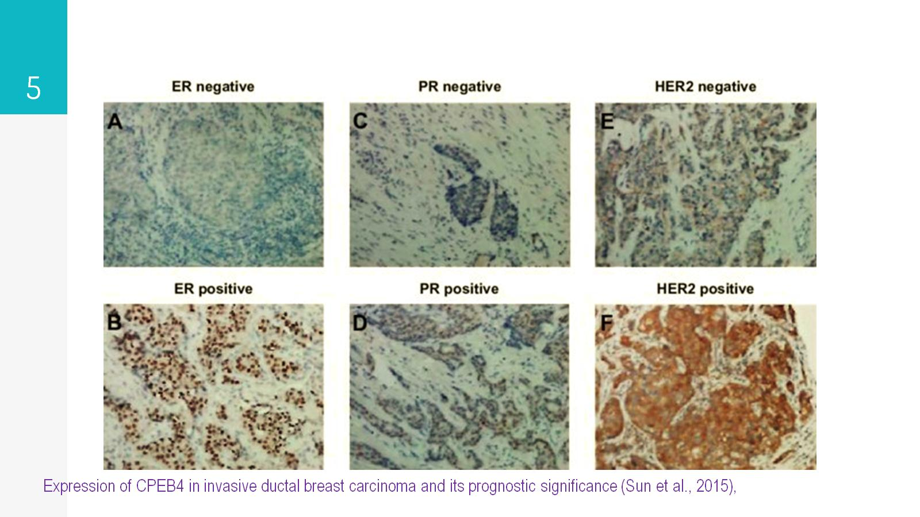

Slide 6
Breast carcinoma – Risk factors

Slide 7
Breast carcinoma – Risk factors

Slide 8
Breast carcinoma – Pathogenesis/genetics

Slide 9
Breast carcinoma – Pathogenesis/HER2 gene

Slide 10
Breast carcinoma - morphology

Slide 11
Breast carcinoma – morphology (in situ)

Slide 12
Breast carcinoma - morphology

Slide 13
Noninvasive (in Situ) Carcinoma

Slide 14
Noninvasive (in Situ) Carcinoma - DCIS

Slide 15
Noninvasive (in Situ) Carcinoma- solid DCIS

Slide 16
Noninvasive (in Situ) Carcinoma- Comedo DCIS

Slide 17
Noninvasive (in Situ) Carcinoma - LCIS

Slide 18
Noninvasive (in Situ) Carcinoma - LCIS

Slide 19
Invasive Carcinoma - Invasive ductal carcinoma (IDC)

Slide 20
Invasive ductal carcinoma - morphology

Slide 21
Invasive ductal carcinoma - morphology

Slide 22
Invasive Carcinoma - Invasive lobular carcinoma

Slide 23
Invasive Carcinoma - Inflammatory carcinoma

Slide 24
Invasive Carcinoma - Inflammatory carcinoma

Slide 25
Invasive breast Carcinoma – Clinical outcome

Slide 26
Invasive breast Carcinoma – clinical outcome

Slide 27
Invasive breast Carcinoma – clinical outcome

