Slide 1
Personality Disorders Dr. Maxim A. Obaisat,MD JRMS, Department of Psychiatry

Slide 2
Definition
Lifelong, persistent, deeply integrated maladaptive behavior and Inner experiences that:
-characterizes the individual
-deviates markedly from culturally excepted (accepted normal)
-onset in adolescence or early adulthood
-Are ego syntonic: (acceptable to the ego)
-Are alloplastic: (adapt by trying to alter the external environment rather than themselves).
-manifests in at least two of the following four areas: cognition, affectivity, interpersonal function, or impulse control and gratification need

Slide 3
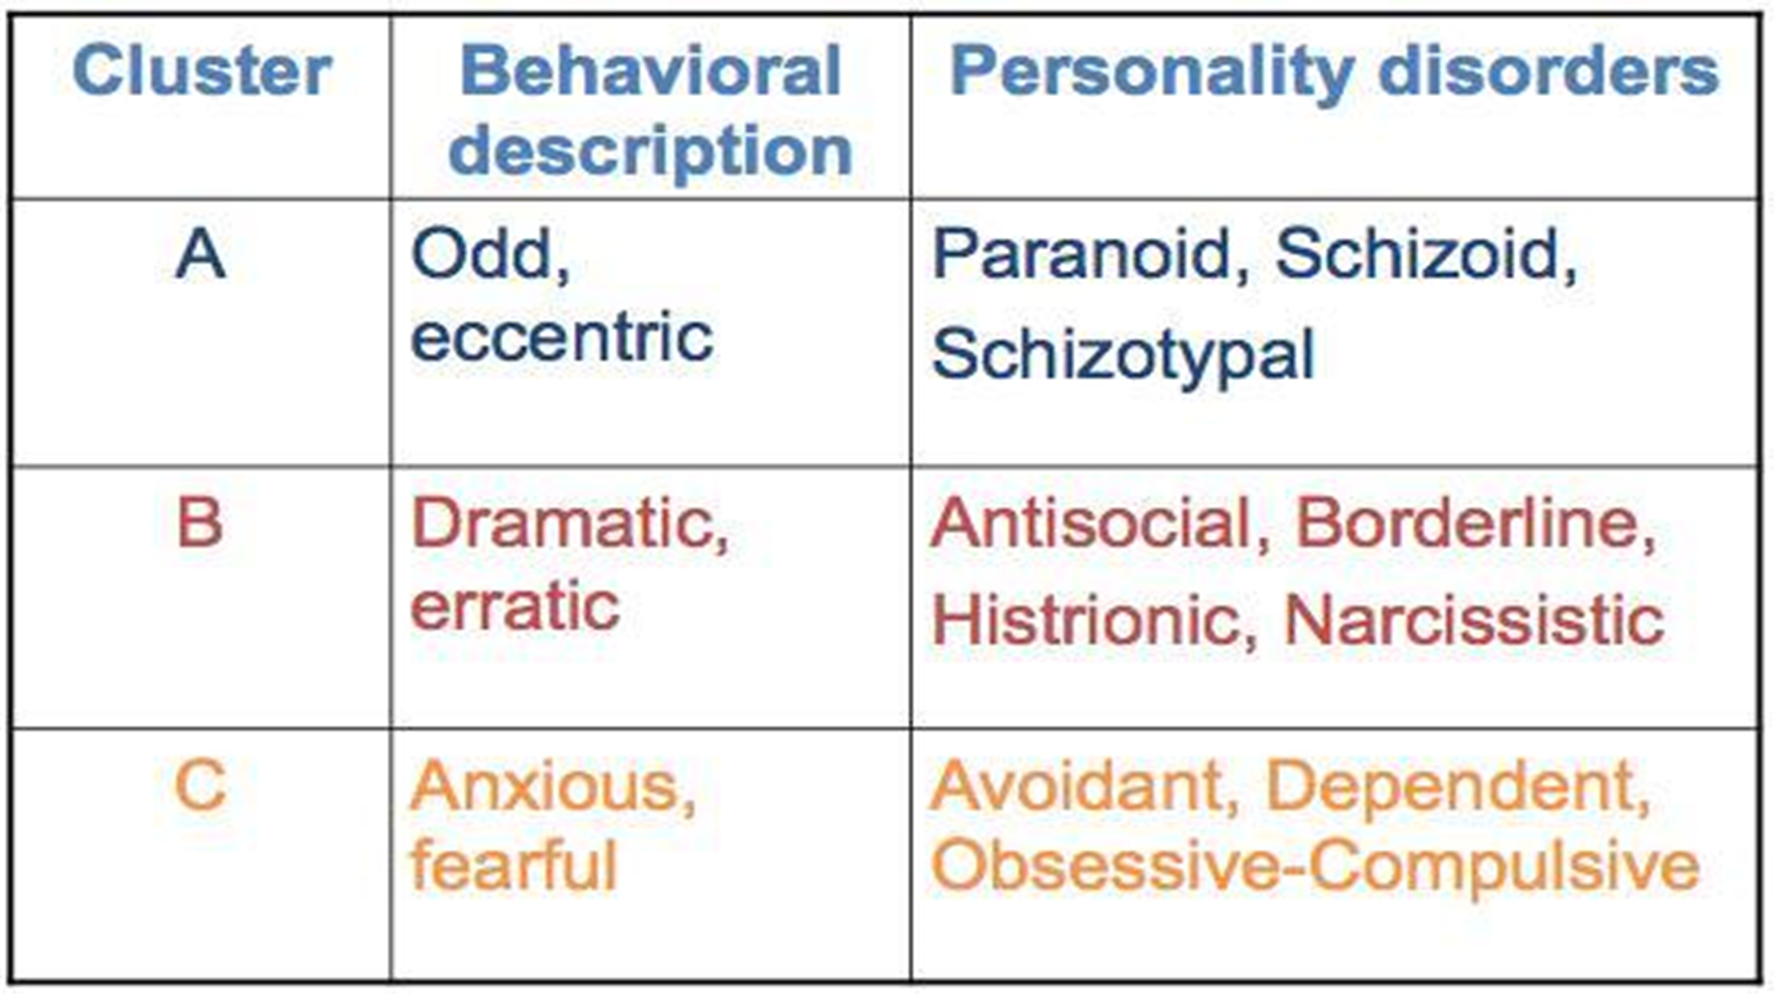

Slide 4
Etiology
Genetics
Monozygotic twins reared apart have nearly same personalities
Cluster A : More common in the biological relatives of patients with schizophrenia than among control groups.
Cluster B: Antisocial personality disorder is associated with alcohol use disorders ; depression is common in family backgrounds of patients with borderline personality disorder; a strong correlation between histrionic and somatization disorders.
Cluster C : Patients with avoidant personality often have high anxiety levels; obsessive-compulsive traits are more common in monozygotic twins than in dizygotic twins – they also show some signs of depression.
Neurotransmitters
-Low levels of 5-HIAA , a metabolite of serotonin is low in people who are impulsive and aggressive.
Environmental Factors
-Children with minimal brain damage are at risk for antisocial personality disorder.
-Link between fearful children raised by fearful mothers and avoidant personality disorder
-Cultures that encourage aggression may contribute to paranoid and antisocial personality disorders.

Slide 6
Paranoid Personality Disorder

Slide 7
Diagnostic Criteria
A. a pervasive distrust and suspiciousness of others such that their motives are interpreted as malevolent, beginning by early adulthood and present in a variety of contexts, as indicated by four (or more) of the following:
1.Suspects, without sufficient basis, that others are exploiting, harming, or deceiving him or her.
2. Is preoccupied with unjustified doubts about the loyalty or trustworthiness of friends or associates.
3. Is reluctant to confide in others because of unwarranted fear that the information will be used maliciously against him or her.
4. Reads hidden demeaning or threatening meanings into benign remarks or events.
5. Persistently bears grudges (i.e., is unforgiving of insults, injuries, or slights).
6. Perceives attacks on his or her character or reputation that are not apparent to others and is quick to react angrily or to counterattack.
7. Has recurrent suspicions, without justification, regarding fidelity of spouse or sexual partner.

Slide 8
Diagnostic Criteria
B. Does not occur exclusively during the course of schizophrenia, a bipolar disorder or depressive disorder with psychotic features, or another psychotic disorder and is not attributable to the physiological effects of another medical condition.
Note: If criteria are met prior to the onset of schizophrenia, add “premorbid,” i.e., “paranoid personality disorder (premorbid).”

Slide 9
Schizoid Personality Disorder

Slide 10
Diagnostic Criteria
A. a pervasive pattern of detachment from social relationships and a restricted range of expression of emotions in interpersonal settings, beginning by early adulthood and present in a variety of contexts, as indicated by four (or more) of the following: 1. Neither desires nor enjoys close relationships, including being part of a family.
2. Almost always chooses solitary activities.
3. Has little, if any, interest in having sexual experiences with another person.
4. Takes pleasure in few, if any, activities.
5. Lacks close friends or confidants other than first-degree relatives.
6. Appears indifferent to the praise or criticism of others.
7. Shows emotional coldness, detachment, or flattened affectivity
B. Does not occur exclusively during the course of schizophrenia, a bipolar disorder or depressive disorder with psychotic features, another psychotic disorder, or autism spectrum disorder and is not attributable to the physiological effects of another medical condition.
Note: If criteria are met prior to the onset of schizophrenia, add “premorbid,” i.e., “schizoid personality disorder (premorbid).”

Slide 11
Schizotypal Personality Disorder

Slide 12
Diagnostic Criteria
A.
a pervasive pattern of social and interpersonal deficits marked by acute discomfort with, and reduced capacity for, close relationships as well as by cognitive or perceptual distortions and eccentricities of behavior, beginning by early adulthood and present in a variety of contexts, as indicated by five (or more) of the following: 1. Ideas of reference (excluding delusions of reference).
2. Odd beliefs or magical thinking that influences behavior and is inconsistent with subcultural norms (e.g., superstitiousness, belief in clairvoyance, telepathy, or “sixth sense”: in children and adolescents, bizarre fantasies or preoccupations).
3. Unusual perceptual experiences, including bodily illusions.
4. Odd thinking and speech (e.g., vague, circumstantial, metaphorical, overelaborate, or stereotyped).
5. Suspiciousness or paranoid ideation.
6. Inappropriate or constricted affect.
7. Behavior or appearance that is odd, eccentric, or peculiar.
8. Lack of close friends or confidants other than first-degree relatives.
9. Excessive social anxiety that does not diminish with familiarity and tends to be associated with paranoid fears rather than negative judgments about self.

Slide 13
Diagnostic Criteria
B. Does not occur exclusively during the course of schizophrenia, a bipolar disorder or depressive disorder with psychotic features, another psychotic disorder, or autism spectrum disorder.
Note: If criteria are met prior to the onset of schizophrenia, add “premorbid,” e.g., “schizotypal personality disorder (premorbid).”

Slide 14
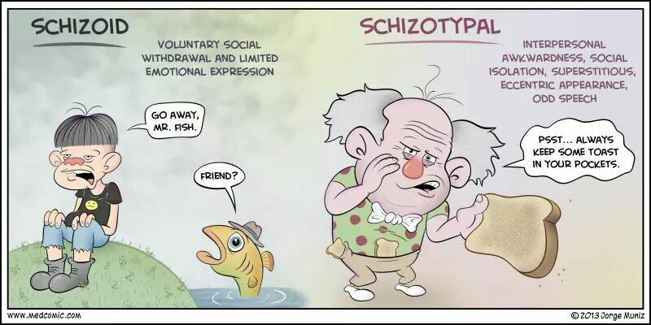

Slide 15
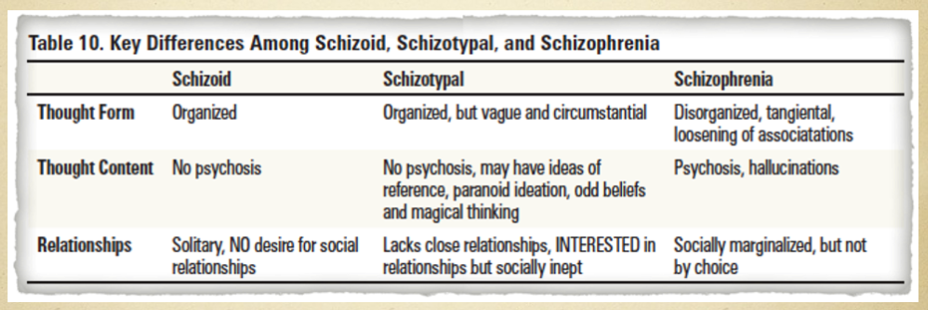

Slide 17
Antisocial Personality Disorder

Slide 18
Diagnostic Criteria
A. A pervasive pattern of disregard for and violation of the rights of others, occurring since age 15 years, as indicated by three (or more) of the following:
1. Failure to conform to social norms with respect to lawful behaviors, as indicated by repeatedly performing acts that are grounds for arrest.
2. Deceitfulness, as indicated by repeated lying, use of aliases, or conning others for personal profit or pleasure.
3. Impulsivity or failure to plan ahead.
4. Irritability and aggressiveness, as indicated by repeated physical fights or assaults.
5. Reckless disregard for safety of self or others.
6. Consistent irresponsibility, as indicated by repeated failure to sustain consistent work behavior or honor financial obligations.
7. Lack of remorse, as indicated by being indifferent to or rationalizing having hurt, mistreated, or stolen from another.

Slide 19
Diagnostic Criteria
B. The individual is at least age 18 years. C. There is evidence of conduct disorder with onset before age 15 years. D. The occurrence of antisocial behavior is not exclusively during the course of schizophrenia or bipolar disorder.

Slide 20
Borderline Personality Disorder

Slide 21
Diagnostic Criteria
A pervasive pattern of instability of interpersonal relationships, self-image, and affects, and marked impulsivity, beginning by early adulthood and present in a variety of contexts, as indicated by five (or more) of the following:
1. Frantic efforts to avoid real or imagined abandonment. 2. A pattern of unstable and intense interpersonal relationships characterized by alternating between extremes of idealization and devaluation.
3. Identity disturbance: markedly and persistently unstable self-image or sense of self.
4. Impulsivity in at least two areas that are potentially self-damaging (e.g., spending, sex, substance abuse, reckless driving, binge eating).

Slide 22
Diagnostic Criteria
5. Recurrent suicidal behavior, gestures, or threats, or self-mutilating behavior.
6. Affective instability due to a marked reactivity of mood (e.g., intense episodic dysphoria, irritability, or anxiety usually lasting a few hours and only rarely more than a few days).
7. Chronic feelings of emptiness.
8. Inappropriate, intense anger or difficulty controlling anger (e.g., frequent displays of temper, constant anger, recurrent physical fights).
9. Transient, stress-related paranoid ideation or severe dissociative symptoms

Slide 25
Histrionic Personality Disorder

Slide 26
Diagnostic Criteria
A pervasive pattern of excessive emotionality and attention seeking, beginning by early adulthood and present in a variety of contexts, as indicated by five (or more) of the following:
1. uncomfortable in situations in which he or she is not the center of attention.
2. Interaction with others is often characterized by inappropriate sexually seductive or provocative behavior.
3. Displays rapidly shifting and shallow expression of emotions.
4. Consistently uses physical appearance to draw attention to self.
5. Has a style of speech that is excessively impressionistic and lacking in detail.
6. Shows self-dramatization, theatricality, and exaggerated expression of emotion.
7. Easily suggestible (i.e., easily influenced by others or circumstances).
8. Considers relationships to be more intimate than they actually are.

Slide 27
Narcissistic Personality Disorder

Slide 28
Diagnostic Criteria
A pervasive pattern of grandiosity (in fantasy or behavior), need for admiration, and lack of empathy, beginning by early adulthood and present in a variety of contexts, as indicated by five (or more) of the following:
1. Has a grandiose sense of self-importance (e.g., exaggerates achievements and talents, expects to be recognized as superior without commensurate achievements).
2. Is preoccupied with fantasies of unlimited success, power, brilliance, beauty, or ideal love.
3. Believes that he or she is “special” and unique and can only be understood by, or should associate with, other special or high-status people (or institutions).
4. Requires excessive admiration.
5. Has a sense of entitlement (i.e., unreasonable expectations of especially favorable treatment or automatic compliance with his or her expectations). 6. Is interpersonally exploitative (i.e., takes advantage of others to achieve his or her own ends).
7. Lacks empathy: is unwilling to recognize or identify with the feelings and needs of others.
8. Is often envious of others or believes that others are envious of him or her.
9. Shows arrogant, haughty behaviors or attitudes.

Slide 30
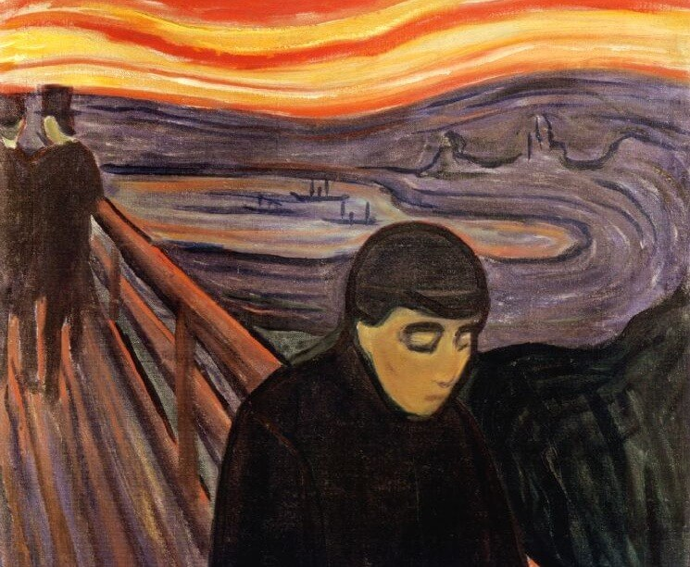
Avoidant Personality Disorder

Slide 31
Diagnostic Criteria
A pervasive pattern of social inhibition, feelings of inadequacy, and hypersensitivity to negative evaluation, beginning by early adulthood and present in a variety of contexts, as indicated by four (or more) of the following:
1. Avoids occupational activities that involve significant interpersonal contact because of fears of criticism, disapproval, or rejection.
2. Is unwilling to get involved with people unless certain of being liked.
3. Shows restraint within intimate relationships because of the fear of being shamed or ridiculed.
4. Is preoccupied with being criticized or rejected in social situations.
5. Is inhibited in new interpersonal situations because of feelings of inadequacy. 6. Views self as socially inept, personally unappealing, or inferior to others.
7. Is unusually reluctant to take personal risks or to engage in any new activities because they may prove embarrassing.

Slide 32
Dependent Personality Disorder

Slide 33
Diagnostic Criteria
A pervasive and excessive need to be taken care of that leads to submissive and clinging behavior and fears of separation, beginning by early adulthood and present in a variety of contexts, as indicated by five (or more) of the following:
1. Has difficulty making everyday decisions without an excessive amount of advice and reassurance from others.
2. Needs others to assume responsibility for most major areas of his or her life.
3. Has difficulty expressing disagreement with others because of fear of loss of support or approval.
4. Has difficulty initiating projects or doing things on his or her own 5. Goes to excessive lengths to obtain nurturance and support from others, to the point of volunteering to do things that are unpleasant.
6. Feels uncomfortable or helpless when alone because of exaggerated fears of being unable to care for himself or herself.
7. Urgently seeks another relationship as a source of care and support when a close relationship ends.
8. Is unrealistically preoccupied with fears of being left to take care of himself or herself.

Slide 34
Obsessive-compulsive personality disorder

Slide 35
That’s right… ☺
Obsessive
Compulsive
Personality
Disorder

Slide 36
Diagnostic Criteria
A pervasive pattern of preoccupation with orderliness, perfectionism, and mental and interpersonal control, at the expense of flexibility, openness, and efficiency, beginning by early adulthood and present in a variety of contexts, as indicated by four (or more) of the following:
1. Is preoccupied with details, rules, lists, order, organization, or schedules to the extent that the major point of the activity is lost.
2. Shows perfectionism that interferes with task completion (e.g., is unable to complete a project because his or her own overly strict standards are not met).
3. Is excessively devoted to work and productivity to the exclusion of leisure activities and friendships
4. Is overconscientious, scrupulous, and inflexible about matters of morality, ethics, or value. 5. Is unable to discard worn-out or worthless objects even when they have no sentimental value.
6. Is reluctant to delegate tasks or to work with others unless they submit to exactly his or her way of doing things.
7. Adopts a miserly spending style toward both self and others; money is viewed as something to be hoarded for future catastrophes.
8. Shows rigidity and stubbornness

Slide 37
Treatment
-A multidisciplinary approach is often essential as psychological, social, & biological treatment modalities have an important role. - A comprehensive assessment should be made od sources of distress (thoughts, emotions, behavior & relationships) to self & others, other comorbid mental illness & specific impairments of functioning at work or home . -If at all a formulation of realistic goals of treatment should be discussed & agreed with patients. -Hospital admissions may sometimes be helpful in times of crisis.
Psychosocial interventions include : -Assistance with social problems such as housing, finances, employment, and disturbed relationships. -Supportive Psychotherapy provides patients with an authority figure during times of crisis & focuses on acceptance and helping patients with their needs. -Cognitive behavioral therapy may target specific symptoms or behaviors, e.g. depression, anxiety, anger & deliberate self harm. -Cognitive analytic therapy (CAT) has shown some promise in patients with borderline personality disorder. -Dialectical behavioral therapy (DBT) is a promising intervention for borderline personality disorder & has shown to reduce parasuicidal behavior & time spent in hospital + improve patient engagement and social & global functioning.

Slide 38
Treatment
Pharmacological treatments are used to treat specific symptoms as apposed to treating the underlying personality : - Mood stabilizers such as Lithium, Lamotrigine and Carbamazepine may be useful in treating aggression, impulsivity & mood instability. - Antipsychotics may be of some use in treating the psychotic symptoms that sometimes are experienced by Schizotypal & borderline personality disorder patients and have shown to reduce the parasuicidal behavior, impulsivity, aggression & agitation. - Antidepressants may be useful in treating depressive symptoms. SSRI’s may help with obsessive-compulsive symptoms as well as impulsivity & self-harm behavior. - Benzodiazepines should be used with caution as abuse may lead to dependence. They may, however, be used to alleviate acute anxiety or sedate an acutely agitated or aggressive patient.

Slide 39
Course & prognosis
- Patients with personality disorder have a greater incidence of other mental illnesses such as depression, anxiety, Schizophrenia & OCD. - These illnesses tend to be more severe & have a worse prognosis than if the personality disorder was not present. -Patients with personality disorders ( especially cluster B) also have higher rates of suicide & accidental death than the general population. -Half of all borderline personality disorder patients will show clinical recovery at 10-25 year follow-up.
- Schizotypal & obsessive-compulsive personality disorders tend to be stable over time, although schizotypal patients may go on to develop schizophrenia.

Slide 40
Any Questions?

