Slide 1
Phobias
Prepared by Mohammed Hashem

Slide 2
Fear VS Anxiety
Anxiety : Apprehension about a future threat
Fear : Response to an immediate threat
Both involve physiological arousal → Sympathetic nervous system
Both can be adaptive:
Fear triggers “fight or flight” → May save life
Anxiety increases preparedness
Absence of anxiety interferes with performance
Moderate levels of anxiety improve performance
High levels of anxiety are detrimental to performance

Slide 3
DSM-5 Anxiety Disorders :
Social anxiety disorder
Panic disorder
Specific phobias
Agoraphobia
Generalized anxiety disorder

Slide 4
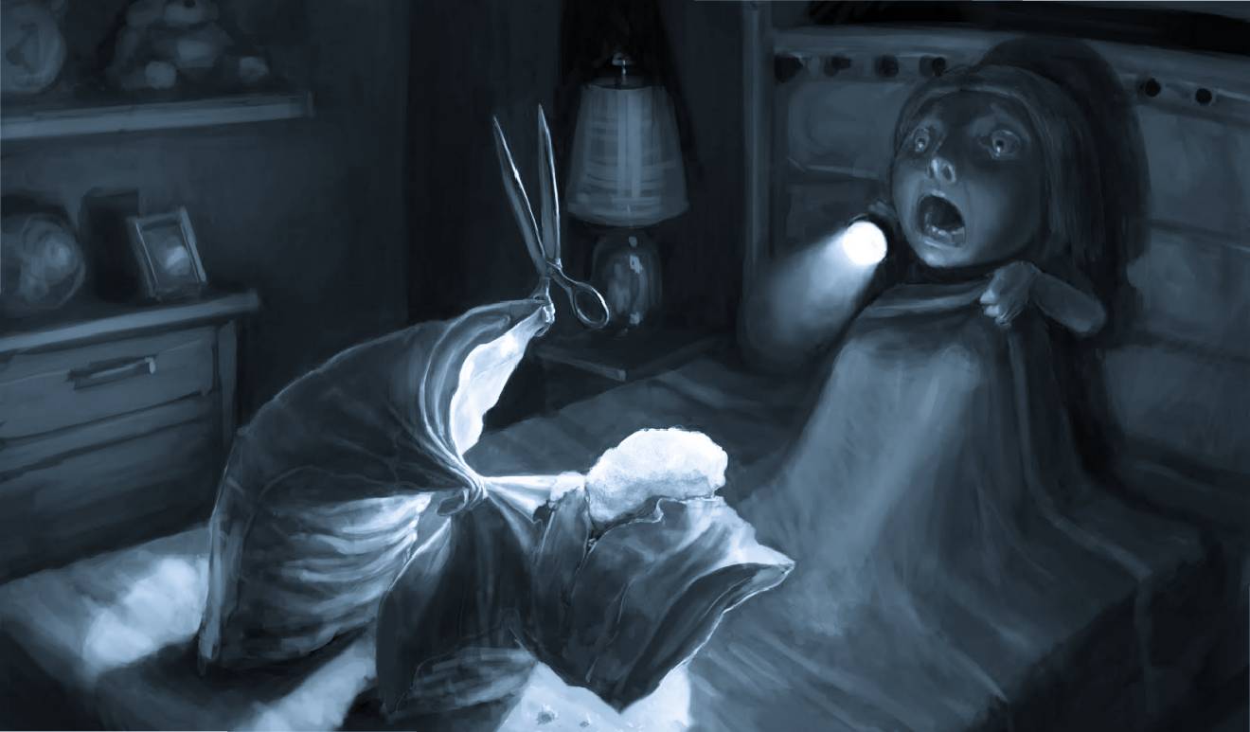
PHobia
The term phobia refers to an excessive fear of a specific object, circumstance, or situation. A specific phobia is a strong, persisting fear of an object or situation. The diagnosis of specific phobia requires the development of intense anxiety, even to the point of panic, when exposed to the feared object.
Fear out of proportion to actual threat
Awareness that fear is excessive
Must be severe enough to cause distress or interfere with job or social life
Avoidance

Slide 5
EPIDEMIOLOGY
Approximately 5 to 10 percent of the US population is estimated to have Phobia
Specific phobia is the most common mental disorder among women
Specific phobia is the second most common among men, secondonly to substance-related disorders.
The rates of specific phobias in women were double those of men, although the ratio is closer to 1 to 1 for the fear of blood, injection, or injury type.
Etiology
Not fully understood but thers few theories :
Stimulus responce model
Psychoanalytic theory
Genetic-Enviromental factors
Notes:
Stimulus responce model
Pairing of a naturally frightening stimulus with a second inherently neutral stimulus.
when the two stimuli are paired on several occasions, the originally neutral stimulus takes on the capacity to arouse anxiety by itself.
The neutral stimulus, therefore, becomes a conditioned stimulus for anxiety production
Psychoanalytic
When ego defences doesnt fully work as repression the ego must call on auxiliary defences like displacement, symbolization and avoidance.
In agoraphobia, it is the separation anxiety playing a central role.
Genetic-Enviromental factors

Slide 6
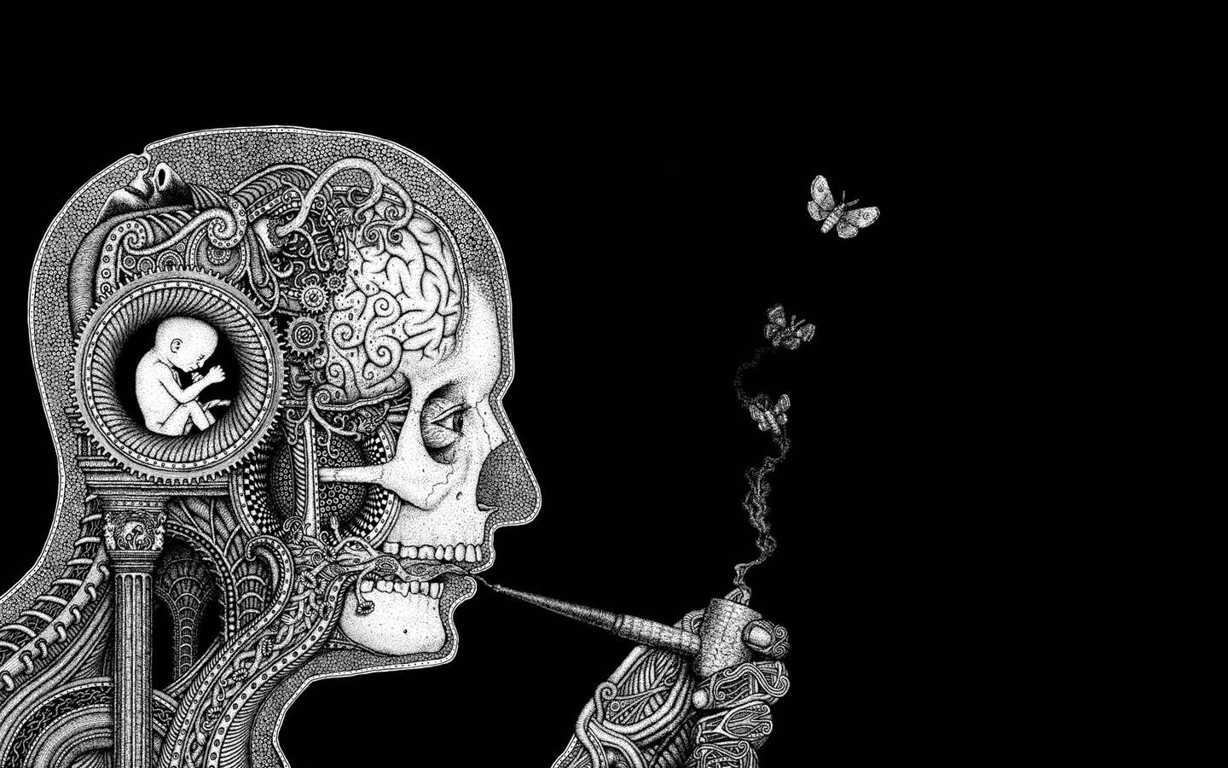
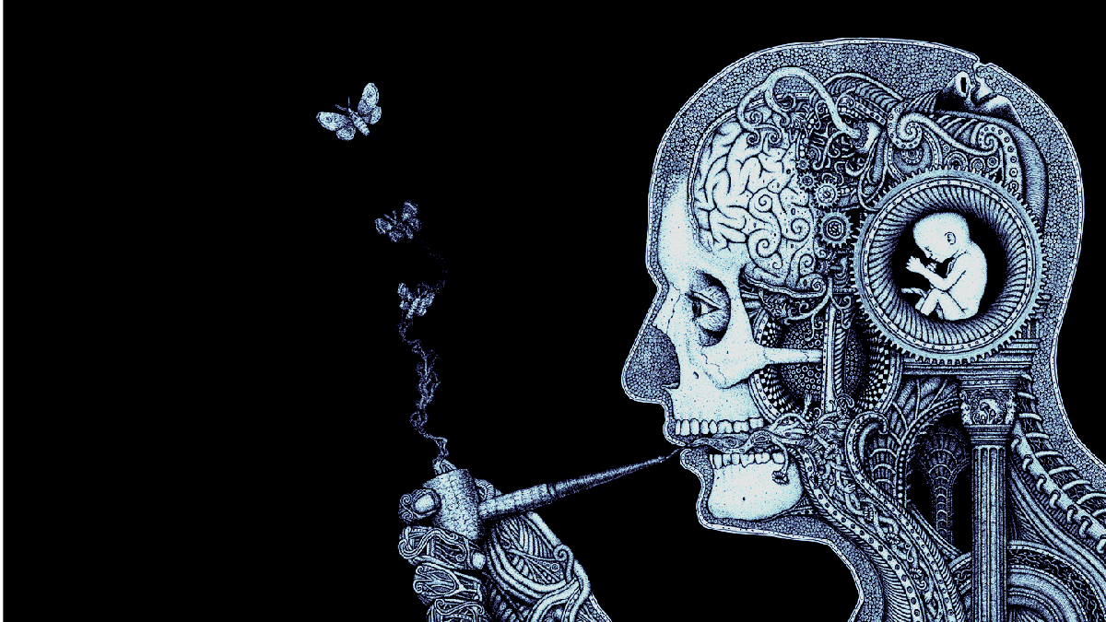
Specific Phobia
The development ofspecific phobia may result from the pairing of a specific object or situation with the emotions of fear and panic , ether by having a strong emotional experience, by obeservation of the reaction of an other (a parent) or information transfer (being taught about the dangers)
Specific phobia tends to run in families.The blood-injection-injury type has a particularly high familial tendency.

Slide 7
DSM-5 Criteria for Specific Phobia
Marked fear or anxiety about a specific object or situation (next slide)
Marked and disproportionate fear consistently triggered by specific objects or situations.
The phobic object or situation almost always provokes immediate fear or anxiety.
The object or situation is avoided or else endured with intense anxiety
Symptoms persist for at least 6 months
The disturbance is not better explained by the symptoms of another mental disorde

Slide 8
Types of phobia
The DSM-5 includes distinctive types of specific phobia:
Type of phobia | Example | Associated characteristics
Animal type | Snakes, Spiders | begins during childhood
Enviromental | Storms, heights, water | begins during childhood
Blood, injection, injury | Blood, injection, injury or other invasive medical procedures | Run in familes possible bradycardia and fainting
Situational | public transport, tunnels, elevators, flying, driving, closed spaces | begins during childhood Early adulthood peak
other (anything that dosnt fit the other four) | choking, Ilness, clowns, fear of getting a phobia (phobophbia), number 13 (treskidecophobia) | Early adulthood peak
Notes:
Acrophobia Fear of heights
treskidecophobia Fear of number 13
Agoraphobia Fear of open places
arachnophobia Fear of Spiders
Ailurophobia Fear of cats
Hydrophobia Fear of water
Claustrophobia Fear of closed spaces
Cynophobia Fear of dogs
Mysophobia Fear of dirt and germs
Pyrophobia Fear of fire
Xenophobia Fear of strangers
Zoophobia Fear of animals

Slide 9
Types of phobia
Diffrent phobias :
Acrophobia Fear of heights
treskidecophobia Fear of number 13
Agoraphobia Fear of open places
arachnophobia Fear of Spiders
Ailurophobia Fear of cats
Hydrophobia Fear of water
Claustrophobia Fear of closed spaces
Cynophobia Fear of dogs
Mysophobia Fear of dirt and germs
Pyrophobia Fear of fire
Xenophobia Fear of strangers
Zoophobia Fear of animals

Slide 10
Diffrential diagnosis
Substance abuse
nurological diseases (tumor, cerebrovascular)
other anxity disorders
Differentiation among panic disorder, agoraphobia, social phobia, and specific phobia can be difficult in individual cases. In general, patients with specific phobia tend to experience anxiety immediately when presented with the phobic stimulus and limited to the identified situation
patients are not abnormallyanxious when they are neither confronted with the phobic stimulus nor caused to anticipate the stimulus.

Slide 11
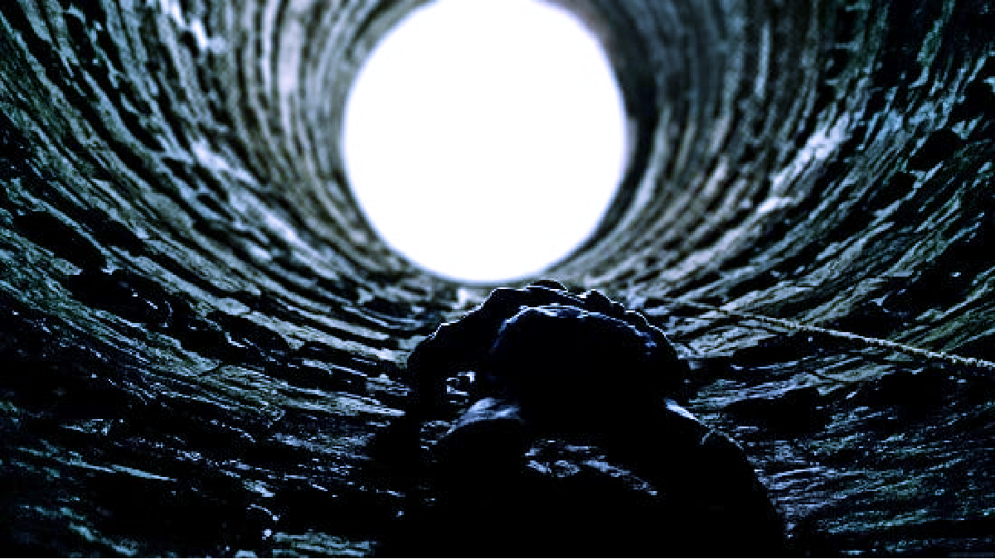
Treatment
Befor talking about treatment, note that Limited prospective epidemiological data are available that chart the natural course of specific phobia. Because patients with isolated specific phobia rarely present for treatment
Behavior Therapy
The most studied and most effective treatment
The key aspects of successful treatment are
Patient's commitment to treatment
Clearly identified problems and objectives
Available alternative strategies for coping with the feelings
The most common behavioral treatment techniques is systematic desensitization

Slide 12
systematic desensitization
In this method, the patient is exposed serially to a predetermined list of anxiety-provoking stimuli graded in a hierarchy from the least to the most frightening.
Through the use of antianxiety drugs, hypnosis, and instruction in muscle relaxation, patients are taught how to induce in themselves both mental and physical repose. After they have mastered the techniques, patients are taught to use them to induce relaxation in the face of each anxiety-provoking stimulus.
As they become desensitized to each stimulus in the scale, the patients move up to the next stimulus until, ultimately, what previously produced the most anxiety no longer elicits the painful affect

Slide 13
Other treatment modalites
Intenstive exposure (Flooding)
Insight-Oriented Psychotherapy : increase the patient's development of insight into psychological conflicts that, if unresolved, can manifest as symptomatic behavior
Virtual Therapy (using computer screens or Virtual reality)
Hypnosis
Supporative and family therapy (useful in helping the patient during other treatment, also help the family understand the nature of the patients problem )

Slide 14
Agoraphobia
refers to a fear of or anxiety regarding places from which escape might be difficult mainly public places. It can be the most disabling of the phobias because it can significantly interfere with a person's ability to function in work and social situations outside the home.
75% - 50% of affected patients have panic disorders as well
onset is unknown but in many casees it follows a traumatic event
Patients with agoraphobia rigidly avoid situations in which it would be difficult to obtain help. They prefer to be accompanied by a friend or a family member

Slide 15
DSM 5 includes distinctive Situations for Agoraphobia
(the first criteria says) Marked fear or anxiety about at least one situation from two or more of five situation groups:
Using public transportation (e.g., bus, train, cars, planes)
Being in an open space (e.g., park, shopping center, parking lot)
Being in an enclosed space (e.g., stores, elevators, theaters)
Being in a crowd or standing in line
Being alone outside of the home.
The fear or anxiety must be persistent and last at least 6 months

Slide 16
Agoraphobia Treatment
Benzodiazepine : the most rapid onset agains panic, The major reservations is the potential for dependence, cognitive impairment, and abuse
SSRIs (reduce and prevent relaps in various forms of anxity)
TCAs
Cognitive Behavioral Therapy (CBT)
Supporative
Insight-Oriented
Behavioral
Cognitive
Virtual

Slide 17
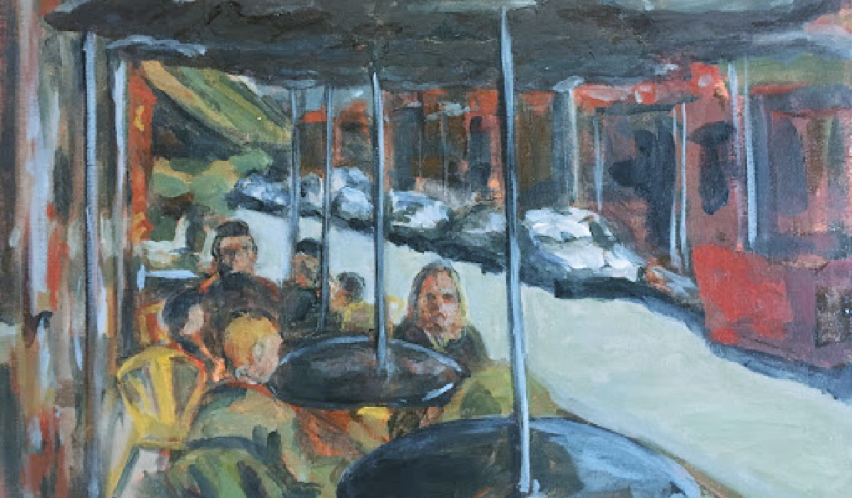
Social Anxiety (Social Phobia)
The fear of social situations in general, including situations that involve scrutiny or contact with strangers.
The fear is of embarrassing themselves in social situations (i.e.,social gatherings, oral presentations, meeting new people).
They may have specific fears about performing specific activities such as eating or speaking in front of others, or they may experience a vague, nonspecific fear of "embarrassing oneself." In either case, the fear in social anxiety disorder is of the embarrassment, not of the situation itself
Persons with social anxiety disorder may have a history of
other anxiety disorders, mood disorders, substance-related disorders, and bulimia nervosa.
Notes:
Epidemiology
Various studies have reported a lifetime prevalence ranging from 3 to 13 percent for social anxiety disorder. The 6-month prevalence is about 2 to 3 per 100 persons (Table 9.5-1). In epidemiological studies, females are affected more often than males, but in clinical samples, the reverse is often true. The reasons for these varying observations are unknown.

Slide 18
Specific phobia VS Social Phobia VS Panic disorder
its difficult to distinguish between panic disorder and specific or social phobias.
A Patient who experienced a single panic attack in a specific setting (e.g., an elevator) may go on to have long-lasting avoidance of the specific setting, regardless of whether they ever have another panic attack. These patients meet the diagnostic criteria for a specific phobia,
In another example, a person who experiences one or more panic attacks may then fear speaking in public. Although the clinical picture is almost identical to the clinical picture in social phobia, a diagnosis of social phobia is excluded because the avoidance of the public situation is based on fear of having a panic attack rather than on fear ofthe public speaking itself so its most likely panic disorder

Slide 19
Etiology of social phobia
Childhood and developmental theories
The success of pharmacotherapies in treating social anxiety disorder has generated two specific neurochemical hypotheses
the use of ß-adrenergic receptor antagonists- for performance phobias (e.g., public speaking) has led to the development of an adrenergic theory, patients may release more norepinephrine or epinephrine,
The observation that MAO Is may be more effective than tricyclic drugs in combination with preclinical data, has led some investigators to hypothesize that dopaminergic activity is related to the pathogenesis of the disorder.

Slide 20
Treatment
Psychotherapy and pharmacotherapy are useful in treating social anxiety disorder. Some studies indicate that the use of both pharmacotherapy and psychotherapy produces better results than either therapy alone
Effective drugs for the treatment of social anxiety disorder include
SSRIs
Benzodiazepines
Venlafaxine (SNRI)
Buspirone
The treatment of social anxiety disorder associated with performance situations frequently involves the use of ß-adrenergic receptor antagonists shortly before exposure

Slide 21
Thank you for
Prepared by Mohammed Hashem
refernace : Kaplan & Sadock's Synopsis of Psychiatry 11th ed

