Slide 1
بِسْمِ اللّهِ الرَّحْمَنِ الرَّحِيمِ

Slide 2
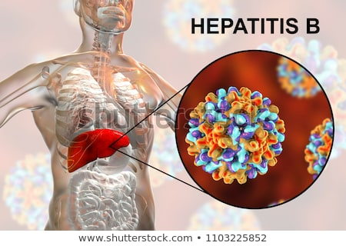
HEPATITIS B
Prof DR. Waqar Al – Kubaisy
12 Dec.. 2022

Slide 3
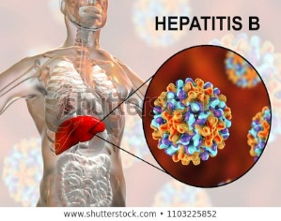
HEPATITIS B
Hepatitis B (formerly known as "serum" hepatitis
Hepatitis B is a global public health threat and the world’s most common serious liver infection.
It is up to 100 times more infectious than the HIV/AIDS virus.
It also is the primary cause of liver cancer (also known as
hepatocellular carcinoma or HCC), which is the second-leading cause of cancer deaths in the world.
It is a major global health problem, & the most serious type of viral hepatitis.
However, it can be prevented by currently available
safe and effective vaccine.
Clinically it is characterized by variety of outcomes.
Usually, it is an acute self-limiting infection, which may be either
Subclinical or Symptomatic.
Roughly 70 %of an acute HBV infection have symptoms

Slide 4
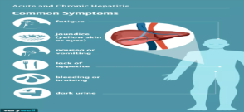
Cont.… HEPATITIS B
Chronic HBV infection.
around 5% of adults,
30 % of children, and roughly
95% of early childhood and infants
exposed at birth
These people are considered carriers since the virus remains in their blood
In approximately 5 to 15 % of cases, HBV infection fails
to resolve and become persistent carriers of the virus
Persistent HBV infection may cause progressive liver disease including chronic active hepatitis and HCC.
HBV can form a dangerous alliance with Delta Virus and
produce a new form of virulent hepatitis which is considered to be a widespread threat for much of the world.
will not clear the virus and will develop a chronic HBV infection

Slide 5
Geographical Distribution
Hepatitis B is a major global health problem, and
the most serious type of viral hepatitis.
More than 2 Billion people WW have evidence(one out of three people) of past or current HBV infection and
Approximately 1.5 million people become newly infected each year
Almost 300 million people are chronically infected
Approximately 10% of infected individuals are diagnosed
Approximately two people die each minute from hepatitis B
HBV is the leading cause of liver cirrhosis & HCC WW
The virus causes 60-80% of all primary liver cancer.
Between 5-15 % of adults, and
up to 95 %of infants infected
. Among these,
25%, in the long term, develop serious liver disease
About1/2million deaths/year are due to advanced chronic hepatitis, and
340000 are due to (HCC
with HBV
become carriers

Slide 6
Cont. …Geographical Distribution
The burden of hepatitis B infection is highest in the
WHO Western Pacific Region(116 million )
WHO African Region, (81 million) people, are chronically infected.
WHO Eastern Mediterranean Region Sixty million people are infected WHO South-East Asia Region, 18 million
WHO European Region 14 million and
WHO Region of the Americas 5 million
Hepatitis B is Endemic throughout the world, especially in
Tropical& Developing countries &also in some regions of Europe
Its prevalence varies from country to country and
depends upon a complex mix of Behavioural, Environmental
and Host Factors
In general it is lowest in countries or areas with high standards of living.
The HBV infection is a global problem, with 66 %of all the world's population living in areas where there are high levels of infection
Based on HBsAg carrier rates, countries categorized into 3groups

Slide 7
Geographical Distribution
Based on HBsAg carrier rates, countries categorized into 3groups
High Endemicity (≥ 8 %),
Intermediate (2-8 %), and
Low Endemicity ( < 2 %).
Hepatitis B is endemic in China and other parts of Asia.
In these regions most people become infected in childhood and
8-10% of the adult population are chronically infected.
In the Middle East an estimated 2-5% of the general population is chronically infected.
In Western Europe and North America <1% population is infected
In Jordan The national prevalence of HBV is estimated to be around 2.4% ( 2017)and has declined from 9.9% (1985) in the pre-vaccination era.

Slide 8
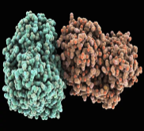
Epidemiological determinants
Agent factors
(a) Hepatitis B virus was discovered in 1963.
The virus is highly contagious
In highly endemic areas, hepatitis B is most commonly spread
through vertical, from mother to child at birth (perinatal transmission) or
through horizontal transmission (exposure to infected blood) especially from an infected child to an uninfected child during the first 5 years of life.
The development of chronic infection is common in infants infected from their mothers or before the age of 5 years.
transmitted also through contact with the blood
or other body fluids of an infected person.

Slide 9
HBV has three distinct antigens (Ags)stimulating the
production of three corresponding Abs
Surface Ag "Australia Ag"{HBsAg) surface Abs(anti-HBs
Core Ag {HBcAg), core Abs (anti-HBc )and
"e" Ag (HBeAg). "e" Abs (anti-HBe).
Agent factors
These Abs and their Ags constitute very useful markers of HBV infection.
Pts with HBV infection are expected to haveone or more HBV markers
(b) Reservoir of Infection :
Man is the only reservoir of infection ;either carriers or cases.
continued infection is due to the large number of the carriers
The Persistent Carrier state has been defined as the presence
of HBsAg (with or without concurrent HBeAg) for more than 6 months
Cases may range from unapparent to symptomatic cases.

Slide 10
(c) Infective Material:
Contaminated blood is the main source of infection,
the virus has been found in body secretions such as saliva, vaginal secretions and semen of infected persons.
d) Resistance :
HBV is quite stable and
capable of surviving for at least 7 days on environmental' surfaces. It is an important occupational hazard for HCWs
It can be readily destroyed by sodium hypochlorite,
by heat sterilization in an autoclave for 30 -60 minutes
(e) Period of Communicability :
HBV is present in the blood during the
incubation period (for a month before jaundice) and
acute phase of the disease.
Period of communicability is usually several months
{occasionally years in chronic carriers) or
until disappearance of HBsAg and appearance of surface Abs
Agent factors

Slide 11
Host factors
(a)AGE :
The outcomes of HBV infection are age dependent.
Acute HBV occurs in approximately
1 %of perinatal, 10 %of early childhood (1-5 years of age) and
30 %of late (> 5 years age) HBV infections.
Mortality from fulminant HB is approximately 70 %
The development of Chronic HBV infection is inversely related to age and occurs in approximately
95 % of persons infected perinatally,
in 30 % infected in childhood (<6 years of age)
in 5 % infected a≥ 6 years of age

Slide 12
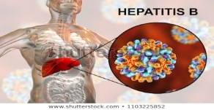
Cont. …Host factors
(
(b) High-risk Groups :
Certain groups carry higher risks.
Health care workers and Laboratory personnel,
Annual incidence of HBV infection in surgeons is estimated to be
50 times greater than that in the general population, and
more than twice that of other physicians.
Recipients of blood transfusions,
Homosexuals, Prostitutes, Percutaneous drug abusers,
Infants of HBV carrier mothers,
Recipients of solid organ transplants and
Patients who are immuno compromised.
Serological screening & vaccination of high-risk groups is highly recommended

Slide 13
.
(c) Hepatitis B and HIV Infection:
About 1% HBV pts (2.7 million) are also infected with HIV.
Conversely, WW the
Globally prevalence of HBV in HIV-infected persons is 7.4%.
Although HBV infection have a minimal effect on the progression of HIV,
HIV markedly increases the risk of developing HBV-associated liver cirrhosis &HCC
mortality rate increases among HIV-+ve due to HBV co infection
Cont. …Host factors
Incubation Period
30 - 180 days.
Lower doses of the virus result often in longer IP.
average IP is about 75 days

Slide 14
DIAGNOSIS
It is not possible, on clinical grounds, to differentiate HB from other viral hepatitis
Laboratory BL tests for confirmation of the diagnosis is essential
They can be used to distinguish acute and chronic infections.
Laboratory diagnosis of HBV infection focuses on the
detection of the (HBs Ag).
Acute HBV infection
is characterized by the presence of HBsAg and IgM antibody to the, HBcAg.
During the initial phase of infection, patients are also seropositive for HBeAg.
HBeAg is a marker of high levels of replication of the virus.
The presence of HBeAg indicates that the patient’s blood
and body fluids are HIGHLY INFECTIOUS.
These Abs and their Ags constitute very useful markers of HBV infection.
Pts with HBV infection are expected to have one or more HBV markers.

Slide 15
There are three distinct antigen antibody systems that relate to HBV infection and a variety of circulating makers that are useful in diagnosis. Interpretation of common serological patterns is as shown in Table below
Low levels of lgM anti-HBc may also be detected.

Slide 16
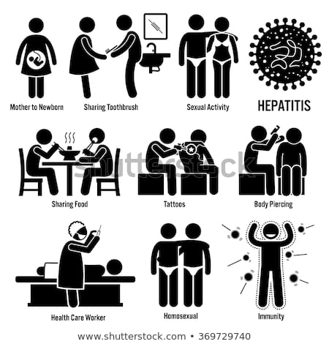
Chronic infection is characterized by the
persistence of HBsAg for at least 6 months (with or without HBeAg).
Persistence of HBs Ag is the principal marker of risk for
Developing chronic liver disease and liver cancer (HCC) later in life.
Modes Of Transmission
HBV is spread by percutaneous or mucosal
Exposure to infected blood and
various body fluids, (saliva, menstrual, vaginal, & seminal fluids.
a. Parenteral route
Hepatitis B is a blood-borne infection.
It is transmitted by infected Bl and Bl. products through
transfusions dialysis, contaminated syringes and needles,
pricks of skin, handling of infected blood,
accidental inoculation of minute quantities of blood such as may
occur during surgical and dental procedures, immunization, tattooing,
ear piercing, nose piercing, circumcision, acupuncture, etc .
also occur through the reuse of needles and syringes either
in health-care settings or among persons who inject drugs
Accidental percutaneous inoculations by shared razors &tooth brushes

Slide 17
Cont.…Modes Of Transmission
b. Perinatal transmission
Spread of infection from HBV carrier mothers to their babies
In highly endemic areas, HBV is most commonly spread from mother to child at birth (perinatal transmission),or through horizontal transmission especially from an infected child to an uninfected child during the first 5 years of life.
The development of chronic infection is very common
in infants infected from their mothers or before the age of 5 years appears to be an important factor for the high prevalence of HBV infection in some regions, particularly China and Southeast Asia
Majority of children born to HBeAg+Ve mothers become chronically infected.

Slide 18
The mechanism of perinatal infection is uncertain.
Although HBV can infect the foetus in utero, this rarely happens
and most infections appear to occur at birth, as a result of a
leak of maternal blood into the baby's circulation, or
ingestion or accidental inoculation of blood .
Infection of the baby is usually anicteric and is recognized by
The appearance of surface antigen (HBsAg) between 60-120 days after birth
c. Sexual transmission
There is ample evidence for the spread of infection by sexual route.
The sexually promiscuous, particularly
male homosexuals, are at very high risk of infection with HBV.
Heterosexual persons with multiple sex partners or
contact with sex workers

Slide 19
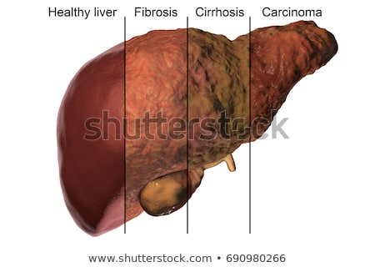
Cont. ..Modes Of Transmission
d. Other routes
Transmission from child-to-child, often called horizontal transmission, is responsible for a majority of HBV infections and carriers in parts of the world other than Asia. The spread occurs through physical contact between children
In addition, infection can occur during medical, surgical and dental procedures,
through tattooing, or through the use of razors and similar objects that are contaminated with infected blood.
HB is an important occupational hazard for HCWs
In short, transmission occurs in a wide variety of epidemiological settings.
It can spread either from carriers or
from people with no apparent infection, or
during the incubation period, illness or
early convalescence.

Slide 20
Who is at risk for chronic disease?
The probability of HBV to becomes chronic depends upon the age at which a person becomes infected.
Children <6 years of age who become HBV infected are the most likely to develop chronic infections.
In infants and children:
80–95% of infants infected during the first year of life develop chronic HBV
30–50% of children infected before the age of 6 years develop chronic HBV
In adults:
<5% who are infected as adults will develop chronic infection and
20–30% of chronically infected adults will develop cirrhosis and/or liver cancer

Slide 21
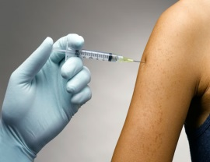
Prevention and Containment
SINCE THERE IS NO SPECIFIC TREATMENT,
Prevention has been the major aim in managing HBV.
HB is preventable with currently available safe and effective vaccines.
WHO strongly recommends that all regions and countries develop
goals for HBV control appropriate to their epidemiological situation.
The following measures are available : .
a. Hepatitis B Vaccine
The recombinant hepatitis B vaccine was introduced in 1986.
The active substance in hepatitis B vaccine is HBsAg
The vaccine is 95% effective in preventing infection and
prevent the development of chronic disease and HCC due toHBV.
Adults dose of 10-20 micrograms initially and again at 1 and 6 months.(0 ,1, 6 month)
Children age <10 years half of the adult dose at the same time intervals.
Deltoid muscle is preferred for injection

Slide 22
Deltoid muscle is preferred for injection
For infants & children under 2 years, anterolateral aspect of thigh is used.
Intradermal administration is NOT recommended because the immune response is less reliable particularly in children
HB vaccine does not interfere with immune response to any other vaccine & vice-versa.
The birth dose of H B vaccine can be given safely together with BCG
However, the vaccines should be given at different sites
The vaccine should be stored at 2-8°C. Freezing must be avoided
There are multiple options for incorporating (combine)the HB vaccine into national immunization programmes.
The choice of schedule depends on the local epidemiological situation and programme considerations.
The recommended schedule for vaccination categorized into those

Slide 23
Hepatitis B Vaccine Cont.
The recommended schedule for vaccination categorized into those:
a birth-dose and
those that do not.
Schedules with a birth-dose
In countries with a high perinatal HBV infection, specifically where
the prevalence of chronic HBV infection in the general population is >8 %,
First dose of HB vaccine should be given within 24 hrs after birth to prevent perinatal
WHO recommends that all infants should receive their first dose of vaccine as soon as possible after birth, preferably within 24 hours.
Birth (first) dose and followed by
2nd , 3rd or 4th doses to complete the primary series.
usually given with other routine infant vaccines
minimum recommended interval between the doses is four weeks
WHO does not recommend a booster dose of HB vaccine

Slide 24
WHO does not recommend a booster dose of HB vaccine.
Protection lasts at least 20 years, and is possibly life-long
The low incidence of chronic HBV infection in children under 5 years of age at present can be attributed to the widespread use
of HB vaccine
low or intermediate endemicity. (Immunization in adults )
In those settings Routine pre-exposure vaccination should be
considered for groups of adults high-risk groups They include:
People who frequently require blood or blood products, dialysis patients, recipients of solid organ transplantations;
People interned in prisons;
Persons who inject drugs;
household and sexual contacts of people with chronic HBV infection;
People with multiple sexual partners
Healthcare workers and others who may be exposed to blood and blood products through their work; and
travellers who

Slide 25
Cont….low or intermediate endemicity.
travellers who have not completed their HB vaccination series,
before leaving for endemic areas
Adults age ≥20 years should receive 1 ml of adult formulation.
usual schedule for adults is two doses separated by no less than 4 weeks, and a third dose 4 to 6 months after the second dose
All children and adolescents younger than 18 years-old and
not previously vaccinated should receive the vaccine if they live in countries where there is low or intermediate endemicity
Hepatitis B immunoglobulin (HBIG)
For immediate protection, HBIG is used for those acutely
exposed to HBsAg-positive blood, for example
surgeons, nurses or laboratory workers
(b) New born infants of carrier mothers
(c) sexual contacts of acute hepatitis B patients, and
(d) patients who need protection against HBV infection after liver transplantation.
The HBIG should be given

Slide 26
Cont. …Hepatitis B immunoglobulin (HBIG)
The HBIG should be given as soon as possible after an accidental inoculation (ideally within 6 hours and preferably not later than 48 hours).
At the same time the victim's blood is drawn for HBsAg testing.
If the test is negative, vaccination should be started immediately
and a full course given.
If the test is positive for surface antibody, no further action is needed
Recommended dose is 0.05 to 0.07 ml/kg of body weight.
Two doses should be given 30 days apart .
HBIG provides short-term passive protection approximately 3 months.
Passive-active immunization .
The administration of HBIG and HB vaccine is more efficacious than HBIG alone.
HBIG does not interfere with the antibody response to the HB vaccine.
This combined procedure is ideal, both for
prophylaxis of persons accidentally exposed to blood known to contain HBV , and
prevention of the carrier state in the new-born babies of carrier mothers.
HBIG (0.05-0.07 ml/kg)

Slide 27
Cont. … Passive-active immunization .
HBIG (0.05-0.07 ml/kg) should be given ASAP and within 24 hours, if possible.
HB vaccine 1.0 ml (20 mcg/1.0 ml) should be given IM within 7 days of exposure, and
2nd &3rd doses should be given one and six months, respectively, after the first dose.
d. Other Measures
implementation of blood safety strategies, including
screening of all donated blood and blood components
used for transfusion, can prevent transmission of HBV. Worldwide,
All blood donors should be screened for HBV infection,
and those positive for HBsAg should be rejected.
Voluntary blood donation should be encouraged because purchased blood has shown a higher risk of post-transfusion hepatitis .
Safe injection practices,
Unsafe injections decreased from 39% in 2000 to 5% in 2010
. Furthermore, safer sex practices, including minimizing the number of partners and using barrier protective measures
Health personnel should be alerted to the importance of adequate sterilization of all instruments and to the practice of simple hygienic measures.
HB Carriers should be told not to share razors or tooth brushes and use barrier methods of contraception; they should not donate blood

Slide 28
Serological testing in vaccine recipients
Pre-vaccination serological testing:
It is recommended for
ALL persons born in Africa, Asia, the Pacific Islands, and other regions with HBsAg prevalence of ≥2%
Household, sex and needle sharing contacts of HBsAg-positive persons
Homosexuals;
Injecting drug users;
Certain persons receiving cytotoxic or immunosuppressive therapy.
is not indicated before routine vaccination of infants and children
Post vaccination serological testing
It is recommended for
chronic haemodialysis patients
Immunocompromised
persons with HIV
sex partners of HBsAg+
infants of HBsAg+ women certain HCWs
Not routinely recommended following vaccination of infants, children, adolescents, or most adults.

Slide 29
Qs ???
Qs ???

Slide 30
Hepatitis B In Jordan by Health District Year:2000-2014
ear | 2000 | 2001 | 2002 | 2003 | 2004 | 2005 | 2006 | 2007 | 2008 | 2009 | 2010 | 2011 | 2012 | 2013 | 2014
Capital Directorate | 2 | 15 | 4 | 3 | 5 | 2 | 3 | 3 | 2 | 0 | 0 | 0 | 1 | 0 | 0
Madaba Directorate | 2 | 4 | 1 | 1 | 1 | 0 | 2 | 0 | 0 | 0 | 1 | 0 | 0 | 0 | 0
Balqa Directorate | 0 | 3 | 1 | 3 | 1 | 2 | 4 | 0 | 2 | 2 | 0 | 1 | 0 | 0 | 1
Ramtha Directorate | 0 | 0 | 0 | 0 | 1 | 4 | 1 | 3 | 0 | 0 | 0 | 0 | 0 | 0 | 0
Ma'an Directorate | 0 | 0 | 2 | 1 | 1 | 0 | 1 | 0 | 0 | 0 | 0 | 0 | 0 | 0 | 0
Deir Alla Directorate | 0 | 3 | 0 | 1 | 0 | 3 | 0 | 1 | 1 | 1 | 1 | 0 | 0 | 0 | 0
Agwar Shamaliyah Directorate | 1 | 3 | 4 | 4 | 4 | 3 | 6 | 0 | 0 | 1 | 1 | 0 | 0 | 0 | 0
Tafeileh Directorate | 3 | 4 | 2 | 6 | 3 | 0 | 1 | 0 | 1 | 0 | 0 | 0 | 0 | 0 | 0
Bani Kenaneh Directorate | 0 | 0 | 0 | 0 | 1 | 0 | 0 | 0 | 1 | 0 | 0 | 0 | 0 | 0 | 0
Badia Shamaliyah Directorate | 0 | 1 | 0 | 0 | 2 | 0 | 0 | 0 | 0 | 0 | 0 | 0 | 0 | 0 | 0
Irbid Directorate | 8 | 21 | 23 | 12 | 0 | 1 | 1 | 0 | 1 | 0 | 0 | 1 | 0 | 0 | 0
Ajloun Directorate | 0 | 1 | 0 | 0 | 1 | 0 | 2 | 0 | 0 | 0 | 1 | 1 | 0 | 0 | 0
Mafraq Directorate | 0 | 0 | 2 | 0 | 0 | 0 | 0 | 0 | 0 | 0 | 0 | 0 | 0 | 0 | 0
Karak Directorate | 2 | 3 | 0 | 0 | 0 | 0 | 0 | 0 | 0 | 0 | 0 | 0 | 0 | 0 | 0
East Amman Directorate | 1 | 0 | 2 | 1 | 1 | 0 | 0 | 0 | 0 | 0 | 0 | 0 | 0 | 0 | 0
Shounah Janoobiyah Directorate | 2 | 2 | 3 | 0 | 0 | 4 | 0 | 2 | 0 | 0 | 0 | 0 | 0 | 0 | 0
Koura Directorate | 0 | 0 | 0 | 0 | 2 | 0 | 0 | 1 | 0 | 0 | 0 | 0 | 0 | 0 | 0
Zarqa Directorate | 16 | 11 | 11 | 10 | 2 | 4 | 4 | 2 | 0 | 0 | 0 | 2 | 1 | 0 | 0
Aqaba Directorate | 0 | 0 | 0 | 0 | 1 | 0 | 0 | 1 | 3 | 1 | 0 | 0 | 0 | 0 | 0
Jerash Directorate | 2 | 0 | 1 | 3 | 2 | 9 | 0 | 2 | 2 | 0 | 0 | 0 | 0 | 0 | 0
Agwar Janoobiyah Directorate | - | - | - | - | - | - | 0 | 0 | 0 | 0 | 0 | 0 | 0 | 0 | 0
Total | 39 | 71 | 56 | 45 | 28 | 32 | 25 | 15 | 13 | 5 | 4 | 5 | 2 | 0 | 1

