Slide 1
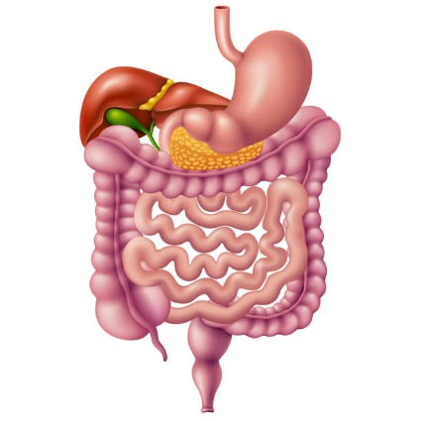
GIT Module 2020-2021 Parasitic Infections of the GIT (3) (B. coli, G. lamblia & Cryptosporidium)
Dr. Mohammad Odaibat
Department of Microbiology and Pathology
Faculty of Medicine, Mu’tah University

Slide 2
Parasites
Protozoa
Helminths
Pseudopodia
Amoebae
Single celled organisms
Flagellates
Flagella
Classification based
on motility
Ciliates
Cilia
Sporozoa
(coccidia)
Non-motile
Obligatory intracellular

Slide 3
Intestinal protozoa
Amoebae
Ciliates
Flagellates
Sporozoa
(coccidia)
Entamoeba histolytica
Balantidium coli
Cryptosporidium
Giardia lamblia

Slide 4
Ciliates
General characters
1- Move by cilia.
2- Multiply asexually by transverse binary fission and sexually by conjugation between two organisms.
3- Contain 2 compact nuclei: A large kidney shaped nucleus (macronucleus) and a small one (micronucleus).
4- Form cyst.
5- Balantidium coli is the only member of the ciliates known to be pathogenic to human.

Slide 5
Balantidium coli
The largest protozoa
Geographical distribution: Cosmopolitan especially in pig raising countries.
Habitat: Large intestine (caeum & rectosegmoid region).
D.H: Man.
R.H: Pigs and rats.

Slide 6
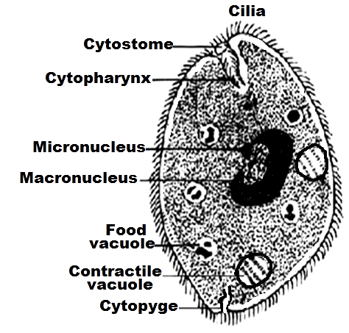
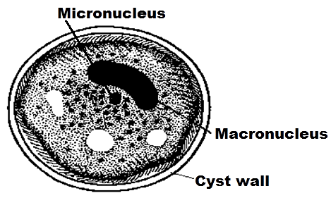
Morphological characters
1- Trophozoite stage
2- Cyst (I.S)

Slide 7
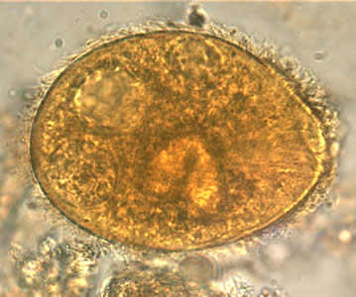
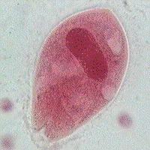
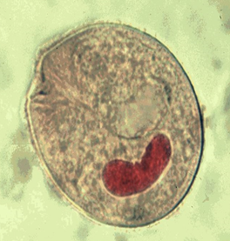
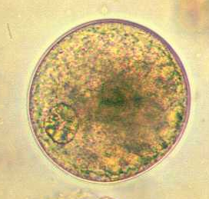
B. coli trophozoite
B. coli trophozoite
B. coli trophozoite
B. Coli cyst

Slide 8
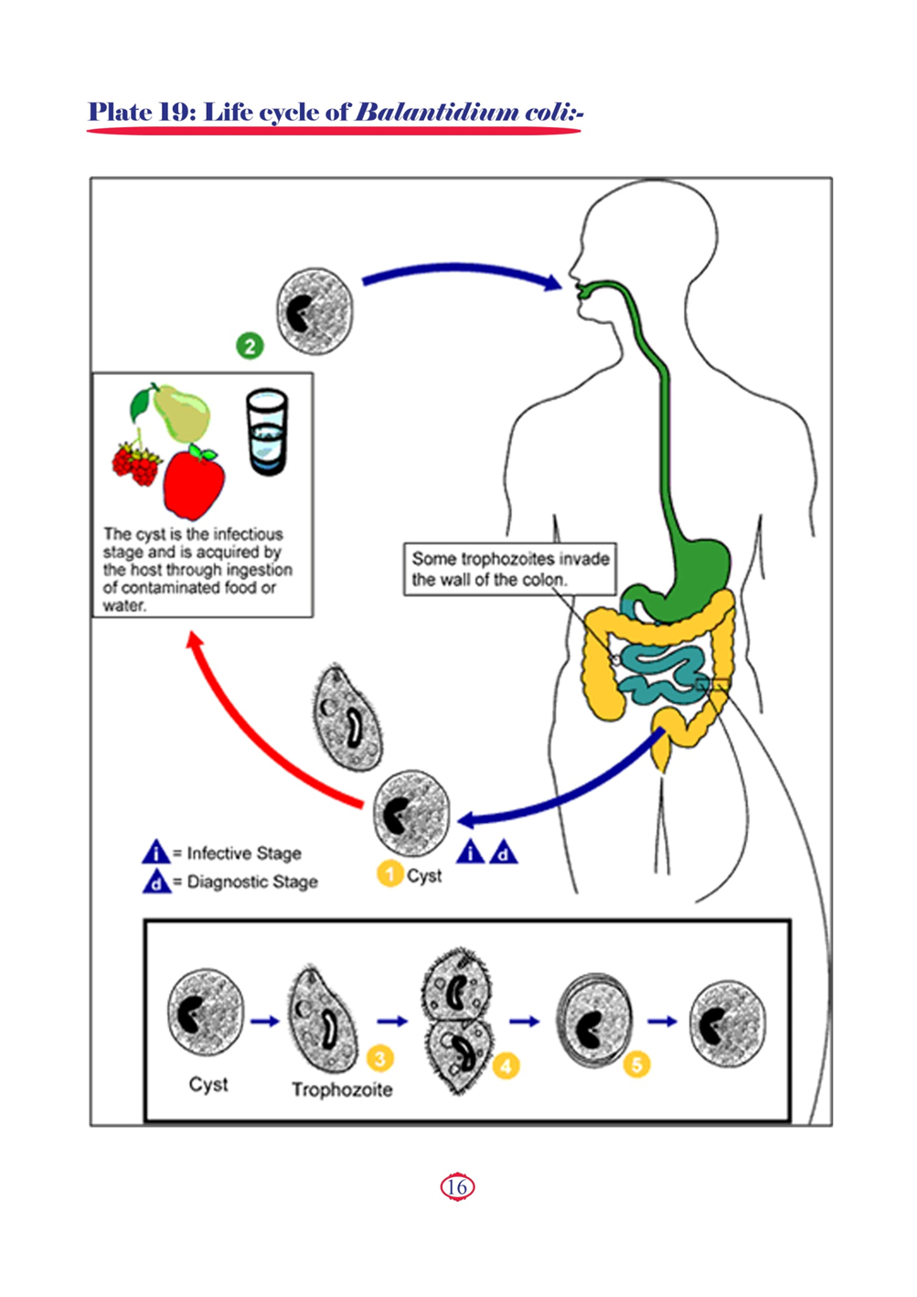
Balantidium coli life cycle

Slide 9
Balantidium coli
Mode of transmission
1- Ingestion of food or drink contaminated with mature cyst directly or indirectly by flies.
2- Handling food by infected food handlers as cookers and waiters.
3- Autoinfection (hand to mouth infection).

Slide 10
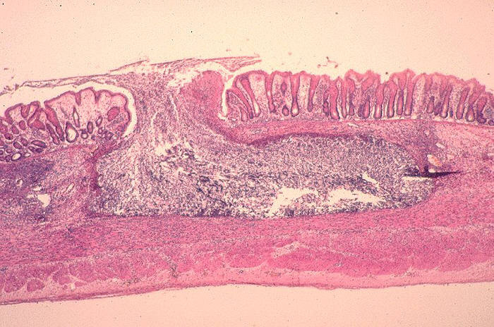
Pathogenesis and symptomatology
Disease: Balantidiasis or balantidial dysentery
In heavy infection, the mucosa and submucosa of the large intestine are invaded and destroyed by the multiplying organisms. This is helped by the boring action of the cilia and the proteolytic secretion ⮊ the formation of small abscesses that leads to flask shaped ulcers with red undermined edges.
Infection is severe in immunocompromised patients

Slide 11
Clinical pictures
1-Asymptomatic infection
2-Symptomatic infection
Complication
Haemorrhage
Appendicitis.
Intestinal perforation & peritonitis.
Most common , trophozoites remain in the intestinal lumen feeding as a commensal without tissue invasion (Asymptomatic patient known as a healthy carrier and cyst carrier)
Acute balantidial dysentery
Chronic infection
Fever, abdominal pain, tenderness, tenesmus & frequent motions of loose stool containing mucus, blood and trophozoites.
low grade fever, recurrent episodes of
diarrhea alternates with constipation. Only cysts are found in stool

Slide 12
Laboratory diagnosis
a) Direct
b) Indirect
Macroscopic: Offensive loose stool mixed with mucus and blood.
Microscopic:
1-Stool examination: Reveals either trophozoites (in loose stool) or cysts (in formed stool) by direct smear, iodine stained.
2-Sigmoidoscopy:To see the ulcer or the trophozoites in aspirate or biopsy of the ulcer.
3-X-ray after barium enema: to see the ulcer, deformities or stricture.
-Serological tests: CFT, IHAT, IFAT, ELISA and GDPT (gel-diffusion precipitin test).
✍N.B. These serological tests are positive only in case of invasion to intestinal mucosa but negative in asymptomatic carriers.

Slide 13
Treatment
1- Tetracycline.
2- Metronidazole (Flagyl).
Flagellates
General characters
1- Move by one flagellum or multiple flagella.
2- Multiply by longitudinal binary fission.
3- Vesicular nucleus with central karyosome.
4- Some species have a cytostome (mouth).

Slide 14
Giardia lamblia
Geographical distribution: Cosmopolitan especially tropical and subtropical regions.
Habitat: In the small intestine mainly the crypts of the duodenum and occasionally in the common bile duct and gall bladder.
D.H: Man.
G. lamblia one of the opportunistic protozoa.

Slide 15
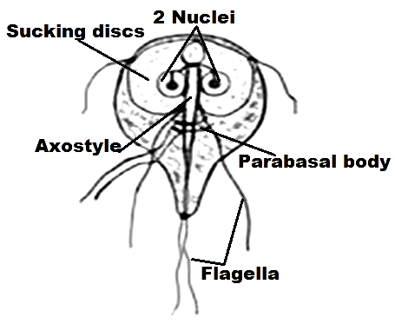
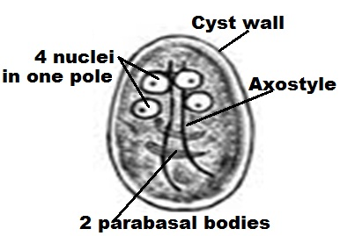
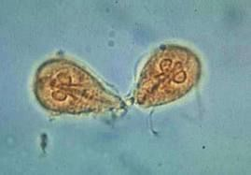
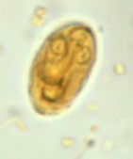
Morphological characters
1-Trophozoite stage
2- Cyst (I.S)

Slide 16
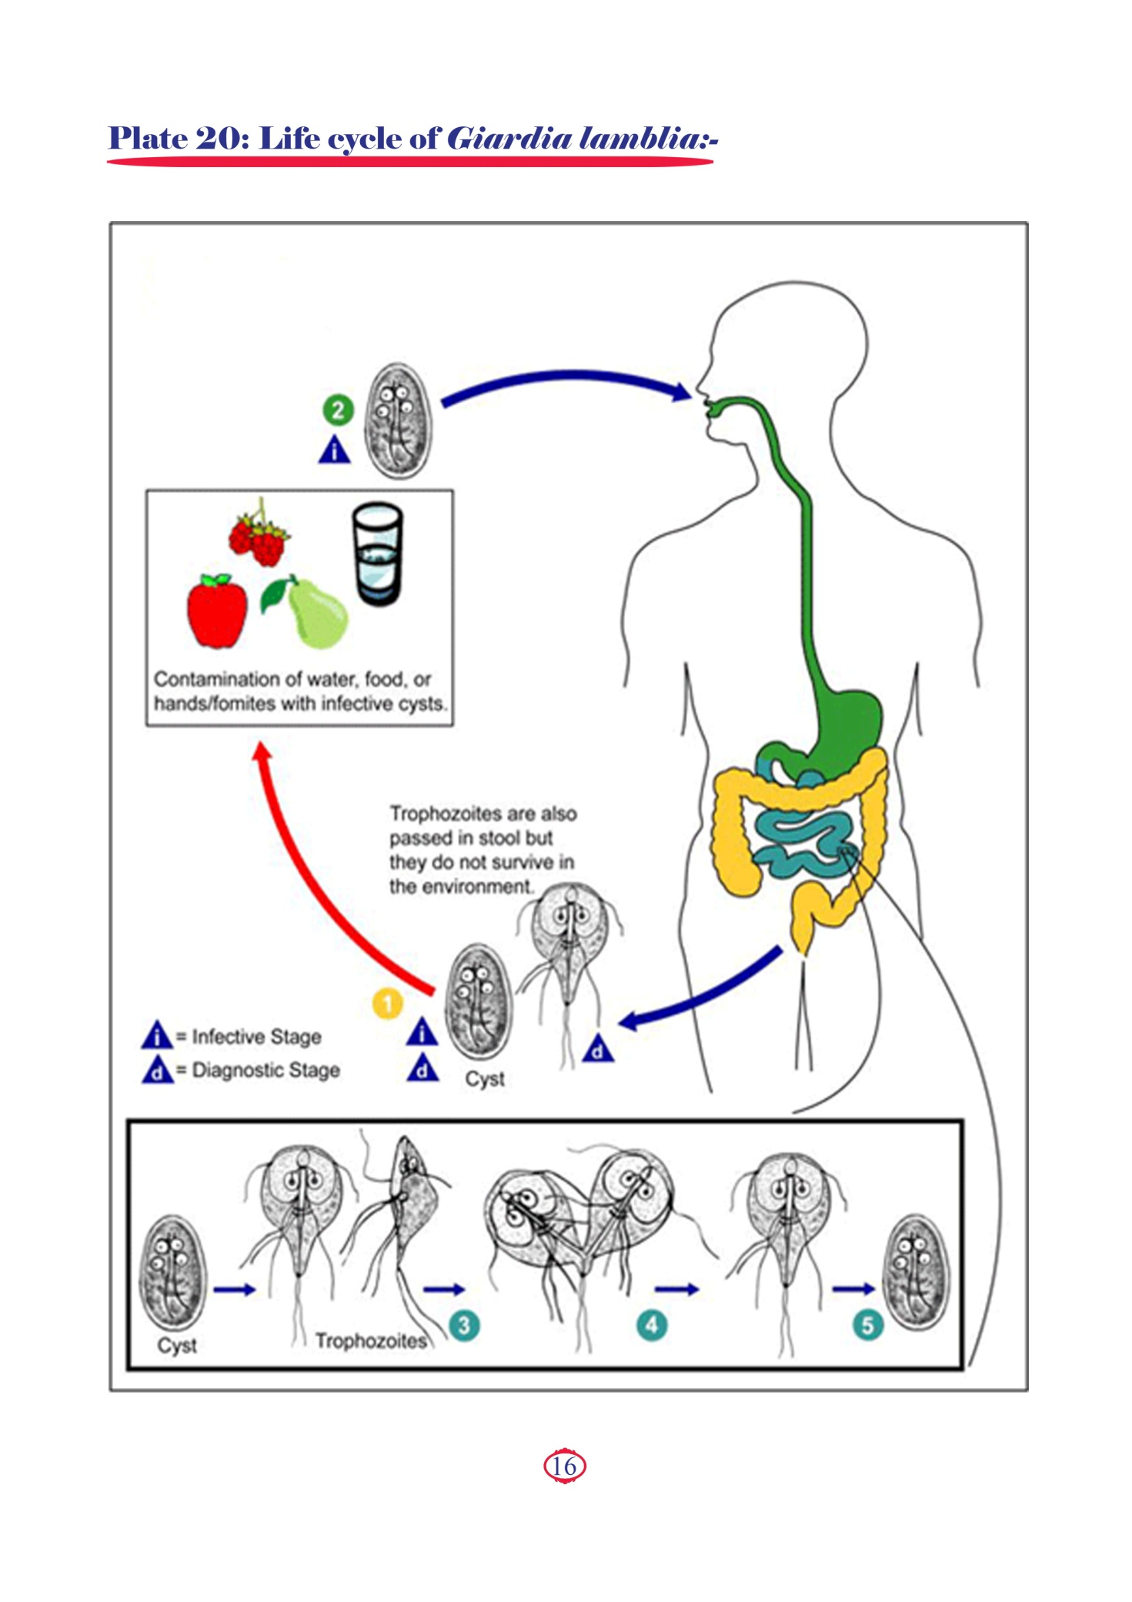

Slide 17
Mode of transmission
1- Ingestion of food or drink contaminated with mature cyst directly or indirectly by house flies.
2- Handling food by infected food handlers as cookers and waiters.
3- Autoinfection (hand to mouth infection).

Slide 18
Pathogenesis and symptomatology
Disease: Giardiasis
Predisposing factors for the development of infection with G. lamblia
Hypogammaglobulinaemia.
Low level of secretory IgA in the gut.
Achlorhydria (decreased Hcl).
Malnutrition.

Slide 19
The pathogenesis of G. lamblia infection depends on the following factors:
a) Mucosal factors
b) Luminal factors
Direct attachment of the trophozoites to the duodenal mucosa leads to:
- Atrophy of duodenal microvilli and hyperplasia of the crypts ⮊malabsorption syndrome for:
Lactose ⮊ lactose intolerance.
Glucose and amino acids.
Fat ⮊ steatorrhea (light coloured fatty stool ).
Fat soluble vitamins (A,D,E,K) and vitamin B12.
Infection with Giardia lamblia infection leads to:
1- Bacterial overgrowth ⮊ mucosal damage and bile salts deconjugation ⮊
impaired absorption of fat ⮊ steatorrhoea
2- Decrease luminal bile salts: Due to the uptake of bile salts by Giardia lamblia trophozoite during its growth ⮊ impaired absorption of fat and fat soluble vitamins and also vitamin B12.
3- Inhibition of digestive enzymes such as lipase and trypsin ⮊ maldigestion

Slide 20
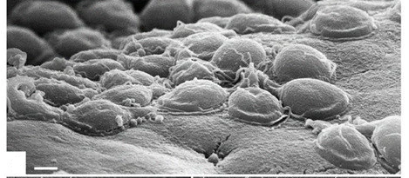
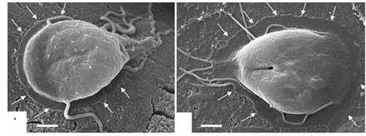
T
T
Trophozoites (T) attaching to the intestinal surface of
an experimentally infected mouse.
Higher magnification view of a trophozoite attaching to the mouse and to human intestinal surface cells

Slide 21
Clinical pictures
1-Asymptomatic infection
2-Symptomatic infection
Most common.
The trophozoites remain in the intestinal lumen feeding on surrounding nutrients and mucus without causing manifestations (Asymptomatic patient known as a healthy carrier).
Acute giardiasis
Chronic giardiasis
complications
Common in children and travelers to endemic areas.
Fever, abdominal colic, epigastric pain, anorexia, flatulence, vomiting, watery diarrhoea with excess mucus (no blood) but later steatorrhoea occurs⮊ dehydration and loss of weight. Trophozoites are found in the stool in this case.
Invasion to gall bladder ⮊ cholycystitis, jaundice and biliary colics.
In immunocompetent patient, giardiasis is self limiting.
In immunodeficient patient, IgA secreation in the gut is decreased ⮊ severe infection with persistent diarrhea, steatorrhoea, malabsorption syndrome and weight loss.

Slide 22
2-Symptomatic infection
Acute giardiasis
Chronic giardiasis
Complications
- Common in adults.
-The patient suffers from anorexia, epigastric pain, dyspepsia, nausea, vomiting & diarrhea alternating with constipation. Only cysts are found in stool.
1- Retardation of growth & development in infant and young children.
2- Malnutrition and malabsorption syndrome.
3- Biliary tract disease.

Slide 23
Laboratory diagnosis
Direct methods
Indirect methods
Macroscopic
Microscopic
Stool is bulky, offensive, loose and greasy mixed with mucus and usually float on the water surface in toilet.
1) Stool examination: Reveals either trophozoites (in loose stool) or cysts (in formed stool) by: direct smear or concentration methods.
2) Endoscopic biopsy from duodenum for trophozoites & pathological changes in mucosa.
-Serological tests.
-Faecal antigen ELISA: Immunologic test for detection of G. lamblia antigen in the stool. It is a sensitive & specific test.
-PCR: For detection of DNA of G. lamblia

Slide 24
Treatment
1- Metronidazole (Flagyl).
2-Nitazoxanide
Coccidia
General characters
1- Single-celled obligate intracellular parasites.
2- Multiply by alternation of sexual and asexual cycle either in the same host or two different hosts.
3- They are opportunistic parasites that common affected immunosuppressed persons.

Slide 25
Cryptosporidium
Geographical distribution: Cosmopolitan especially among immunosuppressed patients.
D.H & I.H: Man
R.H: Domestic animals such as cattle, sheep, goats & dogs.
Habitat:
Mainly in the brush border of the small & large intestine.
In the epithelium of the respiratory and biliary tracts
(in immunocompromised individuals).
Cryptosporidium species are:
1- C. parvum. 2- C. muris. 3- C. bovis.

Slide 26
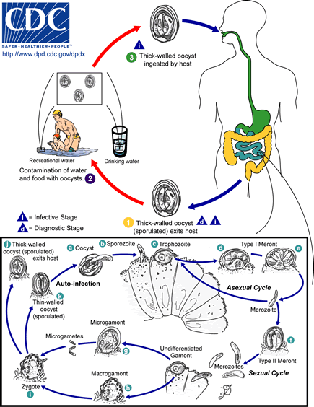

Slide 27
Mode of transmission
Contamination of food or drink with mature oocyst either directly by stool of patient or animal or indirectly by house fly.
Handling food by infected food handlers as cookers and waiters.
Autoinfection both external (hand to mouth infection) & internal.
Inhalation of oocysts.

Slide 28
Pathogenesis and symptomatology
Disease: Cryptosporidiosis
The parasite is located in the brush border of the epithelial cells of the small intestine (intracellular but extracytoplasmic) ⮊ damage to the microvilli where it attaches.
In immunocompenent patient
In immunocompromised patient
Acute self limited watery diarrhoea that can last for a few weeks with abdominal cramps, low fever, nausea, vomiting, malabsorption and dehydration.
The disease is more severe with cholera like diarrhea ⮊ severe malabsorption and weight loss. The diarrhea is chronic and last for 2 months or more.

Slide 29
Laboratory diagnosis
Direct
Indirect
Stool examination for detection of oocysts by:
Direct smear.
Concentration floatation methods.
Smear stained with modified Ziehl-Neelsen stain or acid fast stain.
Intestinal biopsy stained with hematoxylin and eosin for detection of oocysts attached to the brush border.
Serological tests: For detection of antibodies.
Antigen detection in the stool by using: DFAT, ELIZA, IFAT.
PCR.
For biliary cryptosporidiosis: Ultrasonography and endoscopy.

Slide 30
Treatment
For immunocompetent patient
For immunocompromised patient
Spiramycin.
In case of pulmonary cryptosporidiosis ⮊ Azithromycin + Paromomycin.
In case of biliary cryptosporidiosis ⮊ Biliary drainage.
Supported treatment: Fluid + antidiarrhoeal treatment ⮊ ends with spontaneous recovery.
Drugs: Nitazoxanide and Spiramycin

Slide 31
THANK YOU

Slide 32
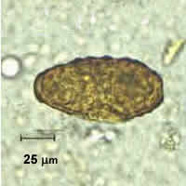
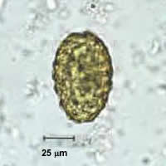
Case Studies
Case 1
A 3-year-old girl was seen in a small rural clinics with complaints of abdominal pain and upset stomach. A local laboratory performed a routine stool examination and observed the objects shown in the images. The laboratory suspected the objects were artifacts. A portion of the stool concentrate was sent to a reference laboratory for confirmation that parasite cysts or eggs were not present.
What is your diagnosis?

Slide 33
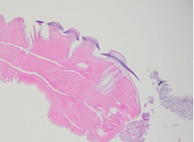
Case Studies
Case 2
A 69-year-old male was undergoing a routine colonoscopy performed as a screen for colorectal cancer. The patient was asymptomatic and a stool ova and parasite examination (O & P) performed prior to the procedure was negative. However, the gastroenterologist recovered a worm from the ascending colon during the procedure and sent it to the pathology laboratory for identification. Figures show what was observed on hematoxylin and eosin (H & E) stained slides. Eggs seen inside the worm measured 50 x 25 micrometers on average.
What is your diagnosis?
Based on what morphologic features.

Slide 34
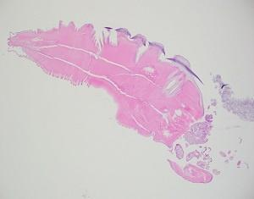
Case Studies
Case 2

Slide 35
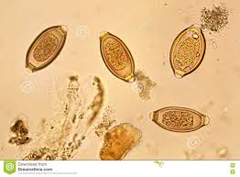
Case Studies
Case 3
A 545 year old male was referred to the gastroenterology clinic with complaints of epigastric pain, diarrhea and unintentional weight loss over the past couple of weeks. Travel history was significant for a recent mission trip to rural areas of the Philippines. About a month after his return, he developed epigastric pain and clinically significant diarrhea, with anywhere from 2-8 bowel movements per day. Testing for blood counts, hepatitis and HIV was performed and stool was collected for culture and ova & parasite exam (O&P). He also underwent a colonoscopy with multiple biopsies.

Slide 36
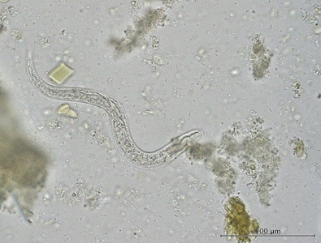
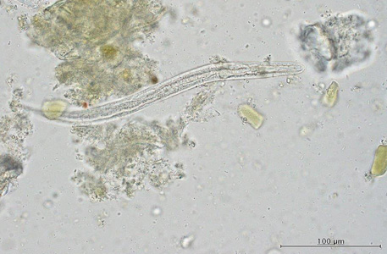
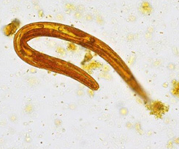
Case Studies
Case 4
A 50-year-old female from Canada presented to a health care provider with abdominal pain, diarrhea, and peripheral eosinophilia. A stool specimen was collected in sodium acetate-acetic acid-formalin (SAF) and a formalin-ethyl acetate (FEA) concentration was performed. \
Figures A-C show what was observed microscopically on a wet mount; Figure C stained with iodine.
What is your diagnosis? Based on what criteria?
A
B
C

Slide 37
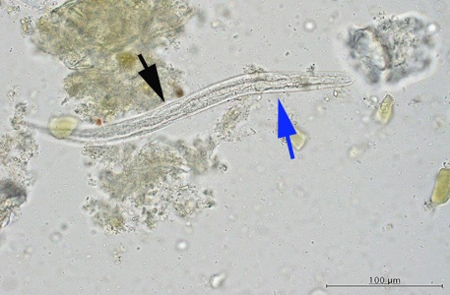
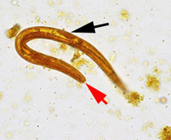
Case Studies
Case 4…..
This was a case of strongyloidiasis caused by S. stercoralis. Diagnostic morphologic features shown in the images included:
a prominent genital primordium (black arrow, Figures B and C).
a short buccal canal (red arrow, Figure C).
a rhabditoid esophagus (blue arrow, Figure B).
The morphologic features were consistent with first-stage rhabditiform (L1) larvae which is the stage usually found in stool.
B
C

Slide 38
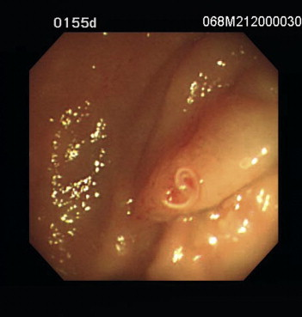
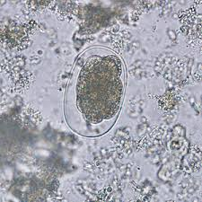
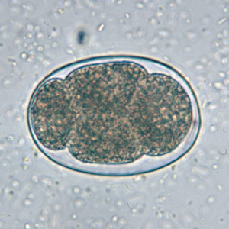
Case Studies
Case 5
A 54-year-old male was admitted because of having suffered from progressive watery diarrhea for 12 days. He had no history of diabetes mellitus, hypertension, heart disease, organ transplantation, or malignancy. After admission, he still complained of diarrhea despite medical treatment. The laboratory examination showed leukocytosis with eosinophilia and a stool examination by the concentration method was negative four times. When a sigmoidoscopy was performed as a part of an explorative survey, a single protruding mass consisting if a moving adult hookworm was found. The fifth stool examination by the concentration method identified hookworm ova. The patient was treated with oral mebendazole 100 mg twice a day for 3 days. The diarrhea and eosinophilia subsided after this treatment.

