Slide 1
Liver & pancreatic injury
Done by: supervised by: dr. emad aburajoh
Leen alshawabkeh
Rand awwad
Rakan wadi
Raneem manasrah
Sarah abu tabanjeh

Slide 2
Liver injury
Liver is the second most common organ injured in abdominal trauma
Liver trauma can be divided into : Blunt (more common , higher mortality )& Penetrating injury .
Symptoms
right upper quadrant pain, which increase with deep breathing
nausea ,vomiting, tachycardia and fainting .
Physical examination
1.tenderness to palpation in the right upper quadrant of the abdomen
2. low blood pressure and pulse over 100
Investigations
.FAST
.CT chest and abdomen with contrast in hemodynamically stable patient
.Laparotomy if hemodynamically unstable

Slide 3
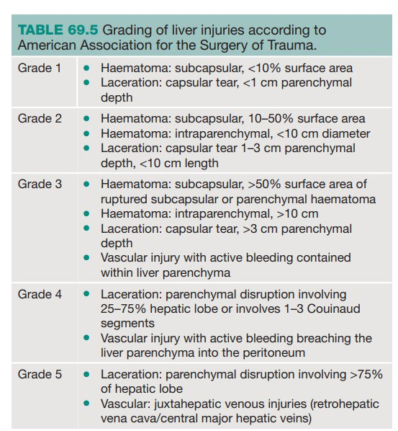
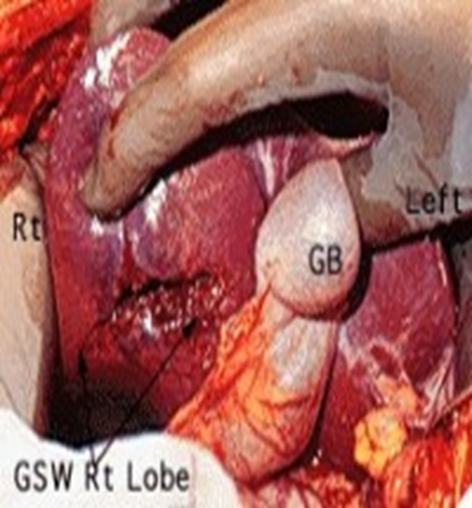
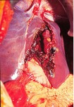
Liver injury scale
Grade II
Grade IV

Slide 6
Management of liver injury
Nonoperative management:
is safe, effective, and the treatment modality of choice in hemodynamically stable patients.
The weakness in this treatment is the possibility of missing an associated intra abdominal injury
Operative management :
- simple suture techniques
- resectional debridement to control hemorrhage.
- Anatomic resection
-hepatic artery ligation
- perihepatic packing
-fibrin glue application
-pringle maneuver

Slide 7
Operative management
‘rooftop’ incision with midline extension to the xiphisternum and retraction of the costal margins gives
excellent access to the liver and spleen.
perihepatic packing
perihepatic packing which involves placing packs above, behind and below the liver, is the most useful method of providing haemostasis.
Compression of the liver with packs and correction of coagulopathy, if present, will control most of the active bleeding.
Diffuse parenchymal injuries should be treated by packing the liver
This is effective for the majority of liver injuries if the liver is packed against the natural contour of the diaphragm by packing from below and the abdomen closed to facilitate compression of the parenchyma
Large abdominal packs should be used to ease their removal
Care should be taken to avoid over packing, as this may produce pressure necrosis of the liver parenchyma or abdominal compartment syndrome.
patient should have the packs removed after 48 hours, and usually no further surgical intervention is required.

Slide 9
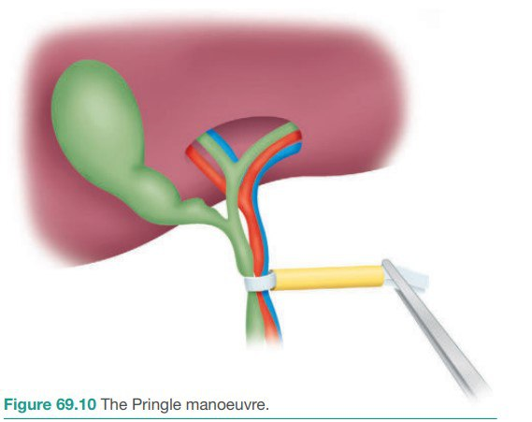
Pringle maneuver
If bleeding persists after packing further control can be achieved by vascular inflow occlusion by placing an atraumatic clamp across the foramen of Winslow (the Pringle manoeuvre) to temporally occlude hepatic artery and portal vien
Inflow occlusion facilitates suturing of lacerations and vessels
the liver is tolerated for up to 45 minutes, allowing sufficient time in a blood-free field for repair of injuries

Slide 10
Complications
Intrahepatic haematoma
Liver abscess
Bile collection
Biliary fistula
Hepatic artery aneurysm
Arteriovenous fistula
Arteriobiliary fistula
Liver failure

Slide 11
Pancreatic Injury
Etiology
The pancreas, sitting in a relatively protected position high in the retroperitoneum,
INJURIES TO THE PANCREAS
-External injury -Iatrogenic injury
-blunt -penetrating
Penetrating trauma to the upper abdomen or the back carries a higher chance of pancreatic injury.
Clinical Presentation
Pancreatic injury can be symptom free early in the post injury time frame and even silent in many cases.
Notes:
is infrequently injured in typical blunt injuries.
Penetrating trauma
- 70% of all pancreatic injuries
- Stab / firearm wounds
Blunt abdominal trauma
- 30% cases
Blunt pancreatic trauma usually presents with epigastric pain, which may be minor at frst, with the progressive development of more severe pain due to the sequelae of leakage of pancreatic fuid into the surrounding tissues. The clinical presentation can be quite deceptive; careful serial assessments and a high index of suspicion are required.

Slide 12
Pancreatic Injury
Pancreatic injuries may range from a contusion or laceration of the parenchyma without duct disruption to major parenchymal destruction with duct disruption (sometimes complete transection) and, rarely, massive destruction of the pancreatic head.
The most important factor that determines treatment is whether the pancreatic duct has been disrupted.

Slide 13
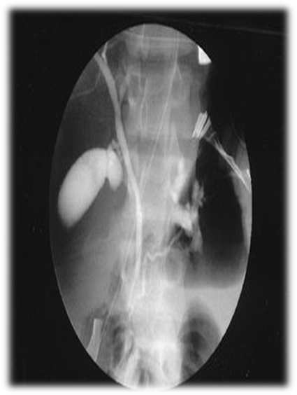
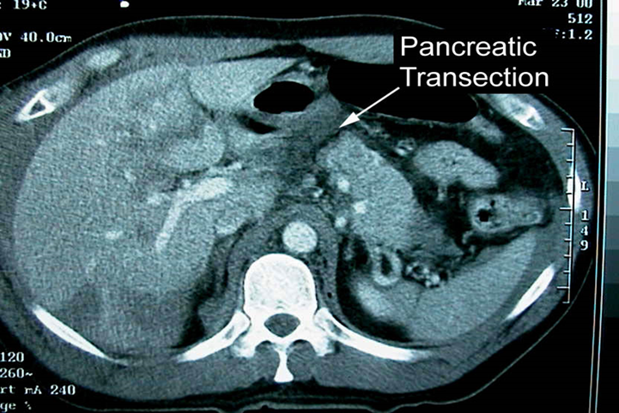
Investigations
Serum amylase
Plain abdominal x-ray
CT Abdomen: mainstay of accurate diagnosis
ERCP
Exploratory laparotomy
Notes:
A rise in serum amylase occurs in most cases. A CT scan of the pancreas will delineate the damage that has occurred to the pancreas (Figure 72.21). If there is doubt about duct disruption, an urgent ERCP should be sought. MRCP may also provide the answer, but the images can be difcult to interpret
In patients experiencing blunt trauma, CT scans provide the best overall method for diagnosis and recognition of a pancreatic injury.
Contraindicated if the patient is hemodynamically unstable
Findings:
A hematoma surrounding the pancreas
Fluid in the lesser sac
Parenchymal lacerations
Transections
(ERCP) can be used in cases where clinically there is high suspicion of pancreatic ductal injury .

Slide 14
Operative Management
Non-operative management
If there is no evidence of a ductal injury on CT, non-operative management is acceptable, although it may be wise to perform ERCP to establish normal ductal anatomy definitively.
Indications:
Peritonitis on physical examination
Hypotension
Evidence of disruption of the pancreatic duct
Notes:
In non-operative management, serial physical and laboratory examinations (ie, hemoglobin, amylase, lipase) are required.
A continued increase in serum amylase levels or change on physical examination mandates an abdominal operation or repeat imaging with CT or ERCP.
The most important factor that determines treatment is whether the pancreatic duct has been disrupted.
--------
Haemostasis and closed drainage are adequate for minor parenchymal injuries. If the gland is transected in the body or tail, a distal pancreatectomy should be performed, with or without splenectomy. If damage is purely confned to the head of the pancreas, haemostasis and external drainage
--------
are normally efective. In the emergency setting, in an unstable patient with concomitant injuries, a surgeon unaccustomed to pancreatic surgery should refrain from trying to ascertain whether the duct in the pancreatic head is intact or embarking on a major resection. However, if there is severe injury to the pancreatic head and duodenum, then a pancreatoduodenectomy may be necessary.
-------
External injury to the pancreas ● Other organs are likely to be injured ● It is important to ascertain if the pancreatic duct has been disrupted ● CT and ERCP are the most useful tests ● Surgery is indicated if the main pancreatic duct is disrupted

Slide 15
Iatrogenic injury
This can occur in several ways:
● Injury to the tail of the pancreas during splenectomy, resulting in a pancreatic fistula.
Injury to the pancreatic head and the accessory pancreatic duct (Santorini), which is the main duct in 7% of patients, during Billroth II gastrectomy.
● Enucleation of islet cell tumours of the pancreas can result in fistulae.
● Duodenal or ampullary bleeding following sphincterotomy. This injury may require duodenotomy to control the bleeding.
Notes:
A pancreatogram performed by cannulating the duct at the time of discovery of such an injury will demonstrate whether it is safe to ligate and divide the duct. If no alternative drainage duct can be demonstrated, then the duct should be reanastomosed to the duodenum or alternatively resection of the pancreatic head should be considered.

Slide 16
Prognosis
The most common cause of death in the immediate period is bleeding, usually from associated injuries.
Fistula formation is the most frequently reported complication,
Treatment : wide local drainage and good nutrition and supportive care, usually resolve spontaneously within 2 weeks of injury
Notes:
Once the acute phase has passed, the morbidity related to the pancreatic injury itself is treatable, with a complete return to normal activity being the usual outcome.
Persistent drain output occurs in up to a third of patients (see Pancreatic fistula). Sometimes, in the aftermath of trauma that has been treated conservatively, duct stricturing develops, leading to recurrent episodes of pancreatitis. The appropriate treatment in such cases is resection of the tail of the pancreas distal to the site of duct disruption
Complications of Pancreatic injury
Chronic pancreatitis, traumatic pseudocysts.
Management of pancreatic fistulae Tests
● Measure amylase level in fluid
● Determine the anatomy of the fstula
● Check if the main pancreatic duct is blocked or disrupted Measures
● Correct fuid and electrolyte imbalances
● Protect the skin
● Drain adequately
● Parenteral or nasojejunal feeding
● Octreotide to suppress secretion
● Relieve pancreatic duct obstruction if possible (ERCP and stent)
● Treat underlying cause
A pancreatic pseudocyst may develop. If the main duct is intact, the cyst can be aspirated percutaneously in the frst instance; it may not be necessary to undertake a cyst gastrostomy. If the cyst develops in the presence of complete disruption of the pancreas, there is no alternative but to undertake a distal resection or, occasionally, a pancreatojejunostomy with a Roux-en-Y loop. In a patient who presents with a peripancreatic cyst and a history of previous blunt abdominal trauma, do not assume that it is a post-traumatic pseudocyst. The possibility of a cystic neoplasm should be considered and excluded.

Slide 17
Duodenal injury
In humans , the duodenum is a C-shaped hollow jointed tube .
It is devided anatomically into four sections
Duodenal injury is frequently associated with injuries to the
adjoining pancreas. Like the pancreas, the duodenum lies
retroperitoneally ( except the first part ) and so injuries are hidden, discovered late
or at laparotomy performed for other reasons.

Slide 18
Clinical presentation
The diagnostic accuracy of duodenum injury is low because it has no specific clinical symptoms and signs. the injury may not present with any peritoneal irritation sign.
May be present with abdominal pain , retching or vomiting with blood in the vomitus.
Abdominal distension especially in the upper quadrant .
Diagnosis
Water-soluble radiopaque contrast medium can be injected through a nasogastric tube just before the abdominal film is taken. If leakage happens, rupture of duodenum can be confirmed.
CT is the diagnostic modality of choice
The only sign may be gas or a fluid collection in the periduodenal tissue , and leakage of oral contrast , administration of which may improve accuracy of diagnosis

Slide 19
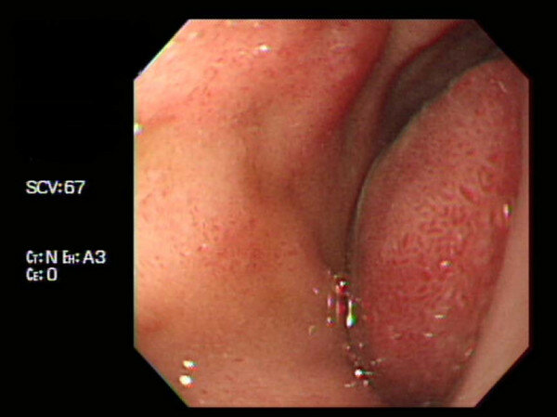
Management
Duodenal Hematoma Management:
Non operative: NGT , TPN
Surgical: Evacuation after 2 weeks
Duodenal perforation management:
Primary repair ( most perforations of the duodenum can be treated by primary repair)

Slide 20
Management
Management of Duodenal injury depends on which portion is affected:
1st portion → debridement & end-to-end anastomosis (because of the mobility and rich blood supply of the gastric pylorus )
2nd portion → For lesions between the accessory papilla and the papilla of Vater, avascularized jejunal graft, either a patch or tubular interposition graft, may be required.

Slide 21
Management
3rd & 4th portion → resect the third and fourth portions and perform a duodenojejunostomy on the left side of the superior mesenteric vessels
High-risk or complex duodenal repairs → Whipple procedure (Pancreaticoduodenectomy)

Slide 22
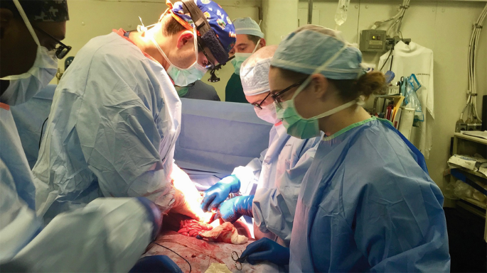
Damage control resuscitation and surgery

Slide 23
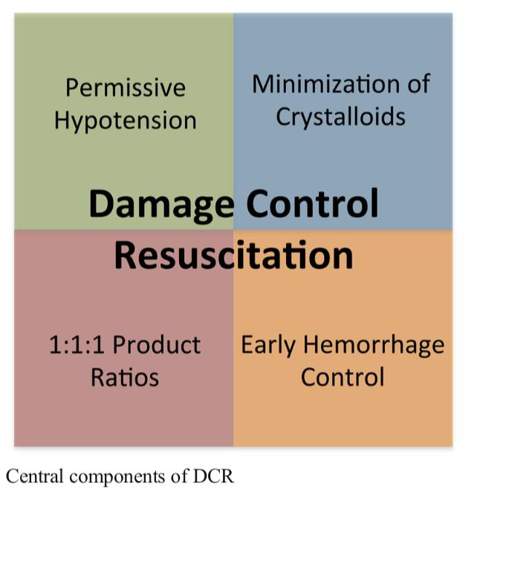
Damage Control resuscitation
DCR is metabolic decompensation of the severely injured trauma patient by :
Notes:
recommended to maintain the systolic blood pressure (SBP) between 70 and 80 mmHg before definitive surgical repair to keep it low enough to avoid dislodging a potentially forming blood clot at the site of traumatic hemorrhage and high enough to continue to perfuse vital organs.
a 1: 1: 1: 1 blood component ratio of packed red blood cells, fresh frozen plasma, platelets and cryoprecipitates to decrease mortality and decreases the overall incidence of complications as there were with crystalloids
Hemorrhage control which include direct pressure, wound packing and/or tourniquet application

Slide 24
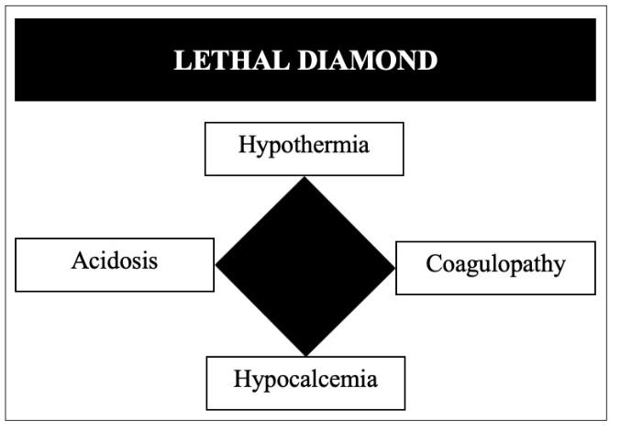
Those patients are at high risk of death which was previously described as death triad
recently the concept of hypocalcemia was included as a new component and so creating the new “Lethal Diamond”

Slide 25
hypocalcemia
55% of all trauma patients have hypocalcemia prior to receiving any kind of blood transfusion
hypocalcemia is potentially aggravated by initial management via a DCR in which blood products are typically stored in local blood banks using citrate which in turn chelates ionized calcium in the bloodstream.
as serum calcium levels drop, coagulopathy occurs, which can lead to continued hemorrhage and possible death.
Severe, ionized hypocalcemia has been defined as <0.9 mmol/L

Slide 26
Damage Control Surgery
Damage control surgery (DCS) represents a staged surgical approach to the treatment of critically injured trauma patients

Slide 28
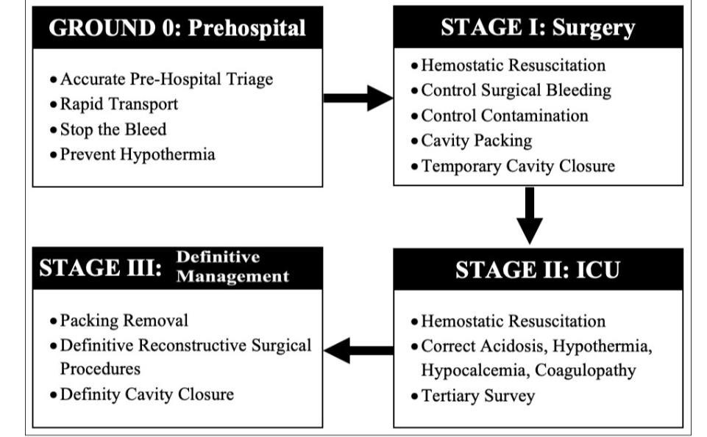

Slide 30
Thank you !

