Slide 1
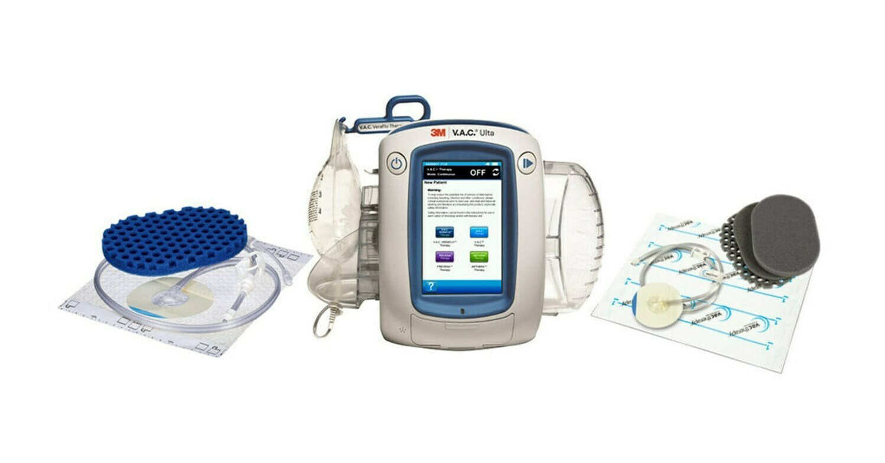
Negative pressure wound therapy
Supervised by: Dr. Mahmoud Awaisheh
Done by :
Ebtehal Qudah
Anood maaitah
Baraah Qudah
Ekrema hayajneh

Slide 2
A wound is a rapid onset of injury that involves lacerated or punctured skin (an open wound), or a contusion (a closed wound) from blunt force trauma or compression. In pathology, a wound is an acute injury that damages the epidermis of the skin. To heal a wound, the body undertakes a series of actions collectively known as the wound healing process.
What's the wound?

Slide 3
So…
What's the negative pressure wound therapy?
Negative pressure therapy (NPT also commonly referred to as VAC therapy will be used to indicate any type of negative pressure therapy system where a dressing is applied to a wound and then is connected to a device that generates a continious or intermittent suction and has been approved by the FDA for prescription by physician or other medical staff for specific indication
NPT is a treatment option for patients that have wounds which are healing by secondary or tertiary intent these are wound would normall heal slowly and fill with granulation tissue from the base and edges of the wound before the wound reepithelize
NPT increse the speed of healing and promote healing by removing edema ,exudate and other factors within the wound

Slide 4
Npwt benefits:
Decreasing swelling and inflammation
Decrease risk of bacterial infection
Increase blood flow to the wound
Gentle pulling together of the wounds edges
Decrease overall discomfort
Less changing of wound dressing compared with other treatments

Slide 5
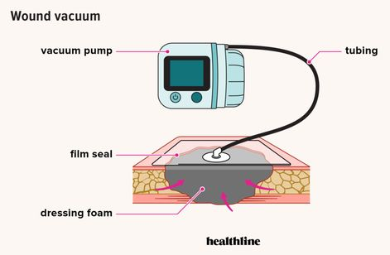
Content of NPWT dressing pack:

Slide 6
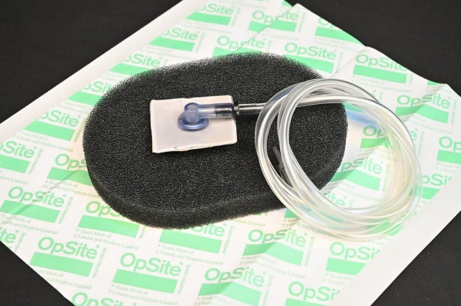
Foam based primary dressing ;
This black foam comes in a variety of sizes and shapes , in addition this can be cut OR molded to specific size and dimensions

Slide 7
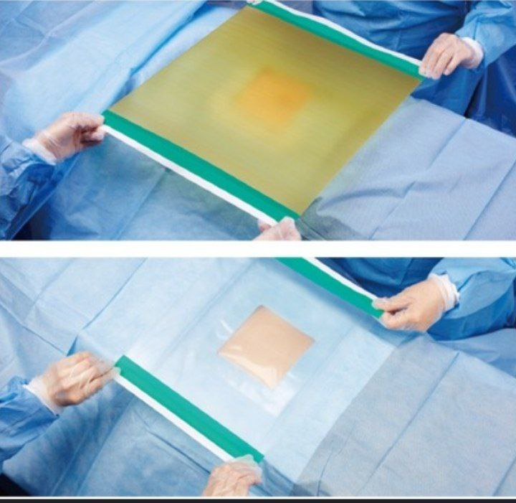
Adhesive dressing ;
to create a barrier around he wound to exclude the healthy skin from the foam dressing

Slide 8
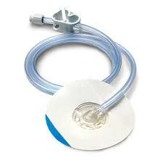
Negative pressure tube :
applied over the foam or sponge and the adhesive film\dressing

Slide 9
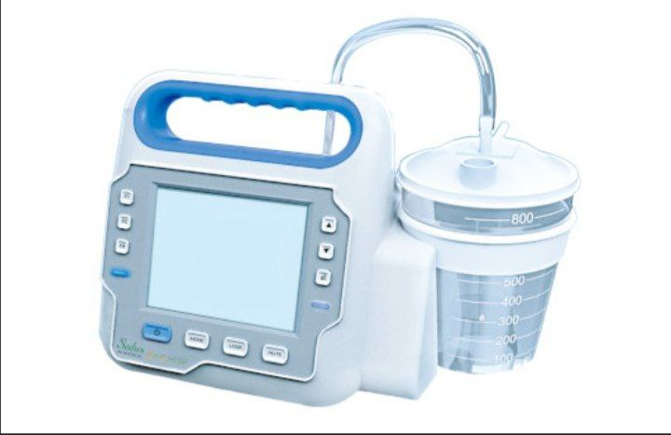
Vacuum pump
This device has 2 components
-1 permanent device that has a generator whch creates suction or negative pressure
2- disosable component which is the canister that will collect the drainage fromthe wound .

Slide 10
How npwt works?
Provides a closed and moist wound healing environment
Decreases wound volume
Removes excess fluids that can inhibit wound healing
Helps remove interstitial fluid
Promotes granulation

Slide 11
Who need to use npwt?

Slide 12
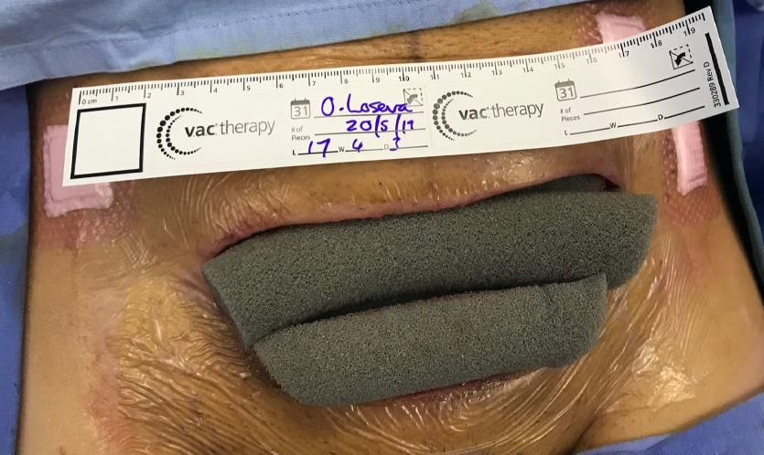
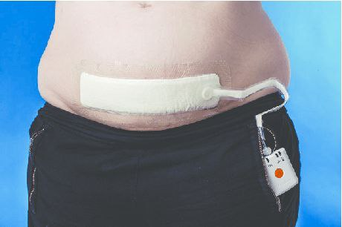
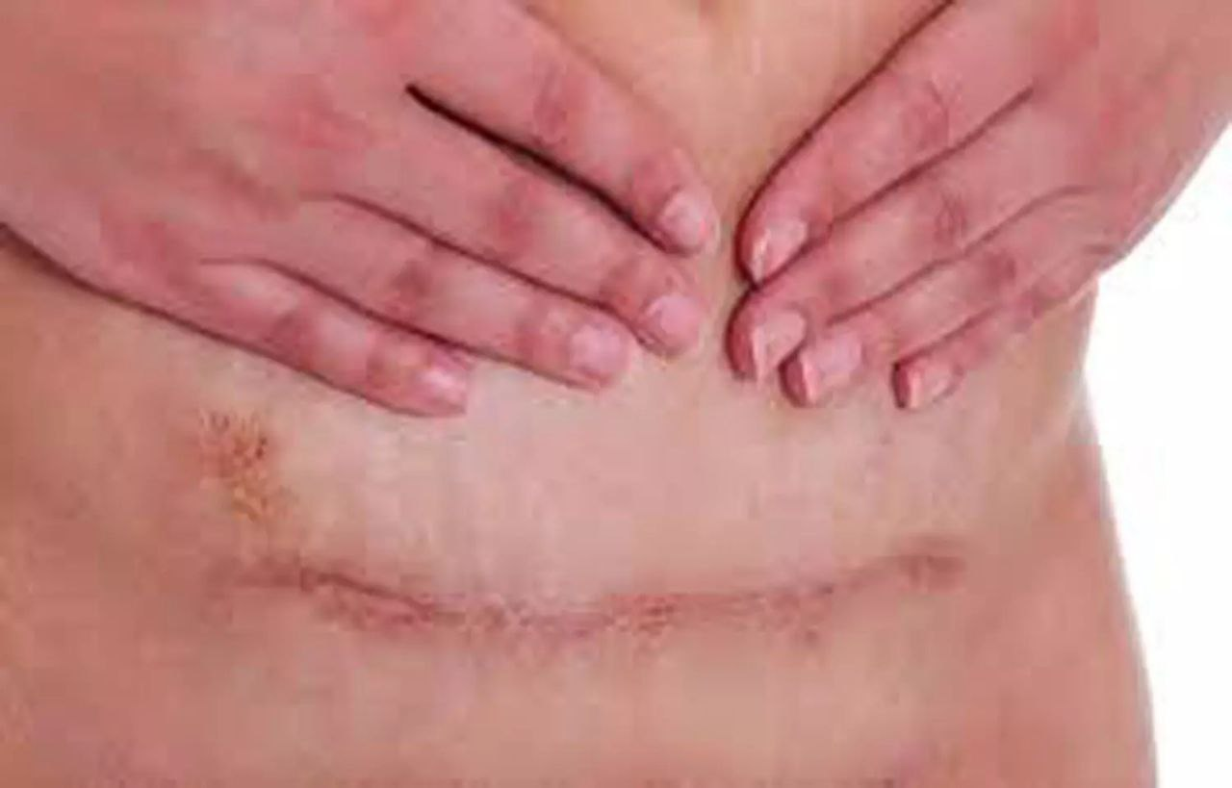
1
Cesarean delivery ( C-section)
Studies on the effectiveness of NPWT at Cesarean delivery are heterogeneous but suggest reduction in surgical site infection and overall wound complications.
Larger definitive trials are needed to clarify the clinical utility of NPWT after Cesarean delivery

Slide 13
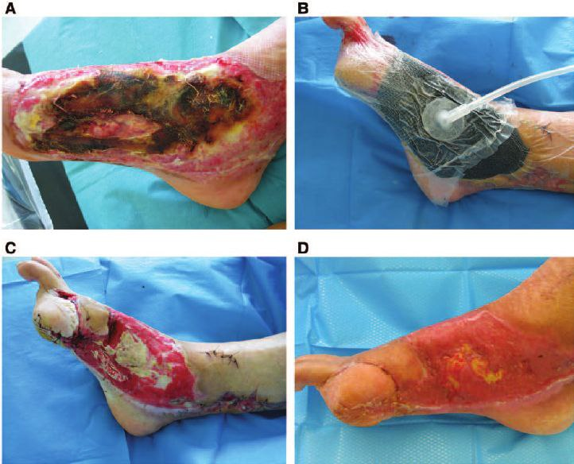
Burns : burn wounds may benefit from NPWT by reducing edema formation and increasing perfusion thus NPWT prevent the progression of partial thickness burn injuries
2

Slide 14
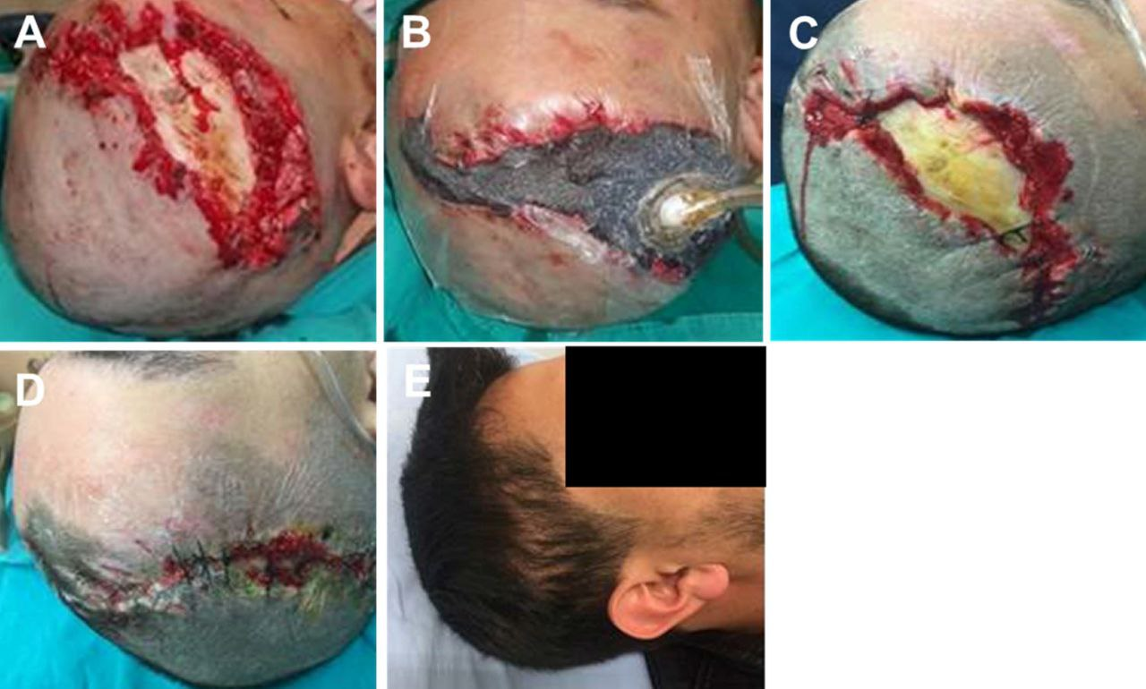
Traumatic and surgical wounds :
NPWT might be usful in the healing of traumatic and postoperative wounds
One review concluded that NPWT has potential to reduce infections after Surgary
3

Slide 15
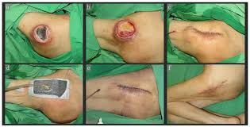
pressure ulcer :
Pressure ulcer are sore skin spots caused by continuous pressure.
NPWT may be suitable treatment option in. Some cases
One study trusted source looked at the use of this therapy to heal patients ulcer. Using NPWT healed the ulcer in 6 weeks at half the cost of reconstructive surgary
4

Slide 16
Types of wound not suitable for npwt
NPWT is suitable for wide range of wound some types of wounds aren't suitable for NPWT these include :

Slide 17
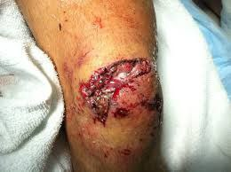
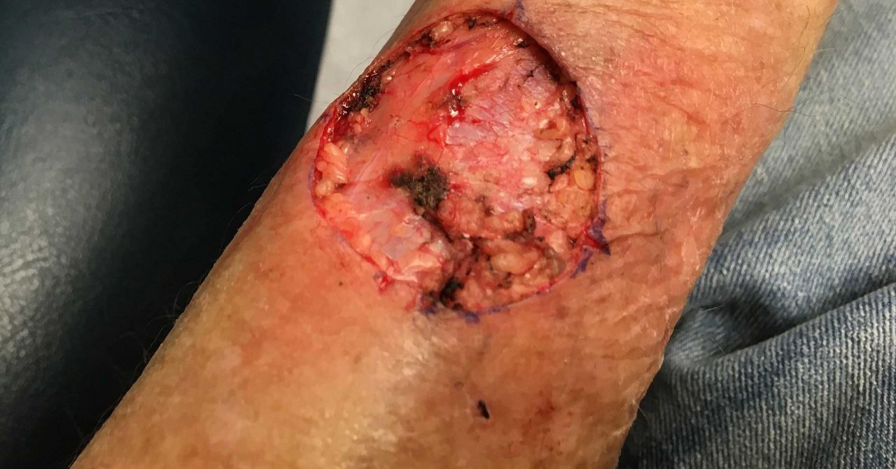
1
Wound near joints that may be reopen with limb movment
2
Cancer tissue present in the wound

Slide 18
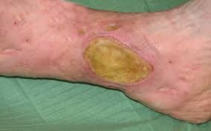
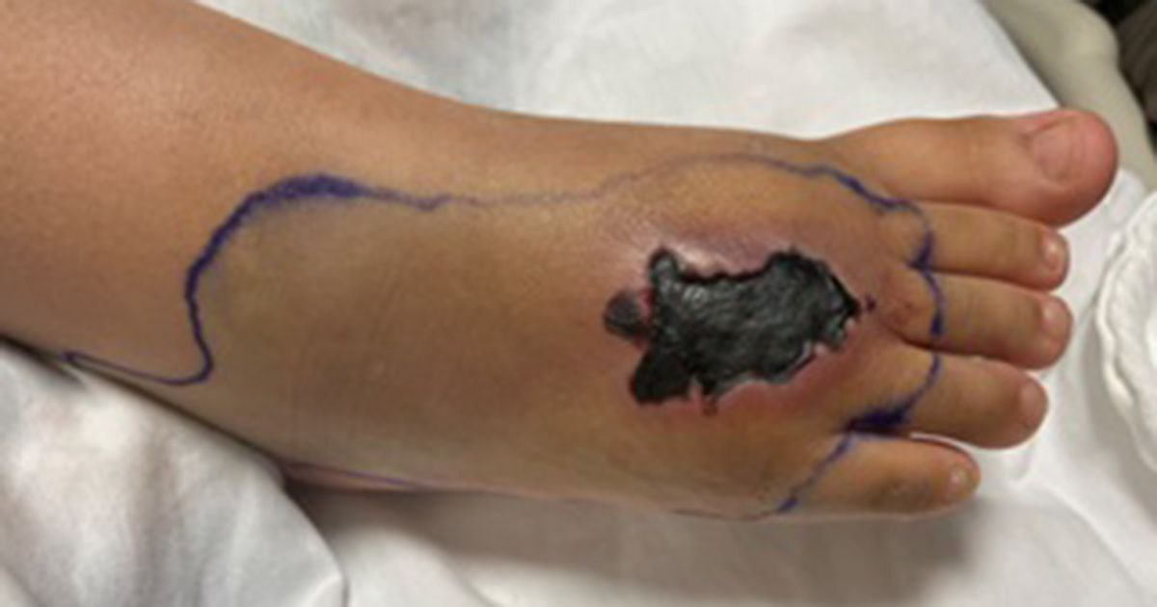
Exposed organs or blood vessels
3
Infected wounds
4
5
Necrotic tissue with eschar encompassing more than 20 percent of the wound bed

Slide 19
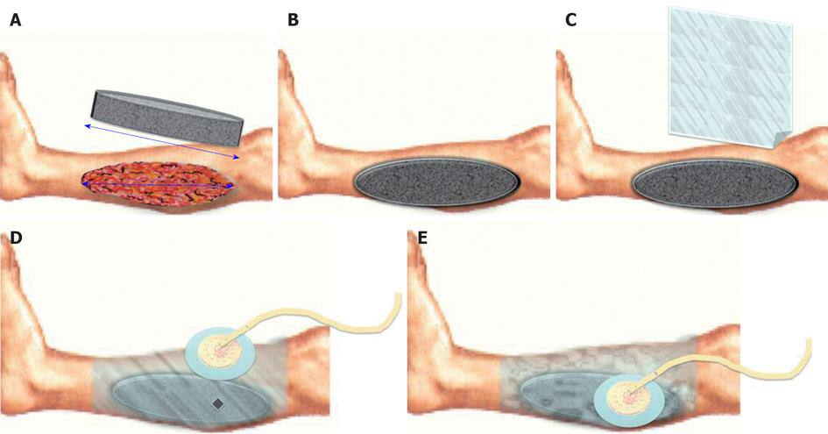
How to apply npwt?

Slide 20
1
Cut wound interface to fit shape wound.
- The foam have a different shape and type examples :
a. Reteculated black foam
b.silver reteculated foam
c.green foam
d.white foam
*** PPI (pores per linear inch )
The most common type of foam in the NPWT is a reteculated black foam

Slide 21
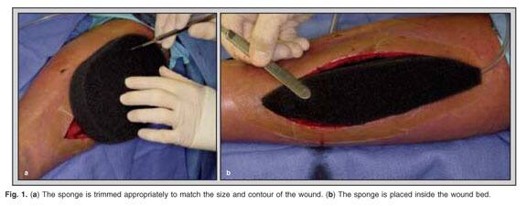

Slide 22
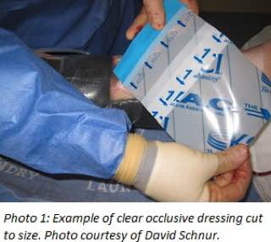
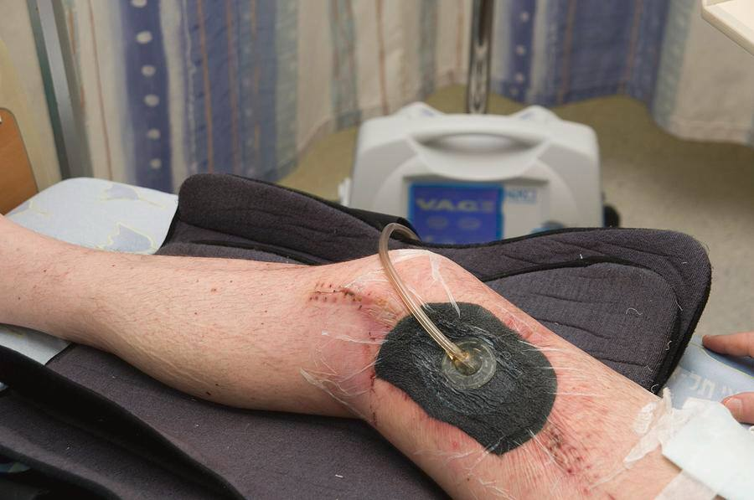
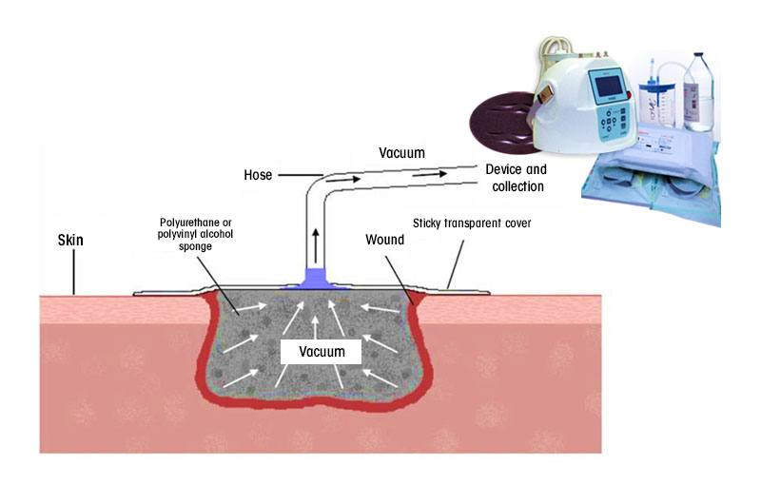
2
The foam dressing covered by occlusive adhesive transparent dressing
3
Place vented end of flexible vacuum tubing flush with wound interface
4
Connect the tube to canister of vacuum pump

Slide 23
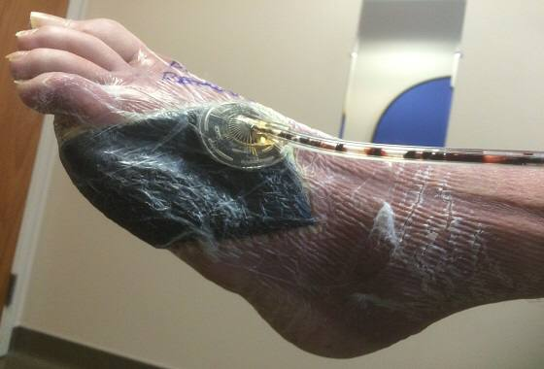
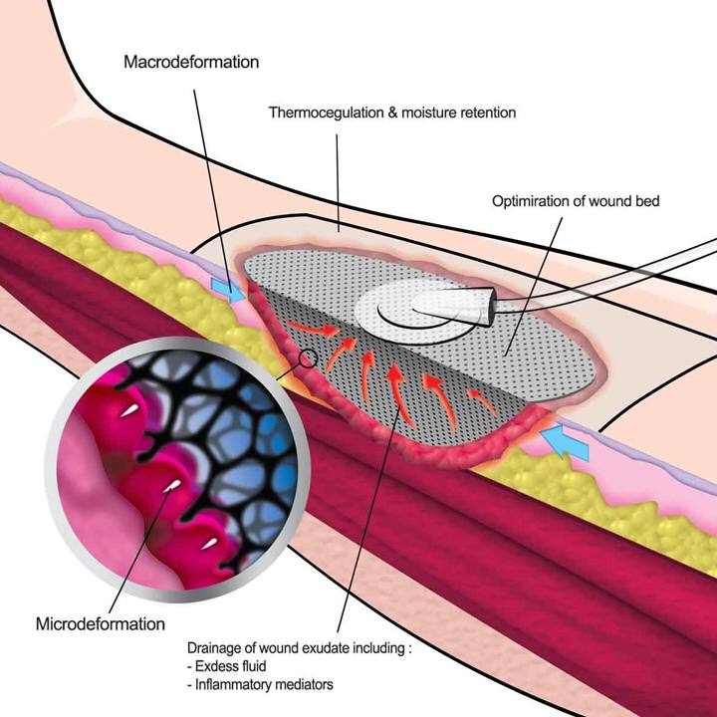
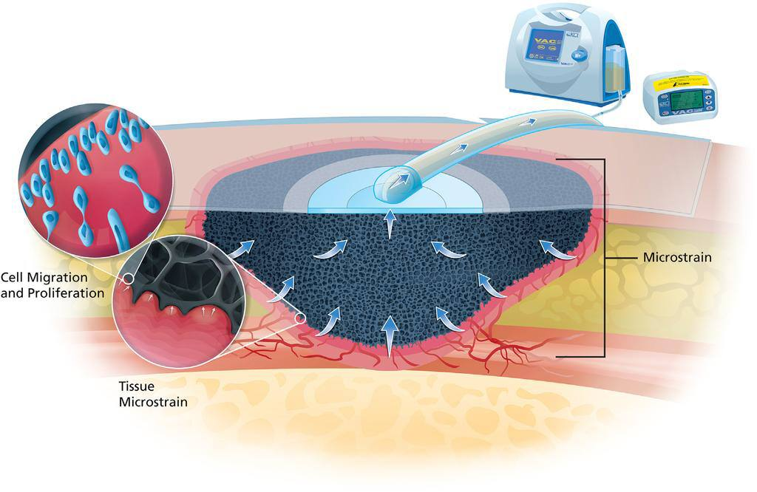
After suction applied:
1. The size of foam reducing under pressure and the wound contraction (macro deformation)
2. absorption of the fluid from the wound
3. under pressure increase blood flow to tissue
4. GRANULATION of tissue (microdeformation )

Slide 24
Complications
- Despite it’s excellent properties in promoting wound healing , there are sporadic but increasing reports on the complications. These complications included :
1- Wound infection caused by anaerobes OR due to retained foam.
2- Loss of blood & fluids.
3- Overgrowth of granulation tissue into foam.
4- Pain (usually dissipates after 20 minutes).
5- Enteric fistula if foam placed over compromised intestine.
6- Maceration and pressure damage to adjacent skin areas.
7- Reduction in perfusion caused by pressure on small vessels.

Slide 25
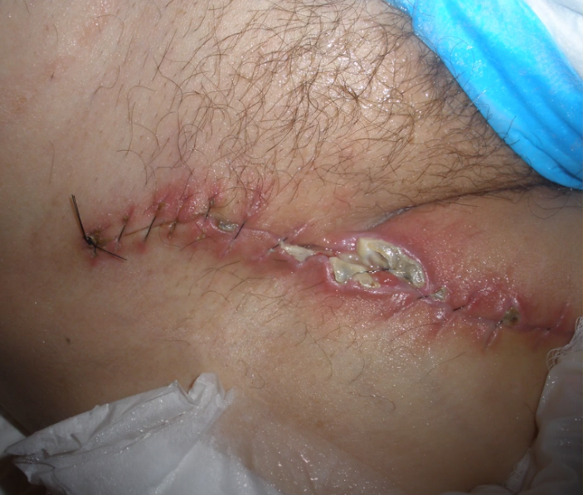
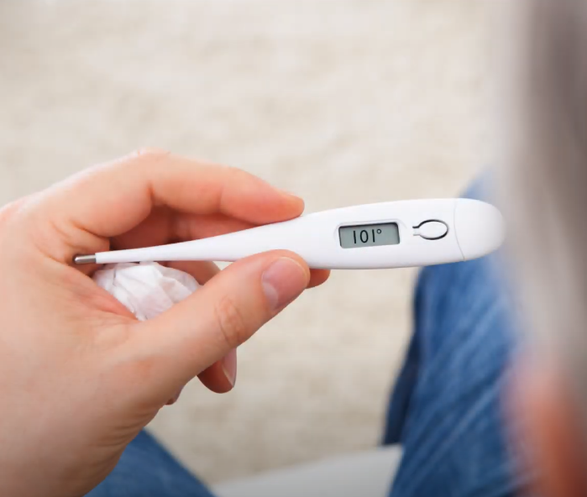
When to stop using npwt
Oral temperature greater than 101 F (38.3 C).
Bleeding around the wound
Rash around your wound
Dizziness or nausea or vomiting
Confusion or sore throat
Headache or diarrhea

Slide 26
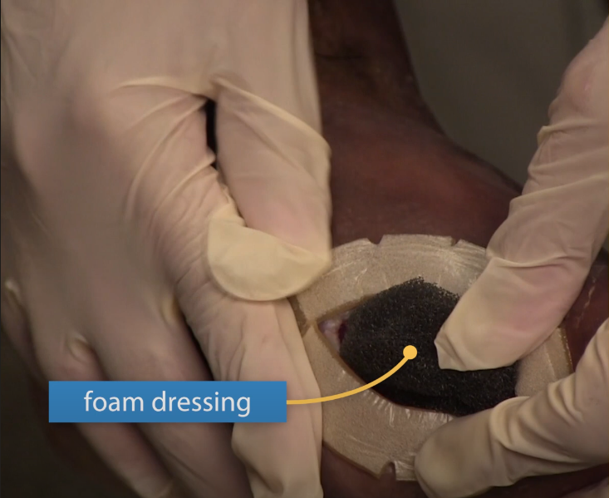
Notes:
The length of time the procedure takes vary widely depending on the size & location of your wound.
The dressings should be changed two to three times a week. If your wound gets infected , the dressings may need changing more often.
Usually , a healthcare provider will change your bandages. In some cases, a family member or a caregiver can be trained to change your dressings.

Slide 27
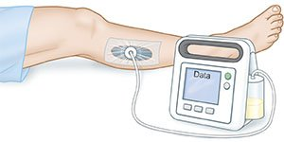
summary:
NPWT is only an adjunct to management of chronic, acute and difficult wounds and it’s not the ultimate solution
NPWT prepares wound bed for greater chance of successful closure
NPWT does not replace surgical procedures

Slide 28
Thank you

