Slide 1
approach to the patient with diarrhea
Presented by
Marah bin Tareef
Raghad alshamayleh

Slide 2
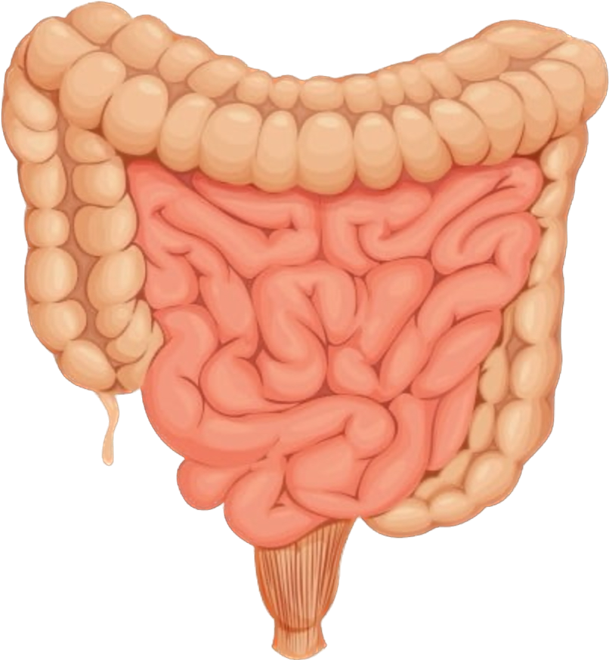
Diarrhea
Definition
Pathophysiology
Classification
Management

Slide 3
Clinical definition: Alteration in a normal bowel movement characterised by an increase in the water content, volume, or frequency (more than three per day) of stool.
Acute diarrhea is generally considered less than 72 hours to 14 days
Persistent diarrhea is considered between (15-30)
Chronic diarrhea is generally considered more than 30 days

Slide 4
Classifications

Slide 5
Acute diarrhea

Slide 8
Most cases of acute diarrhea are associated with contaminated food and water sources.
Most cases of acute diarrhea are due to infection which is self-limiting.
The major causes of infectious diarrhea are:
Viruses
Unique features usually include low grade fever, nausea and vomiting, abdominal cramps, and watery diarrhea.
1-Norovirus: , Elderly immunocompromised patients, and children are most commonly affected.
2- Rotavirus: Most common cause of diarrheal outbreak/epidemic, Frequent cause of viral gastroenteritis in infants and young children worldwide, their transmission is fecal-oral, and vaccine is available.
3-Adenovirus: Primarily affects children < 4 years old, and similar to rotavirus in transmission and presentation.

Slide 9
*Bacteria: Symptoms include moderate/high fever, tenesmus, and diarrhea (watery, bloody, and/or mucoid). Such as:
1-Campylobacter jejuni: The most common cause of bacterial foodborne gastroenteritis. (in unpasteurized milk)
2-Salmonella enteritidis and nontyphoidal salmonella: The second-most common cause of bacterial foodborne gastroenteritis. (in eggs, meat, unpasteurized juice and milk)
3- Shigella: Causes mucoid-bloody diarrhea, high fever, and tenesmus. Transmitted fecal-orally in areas with poor sanitation, through unpasteurized milk products, contaminated water, or unwashed raw vegetables.
4-Vibrio cholerae: May cause profuse diarrhea ("rice water stools").
5-Diarrheagenic E. coli infection: part of the normal colonic flora, also transmitted by fecally contaminated food and water. strains/types of E.coli cause diarrhea:
*enterotoxigenic E coli (Traveler's diarrhea) → watery diarrhea.
*enterohaemorrhagic E coli → bloody diarrhea.

Slide 10
6-Yersinia enterocolitica: Transmitted primarily via contaminated unpasteurized milk products or undercooked pork. Manifestations include subacute abdominal pain, fever, diarrhea that can be bloody, and pseudo appendicitis.
7- Clostridium difficile: Can cause Antibiotic-associated diarrhea.
8-Mycobacterium: Atypical bacteria that may cause opportunistic infections among AIDS patients.

Slide 11
Chronic diarrhea

Slide 12
Definition
persistent alternation of stool consistency with loose stool and increase frequency of greater than 4 weeks duration
Most of the cause are non infectious
Occur in 5% population

Slide 13
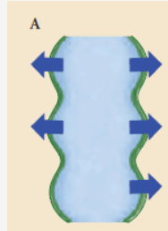
Classification
1-secrotory diarrhea
2- osmotic diarrhea
3- steatorrheal diarrhea
4- inflamatory diarrhea
5- dysmotility diarrhea

Slide 14
Secretory diarrhea
due to derangement in
fluid and electrolyte transport
across the enterocolonic mucosa
characterized clinically by watery ,
large –volme feacal output (<1L/d)
tapically painless
persist with fasting

Slide 15
Osmotic diarrhea
Occurs when ingested pooly
absorbed osmotically active
solutes draw enough fluid into
the lumen to exceed the reabsorptive
capacity of the colon
Fecal water output water increase in proportion to solute load
Characteristically ceases with fasting

Slide 16
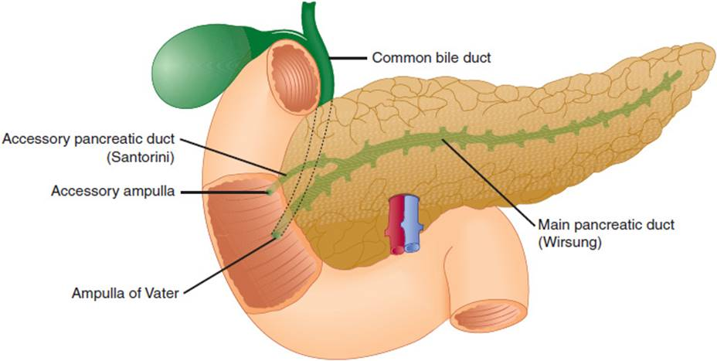
Steatorrhea
Fat malabsorption lead to greasy , foul smelling difficult flush diarrhea
Associated with weight loss and nutritional deficiencies
Defined as stool fat exceeding 7g /day

Slide 17
Inflammatory diarrhea
Accompanied by pain , fever ,
bleeding or other manifestation
of inflammation
Stool analysis reveal the presence of leukocytes or leukocyte –derived protein
such as calprotectin
characterized clinically by bloody and mucus like

Slide 18
Dismotality diarrhea
Rapid transit time may accompany diarrhea as a secondary phenomenon
primary dysmotitity is unusal cause of true diarrhea
Secondary cause by :
-autonomic neuropathies (diabetic diarrhea)
-drug (prostaglandin , prokinetic agent )
-IBS
-hyperthyrodism

Slide 20
Approach
History
Duration (acute , chronic ,intermittent)
Nature and amount
Course (increase or decrease or constant )
Color and special odor
Frequency
day and night variability
Associated factor (fever ,vomiting , tenesmus , abdominal pain ,blood in stool and weight loss,urgency, faecal incontinence)
precipitating factor ( drug ,special food ,stress )
Relieving factor : (self limiting ,fasting , drug )
Recent travel and where to and recent medication (antibiotic)
Systemic disease : uncontrolled diabetic , hyperthyroidism .
Previous GIT surgery ( stomach surgery , small intestine surgery , gallbladder surgery .

Slide 21
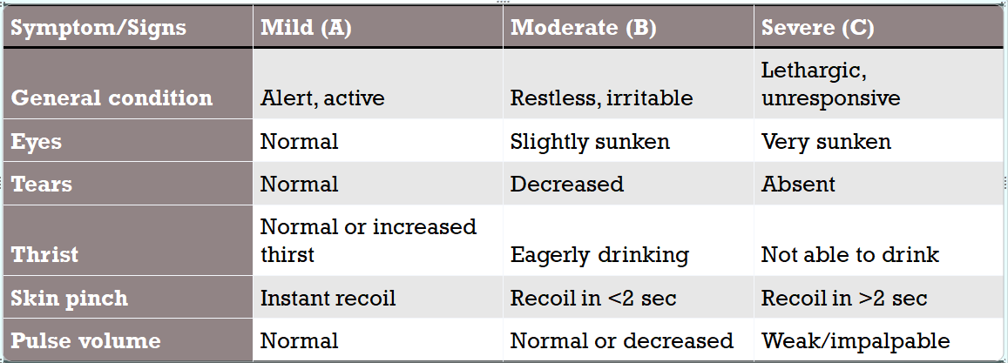
Physical Examination
1-vital sign ( BP,RR,PR , temperature )
2-abdominal exam )ascites ,organomegaly and palpable masses(
3- rectal exam) Perianal fistulas, abscess and anal sphincter tone(
4-thyroid exam
5- dehydration

Slide 22
Investigations
Laboratory test are unusally unnecessary in acute diarrhea
CBC—look for anemia, WBC elevation
Stool sample—for presence of fecal leukocytes
-If fecal leukocytes are absent, there is no need to order stool cultures
- If fecal leukocytes are present and the patient has moderate to severe diarrhea consider sending stool for culture
Stool sample
- test three samples for presence of ova and parasites
- measure for C. difficile toxin if the patient has been treated with antibiotics recently
Bacterial stool culture (This has low sensitivity and is an expensive test)
Colonoscopy/flexible sigmoidoscopy—may be considered for patients with blood in the stool or for patients with chronic diarrhea for which a cause cannot be identified
CT scan may be helpful if IBD or diverticulitis is suspected

Slide 23
Management of acute diarrhea
1.general supportive :
Fluid repletion
Diet
2.antimotility drug :
loperamide
3.antibiotic
not routinely used in adults with acute diarrhea (risk of C. difficile, eradication of normal flora, bacterial resistance) unless: Severe disease (>6 motions per day, high fever, hospitalization for volume repletion) Invasive bacterial infection (bloody diarrhea) Age >70, immunocompromised patients.

Slide 24
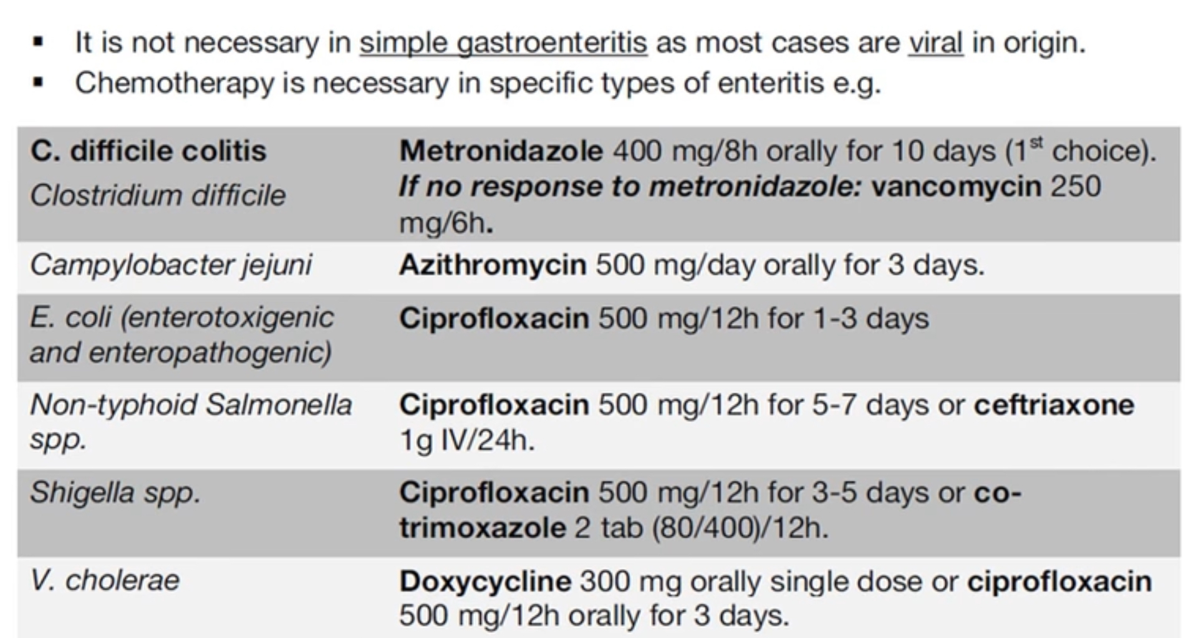

Slide 25
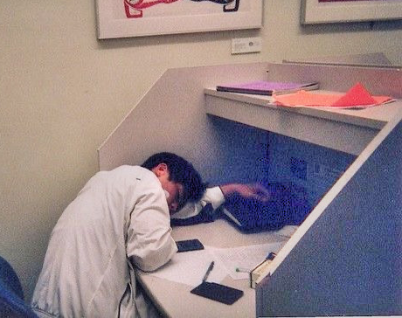
Thanks for your attention

