Slide 1
Vulval and Vaginal Lesions

Slide 2
Non-neoplastic epithelial disorders
Classification:
Lichen sclerosis.
Squamous cell hyperplasia (Hyperplastic dystrophy).
Other dermatoses.
Lichen planus.
Psoriasis.
Seborrheic dermatitis
Inflammatory dermatoses.
Ulcerative dermatoses.

Slide 3
Lichen Sclerosus

Slide 4
Lichen sclerosus is a chronic inflammatory disease of unknown cause that is characterized by white, atrophic plaques with intense pruritus affecting the skin, nails, hair, and/or mucous membranes. It most commonly affects the anogenital. Epidemiology : most commonly affect perimenopausal and postmenopausal women . Etiology: unknown Although the condition is benign, it is associated with an increased risk of squamous cell carcinoma.

Slide 5
Clinical features
Early disease Papules and plaques that are white, polygonal, well-demarcated, and potentially surrounded by a red inflammatory halo
Dominant symptom: severe pruritus, possibly pain/soreness
May be associated with dyspareunia and dysuria
Extragenital lesions: oral and areas of skin(e.g., back, shoulders, neck, wrists, thighs, and under the breast)
Advanced disease: ulceration, hemorrhage, lichenification, skin thinning/fragility, and erosive scarring

Slide 6
An irregular sclerotic white plaque with a reddened, inflammatory edge localized to the vulva and perianal region is visible. The labia minora and majora are hard to distinguish from one another because of atrophy and sclerosis; the vaginal opening is markedly narrowed.

Slide 7
Diagnosis
Suspected based on clinical presentation
biopsy: confirms diagnosis and rules out squamous cell carcinoma
children have no associated malignancy risk and can be diagnosed clinically.

Slide 8
Treatment
First-line: superpotent topical steroids(clobetasol, sometimes betamethasone)
Second-line: topical calcineurin inhibitors (e.g., tacrolimus)
If necessary, surgical excision

Slide 9
Squamous cell hyperplasia

Slide 10
Squamous cell Hyperplasia
Squamous cell hyperplasia, previously known as hyperplastic dystrophy
Thickened skin with white hyperkeratotic patches, excoriation and fissures.
Etiology:
Repetitive surface irritation and trauma from irritants that causing scratching and rubbing.
Histology:
Hyperkeratosis, Cellular epithelial proliferation with normal maturation and inflammatory response in the dermis (lymphatic and plasma cell infiltration).

Slide 11
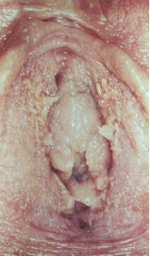
Symptoms : Itching is a common symptom ( Itch – scratch – itch cycle )
Management : The same as lichen sclerosus

Slide 12
Benign Vulval lumps
Bartholin’s cyst.
Skene’s duct cyst.
Epidermal-inclusion cyst.
Congenital mucous cysts (arise from Mesonephric ducts remnants).
Cyst of the canal of Nuck (give rise to hydrocele in L. majora).
Sebaceous cyst.
Papillomatosis (solid).
Fibroma (solid).
Lipoma (solid).
Condylomata (solid).

Slide 13
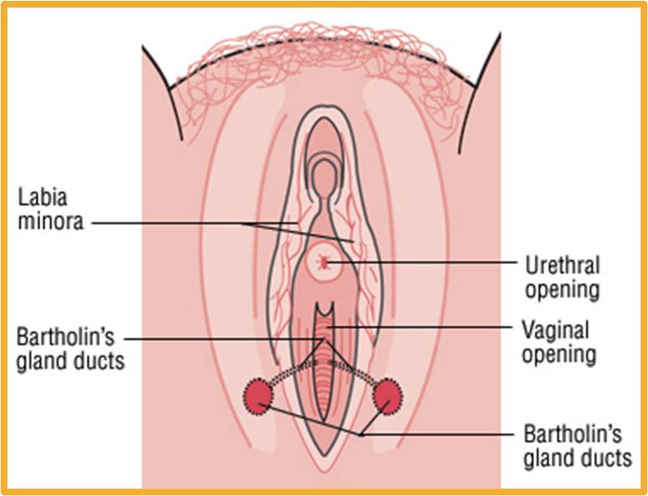
Bartholin glands
The Bartholin's glands are located posteriolaterally one on each side of the vaginal opening
Normally these glands are invisible and they secrete mucus to lubricate the vagina.

Slide 14
Bartholin-duct cyst
Most common Vulval cyst.
Usually unilateral, on the posterio-lateral side of the introitus.
Usually about 2 cm.
Usually asymptomatic and contains sterile mucus.
Secondary infections, forming a Bartholin's abscess. polymicrobial infection e.g., E. coli (most common), Staphylococcus species, Streptococcus species,N. gonorrhoeae, C. trachomatis → infection of Bartholin gland or cyst

Slide 15
Diagnosis
The diagnosis is clinical and it is important to differentiate a Bartholin’s cyst from the differential diagnosis of a sebaceous cyst, vaginal wall cyst or perianal abscess.

Slide 16
Management
Conservative approach
Indicated for smaller, asymptomatic cysts ≤ 3 cm
Involves sitz baths to facilitate rupture of the cyst and/or warm compresses
- Outpatient treatment is I&D with placement of a Word catheter under local anesthesia.
- The balloon is inflated and left in place for a month to allow a drainage tract to form.
Antibiotic treatment is usually not needed.
- Some women develop recurrent Bartholin cysts or abscesses and undergo a marsupialization procedure, which creates another point of drainage for the Bartholin gland.s

Slide 17
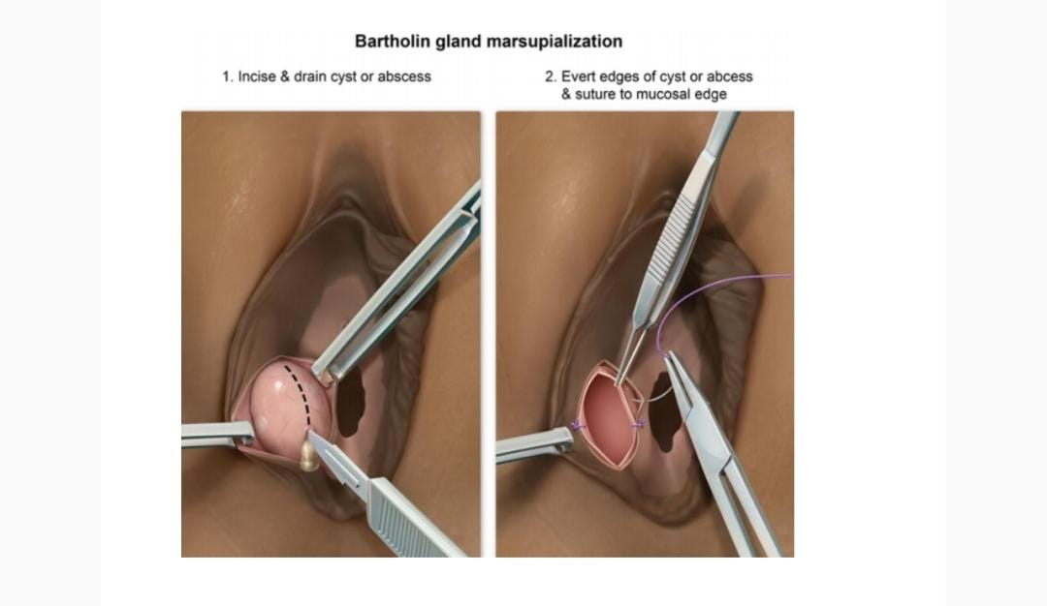

Slide 18
SKENE’S GLANDS And Skenitis

Slide 19
Skene's gland:
Function: unknown, they are thought to provide lubrication to the urethra.
Anatomy:
Its also known as periurethral glands, or paraurethral glands, they are structures located on the upper wall of the vagina, around the lower end of the urethra and are normally neither seen nor felt, except in the presence of disease or infection.

Slide 20
Skenitis/ Skene’s-duct cyst :
Gonorrhea is the most common cause of this type of infection, but it may also be caused by a UTI. Due to its close proximity to the urethra
Most are small and asymptomatic
May become swollen and tender(large cysts may cause dyspareunia)

Slide 21
Clinical features
urinary infection that fails to be cured, or recurs after appropriate
antibiotic therapy.
-Pain at the urethral opening or at the urethral-vaginal septum
Pronounced local tenderness with contact, e.g., with touch, tight pants, Pain during intercourse.
Urinary tract symptoms
physical findings
Tenderness at the urethral opening or at the urethral-vaginal septum.
﻿﻿A discharge of pus from the ducts of the Skene's glands which can be expressed by compressing the urethra.
﻿﻿A red and inflamed para-urethral mass.

Slide 22
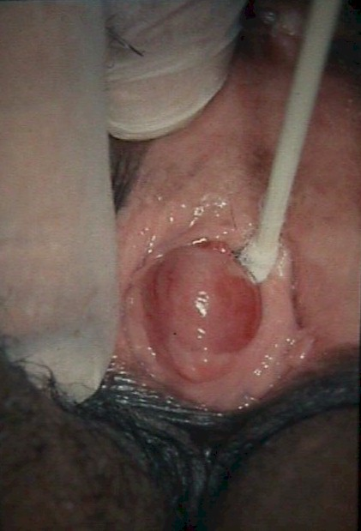
Diagnose
by physical examination
however ultrasonography or cystoscopy used to distinguish it from diverticulum of the distal urethra
Culture for Gonococcal, Chlamydia

Slide 23
Treatment
Most important step in management is folley's catheter in case of urethral obstruction
Long course of a potent antibiotic.
4-6 week period of time is often required to achieve resolution.
•A surgical procedure will be required (drainage) if the Skenitis does not respond to antibiotics

Slide 24
Inclusion cysts of the vulva

Slide 25
Vaginal Inclusion Cyst
They are common , innocent , symptomless swellings at the introitus of valva , but may cause dysparonia.
It contains creamy yellow debris & lined with stratified squamous epithelium.
It may become infected and cause pain .

Slide 26
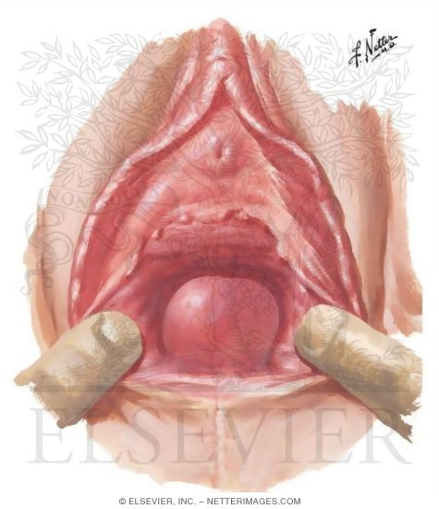
Vulvar Inclusion Cyst
Vulvar Inclusion
Cyst

Slide 27
Etiology
They are often a result of healing of an episiotomy or vulvar laceration following vaginal delivery but can occur spontaneously.
An epithelial gland just beneath the skin, which normally would drain its' secretions to the surface of the skin, becomes trapped beneath the skin.
Secretions accumulate, forming a small cyst.

Slide 28
Diagnosis: mainly clinically but doctor might suggest additional tests to rule out other conditions(malignancies). tests may include: a biopsy of a tissue sample from the cyst to rule out the possibility of vaginal cancer tests on the secretions from the vagina or cervix to determine if a sexually transmitted infection (sti) is present

Slide 29
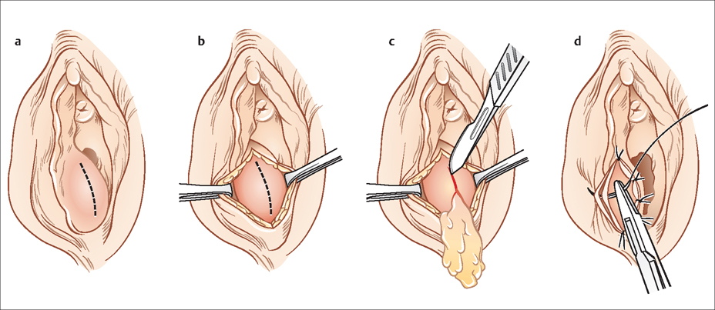
Treatment
Usually not treated unless infected or cosmotic
Incision and drainage (carries risk of re-infection)
You could also have a procedure called marsupialization in which a small incision is made in the cyst to drain the fluid and then the edges of the incision are sutured to the sides of the incision.

Slide 30
Can you pop an inclusion cyst?
If irritated, these can become painful. They can also turn red from swelling. Like other types of acne, you shouldn't try to squeeze out a cyst in order to “pop” it.
مليش دخل من الي قبلي

Slide 31
Case 1
History
A 17-year-old girl presents with a vulval swelling. She noticed a lump a few weeks earlier and in the last 2 days it has enlarged and become painful. She cannot walk normally and has not been able to wear her normal jeans because of the discomfort. She feels well in herself however.
She has been sexually active since the age of 14 years and uses the depot progesterone injection for contraception and therefore does not have periods. She has been with her boyfriend for 8 months and on direct questioning reports unprotected intercourse with two other boys in that time. She had a sexual health screen in a genitourinary clinic 1 year ago and the result was normal. There is no other medical history of note and she takes no medication.

Slide 32
Case 1
Examination
The temperature is 37.7°C, heart rate 68/min and blood pressure normal. Abdominal examination is normal. There is a left-sided posterior labial swelling extending anteriorly from the level of the introitus, measuring 6 × 4 × 4 cm. It appears red, fluctuant, tense and is exquisitely tender to touch. Bilateral tender inguinal lymph nodes are noted.

Slide 33
Case 1
Bartholin's abscesses are relatively common and cause acute painful unilateral vulval swelling.
Drainage of the abscess and marsupialization of the skin edges are the mainstay of treatment but recurrence is still common.
Pus should always be sent for culture as gonorrhoea is isolated from up to 20 per cent of Bartholin's abscesses.

Slide 34
Case 2
A 64-year-old woman comes to the physician because of a 4-month history of vulvar itching and dryness. During this period, she has also had pain during sexual intercourse but no postcoital bleeding. Her last menstrual period was at the age of 51 years. She has type 2 diabetes mellitus and her only medication is metformin. Pelvic examination shows atrophic labial folds. There are excoriation marks and a well-demarcated, white plaque on the vulva. The remainder of the examination shows no abnormalities. The results of a punch biopsy show no evidence of malignancy. Which of the following is the most appropriate next step in treatment for this patient's lesions?

Slide 35
Case 2
Lichen sclerosis

Slide 36
Case 3
A woman in her early 20s presented to the emergency department complaining of pelvic pressure, vaginal pain, and vaginal discharge. Her symptoms had been continuous for three days. She had no personal history of an abnormal pap smear. Previously, the patient had been seen at an outpatient doctor’s office, and the diagnosis was suspected to be urethritis, gonorrhea, and/or chlamydia. At that time, she was given the oral antibiotic levofloxacin and an intramuscular injection of the anti- bacterial drugs azithromycin and ceftriaxone. On her current visit, she stated her symptoms were unresolved. Vaginal examination showed a 2-cm swollen area visualized on the left side lateral to the urethra. Yellow- colored discharge was seen, and the swollen area was tender upon palpation.

Slide 37
Case 3
Skene’s gland abscess

Slide 38
Benign Cervical lesions

Slide 40
Benign diseases of the cervix
Cervical ectropion.
Cervical polyp
Nabothian cyst.
Cervical warts.

Slide 41
Carvical ectropion
Cervical erosion ( glandular epithilum that line the endocervix are present on thr ectocervix )
Any factor that affects the acidity of the vagina can lead to Ectropion
Usually common physiologic condition in adolecents , pregnancy , usage of ocp , or who had cervical laceration during labour , delivery

Slide 42
Hx
Pt usually asymptomatic and diagnosed during routine pelvic exam
But may come with :
excessive vaginal discharge : mc compliant , excessive mucous non-purulant discharge .
Spotting ( post-coital bleeding mostly , intermenstrual bleeding )

Slide 43
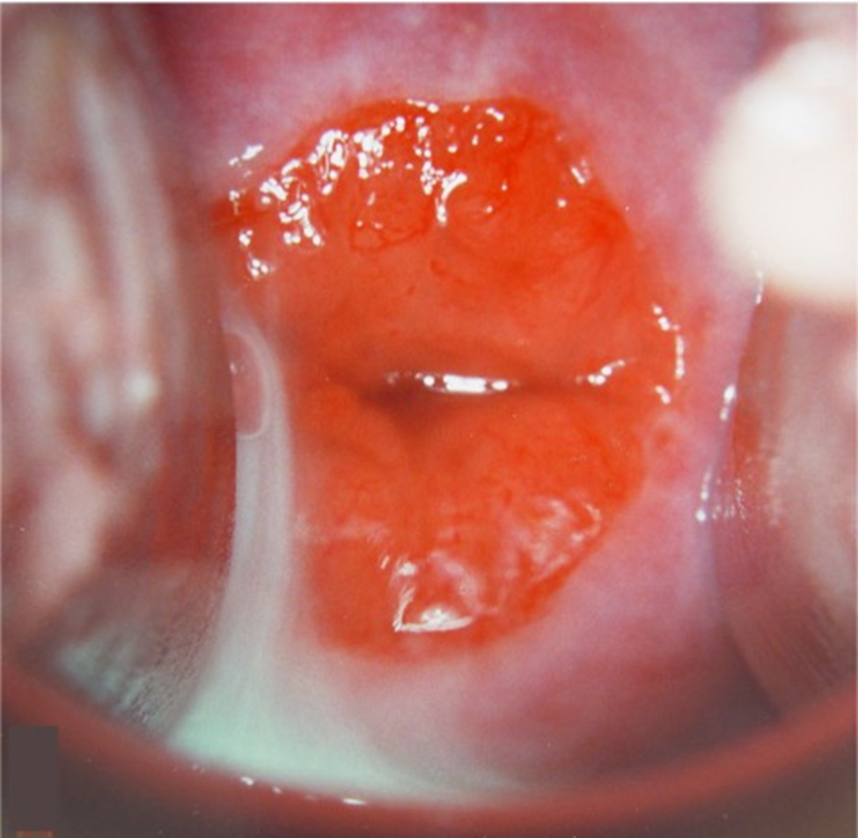
Examination
By speculum exam the everted epithelium has a reddish appearance similar to granulation tissue and may be covered by a yellow turbid discharge.

Slide 44
Further investigation to exclude other condition like cervicitis (NAAT , triple swab if purulant vaginal discharge )
differentiate BTW ectropion and CIN , and cervical cancer by (pap smear, colposcopy, colposcope with biobsy )

Slide 45
Treatment
Ectropion does not need to be treated except in the rare occurrence of excessive mucous discharge or spotting that is very bothersome to the patient.

Slide 46
Treatment
Two options :
-two-week trial of an acidifying agent, such as boric acid suppositories 600 mg vaginally at bedtime for two weeks
-ablative procedure using cryosurgery or electrosurgery, but this is invasive and will result in copious vaginal discharge until healing is completed, which may take weeks. Ablative treatment can also result in cervical stenosis, which can adversely affect future fertility and, if pregnancy is achieved, labor and delivery.

Slide 47
Cystic lesion ( Nabothian cyst)
(also called mucinous retention cysts, epithelial inclusion cysts)
These lesions are discrete cystic structures that form when a cleft of columnar epithelium becomes covered with squamous cells and the columnar cells continue to secrete mucoid material.
The cysts vary from microscopic to several centimeters in size
Nabothian cysts may occur following minor trauma or childbirth.

Slide 48
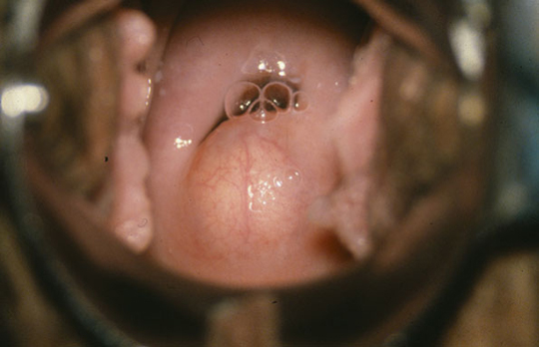
Hx and Examination
Usually asymptomatic but the pt may come with feeling of fullness in vagina also may cause dyspareunia or a pressure sensation.
On speculum exam may appear cystic lesion translucent or opaque

Slide 49
Treatment
Nabothian cysts are typically asymptomatic. The only indication for treatment is
-relief from pain or a bothersome feeling of fullness in the vagina
Ablation of the cyst using electrosurgery is the usual approach
the main disadvantage to surgical treatment is the possibility of causing scar tissue, which itself can lead to dyspareunia or cervical stenosis.

Slide 50
Non-cystic lesion
Cervical polyp: common in reproductive age espicially after age 40 years
The etiology is unknown. Chronic inflammation of the cervical canal may play a role.
Ddx : prolapsed fibroid or endometrial polyp

Slide 51
Hx
The pt usually come with :
bleeding ( postcoital , intermenstural)
excessive discharge
or may be asymptomatic

Slide 52
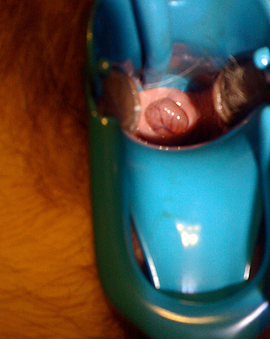
examinatoin
By speculum exam : Single or multiple cervical polyps usually arise from the endocervical canal but can also originate from the portio
tear-shaped or lobular structures appear red, purple, or flesh-colored, depending upon the vascularity and congestion present, and usually look moist and shining.

Slide 53
the size is typically less than 3 cm in diameter
The pedicle is usually long and thin but may be short and broad-based.

Slide 54
Treatment
Polyps should be removed if they are symptomatic ( bleeding, excessive discharge), large (≥3 cm), or appear atypical.
Polypectomy can usually be accomplished by grasping the base of the polyp with forceps and twisting it off. If visible, the base can be cauterized to prevent bleeding and reduce the chance of recurrence. If the base is wide, such as is the case with a sessile polyp, the main portion of the polyp should be removed with a biopsy forceps and the base destroyed with electrosurgery or laser to reduce the likelihood of recurrence.
Malignancy is rarely found in a cervical polyp however, polyps that are removed should be submitted to the laboratory for histological study.

Slide 55
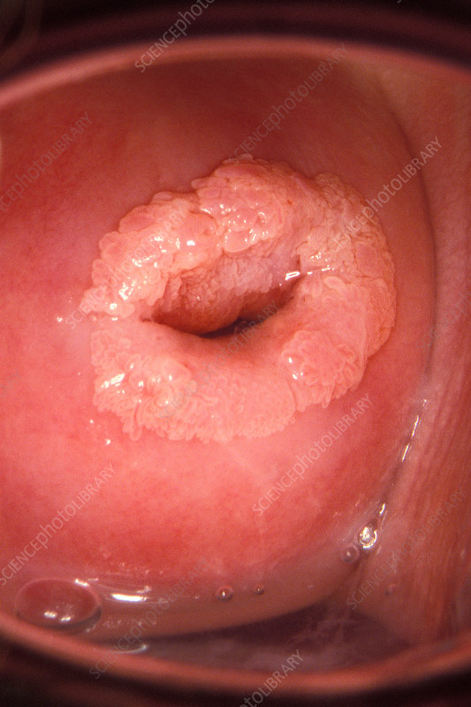
Cervical warts
Due to HPV
In HX :Its mostly asymptomatic.
May be visible grossly as Single or multiple condylomata acuminata , These warts are often flat,
In examination :When swabbed with a solution of 3 to 5 percent acetic acid, they become white and thus more visible to the naked eye.
Cytology/colposcopy may reveal squamous intraepithelial neoplasia.

Slide 56
Benign Disease of the Uterus
Endometrial Fibroids
Adenomyosis

Slide 57
Fibroid
Uterine leiomyomas (fibroids) are benign, hormone-sensitive uterine neoplasms.
It is the most common pelvic neoplasm in females.
They arise in reproductive-age females and, when symptomatic, typically present with symptoms of abnormal uterine bleeding and/or pelvic pain/pressure. Uterine fibroids may also have reproductive effects (eg, infertility, adverse pregnancy outcomes).
Etiology: Excessive estrogen causes more proliferation of mymetruim , so hypersetorgenic state : early meanrch , late menapause , nulliparity , anovulation like PCOS, obese , ethnicity black race

Slide 58
Fibroid: Presentation
The majority of myomas are small and asymptomatic, but many patients with fibroids have significant problems that interfere with some aspect of their lives and warrant therapy. These symptoms are related to the number, size, and location of the tumors.
Symptoms are classified into three categories:
1)Heavy or prolonged menstrual bleeding
2)Bulk-related symptoms, such as pelvic pressure and pain
3)Reproductive dysfunction (ie, infertility, miscarriage, obstetric complications)
Among symptomatic patients with uterine fibroids, abnormal uterine bleeding (AUB) is most commen presenting symptom.

Slide 59
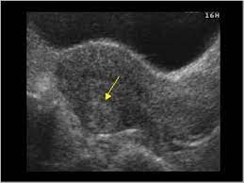
Fibroid: Investigation
1)Ultrasound (best initial test)
Concentric, hypoechoic, heterogeneous tumors
Calcifications or cystic areas suggest necrosis
2)Saline-infused sonography: can be used to better visualize submucosal and intramural fibroids
3)Hysteroscopy: to assess submucosal fibroids
4)MRI: to evaluate the uterus and ovaries for potentially complicated surgical cases and visually differentiate between leiomyomas, adenomyomas, and adenomyosis

Slide 60
Fibroid: Treatment
Treatment should only be considered in symptomatic patients because of the side effects of medical therapy and surgery. The goal is to relieve symptoms. Perimenopausal women warrant expectant management in most cases.
Asymptomatic fibroids
Do not require treatment
Frequent follow-ups (approx. every 6–12 months) with pelvic ultrasonography and symptom monitoring
Patients should be counseled to contact their physician if new symptoms develop.
Symptomatic fibroids
The choice of treatment modality depends on the patient's desire to preserve fertility, other personal preference, comorbidities (e.g., contraindications to surgery), and severity of symptoms.
Postmenopausal patients and those who do not wish to conceive in the future are eligible for all forms of treatment, i.e., medical therapy, interventional therapy, and surgery. The options available to patients who wish to conceive in the future are medical therapy and myomectomy.

Slide 61
Fibroid: Medical Therapy
First-line:
1)Combined oral contraceptive pill and progestin-only contraceptive pill:
Control bleeding and pain but may promote the growth of leiomyomas also used as adjuvants to GnRH agonist therapy
2)Progestin-releasing intrauterine device (IUD): controls heavy and painful bleeding but does not treat fibroids themselves (only for fibroids that do not distort the inside of the uterus)
3)Antifibrinolytics (e.g., tranexamic acid): Reduce heavy bleeding, used in patients who do not wish to use hormonal contraceptives
4)NSAIDs: for dysmenorrhea
Second-line: drugs that may help reduce tumor size and decrease tumor vascularization
1)Gonadotropin-releasing hormone (GnRH) agonists: e.g., leuprolide, goserelin, nafarelin
Optimal treatment prior to surgery but not suited for long-term monotherapy (> 6 months) due to risk of osteoporosis, hot flushes, depression, Decrease size of leiomyomas,Suppress growth of new leiomyomas,Decrease tumor vascularization nduce amenorrhea and, thereby, improve anemia
Leiomyomas recur once therapy is discontinued (rebound growth).
2)GnRH antagonists e.g., oral elagolix, relugolix
3)Androgenic agonists (e.g., danazol): suppress growth of fibroids but have many potential side effects (e.g., acne, edema, hair loss, etc.)
4)Selective progesterone receptor modulators (SPRMs): e.g., ulipristal acetate, mifepristone (currently only approved in Canada and Europe)
common cold
Most patients have mild symptoms and generally do not cause pneumonia; influenza can cause high fever, cough, sore throat, muscle pain, etc.
Symptoms of the patients are mainly fever, fatigue, and dry cough. Some patients have no fever symptoms and may experience chest tightness and dyspnea.

Slide 62
Fiboid:Surgical Treatment
Myomectomy: surgical removal of fibroids
Surgery is often preferred in rapidly growing fibroids, recurrent refractory bleeding secondary to medical therapy, and in severe symptoms.
Approach
Hysteroscopic myomectomy: submucosal fibroids and some intramural fibroids that are primarily intracavitary
Abdominal myomectomy (laparoscopic or open incision): subserosal and intramural fibroids

Slide 63
Fiboid:Surgical Treatment
Treatment options that will affect fertility
Interventional therapy
1)Uterine artery embolization: a percutaneous, radiologic procedure in which an embolic agent is injected into the uterine artery in order to block the blood supply to the fibroid(s)
25% of patients require further invasive treatment (e.g., hysterectomy) due to failed embolization or recurrent symptoms
Indications
Recurrent refractory heavy bleeding and/or severe pain unresponsive to medical treatment
Contraindications to surgery or personal preference to avoid surgery
No desire to preserve fertility, but wish to preserve the uterus
2)Magnetic resonance-guided focused ultrasound surgery (MRgFUS): a procedure that utilizes MRI and ultrasound waves to destroy fibroids
3)Surgery: hysterectomy with/without bilateral salpingo-oophorectomy (definitive treatment) )

Slide 64
Adenomyosis
Adenomyosis: benign disease characterized by the occurrence of endometrial tissue within the myometrium.
Epidemiology: peak incidence at 35–50 years
Etiology: The exact etiology is unknown, though some risk factors have been identified:
Endometriosis
Uterine fibroids
Parity
Clinical features
May be asymptomatic
Dysmenorrhea
Abnormal uterine bleeding
Chronic pelvic pain, aggravated during menses
Globular, uniformly enlarged uterus that is soft but tender on palpation

Slide 66
Adenomyosis
Diagnostics
Diagnosis is clinical and may be supported by transvaginal ultrasound and MRI findings
Asymmetric myometrial wall thickening
Myometrial cysts
Histology serves to confirm the diagnosis.
Treatment
Conservative
Combined oral contraceptives ,
Progestin-only contraception (e.g., IUD, continuous-use contraceptive pill)
NSAIDs for pain relief
GnRH agonists
Surgical
Hysterectomy is the definitive treatment.
Excision of single, organized adenomyomas.

Slide 67
DDX for fibroid

Slide 68
DDX for Heavy menstrual bleedind

Slide 69
A 42-year-old woman, gravida 2 para 2, comes to the office for evaluation of pelvic pain. The patient's menses are painful, with heavy bleeding that requires her to change her tampon every hour during the first 2 days. She did not have painful menstrual periods until a few years ago. The pelvic pain used to subside after menses but has become constant over the past few months and is unrelieved by ibuprofen. Her menstrual cycles are regular, occur every 28-30 days, and last 4 days. She has had no dysuria, urinary frequency, or constipation. The patient had a tubal ligation after her last delivery. She has not had cervical cancer screening within the past 5 years and is not sexually active. Temperature is 36.7 C (98 F), blood pressure is 120/70 mm Hg, and pulse is 78/min. Examination shows a boggy uterus that is tender to palpation.
Notes:
This patient's chronic pelvic pain and heavy menstrual bleeding are most likely due to adenomyosis, a condition in which endometrial glands and stroma accumulate abnormally within the uterine myometrium. Adenomyosis typically occurs in multiparous women age >40 and is characterized by new-onset dysmenorrhea due to the cyclic shedding of the endometrium within the myometrium. The continued accumulation of endometrial tissue within the myometrium causes an increase in the endometrial cavity surface area (resulting in heavy menstrual bleeding) and progression to chronic pelvic pain. The entrapped endometrial tissue within the uterine myometrium results in a boggy, tender uterus on examination; it also induces myometrium hypertrophy, which causes a concentric or symmetrically enlarged uterus. The initial workup of suspected adenomyosis consists of pelvic ultrasonography and/or MRI. A definitive diagnosis is made histologically after hysterectomy, which is also the treatment for patients who do not improve with conservative management (eg, oral contraceptives, progestin-releasing intrauterine device).

Slide 70
A 30-year-old nulliparous woman comes to the office because of painful and heavy menstrual bleeding for the past 11 months. Menses occur at regular 30-day intervals and last 10 days with heavy flow and passage of clots. Her last menstrual period was 2 weeks ago. Menarche occurred at 10 years of age. She and her husband have tried to conceive for the past year and she had a miscarriage 6 months ago. Family history is unremarkable. She does not smoke cigarettes, drink alcohol, or use illicit drugs. She takes no medications. Vital signs are within normal limits. Pelvic examination shows no abnormalities. Laboratory studies, including a complete blood count and coagulation studies, are within the reference ranges. A serum pregnancy test is negative. Pelvic ultrasonography shows a hypoechoic, 2 cm in diameter, round mass in the uterine cavity that is attached to the uterine wall by a narrow stalk. Which of the following is the most appropriate next step in management?
A)GnRH agonist
B)Hystroscopic myomectomy
C)Endometrial ablation
D)uterine artery embolization.
Notes:
Hysteroscopic myomectomy is the first-line treatment of submucosal fibroids. Large submucosal fibroids may prevent nidation or increase the risk of miscarriage, and fibroid removal can improve chances of a successful pregnancy. Hysteroscopic myomectomy can be performed as a minimally invasive outpatient procedure that poses a low risk to future fertility and provides rapid relief of symptoms. In patients who do not desire surgery or in whom surgery is contraindicated, medical management with combined oral contraceptives or progestin-releasing intrauterine devices is recommended. Other treatment options include gonadotropin-releasing hormone analogs (second-line treatment), or uterine artery embolization (third-line treatment).
UTERINE LEIOMYOMA

Slide 71
A 42-year-old woman, gravida 3, para 3 comes to the physician because of a 14-month history of prolonged and heavy menstrual bleeding. Menses occur at regular 28-day intervals and last 7 days with heavy flow. She also feels fatigued. She is sexually active with her husband and does not use contraception. Vital signs are within normal limits. Pelvic examination shows a firm, irregularly-shaped uterus consistent in size with a 16-week gestation. Her hemoglobin concentration is 9 g/dL, hematocrit is 30%, and mean corpuscular volume is 92 μm3. Pelvic ultrasound shows multiple intramural masses in an irregularly enlarged uterus. The ovaries appear normal bilaterally. The patient has completed childbearing and would like definitive treatment for her symptoms. Operative treatment is scheduled. Which of the following is the most appropriate next step in management?
A)Progesterone only contarceptive pill
B)Red cell concentrates
C)Levonogestril IUD
D)Leuprolide
E)Estrogen-Progesterone contarceptive pills
Notes:
A GnRH agonist (e.g., leuprolide) is prescribed for patients with large and/or multiple uterine leiomyomas 2–3 months prior to surgery. GnRH agonists can reduce the size of leiomyomas by inducing hypoestrogenism and hypoprogesteronism. A reduction in the size of leiomyomatous uterus decreases surgical time, speeds up postoperative recovery, and may even enable a vaginal hysterectomy (which causes less blood loss than an abdominal hysterectomy). GnRH agonists also treat menorrhagia by inducing amenorrhea, which improves hematocrit levels before surgery

Slide 72
A 37-year-old woman, gravida 3, para 3, comes to the physician for very painful menses that have caused her to miss at least 3 days of work during each menstrual cycle for the past 6 months. Menses occur with heavy bleeding at regular 28-day intervals. She also has constant dull pain in the pelvic region between cycles. She is otherwise healthy. She weighs 53 kg (117 lb) and is 160 cm tall; BMI is 21 kg/m2. Pelvic examination shows no abnormalities. Pelvic ultrasonography shows a uniformly enlarged uterus and asymmetric thickening of the myometrial wall with a poorly defined endomyometrial border. Which of the following is the most likely cause of these findings?
A)Endometrial tissue within the uterine wall
B)Endometrial tissue within the fallopian tubes.
C)Neoplastic changes of the endometruim.
D)Benign smooth muscles of the uterus.

Slide 73
A 29-year-old nulliparous woman comes to the physician for an annual health maintenance examination. She feels well, has no history of serious illness, and takes no medications. Menarche was at the age of 10 years and menses occur at regular 28-day intervals with moderate flow lasting for 5 days. She is sexually active in a monogamous relationship with her husband and uses a copper intrauterine device (IUD) for contraception. She is 167 cm (5 ft 6 in) tall and weighs 92 kg (203 lb); BMI is 33 kg/m2. Vital signs are within normal limits. Physical examination, including pelvic examination, shows no abnormalities. Transvaginal ultrasonography shows a well-positioned IUD and a 3.5-cm, concentric, hypoechoic, heterogeneous mass in the posterior myometrial wall. Ultrasonography performed 4 years ago, when the copper IUD was placed, showed no abnormalities. Which of the following is the most appropriate next step in management?
A)Replace copper IUD with progesterone IUD
B)Replace ultrasound in 6-12 months
C)Remove copper IUD and perscripe oral contraxeptive pills.
D)Preform hystroscopy with endometrial biobsy.
Notes:
Patients like this one with asymptomatic uterine leiomyomas do not require treatment, as leiomyomas often remain stable or regress on their own. These patients can be followed up approximately every 6–12 months with symptom monitoring and pelvic ultrasonography for evaluation of leiomyoma growth. Patients should be counseled to contact their physician earlier if new symptoms develop, such as menstrual abnormalities (e.g., menorrhagia), reproductive dysfunction (e.g., infertility, dyspareunia), and bulk symptoms (e.g., pelvic discomfort, urinary frequency, constipation). Treatment should be considered in patients with symptomatic leiomyomas.
****Hystroscopy with endometrial biopsy should be performed in patients with suspected uterine malignancy (e.g., leiomyosarcoma). In patients with a known history of uterine leiomyoma, malignancy should be suspected if they present with significant bulk symptoms (e.g., pelvic pain) and bleeding that is out of proportion to uterine size. Although this patient has a history of leiomyoma, she is asymptomatic; therefore, hysteroscopy with endometrial biopsy is not indicated.
While hysteroscopy alone can be performed in patients with submucosal leiomyomas to evaluate the extent of protrusion into the endometrial cavity, this patient has an intramural leiomyoma and is, therefore, unlikely to benefit from a hysteroscopic evaluation.

Slide 74
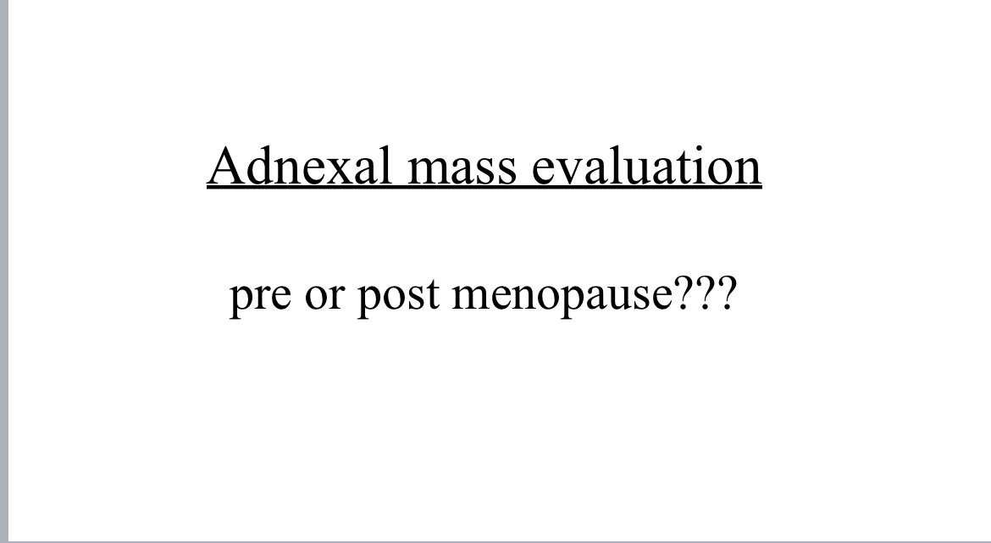

Slide 75
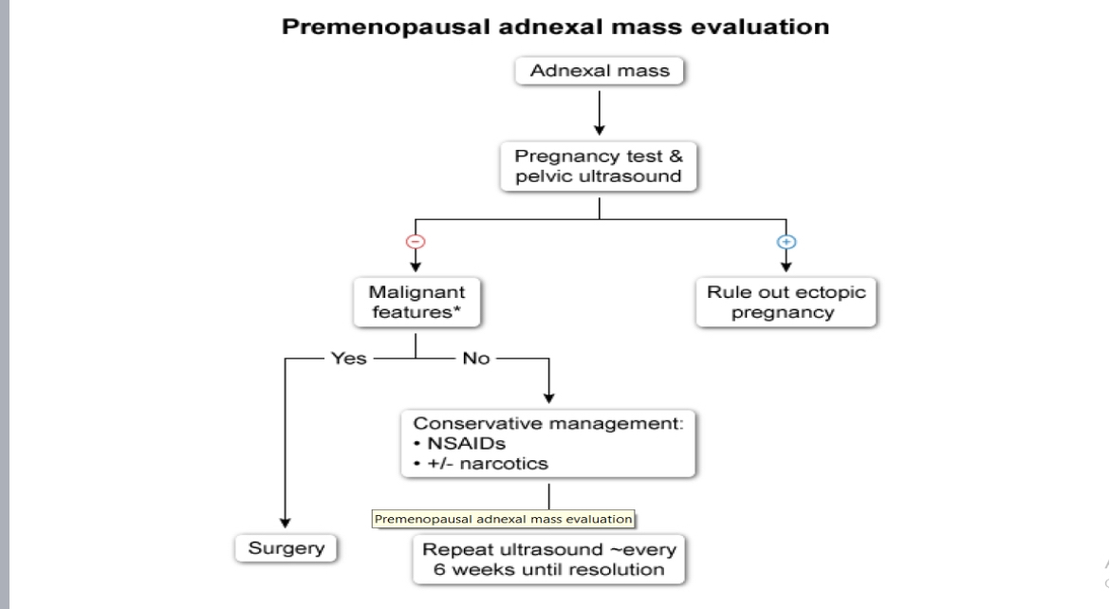

Slide 77
Benign ovarian mass

Slide 78
A 42-years-old woman, G3p2+1came to Hospital’s with complaints of tightness and difficulty in breathing because her abdomen is increasingly enlarged and hardened. Complaints were already present for three years ago, but she never sought medical attention until now because she started feeling short of breath. The patient also complained of generalized abdominal pain that is colicky in nature intermittent 7/10 severity associated with nausea and constipation not associated with fever or any abnormal vaginal discharge

Slide 79
Past gynaecological history
Menarche at 13 y/o regular 4-5/29 light no dysmenorrhea
Her cycle was irregular and patient complain also from deep dyspareunia for 5 years
No heavy bleeding or intermenstural bleeding

Slide 80
Family history
There is no family history of ovarian or breast cancer

Slide 81
Physical examination
Measurement of vital signs are as follow: blood pressure 130/80 mmHg; heart rate 89, regular; respiratory rate 22 breaths per minute, regular; axillary temperature 36C; and oxygen saturation 99%. The patient weighs 67 kg with 153 cm height (nutritional status is classified as obese, BMI 27.5 kg/m².
There is no sign of hirsutism And acne

Slide 82
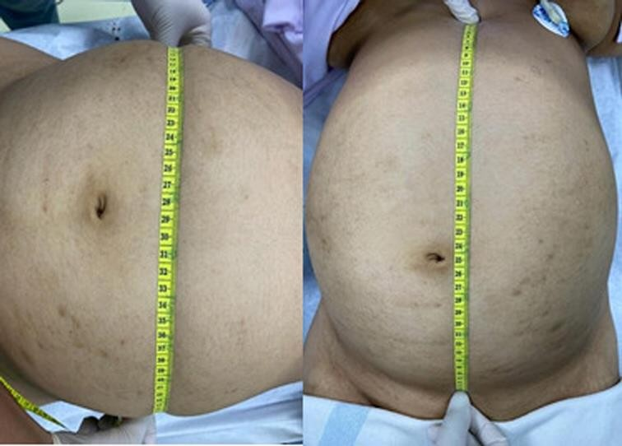
Inspection of the abdomen revealed
significant distention (32 cm × 54 cm) . Bowel
sound was absent on auscultation. Abdomen was dull on percussion, tenderness on palpation. Liver and spleen were unpalpable
The mass is mobile .
Normal hair distribution

Slide 83
Pelvic examination
By speculum examination the cervix is closed and normal on Colour and no abnormal purulent cervical discharge
Pv examination there is no cervical motion tenderness
Bimanual exam the uterus is small in size normal contour firm smooth surface anteverted freely movable non tender and it separated from the mass and Adnexal motion tenderness

Slide 84
Lab test
Pregnancy test was negative
Complete blood count examination revealed an increase in creatinine (1.6 mg/dL and calcium (1.28 mmol/L [normal range 1.00–1.15 mmol/L]), other parameters were normal.
CRP negative
LH 7 IU/L (normal range)
All tumor markers were within normal limit
CA125 elevated (86.5)

Slide 85
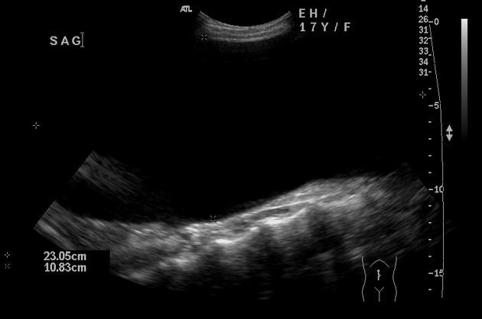
Abdominal Ultrasound

Slide 86
U/s finding
A large unilocular cystic lesion, located in the midline. There are no evident solid components, papillary projections or internal septations. On ultrasound, it is difficult to assess the lesion in its entirety due to the very large size. The right ovary is identified, separate to the mass. Left ovary not visualised

Slide 87
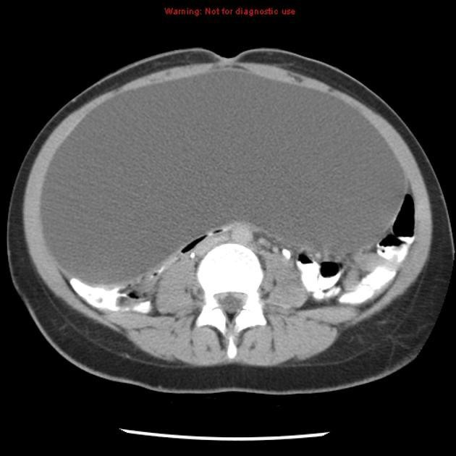
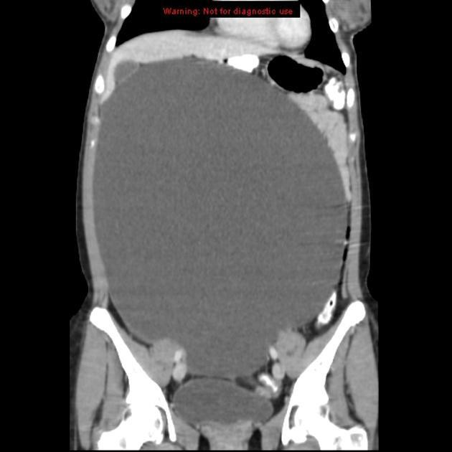
Ct scan
CT confirms the presence of a large, solitary well-defined abdominopelvic cystic mass lesion. There are no internal septations, solid components or papillary projections.
There is a small amount
of pelvic free fluid.
Size 25 *27 cm

Slide 88
Risk of malignancy index
RMI=ultrasound finding x Menopausal symptom xCA125 = zero due to no abnormal U/S finding
Risk of malignancy <3%

Slide 89
The surgical management of giant ovarian cystadenoma must pay attention to various factors, especially in the case of adolescents, where the operative strategy is to cure, and also maintain fertility in the patient. And during surgery, do not take the part where there is no cyst, and only do a cystectomy (9). The management approach is determined on the size of the cyst, the equipment available, and the surgeon’s level of skill. Many experts advise against aspirating the contents of the cyst because of problems such as infection, hemorrhage, cyst rupture, and a higher risk of peritoneal adhesion. An immediate complication to be feared when removing a giant ovarian cyst is the vacuum shock requiring a good preventive vascular filling

Slide 90
The patient scheduled for oophorectomy through open incision below umbilical midline Ovarian cyst was successfully removed without any complications during and after surgery. No complications were observed in the 30 days after surgery. Histopathological examination results confirmed serous cystadenoma

Slide 91
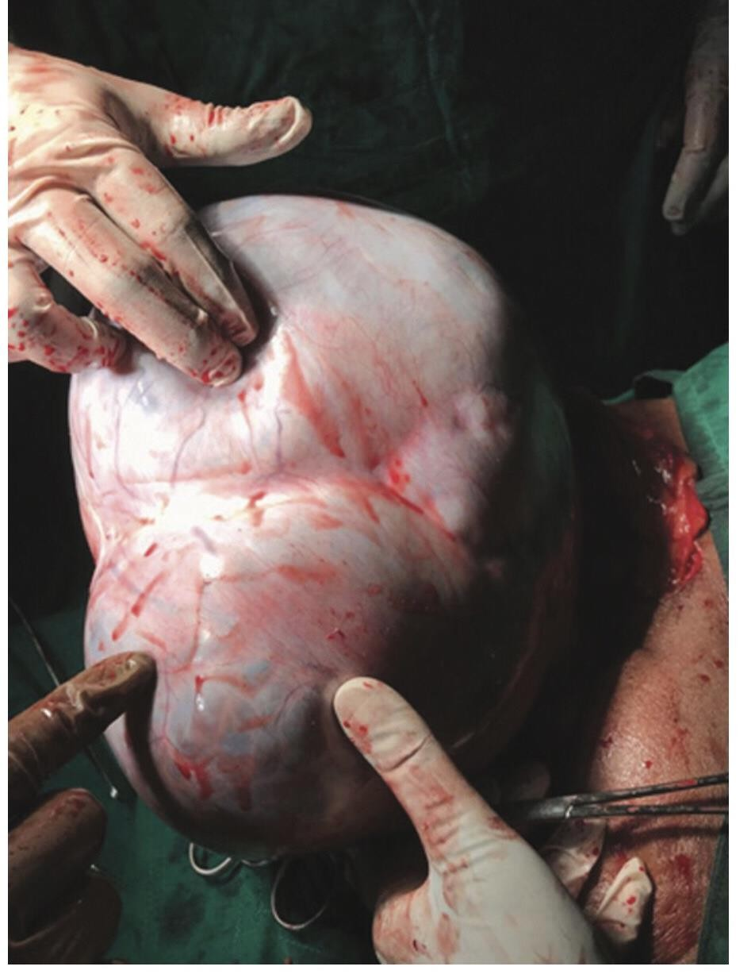

Slide 92
Differential diagnosis
Functional cyst (duration less than 3 cycle and size less than 10 cm)
Mucinous cystadenoma (ultrasound finding )
Gravied uterus (negative pregnancy test and duration and Normal size of uterus )
Luteoma (no pregnancy )and no sign of virilization
Pcos no sign of hyperandrogenism and LH within normal range and the size
is smaller
Endometriomas in rare cases it exceed 15 cm but here the ultrasound finding rule out endometriomas

Slide 93
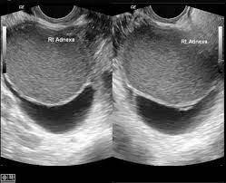

Slide 94
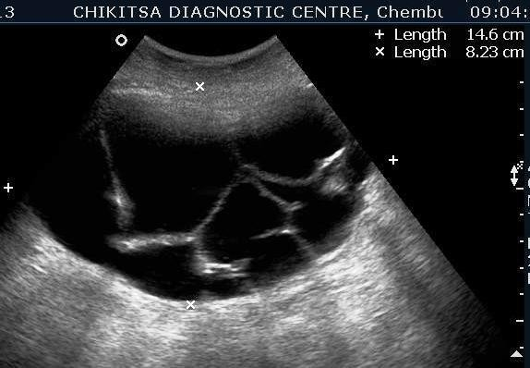
Mucinous cystadenoma

