Slide 1
Resting membrane potential
Dr. Nour A. Mohammed
MUTAH SCHOOL OF MEDICINE

Slide 2
Definition:
it is the potential difference between inside and outside the cell membrane with inside relatively negative to outside.
It ranges from –9 mvolt to –100 mvolt .
in RBCs it equals -30 mvolt.
in medium sized nerve it equals -70 mvolt
in large sized nerve it equals –90 mvolt
in the muscle –90 mvolt.

Slide 4
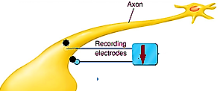
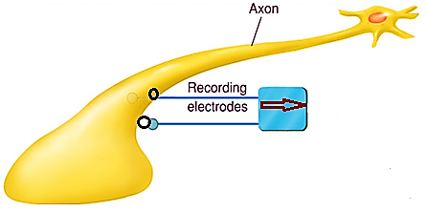
Evidence:
If 2 electrodes are put on the outer surface of the cell membrane or on the inner surface of cell membrane, no deflection on the galvanometer (there is no potential difference).
If one electrode is put on outside and the other inside the cell membrane
there is deflection in the galvanometer.

Slide 5
Causes of RMP
It is due to unequal distribution of ions across the cell membrane
outside: Na⁺(142mEq./L), Cl⁻(103mEq./L), HCO₃⁻(28mEq./L)
inside: K⁺(140mEq./L) & protein⁻ (40mEq./L))
more cations outside
and more anions inside.

Slide 6
This unequal distribution is caused by three factors:
I- Selective permeability of the cell membrane
2- Na+ - K+ pump
3- The membrane is impermeable to the intracellular protein anions with large molecular weight (protein)

Slide 7
[I] Selective permeability of the cell membrane:
The cell membrane is semipermeable and has pores (channels)
These channels are:
1- leakage channels (passive)
2- gated channels (active)

Slide 8
1- leakage channels (passive)
Watery pathway through protein molecules.
Open all time.
Not gated
Tube shaped, 7o (Angstrom) in diameter.
Highly selective and this selectivity depend on
N.B: Na ⁺ channels have negative charge while K ⁺ channels have no charge

Slide 9
To which ion the cell membrane is more permeable (Na ⁺ or K ⁺ ) and why ?

Slide 10
The membrane is more permeable to K+ than to Na+ ions because the hydrated K+ is smaller in size than the hydrated Na+ .So, K+ permeability 50-100 times greater than Na+ permeability.

Slide 11
2-Gated channels (active)
have gates
These gates may be opened or closed by changing the shape of protein molecules in the channel in response to various agents:
1- if change in ionic composition (Voltage gated channels)
2- if binding with certain chemical substances (ligand gated channels).
**Na+ channels have outer activation and inner inactivation gates .
** K+ channels have one inner gate.

Slide 12
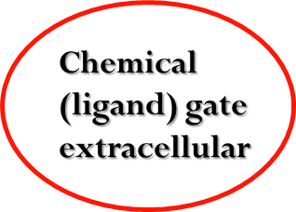
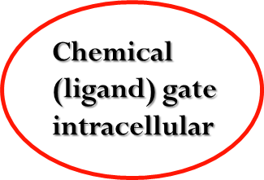
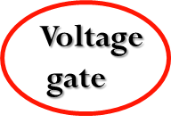

Slide 13
N.B.
During rest the movement of ions is through the leakage channels
During stimulation and action potential it occurs via the gated ones.

Slide 14
Membrane permeability:
As regard to Na⁺: Na⁺ tend to diffuse into the cell according to its concentration and electrical gradient until it is balanced by Na⁺ efflux according to electrical gradient, at equilibrium the membrane potential = +61 mv.
As regard to K⁺: K⁺ diffuse from inside to outside according to its concentration gradient till +ve charge outside repel more K⁺ diffusion (electrical gradient). at equilibrium the membrane potential = -94 mv.

Slide 15
Nernest equation
used to determine the equilibrium potential of each ion.
Electromotive force (EMF) = ± 61 log (concentration inside/conc. outside the membrane).
e.g. for Na+ EMF = -61 log (15/150) = +61 millivolt.
for K+ EMF = -61 log (150/5) = -94 millivolt.
According to the degree of the permeability of the membrane to Na+ and K+ the potential will determined.
Goldman equation is used to determine the equilibrium potential of all ions ,which is about –86 millivolt (near to the equilibrium potential of K+ indicating that K+ permeability is the main force responsible for the resting membrane potential.

Slide 16
[II] Na+ - K+ pump:
At rest:
some Na⁺ can enter inside the nerve fibre.
During action potential large number of Na⁺ ions enter the cell and K⁺ efflux occur so,
the Na⁺ pump is required to return Na⁺ outside (against conc. and electrical gradient) and K⁺ pump is required for return K⁺ inside the cell against the concentration gradient only.

Slide 17
Na⁺-K⁺ pump needs:
energy source (ATP)
ATPase enzyme for liberation of energy.
large carrier protein present in the cell wall.
Its internal surface has 3 receptors for Na⁺ and ATPase,
the external surface has 2 receptors for K⁺.

Slide 18
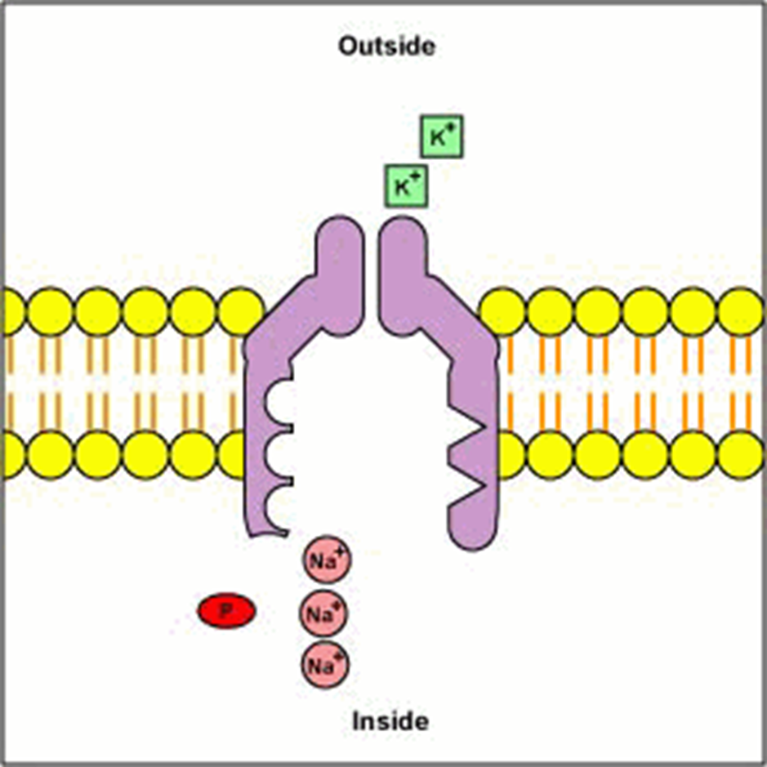
When activated :
by energy from splitting of ATP by ATPase enzyme the pump rotates to push:3 Na⁺ to outside and 2K⁺ to inside the cell membrane.

Slide 19
Importance of the Na⁺-K⁺ pump
1- Maintenance of Na⁺ (extra cellular) and K⁺ (intracellular).
2- It is an electrogenic pump as it causes RMP is more negative inside (- 4 mvolt), (2K⁺ influx and 3 Na⁺ outflux).
3- Control of cell volume as if Na⁺ remains inside the cell, water enters by osmosis and the cell swells.

Slide 21
III] The membrane is impermeable to the intracellular protein anions with large molecular weight.
So
more negative charges inside the cell
(Donnan effect)
This protein regulates diffusion of other anions and cations until reach the Donnan’s equilibrium
Cl- x K+ (inside) = Cl- x K+ (outside)

Slide 22
N.B.
1- the more the negativity of the resting membrane the more the excitability of the tissue
2- the most excitable tissue in the body are nerve and muscles.

