Slide 1
وسهلا
أهلا
الأستاذ الدكتور/ يوسف حسين
أستاذ التشريح وعلم الأجنة
كلية الطب – جامعة الزقازيق- مصر
رئيس قسم التشريح والأنسجة وعلم الأجنة - كلية الطب - جامعة مؤتة
دكتوراة من جامعة كولونيا المانيا
جروب الفيس
د. يوسف حسين (استاذ التشريح)

Slide 2
Uterine cycle

Slide 3
Uterine (menstrual) cycle
- During each ovarian cycle, the endometrium of the fundus and body of the uterus also undergoes cyclic changes that end in hemorrhage (menstruation).
The duration of the menstrual cycle is about 28 days
Starting from the first day of hemorrhage.
- The first cycle at puberty is called menarche.
- The cycle end at menopause age.

Slide 4
Stages of the uterine (menstrual) cycle
Blood
Basal part of uterine gland
(I) Stage of menstruation (bleeding):
** Duration about 3-5 days.
** It consists of blood and pieces of endometrium
** Blood does not clot due to its high contents of fibrinolytic enzymes.
** Structure of the endometrium:
- It is formed of basal layer.
- Its thickness is about 0.5 mm.
** Causes: Sudden drop of the estrogen and progesterone levels in the blood due to degeneration of corpus luteum leading to spasm of the spiral arteries.

Slide 5
Stages of the uterine (menstrual) cycle
Flat cells
(II) Stage of repair إصلاح:
- Duration about 3-4 days
The cells of the basal part of the uterine glands proliferate and migrate to cover the raw surface of the endometrium by flat cells.
** Causes: the effect of estrogen hormone secreted from the ovary.

Slide 6
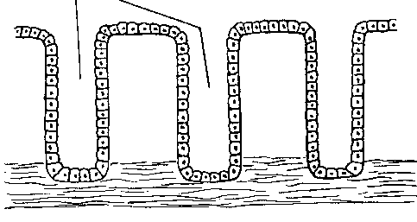
Stages of the uterine (menstrual) cycle
(Ill) Stage of proliferation:
** Duration: about 5-6 days.
** The endometrium shows the following changes:
1- The endometrial cells become cuboidal.
2- The endometrial glands are longer and straight about 4 mm.
3- The spiral arteries become longer and straight.
** Causes: the effect of estrogen hormone secreted from the ovary.

Slide 7
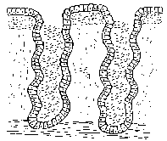
(IV) Stage of secretion:
** Duration: about 10-14 days.
** Causes: it is under the control of progesterone hormone secreted by the corpus luteum الجسم الاصفر.
** The endometrium shows the following changes:
1- The endometrial cells become highly columnar.
2- The endometrial glands become highly tortuous and filled with mucus and glycogen (uterine milk).
3- The spiral arteries become more dilated and tortuous.
4- The thickness is increased about 5-7 mm.
5- The endometrium is formed by 3 layers
Superficial compact layer: contains apices of the glands.
Middle spongy layer: contains the main part of the glands.
- The above 2 layers are supplied by spiral arteries that are estrogen dependent. These layers are only lost with spasm of these arteries.
Deep basal layer: containing the basal part of the uterine glands.
This layer is supplied by the basal (straight) arteries.
Compact Layer
Spiral artery
Spongy Layer
Basal Layer

Slide 8
Common problem of the cycle
Premenstrual tension syndrome: abdominal cramps, lower back pain, bowel issues, fluid retention, headache, trouble sleeping, fatigue, acne, tender breast, mood swings and irritability.
Dysmenorrhea (painful).
Menorrhagia: severe bleeding.
Amenorrhea: no period.

Slide 9
Fertilization

Slide 10
Sperm & Corona radiata
Cumulus ovaricus
Zona pellucida
Head
Cell membrane
Neck
Middle piece
Secondary oocyte
Tail

Slide 11
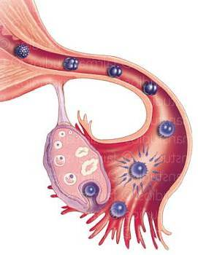
Fertilization is the process by which male & female gametes fuse to form the zygote.
Time of fertilization: during the ovulation that occurs roughly at the 14th days

Slide 12
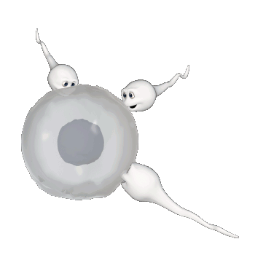
Site: It occurs at ampulla of uterine tube (lateral 1/3 of uterine tube)
The lifespan of the ovum is 24 hour

Slide 13
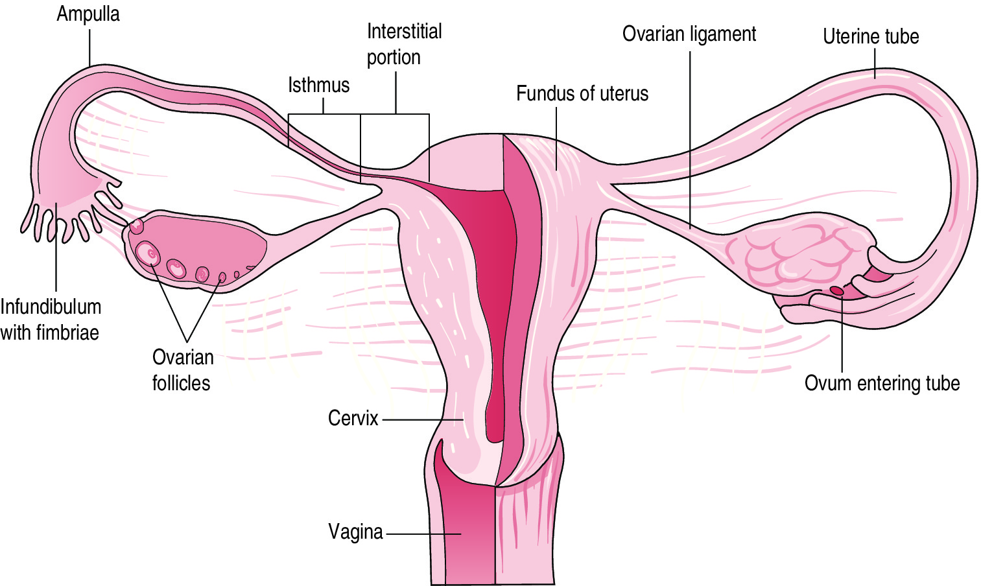
** The sperms reach lateral 1/3 of the fallopian tube by;
1- Movement of tails of the sperms.
2- Contraction of the uterus and fallopian tubes.
3- Movement of the cilia of the uterine tube.

Slide 14
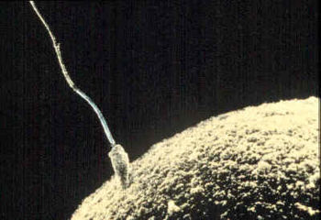
Only 200–300 sperms survive to reach the site of fertilization in the uterine tube
Most of sperms able to fertilization within 48 hours.
Only one can penetrate the secondary oocyte

Slide 15
Steps of Fertilization
Preparatory step
Actual step
1- Penetration of corona radiata barrier (cumulus ovaricus)
2- Penetration of the Zona Pellucida
3- Fusion of plasma membranes of the gametes
1- Sperm Capacitation
2- Acrosomal reaction

Slide 16
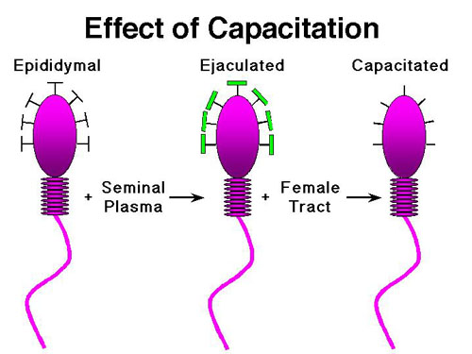
Capacitation, loss of the glycoprotein coat from the acrosomal cap of the sperm head
it lasts about 7 hours in female genital tract
Notes:
This ability is achieved by two processes: (a) capacitation and (b) acrosome reaction.
Capacitation, during which time a glycoprotein coat and seminal plasma proteins are removed from the spermatozoon head

Slide 17
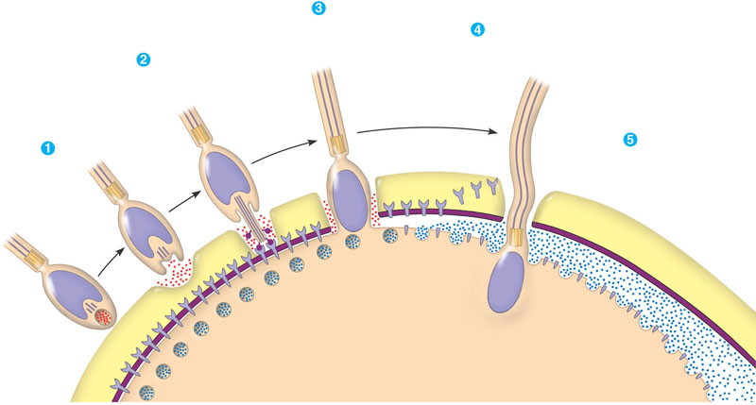
Acrosomal reaction; release of the proteolytic enzymes from the acrosomal cap to help penetration of the sperm to the ovum.
- They include hyaluronidase enzyme, trypsin like enzyme and zona lysine enzyme.
Notes:
The Acrosomal Reaction-
The acrosome reaction, during which acrosin- and trypsin-like substances are released to penetrate the zona pellucida
hydrolytic enzymes dissolve a hole in the jelly coat
actin fibres begin elongate and form the acrosomal process
the acrosomal process elongates further and binds with the sperm binding receptors this binding causes the vitelline membrane to begin to break down

Slide 18
Penetration of the corona radiata cells
Penetration of corona radiate cells by :
Hyaluronidase enzyme of the sperms.
Mucous secretion of fallopian tube.
Only capacitated sperm can pass through the corona radiata barrier

Slide 19
Penetration of the Zona Pellucida
Penetration of the zona pellucida by the zona lysine enzyme and trypsin like enzyme of the sperms.
Zona reaction: After penetration of the sperm, the zona pellucida changes its chemical composition to prevent entry of other sperms.

Slide 20
Fusion of gametes cell membranes
Cortical reaction: after penetration of the sperm, the cell membrane of the 2ry oocyte alters its chemical composition to prevent entry of other sperm.
The 2ry oocyte completes the 2nd meiotic division giving rise to definitive ovum and 2nd polar body. The nucleus of the ovum enlarged to form female pronucleus.

Slide 21
Fusion of gametes cell membranes
The head of the sperm swells and forms the male pronucleus

Slide 22
Fusion of gametes cell membranes
Both male and female pronuclei become in contact with each other and fuse together to form the zygote (46 chromosomes).

Slide 23
Results of Fertilization
Formation of zygote.
Restoration of diploid number (46 chromosomes).
Cleavage (segmentation) starts.
Determination of sex.
Determination of general features by the autosomes chromosomes.
Inhibition of further ovulation and menstrual cycles

Slide 24
Mitosis (cell division) in the new zygote uses centrioles derived from the sperm but the oocyte has no centrioles.
The sperm’s mitochondria degenerate with the formation of the male pronucleus.
This is why all mitochondria in humans are of maternal origin.

Slide 25
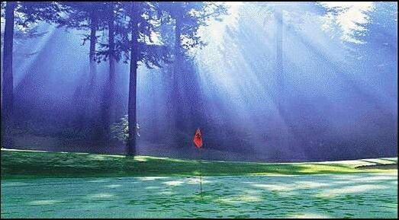
Thank You

