Slide 1
Pathology of the stomach
Dr. Omar Hamdan
Gastrointestinal and liver pathologist Mutah University School of Medicine-Pathology Department Undergraduate Lectures 2023

Slide 2
Overview
▶ Gastric diseases:
1-Inflammatory.
2-Neoplastic.
▶ Stomach parts: cardia, fundus, body, antrum, pylorus.

Slide 3
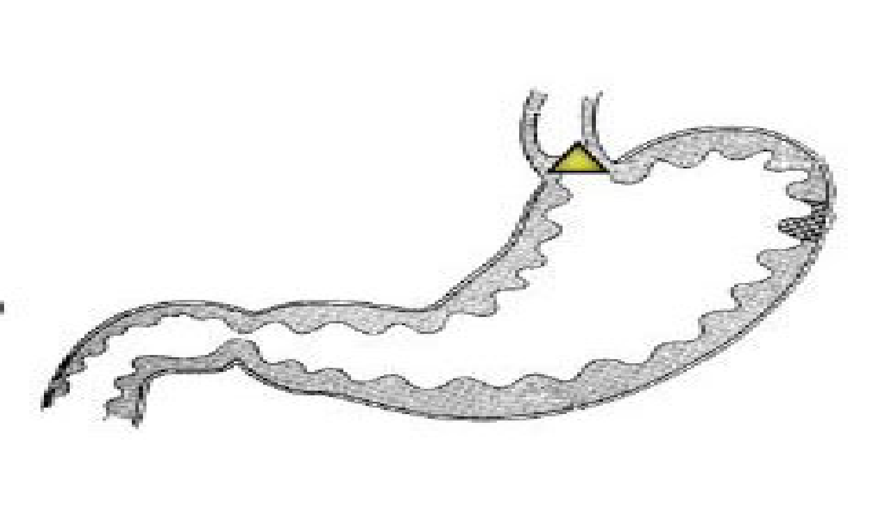
Normal Stomach
Antrum-corpus junction
3 Regions
3. cardia
▶ Cardia: mucin secreting foveolar cells.
▶ Body and fundus: parietal cells (HCL) and chief cells (pepsin).
▶ Antrum: neuroendocrine G cells (gastrin)
fundus
incisura
2. corpus
1. antrum
pylorus
Oxyntic mucosa can occupy the proximal 1/3 of the antrum

Slide 4
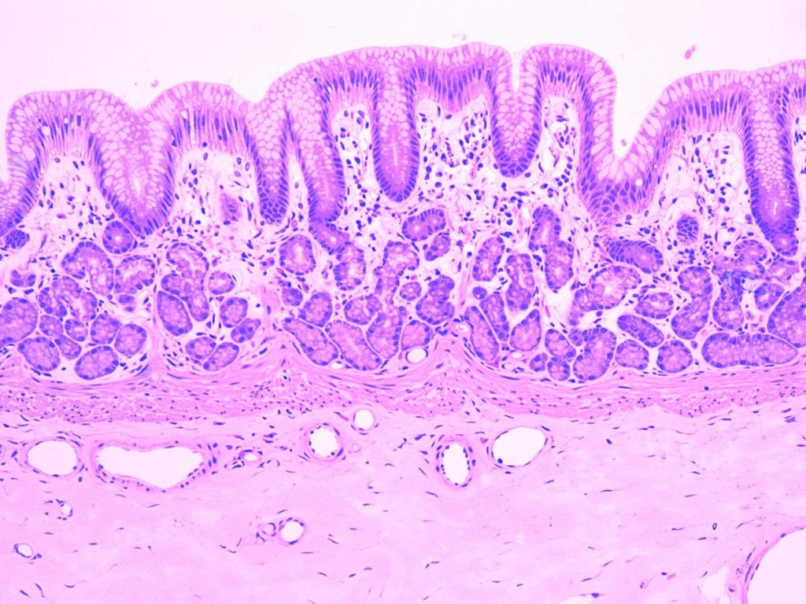
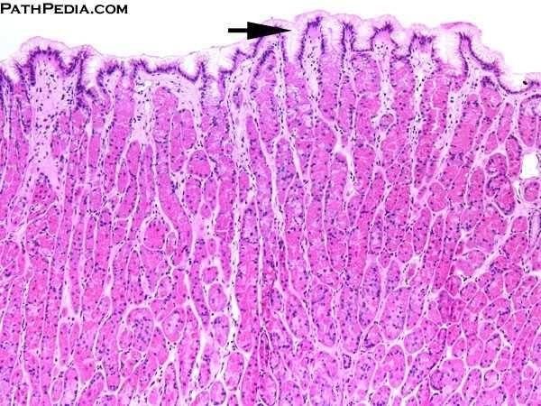
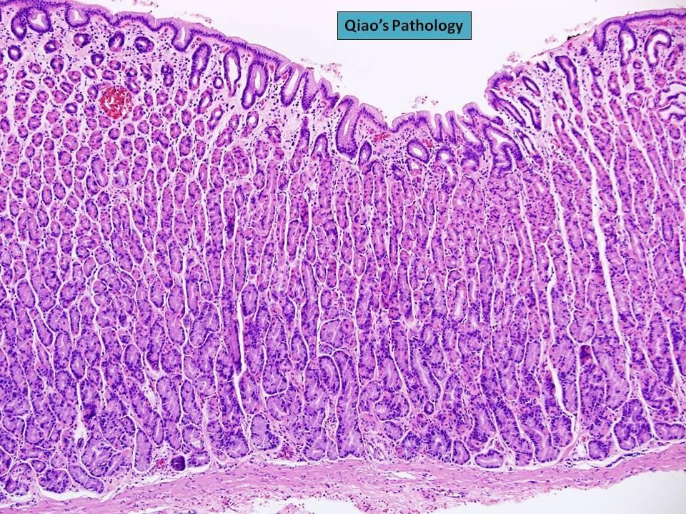
medcell.med.yale.edu

Slide 5
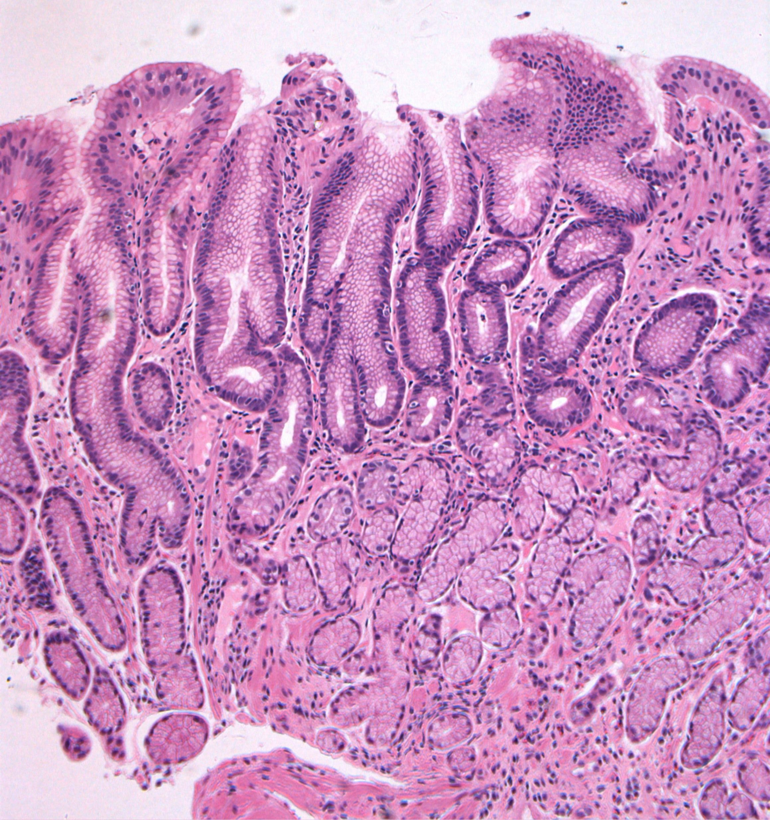
Antrum

Slide 6
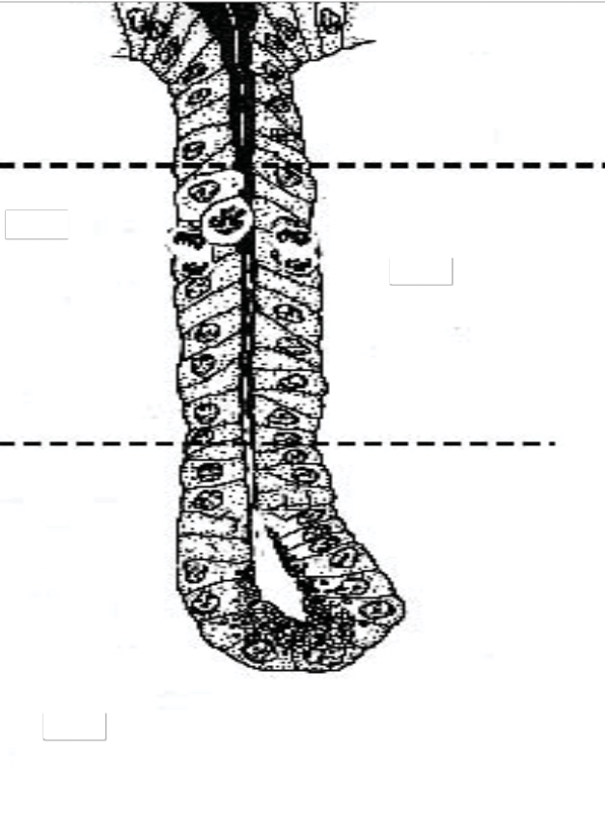
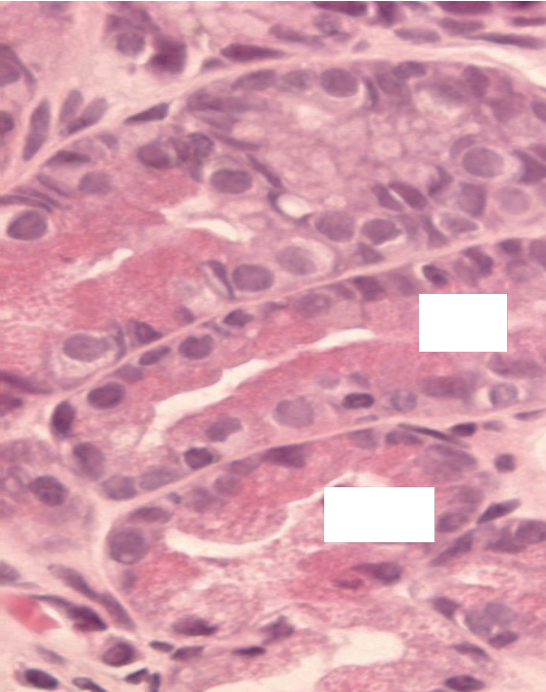
Antrum
Mucous
Normal
Parietal cells
antrum
7

Slide 7
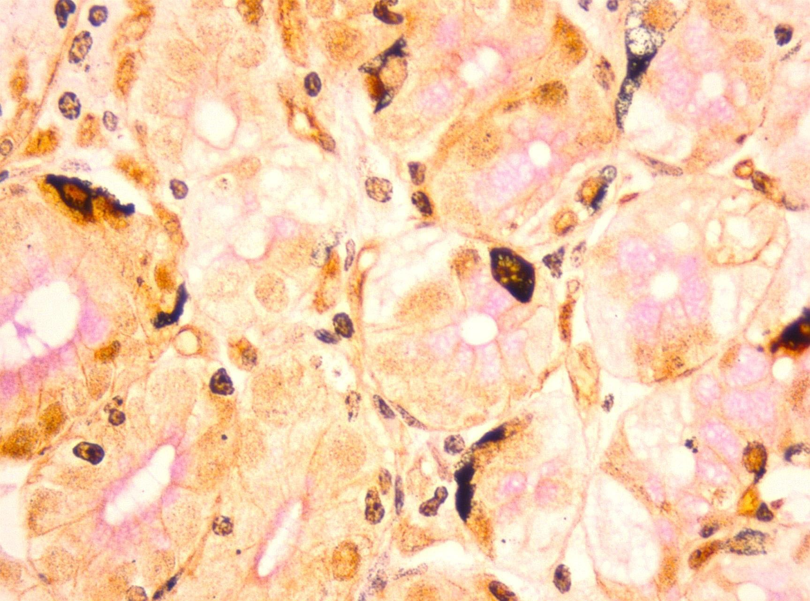
Antrum endocrine cells
Silver stain
Heterogeneous staining pattern
Hence: best use immunostains

Slide 8
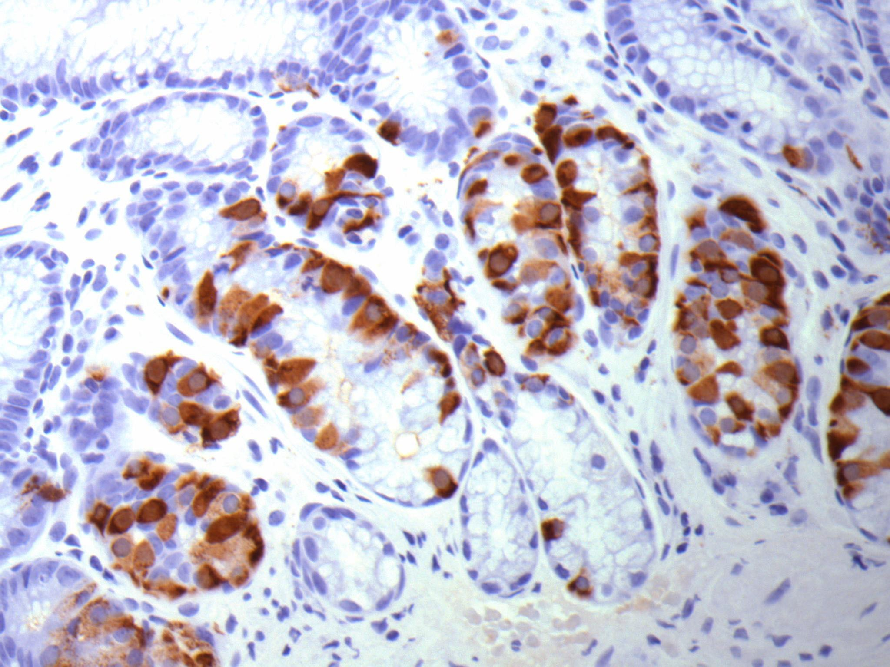
Antrum- Gastrin-Positive

Slide 9
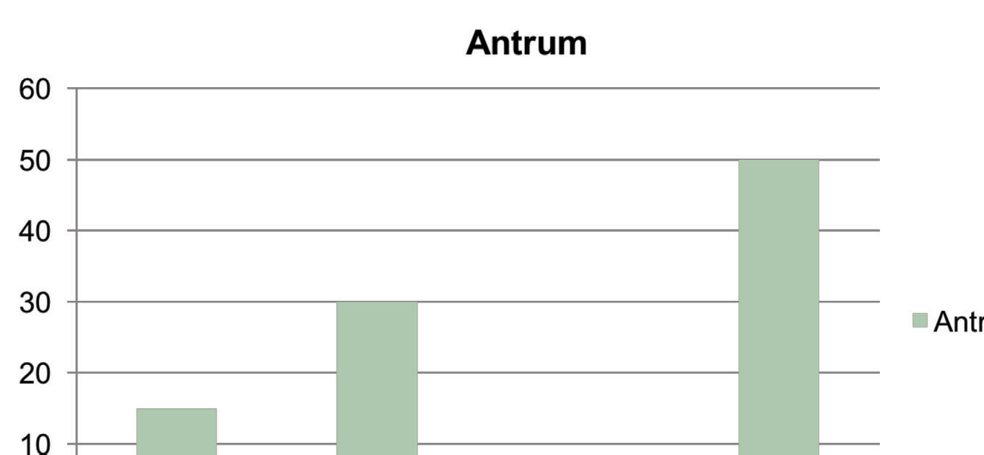
Endocrine Cells Antrum
D somatostatin, EC serotonin, ECL histamine or Ghrelin, G gastrin
Modified from Gasteroenterologia Polska 2006, 13(1): 7-10

Slide 10
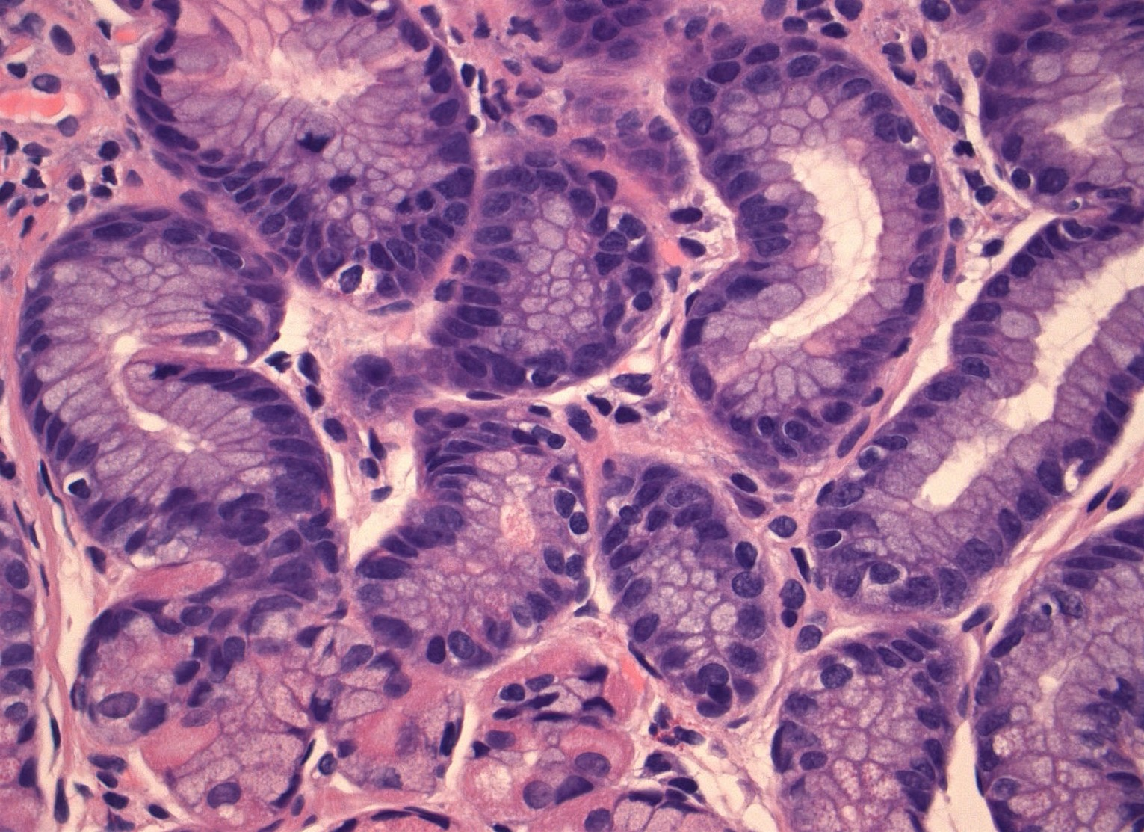
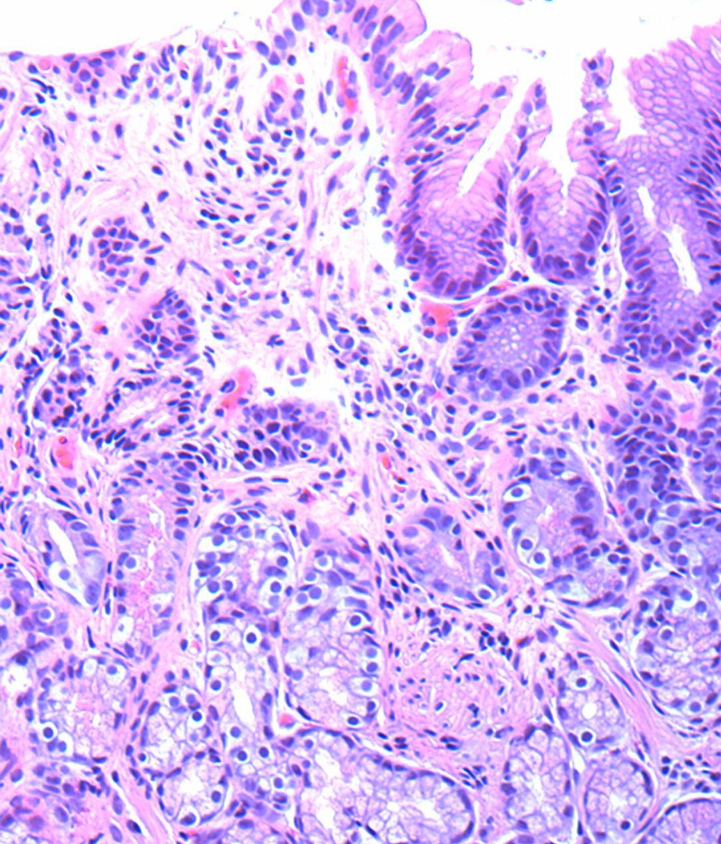
Hypergastrinemia (PPIs) :
Normal : ~ 4 G cells/crypt
> 4 G cells, some crouding

Slide 11
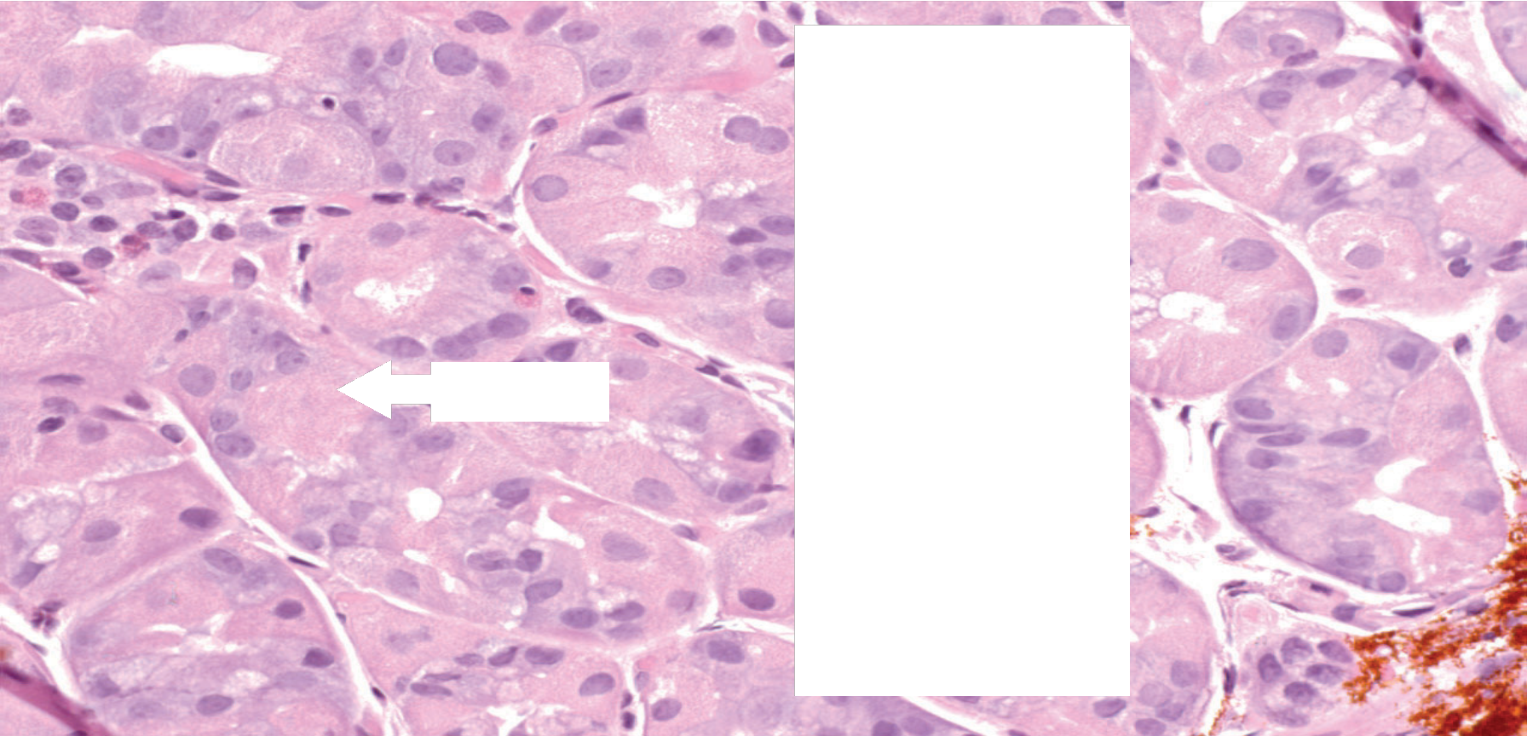
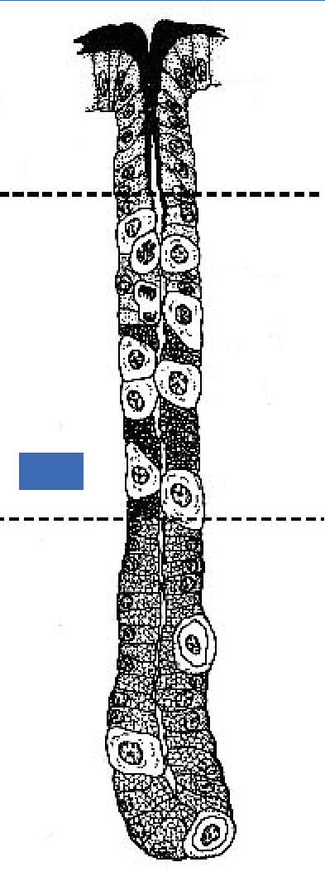
Normal Corpus (oxyntic mucosa)
EGL
Chief
Chief

Slide 12
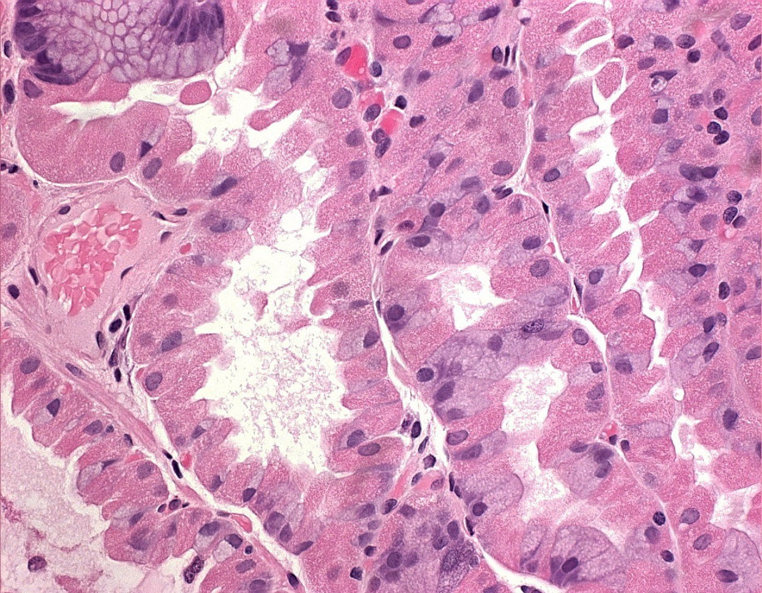
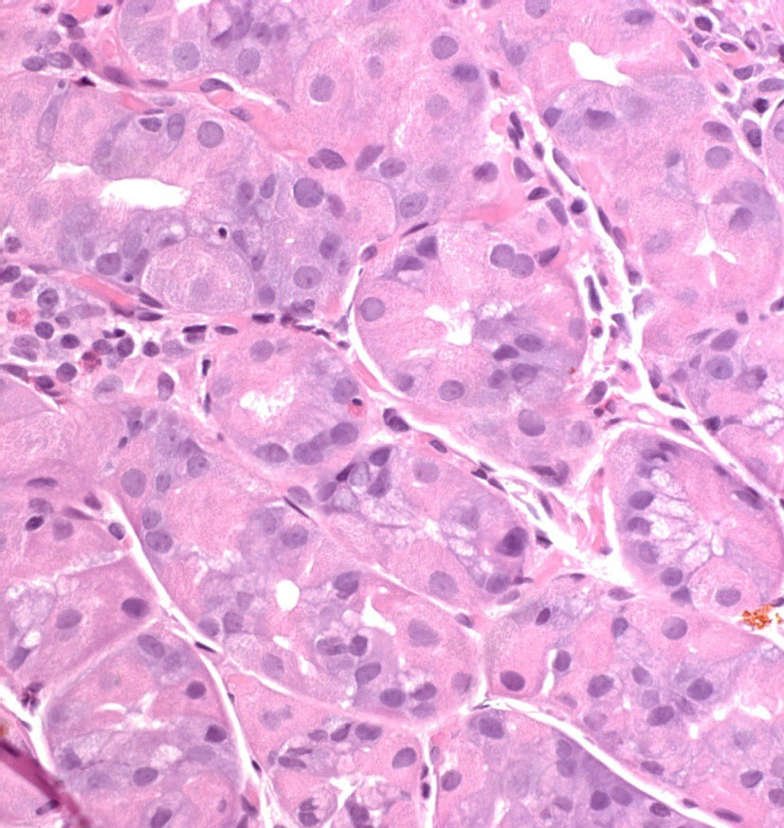
Corpus (oxyntic mucosa)
Constipated parietal cells
Normal Straight lumen border
Hypergastrinemia, e.g.PPls lrregular lumen

Slide 13
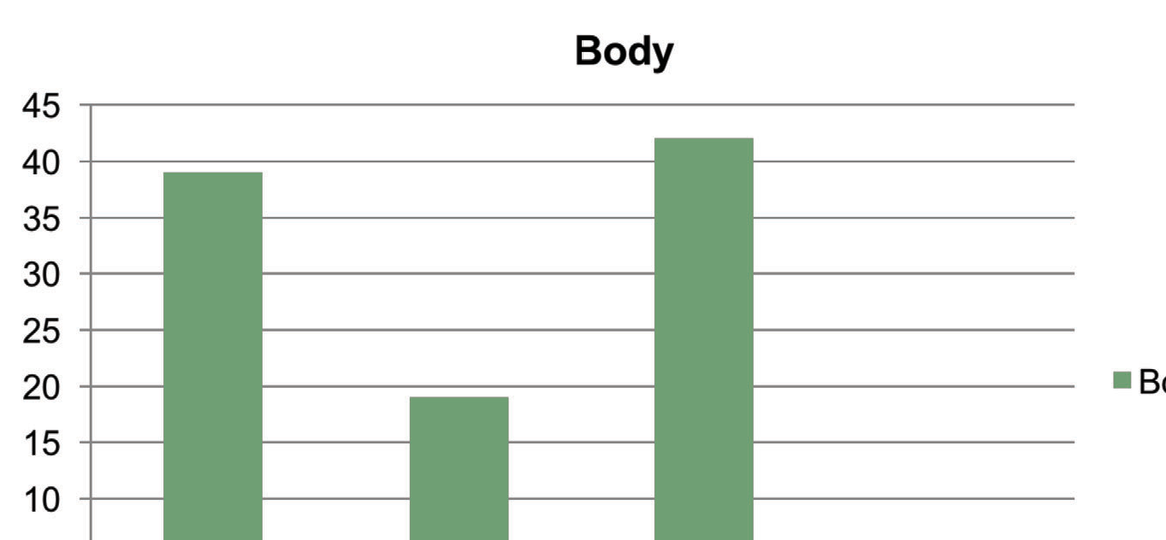
Endocrine Cells body
D somatostatin, EC serotonin, ECL histamine or Ghrelin, G gastrin
Modified from Gasteroenterologia Polska 2006, 13(1): 7-10

Slide 14
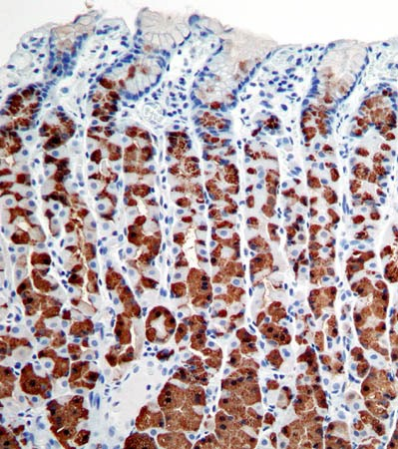
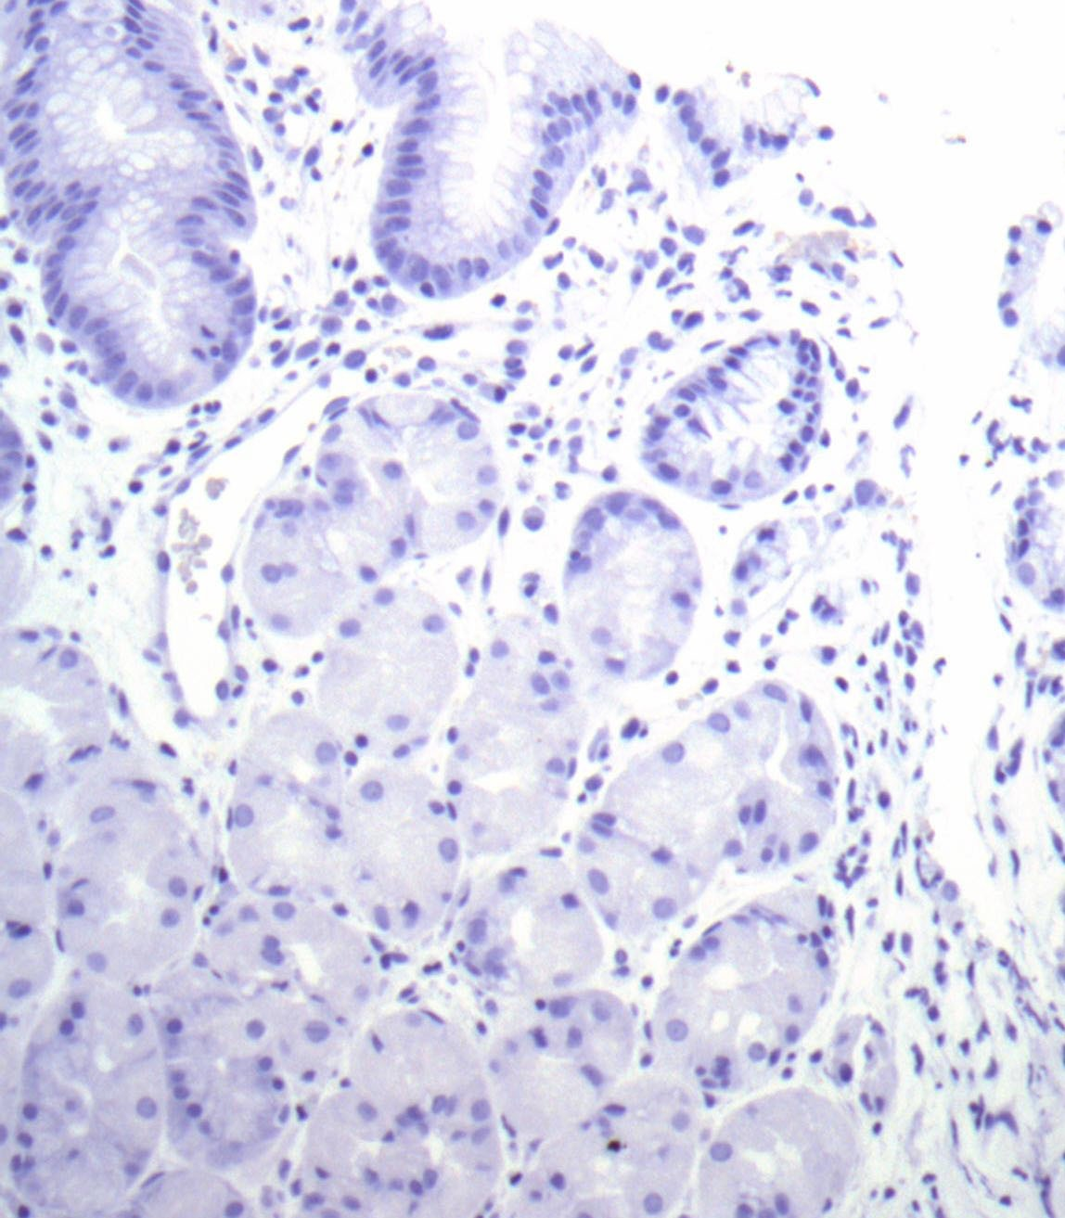
NORMAL CORPUS
Oxyntic endocrine cells make histamine or ghrelin, not gastrin
PGI (pepsinogen I) stains Chief and mucous neck
Gastrin- Negative
El-Zimaity HM¹⁸ T

Slide 15
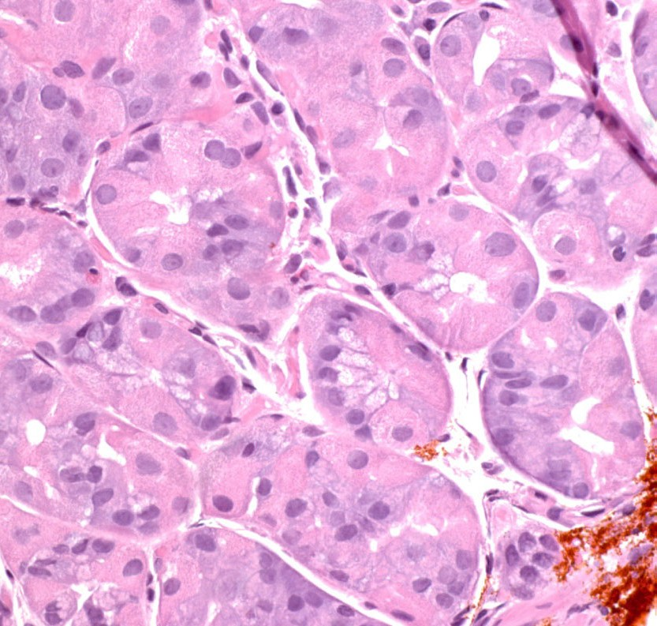
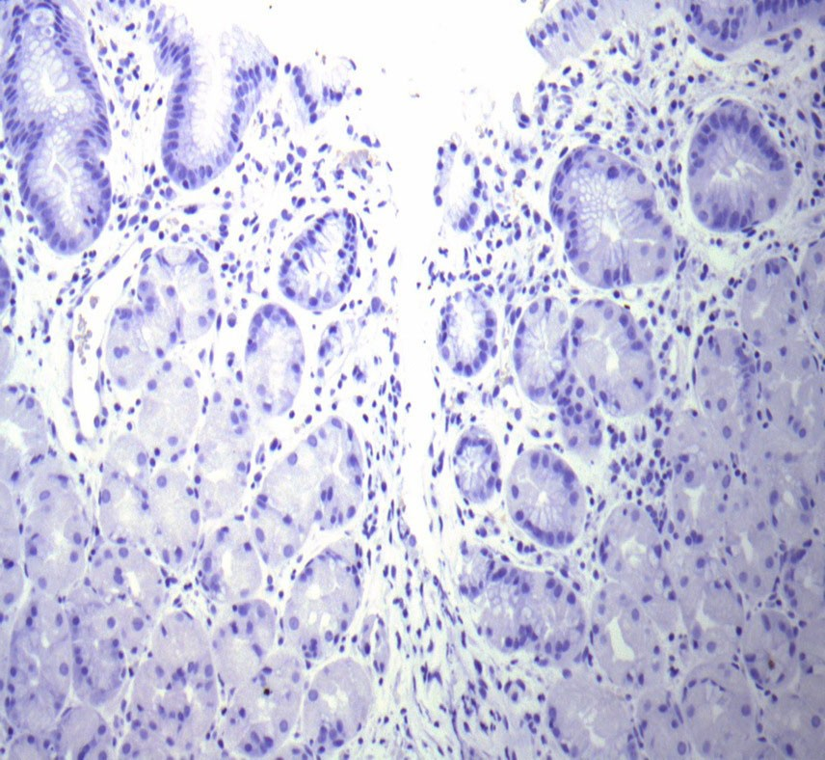
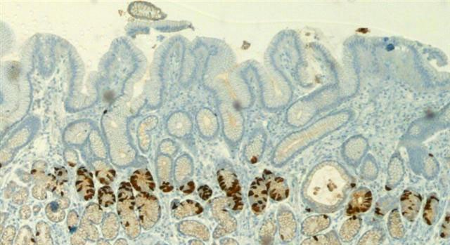
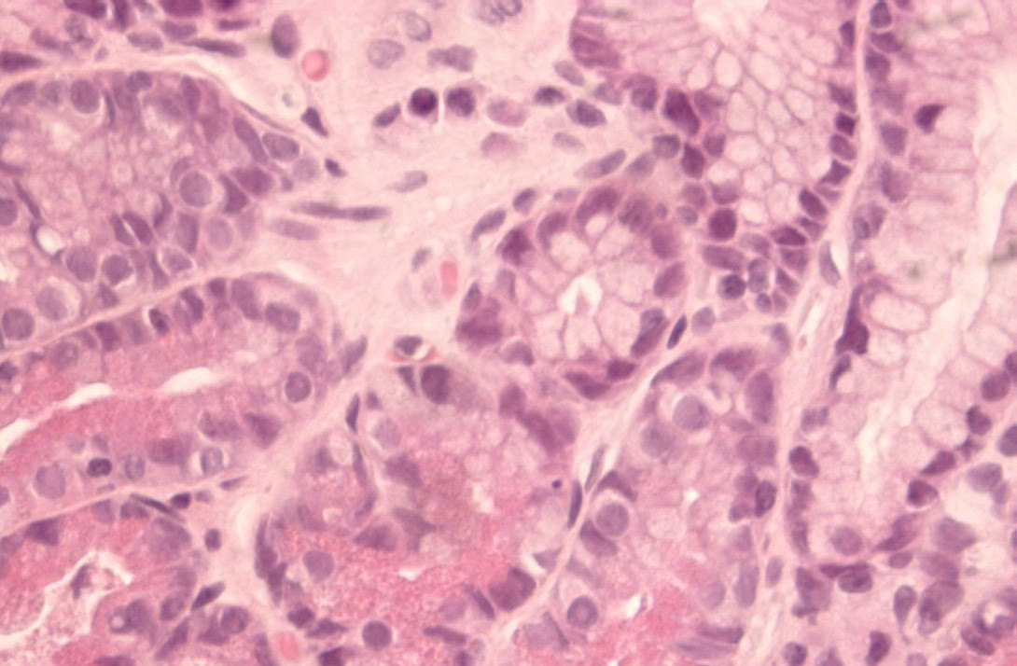
NORMAL
Gastrin (-)
CORPUS
Parietal cells No G cells
El-Zimaity HMT
ANTRUM
Gastrin (+)
Gastrin cells

Slide 16
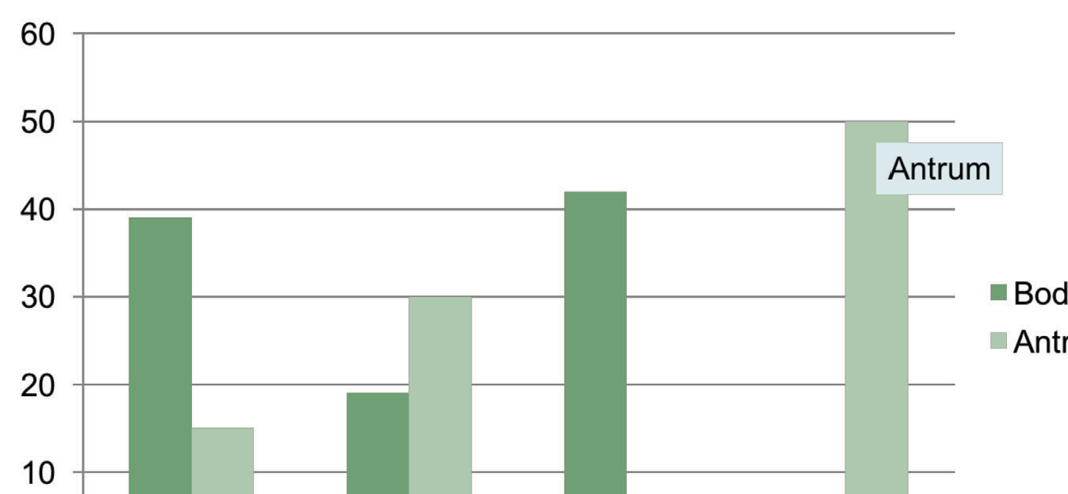
Endocrine Cells Stomach
D somatostatin, EC serotonin, ECL histamine or Ghrelin, G gastrin
body
Modified from Gasteroenterologia Polska 2006, 13(1): 7-10

Slide 17
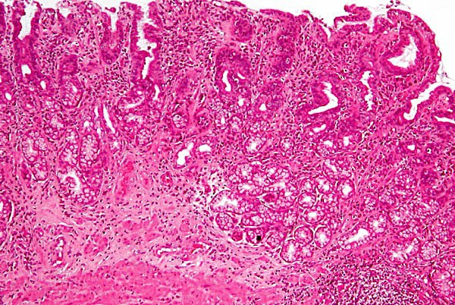
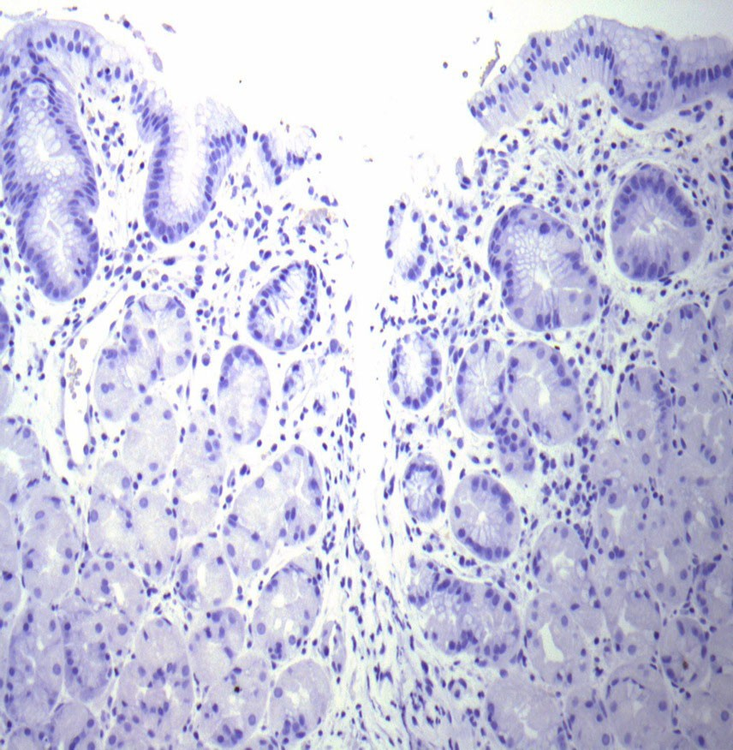
? Clinical relevance
Looks like antrum
No Gastrin cells
Corpus atrophy presenting as pseudo-pyloric metaplasia instead of intestinal metaplasia

Slide 18
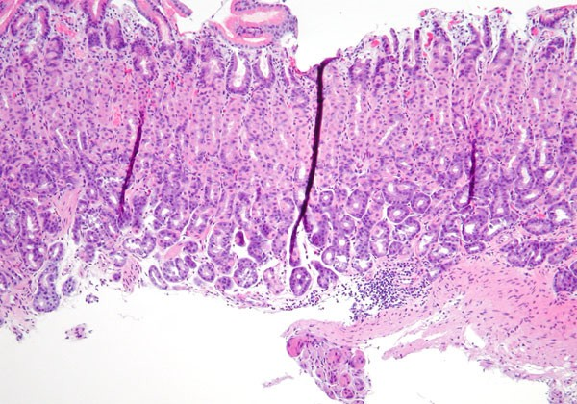
Landmark for NORMAL lymphoid infitrates Musclaris mucosae
unorganized lymphoid infiltrates
NORMAL
Muscularis mucosae

Slide 19
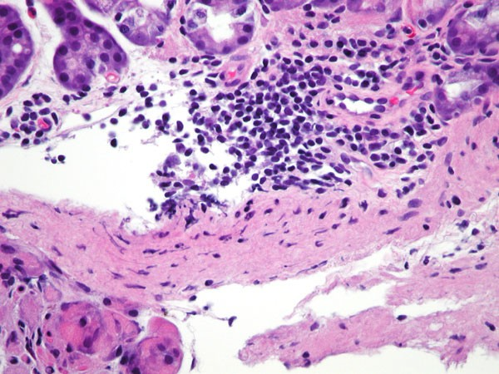
Lymphoid infiltrate:
Loose next to muscularis mucosae
Normal
=

Slide 20
OUTLINE
Normal stomach
Classification of gastritis
Specific types of gastritis
How to interpret gastritis

Slide 21
Updated Sydney System 1994
Type Etiology
Non-atrophic
H. Pylori
Other factors
By pattern
Atrophic
Autoimmune Multifocal
Autoimmune
H. pylori, dietary, environmental
Special Forms Chemical Lymphocytic Eosinophilic Granulomatous Radiation Other infectious
Chemical irritation Gluten, idiopathic Food sensitivity Crohn's, sarcoid Radiation
Virus, fungus, etc.

Slide 22
By etiology
Infectious | Bacterial (H. pylori, T.B.) Viral (CMV) Fungal (candida) Parasitic
Non- Infectious | Chemical/Reflux gastropathy Lymphocytic Auto-immune Inflammatory Bowel Disease Eosinophilic
Part of Systemic involvement | GVHD Vasculitis (Churg Struss) Granulomatous 4. collagenous
Miscellaneous | Hypertrophic gastropathy Vascular lesions (GAVE, portal gastropathy )

Slide 23
My algorithm at low power
Inflammator: MNC, PMN | Diffuse: infectious (+/-H. pylori) Focal: IBD, erosion
Non- Inflammatory | Epithelial: Reactive (chemical/reflux gastropathy Vascular: GAVE & portal gastropathy
Other | Eosinophilic Granulomatous Collagenous

Slide 24
Inflammatory conditions
▶ Acute gastritis.
▶ Chronic gastritis.
▶ Acute gastric ulcer.
▶ Chronic peptic ulcer.

Slide 25
Acute gastritis and gastropathy
▶ Acute gastritis: Mucosal injury, neutrophils present.
▶ Gastropathy: regenerative, no inflammation.
▶ Causes:
▶ NSAIDs, alcohol, bile, and stress-induced
▶ Clinical features:
▶ Asymptomatic, epigastric pain, nausea, vomiting.

Slide 26
Reactive (Chemical/Reflux) Gastropathy
Originally described by Dixon (1990) with NSAIDs and bile reflux (1986).
In Bile reflux: The acid causes most of the damage.
51

Slide 27
CHEMICAL GASTROPATHY
Triad
Foveolar hyperplasia
Smooth muscle fiber hyperplasia
Paucity of acute and chronic inflammatory cells
Other criteria: edema, vasodilation, congestion of capillaries
chronic
acute

Slide 28
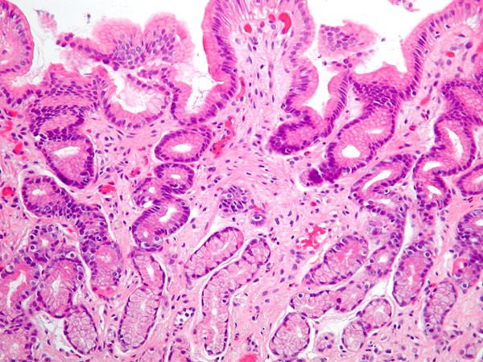
Reactive/Chemical Gastropathy Triad
Foveolar hyperplasia
Smooth muscle fiber hyperplasia
Paucity of acute and chronic inflammatory cells

Slide 29
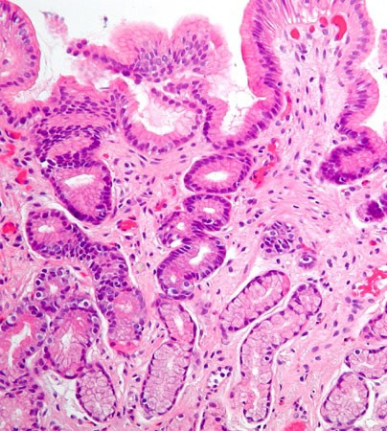
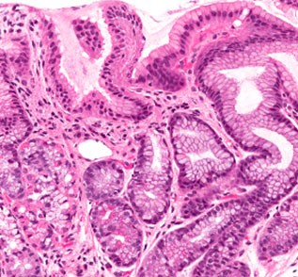
How to identify foveolar hyperplasia? (length of neck region)
Foveolar hyperplasia Long & tortuous
Up to 3 x normal
Normal

Slide 30
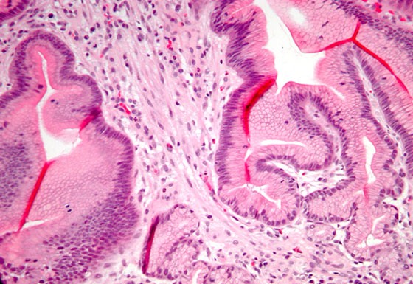
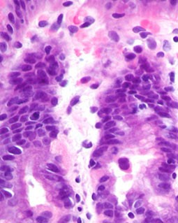
SMOOTH MUSCLE FlBERs
normal
Hyperplasia
3x normal
55

Slide 31
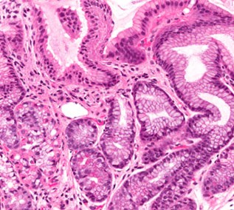
Chemical gastropathy:
Normal
1. Foveolar hyperplasia
2. Smooth muscle fiber hyperplasia
3. No inflammation

Slide 32
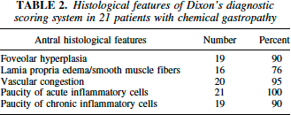

Slide 33
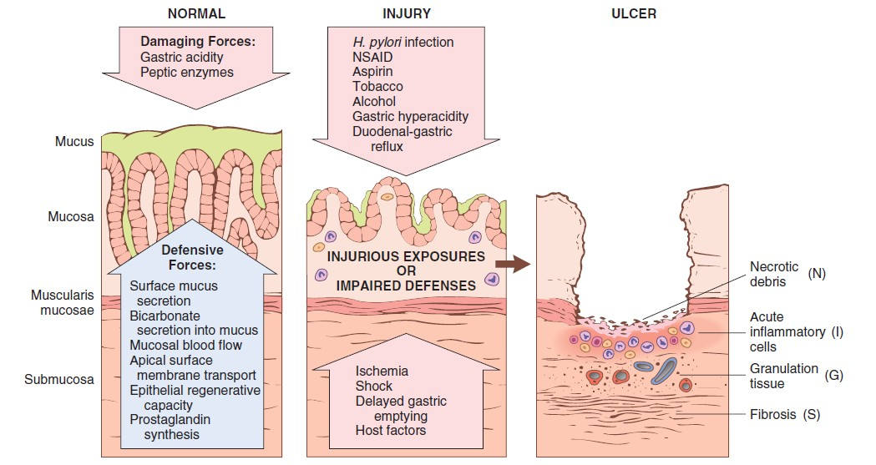
Pathogenesis
Robbins Basic Pathology 10th edition

Slide 34
Pathogenesis
▶ Imbalance between protective and damaging forces
▶ Main causes:
NSAIDs
Uremic patients, H pylori infected patients
Old age.
Hypoxia
Harsh chemicals, (acids or bases)
Alcohol, radiation therapy:
Chemotherapy.

Slide 35
Morphology
▶ Hyperemia.
▶ Edema and slight vascular congestion
▶ Neutrophils, lymphocytes, and plasma cells are not prominent.
▶ Intact surface epithelium.
▶ Advanced: Erosions and hemorrhage, acute erosive hemorrhagic gastritis.
▶ Active inflammation (neutrophils) is not necessary.

Slide 36
Acute gastritis
www.etttamen.com

Slide 37
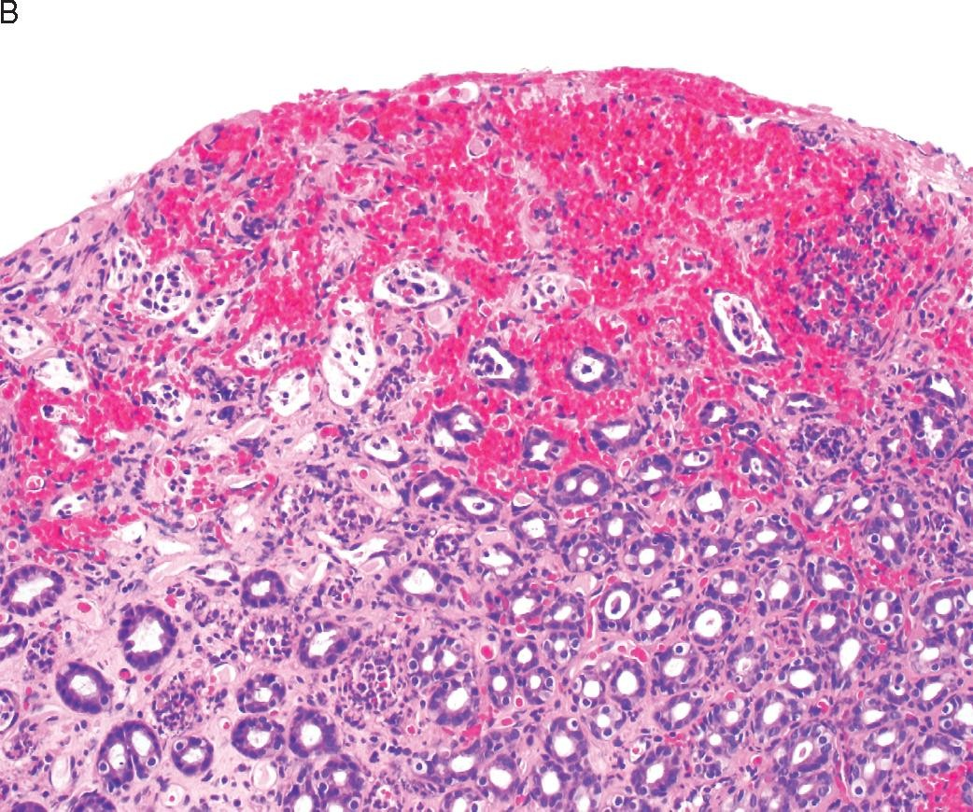
librepathology.org

Slide 38
Stress-Related Mucosal Disease acute gastric ulcers
▶ Severe physiologic stress:
▶ Trauma
▶ Extensive burns
▶ Intracranial disease
▶ Major surgery
▶ Serious medical disease
▶ Critically ill patients

Slide 39
Acute gastric ulcers:
▶ Stress ulcers: critically ill patients with shock, sepsis, or severe trauma.
▶ Curling ulcers: proximal duodenum , severe burns or trauma.
▶ Cushing ulcers: stomach, duodenum, or esophagus, intracranial disease, high risk of perforation.

Slide 40
Morphology
▶ Acute ulcers are rounded and typically less than 1 cm in diameter
▶ Shallow to deep.
▶ Ulcer base brown to black
▶ Anywhere in stomach
▶ Usually multiple.
▶ Normal adjacent mucosa
▶ No scarring
▶ Healing with complete reepithelialization occurs days or weeks after removal of injurious factors

Slide 41
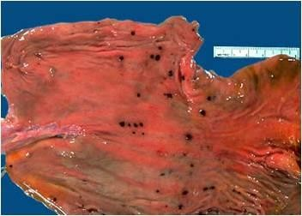

Slide 42
Clinical features
▶ Nausea, vomiting,
▶ Melena
▶ Coffee -ground hematemesis
▶ Perforation complication.
▶ Prophylaxis with proton pump inhibitors
▶ Outcome depends on severity of underlying cause.

Slide 43
Chronic gastritis
▶ Causes:
▶ Helicobacter pylori associated gastritis: most common.
▶ Autoimmune atrophic gastritis: less than 10% of cases.
▶ Less common
▶ Chronic NSAID
▶ Radiation injury
▶ Chronic bile reflux.

Slide 44
Clinical features
▶ Nausea and upper-abdominal discomfort
▶ Vomiting
▶ Hematemesis uncommon.
▶ Less severe but more prolonged symptoms.

Slide 45
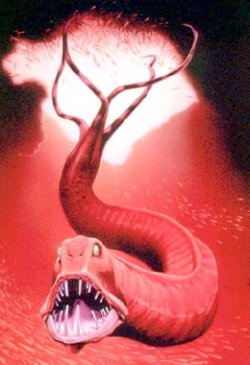
Diffuse Ghronic Inflammation
H. pylori
Gastritis Patterns
Special presentations
Diagnosis (stains)

Slide 46
Helicobacter pylori Gastritis
▶ Discovery of the association of H.pylori with peptic ulcer disease was a revolution.
▶ Spiral or curved, G-ve, bacilli.
▶ Present in almost all duodenal ulcers.
▶ Majority of gastric ulcers or chronic gastritis.
▶ Acute infection is subclinical.
▶ Antral gastritis with increased acid production >> peptic ulcer
▶ Intestinal metaplasia and increased risk of gastric cancer.

Slide 47
▶ Poverty, household crowding, limited education, poor sanitation
▶ Infection is typically acquired in childhood, persists to adult-life.
▶ Pathogenesis:
▶ H.pylori adapted to live in the mucus layer, non-invasive, by
▶ Flagella: allow motility.
▶ Urease: split urea to ammonia, protect bacteria from acidic pH.
▶ Adhesins: bacterial adherence to foveolar cells
▶ Toxins: CagA, for ulcer or cancer development

Slide 48
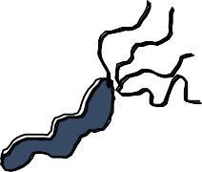
OUTCOMES OF H. PYLORI INFECTION
Environmental Factors
Acute & Chronic Gastritis
Acute Gastritis
Duodenal Ulcer
Gastric Ulcer
Childhood
Gastric Cancer
i
d
ife
-
M -l - -Old
Lymphoma

Slide 49
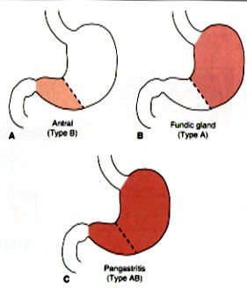
GASTRITIS PATTERN
DU
PA
GU……+ atrophy..Cancer

Slide 50
Q: How do we explain different gastritis patterns with H. pylori infection?
Q: How do bugs in the stomach cause ulcers in the duodenum?

Slide 51
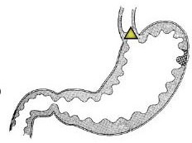
No bacteria likes too much acid including H. pylori
H. pylori prefers neutral pH and dies below 4.0 or above 8.2
corpus
Acid
antrum
H. pylori starts its life in the antrum where it is less acidic

Slide 52
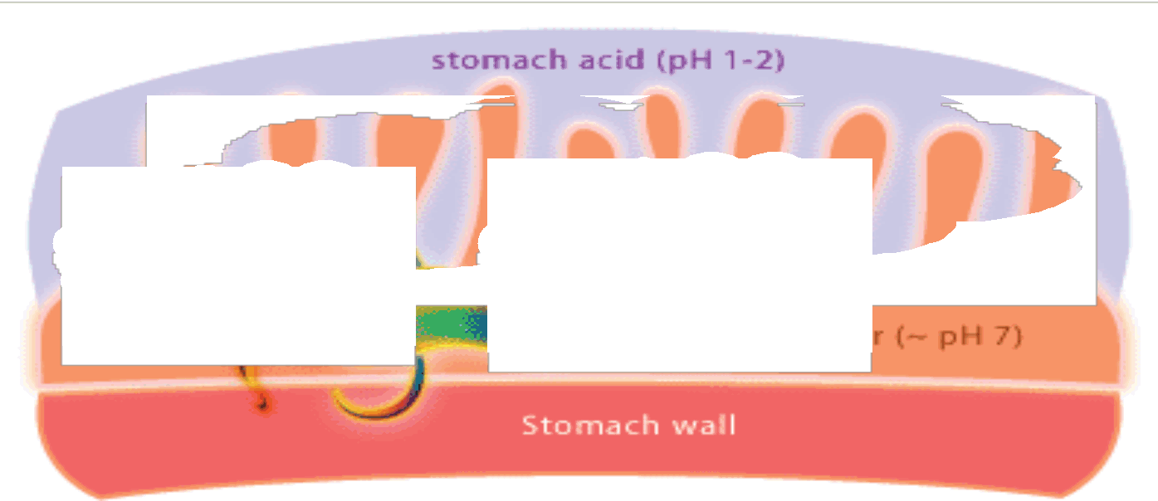
No bacteria likes acid
Starts in the antrum
Surrounds itself with a cloud of
ammonia and bicarbonate
to counter gastric acidity
(it produces urease which converts urea (abundant in saliva & gastric juices) to ammonia and bicarbonate)
C=O(NH2)2 + H+ +2H2O --urease--> HCO3⁻ + 2(NH4) ⁺

Slide 53
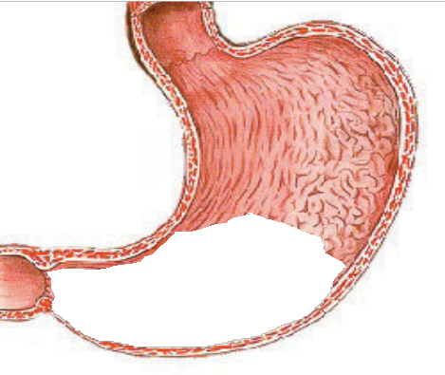
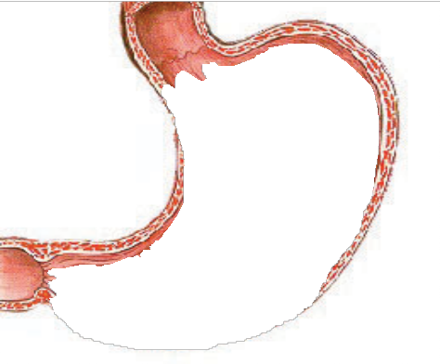
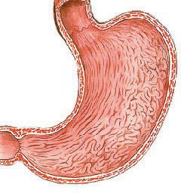
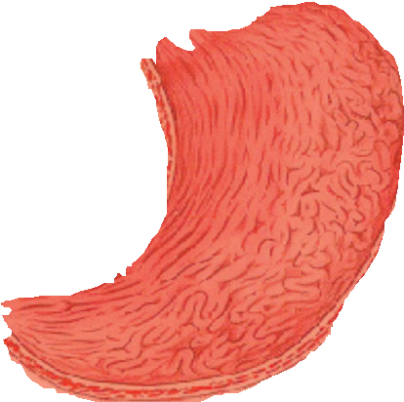
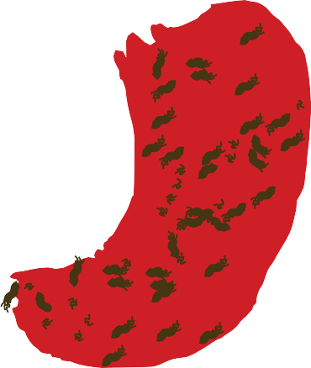
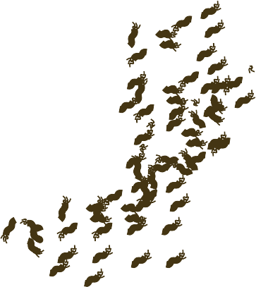
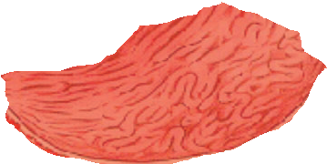
Gastritis Stages
proximal migration of H. pylori
Antral Predom. Corpus gastritis Pan-atrophic

Slide 54
Sustained H. Pylori Gastritis
antrum
corpus
Pan Gastritis with superficial inflammation in the corpus

Slide 55
And later H. Pylori Gastritis
Antrum
Corpus
Pan-Gastritis with deeper inflammation in ! corpus

Slide 56
Too Late H. Pylori gastritis
Pan Gastritis with corpus atrophy
With increased risk for gastric carcinoma

Slide 57
Morphology
▶ Gastric biopsy: H. pylori in mucus layer, antrum.
▶ Neutrophils within the lamina propria
▶ Plasma cells, lymphocytes & macrophages.
▶ Lymphoid aggregates>>> increased risk of MALT lymphoma.
▶ Intestinal metaplasia (goblet cells)>>> dysplasia >> increased risk of adenocarcinoma

Slide 58
Robbins Basic Pathology 10th edition

Slide 59
Intestinal metaplasia
Robbins Basic Pathology 10th edition

Slide 60
Diagnosis and treatment
▶ Serologic test: anti-H .pylori antibodies.
▶ Stool test for H.pylori.
▶ Urea breath test.
▶ Gastric biopsy
▶ Bacterial culture.
▶ PCR test for bacterial DNA.
▶ Treatment: combinations of antibiotics and PPI.

Slide 61
Lymphoid Follicles in H. pylori infection
Pre-treatment Post treatment

Slide 62
Autoimmune Gastritis
▶ Antibodies to parietal cells and intrinsic factor in serum.
▶ Reduced serum pepsinogen I levels
▶ Antral endocrine cell hyperplasia
▶ Vitamin B12 deficiency >>> pernicious anemia and neurologic changes
▶ Impaired gastric acid secretion (achlorhydria)
▶ Spares the antrum.
▶ Marked hypergastrinemia

Slide 63
Pathogenesis
▶ Immune-mediated loss of parietal cells >>> reductions in acid and intrinsic factor secretion.
▶ Acid reduction leads to hypergastrinemia
▶ Hyperplasia of antral G cells
▶ Deficient intrinsic factor >> deficient ileal VB12 absorption >> megaloblastic anemia.
▶ Some chief cell damage >> reduced pepsinogen

Slide 64
Morphology
▶ Damage of the oxyntic (acid-producing) mucosa.
▶ Diffuse atrophy, thinning of wall, loss of rugal folds
▶ Lymphocytes, plasma cells, macrophages, less likely neutrophils.
▶ Intestinal metaplasia >>> dysplasia >> carcinoma.
▶ Neuroendocrine cell hyperplasia >>> tumors.

Slide 65
Clinical features
▶ 60 years, slight female predominance.
▶ Often associated with other autoimmune diseases

Slide 66
Robbins Basic Pathology 10th edition

