Slide 1
urogenital system-I. Male pathology. Prostate
Dr.Eman kreishan, m.d.
2/5/2023.

Slide 2
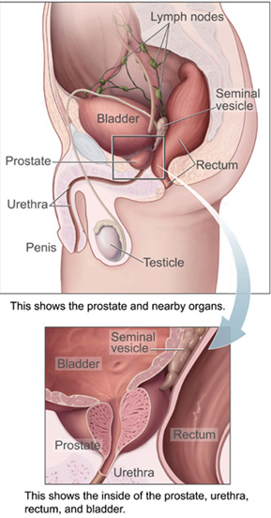
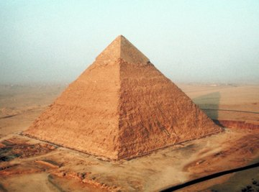
Prostate ..anatomy

Slide 3
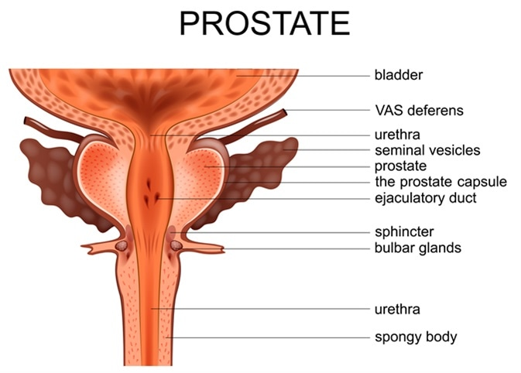
anatomical location
shape
weight and dimension
function

Slide 4
can be divided into biologically distinct regions, the most important of which are the peripheral and transition zones.

Slide 5
Histology

Slide 6
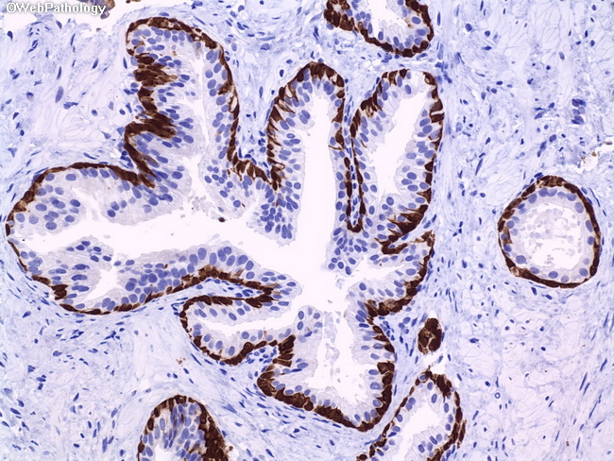
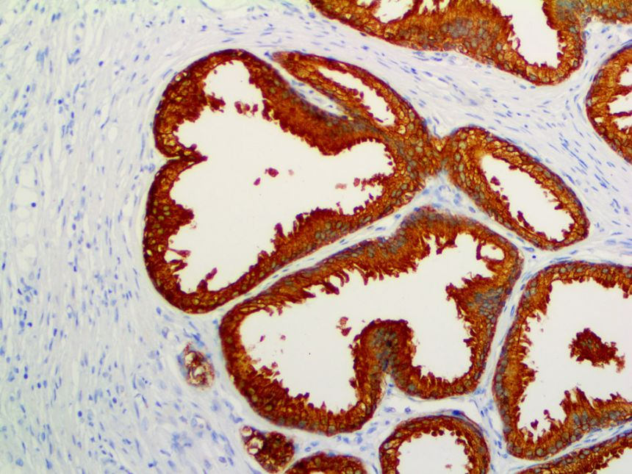
Prostate– Histology
Normal prostate contains glands with two cell layers, a flat basal cell layer & an overlying columnar secretory cell layer.
Surrounding prostatic stroma contains a mixture of smooth muscle and fibrous tissue.

Slide 7
Prostate can be affected mainly by:
Hyperplastic lesions
Most arise in inner transition zone.
Causes urinary obstruction.
Carcinomas
70%–80% arise in peripheral zones.
Often detected by rectal examination

Slide 8
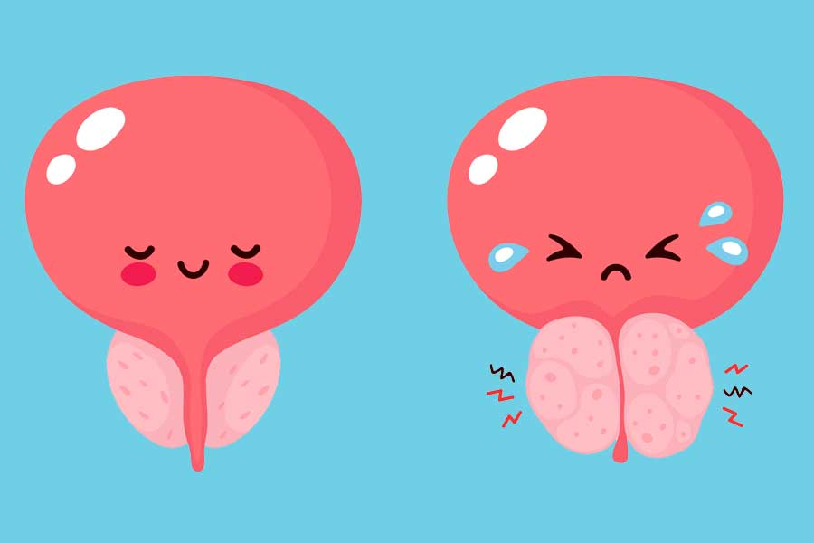
Hyperplastic lesions

Slide 9
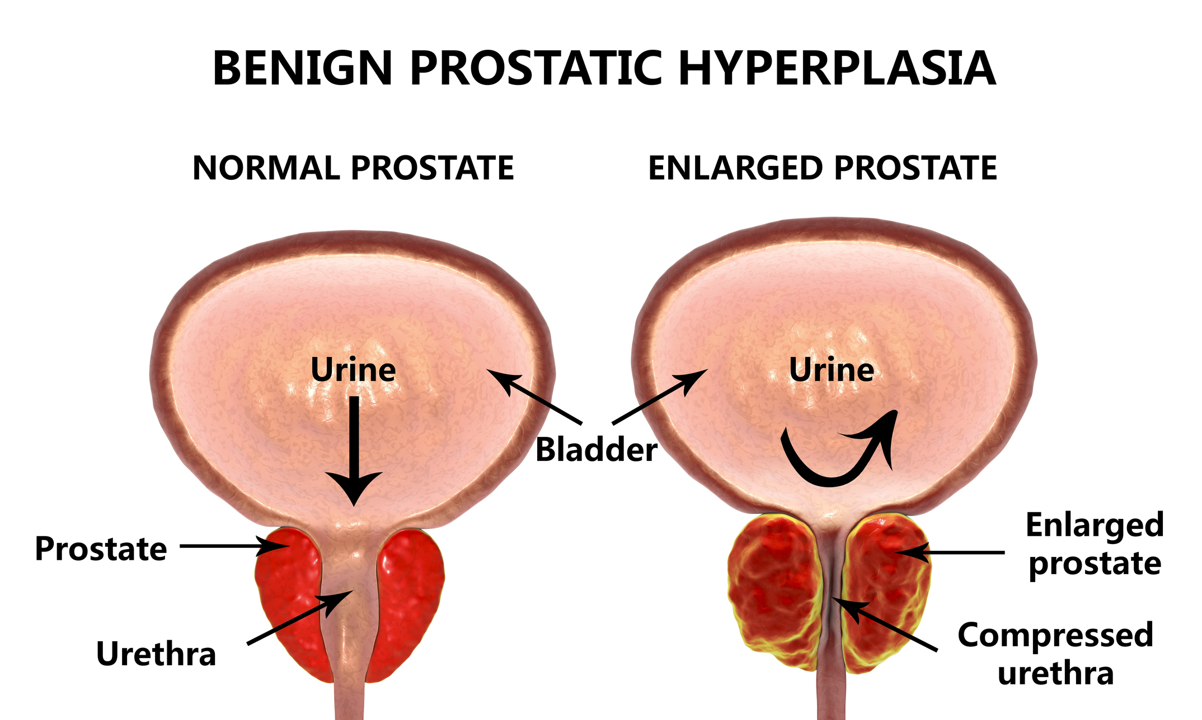
1. Benign Prostatic Hyperplasia
An extremely common cause of prostatic enlargement by the age of 40 years.
An important cause of urinary obstruction.
Although the cause of BPH is incompletely understood, excessive androgen-dependent growth of stromal & glandular elements has a central role.
Does not occur in males castrated before the onset of puberty.

Slide 10
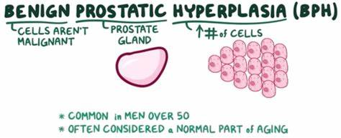

Slide 11
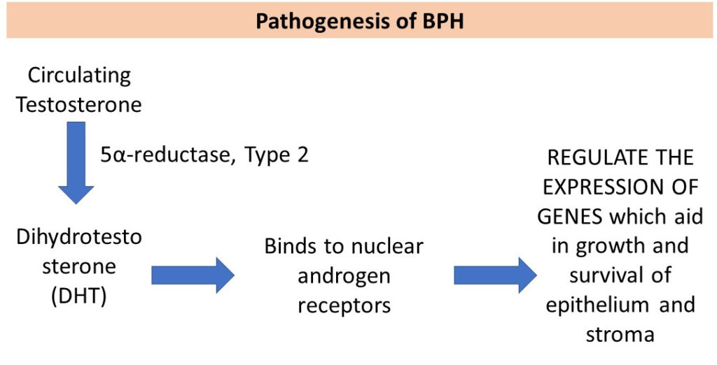
Pathogenesis
DHT(Dihydrotestosterone )-induced growth factors act by increasing the proliferation of stromal cells & decreasing the death of epithelial cells.

Slide 12
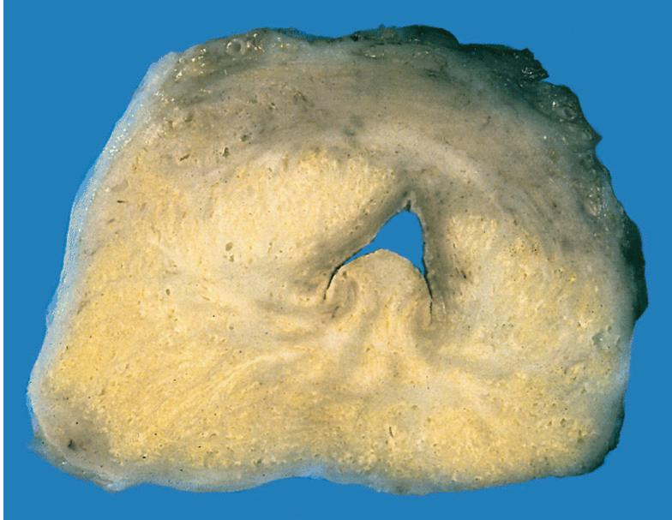
Macroscopic
Benign prostatic hyperplasia nodules
around the urethra bulge above the cut surface in a cross section of the prostate gland.

Slide 13
Microscopic
Epithelial hyperplasia is characterized by nodular lesions composed of variably sized glandular structures lined by basal and secretory cells

Slide 14
Clinical Features
Symptoms: (occur in only 10% of cases) and include:
urgency,
frequency,
nocturia. + ↑ risk of urinary tract infections.
Tx : + Initial pharmacologic; agents inhibit formation of DHT.
Surgical treatment for :
severely symptomatic cases.
resistant to medical (Transurethral resection of the prostate (TURP)).

Slide 16
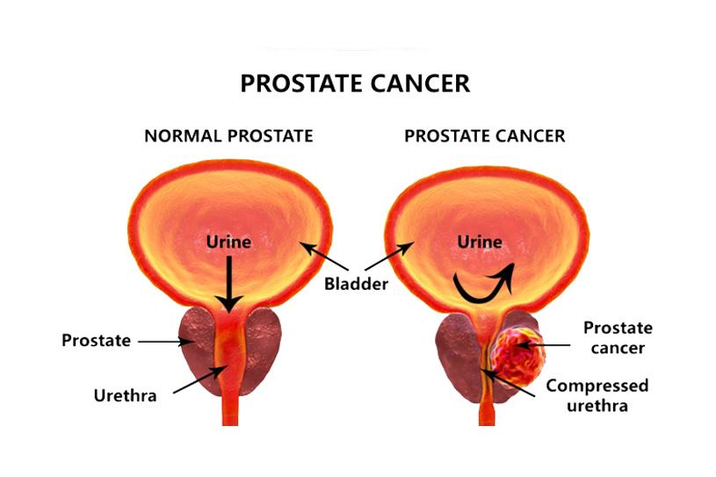
Carcinoma of the Prostate
Adenocarcinoma of prostate is the most common form of cancer in men.
Age: older than 50 years.
Significant drop in prostate cancer mortality → increase detection of disease through screening.

Slide 17
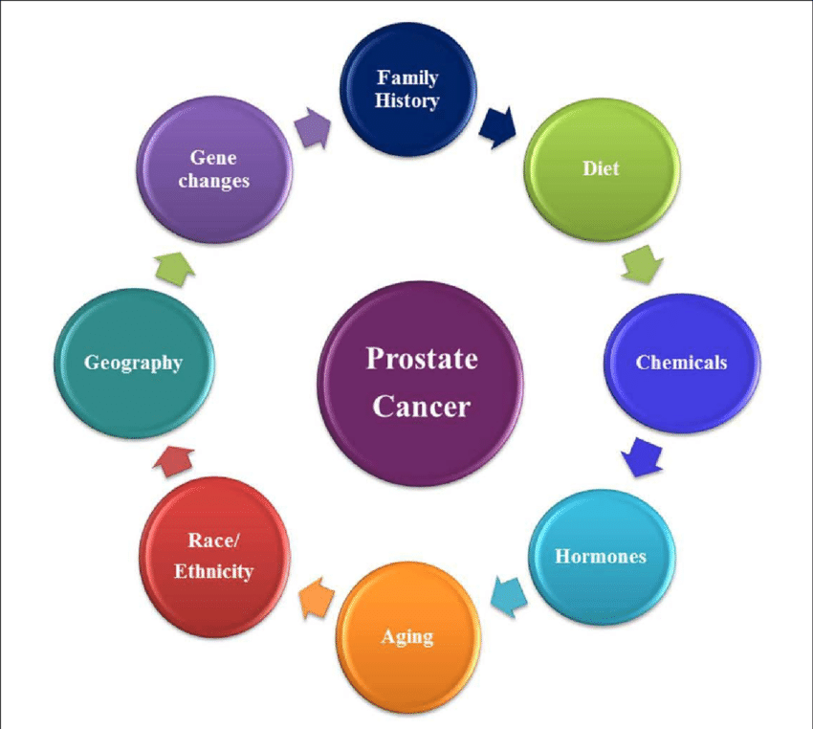
Pathogenesis
Androgens: are of central importance; evident by
Cancer of the prostate doesn't develop in males castrated before puberty.
Cancers often regress for a time in response to surgical or chemical castration.
Heredity.
Environment:
geographical variations that may be due to dietary variations.
Acquired somatic mutations:
+ TMPRSS2-ETS fusion genes are found in ~ 50% of cases.

Slide 18
Morphology
GROSS: firm, gray-white lesions with ill-defined margins.
Most tumors are multifocal.
75 - 80% are posterior / posterolateral peripheral zone

Slide 19
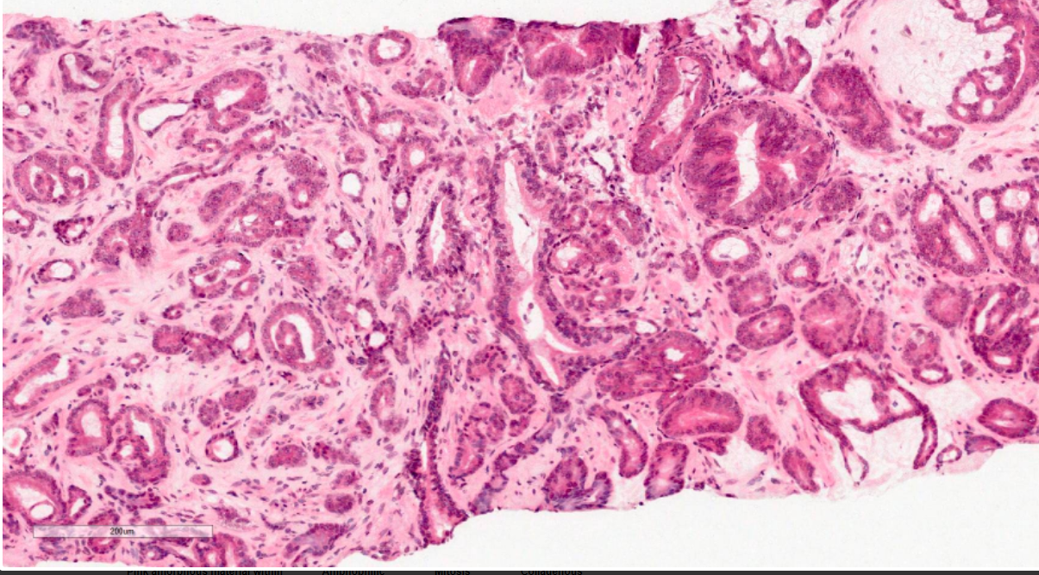
Microscopically
well-defined glands, typically smaller than benign glands and are lined by a single uniform layer of cuboidal epithelium, lacking basal cell layer seen in benign glands.

Slide 20
clinical features
Generally asymptomatic unless locally advanced or metastatic
Often discovered following investigation of nonspecific lower urinary tract symptoms.
Serum screening tests: elevated prostate-specific antigen (PSA) level.
Digital rectal examination (DRE): prostate may feel normal or may be enlarged / asymmetrical .
Bone metastases, particularly to the axial skeleton, are frequent late in the disease and typically cause osteoblastic (bone-producing) lesions.

Slide 21
Diagnosis

Slide 22
Treatment.
The most common treatments for clinically localized prostate cancer are radical prostatectomy and radiotherapy.
The prognosis after radical prostatectomy is based on:
the pathologic stage.
the margins of the resected specimens are free of tumor or not.
Gleason grade (grading system on the basis of glandular patterns of differentiation)

Slide 23
