Slide 1
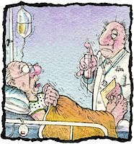
Medical Responsibility (Malpractice)
Nadra Kandeel

Slide 2
Learning Objectives
Define scientific terms
Know how to basically prove a malpractice claim
Classify different types of malpractice
Be aware of basis of its evaluation
Be familiar with examples of different types of malpractice
List legal advises for prophylaxis against malpractice

Slide 3
When a medical practitioner undertakes the care of a patient, he enters into implied contract to treat the patient with reasonable skill and care.
So
There is a commitment by the physician to do his best of knowledge and skills for the benefit of the patient.

Slide 4
Malpractice

Slide 5
Malpractice (malpraxis) is defined as the absence of a reasonable degree of skill and attention on the part of the attending practitioner whereby the health of the patient is endangered.
Negligence unproductive of damage will not give the right to an action, but negligence causing damage will do. If there is any doubt of negligence, the patient can sue the physician for malpractice.

Slide 6
Negligence may be defined as the omission to do something which a reasonable man would do, or doing something which a reasonable man would not do( act of omission or commission) .
When a patient can prove that he has suffered harm as a result of a physician’s failure to provide a reasonable standard of care, which any ordinary physician in his position would take, he has the right to receive financial compensation.

Slide 7
Most legal actions for negligence are within the civil law, few undergo criminal prosecution of the physician for example:
Illegal abortion.
Death of a patient resulting from gross ignorance or negligence of the physician.

Slide 8
There are 3 basic considerations in proving malpractice:
1- A mistake has occurred by the physician
2- A damage or harm happened to the patient.
3- There is a causative relation between the mistake done by the physician and the harm that occurred to the patient.

Slide 9
Types of malpractice
Technical faults:
When the physician does not follow the scientific basic rules in his profession for diagnosis and treatment. These may be major or minor faults.
Objective mistakes:
When a surgeon forgets any object inside a surgical wound e.g. Towel, instrument…etc. all objective mistakes are major malpractice.

Slide 10
The basis of evaluating the malpractice
1- The professional level of the physician.
A general practitioner cannot be considered negligent just because a specialist might have served a patient better.
2- The severity of the case.
3- The time and place of the act.
The act is compared with the attitude taken by an ordinary physician with the same standard, qualification, experience, and circumstances.

Slide 11
The basis of evaluating the malpractice
4- A medical injury may have been caused by any one or more of the medical personnel who have treated the patient.
5- The thing speaks for itself” e.g.
Foreign bodies and slipping instruments in surgical procedures
Burns from heating modalities
Injury to a portion of the patient’s body outside the field of treatment

Slide 12
TYPES OF
MALPRACTICE
In Diagnosis
In Treatment
Anesthetic Malpractice
Surgical Malpractice

Slide 13
Malpractice in Diagnosis

Slide 14
Malpractice in diagnosis:
To reach a proper diagnosis the physician should:
Take a careful history
Examine his patient thoroughly
Ask for investigations (whether laboratory or radiological)
Consult colleagues or professors if he is not sure of a diagnosis
Otherwise he may fall under malpractice if he misses a diagnosis due to ignorance by the basic scientific knowledge.
Liability may be proved when the physician fails to diagnose a condition which would have been diagnosed by a competent practitioner.

Slide 15
Malpractice in diagnosis
Sometimes missed diagnosis or mistake in reaching exact diagnosis is due to
Inexperience
the disease being in its early stage.

Slide 16
Malpractice in Treatment

Slide 17
Mistakes of treatment:
The physician is free in choosing the method of treating his patient as long as he is using scientific basis agreed upon by physicians. The physician is sued for malpractice of treatment in the following conditions:
If he prescribed a wrong drug
If he was not accurate in the dose of the drug in relation to the patient’s age, sensitivity or body build.

Slide 18
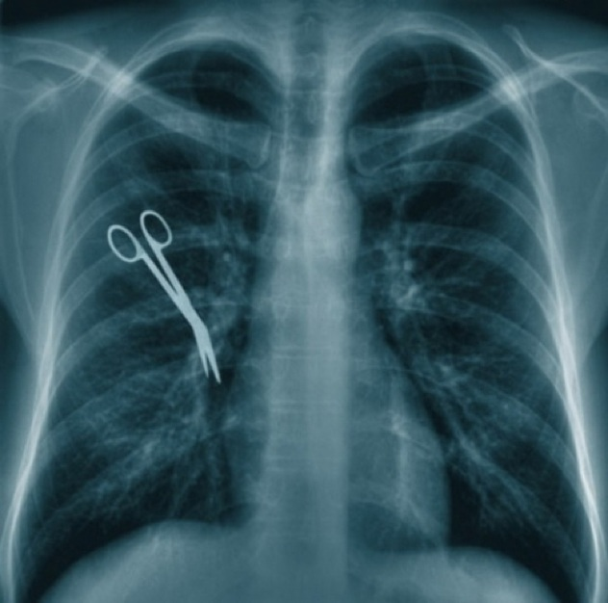
Surgical Malpractice

Slide 19
Surgical mistakes:
Surgery needs skill and concentration. Responsibility of the surgeon lies in the following stages:
Writing the first admission sheet and diagnosis of the case
Stage of preparing for operation (examine, ask for specific investigations, be sure of fitness of patient for operation)
An informed consent (entailing the diagnosis, surgical procedure, anesthesia and expected complications) is signed by the patient except in emergencies

Slide 20
Surgical mistakes:
A surgical report should be filled including every detail, and any problem at the time of the operation should be mentioned
5. The surgeon should do an operation only in his specialty
6. He is responsible for sterilization of the surgical wound

Slide 21
7- In operations the surgeon is responsible for the actions of his team while acting under his immediate supervision (nurses and assistants).
8- Responsibility of the hospital authorities lies in the selection of nurses
9- The responsibility for anesthesia belongs to the anesthetist not the surgeon.
Examples of surgical malpractice:
operating on the wrong patient
operating on the wrong side: limb, organ…etc.
leaving swabs or instruments in the surgical wound

Slide 22
Examples of orthopedic malpractice:
Missed fractures
Tissue damage from over tight plaster
Examples of obstetrician malpractice:
Criminal abortion and complicated therapeutic abortion
Birth injuries
Brain damage of newborn due to hypoxia from prolonged labor
Hysterectomy without being sure of the diagnosis( pregnancy in an old women diagnosed as a mass in the uterus and doing hysterectomy)

Slide 23
Anesthetic Malpractice

Slide 24
Anesthetic malpractice:
The anesthetist is responsible for: preoperative preparation of the patient, anesthesia during the operation, and follow up in recovery.
Examples of malpractice include:
Brain damage from allowing hypoxia to occur
Neurological damage from spinal or epidural injections
Incorrect or excessive anesthetic agent
Allowing awareness of pain during anesthesia

Slide 25
Legal advises for malpraxis prophylaxis
Never guarantee a cure
Get the patient’s informed consent for all procedures (at least all surgical procedures)
When in doubt ask for consultations (consultation protects the patient and protects yourself).
Do not criticize another practitioner
Do not fail to provide maximum care in the selection of assistants
Do not base an important diagnosis on a clinical impression, use available diagnostic aids

Slide 26
Legal advises for malpraxis prophylaxis
Keep up with the advances of medicine. However do not be too advanced and do not experiment on patients
Do not, in absence of emergency, perform any surgery without an informed consent
Good housekeeping: keep good medical records, full and accurate. Keep results of all tests performed on the patient.
Records are “witnesses whose memories never die”. In the defense of malpractice suits, bad records hurt as much as good records help.

Slide 27
Problems in MALPRACTICE
An anesthesiologist ran out of oxygen before the operation was completed, causing the patient to suffer a fatal cardiac arrest.
Is this a case of malpractice or negligence?
What are the responsibilities of the anesthetist?
Do you think this case should be presented in a civil or criminal court?
What are the possible forms of punishment that the doctor would undergo?

Slide 28
Is this a case of malpractice or negligence?
………both negligence and a major form of anesthetic malpractice………………………………………………….
What are the responsibilities of the anesthetist?
-The anesthetist is responsible for:
-Preoperative preparation of the patient,
-Anesthesia during the operation,
-Follow up in recovery
Do you think this case should be presented in a civil or criminal court? Why?
……criminal court, this is considered an objective mistake which proves gross ignorance and negligence on part of the anesthetist as he should have checked his instruments before operation……………………………….
What are the possible forms of punishment that the doctor would undergo?
………criminal prosecution usually means a jail sentence (which could be carried out or not) and erasure from the medical syndicate

Slide 29
A patient who underwent surgery for the repair of a pilonidal cyst under epidural anesthesia ended up with permanent uncontrolled movement of the lower extremities.
Is this a case of malpractice?
If so, what is the type of malpractice in this case?
Should the patient receive financial compensation?
Knowing that this patient was a well known athlete; would this make any difference in the value of compensation?

Slide 30
Is this a case of malpractice?
…………yes………………………………………………..
If so, what is the type of malpractice in this case?
…………anesthetic malpractice
Should the patient receive financial compensation?
…………yes………………………………………………..
Knowing that this patient was a well known athlete; would this make any difference in the value of compensation?
………more compensation

Slide 31
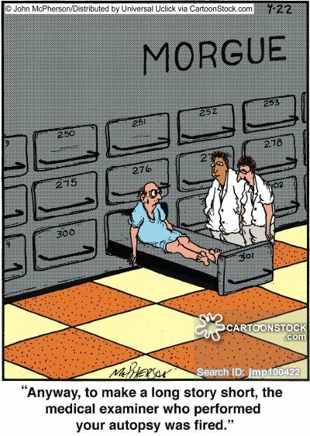
Thank You

