Slide 1
Approach to solitary thyroid nodule
Made by:
Samah Alghazal
Dania Tarawneh
Yaqeen Atieh
Harith Tarawneh
Supervised by Dr. Tariq Aladwan

Slide 2
INTRODUCTION
• Discrete lesion within thyroid gland that is radiologically distinct from surrounding parenchyma, Noted by patient, or as an incidental finding.
• May be:
➤Palpable or impalpable.
➤Functioning or nonfunctioning (cold, warm, hot).
Prevalence increases with:
➤Age
➤ Exposure to ionizing radiation (Nodule in radiated patient: 35-40% cancer)
➤ Pregnancy
EPIDEMIOLOGY:
➤ Ages → 35-59
➤Women 6.4%
➤ Men → 1.5%

Slide 3
• They are found in 4%– 8% of adults by palpation and in 13%– 67% when ultrasound detection is
used. In autopsy studies, they have a prevalence of approximately 50% .
• Younger and older patients (m >40yrs and F >50yrs) more likely to have malignant thyroid nodule.
• Children may present with more advanced disease.
• Incidence F>M, but aggressiveness M>F

Slide 4
CLINICAL ASSESSMENT
• Symptoms of hyperthyroidism and hypothyroidism should be explored:
• Family history
• H/o previous head and neck radiation exposure
• H/o medullary carcinoma, pheochromocytoma, or hyperparathyroidism (MEN syndromes).
Rapid growth of a preexisting or new thyroid nodule (hemorrhage into cyst / carcinoma).
Throat or neck pain (hemorrhage into benign nodule, rarely as/w carcinoma).
• Compressive or invasive symptoms like:
►Voice change
► Hoarseness
➤ Dysphagia
➤Dyspnea

Slide 5
Represents a wide spectrum of disease
Most are:
Colloid nodules,
Adenomas
Cysts,
Focal thyroiditis
Only 5-6% are malignant

Slide 6
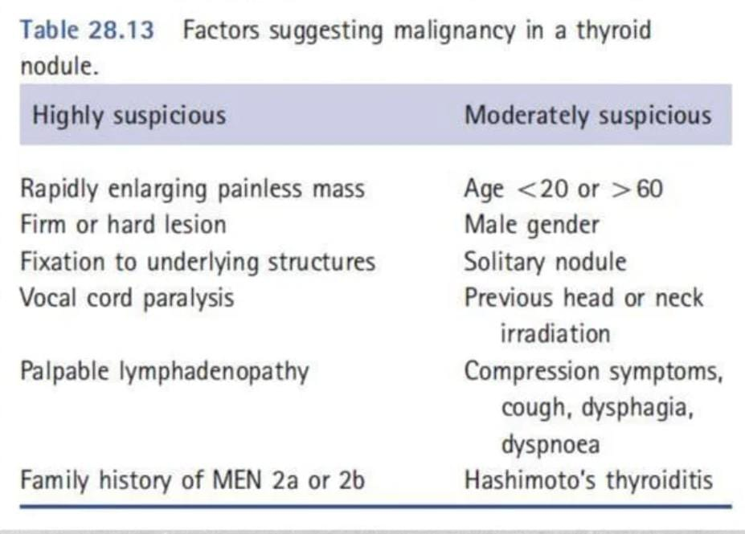

Slide 7
Physical Examination
• Careful palpation of thyroid (solitary or dominant nodule in multinodular gland)
• Firm nodule → 2-3 times increased risk of carcinoma
• Substernal extension estimated by relationship of inf aspect of mass to clavicle.
• Thoracic inlet obstruction by Pemberton maneuver
• Physical findings suggesting possible malignancy include:
➤Vocal cord paralysis
➤Cervical lymphadenopathy (also in Hashimoto thyroiditis, Graves disease, or infection)
➤Fixation of nodule to surrounding tissues.

Slide 8
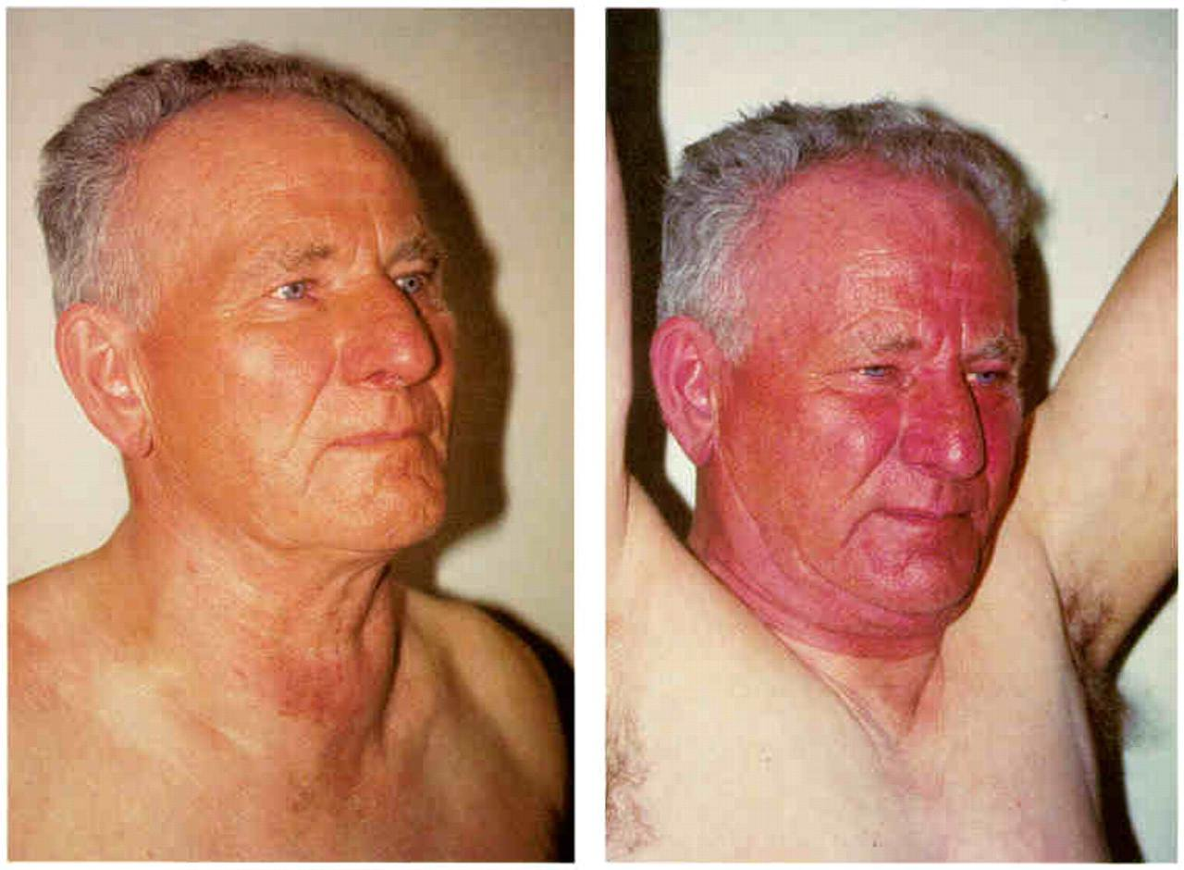
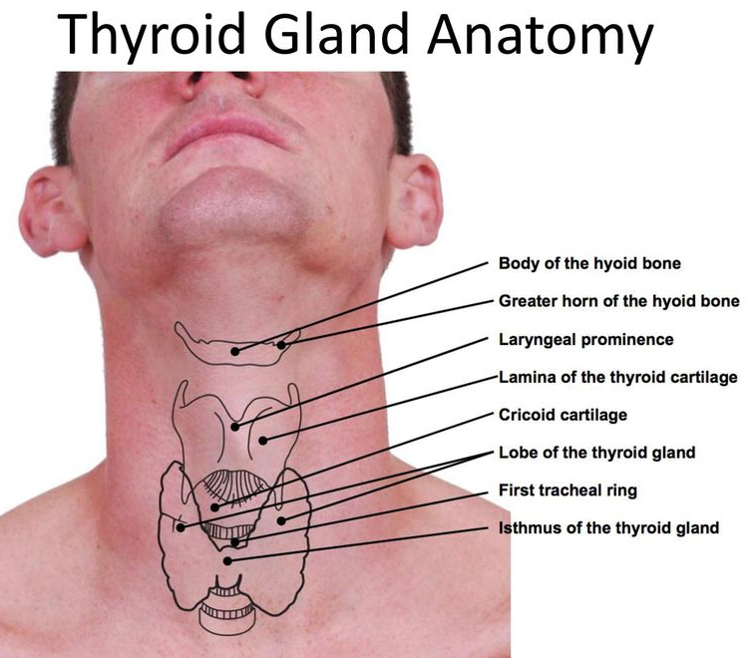
Pemberton test

Slide 9
INVESTIGATIONS
Lab investigations:
➤ CBC, ESR for inflammatory or infectious thyroiditis
➤ TFT, Most patients are euthyroid
➤ TSH is an independent risk factor for predicting malignancy
➤ TPO antibodies in pts with high TSH (Hashimoto's thyroiditis)
➤ Serum calcitonin is elevated in medullary carcinoma of thyroid
➤ 24-hour urine for metanephrines and catecholamines
➤ Serum calcium to exclude hyperparathyroidism

Slide 10
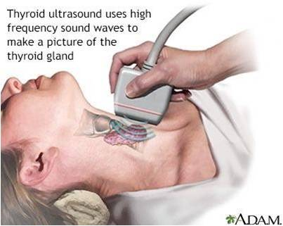
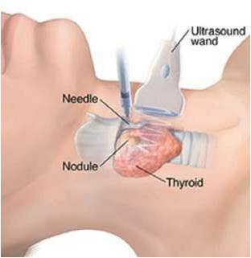
+ Diagnostic procedures :
Radioactive iodine scan
U/s
FNA
+ Diagnosis of mets:
lung x- ray / liver u/s / bone scan / brain ct
+ Diagnose of infiltration:
laryngoscopy / bronchoscopy ….
+ Tumor marker:
serum calcitonin / thyroglobulin

Slide 11
Ultrasonography:
Is helpful for detecting:
Non-palpable thyroid nodules.
Differentiating solid from cystic nodules.
Identifying adjacent lymphadenopathy and differentiating single from multiple nodule.
Identify hemiagenesis and contralateral lobe hypertrophy misdiagnosed as thyroid nodule.
Detect cervical nodes that may contain early clinically occult metastatic disease.
Noninvasive and inexpensive.

Slide 12
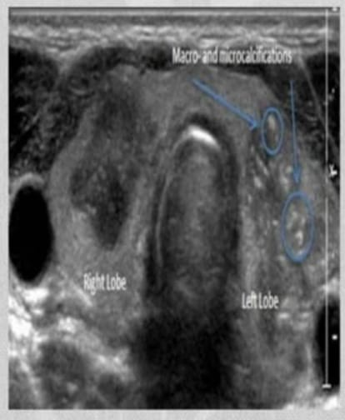
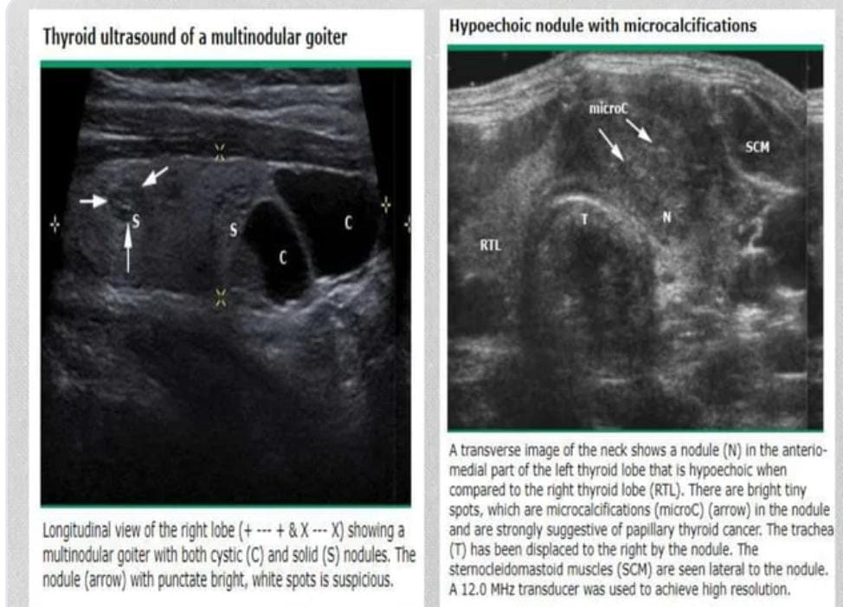
Micro/macro-calcifications

Slide 13
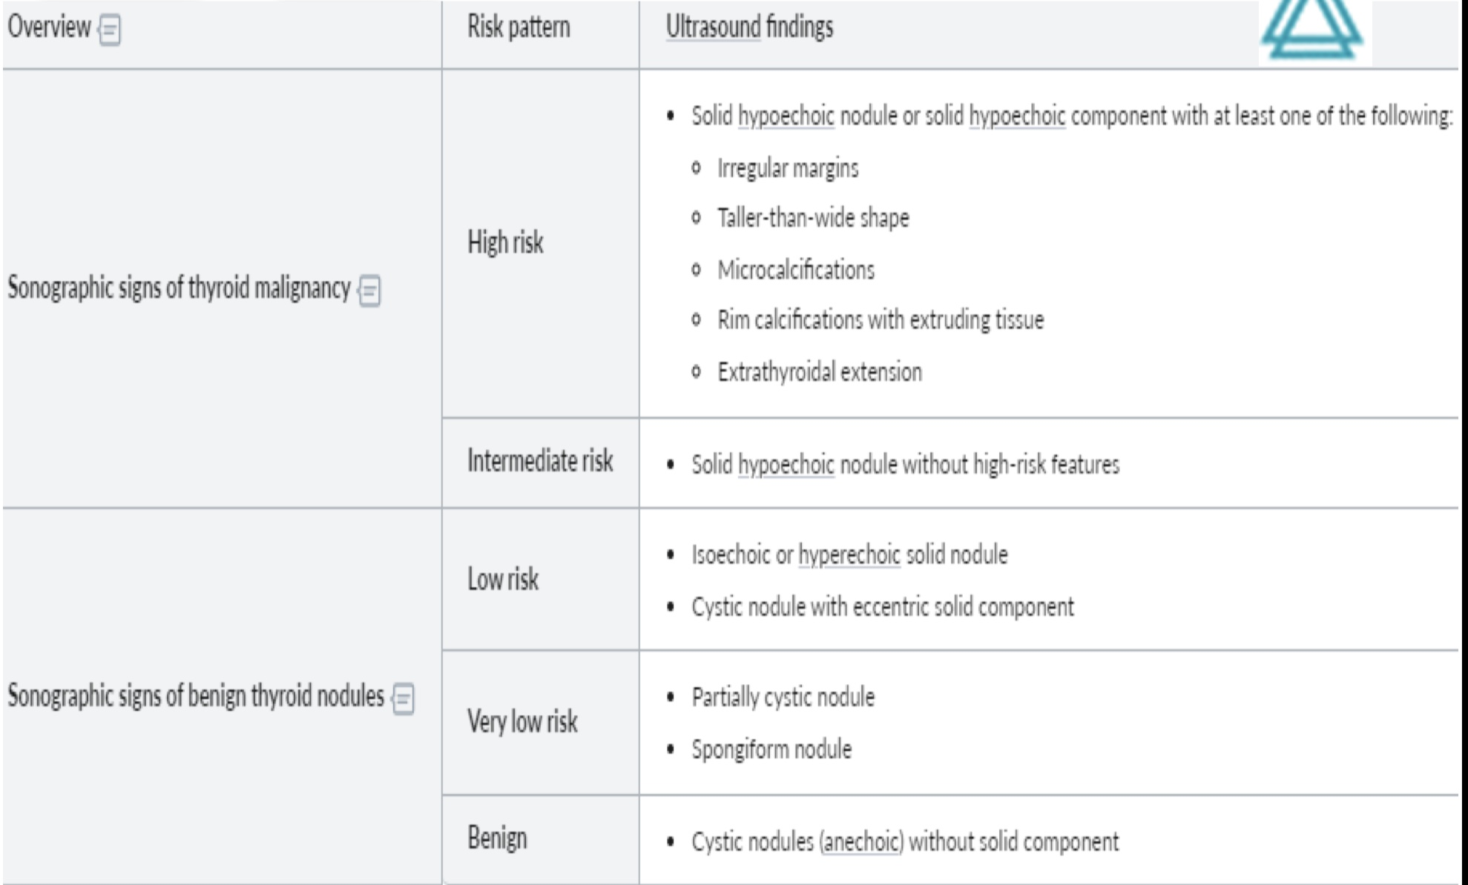

Slide 14
Fine needle aspiration biopsy
A test of choice for initial evaluation of a thyroid nodule – often combined with ultrasound guidance for better diagnostic utility.
This is the only test that can reliably differentiate between benign and malignant nodule and has a sensitivity of 95% and a specificity of 95%.
Reliability depend on: Operator, Cytopathologist, and the specimen should be enough.
Have 5% false negative , and should follow up with periodic FNA if thyroid nodularity persists
FNA IS RELIABLE for all cancer except : follicular Complications : Local discomfort, Hematomas, infection

Slide 15
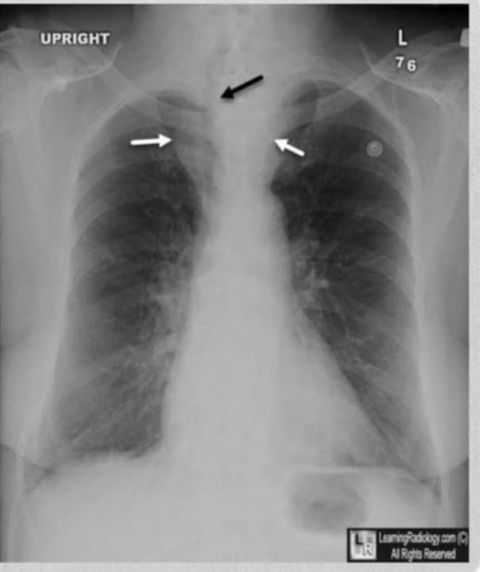
Radiography not routinely done, may show: - tracheal deviation or compression. - pulmonary metastasis - calcifications

Slide 16
Thyroid scintigraphy

Slide 17
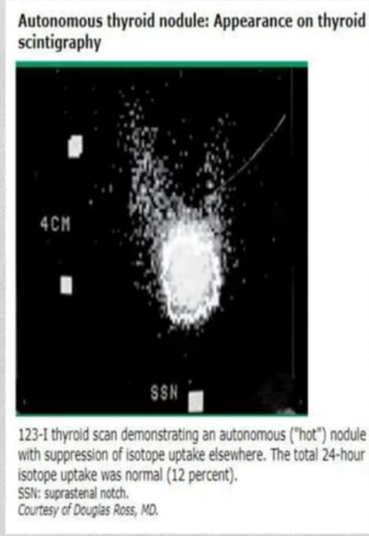
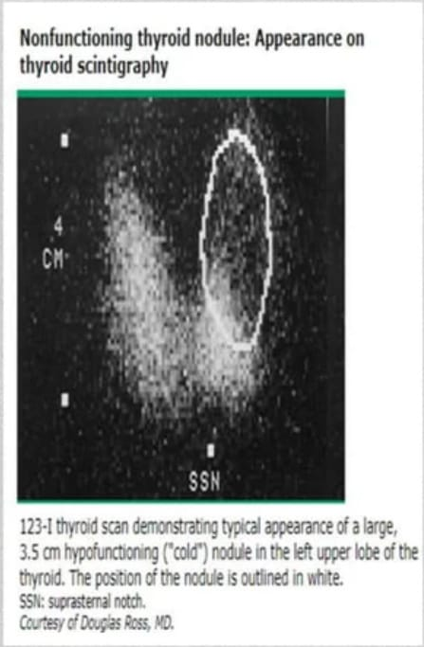
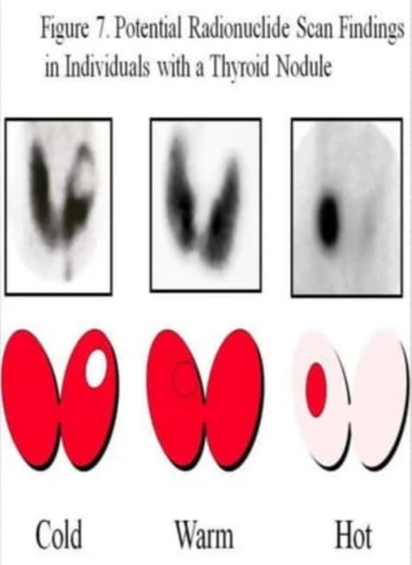

Slide 19
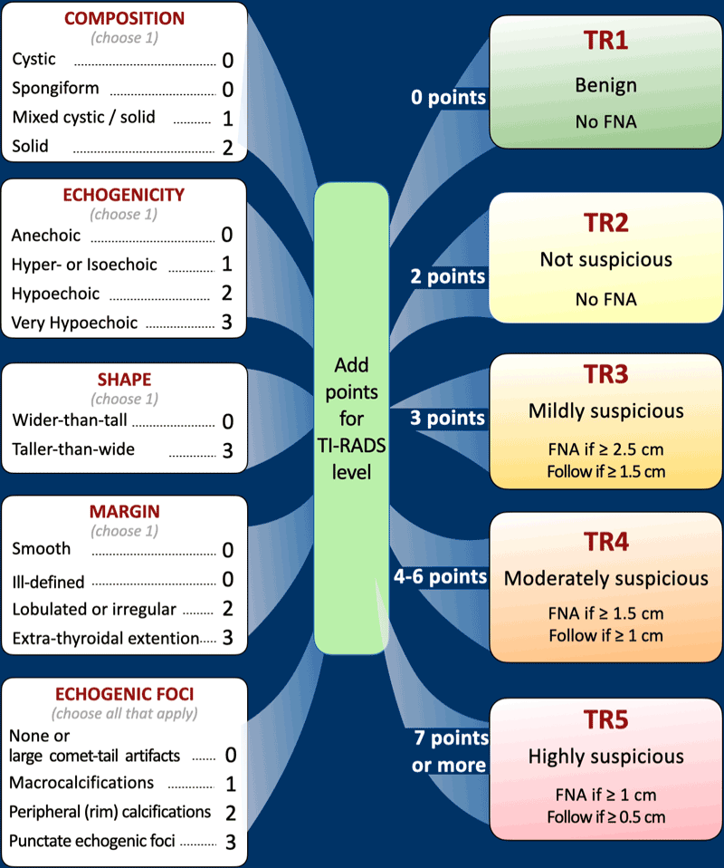
(TIRADS) is a 5 point classification to determine the risk of cancer in thyroid nodules based on ultrasound characteristics.

Slide 20
The Bethesda System is a “Risk of Malignancy” scale (probability of cancer) based on the analysis of cells collected during the FNA procedure

Slide 22
APPROACH TO MANAGEMENT OF A THYROID NODULE:

Slide 24
Preoperative preparation
Patients scheduled for nodulectomy underwent thyroid function tests and a neck U/S .Further investigations included ATPO, thyroglobulin, complete blood count and viral screening.
The decision on nodulectomy was based on a careful assessment of patients' thyroid status, risk factors, nodule characteristics, age, preoperative levels of calcitonin and thyroglobulin, and the chance to preserve thyroid function and achieve complete nodule removal.

Slide 25
Surgical intervention
Bilateral subtotal thyroidectomy is standard therapy for patients with nontoxic multinodular goiter.
If only one lobe is enlarged, unilateral lobectomy and isthmectomy may suffice.
The surgical mortality rate associated with bilateral thyroid operations in patients with non-toxic multinodular goiter is less than 1%
Causes of surgical morbidity are:
Postoperative tracheal obstruction due to hemorrhage or tracheomalacia
Injury to recurrent laryngeal nerve (1–2% of cases when surgeon is experienced)
Hypoparathyroidism (0.5–5% of cases)
Voice changes due to superior-laryngeal-nerve damage
Hypothyroidism

Slide 26
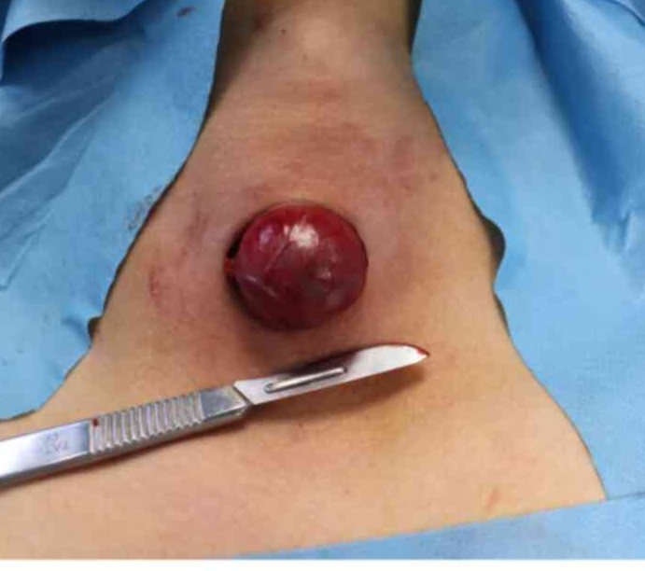
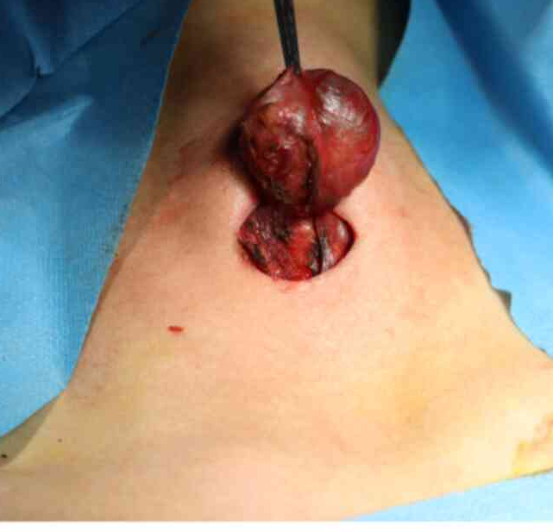
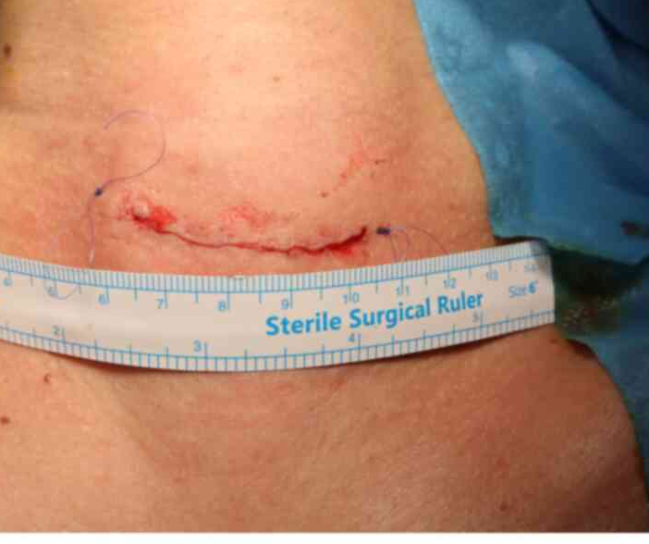
Surgical intervention
Collar incision along a natural skin crease in the midline, which extended more to the site of the nodule.
Ligasure employed to both incise and cauterize the blood vessels and tissues while the surgeon removes the nodule.
The site and length of the incision along the neck's natural crease.

Slide 27
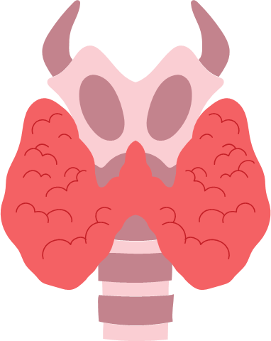
References:
NIH - Surgical Treatment “Evidence-Based and Problem-Oriented”
spandidos-publications - Thyroid nodulectomy: A promising approach to the management of solitary thyroid nodules

