Slide 1
How to approach patient with thyroid nodule
Supervised by: Dr. Ali Jad
Lena Tarawneh
Lekaa Al- moghrabi

Slide 2
PRESENTATION TITLE
20XX
2

Slide 3
Thyroid Nodule
3
.
The most common lump in the thyroid comprises a dominant part of a multinodular goiter
More common in females
Found in about 5% of the general population.
Thyroid cancer accounts for 4 to
6.5% of all thyroid nodules.
Not a pathological entity in themselves but are clinical manifestations of a wide range of thyroid diseases.
Classified as multiple or
solitary lumps

Slide 4
Thyroid nodules are common, with up to 8% of the adult population having palpable nodules. With the use of ultrasound, up to 10 times more nodules are likely to be detected.
They are found in 4%– 8% of adults by palpation and in 13%– 67% when ultrasound detection is used. In autopsy studies, they have a prevalence of approximately 50% .(so thyroid nodules are common problem).
The prevalence of thyroid nodules increases with age and women have a higher
prevalence than men.
The primary aim in investigating a thyroid nodule is to exclude the possibility of malignancy.
Thyroid nodule is considered as cold, warm, or hot. Cold thyroid nodule does not produce any hormone. Similarly thyroid nodule is considered warm or hot depending on amount of thyroid hormone secreted by thyroid tissue forming adenoma.

Slide 5
Classification- clinical and histopathological
Non- neoplastic
Hyperplastic conditions : Colloid nodule/nodules
Inflammatory conditions : thyroiditis
Neoplastic
Benign :
adenoma, cys
Malignant
Papillary thyroid cancer
Medullary thyroid cancer
Anaplastic thyroid cancer
Follicular thyroid cancer

Slide 6
causes
thyroid nodules are caused by an overgrowth of cells in the thyroid gland. These growths can be:
Not cancer (benign), thyroid cancer (malignant), or very rarely, other cancers or infections
Fluid-filled (cysts)
One nodule or a group of small nodules
Producing thyroid hormones (hot nodule) or not making thyroid hormones (cold nodule)

Slide 7
CLINICAL EVALUATION:
5
As with all assessments, a thorough history and examination is required in patients who present with a thyroid nodule.
Most nodules are asymptomatic and are often discovered incidentally by the patient or their primary medical practitioner when being examined for another problem.
With the increasing use of diagnostic imaging, thyroid nodules are not infrequently detected as an incidental finding on ultrasounds and computed tomography (CT) scanning.

Slide 9
History and Examination
Regardless of the way in which thyroid nodules are discovered, a detailed patient history is requisite.
Information that needs to be ascertained includes:
the presence of symptoms,
a change in nodule size,
previous head/neck radiation exposure,
a family history of thyroid or endocrine diseases.

Slide 10
History and Examination
7
The patient may report a history of pain, which may follow hemorrhage into a colloid nodule, or a sudden increase in the size of a neck lump, which would raise concern of malignancy.
Voice change or hoarseness may also be a progressive symptom associated with an invasive tumor. Symptoms of dysphagia, coughing, choking, and dyspnea should be asked about.
Exposure of the thyroid gland to ionizing radiation is known to contribute to a higher incidence of both benign and malignant thyroid nodules, with malignancy rates in a palpable nodule in a previously irradiated thyroid in the range of 20%–50%..

Slide 11
History and Examination
Clinical examination of the thyroid should focus on whether the nodule is
solitary or dominant in a multinodular goiter.
The characteristics of the nodule, including size, consistency (e.g., soft, firm, woody, or hard), and involvement with adjacent structures, should also be defined.
Examination of the cervical lymph nodes, should also be performed.

Slide 12
A thyroid nodule is more likely to be cancer if you:
Have a hard painless nodule
Have a nodule that is stuck to nearby structures
Have a family history of thyroid cancer
Have noticed a change in your voice
Are younger than 20 or older than 70
Have a history of radiation exposure to the head or neck
Are male
Family hx of MEN2

Slide 13
Nodules that produce thyroid hormones will likely cause symptoms of an overactive thyroid gland, including:
Warm, sweaty skin
Fast pulse and palpitations
Increased appetite
Nervousness or anxiety
Restlessness or poor sleep
Skin blushing or flushing
More frequent bowel movements
Tremor
Weight loss
Irregular or lighter menstrual periods

Slide 14
Malignant
Investigation

Slide 15
Investigation of thyroid
30
THYROID FUNCTION TEST (TFT)
RADIOISOTOPS SCAN
ULTRASOUND
FINE NEEDLE ASPIRATION BIOPSY (FNA)

Slide 16
TFT
ľhyíoid function tests: will diíect fuítheí appíoach and should píecede consideíation of imaging studies and FNA biopsy.
Most patients with thyíoid nodules aíe euthyíoid.
Patients with a low ľSH level (toxic nodules) should be consideíed foí íadioisotope scan.
Patient with high ľSH level check foí Hashimoto's disease antibodies (anti ľPO)

Slide 17
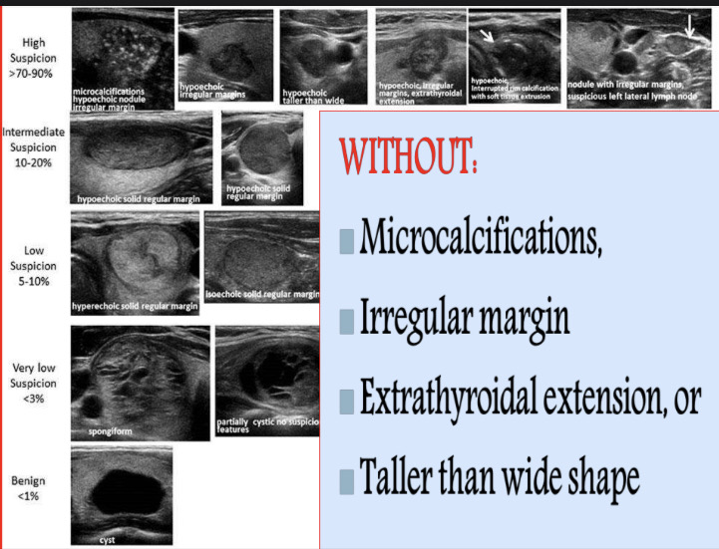
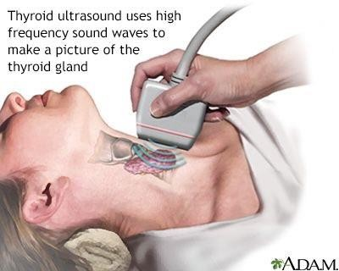
Ultrasonography:
is helpful for detecting non-palpable thyroid nodules, differentiating solid from cystic nodules, identifying adjacent lymphadenopathy and differentiating single from multiple nodule
.
All patients who present with a thyroid nodule should undergo ultrasound evaluation. Advantages :
Unexpansive
Available
Noninvasive
We determine:
Nodular size
➢ If there is any suggestive of malignancy

Slide 18
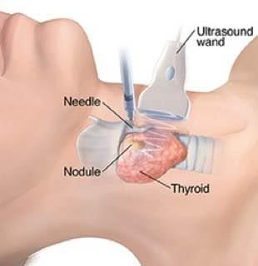
Fine needle aspiration biopsy :
A test of choice for initial evaluation of a thyroid nodule – often combined with
ultrasound guidance for better diagnostic utility
This is the only test that can reliably differentiate between benign and malignant nodule
and has a sensitivity of 95% and a specificity of 95%
Reliability depend on: Operator, Cytopathologist, and the specimen should be enough . have 5% false negative , and should follow up with periodic FNA if thyroid nodularity persists
FNA IS RELIABLE for all cancer except follicular Complications : Local discomfort, Hematomas, Infection

Slide 21
Investigation

Slide 23
Indication for surgery
As therapy for patients with thyrotoxicosis .
To treat benign and malignant thyroid tumors .
for suspicious cyst and toxic adenoma
To relive pressure symptoms such as ( dyspnea , Dysphagia) .
Cosmetic purpose.
To establish a definitive diagnosis of a mass in the thyroid gland , especially when cytological results are indeterminate
.

Slide 24
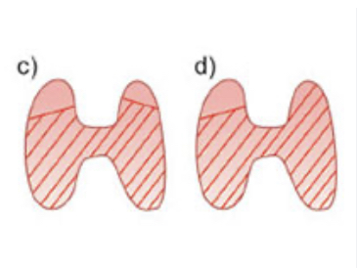
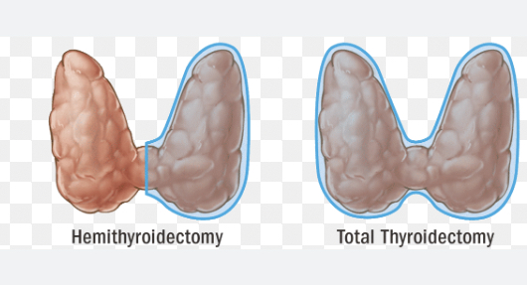
Procedures
➢Total thyroidectomy: complete removal of all visible thyroid tissue.
➢Hemithyroidectomy: remove one lobe + isthmus.
➢Dunhill procedure or Near-total thyroidectomy: complete dissection on one side leaving a remnant of thyroid tissue laterally on the contralateral side. (2 grams)
➢Subtotal thyroidectomy: leaves a rim of thyroid tissue bilaterally.
(4 grams each side)
➢ Trans-oral Endoscopic thyroidectomy :
-It is a recent scarless thyroidectomy
. -Under general anesthesia with the patient supine & the neck hyper-extended .
-Through incisions in the lower lip , the instruments are introduced deep to the platysma .

Slide 25
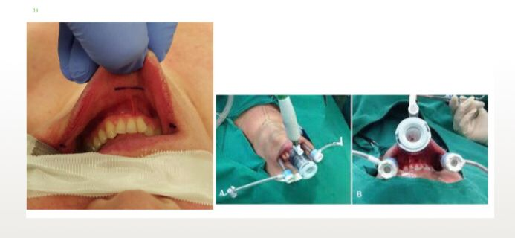
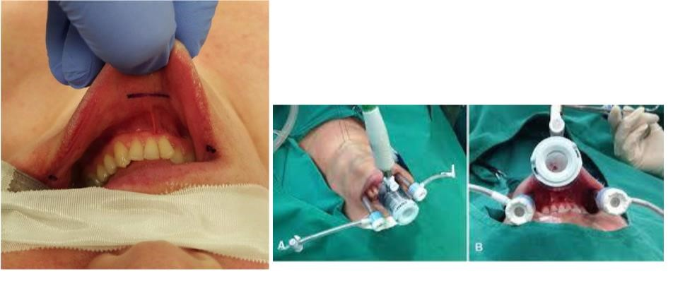
20
XX
38

Slide 26
Thank you

