Slide 1
Major Arrhythmias
Presented by:
Neama Abed
Raneem Al rafayah
Supervised by:
Dr Mahmoud abu znaid

Slide 2
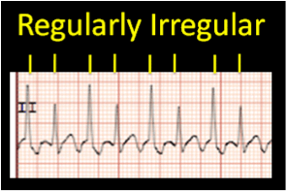
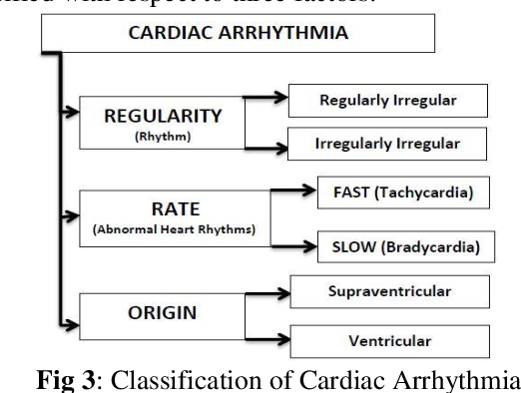
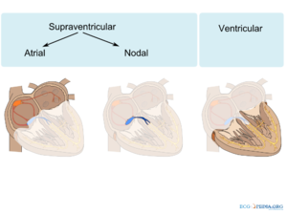
Arrythmia classification:
Arrythmia definition:
Abnormality with the rate or rhythm of the heartbeat.

Slide 3
Symptoms and signs of arrythmia
Symptoms: 1. Palpitation, fatigue and exertional dyspnea 2. Low output symptoms: dizziness, syncope and angina Signs: irregular pulse
Investigations:
ECG: diagnostic test.
Cardiac enzymes and echo: ischemic heart diseases diagnosis as a cause

Slide 4
Classification of Arrhythmia
Regular tachycardia
Sinus tachycardia
PSVT
Atrial flutter
Ventricular tachycardia
Regular bradycardia
Sinus bradycardia
Nodal junctional rhythm
Heart block 1st ,3rddegree
Irregular rhythm
Multi focal tachycardia
Heart block 2nd
Atrial fibrillation
Ventricullar fibrillation
Premature beats (extrasystoles)
Bundle Branch Block

Slide 5
Sinus tachycardia
1-Regular Tachycardia:
It is a condition in which the SAN discharges impulses faster than normal (>100 / min)
Etiology
Physiological : Exercise, Emotions, Excessive coffee .
Pathological : Hypotension, Hyperdynamic circulation, Hyperthermia, Heart failure
Pharmacological : Adrenaline, Atropine

Slide 6
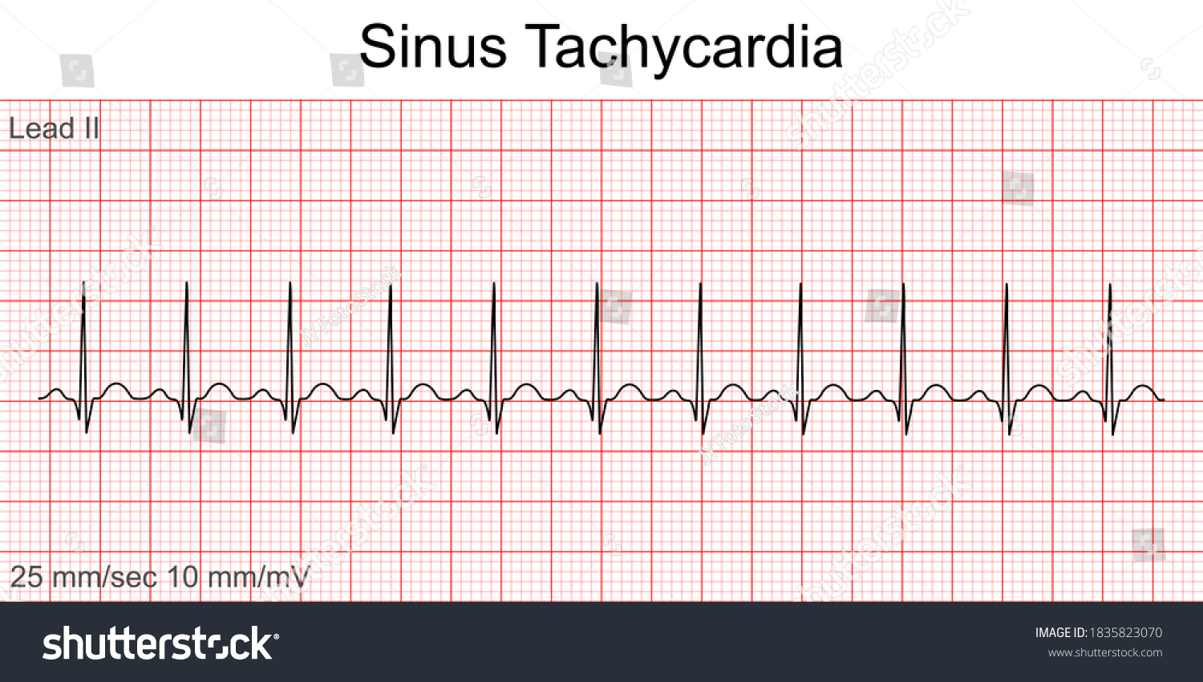
Sinus tachycardia
Rhythm: regular.
Rate: 100 -160 / min.
P waves: are normal & each P wave is followed by normal QRS.

Slide 7
Paroxysmal supraventricular tachycardia
It is a paroxysmal condition in which there is an abnormal focus in the atrium - other than SAN - which discharges regular impulses more than SAN (150-250/min).
This abnormal focus may initiated in any area of the atria (paroxysmal atrial tachycardia) or even in AVN ( paroxysmal nodal tachycardia).
This focus is unstable and will disappear after time (sudden offset), and the heart returns again to follow the SAN (sinus rhythm between attacks).
Etiology
Physiological : Excessive coffee, smoking .
Pathological : rheumatic heart disease, ischemic heart disease (any disease of the heart)
Pharmacological : sympathomimetics

Slide 8
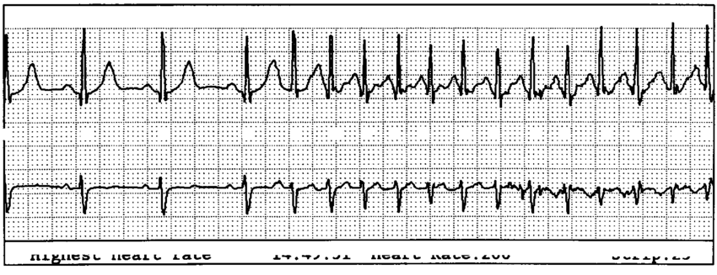
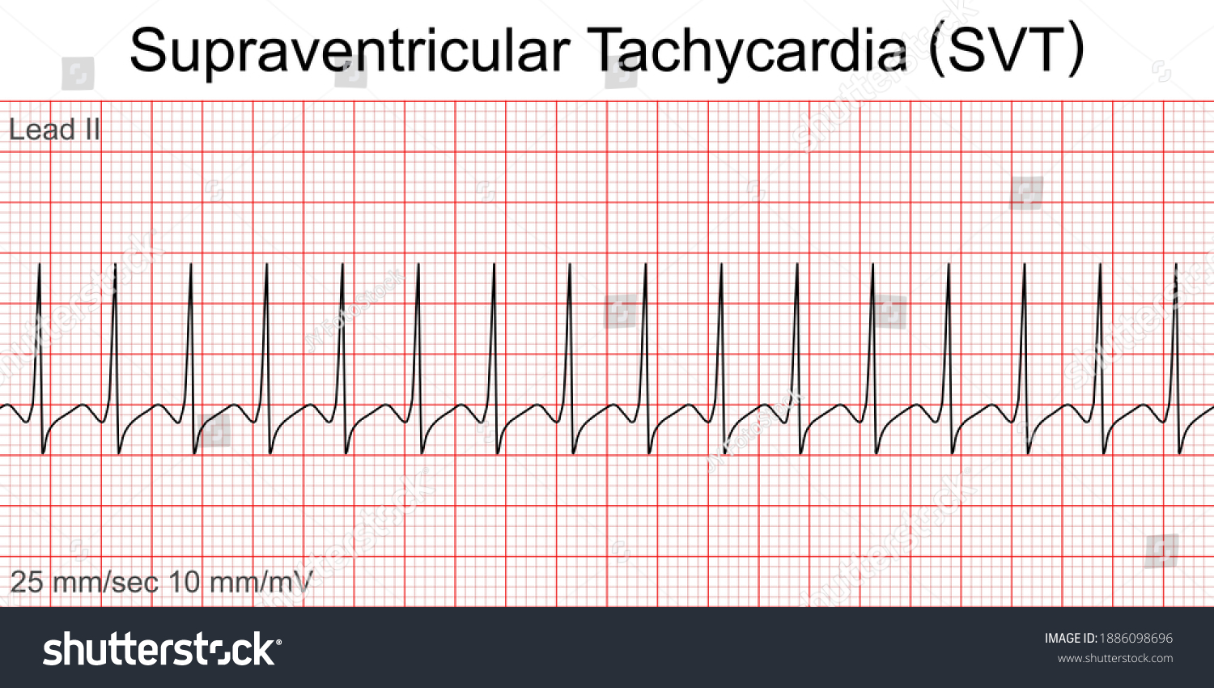
Paroxysmal supraventricular tachycardia
ECG
P wave:
- In atrial tachycardia: deformed.
- In nodal tachycardia : absent or inverted.
QRS : Narrow , regular with normal shape.

Slide 9
Ventricular tachycardia
It is a paroxysmal condition in which there is abnormal focus in the ventricle that discharge impulses more than SAN ( 150 - 250 /min).
Since the focus is in the ventricle & there is no retrograde conduction in the AVN, So ventricles will follow the ectopic focus & atria will follow the SAN ( AV dissociation)
Cardiac arrest may occur (PVT converted to ventricular fibrillation).
Etiology
Pathological : ischemic heart disease (MI is the most common cause),
Rheumatic heart disease, congenital heart disease
Pharmacological : digitalis

Slide 10
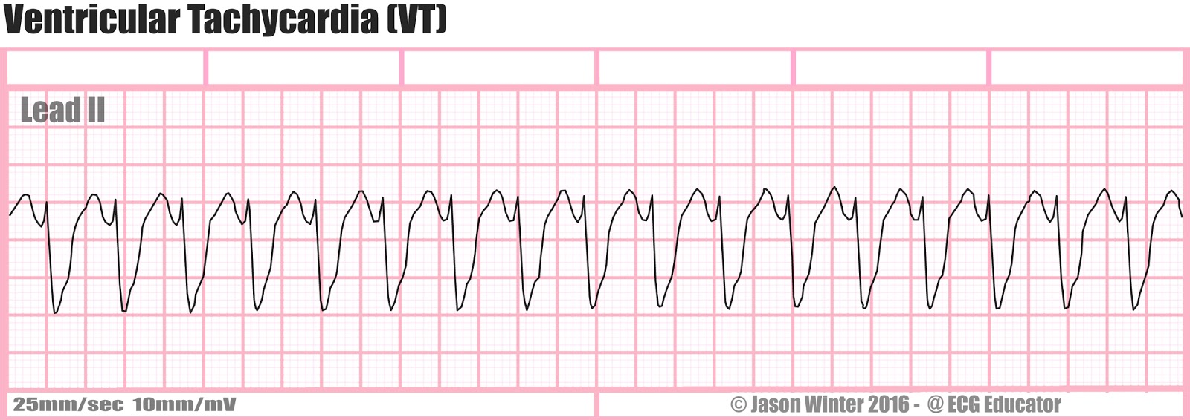
Ventricular tachycardia
ECG
QRS : rapid, regular & wide abnormal (bizarre) shaped.
P waves : Normal rate & shape, May comes before or after the QRS and also may be hidden by the QRS.
No fixed relation between P waves & QRS complexes (atria ventricular dissociation)

Slide 12
Atrial flutter
It is a condition in which there is an abnormal focus in the atrium that discharges rapid regular impulses ( 250- 350 /min), but due to physiological block of AVN (long refractory period) , not all atrial impulses are conducted to the ventricles
Usually associated with 2 : 1, 3 : 1 or 4 : 1 AV block
Etiology (does not occur in normal healthy heart)
Pathological : any disease of heart
-usually indicates a disease, most often either organic heart disease or pulmonary disease (heart failure ( most common association ), rheumatic heart disease , CAD, COPD)
- Atrial flutter is relatively unstable rhythm and often spontaneously converts to either atrial fibrillation or normal sinus rhythm

Slide 13
Atrial flutter
ECG (Saw tooth appearance)
P waves : abnormal ,replaced by multiple small flutter (f) waves before each QRS
QRS: normal, regular, at a rate of with 2 : 1, 3 : 1 or 4 : 1 of the atrial rate according to AVN conduction.

Slide 14
Multifocal atrial tachycardia
Irregular Tachycardia:
Irregular rhythm caused by presence of 3 or more atrial foci
more commonly in patients with Hypoxia (severe pulmonary diseases like COPD)
ECG:
Variable P-wave morphology and variable PR and RR intervals.
- atrial rate 100-200 bpm, 3 or more p wave morphologies.

Slide 15
Sinus Bradycardia:
2- Regular Bradycardia:
It is a condition in which the SAN discharges impulses by a rate less than 60/min
Etiology:
Physiological: During sleep, Athletes .
Pathological: ischemia, increased vagal tone , hypothyroidism
Pharmacological: b blockers, Ca channel blockers, Digitalis, antiarrhythmic drugs.

Slide 16
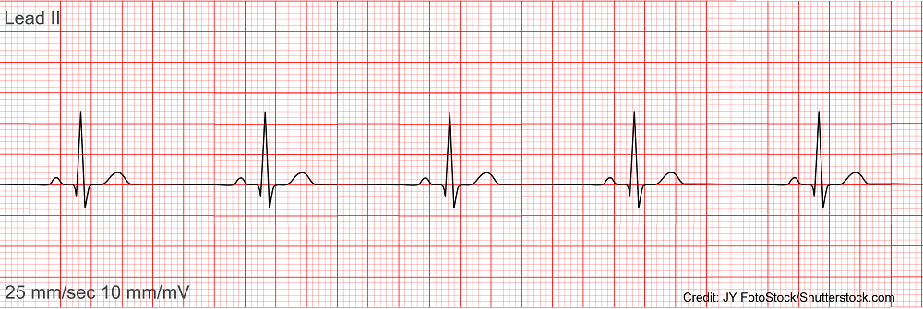
Sinus Bradycardia:
ECG
Rhythm : regular.
Rate:< 60/min.
P waves: are normal & each P wave is followed by normal QRS.

Slide 17
Sick Sinus Syndrome (SSS)
- Sinus node dysfunction characterized by a persistent spontaneous sinus bradycardia , patients usually elderly
- symptoms : include dizziness, confusion , syncope, fatigue, CHF
-pacemaker implantation may be required

Slide 18
Nodal (junctional) rhythm:
It is a condition in which the heart is controlled by the AVN .
Here, the impulses reach the atria & ventricles in the same time .
Etiology
Any disease of heart (most common causes are digitalis & MI)
ECG
P waves: Inverted & come approximately at the same time with QRS so may be absent
QRS: Slow, regular with normal shape.

Slide 19
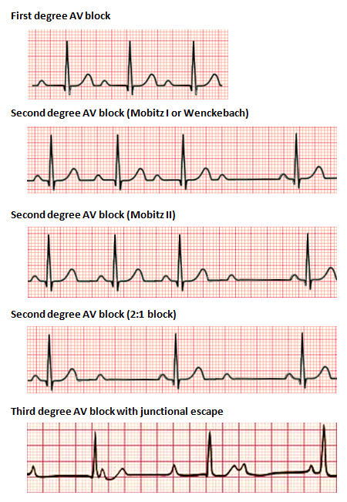
Heart Block:
Causes:
1. Ischemic heart diseases 2. Rheumatic heart disease 3. Paravalvular abscess 4. Drugs (Beta blockers, CCBs, digoxin)
1st degree heart block:
No need for treatment
2nd degree heart block (Mobitz 1):
No need for treatment
2nd degree heart block (Mobitz 2):
Pacemaker implantation is necessary
3rd degree heart block (complete heart block):
Pacemaker implantation is necessary

Slide 20
Heart Block 1st degree
First degree heart block REGULAR ( Just delaye conduction)
o PR interval is longer than 0.2 second.
o All impulses from SAN are conducted to the ventricles.
Etiology: physiologically during sleep or pathologically as in myocarditis.
Usually asymptomatic.

Slide 21
Heart Block
3-Irregular rhythm:
2nd degree ( Mobitz I , Wenckebach block ) IRREGULAR
o Progressive prolongation of PR interval leading finally to the dropout of a QRS complex (due to problem in His-Purkinje system)
& then the cycle is repeated. ( notice that there is irregular pulse).
This condition is not too serious and may occur physiologically during sleep in athletes.

Slide 22
Type II 2nd degree ( Mobitz II ) IRREGULAR
o The AVN transmits one impulse for each 2 ,3, 4 or more atrial impulses.
o This block may be fixed ( e.g. 2:1 all the time) or variable ( irregular).
o pacemaker implantation is necessary

Slide 23
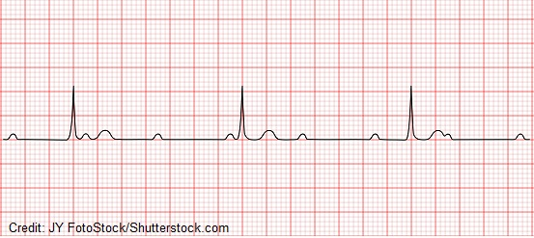
Complete heart block ( 3rd degree ) REGULAR RHYTHM
In this condition all impulses from the atria don't reach the ventricles so, the ventricles will be controlled by idioventricular rhythm.
t the atria are controlled by SAN & the ventricles are controlled by ldioventricular rhythm. (Atria ventricular dissociation)
pacemaker implantation is necessary

Slide 24
Atrial Fibrillation :
3-Irregular rhythm:
It is a condition in which there are rapid irregular impulses (150bpm) arise from the atria by multiple ectopic foci ( so the atria don't contrac effectively)
& due to physiological delay at AVN, not all impulses are conducted to the ventricles.
Etiology: Many patients with atrial fibrillation have structural heart disease such as : Heart failure, Valvular heart disease, Coronary artery disease, Chronic lung disease, Obstructive sleep apnea.

Slide 25
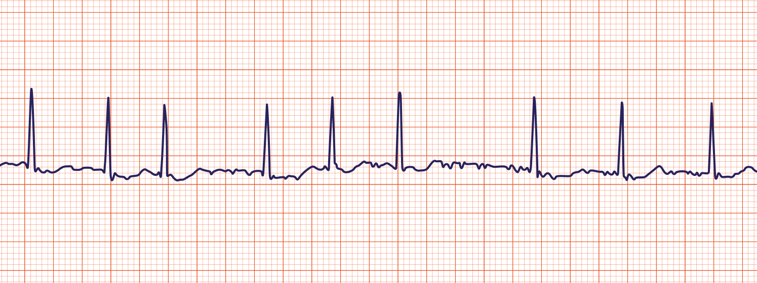
Atrial Fibrillation
ECG
Absent P waves due to rapid atrial activity (350-600 bpm)
irregularly irregular ventricular response (typically 100-180 bpm) normal in shape but irregular in rhythm
Thromboembolism prevention is critical
DC shock if unstable
Rate control and rhythm control are the strategies of treatment

Slide 26
Atrial Fibrillation
Complications of AF:
Thromboembolism.
Angina (due to ↑HR and ↓COP).
It is a precipitating factor of heart failure and pulmonary edema in presence of pre-existing heart disease.

Slide 27
Premature Atrial Complexes
A premature beat arising from ectopic pacemaking tissue within the atria
Etiology: adrenergic excess,drugs,alcohol,tobacco,electrolyte imbalance, ischemia, infection
May cause palpitations, or give rise to PSVTs
usually asymptomatic and don’t require treatment., if symptomatic.. B blocker may be helpful.

Slide 28
Premature Atrial Complexes
ECG
early P waves that differ in morphology from the normal sinus P wave , QRS complex is normal

Slide 29
Premature Ventricular Complexes
Early beat fires on its own from a focus in the ventricle and then spreads to the other ventricle
Etiology:
can occur in patients with or without structural heart disease, hypoxia, electrolyte imbalance, stimulants, caffeine, medications, and structural heart disease

Slide 30
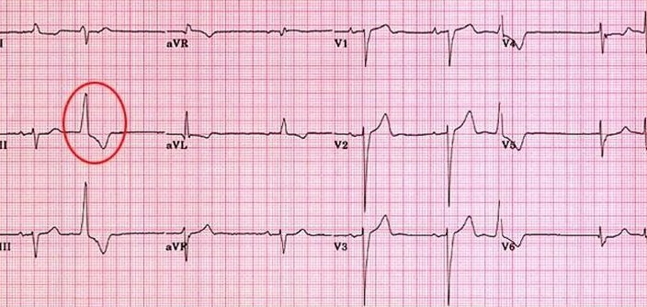
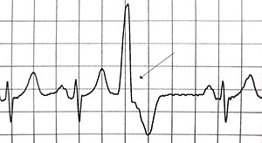
Premature Ventricular Complexes
ECG
wide ,bizarre QRS complexes followed by a compensatory pause, a P wave is not usually seen because it is buried within the wide QRS

Slide 31
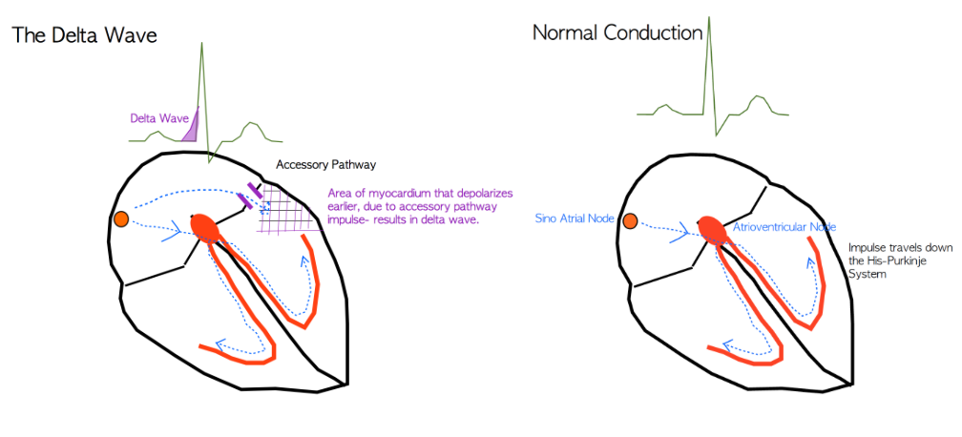
Wolff- parkinson -white syndrome
Definition: Accessory conduction pathway from atria to ventricles through the bundle of Kent causes premature ventricular excitation because it lacks the delay seen in the AV node.

Slide 32
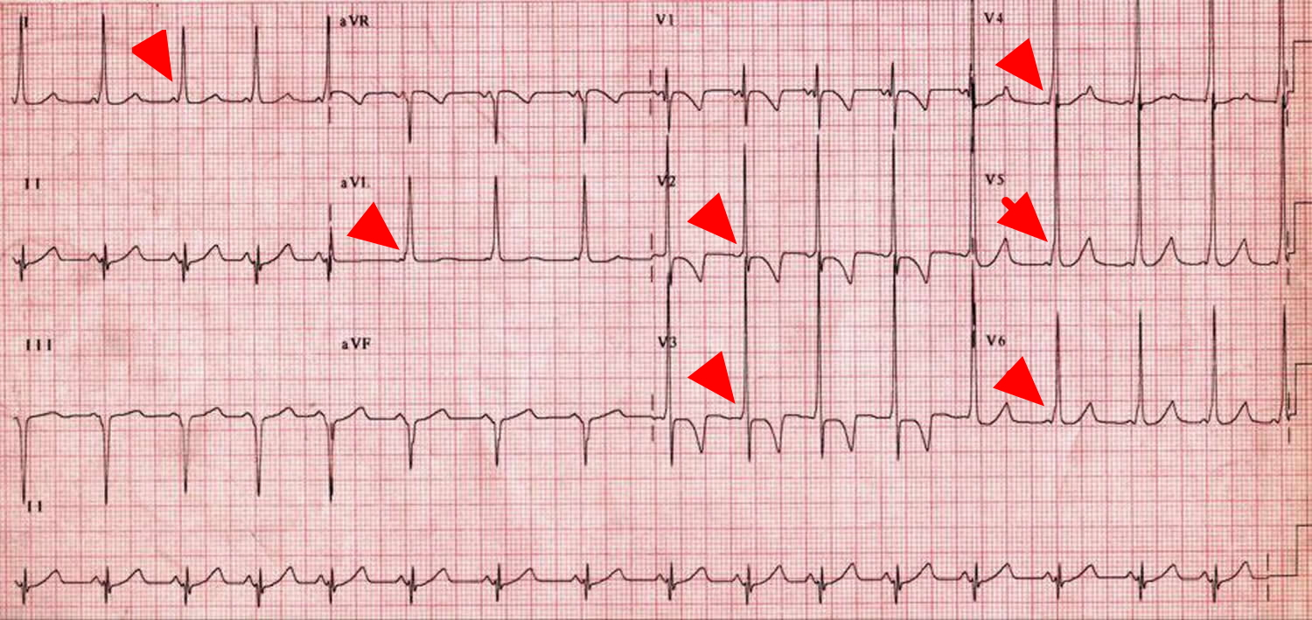
Wolff- parkinson -white syndrome
ECG
narrow complex tachycardia, short PR interval and a delta wave (upward deflection seen before the QRS) , represent early ventricular activation

Slide 33
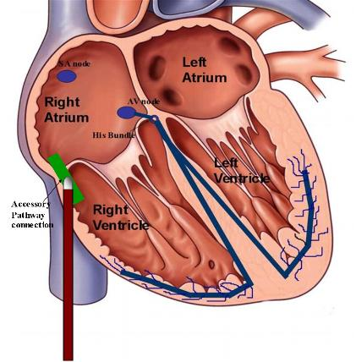
Wolf-Parkinson white syndrome
Definitive treatment: Radiofrequency catheter ablation.
Medical treatment: Procainamide or quinidine
Contraindicated drugs: avoid drugs active on the AV node (e.g., digoxin, CCBs, β-blockers, adenosine) because they may accelerate conduction through the accessory pathway, resulting in Ventricular fibrillation. Type IA antiarrhythmics (i.e., procainamide) are better choices, as they will suppress conduction through the accessory pathway instead.

Slide 34
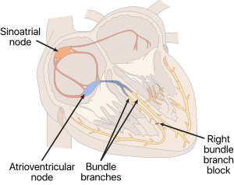
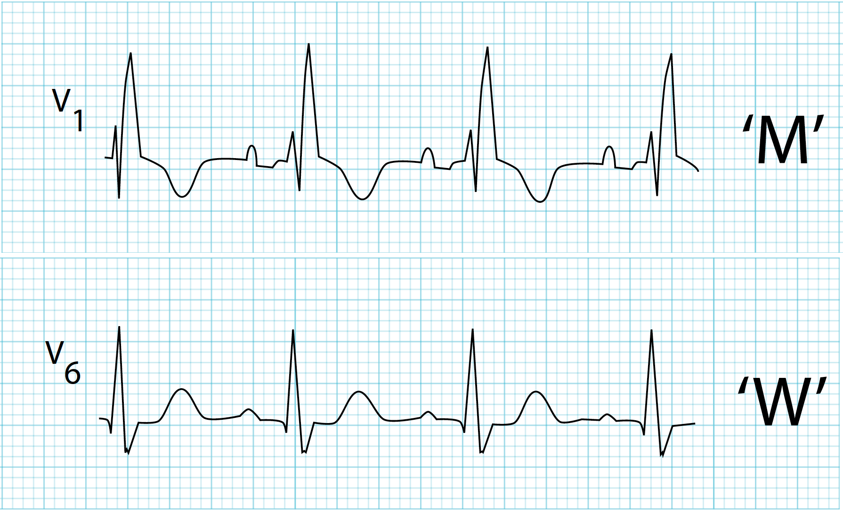
Bundle Branch Block:
Right bundle branch block
ECG findings: 1. Wide QRS due to extra deflection in QRS (rapid depolarization of the left ventricle followed by the slower depolarization of the right ventricle.) 2. M wave at V1 and W wave at V6 (MaRRoW) 3. Right axis deviation
Causes: 1. Right ventricular hypertrophy 2. Ischemic heart diseases

Slide 35
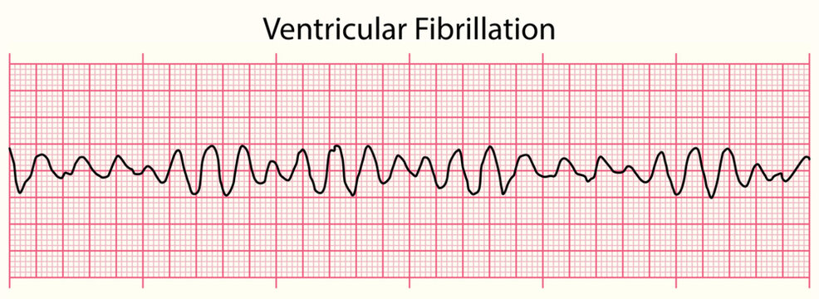
Ventricular fibrillation:
Definition: Multiple foci in the ventricles fire rapidly > chaotic quivering of the ventricles and no cardiac output.
Most episodes of V. Fib begin with VT
Causes: 1. Ischemic heart diseases (most common) 2. Drug toxicity
Clinical features: BP can’t be measured, unconscious.
ECG findings: No atrial P waves can be identified, No QRS complexes.
Treatment: CPR & Defibrillation +/- Epinephrine. Alternatives: A. IV amiodarone followed by DC shock b. Lidocaine, magnesium, and procainamide are alternative second-line treatments.

Slide 36
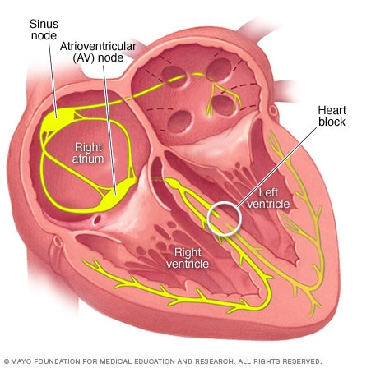
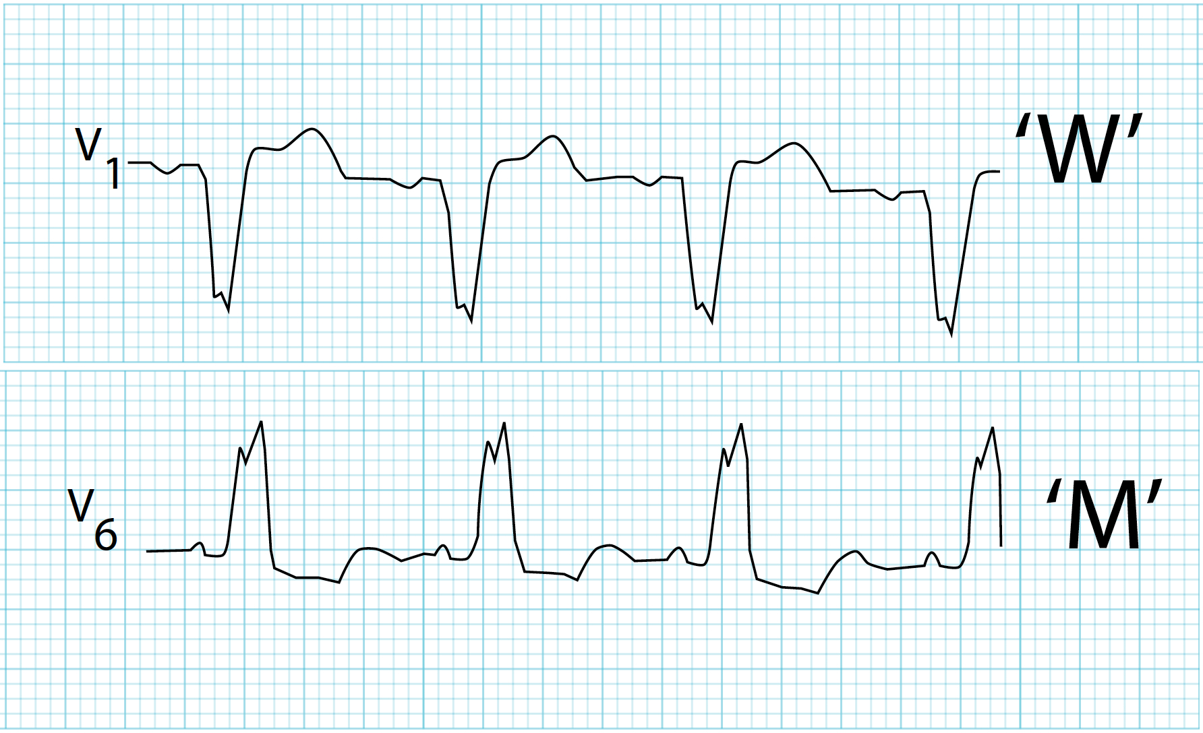
Left bundle branch block
ECG findings: 1. Wide QRS due to extra deflection in QRS (rapid depolarization of the right ventricle followed by the slower depolarization of the left ventricle.) 2. W wave at V1 and M wave at V6 (WiLLiaM) 3. Left axis deviation
Causes: 1. Left ventricular hypertrophy 2. Ischemic heart diseases

Slide 37
Thank you for your attention
I
Now don’t ask questions

